Slide 1




Home
About Us
Contact
Web Dev
Building Skills as a Web Developer

Slide 2
Home
About Us
Contact
What do you know about web development ?

Slide 3




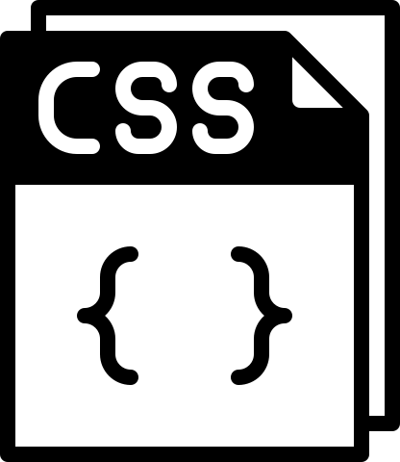






Overview
Home
About Us
Contact
Frontend
Backend
Database

Slide 4
Hyper Text MarkUp Language
It is used to create the structure of web pages. It consists of elements and tags that define the content and layout of a page
Learn Basics
<div> </div>
SEO Basics

Slide 5
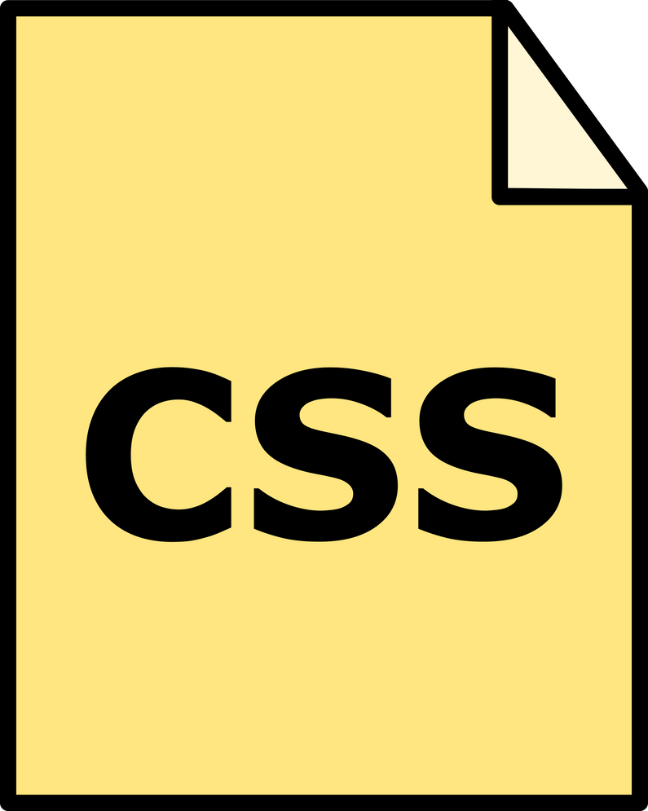
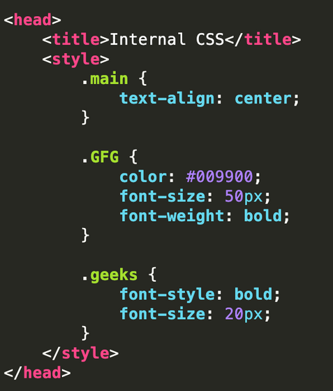
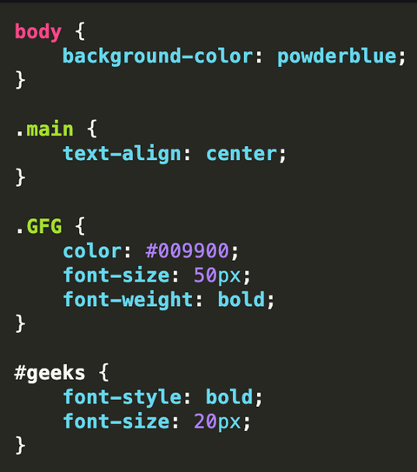
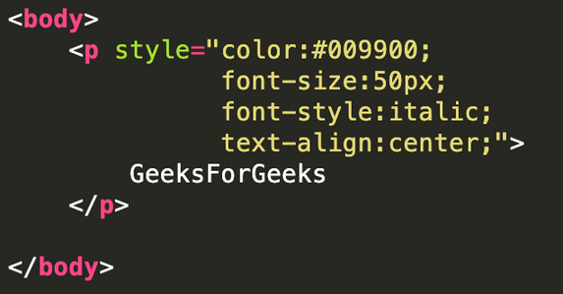
Cascading Style Sheets
CSS (Cascading Style Sheets) is a stylesheet language used to style the web pages
Three types of CSS :
1)Inline CSS
2)Internal CSS
3)External CSS

Slide 6
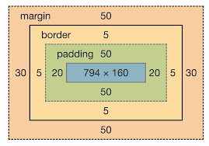
Cascading Style Sheets
Learn Basics
Flex-Box
Box Model
Responsive Design

Slide 7
Projects
Html and Css Only

Slide 8
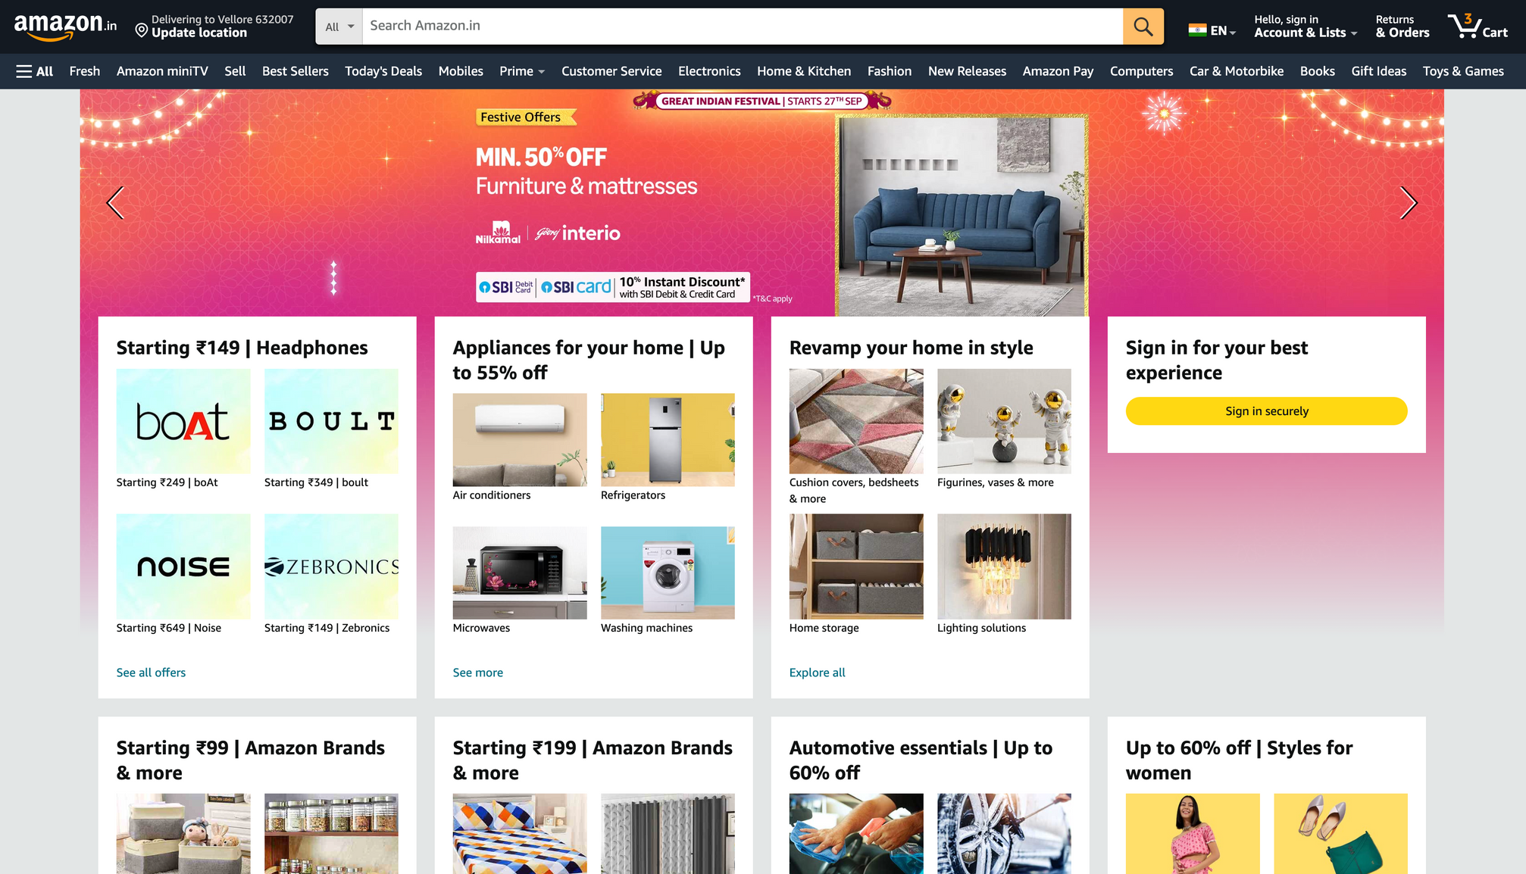
Clone

Slide 9
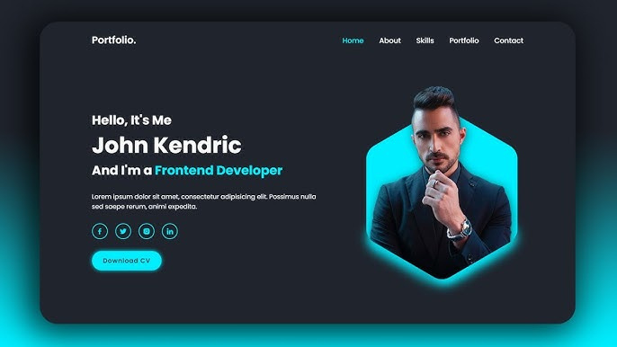
Portfolio

Slide 10

Frameworks of Css
( Industry Standard )
A utility-first CSS framework that allows developers to build custom designs directly in their HTML by using utility classes.
Flexibility in design; no pre-designed components, enabling unique layouts; responsive and mobile-first approach.

Slide 11

Frameworks of Css
Bootstrap
A widely-used framework that provides a collection of pre-designed components and responsive grid layouts, making it easy to create visually appealing websites quickly
Built-in styles for buttons, forms, navigation, and more.

Slide 12

Javascript
Js is a programming language that adds interactivity and provide functionality to web pages.
Learn Basics till array
DOM Manipulation
Api Handling
Error Handling

Slide 13
Projects
Javascript

Slide 14
Todo List
Input feilds for new tasks
Delete button to remove tasks
Save tasks in local storage

Slide 15
Quiz App
Display one question at a time with multiple choice question to the user and displays their score at the end.
Highlight correct and incorrect answers.
Option to restart the Quiz.

Slide 16
Image Carousel
Automatic image sliding with a timer.
Previous and next button for manual navigation.
Indicator to show the current image.

Slide 17

Git/Github
Git is a version control system that track changes in code,allowing mulltiple developers to collaborate.
Learn setup
Branching
Temporary Commits
fork,Pull request

Slide 18
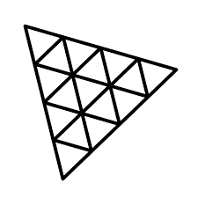
Three.js
It is an open source Javascript library that is used to display graphics ,3D and 2D objects on web browser.
Scenes
Cameras
Geometries and Materials
Rendering and Animation

Slide 19
React.js
React is a popular JavaScript library for building user interfaces, particularly
single-page applications. It allows developers to create reusable UI components,
manage application state efficiently, and handle dynamic data changes.
Components & JSX
Hooks and Props
Api Handling
Redux tool kit

Slide 20
Projects
React.js

Slide 21
Api Handling
Github free api resource
Play with apis , handle more than 5 different type of apis
Display data

Slide 22
Tools often used with react
Material UI
Chakra UI
React hook Form

Slide 23

Backend as a service for your mega projects
Appwrite
Firebase / Supabase

Slide 24
Node.js® is a JavaScript runtime built on Chrome's V8 JavaScript engine.
Basics of node
File system
Socket.io
Real-time tracking system

Slide 25
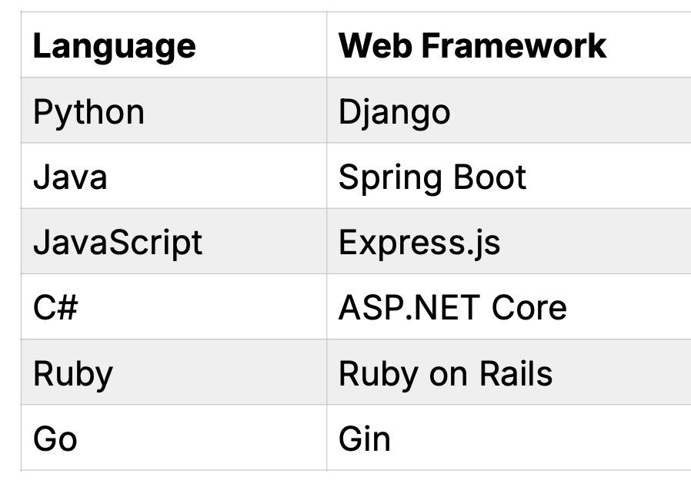
Web Frameworks
Web framework provide us with tools and structured approach to building backend application

Slide 26

Express is a minimal and flexible Node.js web application framework that provides a robust set of features for web and mobile applications. APIs.
Request and Response
APIs
Middleware
Performance

Slide 27
Mongo Db
MongoDB is an open-source, non-relational database management system (DBMS) that stores and processes data in documents instead of tables and rows
NoSQL Database
mongoose
Authentication
CRUD

Slide 29
Any Questions ?

Slide 30
Thank You

