Slide 1


PhishGuard AI
AI-Powered Phishing
Presented by :
Malek Ammar - Atef Hammemi - Med Ali Ferchichi - Abdelhafidh Aoun - Ali Zrida

Slide 2

The Phishing Threat Is Growing
Phishing remains the #1 attack vector — and AI is making it worse. Generative models now produce convincing, personalized lures at scale, bypassing traditional filters.
🎣 Social Engineering
🤖 AI-Generated Lures
Attackers exploit trust, urgency, and fear to trick users into clicking malicious links.
LLMs craft grammatically perfect, context-aware phishing emails that evade keyword filters.
⚡ Scale & Speed
Millions of phishing emails are sent daily. Manual review is impossible — automation is essential.

Slide 3
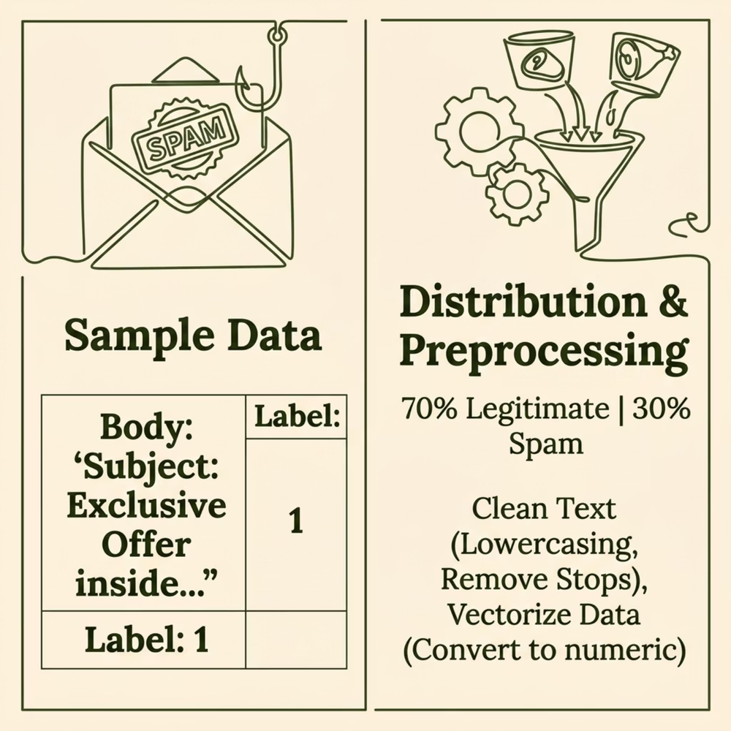


Dataset: SpamAssassin Corpus
What's Inside
The completeSpamAssassin.csv dataset provides a labeled corpus of real-world emails for supervised classification.
Text is extracted from the Body column and vectorized using TF-IDF for model input.
Label 0 — Ham
Label 1 — Spam/Phish
Legitimate, safe emails
Malicious or unsolicited content

Slide 4
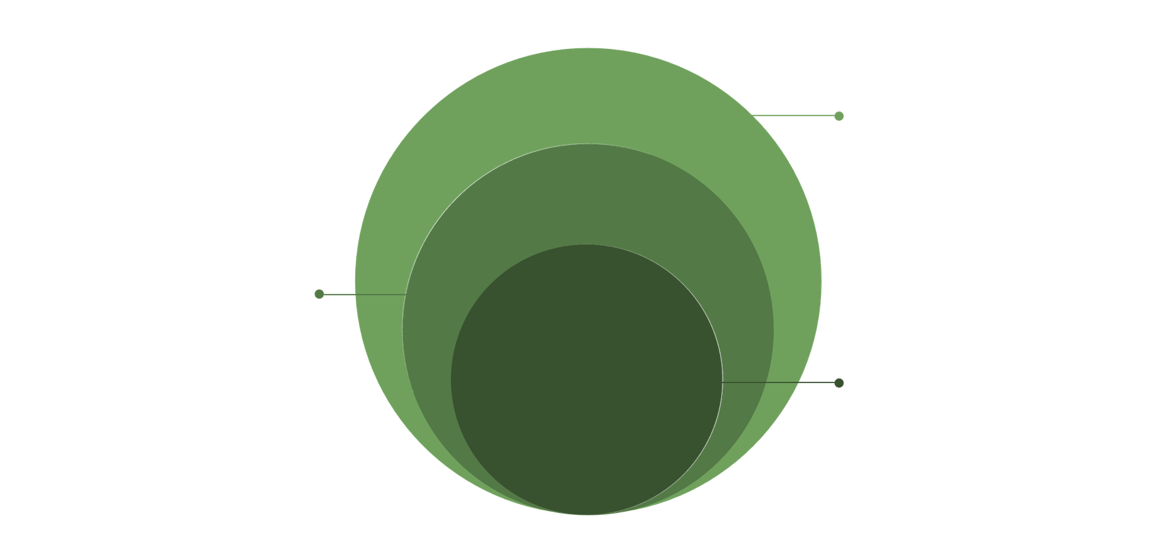
System Architecture
PhishGuard AI is a full-stack Flask application with a clean separation of concerns — from user input to ML inference to visual feedback.
Processing & ML
Cleaning, TF‑IDF, Scikit‑learn classifier
Backend
Flask API routing and file parsing
Core UI
Paste email or upload .eml file
The pipeline processes each email in under a second, returning a full threat assessment with interpretable indicators.

Slide 5





ML Pipeline: From Raw Text to Prediction
Text Cleaning
TF-IDF Vectorization
Strip HTML, remove stopwords, lowercase, tokenize
Convert text to weighted numerical features
Model Training
Prediction Output
Scikit-learn classifier trained on SpamAssassin corpus
Phish/Ham label + confidence probability score
Why TF-IDF? It weights terms by how uniquely they appear in phishing vs. legitimate emails — surfacing suspicious language patterns automatically.

Slide 6

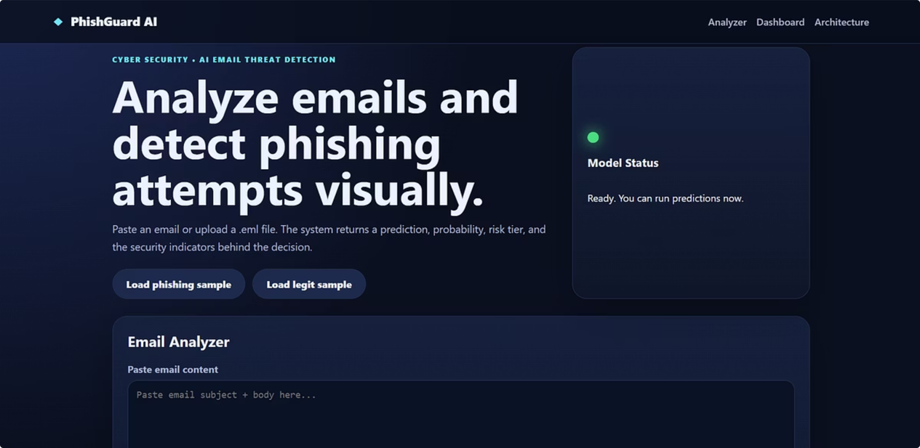



Web App Demo
Email Input
Instant Prediction
Suspicious Indicators
Paste raw email text or upload a .eml file directly in the browser — no installation required.
Results appear in seconds: Phish or Ham classification with a probability confidence score (0–100%).
The app highlights flagged keywords, urgency language, and structural red flags that drove the decision.

Slide 7
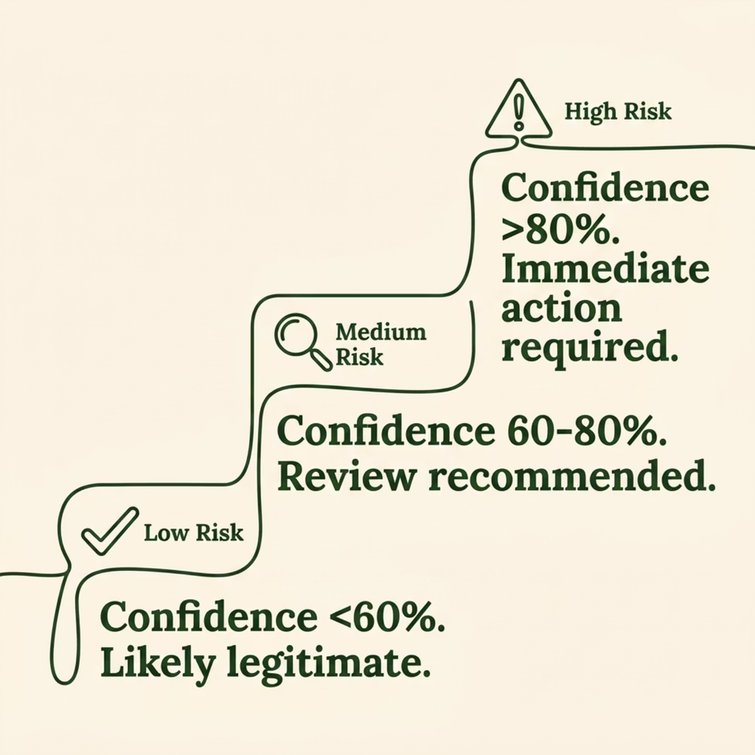

Results & Interpretation
What the Model Returns
🏷️ Classification
📊 Confidence Score
Phish or Ham — binary label based on learned patterns
Probability from 0–100% indicating model certainty
⚠️ Risk Level
🔍 Suspicious Features
Low / Medium / High — mapped from confidence threshold
Specific words/phrases that triggered the phishing flag

Slide 8
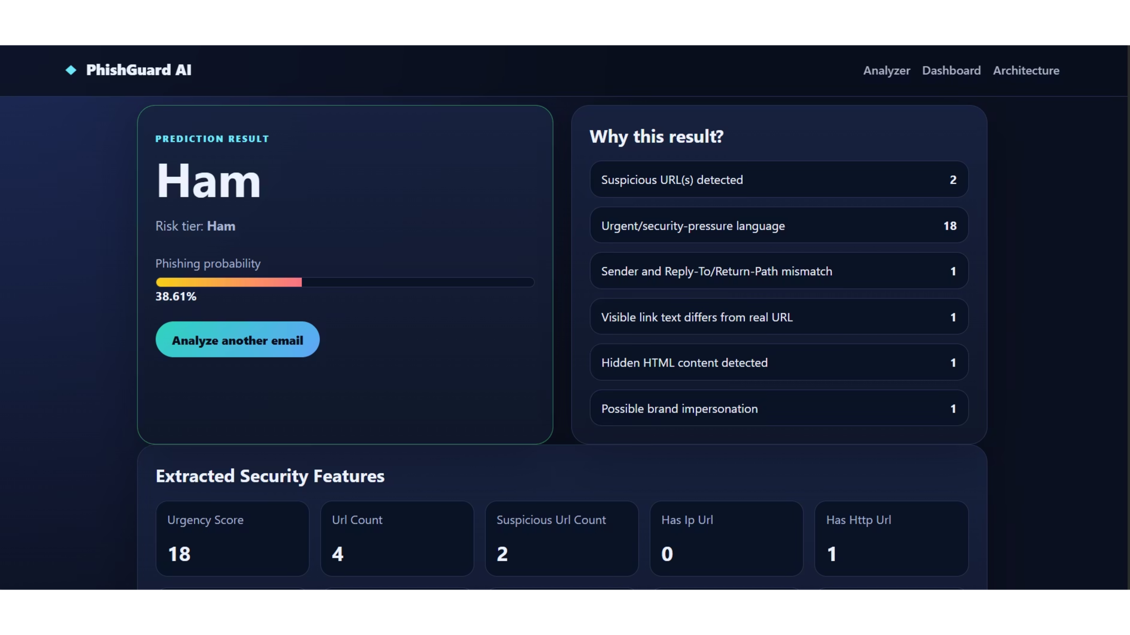

Slide 9

Limitations & Roadmap
Current Limitations
What's Next
No Real-Time Mailbox Access
Text-Only Analysis
01
Header metadata, DKIM/SPF records, and URL reputation are not yet evaluated.
DKIM / SPF / URL Checks
Currently manual input only — no IMAP/SMTP integration yet.
Integrate email authentication and link reputation APIs.
TF-IDF Scope
02
Bag-of-words model misses semantic context and multi-sentence reasoning.
DistilBERT Upgrade
Replace TF-IDF with a transformer model for semantic understanding.
03
Cloud Deployment
Deploy via Docker + Flask on AWS/Render with a REST API.
04
Browser Extension
Real-time Gmail/Outlook integration for end-user protection.

Slide 10





Conclusion
ML for Cybersecurity
Complete Pipeline
Interactive Web App
PhishGuard AI demonstrates how machine learning can support cybersecurity by detecting suspicious emails automatically.
The system uses a complete pipeline: dataset preparation, text preprocessing, TF-IDF vectorization, model training, prediction, and visual web presentation.
The Flask web app makes the project easy to test, explain, and demonstrate during the presentation.
Accessible ML Power
Human-AI Synergy
The project shows that even a simple and accessible ML model can provide useful phishing detection when trained on a real email dataset.
PhishGuard AI is not a replacement for human awareness, but it is a strong support tool for faster and smarter phishing detection.

Slide 11







Resources & Tools Used
A robust stack for detection and future-proofing against evolving threats.
CURRENT STACK
SpamAssassin Dataset
Python
Flask
Foundation for training our ML models.
Primary language for development & scripting.
Lightweight web app for interactive demo.
Scikit-learn
TF-IDF Vectorizer
Pandas & NumPy
Machine learning algorithms for classification.
Transforms email text into numerical features.
Efficient data handling and numerical operations.
Joblib
Web Interface
Testing Samples
Model serialization for quick loading and inference.
User-friendly frontend for email submission.
Real-world examples for validating detection.

Slide 12
Thank You
For more information or inquiries, please contact us!

