Slide 1

Naan Mudalvan
KEYLOGGERS
Aathi Siva Ganesh P
Aalim Muhammed Salegh College of Engineering
CSE
Notes:
1

Slide 2
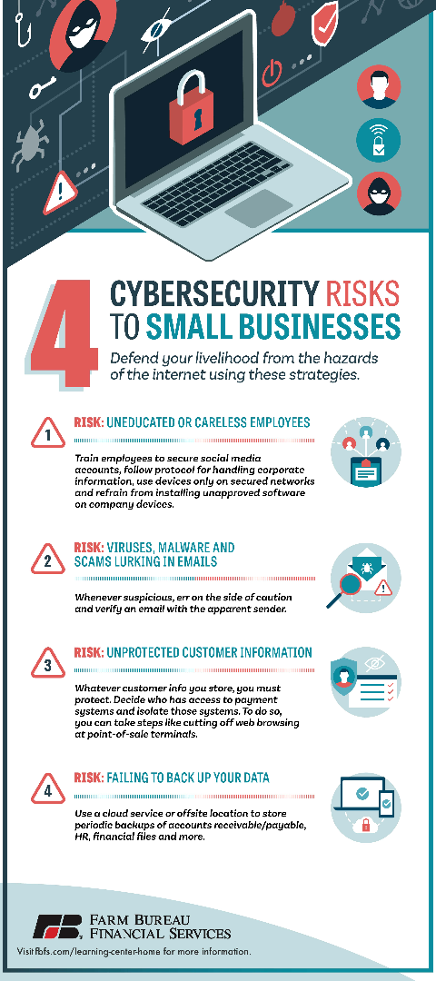
Problem statement
1
Data Breaches
2
Financial Loss
Keyloggers can lead to data breaches, compromising personal and sensitive information.
They can cause financial loss by capturing banking and payment details.
3
Privacy Violation
Keyloggers violate privacy by intercepting passwords and private communication.
Notes:
2

Slide 3



Proposed Solution
Encryption
Firewalls
Antivirus Software
Implement strong encryption methods to protect sensitive data from keyloggers.
Use firewalls to monitor and block suspicious network activity initiated by keyloggers.
Install reputable antivirus software to detect and remove keylogger programs.
Notes:
3

Slide 4
System Approach
Educate Users
Behavior Monitoring
Regular Updates
Train users to recognize potential threats and adopt safe digital practices.
Use behavior-based algorithms to identify abnormal device activities caused by keyloggers.
Ensure regular updates for operating systems and security software to patch vulnerabilities.
Notes:
4

Slide 5
Algorithms And Deployment
Advanced Algorithms
Utilize advanced algorithms to detect and prevent keylogger activities.
Cloud Deployment
Explore cloud-based deployment for centralized keylogger detection and management.
Real-time Monitoring
Implement real-time monitoring systems to detect keylogger behavior.
Notes:
5

Slide 6



Result
Minimized Threats
Enhanced Security
Improved Awareness
With proactive measures, keylogger threats have been significantly minimized.
Implementation of robust security measures has strengthened overall system integrity.
Increased awareness has led to better recognition and prevention of keylogger attacks.
Notes:
6

Slide 7

Output Image:
Notes:
7

Slide 8
Conclusion
Mitigating Risks
User Empowerment
The proactive approach to keylogger threats has resulted in effective risk mitigation.
Users are empowered with knowledge and tools to protect against keylogger attacks.
Ongoing Vigilance
Continuous vigilance is essential to adapt to evolving keylogger tactics and technologies.
Notes:
8

Slide 9
Future Scope
1
AI Integration
Explore AI integration for advanced keylogger detection and intelligent threat response.
2
Blockchain Security
Investigate blockchain technology for enhanced security against keylogger vulnerabilities.
3
User Training
Continue to evolve user training programs to address emerging keylogger threats.
Notes:
9

Slide 10
THANK YOU

