Slide 1


AYURVEDA
AYUR
VEDA
Life
Science/Knowledge
Dharma – Duty
Artha – Wealth
Kama – Desires
Moksha - Salvation

Slide 2
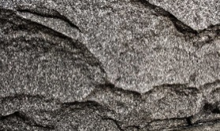
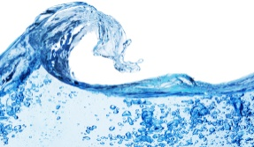
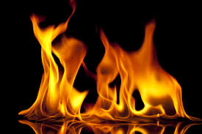


Basic theory
Earth
Water
Fire
Air
Space
Kapha
Pitta
Vata
Reaction
Digestion
Absorption
Metabolism
Organ function
Hormonal function
Movement
Food
Air
Elimination
Neuro impulses
Circulation
Mind
Structure
Bones
Muscles
Organs
Tissues

Slide 3
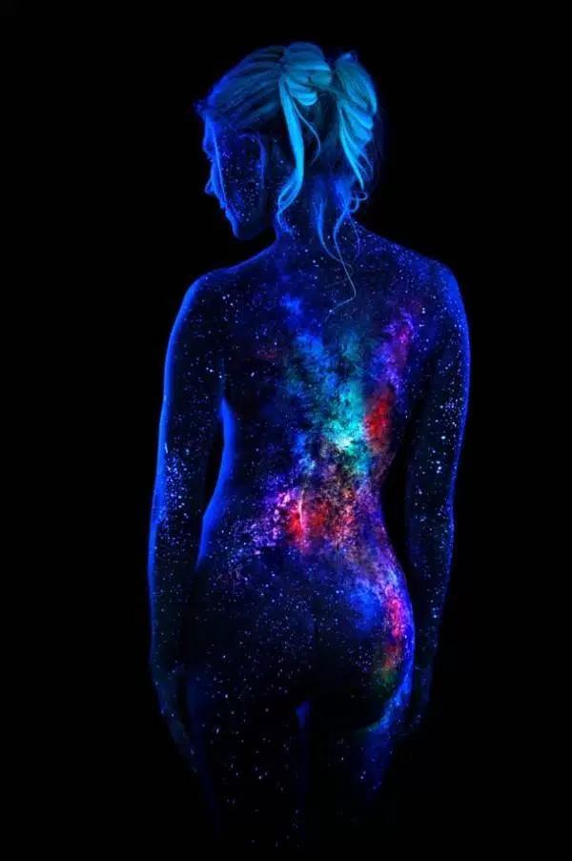

Body style
V
P
K
P
K
V
BALANCE
IMBALANCE

Slide 4
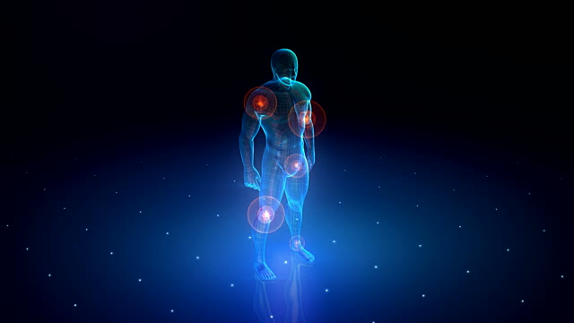
Body style
V
P
V
P
K
K

Slide 5
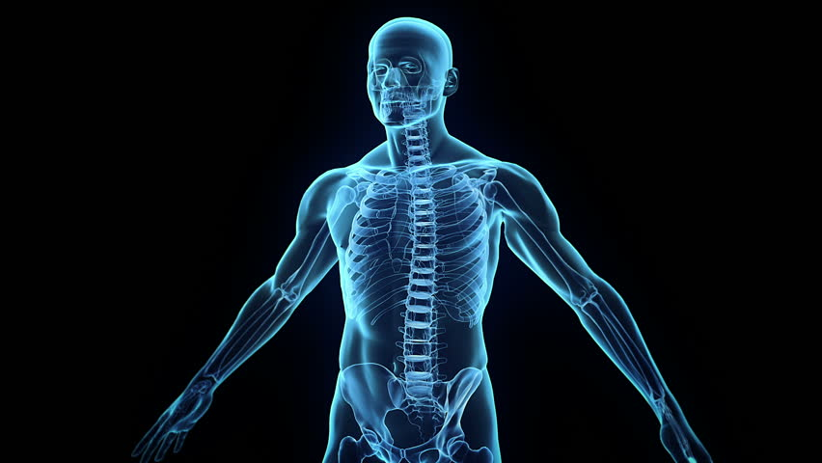
Body style
V
V
P
P
K
K
Pittakapha Vatakapha

Slide 6
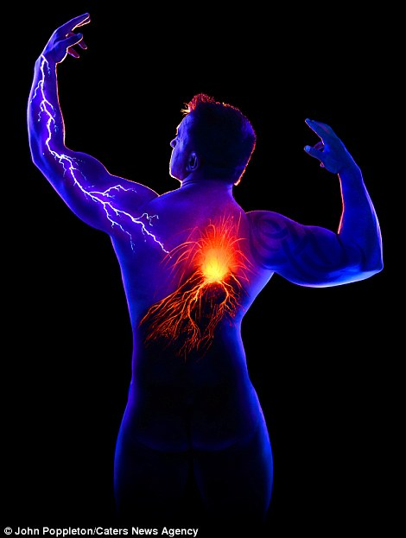
Diseases

Slide 7
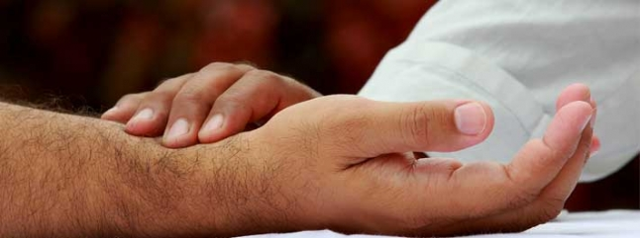
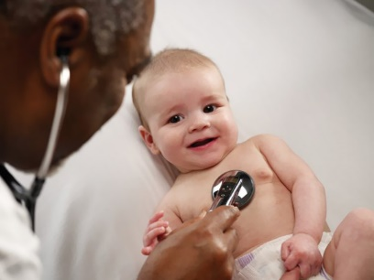

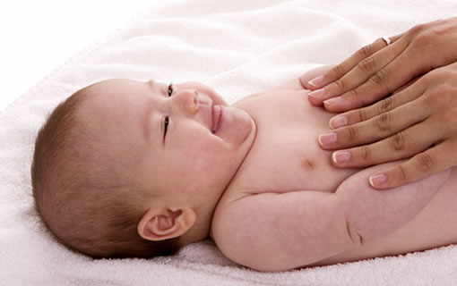
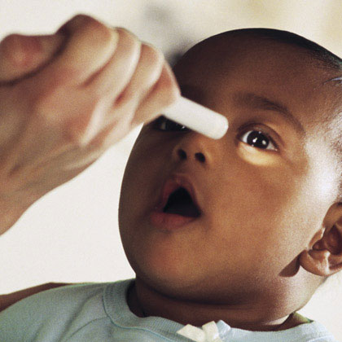
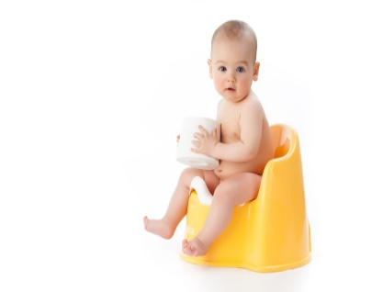

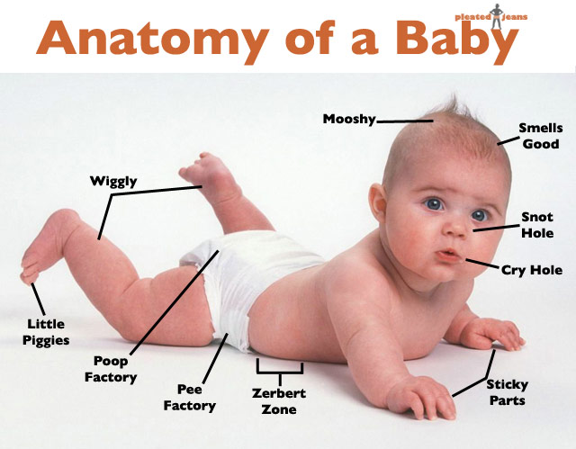
Diagnosis
8 Types
Pulse (Nadi)
Tongue (Jihwa)
Stool (Mala)
Urine (Muthra)
Sound (Shabdha)
Touch (Sparsha)
Eye (Drik)
Anatomy (Akrithi)

Slide 8
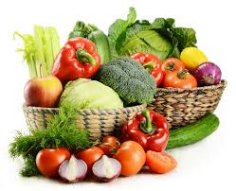

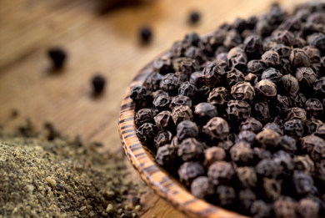
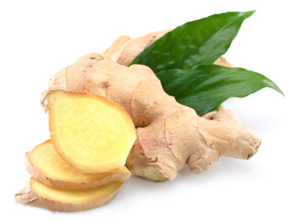
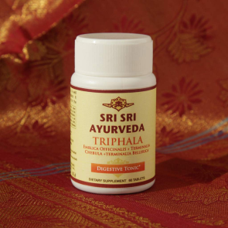
Treatment
Food
According to:
Body style
Imbalance
Age
Season
Work
Region
Lifestyle
Herbs

Slide 9

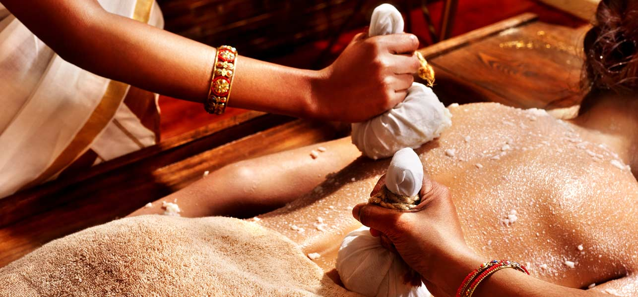
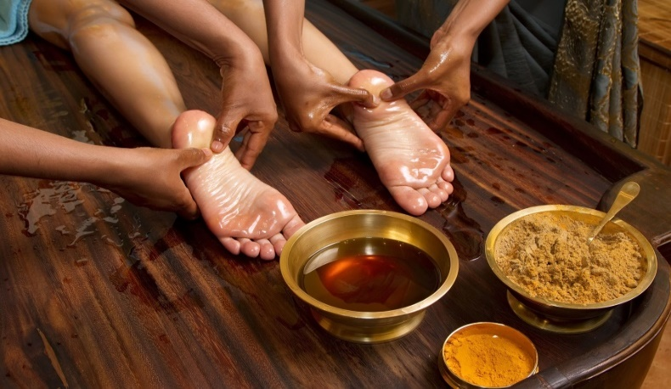
Treatment
Detoxification
Panchakarma
Vamana
Virechana (Purgation)
Nasya (Nasal medication)
Vasti (Enema)
Rakthamokshama (Blood letting)

Slide 10
Stages of disease
Kapha small increase
Kapha increases more
Kapha starts to circulate though out the body
Kapha loadges in new area
Disease
Complication

Slide 11
THANK YOU...

