Slide 1

Credit Card Approval
Aathithya-CB.EN.U4ELC20001
Adarsh-CB.EN.U4ELC20005
Arun-CB.EN.U4ELC20010

Slide 2
Summary of CA-1
To classify people described by a set of attributes as good or bad credit risks for credit card applications.
K-NN algorithm was used to achieve it.
K-NN algorithm stores all the available data and classifies a new data point based on the similarity. This means when new data appears then it can be easily classified into a well suite category by using K- NN algorithm.
It can be used for Regression as well as for Classification but mostly it is used for the Classification problems.

Slide 3
References
Convergence Criteria:
https://www.ibm.com/docs/en/spss-statistics/beta?topic=analysis-k-means-cluster-convergence-criteria
Cosine Similarity:
https://analyticsindiamag.com/cosine-similarity-in-machine-learning/
Euclidean Distance:
https://www.datanovia.com/en/lessons/clustering-distance-measures/

Slide 4
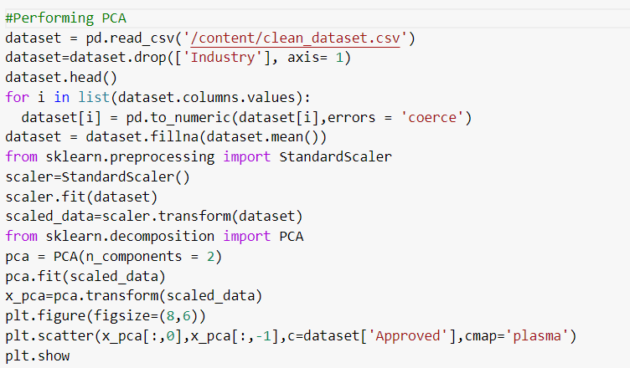
PCA application (10 marks)
Visualizing the data by applying PCA:

Slide 5
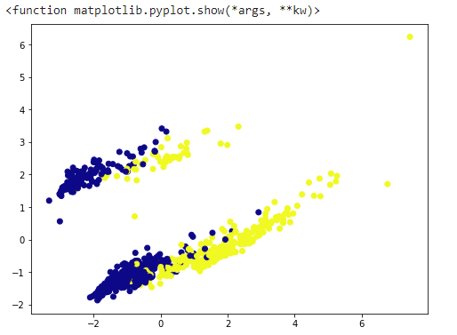

Slide 6
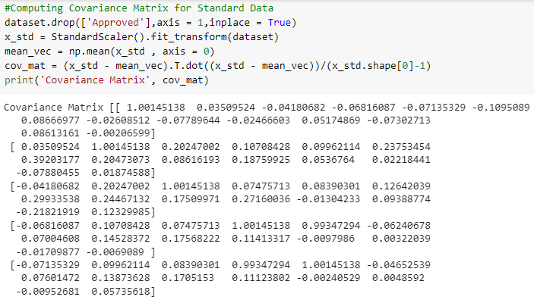
Covariance Matrix for Standard Data (Without Applying PCA):
As the dataset contains higher dimensions covariance matrix is calculated to describe the relation between different dimensions.
The covariance matrix has negative values so the features vary at opposite direction

Slide 7
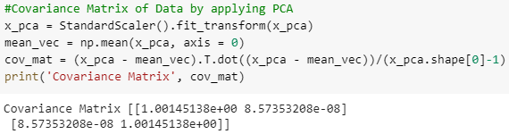
Covariance Matrix for Data After Applying PCA:
To adjust the size of the state PCA is used on covariance matrix
As you can see there was a large covariance matrix before applying PCA and now it is converted to 2x2 matrix
The covariance matrix has only positive values so the features vary in same direction now.

Slide 8
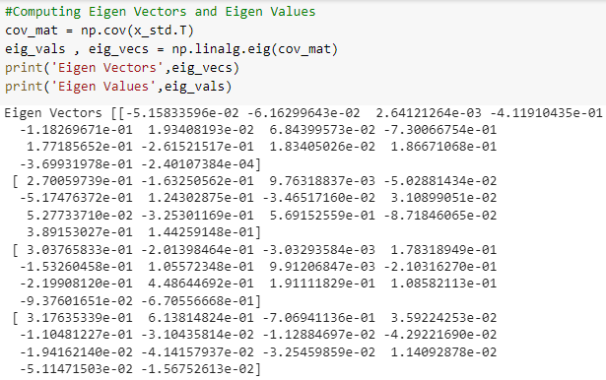
Eigen Values and Eigen Vectors for Standard Data (Without Applying PCA):

Slide 9
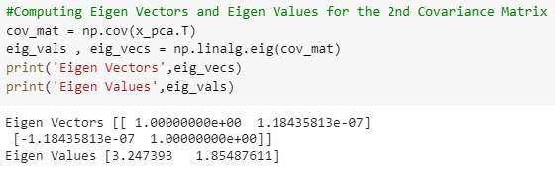
Eigen Values and Eigen Vectors for Data After Applying PCA:
Always highest Eigen value is selected in this case(3.247393). Because the greater the Eigenvalue, the longer the Eigen vector.

Slide 10
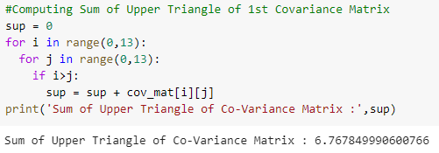
Sum of Upper Triangular Values in Covariance Matrix for Standard Data (Without Applying PCA):
As you can see the sum of upper triangle values is positive before applying PCA

Slide 11
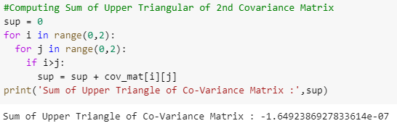
Sum of Upper Triangular Values in Covariance Matrix for Data After Applying PCA:
As you can see the sum of upper triangle values negative after applying PCA.
That is because when PCA is applied dimensionality of the matrix decrease which result in decrease in value of upper triangle of covariance matrix.

Slide 12
Link for the Code:
https://colab.research.google.com/drive/1123Kr7DNfSNKZrbotho6gO4ZcqkalRpa?usp=sharing
Link for the dataset:
https://www.kaggle.com/datasets/samuelcortinhas/credit-card-approval-clean-data

Slide 13
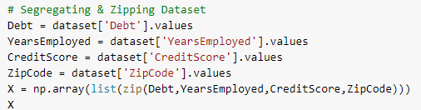
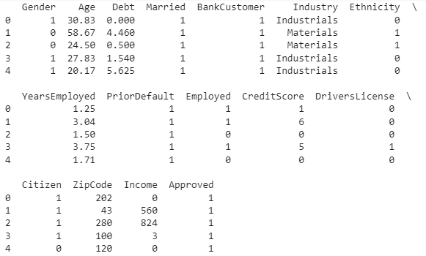
Clustering ( 10 marks)

Slide 14
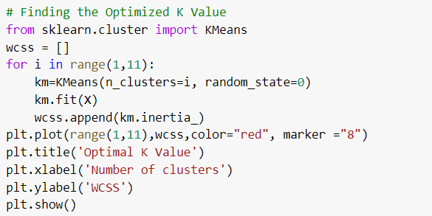
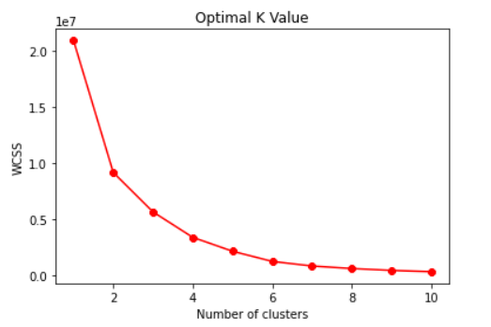
Finding Optimal Value of K
No of cluster take is 10 where 10 features from dataset out of 16 is consider to calculate k value
From the graph it is identified k value = 4

Slide 15
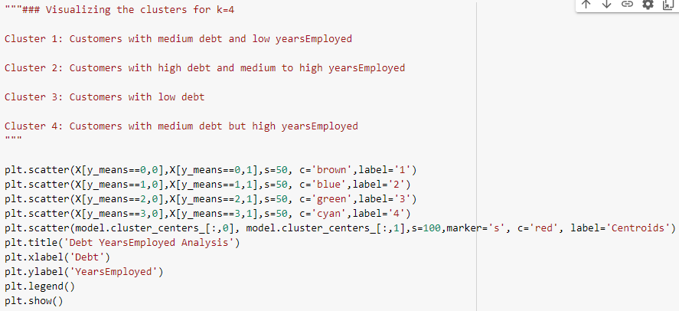
Visualizing the Clusters for Optimal Value of K

Slide 16
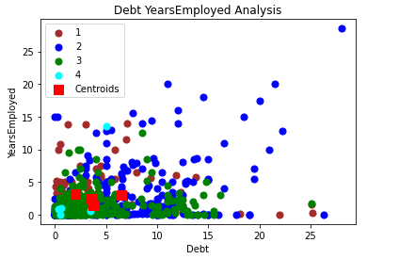
The graph shows the visualization of cluster of k value 4.
As you can see 4 different clusters are described in 4 different colours.

Slide 17
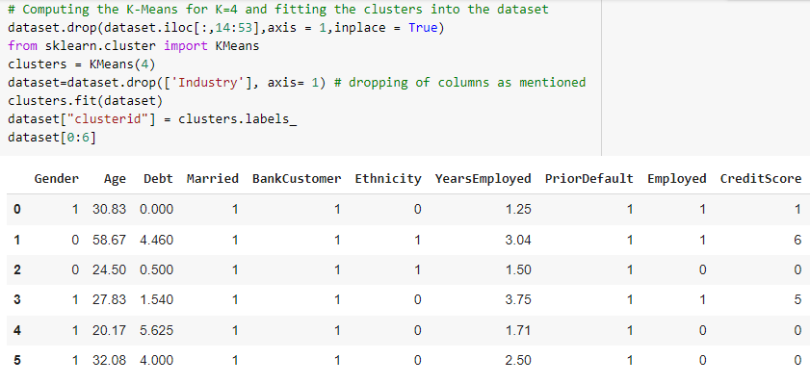
Computing K-Means and fitting the clusters into the dataset
K-Means is computed to minimize the sum of distances between the points and their respective cluster centroid.
Cluster are created and fitted inside dataset in the name of clusterid

Slide 18
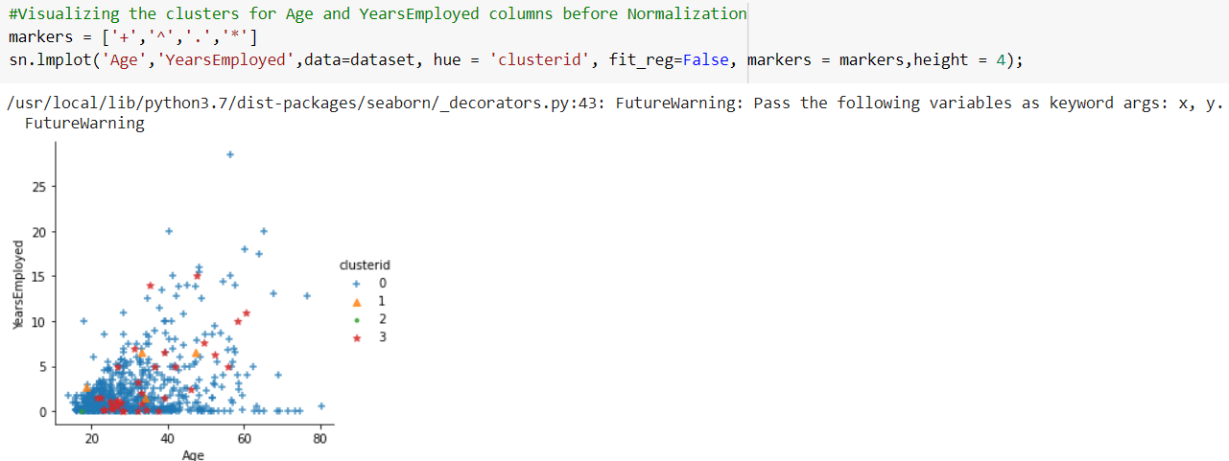
Visualizing the clusters for Age and Years Employed Columns
As you can see the clusters are scattered and are not observed in sorted manner as Normalization of data is not done.

Slide 19
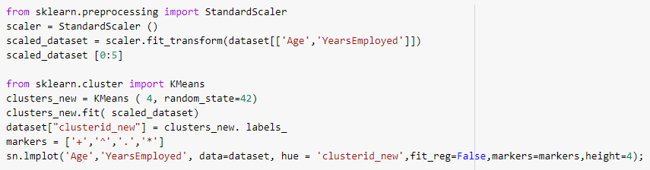
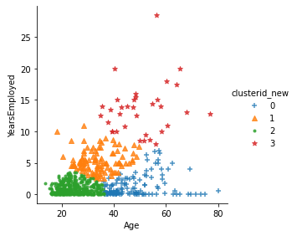
Visualizing the clusters for Age and Years Employed Columns After Normalization
Now you can observe the clusters in sorted way due to normalization of data.

Slide 20
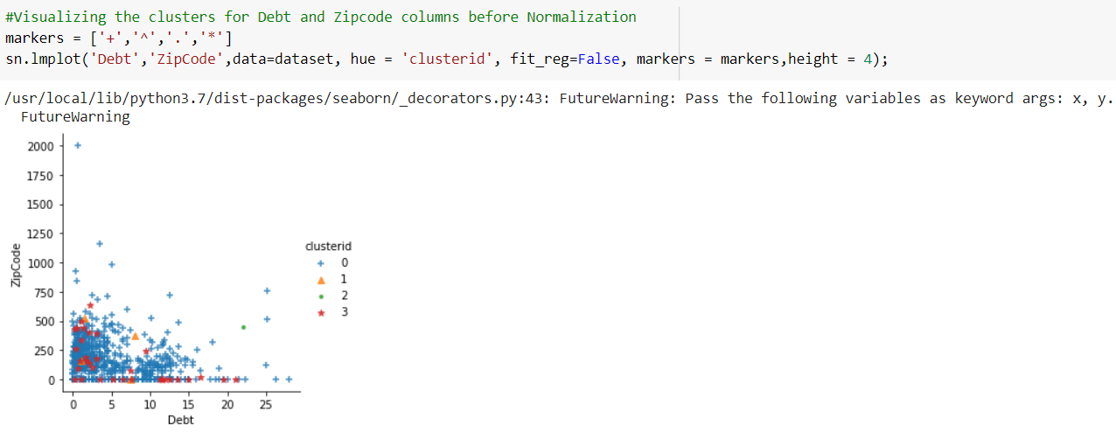
Visualizing the clusters for Debt and Zip Code Columns before Normalization
As you can see the clusters are scattered and are not observed in sorted manner as Normalization of data is not done.

Slide 21
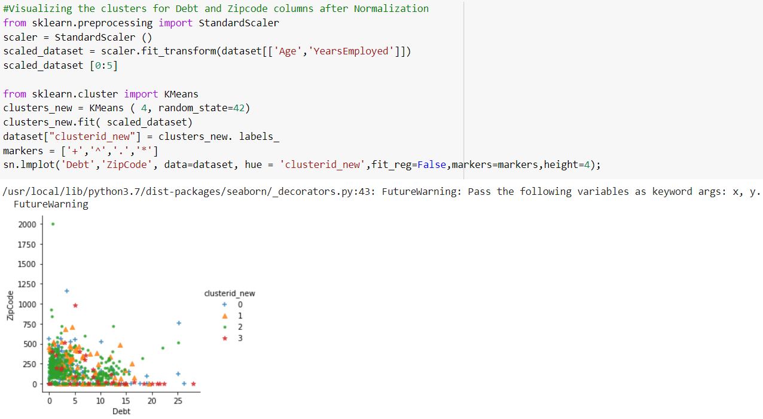
Visualizing the clusters for Debt and Zip Code Columns after Normalization
Now you can observe the clusters in sorted way due to normalization of data.

Slide 22
Two classes are involved in our dataset
The k value selected is related to number of classes
As from this dataset cluster 4(medium debt and high year experience) will be approved for credit card
As the k value is 4 which helps us to organize the data into 4 different cluster to determine which of the 2 classes it belongs

Slide 23
Link for the Code
Link to full code:
https://colab.research.google.com/drive/1la-oFYqqXSbe__TpF3j6qGkgy8keVYJx?usp=sharing
Link of Datasheet:
https://www.kaggle.com/datasets/samuelcortinhas/credit-card-approval-clean-data

Slide 24
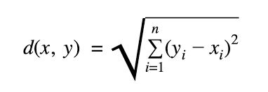
Miscellaneous
Euclidean Distance or Minimum Distance is the method used to find the distance between observations.
Given a set of points in the two-dimensional plane, the minimum Euclidean distance between two distinct points is:
Cosine Similarity: This method is used to compare two different vectors on the basis of how similar their directions are regardless of magnitude.
This method can be used to replace Euclidean Distance in Clustering Method

Slide 25
Convergence Criteria is used in clustering algorithms to check if the data points are completely grouped into correct clusters.
Each Eigenvector has a corresponding eigenvalue. It is the factor by which the eigenvector gets scaled, when it gets transformed by the matrix.
Using eigenvalues and eigenvectors, we can find the main axes of our data.
Principal component analysis uses the power of eigenvectors and eigenvalues to reduce the number of features in our data, while keeping most of the variance
In PCA we specify the number of components we want to keep beforehand.

