Slide 1

Credit Card Approval
Team members

Slide 2
Summary of CA-1
To classify people described by a set of attributes as good or bad credit risks for credit card applications.
K-NN algorithm was used to achieve it.
K-NN algorithm stores all the available data and classifies a new data point based on the similarity. This means when new data appears then it can be easily classified into a well suite category by using K- NN algorithm.
It can be used for Regression as well as for Classification but mostly it is used for the Classification problems.

Slide 3
Summary of CA-2
Used Principle Component Analysis(PCA)

Slide 4
References
Credit Card Approval Dataset:
https://www.kaggle.com/datasets/samuelcortinhas/credit-card-approval-clean-data
Radial Basis Network:
https://www.simplilearn.com/tutorials/machine-learning-tutorial/what-are-radial-basis-functions-neural-networks
SVM vs Neural Network:
https://www.baeldung.com/cs/svm-vs-neural-network#:~:text=An%20SVM%20possesses%20a%20number,many%20layers%20as%20we%20want.

Slide 5
Problem Formulation
Objective: To classify people described by a set of attributes as good or bad credit risks for credit card applications using neural network.
Dataset details:
No.of rows: 691
No.of columns: 16
No.of classes: 2
Method of data collection is unknown
Link to full code mentioned in slides:

Slide 6
Assumptions:
Feature- “Industry” was ignored while computing due to the presence of multiple strings and requires the help of NLP for solving.
The feature “Ethnicity” was numeralised where:
White=0/Black=1/Asian=2/Latino=3/Other=4
The feature “Gender” was numeralised where:
Female=0/Male=1
The feature “Citizen” was numeralised where:
ByOtherMeans=0/ByBirth=1/Temporary=2

Slide 7
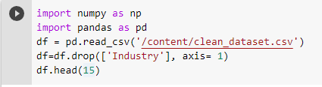
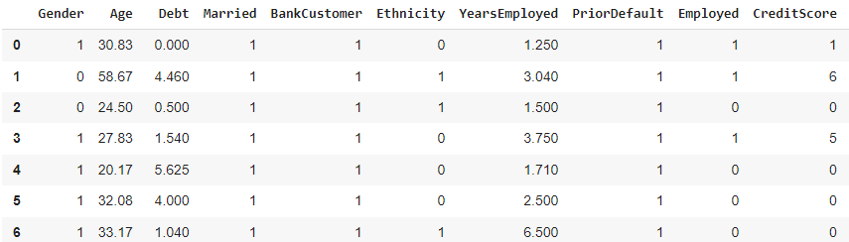
Neural Network application
Visualizing the data

Slide 8

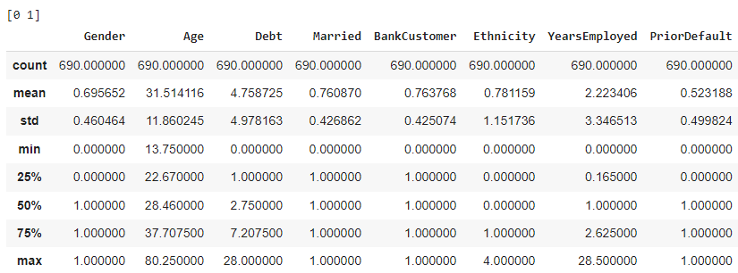
Obtaining unique values for the target using mean, std, min of the given data.
Count is equal to the number of rows = 690

Slide 9
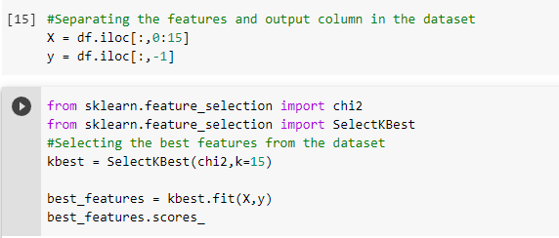

The features and output column (Approved) are separated
Applying a score for each of the features based on their role in obtaining output.

Slide 10
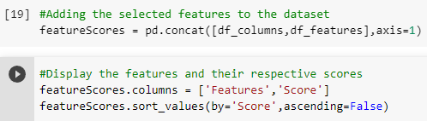
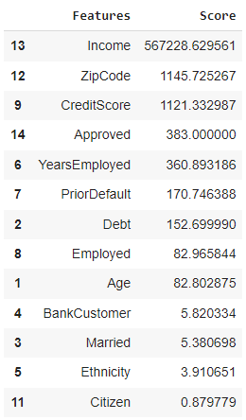
The 15 features are arranged in descending order according to their respective scores.

Slide 11


The dimensions of the dataset are calculated and printed.
This is required to encode the values and plot them.

Slide 12
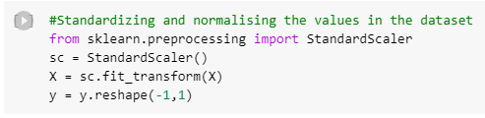
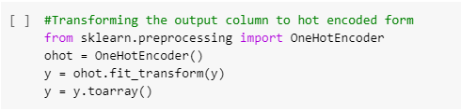

The dataset values are standardized and normalized for preprocessing.
Preprocessing is done by importing OneHotEncoder.
The dataset is then split into testing(20%) and training parts.

Slide 13
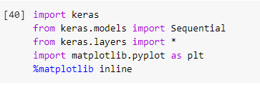
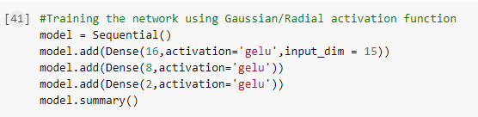
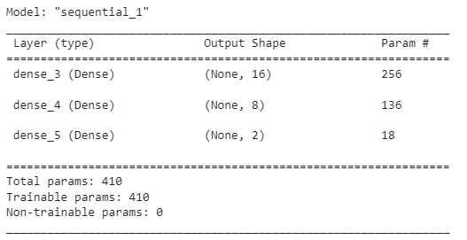
Radial activation function is used and the trainable parameters are obtained.

Slide 14
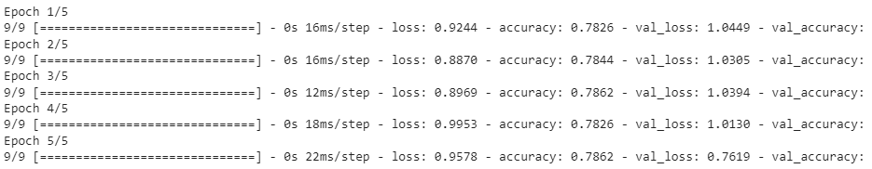
The loss in accuracy, value and value accuracy is found for the dataset.
The model is run for 5 epochs to calculate the accuracy here.

Slide 15
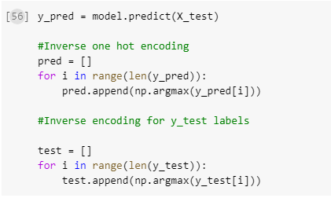


The values are inverse encoded from one hot encoded(i.e., imported library) values.
The accuracy value for the model is then displayed.

Slide 16
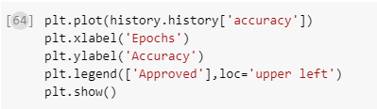
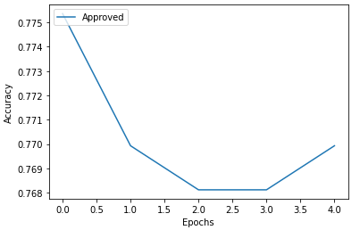
The accuracy of the credit card approval is checked for the number of epochs done and plotted.

Slide 17
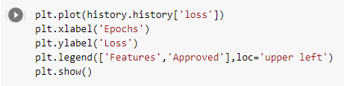
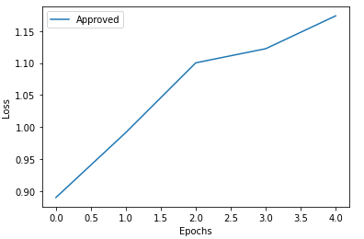
The loss from credit card approval is checked for the number of epochs done and plotted.

Slide 18
Link for the Code:
https://colab.research.google.com/drive/17E0jbckTUy08hc3JlMYblmf708y6t4tG?usp=sharing
Link for the dataset:
https://www.kaggle.com/datasets/samuelcortinhas/credit-card-approval-clean-data

Slide 19
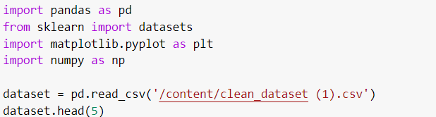
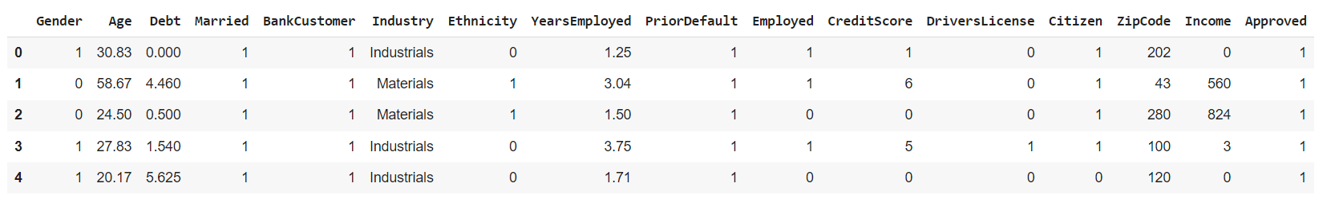
SVM
Visualizing the data

Slide 20
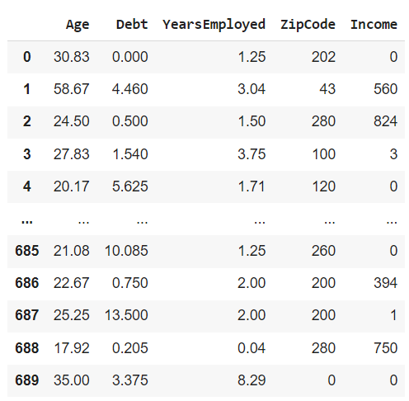
Columns which had binary values is dropped out and stored in modified dataset.
Splitting of dataset for training and testing is done.

Slide 21
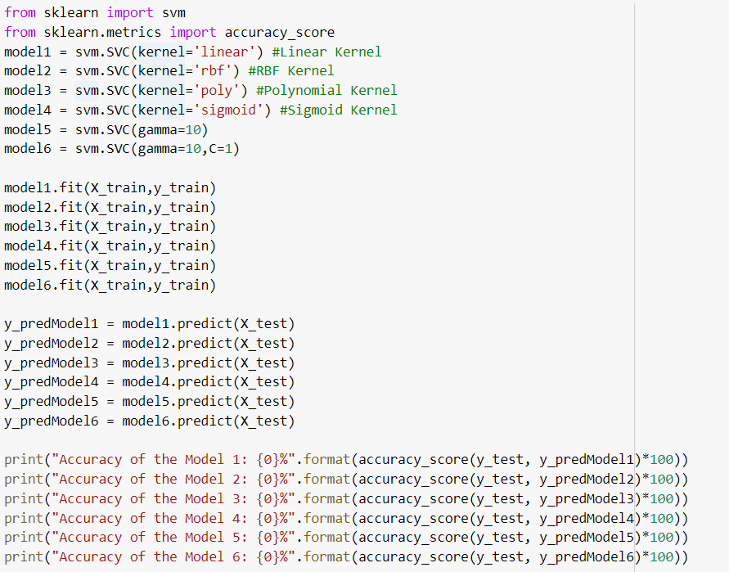
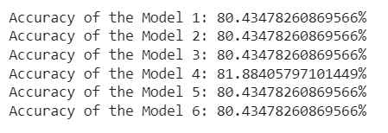
Accuracy of the model is calculated

Slide 22
Inference
Radial Basis Functions: They are a special class of feed-forward neural networks consisting of three layers: an input layer, a hidden layer, and the output layer.
Support Vector Machine or SVM is a Supervised Learning algorithms, which is used for Classification as well as Regression problems. However, primarily, it is used for Classification problems in Machine Learning.
The main difference between SVM and NN is that SVM possesses a number of parameters that increase linearly with the linear increase in the size of the input. A Neural Network, on the other hand, does not.

Slide 23
Neural network can be used for multiple layers unlike SVM.
SVM can be of two of types:
Linear SVM: Linear SVM is used for linearly separable data, which means if a dataset can be classified into two classes by using a single straight line
Non-linear SVM: Non-Linear SVM is used for non-linearly separated data, which means if a dataset cannot be classified by using a straight line
Non-linear SVM uses a kernel corresponds to a method for the reduction in the dimensionality of the input to a classifier.
The kernel is, therefore, the function that’s used in place of a dot product between two vectors
The accuracy of the model changes as the number of epochs changes in Neural Networks.

