Slide 1
Mini Project
An Energy-Efficient PLL-Based Clock Generator Using a Ring Oscillator for IoT Applications
Project Members
Aathithya K
Hemapriyan S
Under the Guidance of
Dr. S. R. Sriram
Assistant Professor
Department of ECE
Anna University

Slide 2
OBJECTIVES
DESIGN TARGETS
32.768
kHz reference input
10
MHz output frequency
≤ 100
µA maximum current
< 100
µs startup time
< 1
ns RMS period jitter
OBJECTIVES
Design a low-power PLL clock generator for IoT applications using Cadence Virtuoso (180 nm CMOS).
Analyze and optimize each PLL block: PFD, charge pump, loop filter, VCO and frequency divider.
Optimize power, loop stability, locking speed and jitter to deliver a stable 10 MHz output within the specifications.

Slide 3
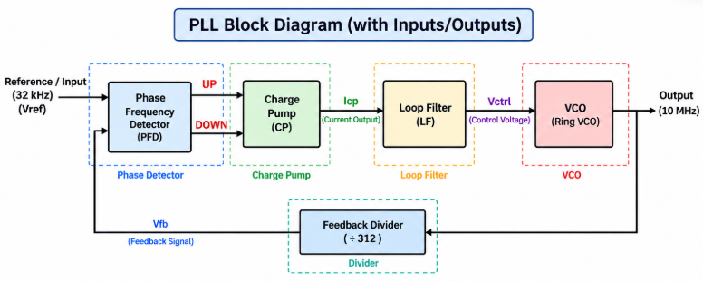
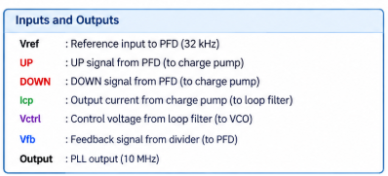
INTRODUCTION
A Phase-Locked Loop (PLL) generates a stable, accurately controlled clock signal.
It compares the phase and frequency of a reference and a feedback signal and continuously adjusts the VCO to keep them synchronized.
A PLL has a PFD, charge pump, loop filter, VCO and frequency divider.
Applications: clock generation, frequency synthesis, communication systems and timing circuits.
Tools: Cadence Virtuoso with 180 nm CMOS technology.
Fig. 1: Block diagram of a PLL, with its inputs and outputs

Slide 4
PROGRESS SINCE REVIEWS 1 AND 2
After Review 1
Designed and simulated the PFD, charge pump, loop filter and VCO.
Obtained the required outputs from each block.
Selected a divider architecture; its implementation in Cadence was not completed.
After Review 2
Built the divider’s basic blocks (D flip-flop and NAND gate) and created their symbols.
Redesigned the PFD at transistor level after symbol-loading issues across systems and libraries; required outputs obtained.
Implemented and simulated ÷5, ÷7 and ÷9 dividers with the expected outputs.
Integrated all PLL blocks except the divider; output frequency approximately as expected.
Review 3 accomplishments
Successfully implemented the complete divide-by-315 frequency divider separately and verified its output.
Integrated the divider with the PLL and verified the overall output waveform.
Achieved an output frequency close to the target frequency.
Measured the PLL’s supply current, start-up time, and RMS period jitter using Cadence simulation features.
Verified the integrated PLL operation and evaluated its performance against the design specifications.

Slide 5
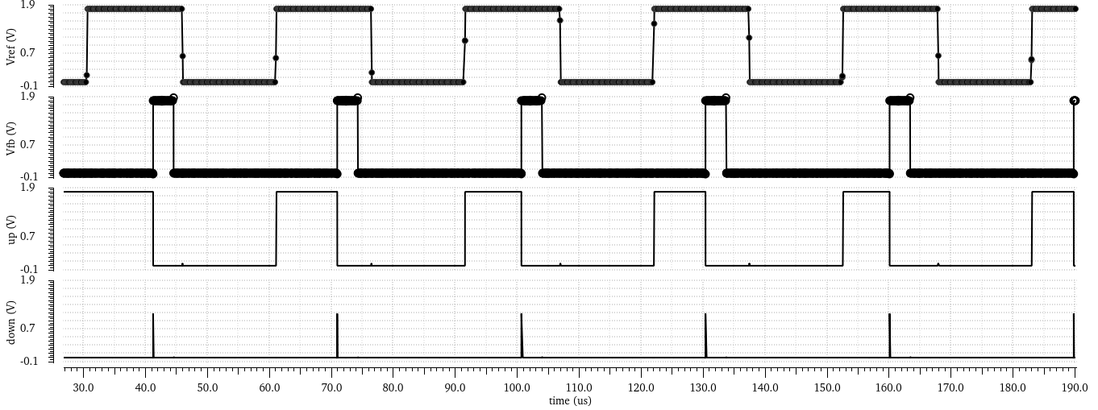
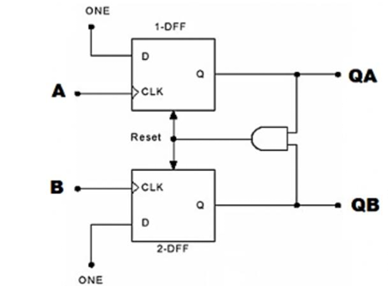
PHASE-FREQUENCY DETECTOR
PFD – output waveform
Chosed the DFF-based PFD for its simple architecture, reliable phase and frequency detection and easy charge-pump integration.
The new design analyze UP/DOWN pulse generation, reset behavior, propagation delay and power consumption.
PFD – circuit diagram

Slide 6
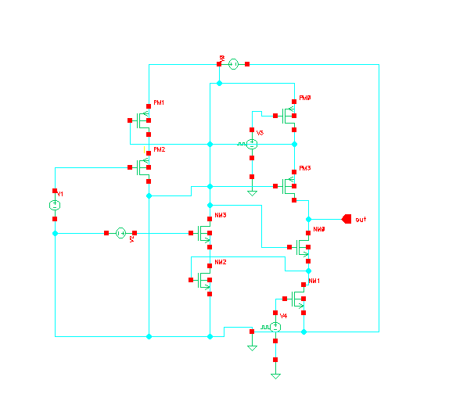
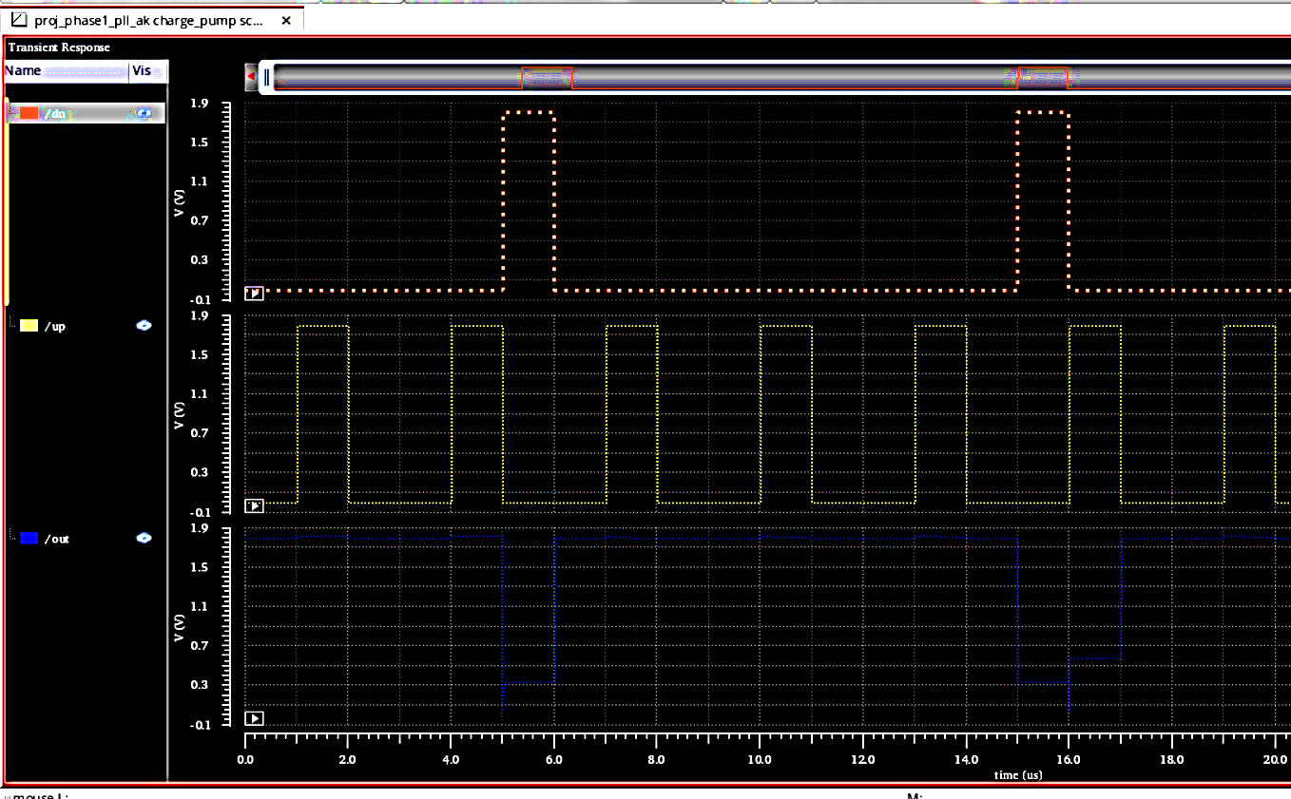
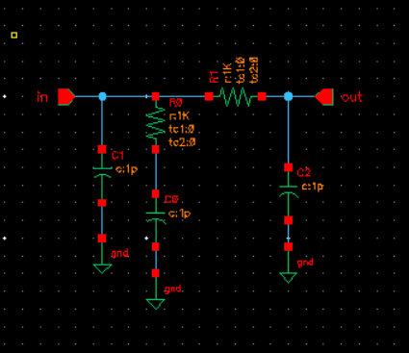
CHARGE PUMP & LOOP FILTER
Charge pump – schematic
Charge pump – output voltage waveform
Loop filter – schematic

Slide 7
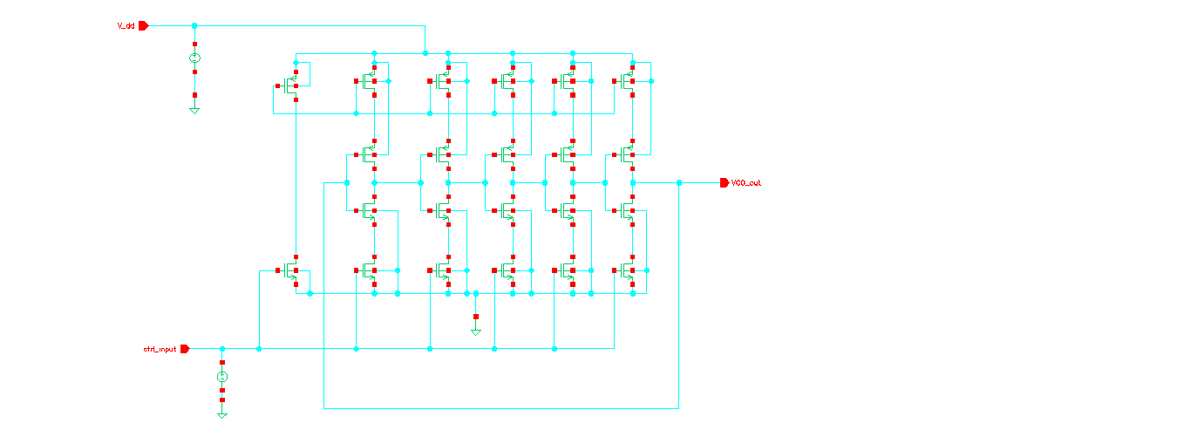
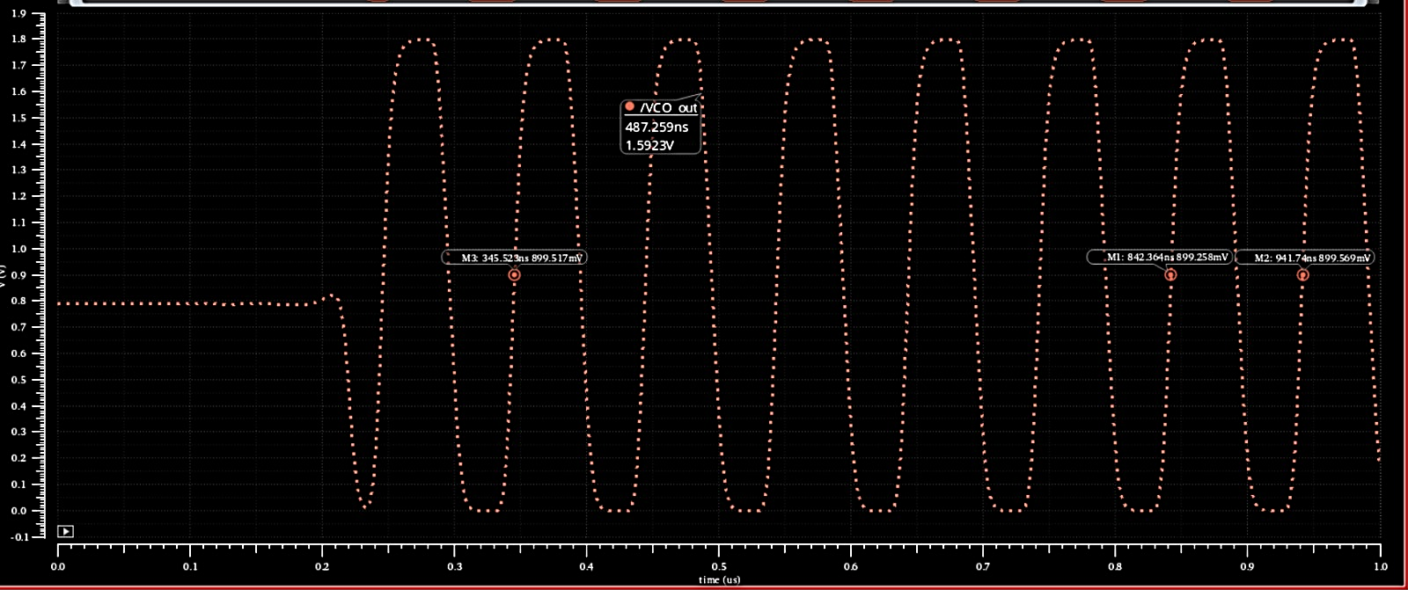
CURRENT-STARVED RING VCO
Measured frequency of Ring VCO
10.06 MHz
From the waveform markers
M1: 842.364 ns, 899.258 mV
M2: 941.74 ns, 899.569 mV
T = M2 − M1 = 99.376 ns
f = 1 / T = 10.06 MHz
Note :
This is a testbench simulation to check the working of the Current starved Ring VCO with V_{ctrl} set to 1V.
VCO – schematic diagram
VCO – output waveform

Slide 8
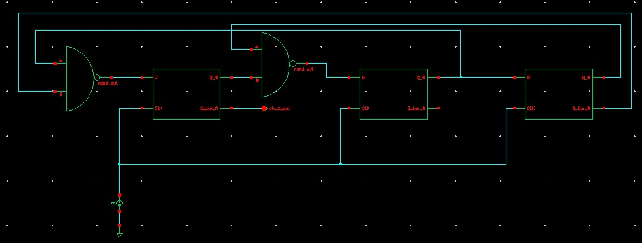
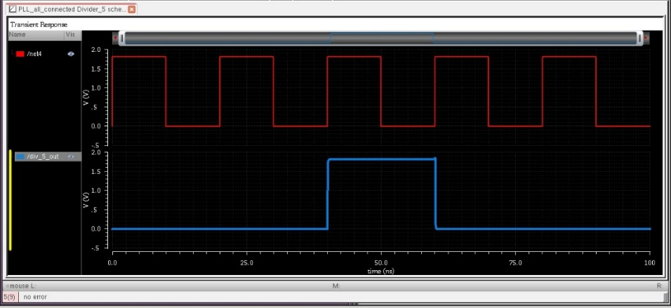
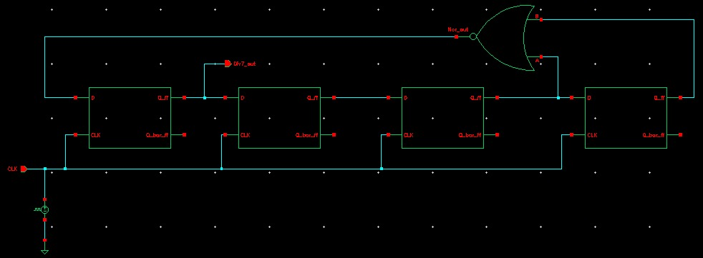
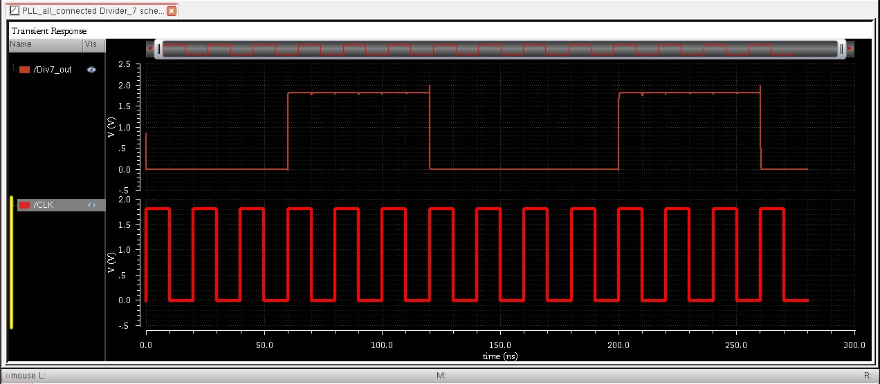
FREQUENCY DIVIDER: ÷5, ÷7
Divide-by-5 – schematic
Divide-by-5 – output waveform
Divide-by-7 – schematic
Divide-by-7 – output waveform

Slide 9
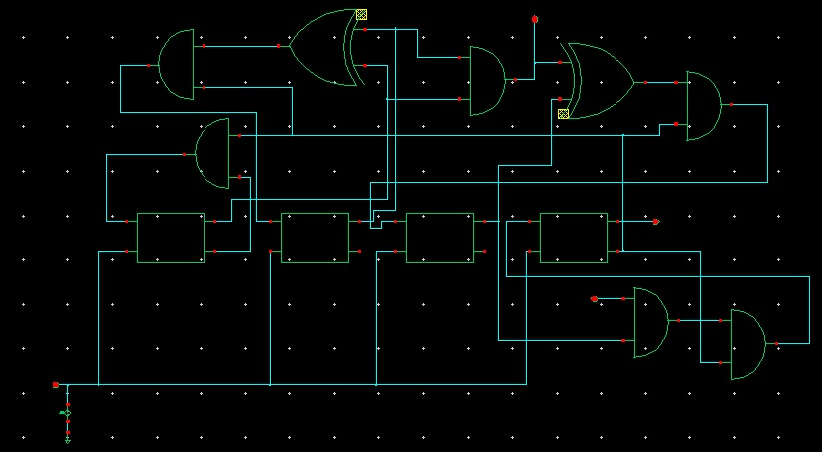
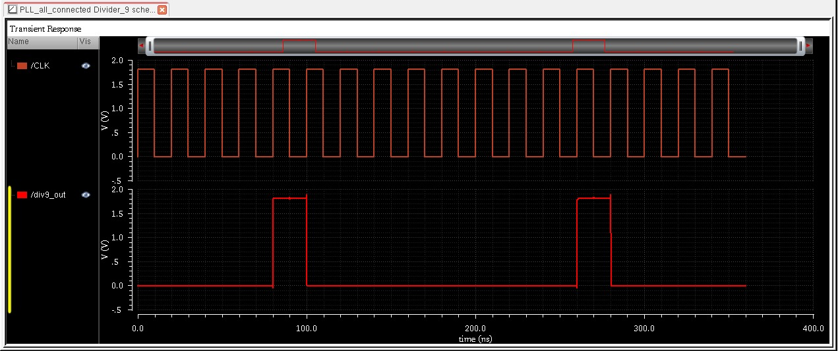
FREQUENCY DIVIDER: ÷9
Divide-by-9 – schematic
Divide-by-9 – output waveform
The ÷5, ÷7 and ÷9 dividers were each implemented and verified with transient simulations. Cascading them gives the required ÷315 divider (5 × 7 × 9 = 315), which was also implemented and verified in simulation.

Slide 10
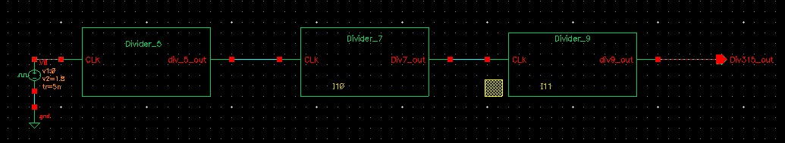
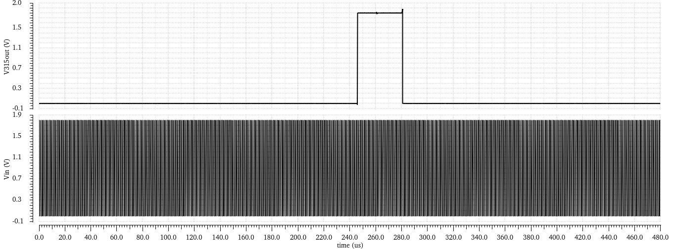
FREQUENCY DIVIDER: ÷315
Divide-by-315– schematic
Divide-by-315 – output waveform
Why ÷315 instead of ÷305?
1. Simpler implementation: ÷315 is built by cascading ÷5, ÷7 and ÷9 stages, whereas ÷305 (= 5 × 61) needs a more complex counter.
2. Lower hardware complexity: The ÷315 design reuses simple divider stages, potentially reducing gate count and design effort versus a custom ÷305 counter.

Slide 11
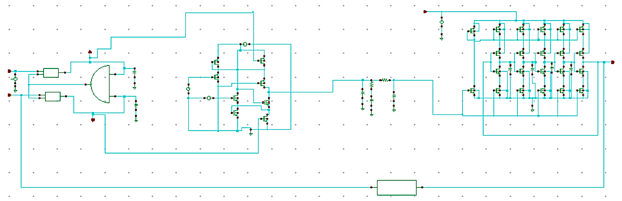
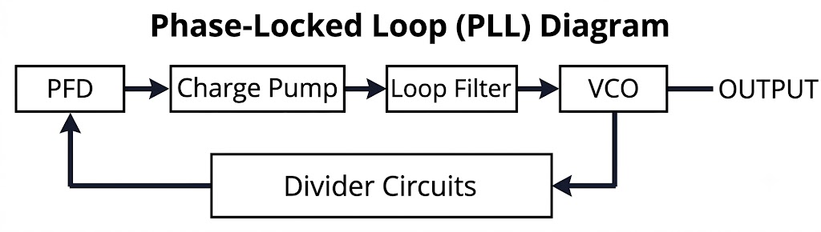
PLL - INTEGRATED BLOCKS SCHEMATIC
PLL – schematic

Slide 12
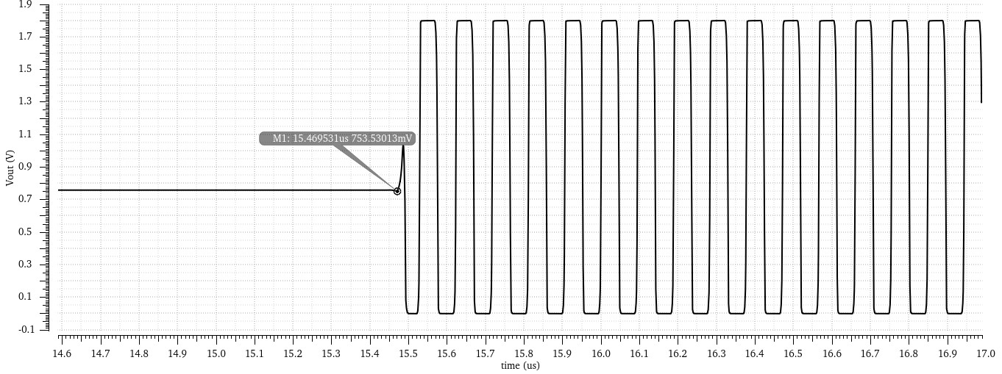
PLL – SIMULATION RESULT
PLL – output waveform
PLL output waveform
T_{avg} = 1133.055 ns / 12 = 94.421 ns (12 cycles)
f = 1 / 94.421 ns = 10.59 MHz
10.59 MHz
Output frequency
94.42 ns
Oscillation period
15.46 µs
Startup time
+5.9 %
Above the 10 MHz target

Slide 13
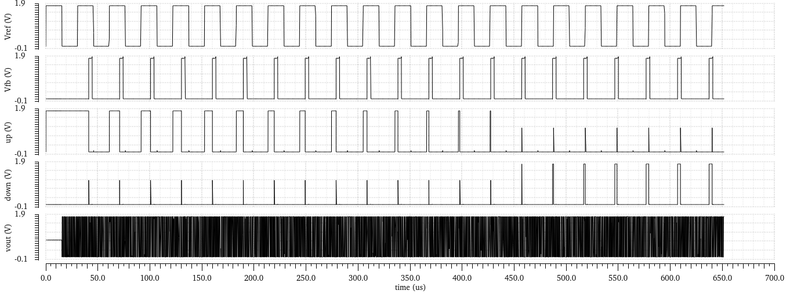
PLL – SIMULATION RESULT
PLL – output waveform
PLL output waveform
PLL Output Waveform compared with V(ref) , V(fb) , Up and Down signals
This Figure shows the PLL signals over 650 µs. Initially, wide UP pulses increase the control voltage and VCO frequency. As the loop approaches lock, UP pulses narrow and DOWN pulses appear to correct the phase error. The PLL output oscillates continuously throughout the simulation.

Slide 14
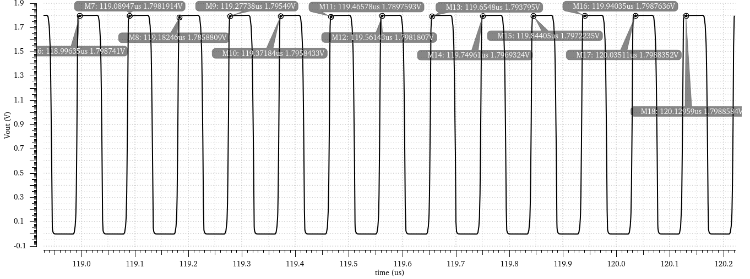
PLL – SIMULATION RESULT
PLL – output waveform
Waveform for Jitter Analysis
T_{avg} = 1133.055 ns / 12 = 94.421 ns
J_{rms} = √(11.5580 ns² / 12) = 0.981 ns
RMS period jitter is calculated over 12 cycles and is below the 1 ns limit.
0.981 ns
RMS period jitter (limit: < 1 ns)

Slide 15
LIMITATIONS
Frequency accuracy
The implemented ÷315 ratio differs from the ideal ratio of about 305.18, causing a deviation from the 10 MHz target output.
Parasitic effects
Interconnect resistance, capacitance and device mismatch have not been evaluated through post-layout simulations.
Robustness testing
PVT corner and Monte Carlo analyses have not been performed to verify performance under process, voltage and temperature variations.
1
2
3
Each limitation is addressed in the future scope on the next slide.

Slide 16
FUTURE SCOPE
Optimize the frequency division ratio and run longer simulations to verify the locked frequency, startup time and jitter. Add PVT and Monte Carlo analyses to evaluate reliability.
Implement the PLL layout in Cadence Virtuoso (180 nm CMOS), focusing on device matching, symmetrical VCO stages, proper grounding and reduced parasitics.
1
Schematic improvement
2
Layout design
Verify the layout with Design Rule Check (DRC), Layout Versus Schematic (LVS) and Parasitic Extraction (PEX), followed by post-layout simulations.
Generate the GDSII file for fabrication and validate output frequency, startup time, period jitter and power consumption experimentally.
3
DRC, LVS and PEX
4
Tape-out and testing

Slide 17
CONCLUSION
Complete PLL integrated and verified
The PFD, charge pump, loop filter, current-starved ring VCO and ÷315 divider were designed in Cadence Virtuoso (180 nm CMOS) and simulated together as a working PLL.
1
Three of four specifications met
Current of 57.18 µA (≤ 100 µA), startup of 15.46 µs (< 100 µs) and RMS period jitter of 0.981 ns (< 1 ns) are within target.
2
Output frequency within 6 % of target
The 10.59 MHz output is +5.9 % above 10 MHz. A refined divider ratio, followed by layout and PVT analysis, are the next steps.
3

Slide 18
REFERENCES
Mittal, D. and Verma, V. (2025) ‘Design of charge pump circuit for PLL application’.
Huang, M., Yu, C.-H., Tsai, J.-H. and Huang, T.-W. (2012) ‘A low-power 24 GHz phase-locked loop with gain-boosted charge pump embedded in 0.18 μm CMOS technology’.
Geng, X., Ye, Z., Xiao, Y., Tian, Y., Xie, Q. and Wang, Z. (2023) ‘A 25.8-GHz integer-N CPPLL achieving 60-fs RMS jitter and robust lock acquisition based on a time-amplifying phase-frequency detector’.
Sarma, S., Sherpa, T. S. and Jana, S. K. (2026) ‘Design of a low-power wide-tuning current-starved voltage-controlled oscillator with 98.4% tuning range’.
Sivasakthi, M. and Radhika, P. (2024) ‘Design and analysis of PVT-tolerant hybrid current-starved ring VCO with bulk-driven keeper technique at 45 nm CMOS technology for the PLL application’.
Baker, R.J. (2010) CMOS: Circuit Design, Layout, and Simulation, 3rd edn, Wiley-IEEE Press, Hoboken, NJ.
Best, R.E. (2007) Phase-Locked Loops: Design, Simulation, and Applications, 6th edn, McGraw-Hill, New York.

