Slide 1

StockWise
An inventory app with a Python interface and a C engine for every data structure and algorithm
Notes:
StockWise helps a small shop manage products, track stock and decide what to restock. The screens are written in Python with Streamlit, and every data structure and algorithm is written from scratch in C. This deck walks through what each file in the project is for.

Slide 2
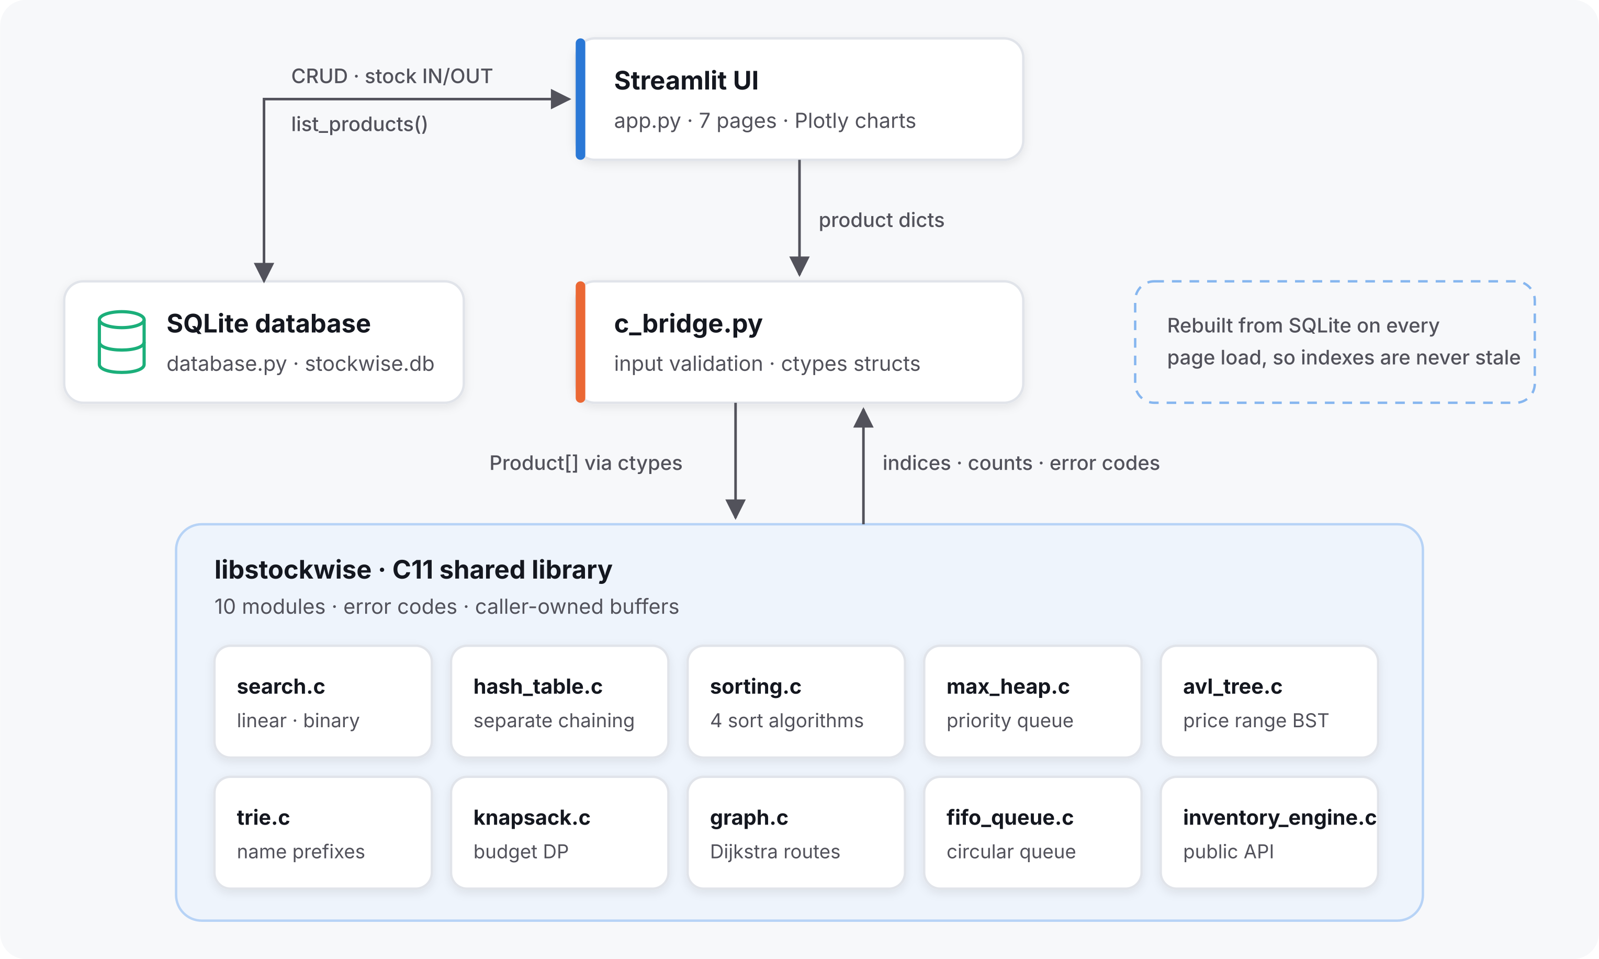




The big picture: four layers
1 Screens
app.py shows the pages and charts
2 Translator
c_bridge.py links Python and C
3 C engine
backend/*.c runs every algorithm
4 Database
database.py saves everything in SQLite
Every page load: read products from SQLite, copy them into C, run the algorithm, show the result.
Notes:
There are four layers. The screens are app.py. When a screen needs an algorithm, it calls c_bridge.py, which converts Python data into C structs and calls the compiled C library. The C engine does the actual searching, sorting and planning and sends back results. All data is stored by database.py in a SQLite file, which is the single source of truth; the C engine is rebuilt from it on every page load, so it is never out of date.

Slide 3





Technology stack: what is used where
Python 3.9+
Streamlit
Plotly, pandas, Graphviz
C11 + GCC
Main language for the app, bridge and tests
Turns Python code into a web app with pages
Interactive charts, data tables, tree and map drawings
Every data structure and algorithm, compiled for speed
app.py, tests/
app.py
app.py
backend/*.c
ctypes
SQLite
Make
unittest
Python's built-in way to call functions in a C library
A database stored in one file, built into Python
One command compiles the C library and runs C tests
Python's test framework plus a C test program
c_bridge.py
database.py, schema.sql
backend/Makefile
tests/, backend/tests/
Notes:
These are all the technologies. Python with Streamlit builds the web interface, Plotly and pandas draw the charts and tables, and Graphviz draws the trees and the route map. The algorithms are in C, standard C11, compiled with GCC using a Makefile. Python's built-in ctypes module calls the C library, and SQLite, also built into Python, stores the data. Tests use Python's unittest plus a C test program.

Slide 4


Project map: every file has one job
Screens
Bridge
Data
app.py
c_bridge.py
database.py
schema.sql
All 8 pages, charts and forms
Python <-> C translation
Tables, saving, sample data
C engine
Tests
Docs and design
backend/*.c
inventory_types.h
Makefile
backend/tests/
tests/
README.md
docs/
assets/
The DSA code, compiled to a library
Prove each part works
Setup guide, viva notes, artwork
Notes:
This is the whole project on one slide. Six groups, and each file belongs to exactly one. If someone asks where something happens, this slide answers it: screens in app.py, translation in c_bridge.py, storage in database.py, algorithms in backend, proof in the test folders, and explanations in the docs.

Slide 5
The Python side
What the user sees, and where the data is kept
Notes:
First the three Python files: the screens, the translator, and the database.

Slide 6



The Python files at a glance
app.py
c_bridge.py
database.py
Python · Streamlit · Plotly
Python · ctypes
Python · sqlite3
Draws all 8 pages, charts and forms. Asks the C engine for every search, sort and plan.
Loads the C library, mirrors its structs, checks inputs and converts C results to dicts.
The only file that talks to SQLite: add, edit, delete, stock in and out, sample data.
schema.sql
requirements.txt
config.toml
SQL · SQLite
pip
TOML · Streamlit theme
Creates the two tables with built-in rules, such as price and stock never below zero.
The Python packages to install with one command: Streamlit, Plotly and pandas.
Lives in .streamlit/. Sets the app's colors, Inter font, rounded corners and sidebar.
Notes:
Here is every Python-side file in one view. Each card says the technology it uses and what it does in one sentence. The next three slides go deeper into the three main ones: app.py, c_bridge.py and database.py.

Slide 7
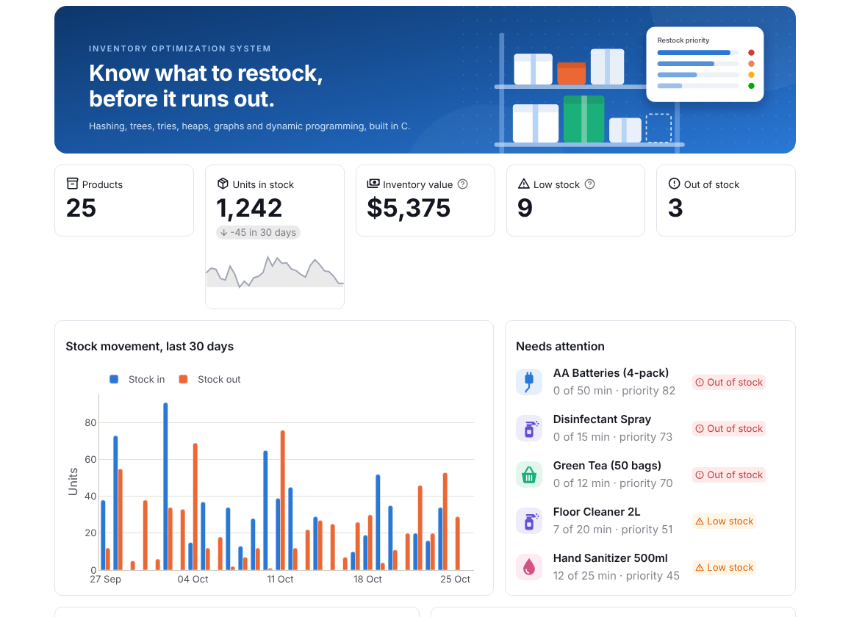
app.py: everything the user sees
Dashboard KPIs, stock trend, what needs attention
Products Card grid, search, price filter, add/edit/delete
Transactions Stock in/out, history, stock age
Restocking Priority ranking and budget planner
Delivery routes Shortest route on a map
Search and sorting Try each algorithm, see the work done
DSA laboratory Visual trees, heaps, DP table, edge cases
About Architecture and complexity table
Notes:
app.py is the Streamlit frontend. It draws the eight pages you see in the sidebar. It never sorts or searches by itself: whenever it needs an algorithm, it asks the C engine through c_bridge.py and only displays the answer, including how many comparisons the algorithm needed.

Slide 8


c_bridge.py: the translator between Python and C
Python data
Validate
Pack
Call C
Unpack
a list of product dicts
no negative price, no duplicate ID
copy into C structs (ctypes)
e.g. sw_prefix_search()
results back to dicts
Loads the library
Declares every C function
Frees memory
libstockwise.so on Linux, stockwise.dll on Windows
argument and return types, so Python calls them safely
Engine.close() releases all C memory; nothing leaks
Notes:
Python and C cannot share data directly, so c_bridge.py translates. It checks the data first, so C never receives a bad value, packs it into C-shaped structs using Python's ctypes module, calls the C function, and converts the answer back. It also loads the compiled library and frees the C memory afterwards.

Slide 9


database.py and schema.sql: permanent storage
Stock can never go negative
products
the check and the update happen in one SQL statement
id, name, category, price, quantity, minimum stock, demand, importance
History always matches stock
the stock change and its history row are saved together
inventory_transactions
every stock in and stock out: product, type, quantity, balance after, time
Ready-made sample data
25 products with 90 days of deliveries and sales
schema.sql creates the two tables. database.py adds, edits and deletes rows.
Notes:
schema.sql defines two tables: products and inventory transactions. database.py is the only file that talks to SQLite. Its key rule: a stock change and its history record are saved in one database transaction, so they always agree, and the update refuses to make stock negative. It also creates realistic sample data on first run.

Slide 10
The C engine
Where every data structure and algorithm runs
Notes:
Now the backend folder: ten C files, each holding one data structure or algorithm.

Slide 11





The C engine at a glance: core files
inventory_types.h
inventory_engine.c
search.c
C11 header
C11 · public API
C11 · arrays
The contract: product and result structs, error codes, and every function declaration.
Python's front door: copies products, builds the hash table, AVL tree and trie.
Linear search checks every product; binary search halves an ID-sorted list each step.
hash_table.c
sorting.c
max_heap.c
C11 · malloc, linked lists
C11 · recursion
C11 · array heap
Finds a product by ID in about one step: id mod buckets picks a short chain to scan.
Merge, Insertion, Quick and Heap Sort, counting every comparison and move.
Priority queue: the most urgent restock is always on top. Reused by Dijkstra and greedy.
Notes:
These six files are the core of the engine. The header defines the shared structures. The engine file is what Python calls. Then search, hash table, sorting and the max-heap: the classic data structures, each in its own file.

Slide 12






The C engine at a glance: planning files
avl_tree.c
trie.c
knapsack.c
C11 · self-balancing BST
C11 · prefix tree
C11 · dynamic programming
A tree sorted by price that rotates to stay short, so price-range filters are fast.
Stores every word of every name letter by letter, so typing "cab" lists all cables.
Picks the restocks with the most priority that fit a budget, compared with greedy.
graph.c
fifo_queue.c
Makefile
C11 · graph, Dijkstra
C11 · ring buffer
GNU Make · GCC
Stores roads as an adjacency list and finds the shortest delivery route.
A circular queue of stock lots: the oldest units leave first, which gives stock age.
make builds libstockwise.so (stockwise.dll on Windows); make test runs the C tests.
Notes:
These files add the advanced structures: an AVL tree for price ranges, a trie for autocomplete, dynamic programming for the budget, a graph with Dijkstra for routes, and a circular queue for stock age. The Makefile compiles everything into one shared library.

Slide 13
Ten C files, one concept each
File | Data structure / algorithm | Used for
search.c | Linear and binary search | Find a product by ID
hash_table.c | Hash table (separate chaining) | Instant lookup by ID
sorting.c | Merge, Insertion, Quick, Heap Sort | Sort products by any column
max_heap.c | Max-Heap priority queue | Rank what to restock first
avl_tree.c | AVL tree (self-balancing BST) | Filter by price range
trie.c | Trie (prefix tree) | Autocomplete product names
knapsack.c | 0/1 knapsack, dynamic programming | Best restock plan within a budget
graph.c | Graph + Dijkstra's shortest path | Shortest delivery route
fifo_queue.c | Circular queue (FIFO) | Track stock lots and their age
inventory_engine.c | Public API (sw_* functions) | The door Python calls through
Notes:
This table is the heart of the project. Read it row by row: each C file holds one concept, and the right column says which feature of the app it powers. The last row, inventory_engine.c, is not an algorithm; it is the front door that Python calls.

Slide 14

The glue: header, engine and Makefile
The contract
The front door
The build recipe
inventory_types.h
inventory_engine.c
Makefile
Shared structs (Product, SearchResult...), error codes, and the declaration of every function
Copies the products, builds the hash table, AVL tree and trie, and exposes the sw_* functions
make compiles all .c files into one library; make test builds and runs the C tests
$ cd backend && make && make test
gcc -std=c11 -O2 -Wall -Wextra -fPIC -shared -o libstockwise.so search.c ... inventory_engine.c
283/283 checks passed
Notes:
Three files hold the C side together. The header is the contract: it declares the shared structures and every function, and c_bridge.py mirrors it exactly. The engine file builds all the indexes when Python hands it the products. The Makefile compiles everything into one shared library and runs the C tests.

Slide 15
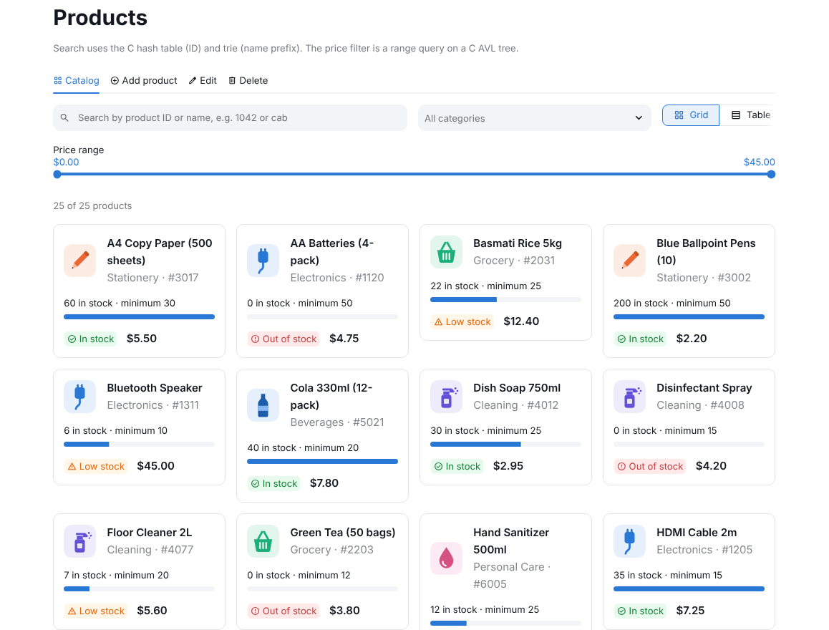
One search, from keypress to result
1
app.py
The user types "cab" in the search box
2
c_bridge.py
prefix_search("cab") checks the text and calls C
3
inventory_engine.c
sw_prefix_search() passes it to the trie
4
trie.c
Walks c > a > b, then collects every name below
5
app.py
Shows the matching cards and "nodes visited"
Notes:
Here is one real request travelling through the files. The user types cab. app.py hands it to c_bridge.py, which calls the engine, which asks the trie. The trie walks three characters and collects every product name below that point, in alphabetical order. The results travel back and app.py draws the product cards.

Slide 16
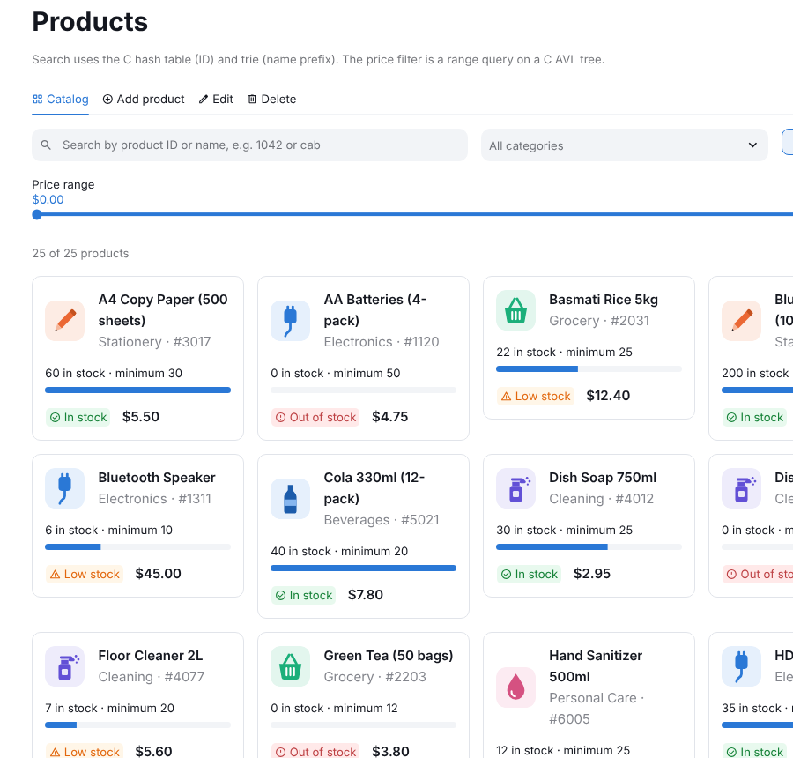
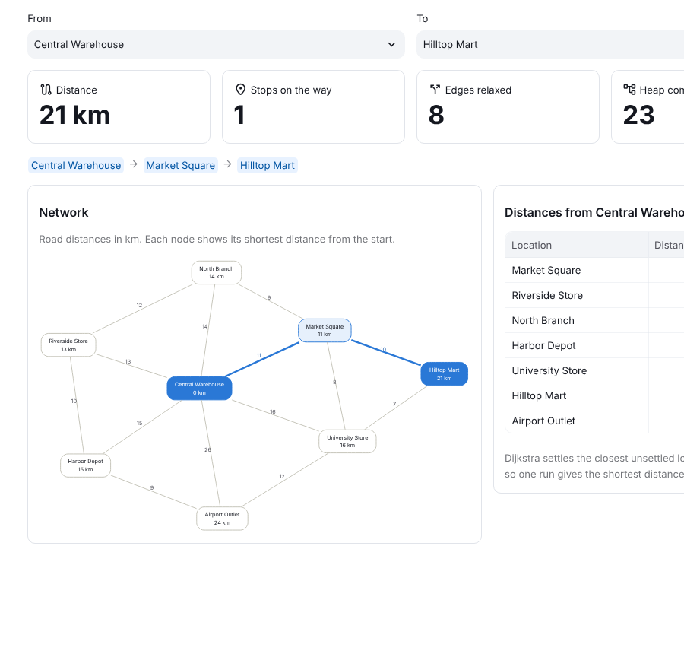
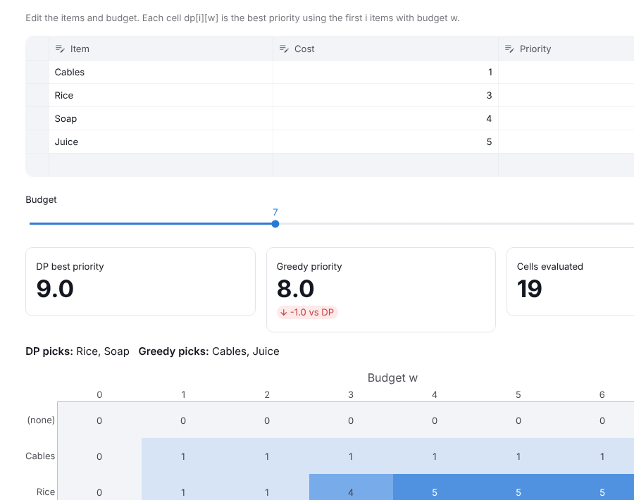
What the DSA concepts look like in the app
Trie + AVL tree
Graph + Dijkstra
Dynamic programming
Autocomplete and price filter
trie.c, avl_tree.c
Shortest delivery route
graph.c
Budget plan beats greedy
knapsack.c
Notes:
Every concept powers a visible feature. The trie and AVL tree drive search and the price slider on the Products page. Dijkstra's algorithm draws the shortest delivery route. The knapsack dynamic programme picks the best restock plan for a budget, and the lab shows its table and why the greedy shortcut can lose.

Slide 17




Tests, docs and design files at a glance
test_engine.c
test_c_bridge.py
test_database.py
C11 test program
Python · unittest
Python · unittest · SQLite
In backend/tests/: 283 checks that call the C functions directly, edge cases included.
Tests the Python-to-C calls: C sorts must match sorted(), knapsack matches brute force.
Tests saving, insufficient stock, deleting, and that the C queue matches stock levels.
assets/
README.md
docs/
SVG images
Markdown
Markdown · PowerPoint
Logo, dashboard banner, empty-state picture, category tiles, architecture diagram.
Setup on Windows and Linux, how to build, run and test, and the C function list.
ALGORITHMS.md (pseudocode), REPORT_AND_VIVA.md (30 viva answers) and this deck.
Notes:
The last group: three test files that prove the code works, the artwork in assets, and the documentation, including the viva preparation and this presentation.

Slide 18
Tests: proof that each part works
283
36
0
19
C checks
Python tests
memory errors
live edge cases
backend/tests/test_engine.c
tests/test_c_bridge.py, test_database.py
C tests under AddressSanitizer
DSA laboratory, Edge cases tab
backend/tests/test_engine.c
tests/test_c_bridge.py, test_database.py
Calls the C functions directly: searches with missing IDs, hash collisions, all four sorts, heap order, AVL balance after 1,000 sorted inserts, trie prefixes, knapsack, Dijkstra, FIFO queue
Checks the Python side: C sorts against Python's sorted(), knapsack against brute force, invalid prices, insufficient stock, saving to SQLite, seeded history
Notes:
The tests are the proof. The C test program runs 283 checks directly on the algorithms, also under a memory checker that found no errors. The Python tests check the bridge and the database, including comparing the knapsack answer with a brute-force search. The lab page also runs 19 edge cases live in front of examiners.

Slide 19




How to run it in three steps
1. Install the Python packages
pip install -r requirements.txt
On Windows
2. Build the C library and test it
Install GCC with MSYS2 and use mingw32-make instead of make. It builds stockwise.dll. README.md has the full steps.
cd backend && make && make test
3. Start the app
streamlit run app.py
Notes:
Running it takes three commands: install the Python packages, compile the C library with make, and start Streamlit. The first run creates the database with sample data automatically.

Slide 20
Thank you
Screens in app.py · translation in c_bridge.py · algorithms in backend/ · data in SQLite
Notes:
To sum up: app.py draws the screens, c_bridge.py translates, the C files do the algorithms, and SQLite keeps the data. Happy to take questions or show any page live.

