Slide 1

Enterprise Data Loss Prevention System Using SHA3 Hashing
Team: Furqan Haider,Aatif Ali Khan,Heba Hammad,Syed Ali Shah
Course: Information Security
Quick demo: core design, detection methods, and a short live simulation.

Slide 2
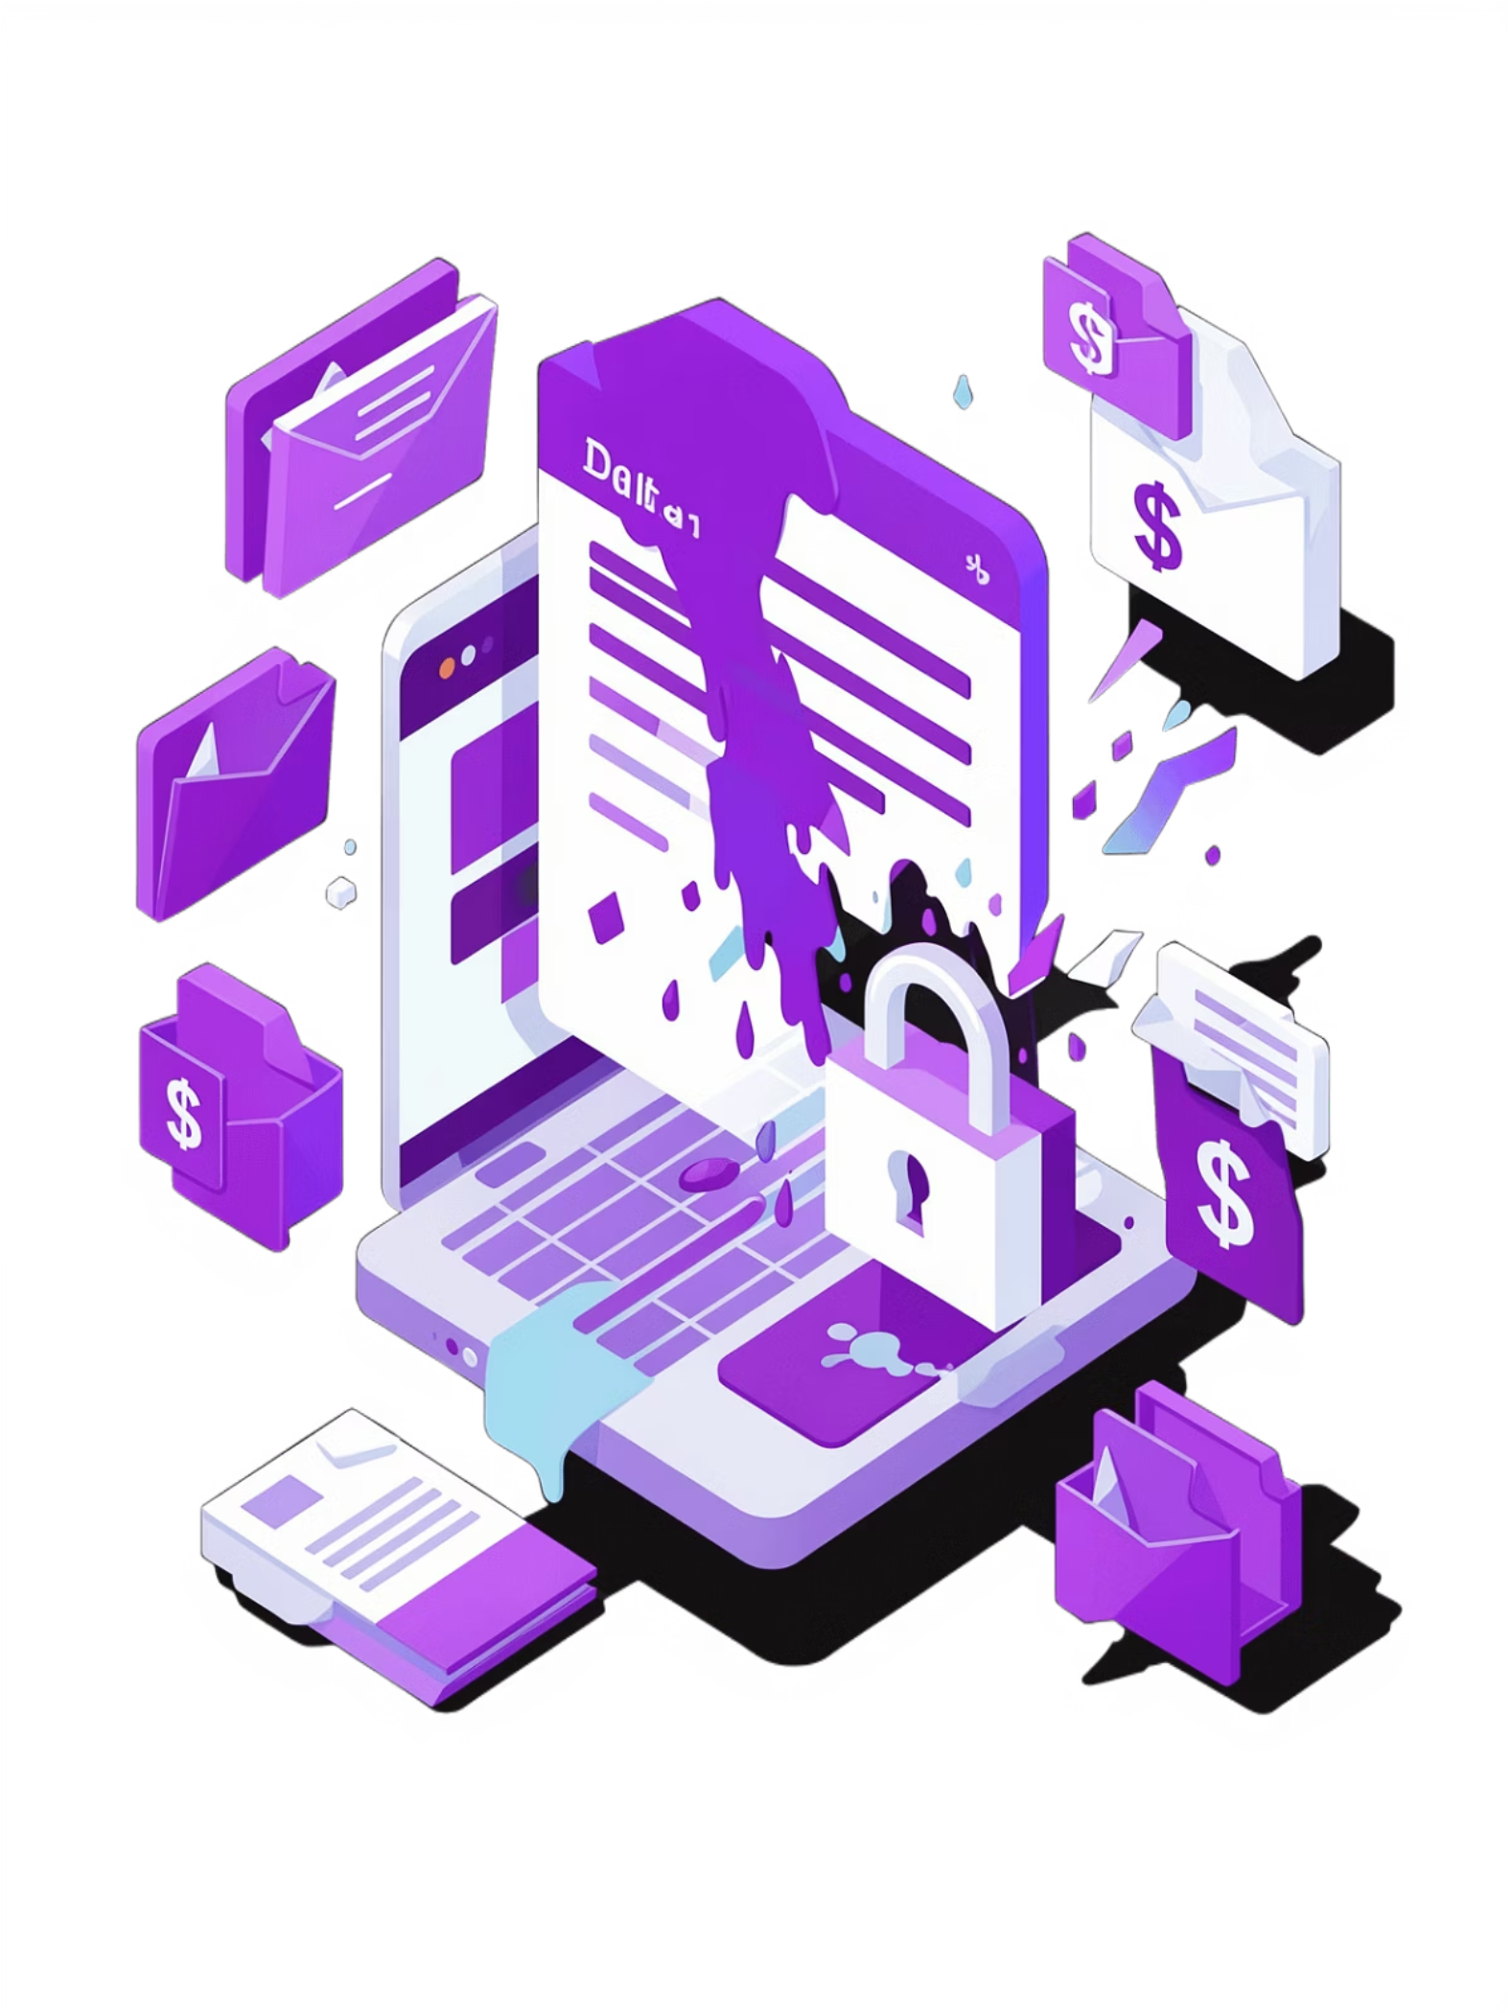

Problem: Data leakage in organizations
Sensitive files leave the network accidentally or maliciously
Insiders and compromised endpoints create high risk
Traditional DLP struggles with obfuscated/edited files
Speaker note: Explain common leakage sources —email, cloud sync, and careless sharing.

Slide 3


Project objective
Detect and prevent sensitive data leakage using SHA3-256
Combine exact hashing with fuzzy matching to catch edits
Provide admin tools, logs, and simulated leak testing
Speaker note: State the goal: high accuracy, low false positives, and practical demo readiness.

Slide 4
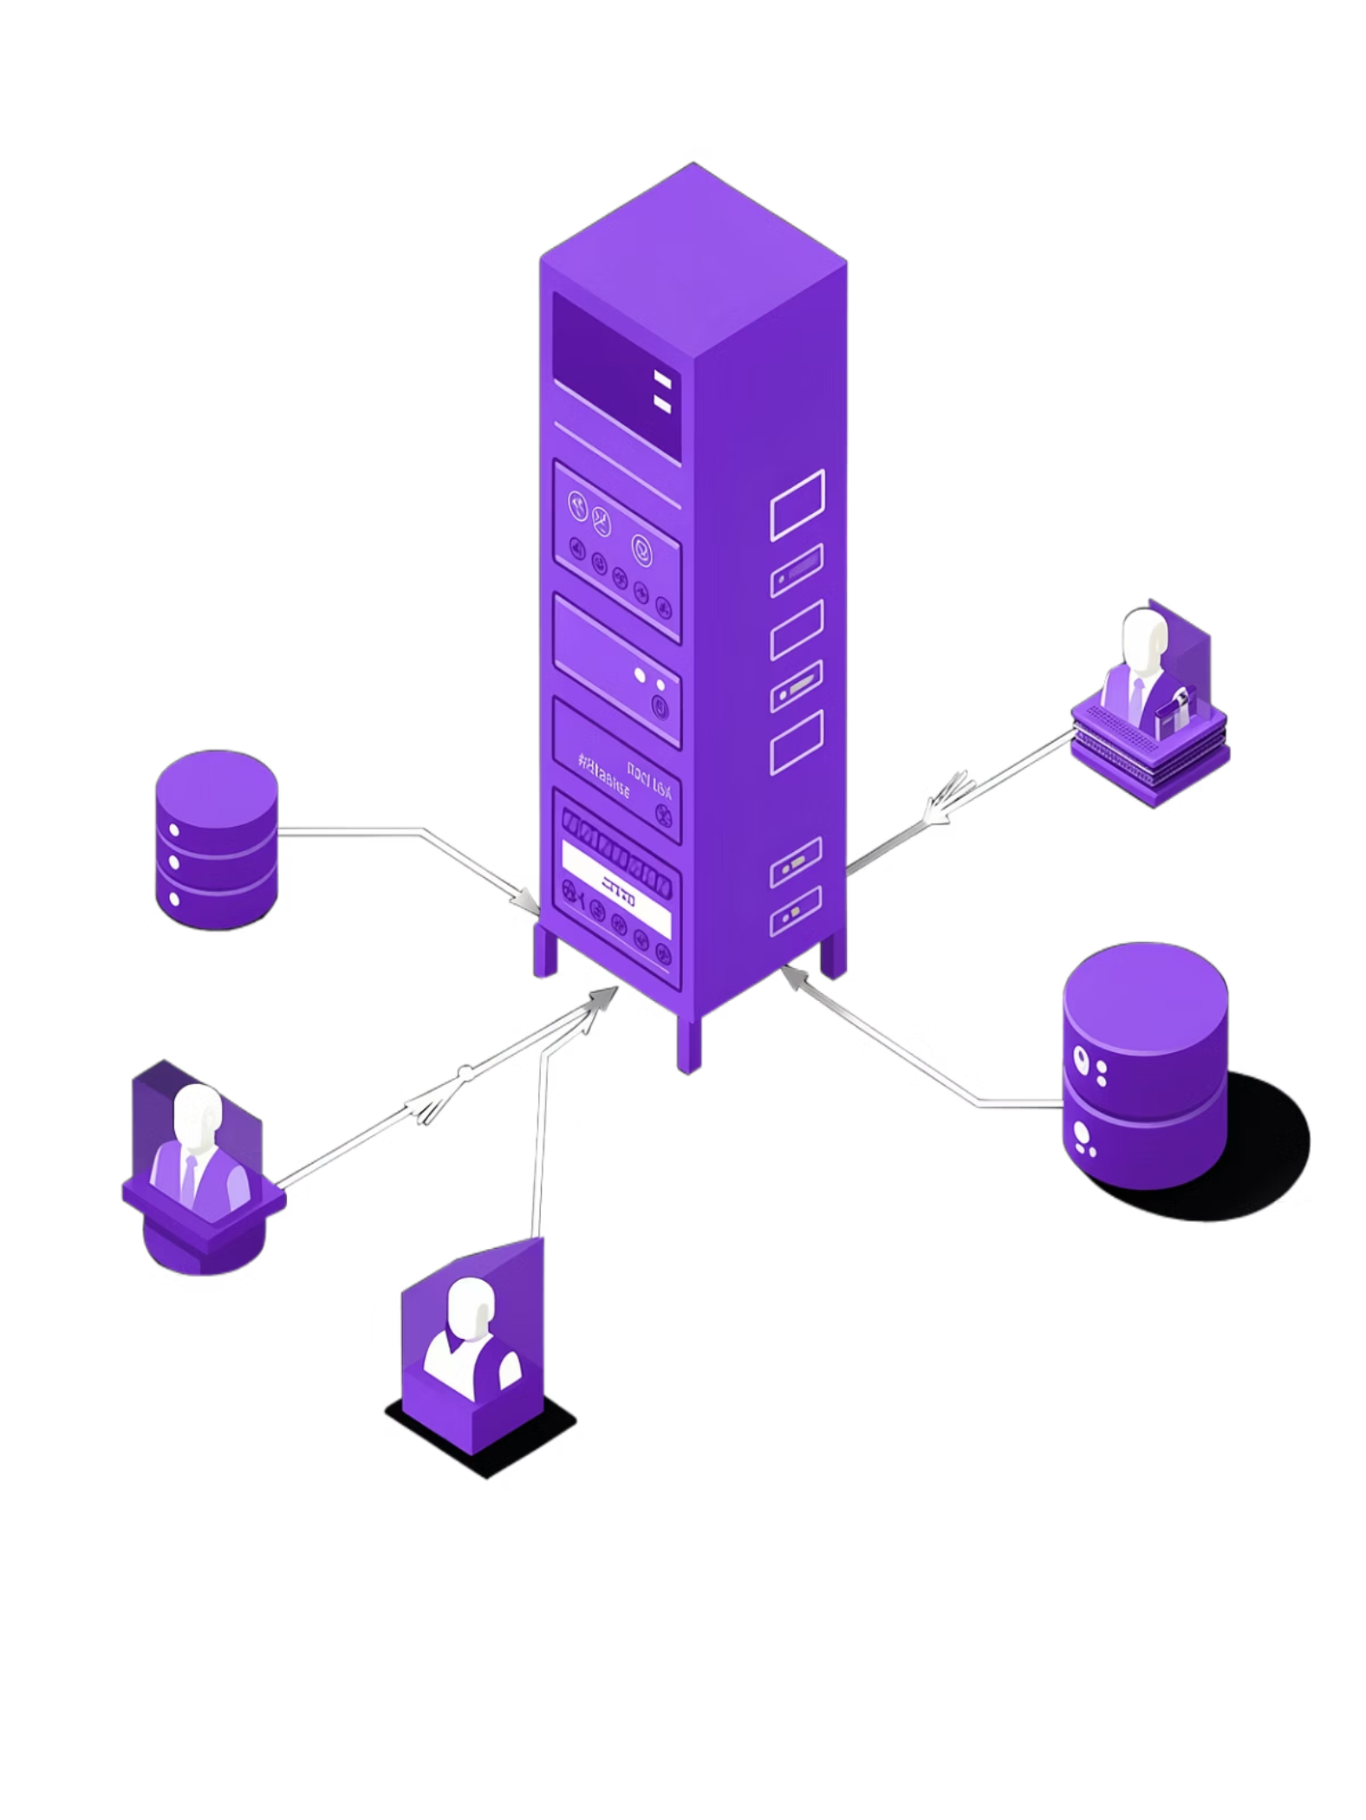
System overview
User-facing web app (Flask) for upload and scanning
DLP engine: hashing + fuzzy similarity checks
Admin dashboard to register sensitive data and review logs
Speaker note: Walk through a typical interaction: admin registers data → users upload → system evaluates.

Slide 5
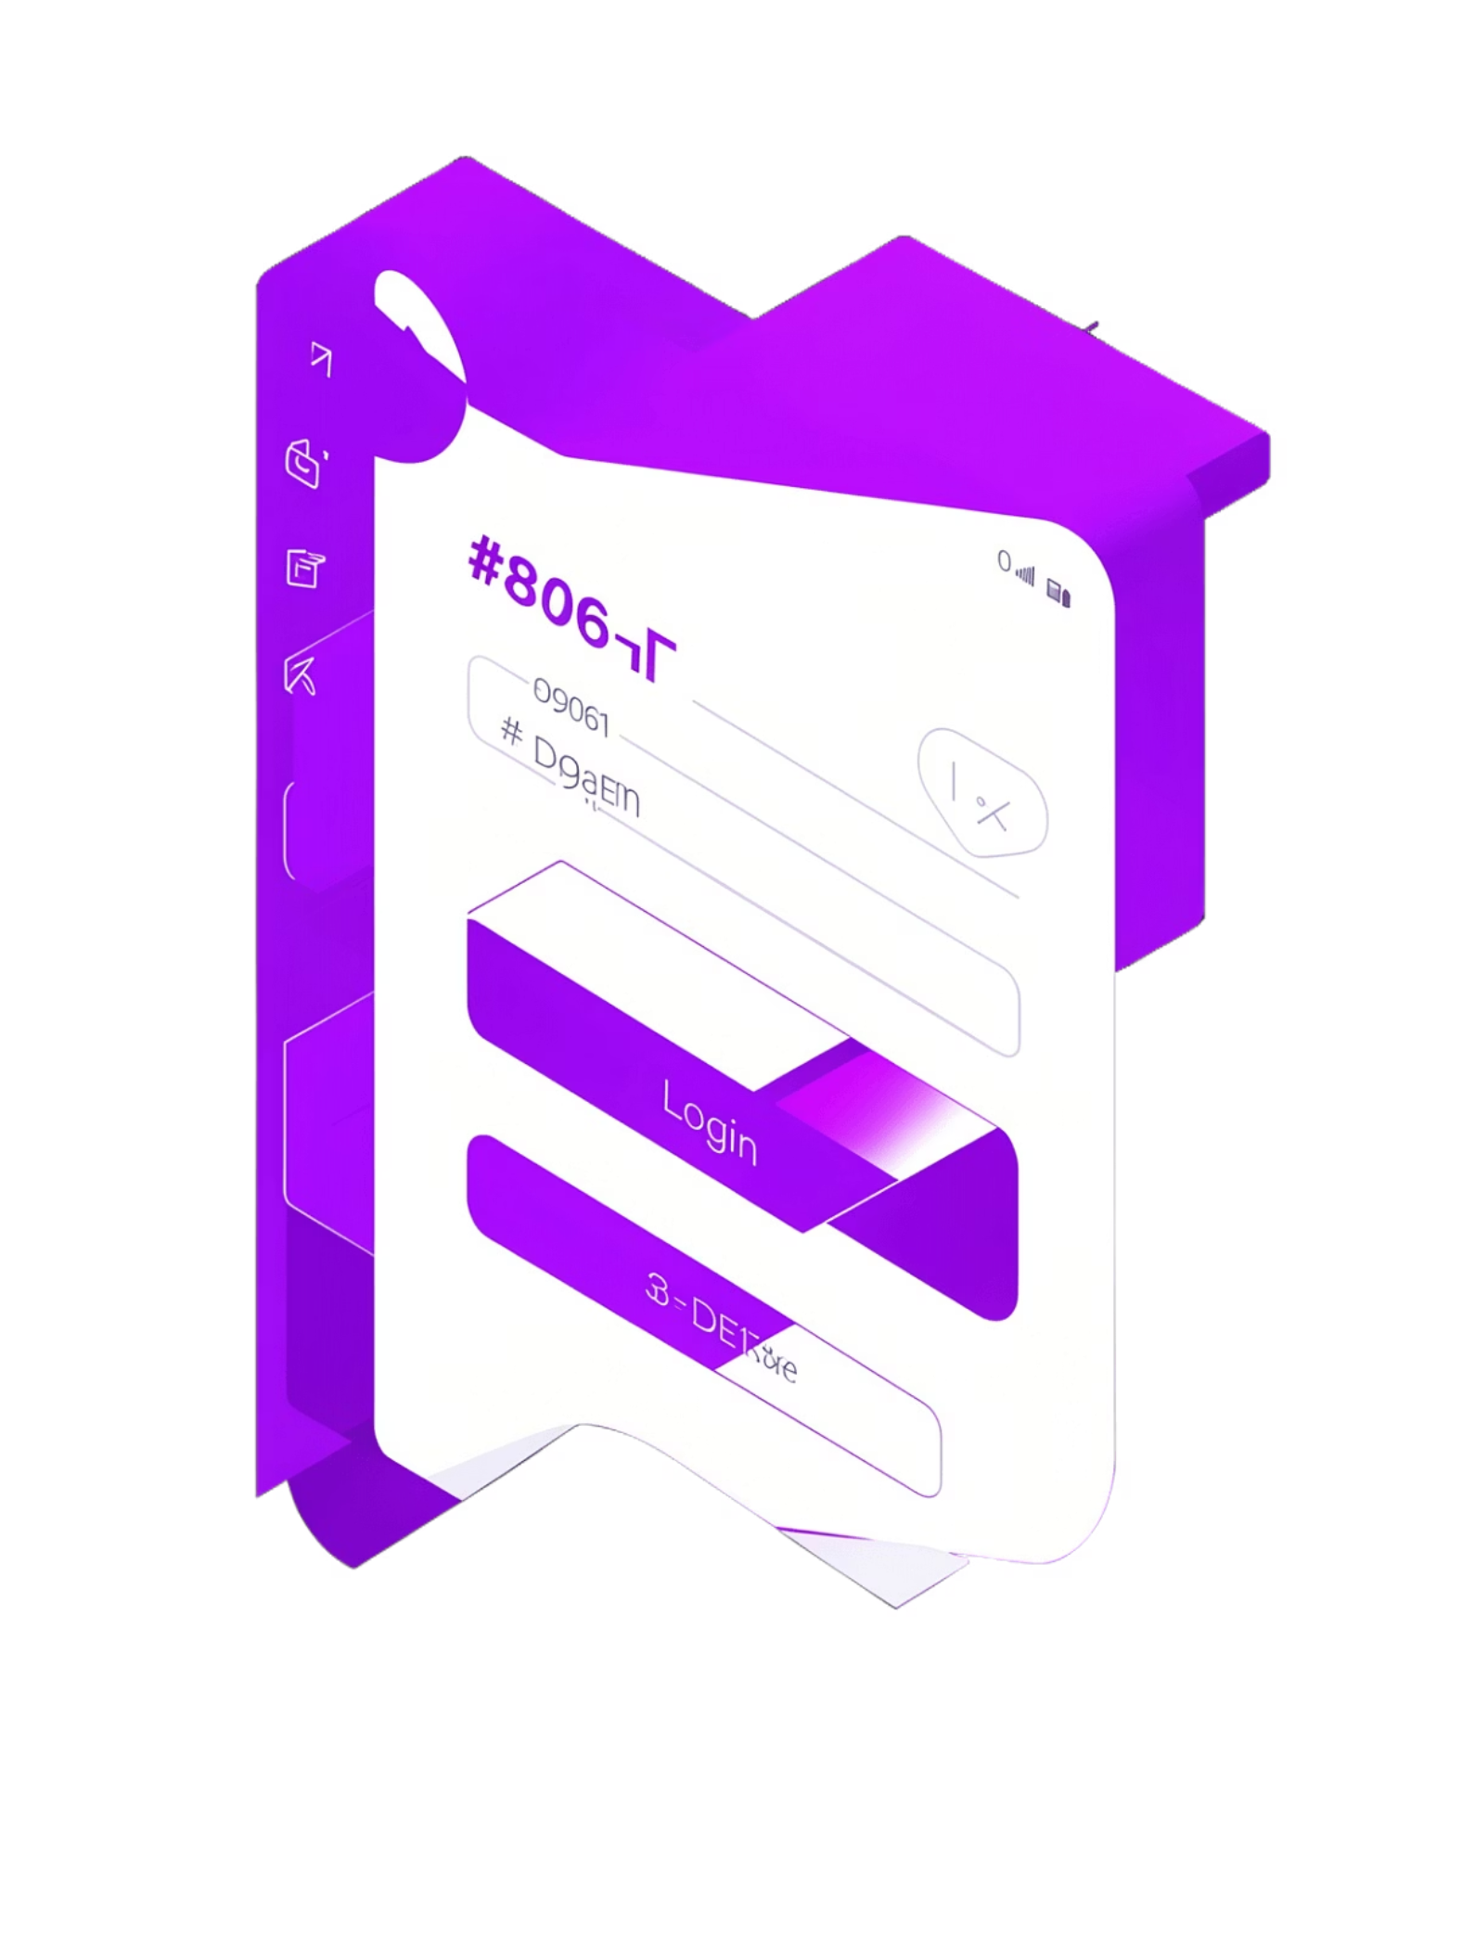
File / Folder structure
Project layout (concise): app.py, dlp_engine/, static/, templates/, db.sqlite
Speaker note: Describe where key modules live: hashing, similarity, database access, and web routes.

Slide 6

Technology stack
Backend: Python + Flask
DB: SQLite for lightweight storage
Frontend: HTML, CSS, JavaScript, Bootstrap
Crypto: SHA3-256 for exact matching
Fuzzy: SimHash with similarity threshold
Speaker note: Mention why SHA3-256 (collision resistance) and why SimHash for fuzzy detection.

Slide 7


Users
Upload content to backend
SQLite database
System Architecture
Admin
Store scan results and logs
Register users and view logs
DLP engine
Flask backend
Hash and simhash evaluation
Routes upload, register, scan
Components: User, Admin, Flask backend, DLP engine (hash + simhash), SQLite
Speaker note: Explain data flow: uploads to backend → DLP engine evaluates → decision returned and logged.

Slide 8
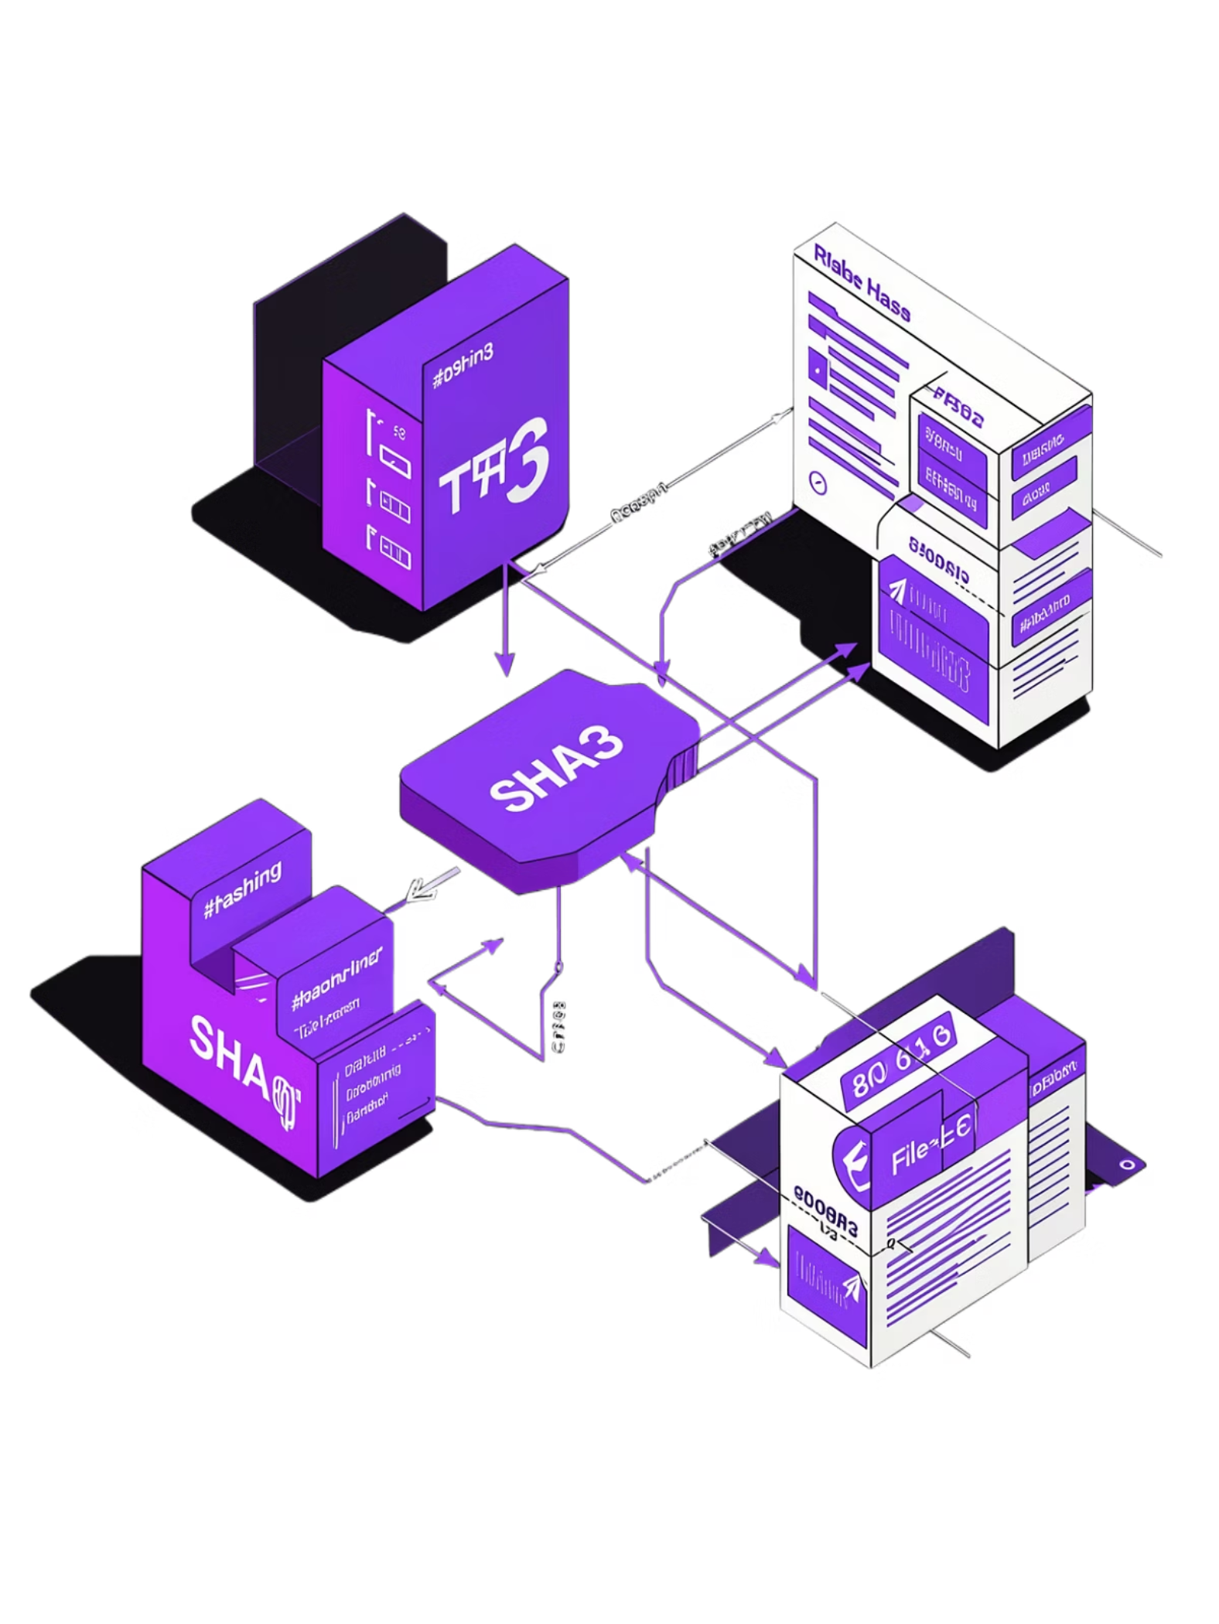
Cryptographic core — SHA3-256
Exact-match detection via SHA3-256 digest of file content
Store digest in database for registered sensitive files
Fast byte-wise comparison for precise matches
Speaker note: Emphasize properties: preimage resistance and suitability for file fingerprinting.

Slide 9


Fuzzy detection — SimHash (≈70%)
Compute SimHash fingerprint from file text/features
Compare hamming distance → convert to similarity score
Threshold: 70% similarity flags potential leakage
Speaker note: Explain SimHash basics and trade-offs: catches edited/obfuscated content but can yield false positives.

Slide 10
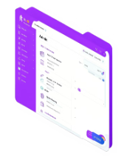
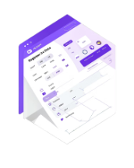
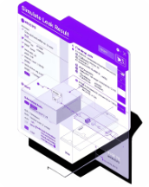
Admin panel
Register data
Main features
Manage registered files and view logs
Upload canonical files to generate SHA3 & SimHash
Login / Signup (user authentication)
Admin panel: register sensitive data & manage policies
Register sensitive data (upload canonical files)
Simulate leak & send email alerts
Audit logs and detection history
Simulate leak
Test detection and email notifications
Speaker note: Point to each screenshot placeholder and explain typical admin actions.

Slide 11
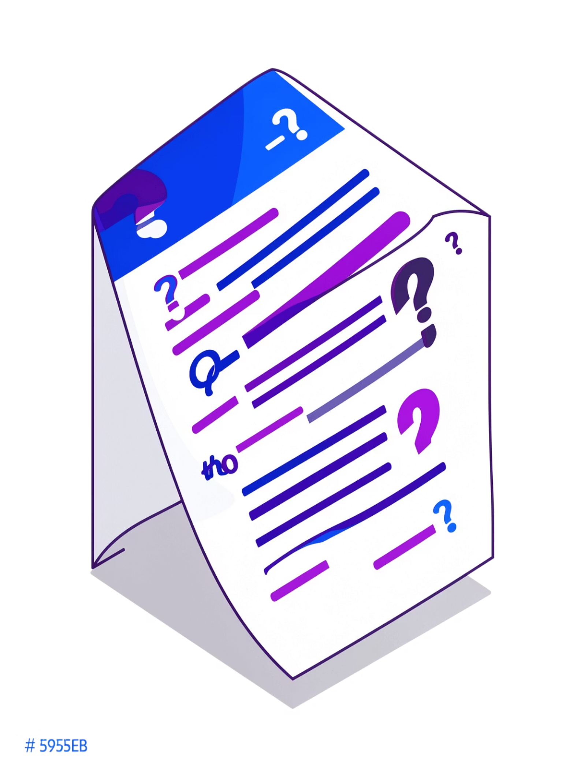
Limitations & Resolutions
Fuzzy Hashing Limitations
Our Solutions
Optimized SimHash implementation for performance
Adaptive thresholds based on content type
False positives from similar benign files
Computational overhead with large datasets
Speaker note: Discuss the trade-offs of fuzzy matching and how we mitigated them to ensure accuracy and efficiency.

Slide 12

Conclusion
Successfully implemented SHA3-256 exact matching and SimHash fuzzy detection for comprehensive data loss prevention.
Multi-layer validation reduces false positives while maintaining high detection accuracy.
System provides practical admin tools and audit capabilities for enterprise security.
Future enhancements could include machine learning for adaptive detection and integration with SIEM platforms.
Speaker note: Summarize the project's impact, reiterate its value for enterprise security, and briefly touch on the exciting possibilities for future development.

Slide 13

Any Questions?
Please feel free to ask any questions you may have.

