Slide 1


HOTEL ROOM
BOOKING SYSTEM
BATCH CODE
2002B2

Slide 2
OUR TEAM MEMBERS
HOTEL
ROOM
MUHAMMAD HUZAIFA
Student 1175352
HAFIZ MUHAMMAD WAQAS
Student 1235313
PROJECT NSTRUCTOR
Miss Aatika Liaquat

Slide 3
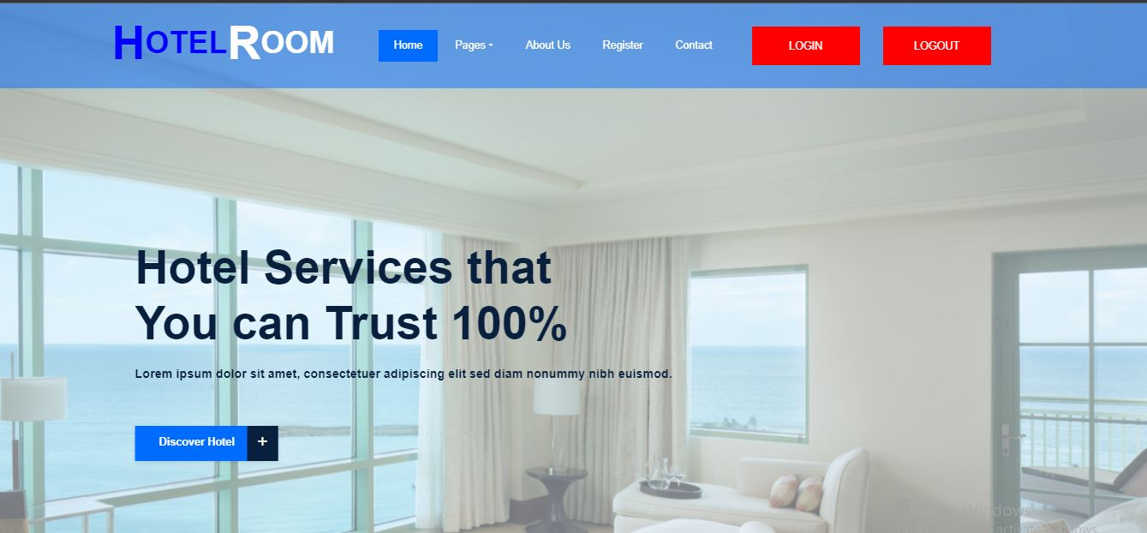
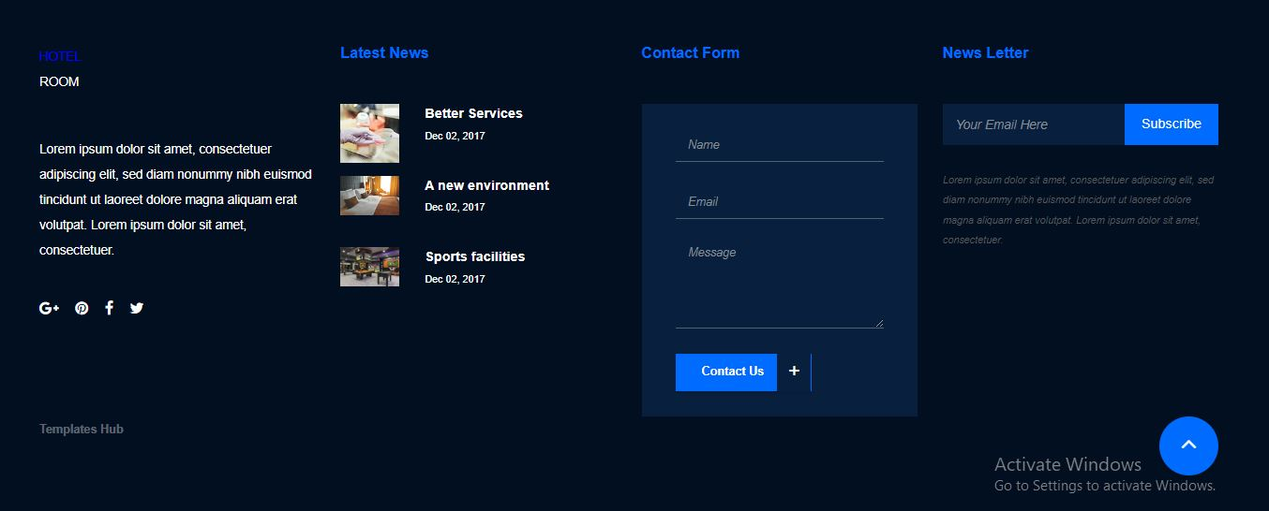
ABOUT PROJECT
HOME PAGE NAVBAR
FOOTER

Slide 4
PROJECT DURATION
ANALYSIS - 1 DAY
DESIGN – 10 DAYS
DEVELOPMENT - 15 DAYS
TESTING - 2 DAYS
DOCUMENTATION – 2 DAYS

Slide 5
TASK SHEET
HAFIZ MUHAMMAD WAQAS: BACKEND/FRONTEND/DOCUMENTATION
MUHAMMAD HUZAIFA:FRONTEND

Slide 6
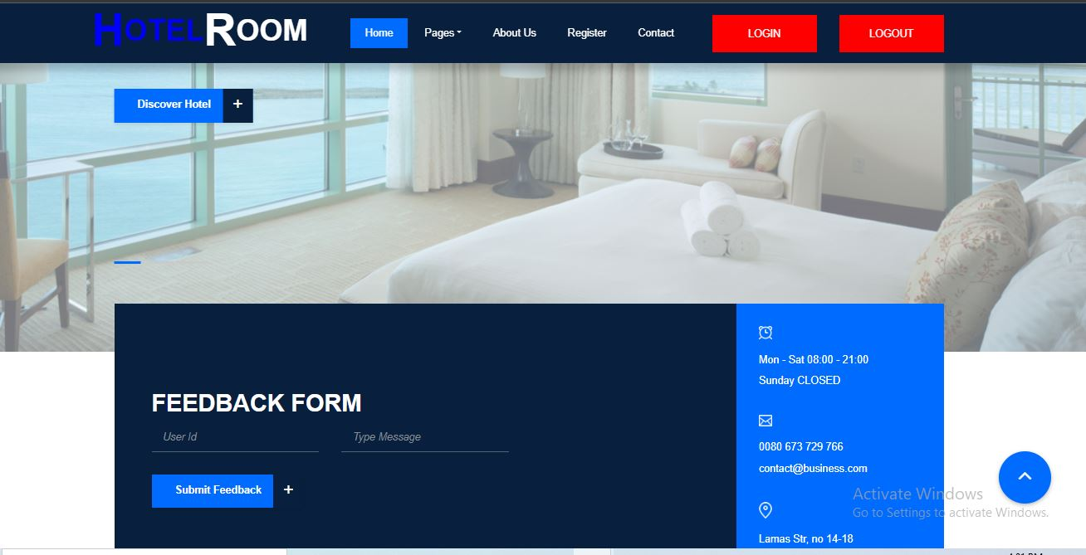
FEED BACK FORM

Slide 7
FRONT END

Slide 8
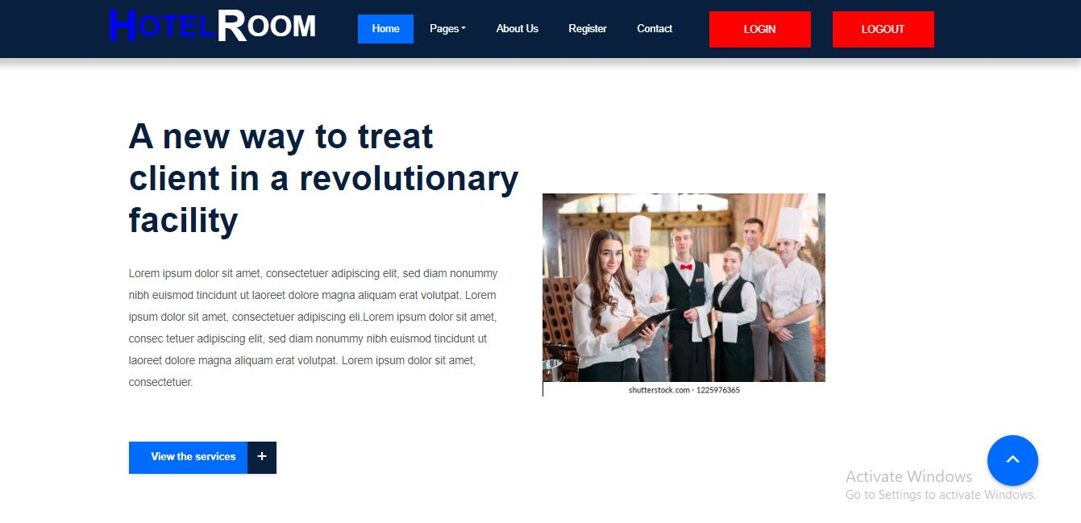
HOME PAGE
NAVBAR AND SLIDER
OUR SERVICES
FOOTER

Slide 9
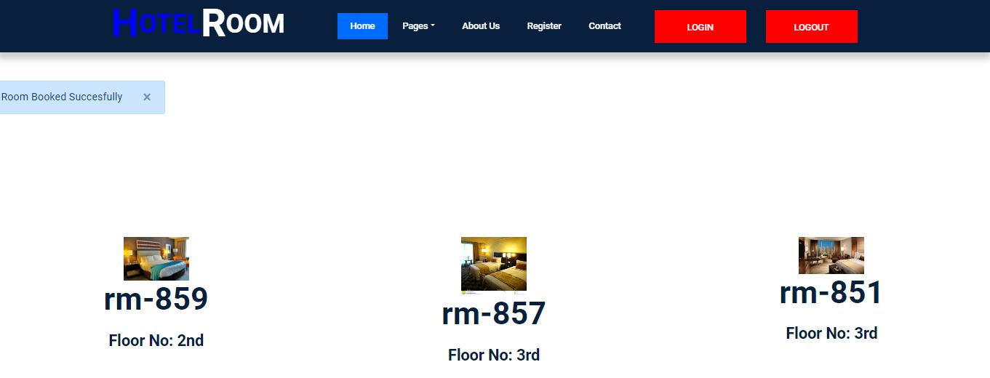
ROOOMS

Slide 10
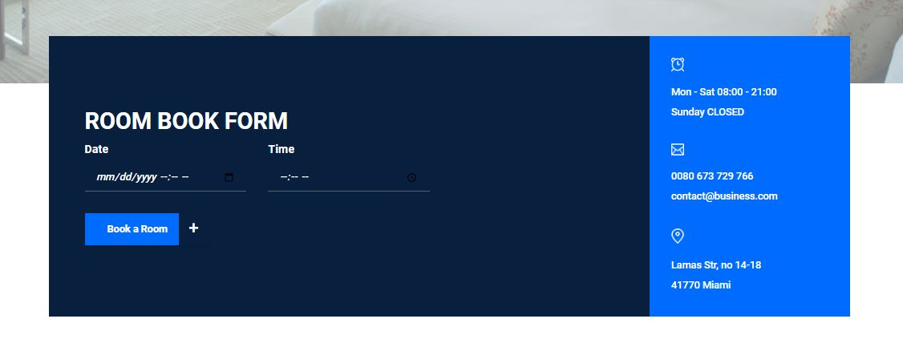
BOOKING PAGE

Slide 11
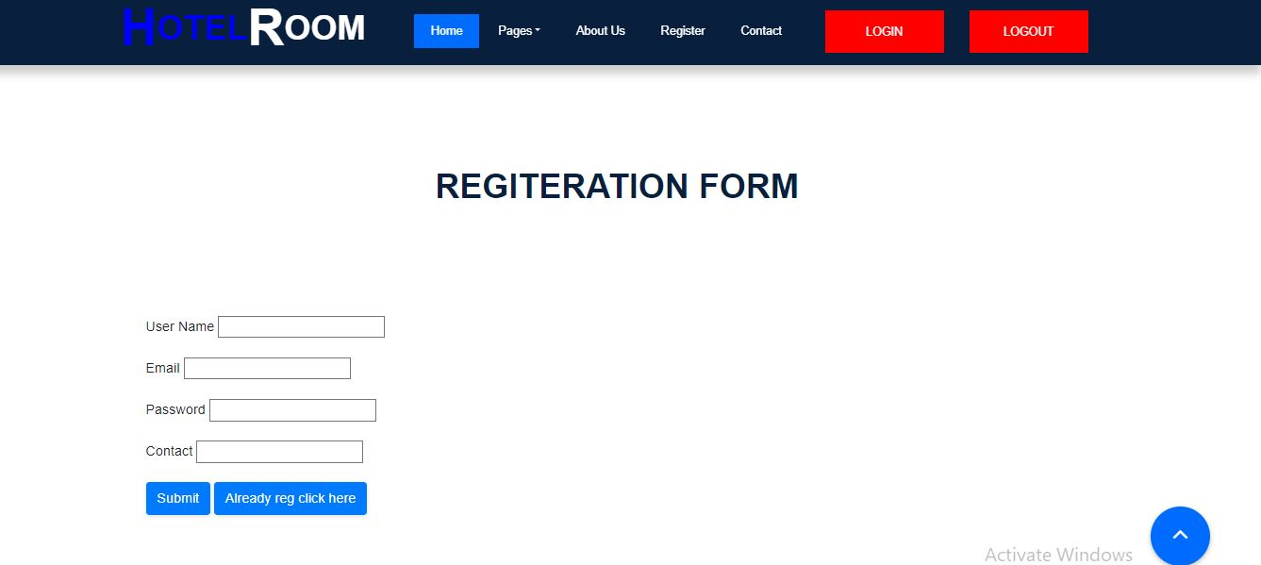
SIGN UP

Slide 12
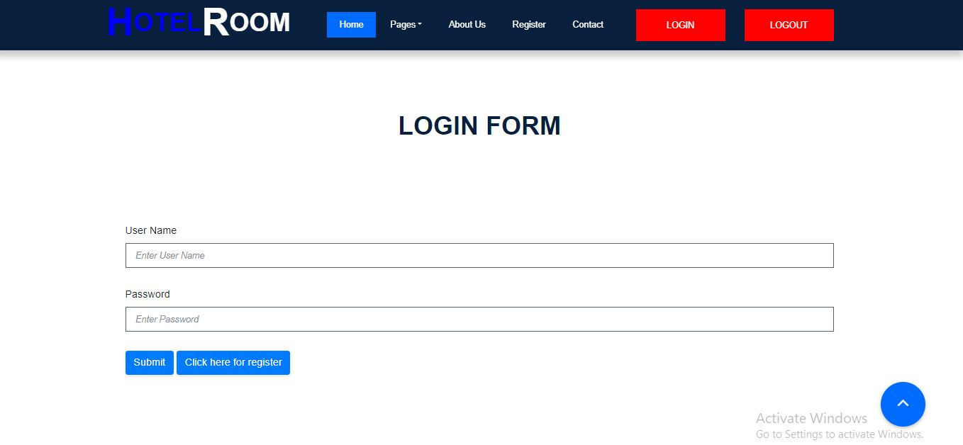
LOGIN

Slide 13
BACK END

Slide 14
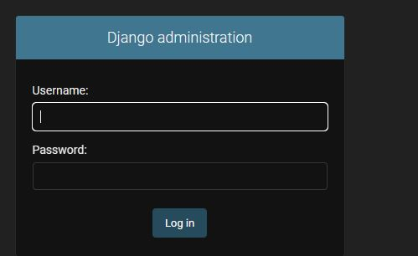
LOGIN FORM

Slide 15
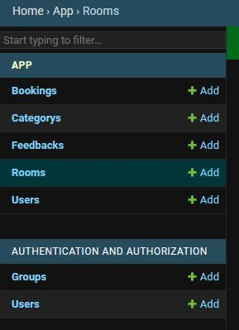
ADMIN DASHBOARD
ALL TABLES

Slide 16
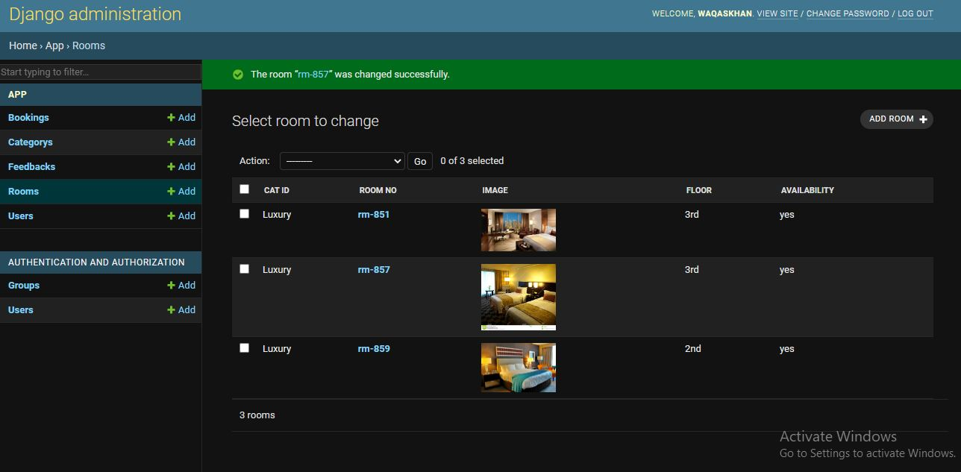
ADMIN DASHBOARD

Slide 17
THANK YOU

