Slide 1
Low-Cost Smart Refrigerator
with Predictive Spoilage Alerts
A Full-Stack MERN + IoT Research Project
TEAM MEMBERS
Smart Fridge
Aatiqah Harmine
2303A51860
IoT Dashboard
Anushka Voorugonda
2303A51176
Neha Fariyal
2303A51598
B. Spoorthi
2303A51802

Slide 2


Introduction -The Problem of Food Waste
13.2%
19%
1/3
of food lost
before consumers
lost in households
worldwide
of all food produced
is wasted globally
The Problem
Our Solution
Traditional refrigerators do not track food items
No real-time monitoring of temperature or freshness
Leads to food waste and health issues
A low-cost Smart Refrigerator System using IoT sensors and AI
Monitors food condition in real-time
Provides alerts before spoilage

Slide 3
Project Objectives
Real-Time Monitoring
Predictive Spoilage Alerts
01
02
Monitor temperature, humidity, and food quantity inside the fridge in real-time from ESP32 hardware to a web dashboard via REST API.
Integrate Gemini AI Use AI to predict when food may spoil and alert the user early.
Full-Stack Web Application
IoT Integration
03
04
Deliver a responsive MERN-stack dashboard with JWT authentication, CRUD food inventory management, and live chart visualizations.
Connect sensors and ESP32 to send data to the cloud system.
Low-Cost & Accessible Design
Scalable Architecture
05
06
Design an affordable system that can work with a normal fridge.
Create a system that can support multiple users and devices.

Slide 4




Stakeholders
End Users
(Households)
System
Administrators
IoT / Hardware
Engineers
AI & Data
Analysts
Users can check food freshness easily
They get alerts before food spoils
Helps reduce food waste
Manage users and system settings
Monitor system performance
Maintain the backend
Set up sensors and ESP32
Ensure data is collected properly
Connect hardware to the system
Analyze sensor data
Improve spoilage predictions
Make the system smarter

Slide 5
Programming Languages, Tools & Software
Hardware (IoT Layer)
Communication
Backend
ESP32 MCU · Wi-Fi Dual-core DHT22 · Temp & Humidity HX711 + Load Cell · Weight HC-SR501 · PIR Motion HC-SR04 · Ultrasonic x2
MQTT Protocol EMQX Broker (primary) HiveMQ (fallback) Wi-Fi 802.11 b/g/n REST API (HTTP)
Node.js + Express.js MongoDB Atlas (NoSQL) Mongoose ODM JWT Authentication Node-RED IoT Platform
Frontend
AI & Analytics
Dev Tools
React 18 + Vite Chart.js + react-chartjs-2 React Router v6 CSS Modules Axios HTTP client
Gemini AI API IoT Deployment Level 4 Predictive Spoilage Model Real-time Analytics Explainable AI (XAI)
VS Code Arduino IDE Figma (UI design) GitHub (version control) Thunder Client (API test)

Slide 6
Prompts Used to Generate Code (Part 1 of 2)
Project Scaffold
P1
"give me dashboard for this application/research paper using react js ,mongo db."
Sensor Data Model
P2
"Create a Mongoose schema for IoT sensor readings with fields: temperature (°C), humidity (%), weightTotal (kg), motionDetected (bool), distanceTop and distanceBottom (cm), timestamps, and an auto-generated spoilageRisk field."
Dashboard Page
P3
"give login page and dash board generate mongo db ,node js/react.js and give me code how to implement in vscode. "
JWT Auth Middleware
P4
"Write Express.js middleware that validates a Bearer JWT token from the Authorization header, decodes the payload, attaches req.user, and returns 401 on failure."

Slide 7
Prompts Used to Generate Code (Part 2 of 2)
Food Inventory CRUD
P5
"Create Express.js routes for food inventory: GET all active items, POST new item with name/category/quantity/expiryDate, PUT update item, DELETE (soft-delete), and GET items expiring within N days."
Gemini AI Spoilage Analysis
P6
"Integrate Google Gemini AI API into the Node.js backend. Pass current temperature, humidity, and food inventory data as context and prompt it to return a JSON spoilage risk assessment with recommendations."
Alerts System
P7
"Build an Express alerts route and Mongoose model for IoT and AI-generated alerts. Include severity (info/warning/critical), isRead flag, GET all alerts, PUT mark-as-read (single and all), and auto-create alerts when sensor thresholds are exceeded."
React Auth Context
P8
"Create a React Context and Provider for JWT authentication. Include login(), logout(), register() functions using Axios, persist the token in localStorage, expose user state, and protect routes with a PrivateRoute component."

Slide 8
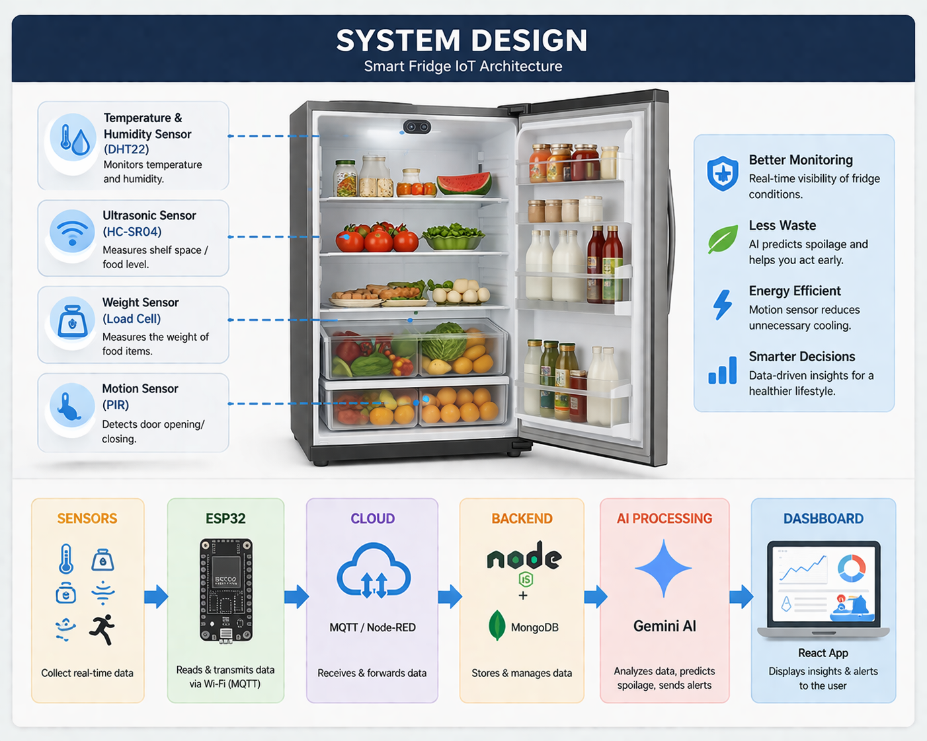
System Workflow
How it Works
Sensors collect data (temperature, weight)
ESP32 sends data to cloud via MQTT
Backend API stores data in MongoDB
AI analyzes data and predicts spoilage
Dashboard displays results

Slide 9
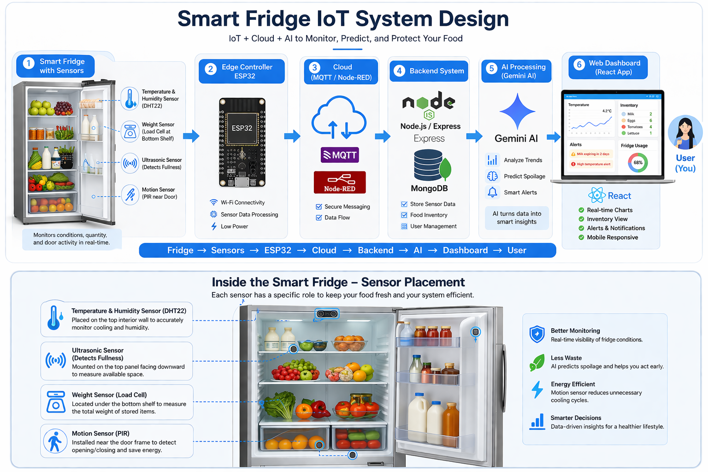
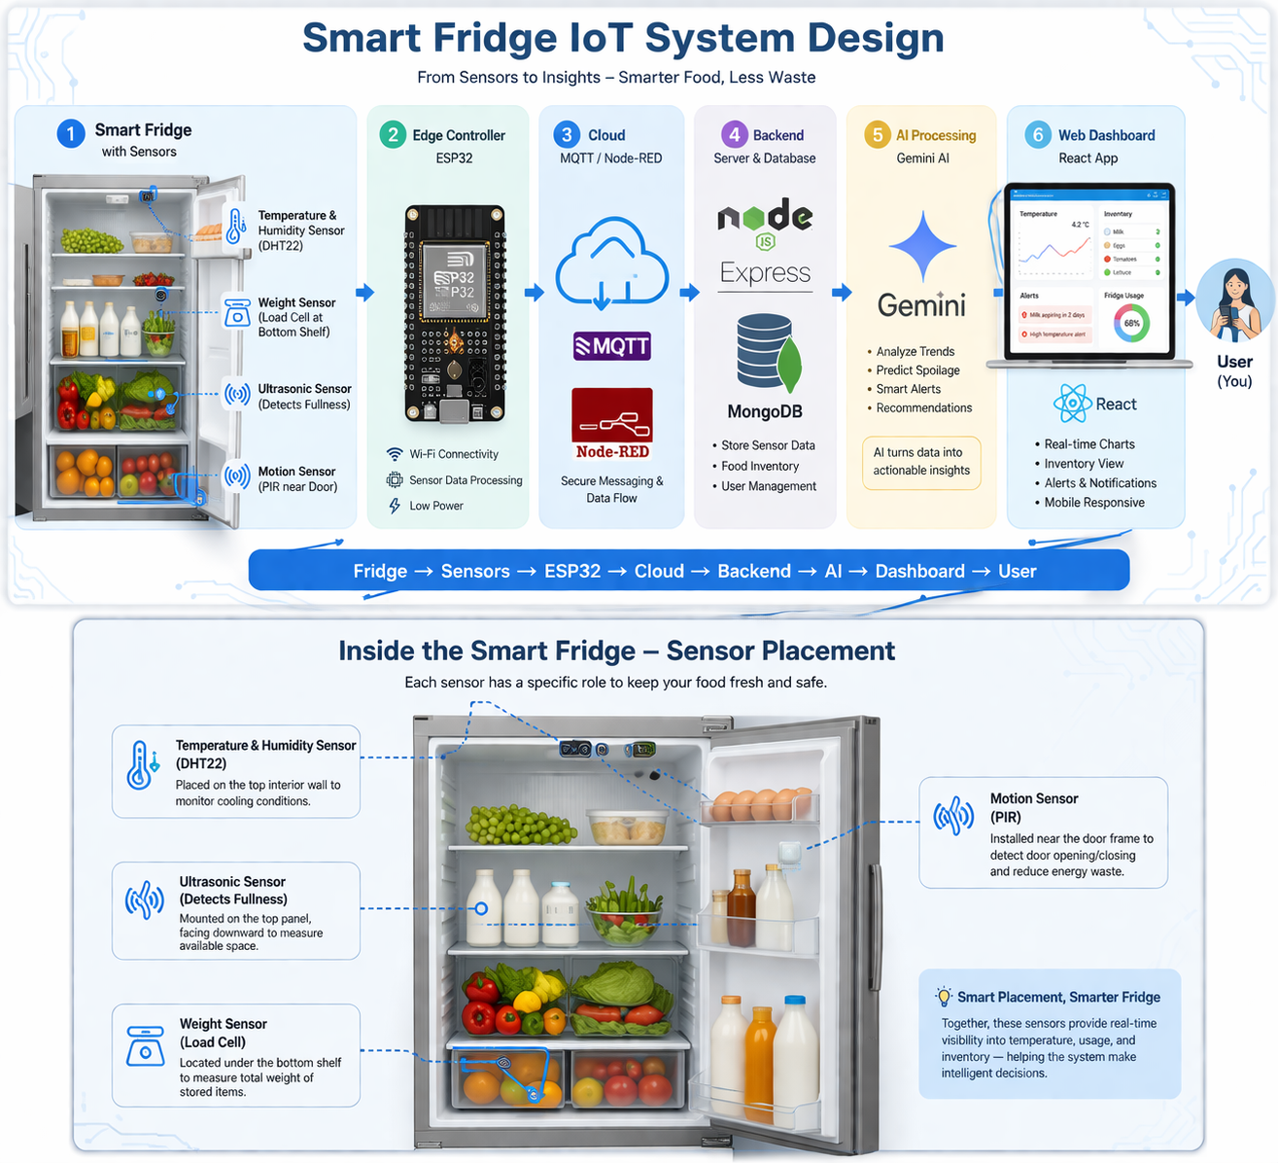
System Workflow
ESP32
Sensors
DHT22, HX711
PIR, Ultrasonic

Slide 11
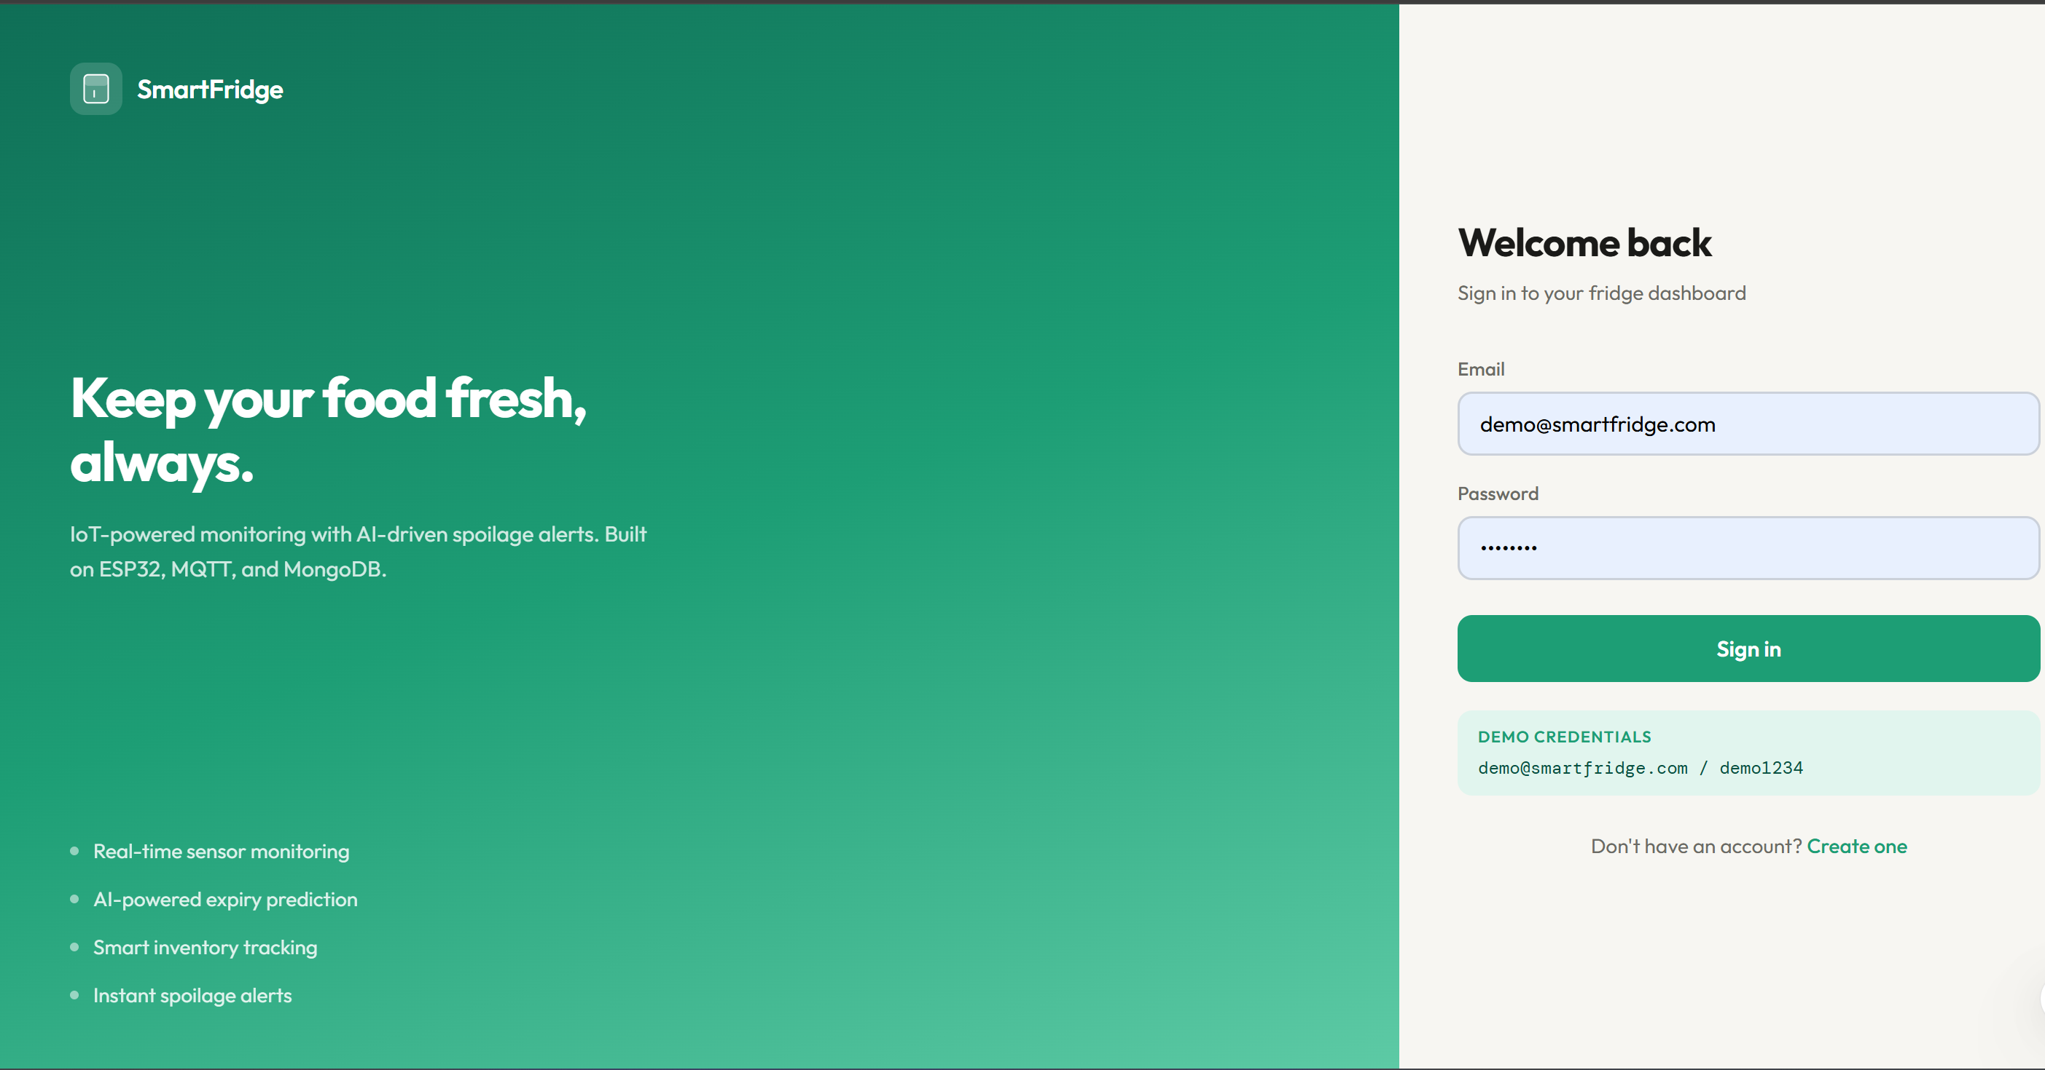
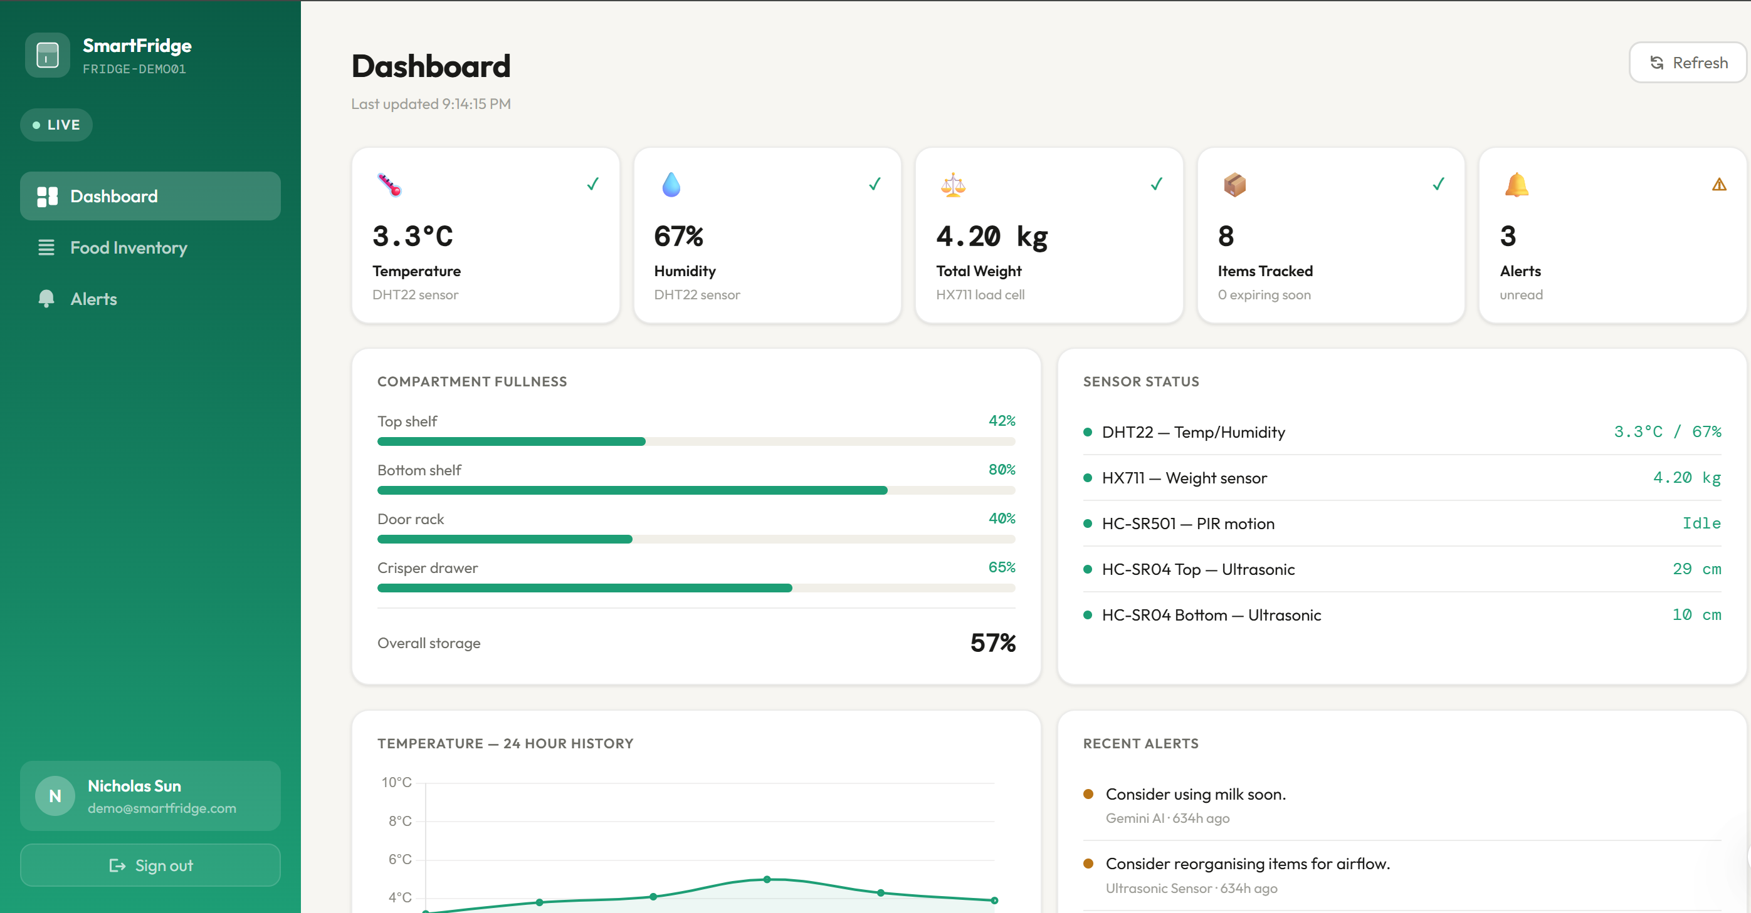

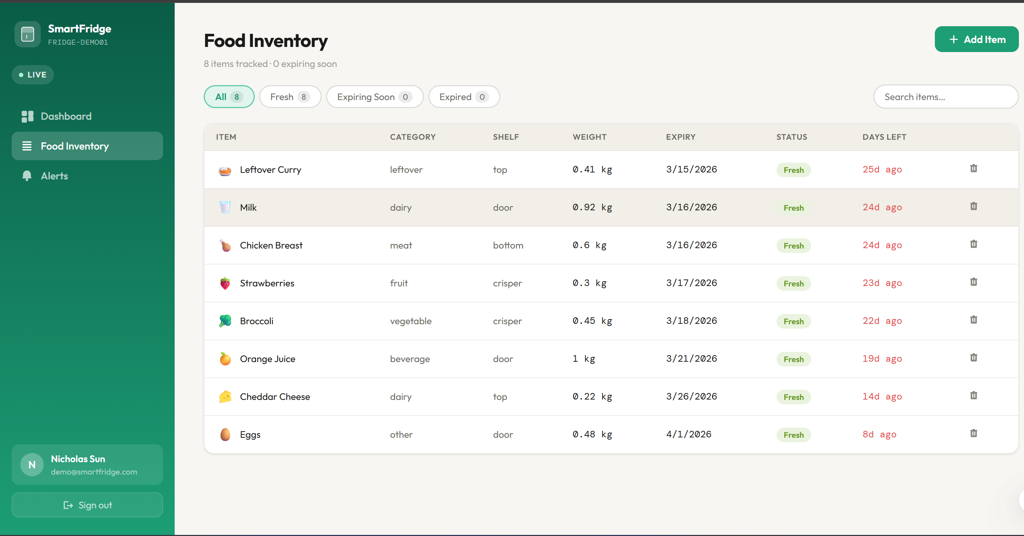
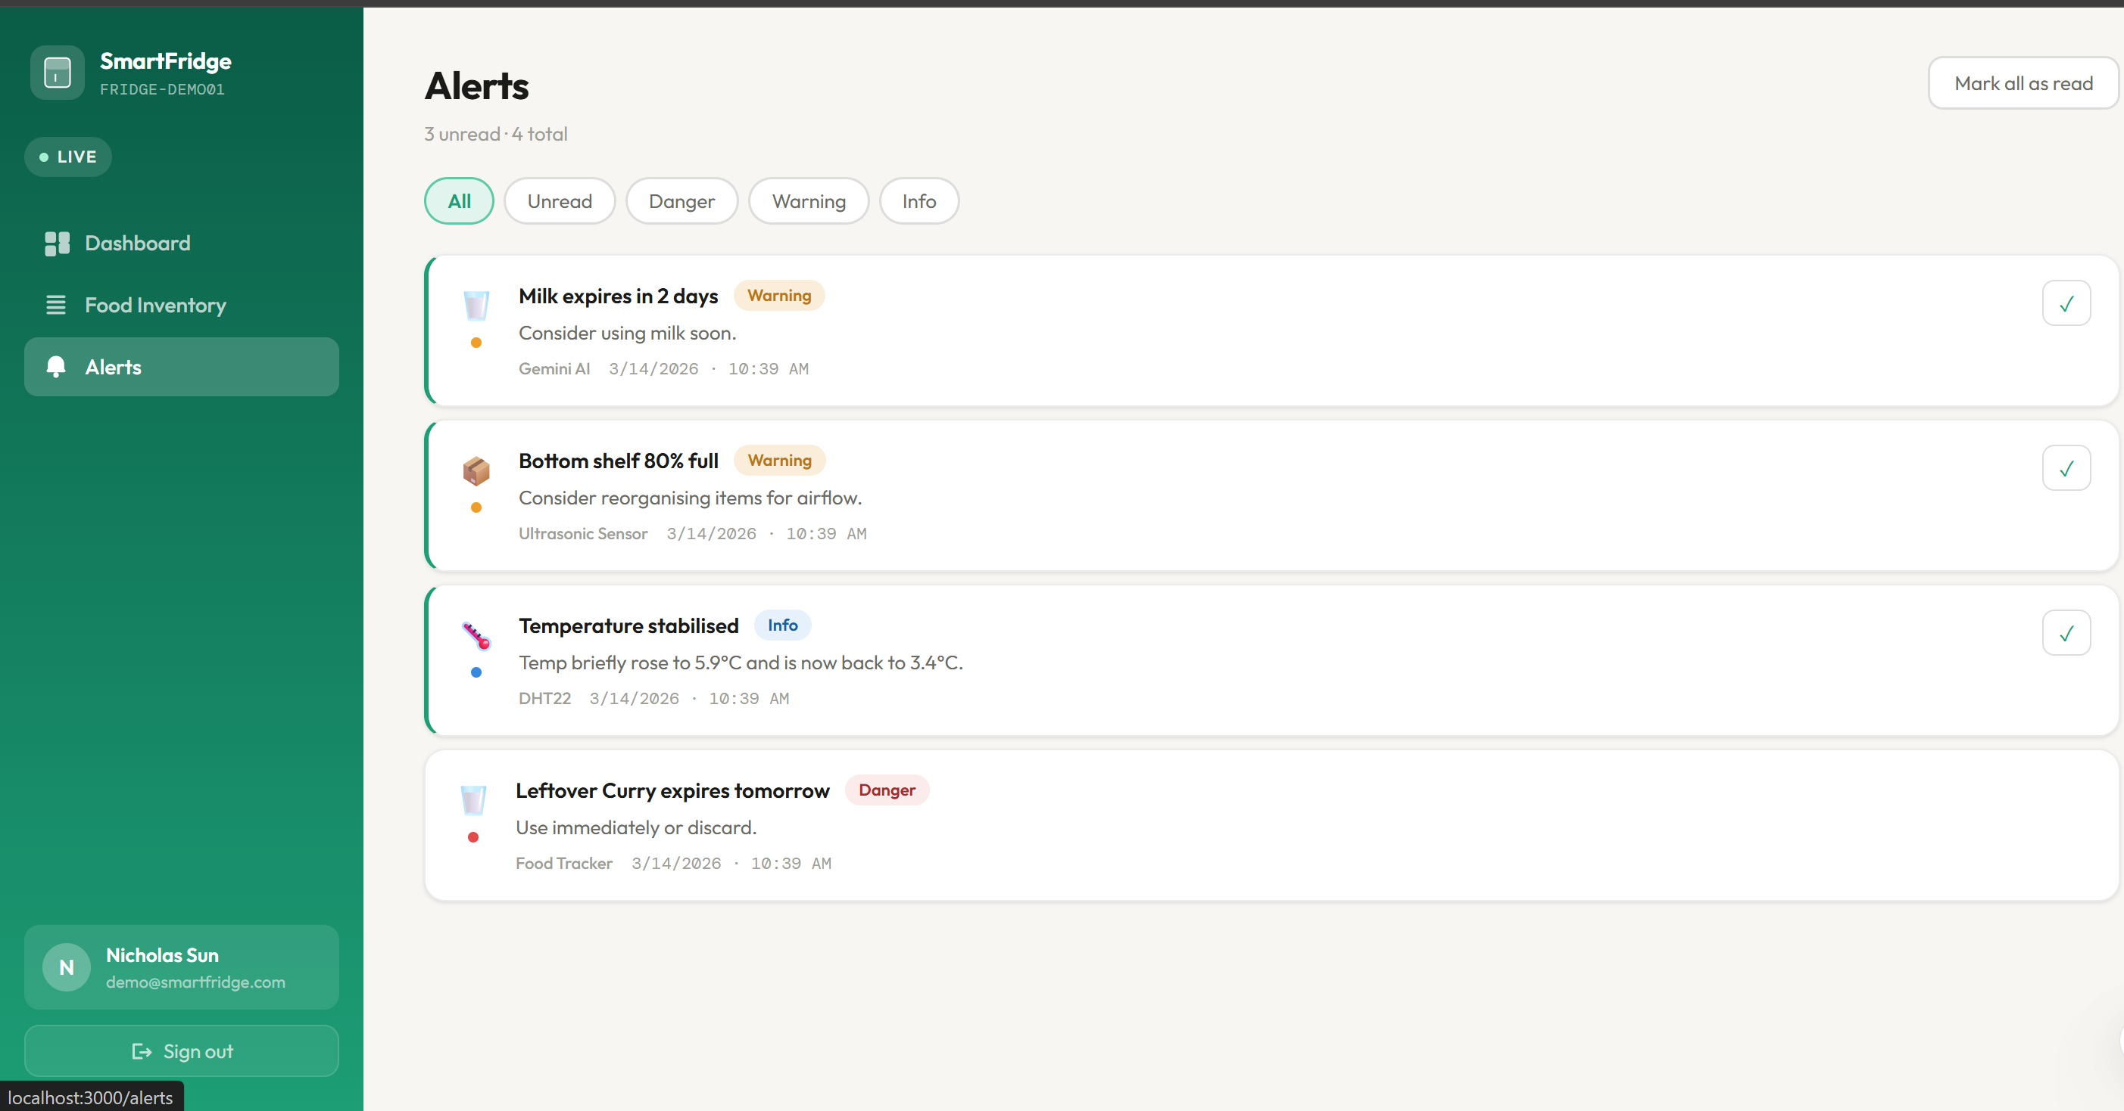


Front-End Application Views
● ● ●
localhost:3000 — Smart Fridge
● ● ●
localhost:3000 — Smart Fridge
Login / Register
Dashboard
JWT auth — email & password form with validation
Live temp/humidity charts + sensor stat cards
[ Screenshot / Live Demo ]
[ Screenshot / Live Demo ]
● ● ●
localhost:3000 — Smart Fridge
● ● ●
localhost:3000 — Smart Fridge
Food Inventory
Alerts Centre
Add, edit, delete items with colour-coded expiry status
IoT + AI alerts with severity badges and mark-as-read
[ Screenshot / Live Demo ]
[ Screenshot / Live Demo ]

Slide 12
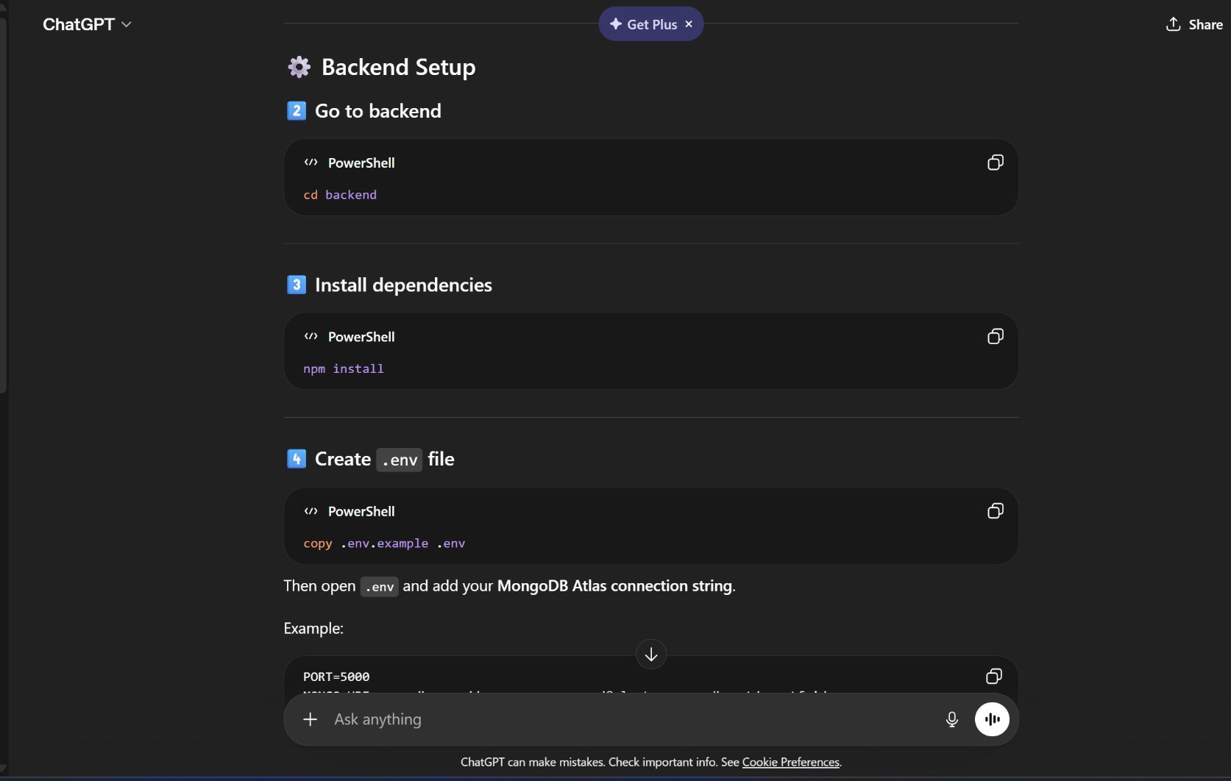
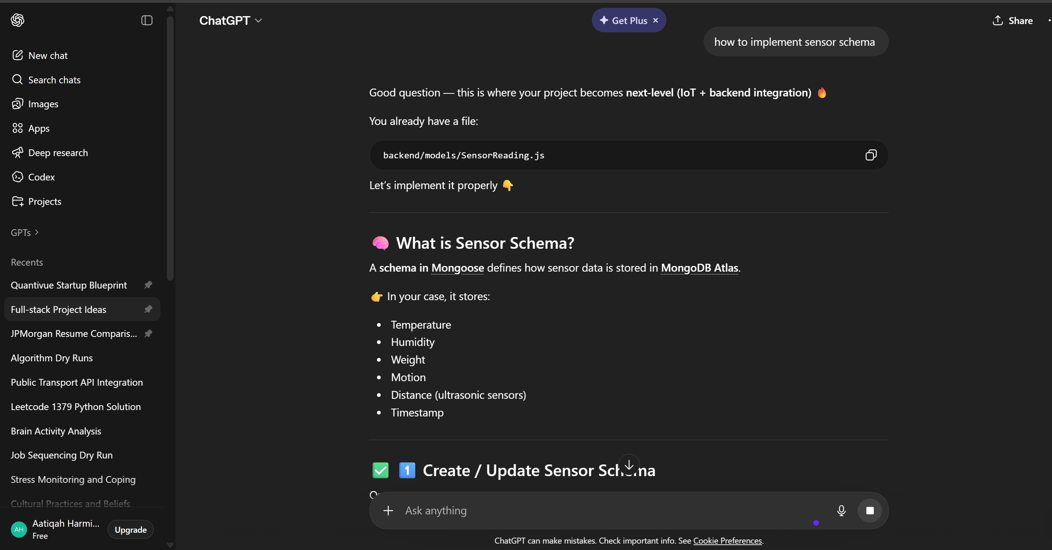
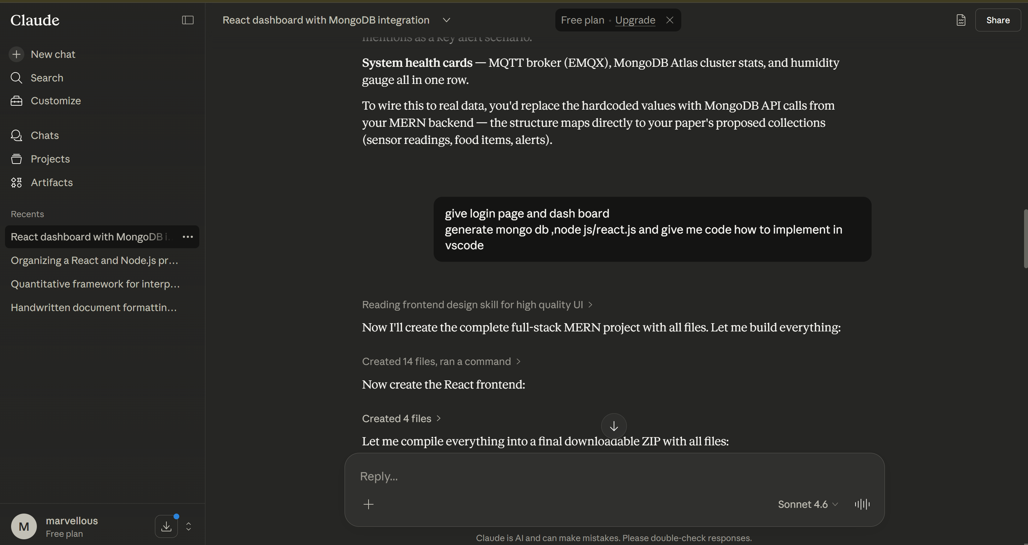
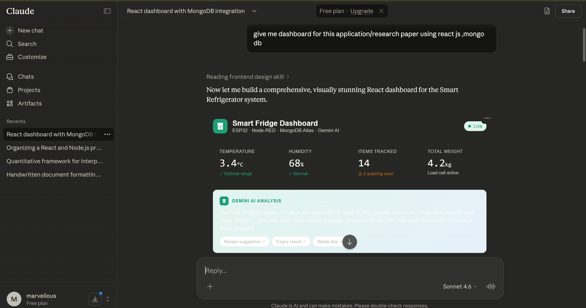
Proof of Prompts Generating Code
Screenshot 1 — Backend Server (P1)
Screenshot 2 — Sensor Schema (P2)
Gemini AI (Google)
ChatGPT (OpenAI)
Screenshot 3 — Dashboard React Page (P3)
Screenshot 4 — Gemini AI Integration (P6)
11 / 12

Slide 13
References
[1] Recommendations for Developing a Low-Cost Smart Refrigerator with Predictive Spoilage Alerts. https://ieeexplore.ieee.org/abstract/document/11158709
[2] Meta Open Source. (2024). React Documentation. https://react.dev/
[3] OpenJS Foundation. (2024). Node.js Documentation. https://nodejs.org/en/docs/
[4] Expressjs.com. (2024). Express.js Guide. https://expressjs.com/
[5] Google AI. (2024). Gemini API Documentation. https://ai.google.dev/
[6] EMQX. (2024). EMQX MQTT Broker Documentation. https://www.emqx.io/docs/
[7] Node-RED. (2024). Node-RED Documentation. https://nodered.org/docs/
[8] Espressif Systems. (2024). ESP32 Technical Reference. https://docs.espressif.com/
[9] npm, Inc. (2024). PptxGenJS Library. https://gitbrent.github.io/PptxGenJS/
[10] Vitejs.dev. (2024). Vite Build Tool Documentation. https://vitejs.dev/guide/

Slide 14
AI TOOLS USED
AI Tools & How They Were Used
Claude (Anthropic)
Gemini AI (Google)
ChatGPT (OpenAI)
Primary Code Generator
IoT Analytics Engine
Research & Planning
Full MERN stack backend (Node.js, Express, MongoDB schemas)
Real-time spoilage prediction from sensor data
Literature review assistance and research synthesis
React frontend: Login, Dashboard, Food Inventory, Alerts pages
Recipe suggestions based on expiring ingredients
System architecture planning and IoT topology design
JWT authentication middleware and route protection
Food freshness analysis from temperature/humidity patterns
Agile sprint planning and project timeline structuring
Database seed scripts and REST API endpoints
Integrated via Gemini AI API within the dashboard
Arduino/ESP32 code review and sensor integration advice
This PowerPoint presentation generated automatically
Explainable AI alerts sent to user dashboard
Debugging assistance for MQTT broker configuration

Slide 15
COMPLETE LIST OF PROMPTS
All Prompts Used to Complete This Project
Category | Prompt Description
Backend | Create a MongoDB schema for a smart refrigerator with User, Sensor Reading, FoodItem, and Alert collections.
Backend | Build a Node.js + Express REST API with JWT auth, sensor routes, food CRUD, and dashboard summary endpoint.
Backend | Write a MongoDB Atlas seed script with demo user, 24h sensor data, 8 food items, and sample alerts.
Frontend | Design a React split-layout login page with teal gradient panel, form validation, and JWT integration.
Frontend | Build a full React dashboard fetching /api/dashboard/summary with metric cards, Chart.js temp history, and food grid.
Frontend | Create a React food inventory page with modal add form, filter tabs, expiry status pills, and delete API calls.
Frontend | Build a React alerts page with severity color coding, mark-as-read, filter tabs, and real-time refresh.
Frontend | Create a React Router + Context API app structure with protected routes and persistent JWT token storage.
IoT | Write an Arduino sketch for ESP32 to read DHT22, HX711, HC-SR501 PIR, and two HC-SR04 sensors, then POST to REST API.
Deployment | Write a VS Code step-by-step setup guide: MongoDB Atlas config, backend .env, npm install, seed, and concurrent dev servers.
AI | Explain how to integrate the Gemini AI API into a MERN app for real-time food spoilage prediction and recipe suggestions.

