Slide 1


Topic : AI-Driven Inclusive Assessment Tools for Skill Ecosystem Domain : Student Innovation Team ID : T187 Team name : AI EQUITY Team members : 2303A51860 2303A51176 2303A51932 2303A51684 2303A51001

Slide 2

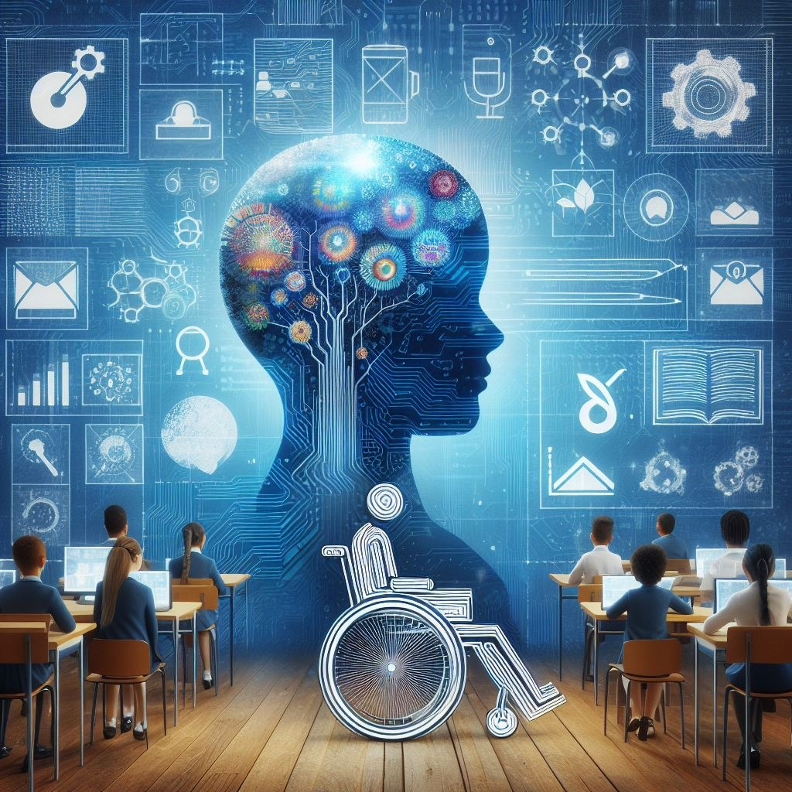
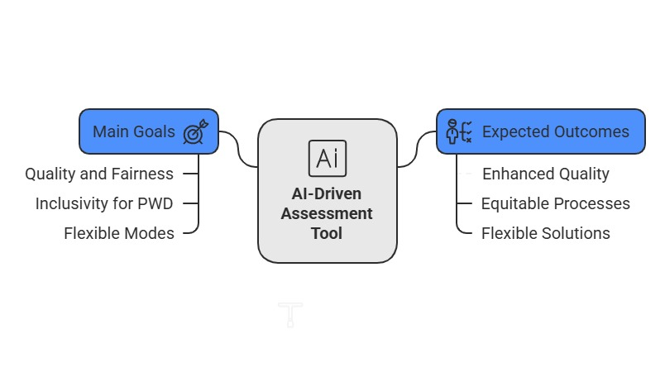
Objective
PURPOSE:
Develop an AI-powered quality assessment tool for assessing skills across various formats like : written exams, MCQs, practical, and viva.
GOALS & OUTCOMES:
Ensure inclusivity for all candidates, including Persons with Disabilities (PWD)
Provide adaptive, personalized assessment experiences using AI.
Enable online, offline, and blended assessment modes.
Offer real-time feedback and data-driven insights.

Slide 3
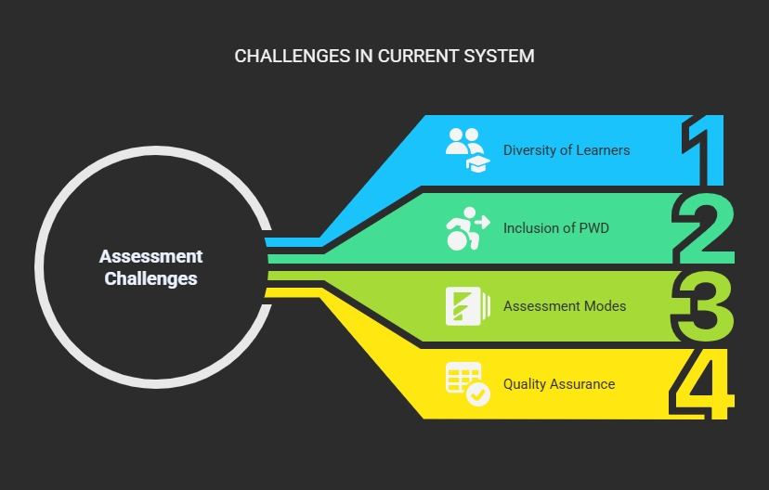
Problem Statement
DEFINING THE PROBLEM:
The current skill assessment system in India faces challenges in standardization, inclusivity, and quality.
CHALLENGES IN CURRENT SCENARIO:
Many assessments are not designed for
flexibility across online/offline modes or
accessibility for PWDs.
There is a lack of real-time analytics to
inform candidates and educators.
Need for a unified, AI-driven solution that
works across the entire skill ecosystem.

Slide 4
Existing system
DESCRIBING THE CURRENT SYSTEM:
Traditional assessment tools are mostly manual and lack personalization.
LIMITATIONS & INEFFICIENCIES:
Limited support for remote or blended learning environments.
Inadequate accessibility for PWD candidates.
No adaptive testing or instant feedback mechanisms.
Feature | Existing Tools | Our Solution
Accessibility | Minimal | PWD-Friendly Interface
Modes | Mostly Offline | Online, Offline, Blended
Personalization | None | AI-Based Adaptivity
Feedback | Delayed | Real-Time
Standardization | Inconsistent | Ecosystem-Wide Standardization

Slide 5
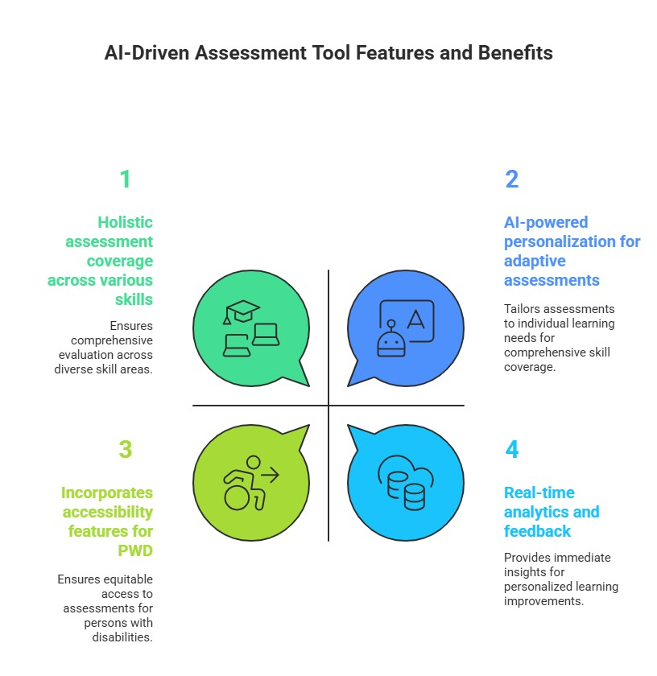
Proposed system
INTRODUCING THE NEW SYSTEM:
AI-driven assessment platform supporting pen-paper, online, descriptive, practical, and viva formats.
ADVANTAGES:
Built-in accessibility tools: voice-to-text, text-to-speech,
custom input options.
KEY FEATURES & FUNCTIONALITIES:
Adaptive testing powered by AI, adjusting difficulty
based on candidate performance.
Multi-mode support: works seamlessly online, offline,
and in blended settings.
Real-time analytics dashboards for candidates and
trainers.

Slide 6
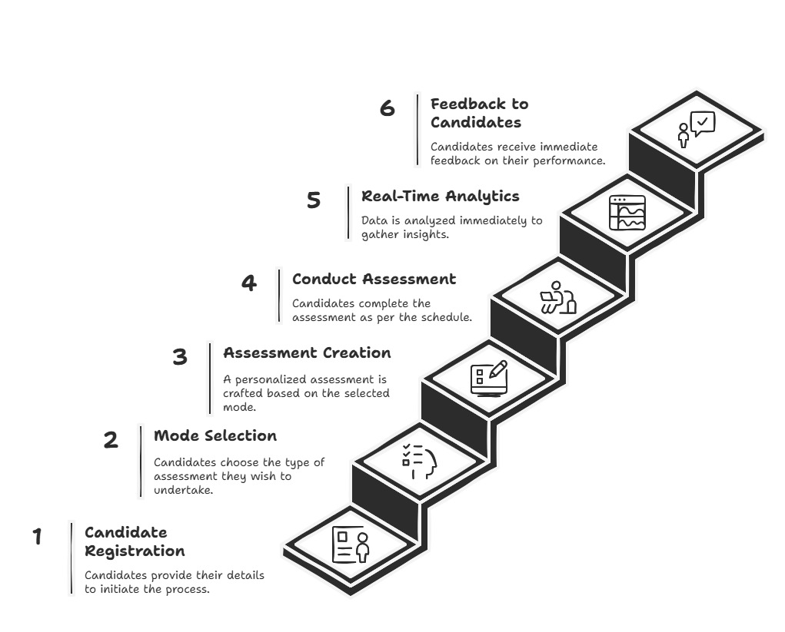
Workflow

Slide 7
System Architecture
Key points to cover
Show the system’s technical structure.
Present a clear 3-layer architecture:
Frontend: User interface ( HTML, CSS)
Backend: Business logic & AI processing (Java)
Database & Storage: Data management (MySQL)
3. Label different components and their
interactions:
Candidate Panel: Test interface, accessibility features
AI Engine: Adaptive question generation, real-time feedback
Admin Dashboard: Performance analytics & monitoring
Tech Stack
Java
MySQL
Encrypted databases
AWS
Google Speech-to-Text, Google Text-
to-Speech
Diagram analysis of final Output

Slide 8
Conclusion & Future Scope
KEY TAKEAWAYS:
Impact: The tool enhances the quality, inclusivity, and efficiency of assessments at all levels.
Equity: Ensures fair opportunities for all candidates, including PWD.
Scalability: Capable of nationwide implementation across different skill programs.
Future Enhancements:
Multilingual support for broader accessibility
Mobile app development for on-the-go assessments
Integration with national skill certification platforms like Digi Locker
🚀 Empowering the future of skill assessment with AI-driven innovation and inclusivity!

