Slide 1
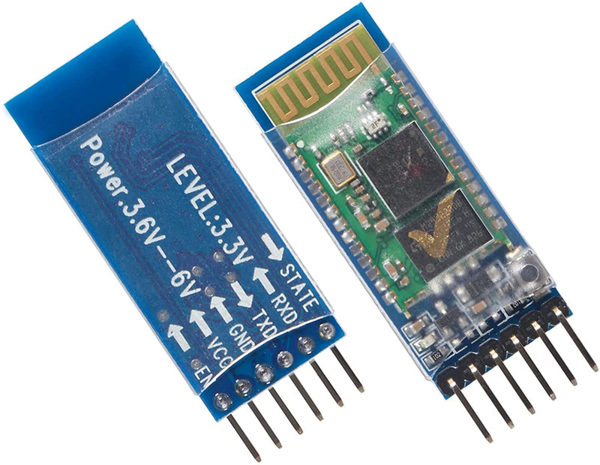
App Overview
The app will have 2 functionalities:
Controlling the speed of the lights
Displaying the score of the test
To perform these two functionalities the app will have to establish a Bluetooth connection with the Arduino, to establish a Bluetooth connection from the app to the Arduino we will import a package named ‘react-native-ble-plx’ and to establish a Bluetooth connection from the Arduino to the app we will use the HC-05 module which is used to make the Arduino Bluetooth compatible.
To the right we can see an image of the HC-05 module that we are going to use to make the Arduino Bluetooth compatible.
It will be powered by 3.3V at 50mA.
It also has a range of 10m with speed of 1Mbps making it ideal for our application.
We will add more functionalities as we develop the app, we plan to add a graph that will allow us to track the progress of the user.

Slide 2



App Overview
Controlling the speed of the lights
To control the speed of the lights from the app we will make use of a slider from which we will be able to change the speed of the lights starting from the minimum speed (1) to the maximum speed (100) with an increment/step value (1).
The slider will also have a display box above it that will show the current speed.
Displaying the score of the test
To display the score of the current test we will implement a button that will fetch the score from the Arduino and display it to the user.
The button will also have a display box above it that will display the score of the user when the user presses the button.
Examples of the slider we will use
Examples of the button we will use

