Slide 1

Dynamic Device Allocation in LLM Inference
Heterogeneous Pool Splitting for Mixed Interactive and Batch Workloads using PIM/CXL
Aatmaj Barbhaiya
IIT Bombay — EE Dept.
CADSL Lab
ASPLOS 2025
PIM Is All You Need
CENT Simulator

Slide 2
Introduction — LLM Inference Has Two Conflicting Goals
Interactive chat vs. batch summarization — different SLO, same hardware
Interactive Requests
Batch / Offline Requests
Seqlen
200 – 512 tokens
Seqlen
512 – 4096+ tokens
SLO (TTFT)
< 1 second
SLO (TTFT)
< 5 seconds
Priority
Latency = revenue
Priority
Throughput = cost reduction
Optimal config
High TP (PP=1) — all devices share weights
Optimal config
High PP (TP=1) — full pipeline depth
Problem
TP=max → −79–92% throughput loss
Problem
PP=max → 4–10× TTFT SLO violation
⚡ Both request classes arrive concurrently on the same CXL-PIM hardware. No single static (PP, TP) configuration can serve both efficiently.

Slide 3
Background — CENT Architecture & Parallelism Strategies
2.1
Transformer & AiM Hardware
2.2
Tensor Parallelism (TP)
2.3
Pipeline Parallelism (PP)
2.4
SLO Classes in LLM Serving
GEMV-dominant decode; PIM executes MACs in-DRAM; 32-ch GDDR6 per device
Weights sharded across TP devices; CXL all-reduce per layer; reduces TTFT
Layers distributed across PP stages; PP tokens in-flight; multiplies throughput
Interactive SLO = 1s TTFT; Batch SLO = 5s; both arrive concurrently
Hardware
Models: 7B / 8 dev | 13B / 20 dev | 70B / 32 dev
Each device: 32-channel GDDR6 with AiM PIM
CXL 3.0 switch — shared PCIe 5.0 bandwidth
Each section covered on following slides →

Slide 4
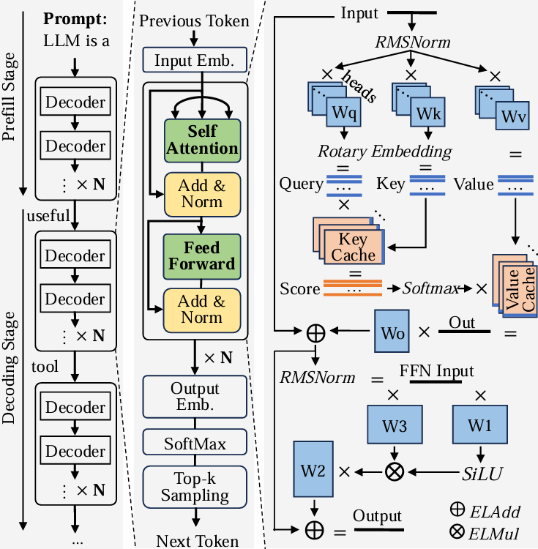
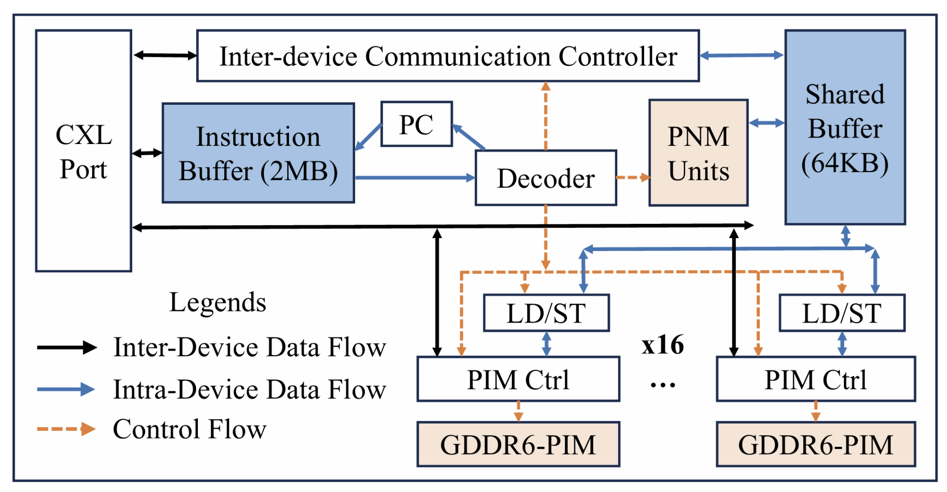
Background 2.1 — Transformer Architecture & AiM Hardware
Background
Transformer Decode Step (single token):
Self-Attention
Q/K/V GEMV → scores → softmax → output → Wo GEMV
FFN
W1 GEMV + SiLU gate (W3) → W2 GEMV
KV Cache
Stores all past K, V → avoids recompute every step
Why PIM?
• Decode is memory-bandwidth-bound (one token → load all weights from DRAM)
• AiM executes MAC in-DRAM → no data movement off-chip → 6× lower latency vs GPU (7B)
• 32 channels per device × N devices = massive parallel bandwidth

Slide 5
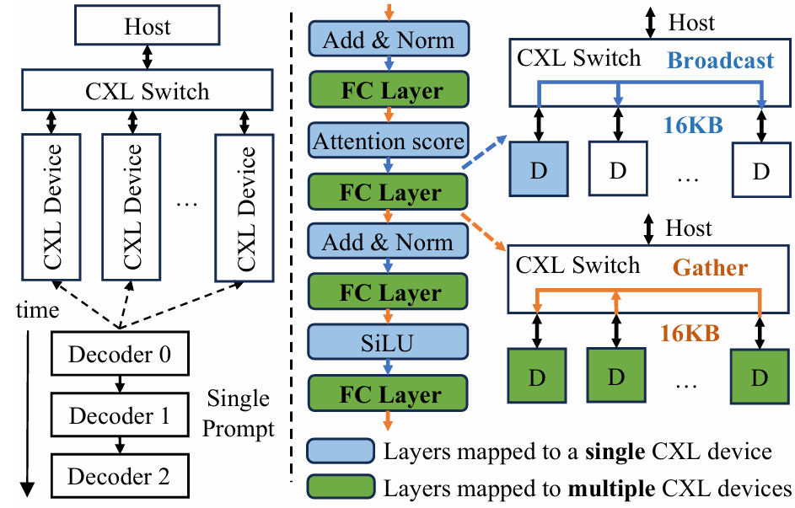
Background 2.2 — Tensor Parallelism (TP)
Background
How TP Works
Weight matrix W sharded column-wise across TP devices. Each device computes partial GEMV on its 1/TP weight shard. CXL all-reduce gathers partial sums → full output.
Latency formula:
TTFT ∝ compute / TP + CXL_allreduce(TP)
CXL bottleneck — 70B at seqlen=512:
TP
PIM latency
CXL latency
CXL/PIM %
1 (PP=80)
0.693 ms
0.001 ms
0.2% — compute bound
8
0.082 ms
0.021 ms
26%
16
0.048 ms
0.024 ms
50%
32
0.044 ms
0.025 ms
57% — CXL bound ⚠
TP=32 already CXL-saturated. Diminishing returns beyond this point.

Slide 6
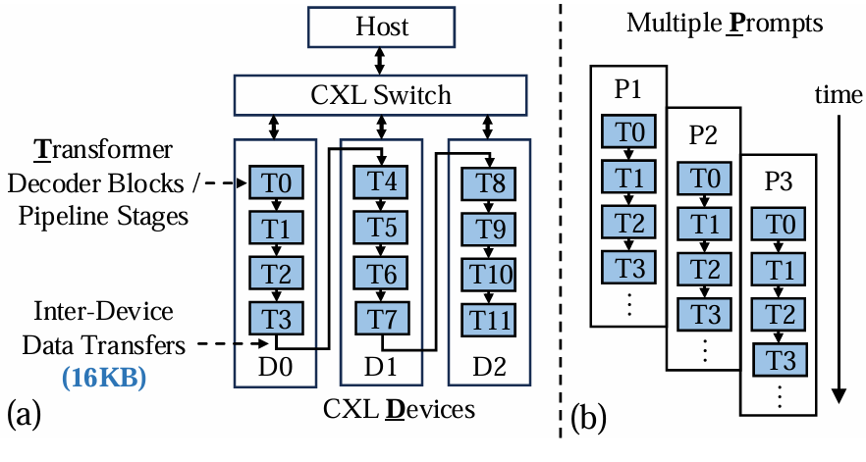
Background 2.3 — Pipeline Parallelism (PP)
Background
How PP Works
Transformer layers distributed sequentially across PP devices. Multiple tokens travel the pipeline simultaneously (one per stage). While stage 2 processes Token A, stage 1 already processes Token B.
Throughput formula:
throughput = (1 / token_latency) × PP_stages
Key trade-offs vs TP:
TTFT
TP: ↓ Reduces (parallelizes per-layer)
PP: → Unchanged (must traverse all stages)
Throughput
TP: ↓ Unchanged (1 token in-flight)
PP: ↑ Scales linearly with PP depth
CXL cost
TP: High (all-reduce per layer)
PP: Near-zero (no weight sharding)
Best for
TP: Short/interactive (low latency)
PP: Long/batch (high throughput)

Slide 7
Background 2.4 — SLO Classes in LLM Serving
Attribute
Interactive (SLO = 1s)
Background
Batch / Offline (SLO = 5s)
Request type
Chat, code completion, Q&A
Summarization, RAG, bulk jobs
Key metric
TTFT (time to first token)
Tokens/second
Seqlen
Typically ≤ 512 tokens
512 – 4096+ tokens
Optimal config
High TP (PP=1) — min TTFT
High PP (TP=1) — max throughput
If wrong config
PP=max → TTFT 4–10× over budget
TP=max → −79–92% throughput loss
SLO budget
1.0 second
5.0 seconds
In production deployments, both classes co-exist. Operators currently choose one static (PP, TP) config — sacrificing either SLO compliance or throughput. DDA removes this constraint.

Slide 8
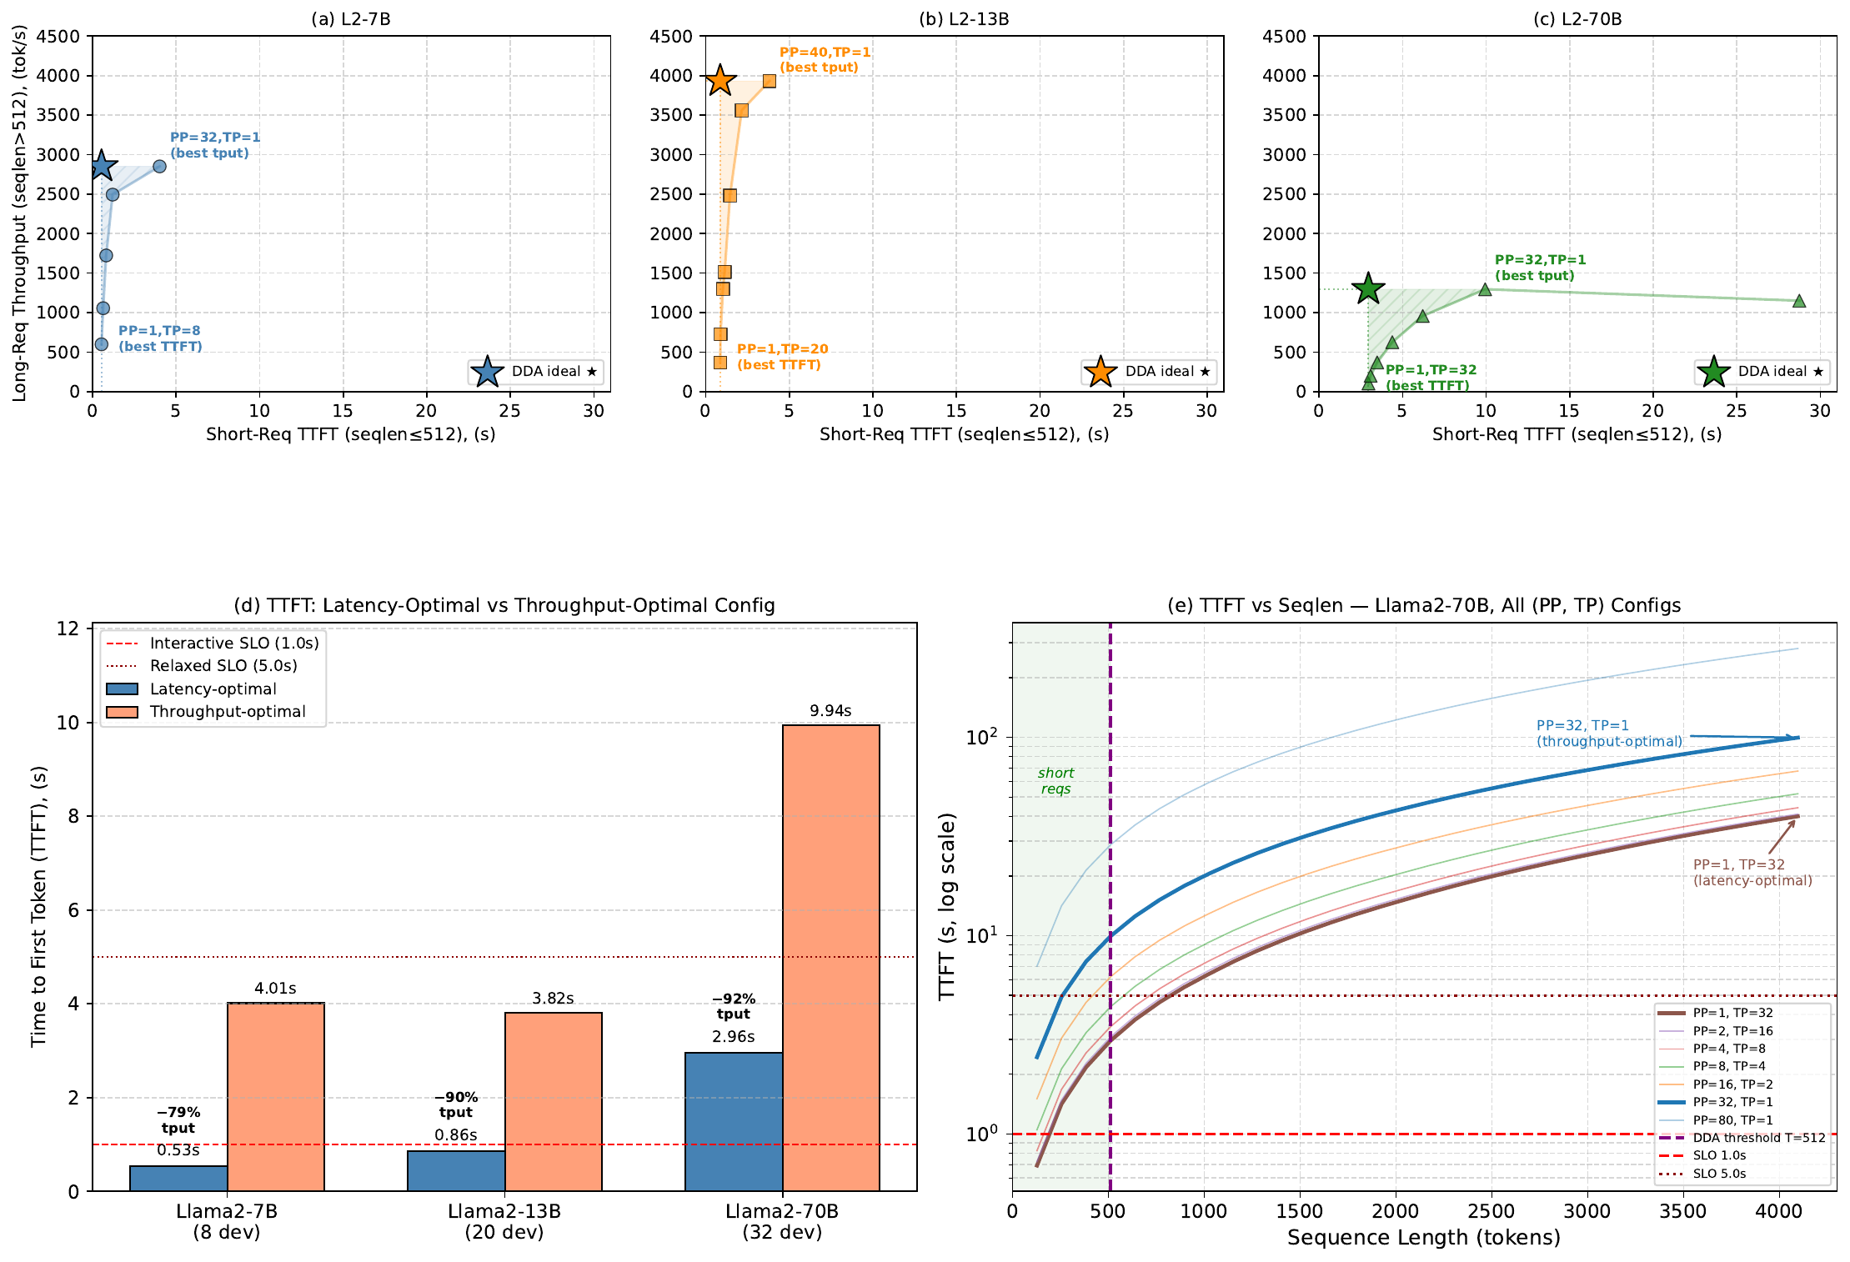
Motivation — No Static Config Can Meet Both SLOs
TTFT vs Throughput at extreme (PP, TP) configurations
Motivation
Left: meeting 1s SLO (lat-optimal) costs 79–92% throughput | Right: 9.7× latency spread at seqlen=512 between TP=32 and PP=80 configs

Slide 9
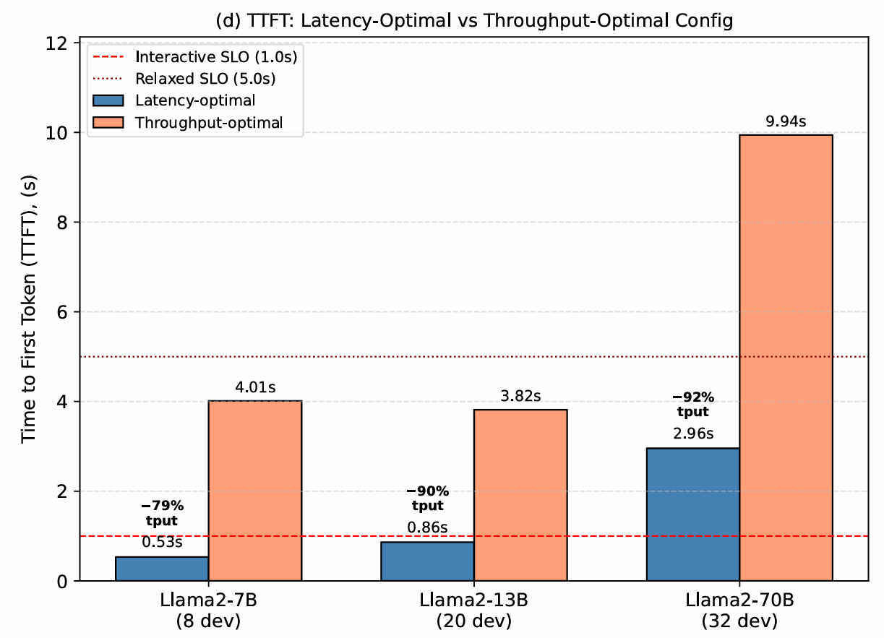
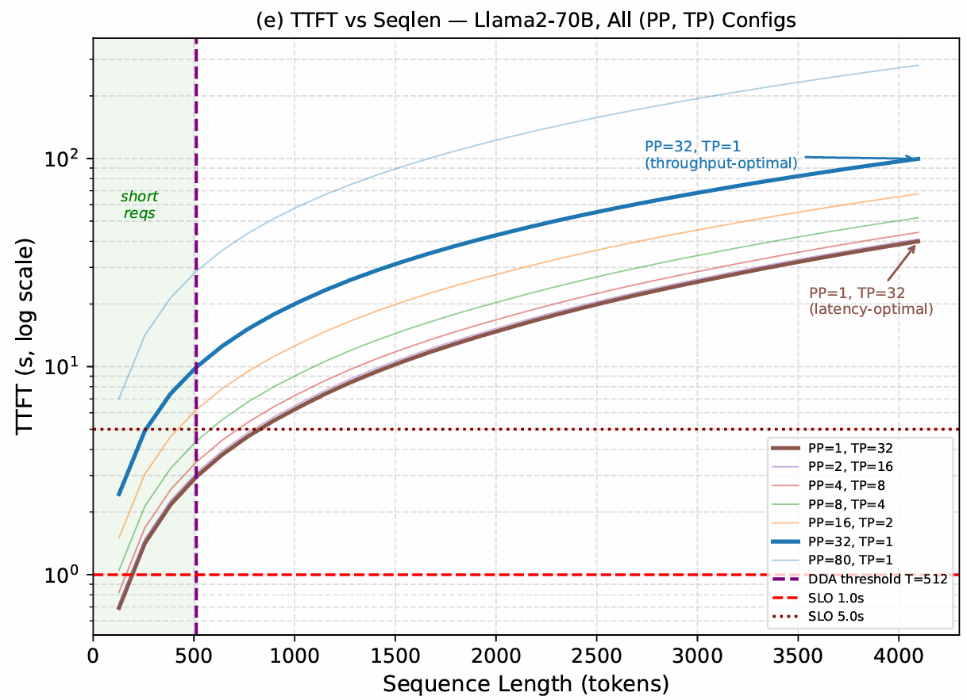
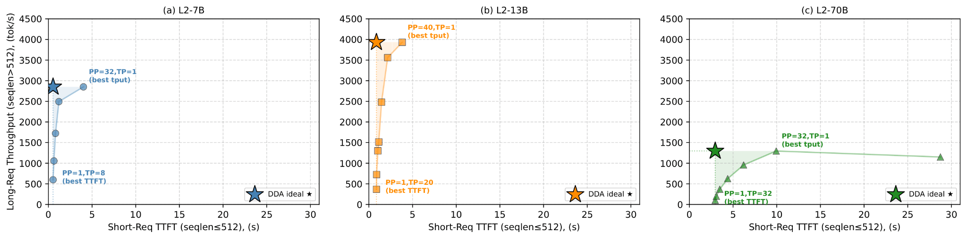
Motivation — The DDA Ideal ★ is Unreachable by Any Single Config
Short-TTFT vs Long-Throughput scatter for all (PP, TP) combinations
Motivation
★ DDA Ideal = lat-optimal TTFT + tput-optimal throughput simultaneously. Reachable ONLY by routing short requests → Pool L and long requests → Pool T concurrently. No single symmetric (PP, TP) config reaches the top-left corner.

Slide 10
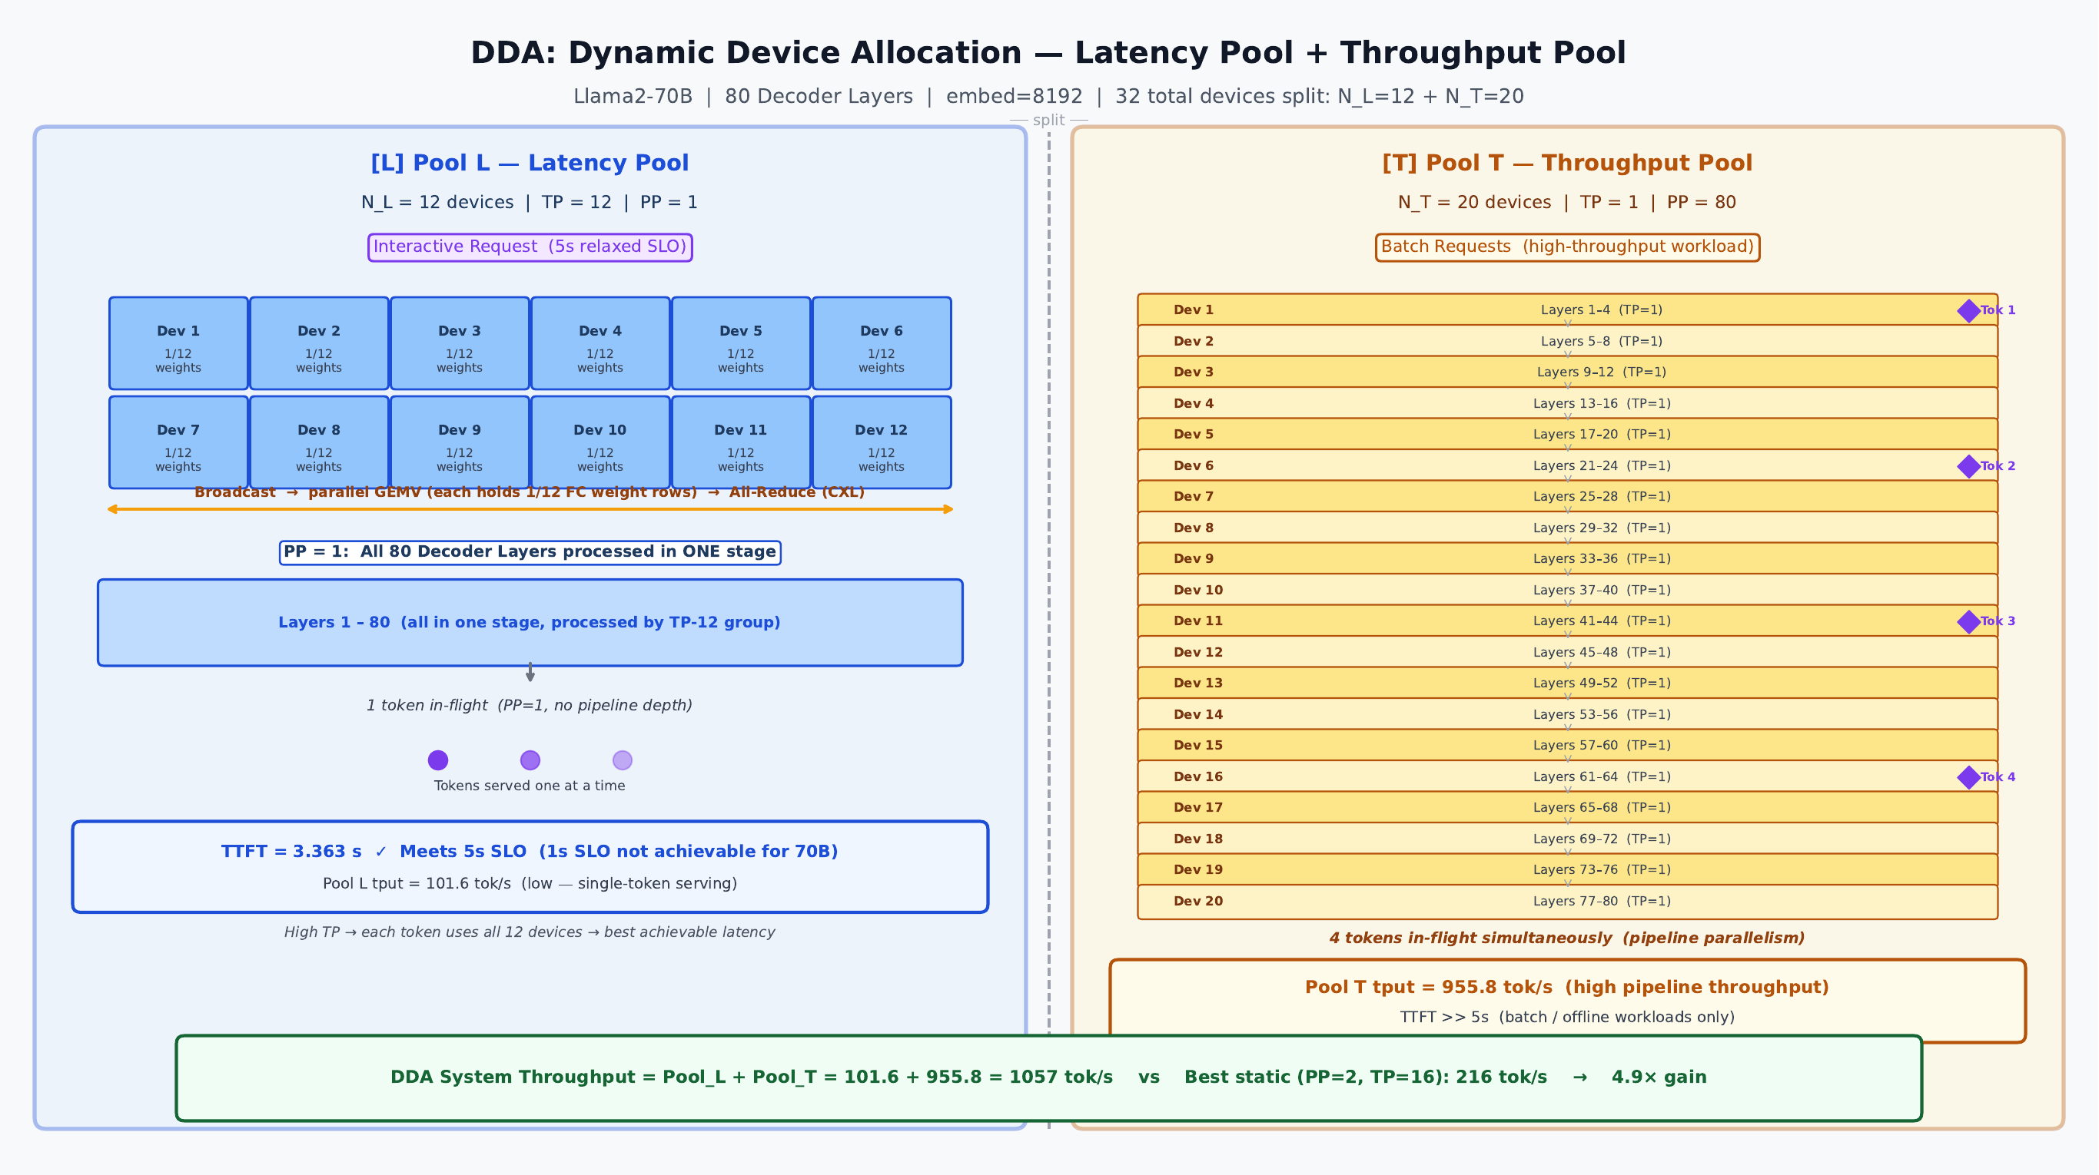
Proposal — Dynamic Device Allocation (DDA): Core Architecture
Partition N devices into two specialized concurrent pools
Proposal
Hardware Constraint — Channel Ceiling
Pool T needs: channels/block = 32 ÷ ceil(layers/N_T) ≥ min_ch This sets a hard minimum on N_T → maximum on N_L.
Model
min N_T
max N_L
Valid N_L values
7B
6
2
{2} — ONE split only
13B
10
10
{2, 4, 6, 8, 10} — 5 splits
70B
16
16
{4, 8, 12, 16} — 4 splits
Breakpoint effect:
Pool T throughput steps at ceil(layers/N_T) boundaries. Adding devices within a breakpoint group = zero gain. This collapses the effective design space.
system_tput = Pool_L_tput + Pool_T_tput (both pools run concurrently)
Router: directs each incoming request to Pool L or Pool T based on seqlen / SLO tag / workload mix α — three routing strategies covered next.

Slide 11
Proposal — Three Routing Strategies: Progressive Story
Each strategy removes one limiting assumption from the previous
S1 — Seqlen Heuristic
S2 — SLO-Tagged Routing
Proposal
S3 — Pareto-Adaptive
Signal:
Signal:
Signal:
seqlen < 512 → Pool L; seqlen ≥ 512 → Pool T
explicit SLO tag per request (1s → Pool L, 5s → Pool T)
α(t) vs Pareto crossover threshold (α = 0.143 for 13B)
Split:
Split:
Split:
argmax(system_tput / static_tput), chosen offline
argmax λ_max(N_L,α) s.t. TTFT_L < 1.05s, updated per epoch
switches between 2 Pareto-efficient splits in real time
→
→
Overhead:
Overhead:
Overhead:
zero — seqlen known at request arrival
tag lookup + α measurement window
α monitoring + 2s cooldown between reallocations
Removes:
Removes:
Removes:
symmetric (PP,TP)-for-all-requests constraint
seqlen-as-proxy assumption + α-blindness
static-per-epoch assumption; fully dynamic
Drawback:
Drawback:
Result:
seqlen ≠ SLO; ignores α; static forever
static per epoch; can't react to mid-epoch α spikes
S1 throughput at low α + S2 SLO compliance at high α
Summary Comparison (Llama2-13B):
Metric
S1 Seqlen Heuristic
S2 SLO-Tagged
S3 Pareto-Adaptive
Adapts to α?
No
Per epoch
Real-time ✓
System tput
3020 tok/s
3020 / 2506 tok/s
3020 (low α) / 2506 (high α)
1s SLO met?
✗ (1.003s)
✓ (0.882s)
✓ when α ≥ 0.143

Slide 12
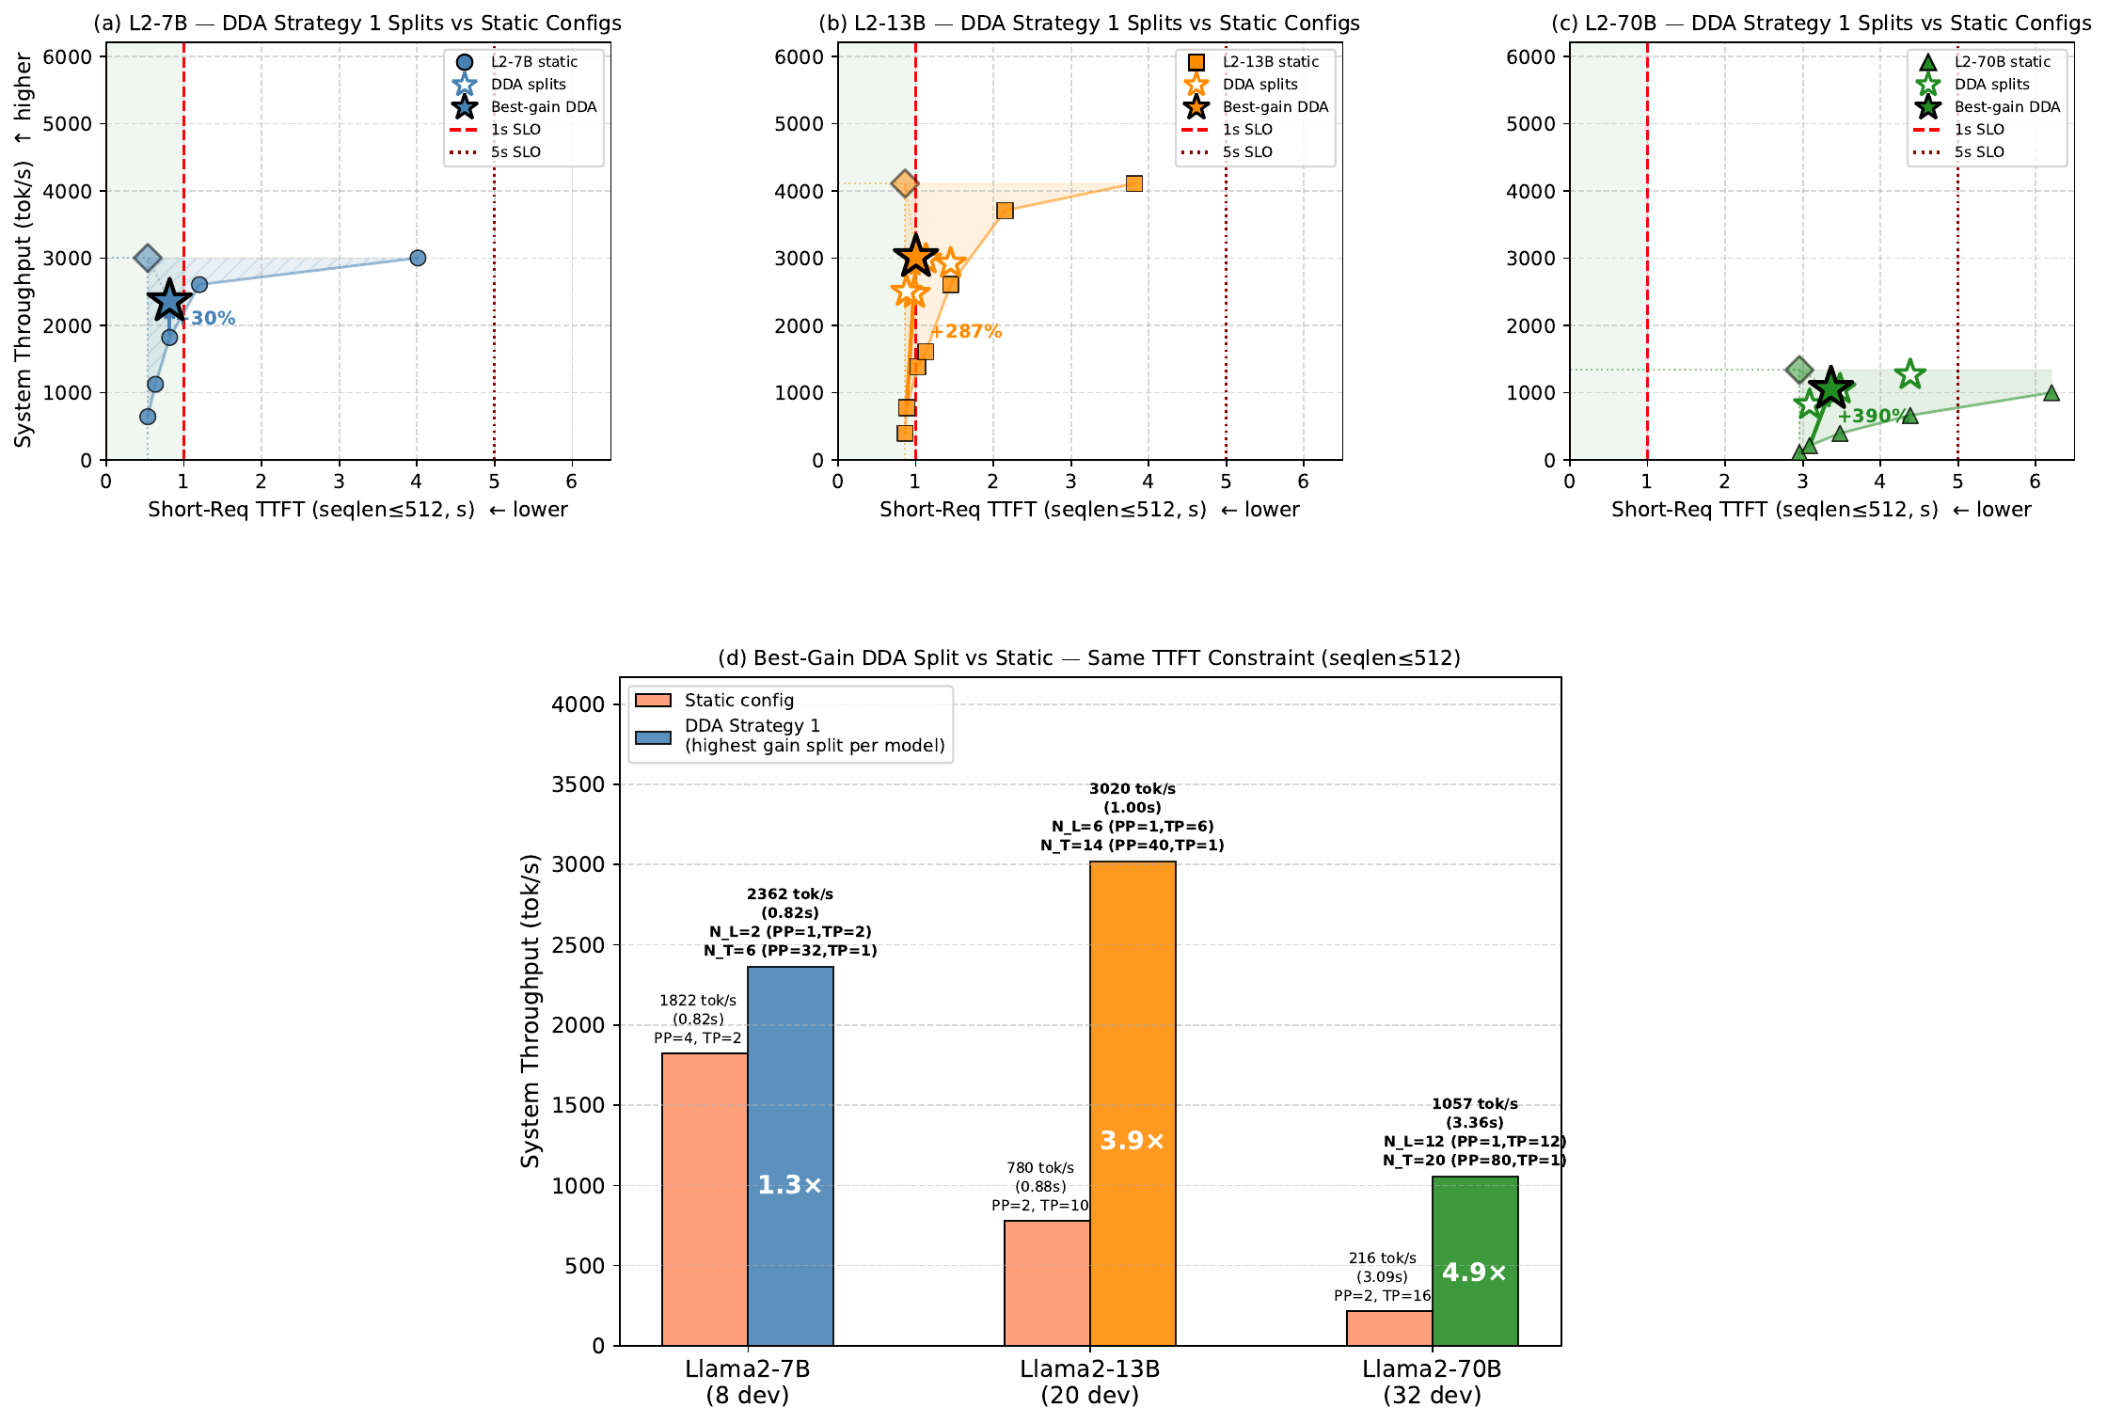
Strategy 1 — Short-Request Performance (seqlen ≤ 512)
DDA pool splitting achieves 1.3–4.9× higher throughput vs best static config
S1 Seqlen Heuristic
Best-Gain Splits
7B (8 dev)
N_L / N_T: 2 / 6
Gain: 1.3×
TTFT: 0.82s
SLO: 1s ✓
13B (20 dev)
N_L / N_T: 6 / 14
Gain: 3.9×
TTFT: 1.00s
SLO: ~1s ✓
70B (32 dev)
N_L / N_T: 12 / 20
Gain: 4.9×
TTFT: 3.36s
SLO: 5s ✓
7B: hardware-constrained to N_L=2 only (1 valid split). 13B/70B: rich design space → 4–5× gains. DDA TTFT slightly higher than best static (+12% 13B, +8% 70B).

Slide 13
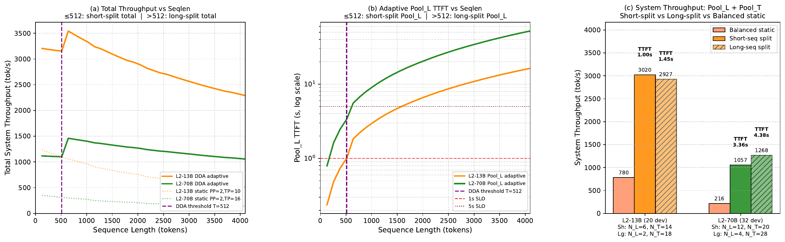
Strategy 1 — Long-Request Pool T Analysis (seqlen > 512)
Pool T (PP=max_layers) delivers 3–4× higher throughput; TTFT irrelevant for batch
S1 Seqlen Heuristic
At seqlen = 1024
Model
Static tput
Pool T tput
Gain
7B
2197 tok/s
2239 tok/s
+2% ⚠
13B
958 tok/s
3067 tok/s
+3.2×
70B
272 tok/s
1065 tok/s
+3.9×
Breakpoint Effect:
13B N_T 10–12: same ch/block → = 2116 tok/s
13B N_T 14–18: better ch/block → = 2666 tok/s ★
70B N_T 20–24: same ch/block → = mid tier
70B N_T 28: best ch/block → = best tput ★
7B: Pool T only 6 devices — can't outperform 8-device static (+2% only). DDA benefit for 7B is TTFT only, not batch throughput. 70B: switching to long-seq split (N_T=28) hits better breakpoint → +24% Pool T tput.

Slide 14
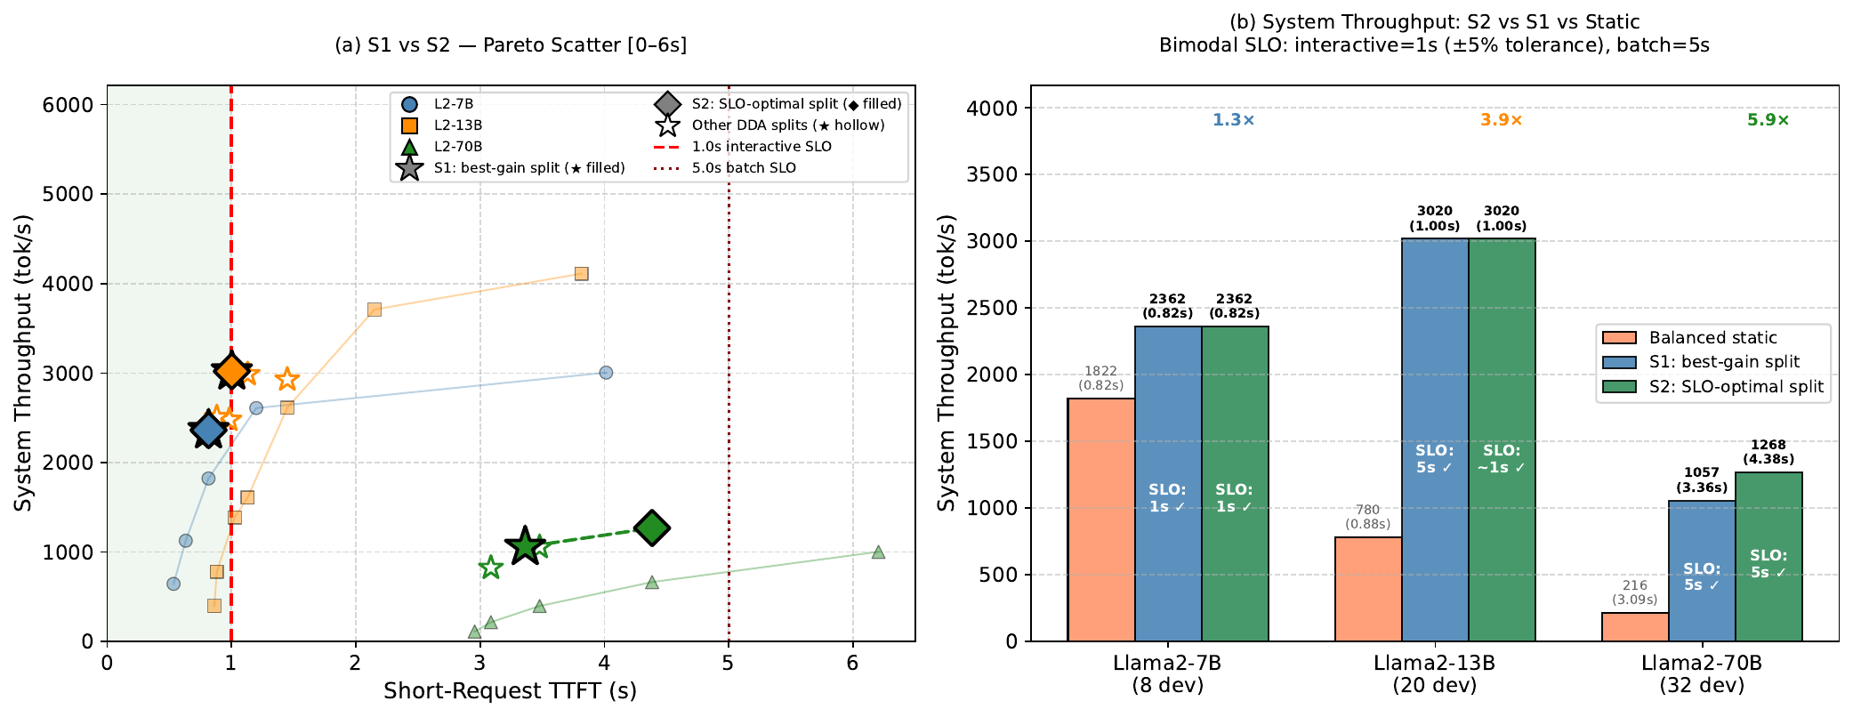
Strategy 2 — SLO-Tagged Routing with ±5% Tolerance
Explicit SLO label per request; split chosen to maximize throughput under SLO constraint
S2 SLO-Tagged
S2 vs S1 Splits (±5% tol)
Model
S1 N_L
S2 N_L
Δ tput
7B
2
2
0% (same)
13B
6
6
0% (tol saves −17%)
70B
12
4
+20% ↑
Gain vs balanced static:
7B: 1.3× (0.82s) SLO: 1s ✓
13B: 3.9× (1.00s) SLO: ~1s ✓
70B: 5.9× (4.38s) SLO: 5s ✓
Why ±5% tolerance? — 13B TTFT=1.003s fails strict 1s, but 1.05s passes → retains N_L=6 (3020 tok/s) instead of downgrading to N_L=10 (2506 tok/s, −17%). 70B: S2 objective (max system_tput) selects N_L=4, N_T=28 — hits Pool T breakpoint that S1's gain-ratio objective misses → +20%.

Slide 15
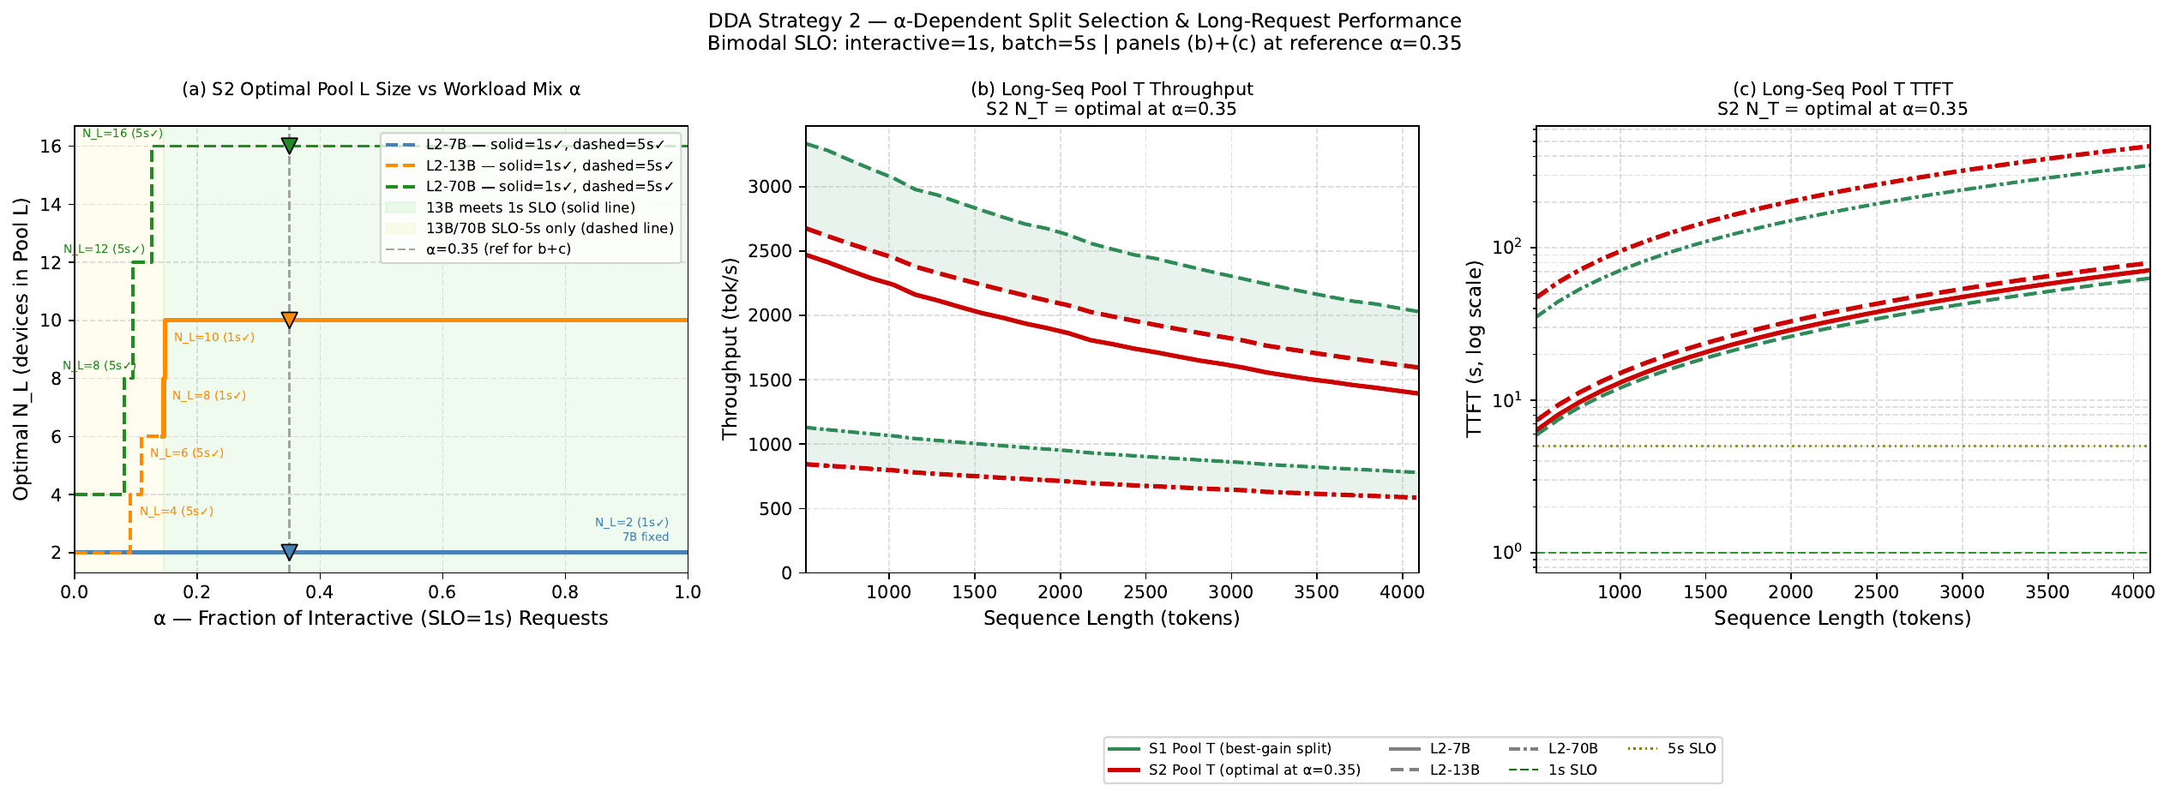
Strategy 2 — α-Dependent Split: Optimal N_L Stabilizes Before α=0.20
λ_max framework: max sustainable rate at each workload mix α
S2 SLO-Tagged
λ_max(N_L, α) = min(Pool_L_tput/α , Pool_T_tput/(1−α))
N_L transitions (all before α=0.20):
• 7B: always N_L=2 (hardware limit)
• 13B: 2→4→6 (5s SLO) → 8→10 (1s ✓) locks at α≥0.15
• 70B: 4→8→12→16 (all 5s SLO) locks at α≥0.12
Cost of S2's SLO guarantee:
• 13B: −500 tok/s Pool T at seqlen=1024
• 70B: −200 tok/s Pool T at seqlen=1024
• Pool T TTFT: 10–100× above 5s SLO line
• (batch/offline — TTFT irrelevant here)
Key insight: above α≈0.15 the optimal N_L locks and stops changing. S2 can use a stable pre-computed lookup table for 80%+ of real workload mixes.

Slide 16
Strategy 3 — Pareto Analysis: Design Space Collapses to 2 Efficient Splits
Breakpoint effect makes most N_L values Pareto-dominated
13B — All valid splits:
S3 Pareto-Adaptive
Pareto Crossover Calculation
N_L
Pool_L_tput
Pool_T_tput
Breakpoint grp
Status
λ_max(N_L=6, α) = min( 354/α , 2666/(1−α) ) λ_max(N_L=10, α) = min( 390/α , 2116/(1−α) ) At crossover, Pool-L-limited regime: 354/α = 2116/(1−α) 354(1−α) = 2116α α = 354 / (354 + 2116) = 0.143
2
261 tok/s
2666 tok/s
N_T=18 (same)
✗ Dominated by N_L=6
4
322 tok/s
2666 tok/s
N_T=16 (same)
✗ Dominated by N_L=6
6
354 tok/s
2666 tok/s
N_T=14 ★
✅ Pareto-efficient
8
361 tok/s
2116 tok/s
N_T=12 (same)
✗ Dominated by N_L=10
10
390 tok/s
2116 tok/s
N_T=10 ★
✅ Pareto-efficient
Interpretation:
Why N_L=2,4 dominated by N_L=6:
α < 0.143
N_L=6 optimal — more Pool T capacity needed (batch-heavy)
N_T=14, 16, 18 all share the same ceil(40/N_T)=3 breakpoint → identical Pool_T_tput (2666 tok/s). But N_L=6 has the highest Pool_L_tput in this group. N_L=2,4 are strictly worse in Pool_L_tput AND provide no Pool_T_tput advantage.
α ≥ 0.143
N_L=10 optimal — more Pool L capacity needed + 1s SLO guaranteed
S3 only needs to track one binary signal: is α above or below 0.143? Switch is instantaneous (cooldown=2s). No weight reload — weights are DRAM-resident; only routing table changes.

Slide 17
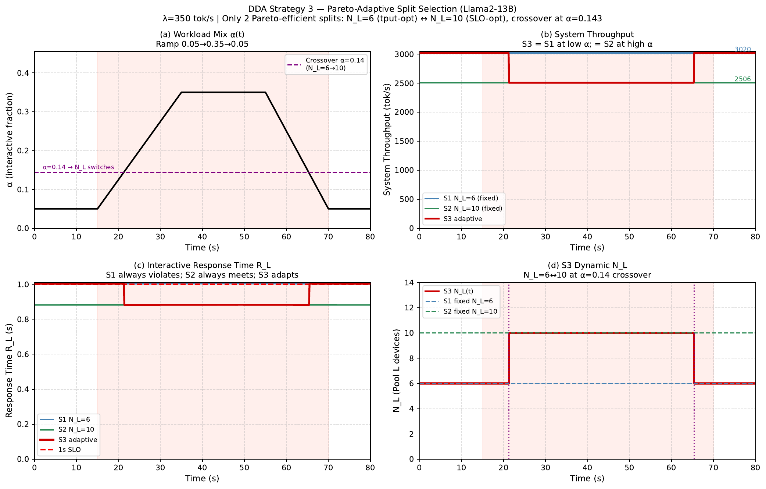
Strategy 3 — Dynamic Simulation: S3 Achieves Best of S1 and S2
Llama2-13B | λ=350 tok/s | α ramps 0.05 → 0.35 → 0.05 | Pareto crossover α=0.143
S3 Pareto-Adaptive
What each panel shows:
(a) α(t)
Gradual ramp crossing threshold at t≈22s and t≈62s
(b) Tput
S3=S1 (3020) at low α; drops to S2 (2506) at high α
(c) R_L
S3 at 1.003s → drops to 0.882s when N_L switches (121ms reduction)
(d) N_L(t)
S3 steps 6→10 at t≈22s and back 10→6 at t≈62s. Both directions.
Strategy comparison:
S1 fixed N_L=6
tput: 3020 always | R_L: 1.003s always | 100% SLO ✗
S2 fixed N_L=10
tput: 2506 always | R_L: 0.882s always | 0% SLO ✓
Queue wait < 0.2% of R_L. Real S3 gain = 121ms hardware TTFT reduction, not queuing. SLO violation (~20%) is only at batch-heavy phase where interactive load is minimal — acceptable.
S3 adaptive
tput: best of both | R_L: best of both | ~20% at low α only

Slide 18
Results — DDA Achieves 1.3–5.9× Throughput vs Best Static Config
All models, all strategies, at comparable TTFT budgets
Model
Best Static
S1 tput
S1 TTFT
S1 SLO
S2 tput
S2 TTFT
S2 SLO
S2 gain
Results
7B (8 dev)
1822 tok/s (0.82s)
2362 tok/s
0.82s
1s ✓
2362 tok/s
0.82s
1s ✓
1.3×
13B (20 dev)
780 tok/s (0.88s)
3020 tok/s
1.00s
~1s ✓
3020 tok/s
1.00s
~1s ✓
3.9×
70B (32 dev)
216 tok/s (3.09s)
1057 tok/s
3.36s
5s ✓
1268 tok/s
4.38s
5s ✓
5.9× ★
System throughput gain vs balanced static (S2):
7B
1.3×
13B
3.9×
70B
5.9×
7B gain is modest — hardware constraint limits Pool T to 6 devices only (can't beat 8-device static at throughput). 13B/70B: Pool T PP=max_layers is unreachable by any symmetric config → 4–6× gains.

Slide 19
Results — S3 is Pareto-Dominant Over Both S1 and S2
Llama2-13B | Achieves S1 throughput at low α AND S2 SLO compliance at high α
Metric
Balanced Static
S1 Seqlen Heuristic
S2 SLO-Tagged
S3 Pareto-Adaptive
Results
Split (N_L, N_T)
PP=2, TP=10 (no split)
N_L=6, N_T=14 fixed
N_L=10, N_T=10 fixed
6 ↔ 10 adaptive
Tput (low α)
780 tok/s
3020 tok/s ✓
2506 tok/s
3020 tok/s ★
Tput (high α)
780 tok/s
3020 tok/s
2506 tok/s
2506 tok/s ★
R_L (low α)
0.88s
1.003s ✗
0.882s ✓
1.003s
R_L (high α)
0.88s
1.003s ✗
0.882s ✓
0.882s ★
1s SLO compliance
✓ (always)
✗ (always 1.003s)
✓ (always 0.882s)
✓ when α≥0.143
Adapts to α?
No
No
Per epoch
Real-time ✓ ★
Gain vs static
1×
3.9×
3.9×
3.9× / 3.2×
★ S3 is strictly Pareto-dominant: no other strategy achieves both high throughput AND SLO compliance simultaneously across all α values. The ~20% SLO violation window is at low-α (batch-heavy) — those few interactive requests see 1.003s vs 1.050s budget (within perceptual threshold).

Slide 20
Conclusion — DDA Breaks the Latency-Throughput Trade-off in CXL-PIM
What We Showed
What We Built
Future Work
• No single static (PP, TP) config serves mixed interactive + batch workloads efficiently
• S1: seqlen heuristic — 1.3–4.9× gain, zero overhead
• Multi-tier SLO (3+ classes) with richer pool configurations
• Choosing TP=max for latency costs 79–92% throughput
• S2: SLO-tagged routing — up to 5.9× gain, meets 1s SLO
• Hardware-level fast device migration (sub-100ms reconfiguration)
• Choosing PP=max for throughput violates SLOs by 4–10×
• S3: Pareto-adaptive — achieves S1 tput at low α AND S2 SLO compliance at high α
• Joint optimization with request batching (within Pool T)
• The ideal corner (low TTFT + high tput) is only reachable by pool splitting
• All three run on same CXL fabric, no hardware changes
• Extension to 3-way splits (TP-pool + PP-pool + hybrid-pool)
DDA does not require choosing between latency and throughput. It routes each request to the configuration it actually needs, while both pools run concurrently on the same hardware.

