Slide 1
💎Diamond Pricing💎
Aatreyi Dutt (24070243059)
Project: Python for Data Science
November 2024

Slide 2
💎 Introduction
The quality of a diamond is determined by its 4Cs - cut, clarity, color, and carat. While carat is calculated using the weight of the diamond, the first three Cs are categorical variables. To understand these variables and their relationship to the price of the diamond better, I will be using a diamond pricing dataset from Kaggle to map out the spread of values and their relationships with price. In order to calculate and visualise these results I will be using the following Python libraries:
Numpy
Pandas
Matplotlib
Seaborn

Slide 3
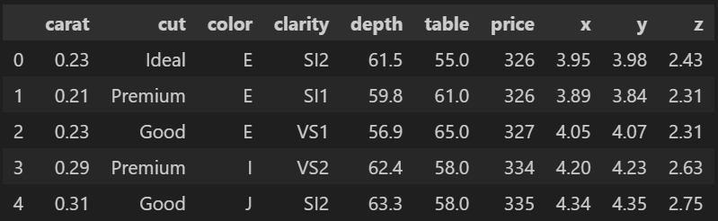
💎 Data

Slide 4
💎 Data Preprocessing
Null values for dimensional data: removed using:
data = data[(data != 0).all(axis=1)]
Categorical data (‘cut’, ‘color’, ‘clarity’):
Finding unique values: eg. data.cut.unique()
Manually label encoding for processing: (with 1 as worst)
data.cut = data.cut.replace(['Ideal','Premium', 'Very Good', 'Good', 'Fair'], [5,4,3,2,1])
data.color = data.color.replace(['D','E','F','G','H','I','J'],[7,6,5,4,3,2,1])
data.clarity = data.clarity.replace(['I1', 'SI2', 'SI1', 'VS2', 'VS1', 'VVS2', 'VVS1', 'IF'],[1,2,3,4,5,6,7,8])

Slide 5
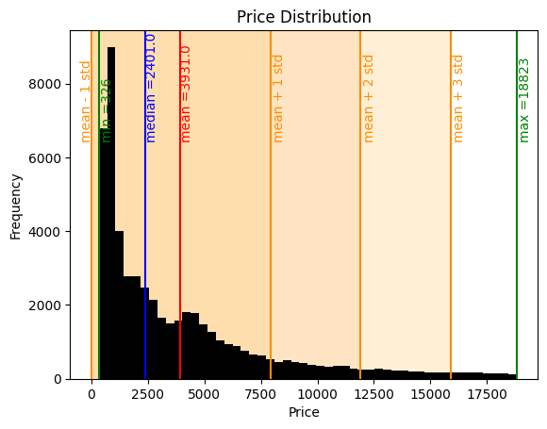
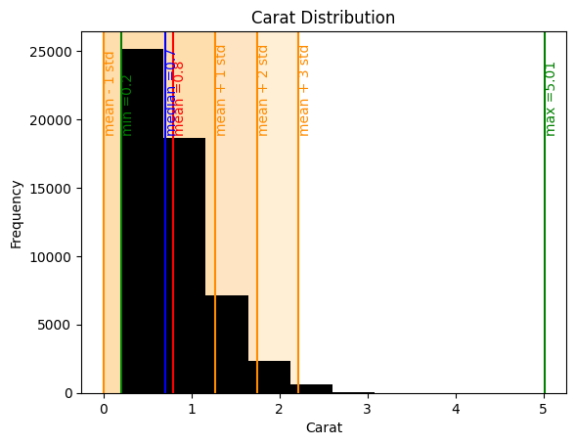
💎 Price, Carat
Price ranges from $326 to $18,823; Carat ranges from 0.2ct to 5.01ct.
For statistics: data.price.describe(), data.price.mean(), data.price.median()
For visualisation:
plt.hist()
plt.axvspan()
plt.axvline()
plt.text()
plt.plot()
plt.bar
plt.ylim()
.value_counts()
.reindex()

Slide 6
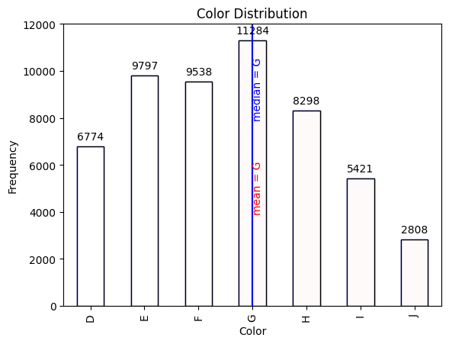
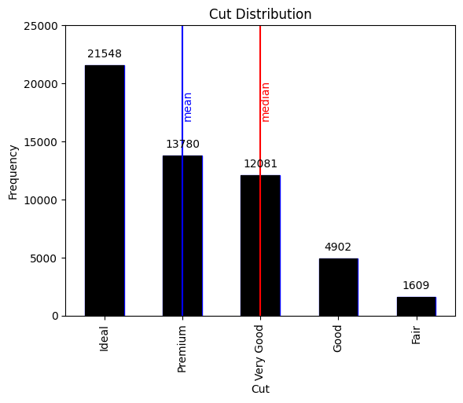
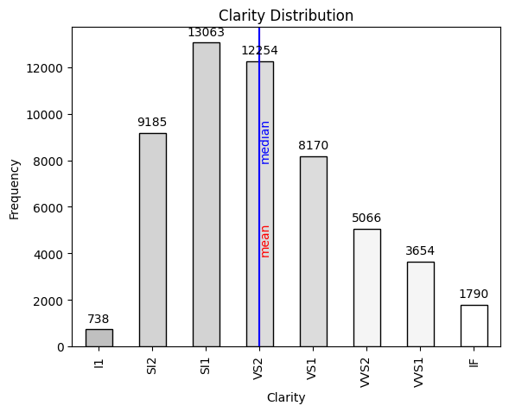
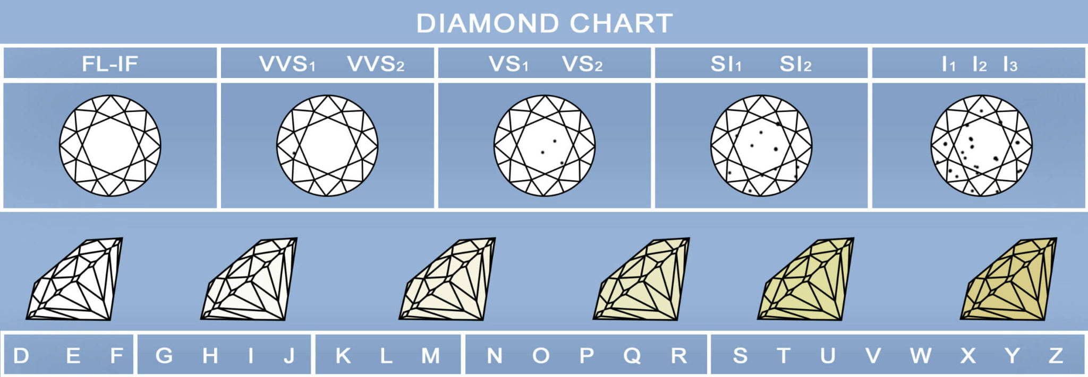
💎 Cut, Color, Clarity

Slide 7
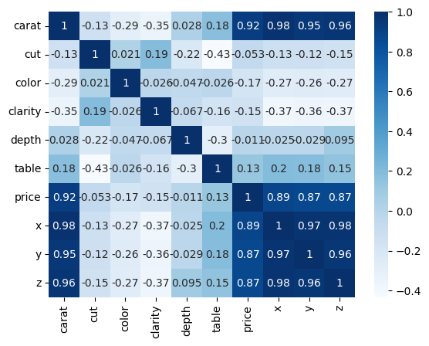
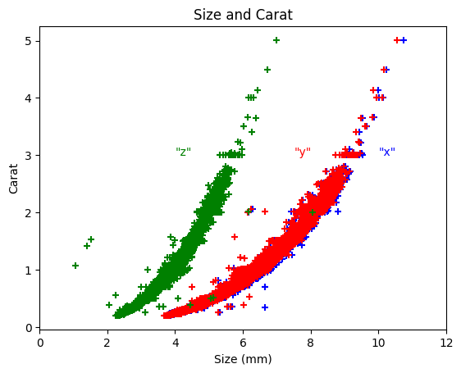
💎 Correlations
Correlations between variables using:
data.corr() & seaborn.heatmap()
Correlation: (x,y,z) & carat using:
plt.scatter()

Slide 8
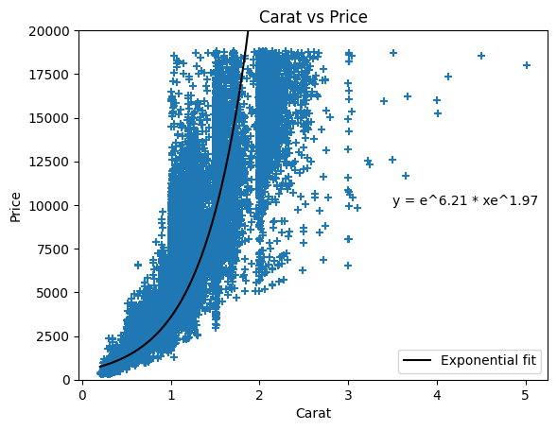
💎 Carat vs Price
Correlation between carat and price using:
plt.scatter()
Line of best fit made using:
np.log()
np.linspace()
np.polyfit()
np.exp()
Equation of line of best fit:
y=e^{6.21} * xe^{1.97}
where y = price ($), x = carat

Slide 9
💎 Future Work
With this understanding of the spread of values and the correlations between attributes in the dataset, future work can be carried out:
Design and test, train and validate a machine learning model based on price prediction
Feature engineering to improve prediction power
Optimize weightages of features in the prediction model according to their relationships with price

Slide 10
💎 Thank you 💎

