Slide 1




What is Data Structure?
Didih rizki chandranegara

Slide 2
Data Structure
Representation of the logical relationship existing between individual elements of data
Way of organizing all data items that considers not only the elements stored but also their relationship to each other
As a mathematical or logical model of a particular organization of data items
Defined as the way of storing and manipulating data in organized form so that it can be used efficiently

Slide 3
Data Structure
Data Structure mainly specifies the following four things
Organization of Data
Accessing methods
Degree of associativity
Processing alternatives for information

Slide 4
Data Structure
Data structure study covers the following points
Amount of memory require to store.
Amount of time require to process.
Representation of data in memory.
Operations performed on that data.

Slide 5
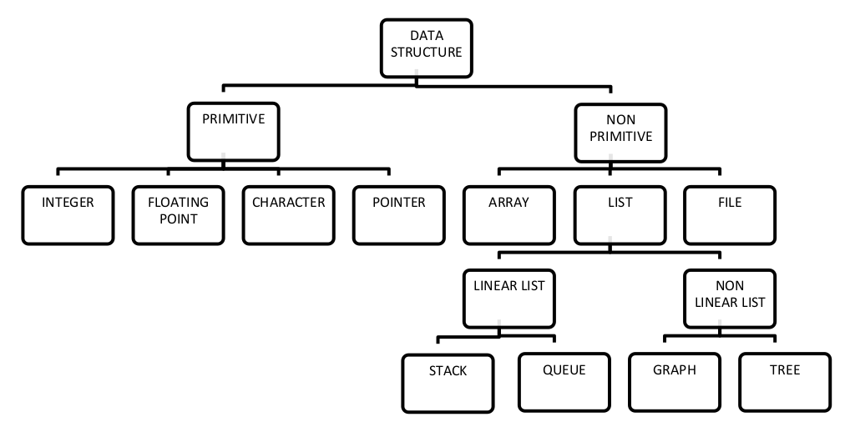
Classification of Data Structure

Slide 6
Primitive Data Structure
Basic data structures and directly operated upon by machine instructions
Has different representations on different computers
Integers, floats, character and pointers are examples of primitive data structures

Slide 7
Non-Primitive Data Structure
These are more sophisticated data structures
These are derived from primitive data structures
The non-primitive data structures emphasize on structuring of a group of homogeneous or heterogeneous data items
Examples of Non-primitive data type are Array, List, and File
A Non-primitive data type is further divided into Linear and Non-Linear data structure

Slide 8
Linear Data Structure
A data structure is said to be Linear, if its elements are connected in linear fashion by means of logically or in sequence memory locations
There are two ways to represent a linear data structure in memory, 1. Static memory allocation 2. Dynamic memory allocation
Examples of Linear Data Structure are Stack and Queue

Slide 9
Non-Linear Data Structure
Nonlinear data structures are those data structure in which data items are not arranged in a sequence
Examples of Non-linear Data Structure are Tree and Graph

Slide 10
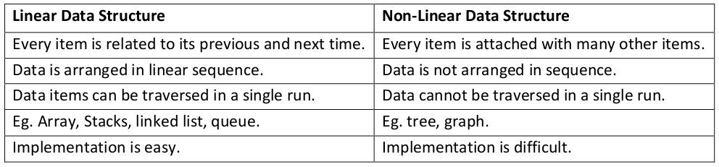
Linear vs Non-Linear Data Structure

Slide 11
Operation on Data Structure
1. Create
The create operation results in reserving memory for program elements. This can be done by declaration statement.
2. Destroy
Destroy operation destroys memory space allocated for specified data structure.
3. Selection
Selection operation deals with accessing a particular data within a data structure

Slide 12
Operation on Data Structure
4. Updating
It updates or modifies the data in the data structure.
5. Searching
It finds the presence of desired data item in the list of data items, it may also find the locations of all elements that satisfy certain conditions
6. Sorting
Sorting is a process of arranging all data items in a data structure in a particular order, say for example, either in ascending order or in descending order

Slide 13
Generics
Generics means parameterized types
The idea is to allow type (Integer, String, … etc., and user-defined types) to be a parameter to methods, classes, and interfaces.
Using Generics, it is possible to create classes that work with different data types.
An entity such as class, interface, or method that operates on a parameterized type is a generic entity.

Slide 14
Why Generics?
The Object is the superclass of all other classes, and Object reference can refer to any object. These features lack type safety. Generics add that type of safety feature.
Generics in Java are similar to templates in C++. For example, classes like HashSet, ArrayList, HashMap, etc., use generics very well. There are some fundamental differences between the two approaches to generic types.

Slide 15
Types of Java Generics
There are two: Generic Method & Generic Classes
Both types of generics use the same syntax, which includes the use of angle brackets and type parameters to specify the generic type or types. This provides a powerful tool for creating flexible and reusable code in Java.
Additionally, you can use bounded types to restrict the types that can be used with a generic class or method. You can also use wildcards to provide greater flexibility in the types that can be used with a generic class or method.

Slide 16
Generic Method
A generic method in Java is a method that can operate on different types of objects.
It allows you to create a method that can be used with different data types without the need to create multiple versions of the same method for each data type.
To define a generic method in Java, you use the angle bracket notation and the type parameter, which is represented by a single uppercase letter within the angle brackets. For example:

Slide 17
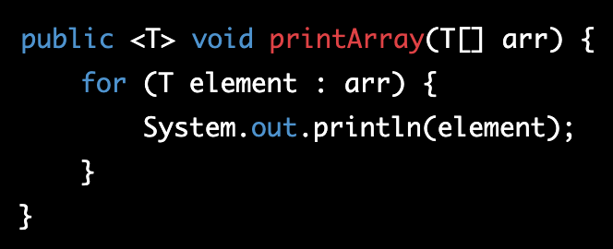
Generic Method
In the above example, the printArray() method is a generic method that takes an array of any type T and prints each element in the array. The T type parameter can be replaced with any valid Java data type, such as Integer, String, or Double, when the method is called.

Slide 18
Generic Method
Generic methods are commonly used with collections and data structures in Java, as they allow you to create methods that can operate on different types of collections without the need to create separate methods for each type of collection.
They also provide type safety, as the Java compiler checks that the types used in the method are compatible with each other.

Slide 19
Generic Classes
In Java, a generic class is a class that can work with different types of objects. It allows you to create a class that can be used with different data types without the need to create multiple versions of the same class for each data type.
To define a generic class in Java, you use the angle bracket notation and the type parameter, which is represented by a single uppercase letter within the angle brackets. For example:

Slide 20
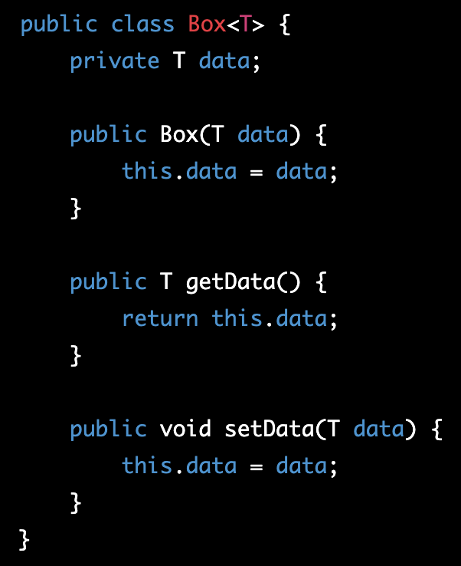
Generic Classes
In the example, the Box class is a generic class that can hold an object of any type T.
The T type parameter can be replaced with any valid Java data type, such as Integer, String, or Double, when an instance of the Box class is created.

Slide 21
Generic Functions
Generic classes are commonly used with collections and data structures in Java, as they allow you to create classes that can work with different types of collections without the need to create separate classes for each type of collection.
They also provide type safety, as the Java compiler checks that the types used in the class are compatible with each other.

Slide 22

Email
didihrizki@umm.ac.id (work)
diedieh02@gmail.com (personal)
Phone : 081349254787

