Slide 1

Project Group No: 29
VPKBIET, Baramati
Hand Gesture Controlled Wheelchair
Internet of Things
1. Rutik Andhalkar[Roll No : 2242082] [PRN No : 72027037F]
2. Prathamesh Shinde [Roll No : 2242069] [PRN No : 72027351L]
3. Aavesh Bagwan [Roll No : 2242088] [PRN no: 72027052K]
4. Dheeraj Shinde [Roll No : 2242022] [PRN no: 72027349J]
Project Guide: R.S.Piske

Slide 2
Index
Introduction
Origin of Problem Statement & Motivation
Literature Review
Objectives
Block Diagram
Methodology & Development Tools
Timeline
Work done till date
Plan for NEXT 6 Months
References

Slide 3
Introduction
In present in world there are around 1 billion people around 15% of the world’s population who are physically challenged and suffering from varies challenges in the daily life.
Hence it is extremely essential to build a system for them so that they can move by themselves without need of any other persons intervention and live more happily and flexibly and be self dependent for physical movement.
There are varies motion controlled wheelchairs present such as eye movement controlled wheelchair, joystick controlled wheelchair, voice controlled wheel chair, head motion controlled wheelchair, or even wheelchairs which are controlled by brain reading.
But most of them have certain issues, To overcome all that issues we found that using hand gesture controlled wheelchair can be very useful and convenient in all the condition for the operator/ patient.
In this by moving wrist of the hand of patient to the right, left, top, down, wheelchair can be moved accordingly to the right, left, forward, and backward respectively.

Slide 4
Origin of Problem Statement & Motivation
As we know if a person is physically challenged he or she needs some other person for their mobility and this results in the over dependency of the patient over there companion.
In this fast paced world everyone is busy in its own work due to this there are very few people in the world who can totally be with the patients all time and take care of them in order to bring independence in mobility of the patient we thought to design an automated wheelchair which can be controlled by the patient by itself through his/her hand gestures
In this wheelchair the automation is not isolated as the luxurious thing it is to be beneficial for all common people so, how to reduce the physical strength used by old age and handicapped people to operate the wheelchair is paramount aim.

Slide 5
Literature Review
Sr. No | Research Paper Title and Publication Details | Authors | Methodology | Results/Conclusion & Discussion
1 | “Wireless head gesture controlled wheelchair for disabled person.” IEEE humanitarian technology conference December 2017 | Shayban Nasif, MuhammedAbdul , Goffar khan | There is transmitter circuit at the head cap which detect motion of the head and then transmit it to the receiver and then receiver works accordingly. | Here they have demonstrated the wheelchair which can be controlled using head gesture, which is cost effective , wireless connection between the transmitter fitted on the head and the receiver makes it use very simple and comfortable.
2 | “Hand Gesture Based Wheelchair Movement Control for Disabled person Using MEMS”. Et al int. Journal of Engineering Research and application , 2014 | Prof Vishal V. Pande | At the transmitter circuit they have used MEMS Accelerometer sensor to sense the hand motion and and uses H Bridge driver at the receiver to control the movement of the motor. | They have build hand gesture controlled wheelchair using MEMS ACCELEROMETER SENSOR, which makes it user friendly than other technology.

Slide 6
Sr. No | Research Paper Title and Publication Details | Authors | Methodology | Results/Conclusion & Discussion
3. | “Hand gesture controlled wheelchair” international journal of scientific and technology research volume 5, issue 04, April 2016. | Pushpendra jha. | Here they have used permanent magnet DC motor at he receiver circuit with ADXL sensor at the receiver | They have build the hand gesture controlled wheelchair which can carr y 110kg of weigtht.
4. | Design of a low cost hand gesture controlled automated wheelchair.” IEEE Region 10 Symposium, june 2020. | Mufrath, Mahmood, Md.Fahim Rizwan, Masuma Sultana | MPU6050 as sensor at the transmitter along with GPS enabled feature | This proposed prototype wheelchair is an automated wheelchair uses hand gesture to control movement
5 | “Hand Gesture Controlled Wheelchair” IRJET International Research Journal of Engineeirng and technology Volume -07 Issue- 07 July 2020. | Krunal Bansod, kushal Asarkar, Mandar topre, vikrant raj | Along with all the transmitter and receiver circuit, they have implemented emergency switch with ultrasonic sensor as well. | The Wheelchair s fully automated and reduces the effort and the physical strength of the disabled person, if anyone have its own wheelchair then automation can be implemented in it also.

Slide 7
Objectives
To make physically challenged people independent for there mobility
To demonstrate cost efficient and user friendly solution for problem
To reduce the efforts of disabled person.

Slide 8
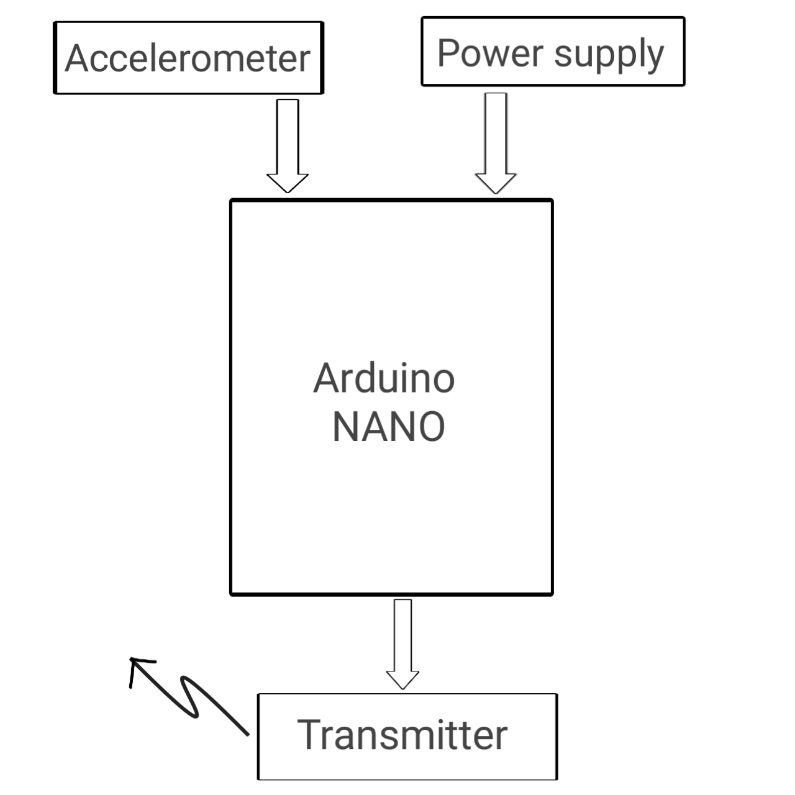
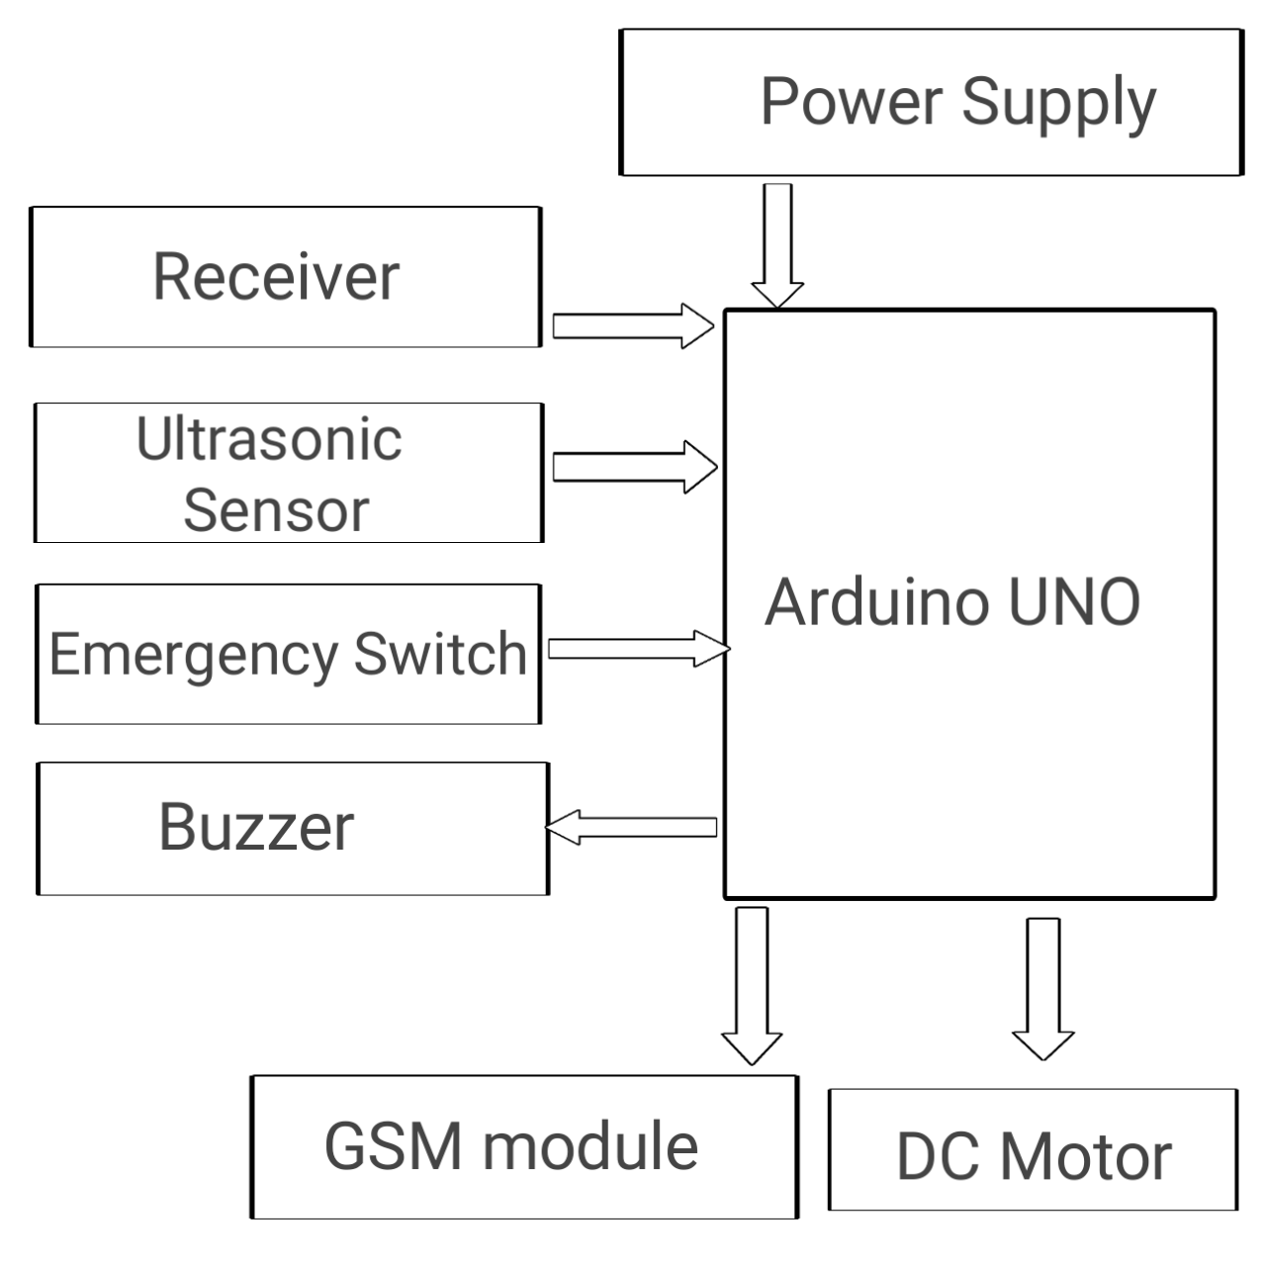
Block Diagram

Slide 9
Methodology & Development Tools
As patient moves there hand it is detected by the sensor present at the transmitter circuit it is accelerometer sensor who do it all, but this signal is analog which is then fed into the analog pin of the Arduino NANO and analog to digital converter present in the Arduino NANO converters it to the digital signal and then process it then after this by encoding the signal it is transmitted toward receiver circuit present at the wheelchair through the transmitter
Now at the receiver side decoder decodes the signal and then fed into the Arduino UNO similiarly there are two more inputs for the Arduino UNO present one is ultrasonic sensor and second one is emergency switch(button). If there is a obstacle present then it is detected by the ultrasonic sensor and fed to the Arduino UNO and then Arduino UNO stop the wheelchair accordingly.
And if there is any emergency then patient will press emergency switch(button) which is essentially a button after that through Arduino UNO, GSM module will be send message to the companion of the patient.

Slide 10
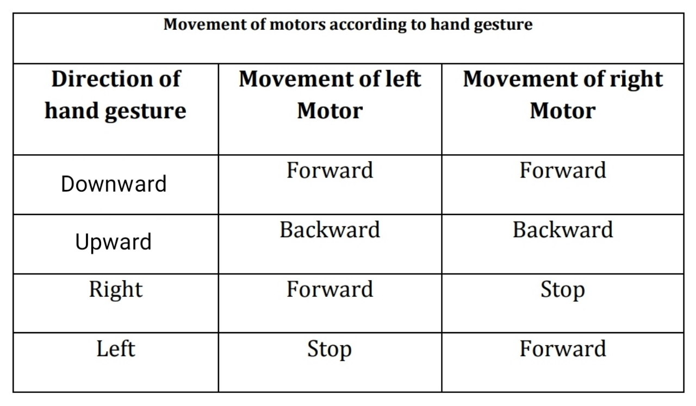
Here we have used two motors for turning and the stability of the system both are dc motors and controlled by the Arduino UNO at the receiver circuit and we have used the motor driver circuit.

Slide 11
Development Tools
Software
Arduino IDE
Hardware
Arduino NANO
Arduino UNO
Accelerometer sensor
DC Motor and Motor Driver
Batteries
Ultrasonic sensor
Transmitter and receiver module
GSM module

Slide 12
Timeline
Activity | Aug 22 | Sept 22 | Oct 22 | Nov23 | Dec23 | jan 23
Literature Review and Study | Done
Collecting all the hardware required and testing them for the project. |  | Done
Build a transmitter circuit of the project with all the programming of the microcontroller |  |  | _
Build the receiver circuit with connecting motors and check its compatibility with transmitter circuit |  |  |  | _
Build a comfortable structure and design of the wheelchair |  |  |  |  | _
Final Write-up & Thesis Submission |  |  |  |  |  | _

Slide 13
Work done till date
Plan for NEXT 6 Months
Time | Activity
Oct 2022 | Build a transmitter circuit.
Nov 2022 | Build the receiver circuit
Dec 2022 | Testing and programming of both circuits
Jan 2023 | Interfacing both circuits
Feb 2023 | Build a design of the wheelchair
March 2023 | Final Write-up & Thesis Submission
Literature Review and Study
Collecting all the hardware required and testing them for the project

Slide 14
References
World Report on Disability, World Health Organisation 2011
Shayban Nasif, Muhammed Abdul Goffar khan “Wireless head gesture controlled wheelchair for disabled person.” IEEE humanitarian technology conference December 2017.
Pushpendra jha “Hand gesture controlled wheelchair” international journal of scientific and technology research volume 5, issue 04, April 2016.
Prof Vishal V. Pande “Hand Gesture Based Wheelchair Movement Control for Disabled person Using MEMS”. Et al int. Journal of Engineering Research and application Vol4, issue 4(Version 4). April 2014.
Kunal Bansod, kushal Asarkar, Mandar topre, vikrant raj “Hand Gesture Controlled Wheelchair” IRJET International Research Journal of Engineeirng and technology Volume -07 Issue- 07 July 2020.
Mufrath Mahmood, Md.Fahim Rizwan, Masuma Sultana “Design of a low cost hand gesture controlled automated wheelchair.” IEEE Region 10 Symposium, june 2020.

Slide 15
Thank you

