Slide 1

Project Group No: 29
VPKBIET, Baramati
Hand Gesture Controlled Wheelchair
Internet of Things
1. Rutik Andhalkar[Roll No : 2242082] [PRN No : 72027037F]
2. Prathamesh Shinde [Roll No : 2242069] [PRN No : 72027351L]
3. Aavesh Mansur Bagwan [Roll No : 2242088] [PRN no: 72027052k]
4. Dheeraj Shinde [Roll No : 2242022] [PRN no: 72027349J]
Project Guide: R.S.Piske

Slide 2
Index
Introduction
Origin of Problem Statement & Motivation
Literature Review
Objectives
Block Diagram
Methodology & Development Tools
Timeline
Work done till date
Plan for NEXT 6 Months
References

Slide 3
Introduction
In present in world there are around 1 billion people around 15% of the world’s population who are physically challenged and suffering from varies challenges in the daily life.
Hence it is extremely essential to build a system for them so that they can move by themselves without need of any other persons intervention and live more happily and flexibly and be self dependent for physical movement.
There are varies motion controlled wheelchairs present such as eye movement controlled wheelchair, joystick controlled wheelchair, voice controlled wheel chair, head motion controlled wheelchair, or even wheelchairs which are controlled by brain reading.
But most of them have certain issues, To overcome all that issues we found that using hand gesture controlled wheelchair can be very useful and convenient in all the condition for the operator/ patient.
In this by moving wrist of the hand of patient to the right, left, top, down, wheelchair can be moved accordingly to the right, left, forward, and backward respectively.

Slide 4
Origin of Problem Statement & Motivation
As we know if a person is physically challenged he or she needs some other person for their mobility and this results in the over dependency of the patient over there companion. In this fast paced world everyone is busy in its own work due to this there are very few people in the world who can totally be with the patients all time and take care of them in order to bring independence in mobility of the patient we thought to design an automated wheelchair which can be controlled by the patient by itself through his/her hand gestures in this wheelchair the automation is not isolated as the luxurious thing it is to be beneficial for all common people so, how to reduce the physical strength used by old age and handicapped people to operate the wheelchair is paramount aim.

Slide 5
Literature Review
Sr. No | Research Paper Title and Publication Details | Authors | Methodology | Results/Conclusion & Discussion
1 | “Wireless head gesture controlled wheelchair for disabled person.” IEEE humanitarian technology conference December 2017 | Shayban Nasif, MuhammedAbdul , Goffar khan
2 | “Hand Gesture Based Wheelchair Movement Control for Disabled person Using MEMS”. Et al int. Journal of Engineering Research and application , 2014 | Prof Vishal V. Pande

Slide 6
Sr. No | Research Paper Title and Publication Details | Authors | Methodology | Results/Conclusion & Discussion
3. | “Hand gesture controlled wheelchair” international journal of scientific and technology research volume 5, issue 04, April 2016. | Pushpendra jha.
4. | Design of a low cost hand gesture controlled automated wheelchair.” IEEE Region 10 Symposium, june 2020. | Mufrath, Mahmood, Md.Fahim Rizwan, Masuma Sultana
5 | “Hand Gesture Controlled Wheelchair” IRJET International Research Journal of Engineeirng and technology Volume -07 Issue- 07 July 2020. | Kunal Bansod, kushal Asarkar, Mandar topre, vikrant raj

Slide 7
Objectives
To make physically challenged people independent for there mobility
To demonstrate cost efficient and user friendly solution for problem
To reduce the efforts of disabled person.

Slide 8
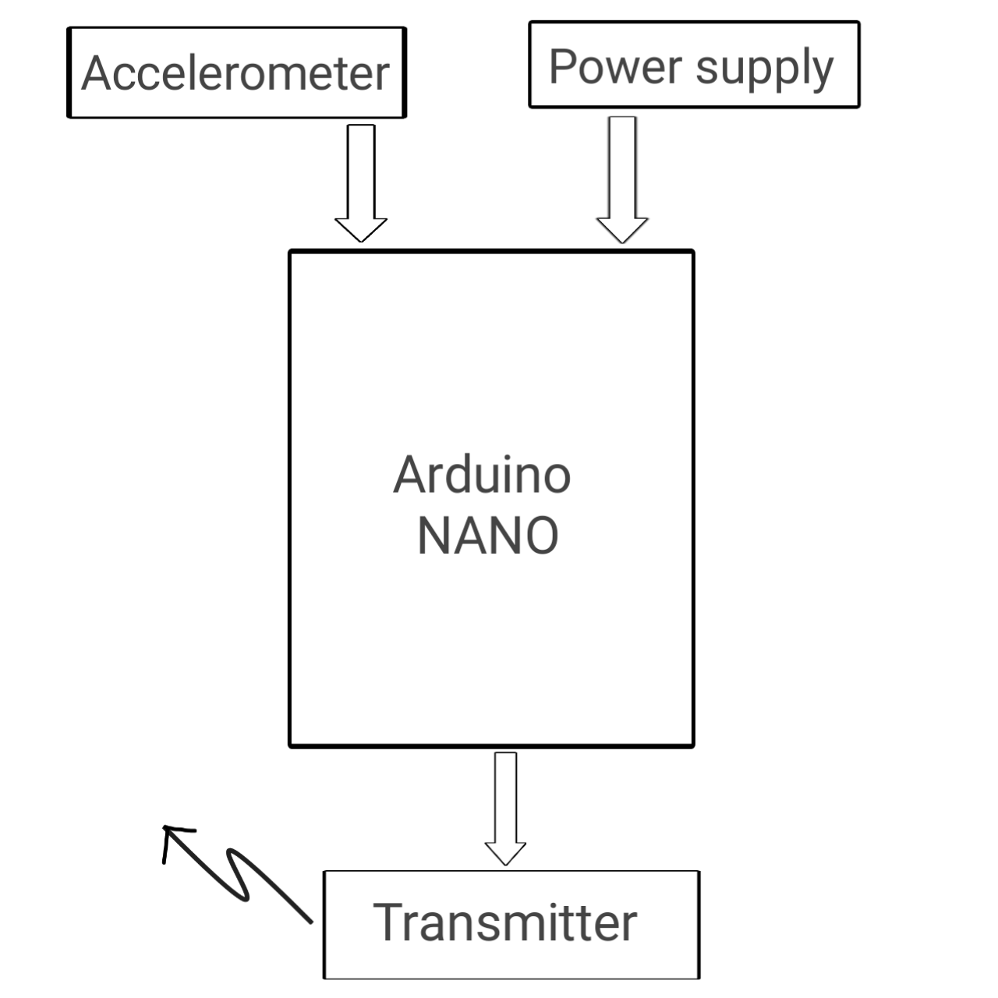
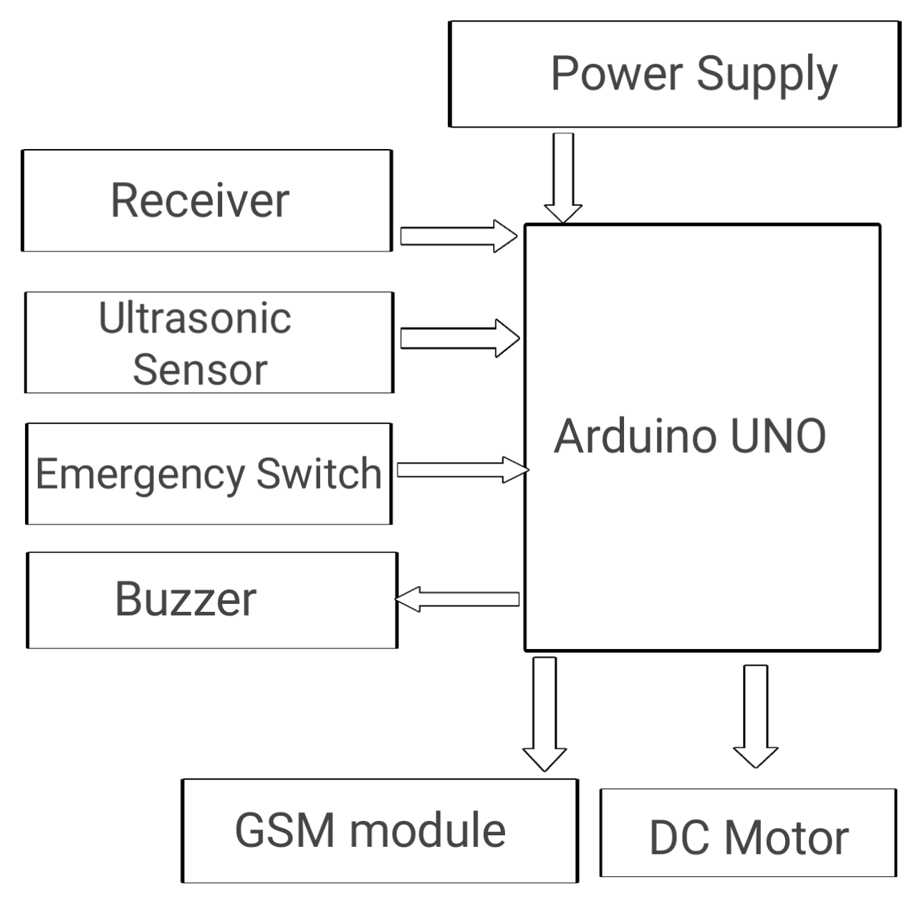
Block Diagram

Slide 9
Methodology & Development Tools
As patient moves there hand it is detected by the sensor present at the transmitter circuit it is accelerometer sensor who do it all, but this signal is analog which is then fed into the analog pin of the Arduino NANO and analog to digital converter present in the Arduino NANO converters it to the digital signal and then process it then after this by encoding the signal it is transmitted toward receiver circuit present at the wheelchair through the transmitter
Now at the receiver side decoder decodes the signal and then fed into the Arduino UNO similiarly there are two more inputs for the Arduino UNO present one is ultrasonic sensor and second one is emergency switch(button). If there is a obstacle present then it is detected by the ultrasonic sensor and fed to the Arduino UNO and then Arduino UNO stop the wheelchair accordingly and if there is any emergency then patient will press emergency switch(button) which is essentially a button after that through Arduino UNO, GSM module will be send message to the companion of the patient.

Slide 10
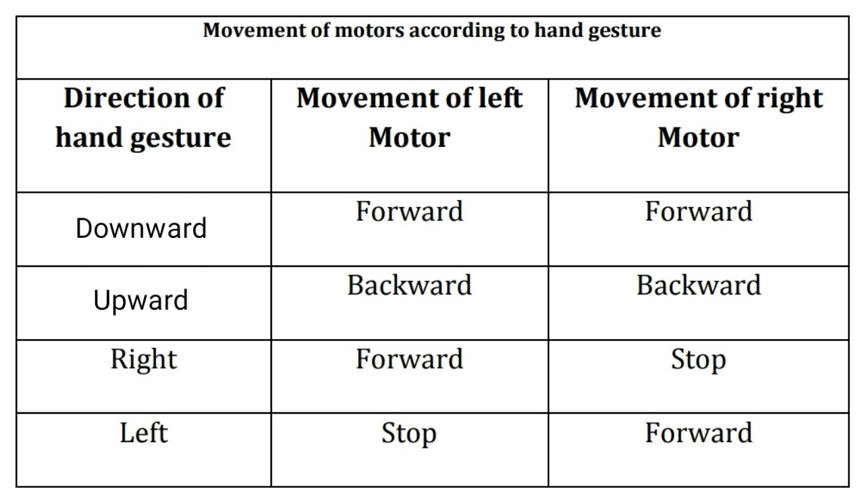
Here we have used two motors for turning and the stability of the system both are dc motors and controlled by the Arduino UNO at the receiver circuit and we have also used the motor driver circuit.

Slide 11
Timeline
Activity | Aug 21 | Sept 21 | Nov 21 | Jan 22 | Feb22 | March 22
Literature Review and Study | Done
Collecting all the hardware required and testing them for the project. |  | Done
Build a transmitter circuit of the project with all the programming of the microcontroller |  |  | _
Build the receiver circuit with connecting motors and check its compatibility with transmitter circuit |  |  |  | _
Build a comfortable structure and design of the wheelchair |  |  |  |  | _
Final Write-up & Thesis Submission |  |  |  |  |  | _

Slide 12
Work done till date
Plan for NEXT 6 Months
Time | Activity
Oct 2021 | Build a transmitter circuit.
Nov 2021 | Build the receiver circuit
Dec 2021 | Testing and programming of both circuits
Jan 2022 | Interfacing both circuits
Feb 2022 | Build a design of the wheelchair
March 2022 | Final Write-up & Thesis Submission
Literature Review and Study
Collecting all the hardware required and testing them for the project

Slide 13
References
World Report on Disability, World Health Organisation 2011
Shayban Nasif, Muhammed Abdul Goffar khan “Wireless head gesture controlled wheelchair for disabled person.” IEEE humanitarian technology conference December 2017.
Pushpendra jha “Hand gesture controlled wheelchair” international journal of scientific and technology research volume 5, issue 04, April 2016.
Prof Vishal V. Pande “Hand Gesture Based Wheelchair Movement Control for Disabled person Using MEMS”. Et al int. Journal of Engineering Research and application Vol4, issue 4(Version 4). April 2014.
Kunal Bansod, kushal Asarkar, Mandar topre, vikrant raj “Hand Gesture Controlled Wheelchair” IRJET International Research Journal of Engineeirng and technology Volume -07 Issue- 07 July 2020.
Mufrath Mahmood, Md.Fahim Rizwan, Masuma Sultana “Design of a low cost hand gesture controlled automated wheelchair.” IEEE Region 10 Symposium, june 2020.

Slide 14
Thank you

