Slide 1
INTRUSION DETECTION
Dataset:
The dataset consist of intrusions simulated in a military network environment.
By modelling a typical US air force Lan, raw TCP/IP dump data for a network.
Lan was blasted with multiple attacks
TCP packets are data packets that flow from a source IP address to a target IP address under a well-defined protocol and start and terminate at a specific time interval.
Connection is labelled as either normal or as an attack with exactly one specific attack type

Slide 2
41 quantitative and qualitative features are obtained from normal and attack data (3 qualitative and 38 quantitative features)
Classes: Normal and anomaly.
Classifiers:
Naïve Baye Classifier
Decision Tree Classifier
Kneighbour Classifier
Logistic Regression Classifier

Slide 3
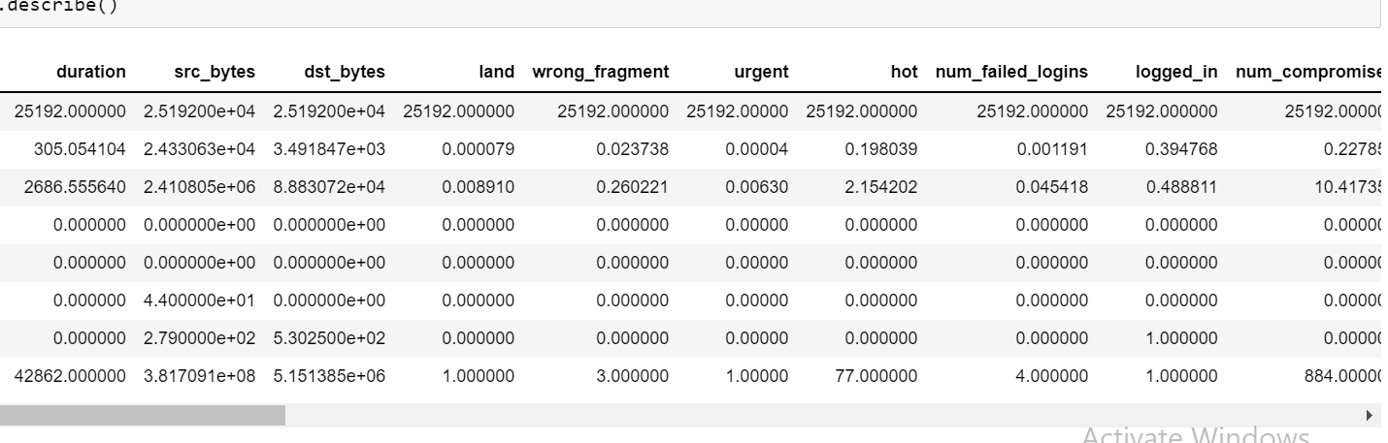
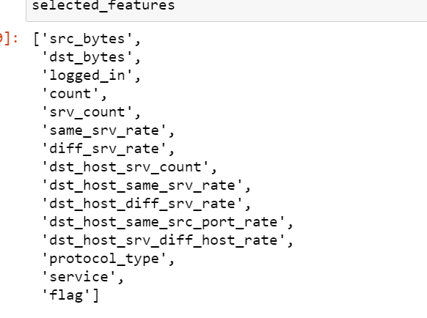
Features
Initially we have 40 features.
We selected 10 most important features.

Slide 4
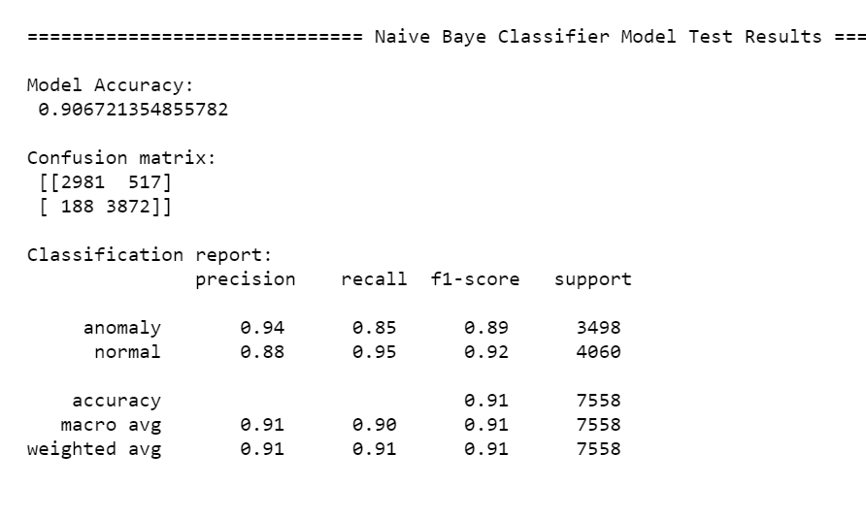
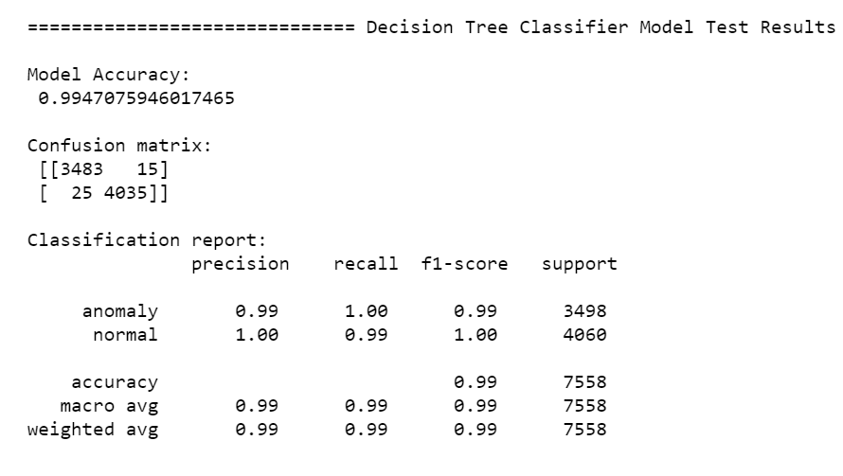
Test results
Test results on Naïve bayes classifier.
Test results for decision tree classifier. Achieved 99% accuracy.

Slide 5
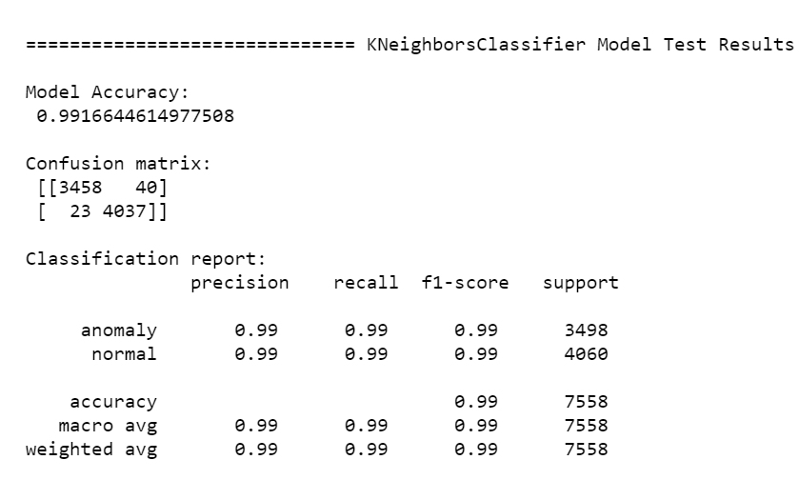
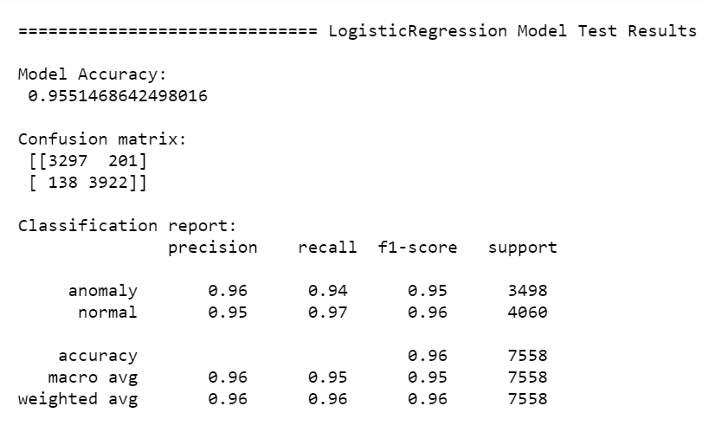
Test results for KneighborClassifier Model.
Test results for Logistic regression Model.

Slide 6
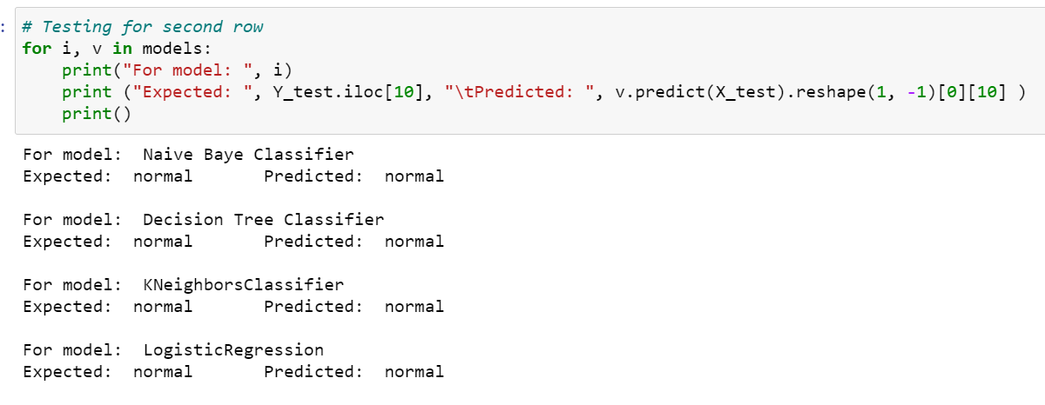
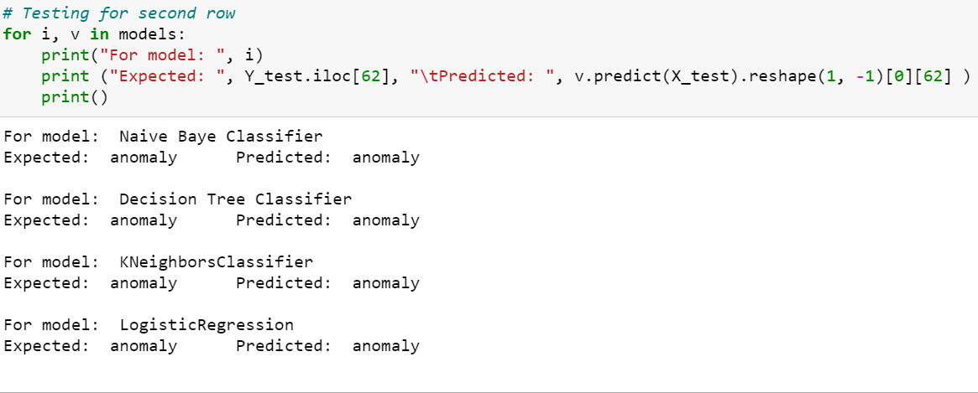
Checking on Different Test Inputs
For 10th input value from test set our all 4 models gave accurate results that is normal class.
For 62th input value from test set the expected is anomaly and all the models gave accurate results and detected the anomaly.

Slide 7
Consclusion
From this we concluded that all classifiers are working fine.
But from model accuracy we can conclude that Decision Tree Classifier and Knearest neighbor Classifier are best for detecting normal and anomaly in this case.
Future Work
We can also do more research in this domain and develop new machine learning and Deep architecture models like 1D cnn and 1D resnet models for intrusion detection.

