Slide 1
Comparative Evaluation of Vision-Based Finger Tracking for Piano Interaction
MediaPipe Hands vs OpenPose · BSc (Hons) Computing · Production Project 2026
Aayam Regmi · The British College / Leeds Beckett University · 2026

Slide 2
Introduction
Research context, aims and scope

Slide 3
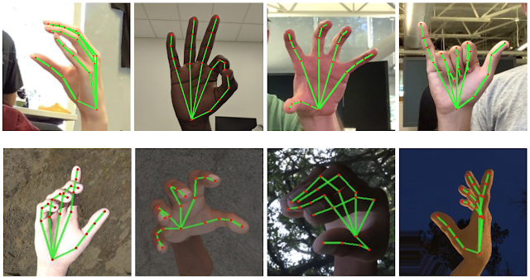
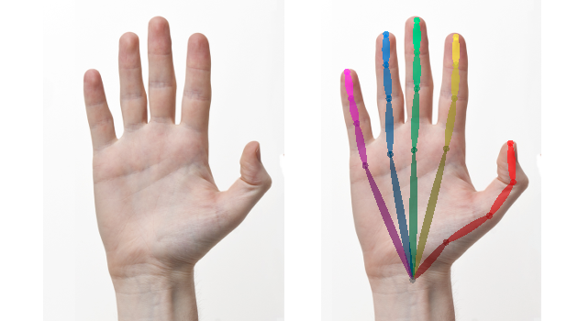
Introduction & Research Aims
MediaPipe Hands Zhang et al. (2020)
OpenPose Hands Cao et al. (2019)
• Evaluate vision-based hand tracking models for real-time piano performance monitoring
• Ground truth: MIDI signals from Casio CTK-2400 synchronized with overhead video
• Research question: Which model is better suited for a real-time piano tutor app?

Slide 4
Literature Review
Prior work in hand tracking & piano interaction

Slide 5
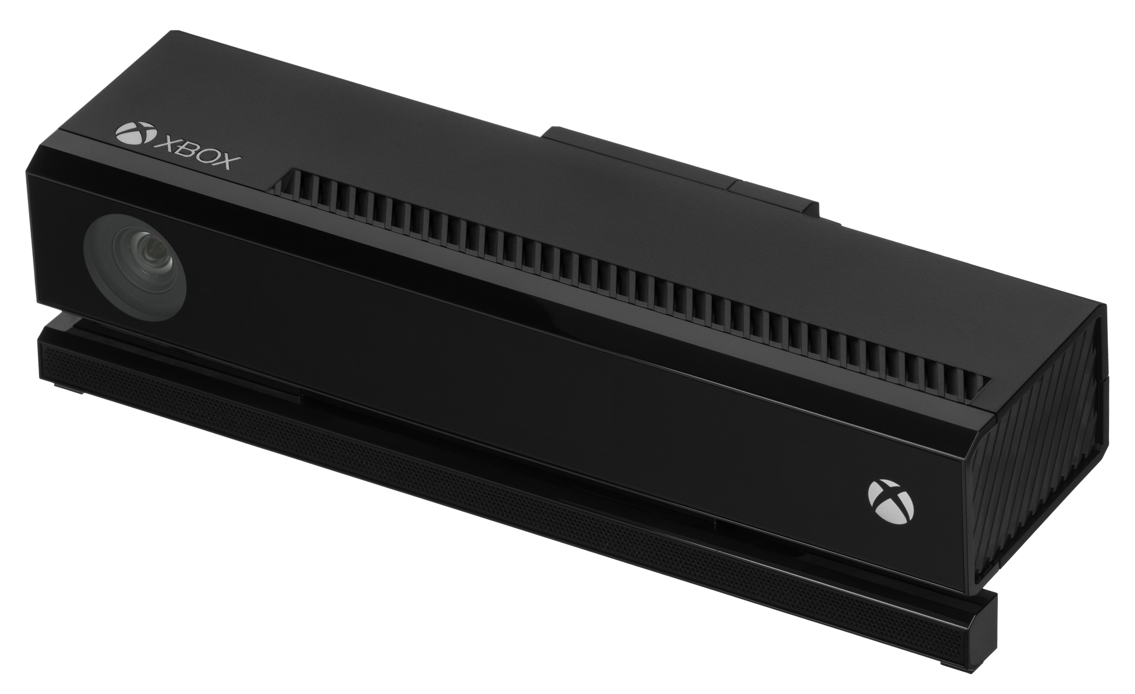
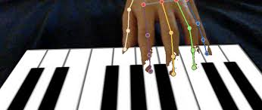
Literature Review
📷 Kinect depth sensor image placeholder
Han et al. (2013)
🎹 AR piano overlay on real keyboard
Hiranaka et al. (2022)
📷 Kinect depth sensor image placeholder
Han et al. (2013)
🎹 AR piano overlay on real keyboard
Hiranaka et al. (2022)
Kinect depth sensor -> Extra coding complexity 3D processing requirement
Molchanov et al. (2016): single-camera CNN landmark detection — no depth hardware needed
Liang et al. (2016): RGB-D virtual piano (>90% accuracy but requires depth camera)
Lugaresi et al. (2019): temporal smoothing reduces jitter but adds latency on fast movements
Pu et al. (2023): real-world occlusion & rapid motion reduce accuracy more than benchmarks

Slide 6
System Design
Data collection pipeline

Slide 7
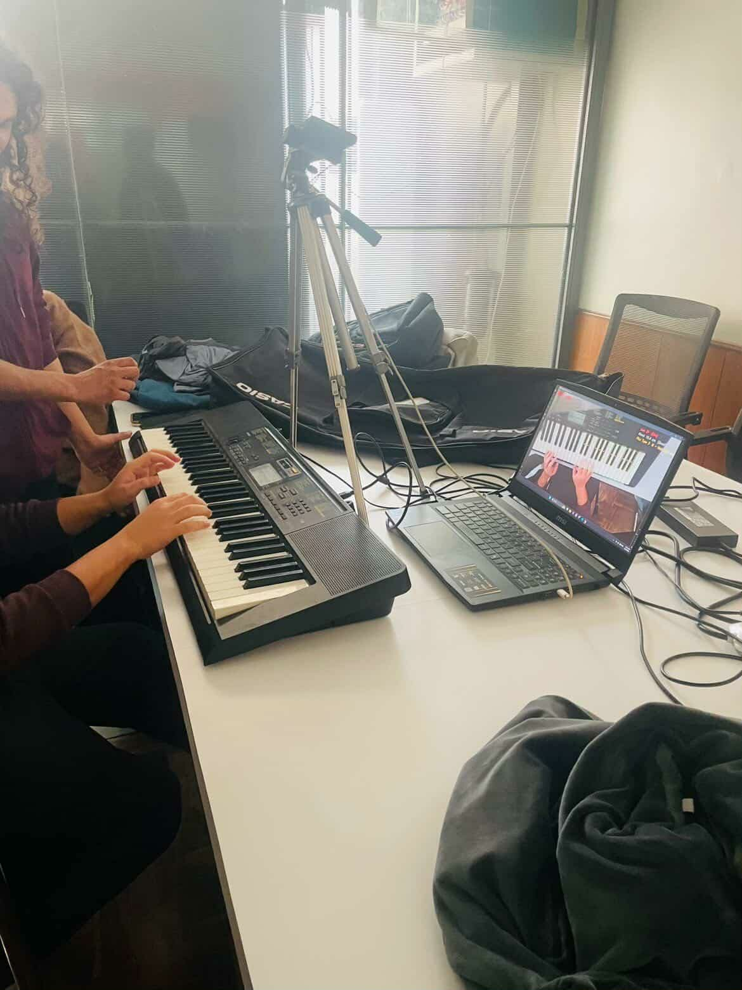
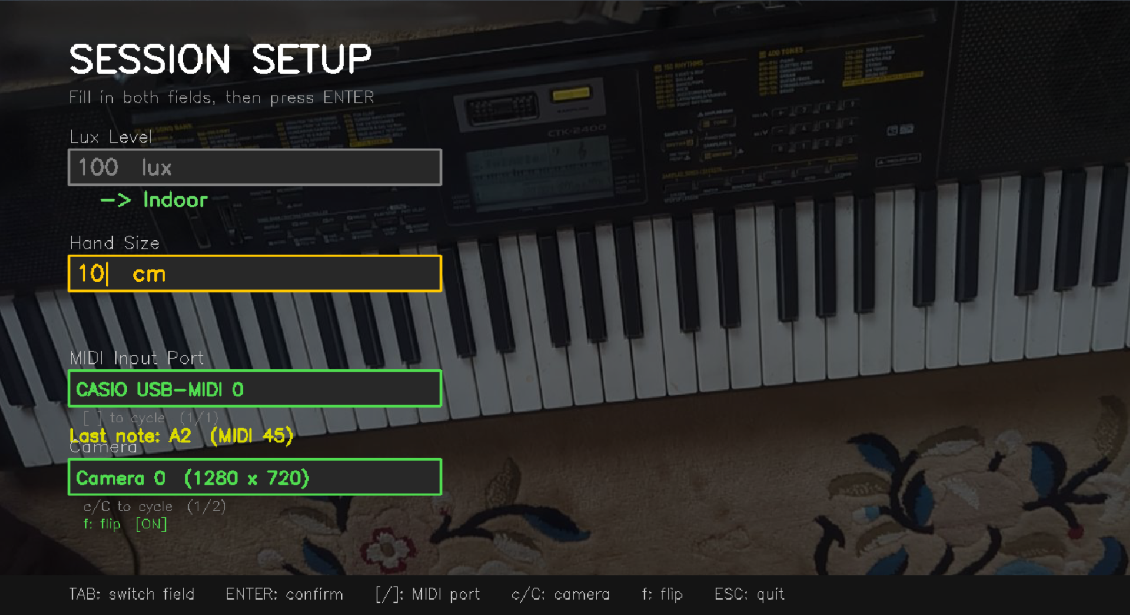
Data Collection Pipeline Overview
• SPACE-press sets shared rec_t0 → anchors video AND MIDI to same origin
• MIDI daemon thread polls every 1 ms · video at ~30 FPS
• Output per session: .mp4 _frames.csv _midi.jsonl _midi.mid _session.json
• No PII stored — participant identity is folder index p### only

Slide 8
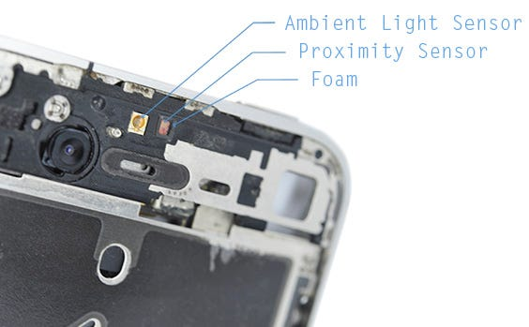
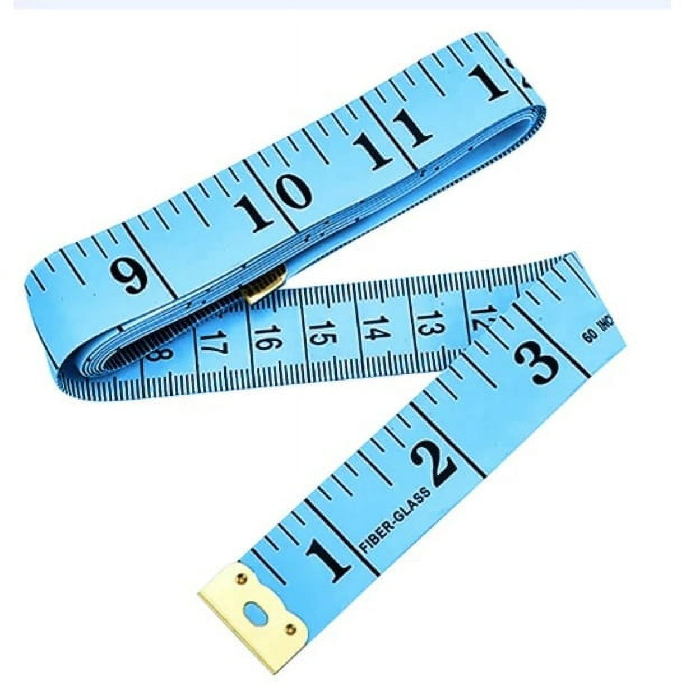
Participant & Environmental Characterisation
Fitzpatrick scale chart / diagram
Skin Tone (ITA method)
Lux meter phone app screenshot
Ambient Illuminance
Hand Size (cm) Tape measure on hand photograph
Skin Tone (ITA method) (Chardon et al., 1991)
Mobile phone Lux sensor
Hand Size (cm)

Slide 9
Implementation
MPJPE metric, polygon mask & MIDI–video sync

Slide 10
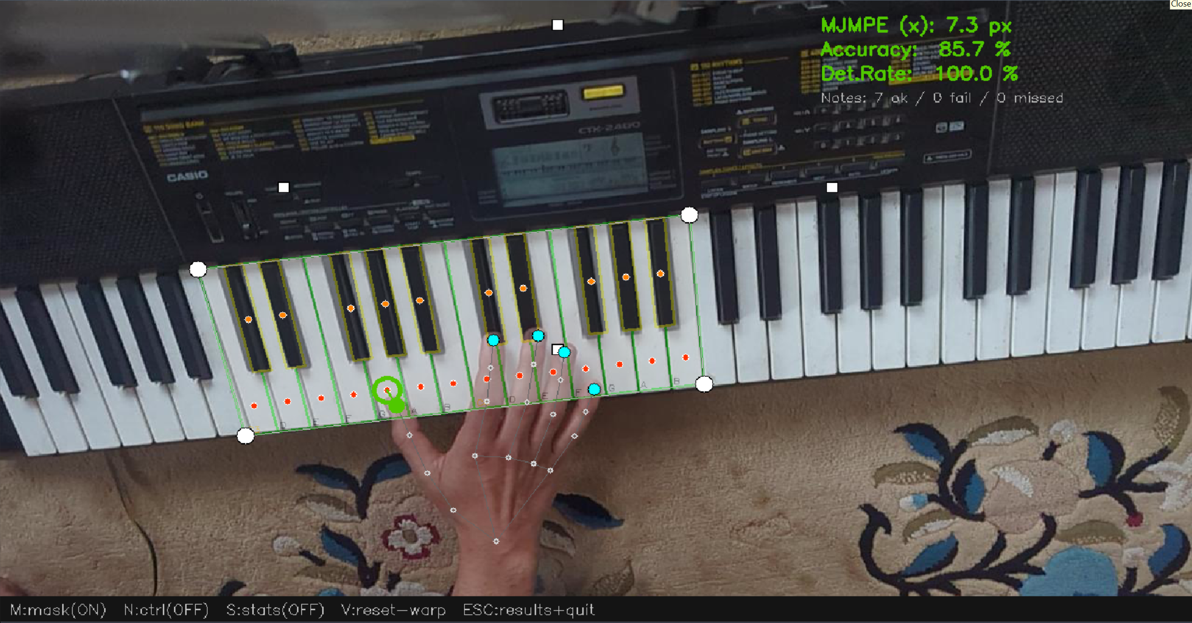
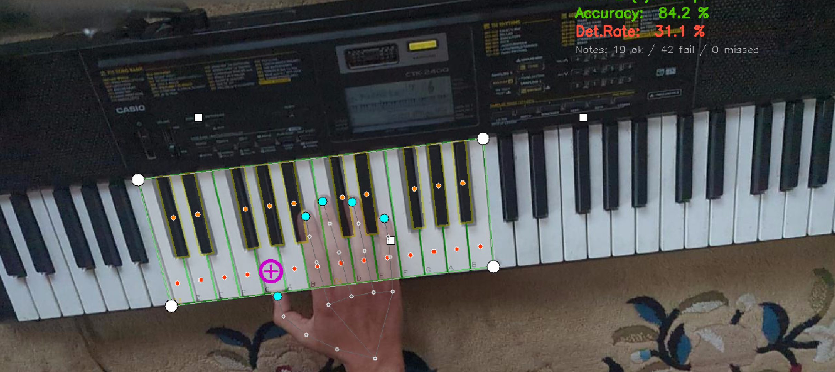
Polygon Hit rate using calibration mask
• Polygon containment: tip must lie INSIDE key boundary — 3 outcomes: matched / detection_fail / missed
• MPJPE accumulated only for matched events · detection_fail tracked separately
• Per-hand: L / R × fingers 0–4 · key assignment: key_cx relative to frame midpoint
Perspective homography transformation matrix calibration for polygon wrap Siddique et al. (2019)

Slide 11
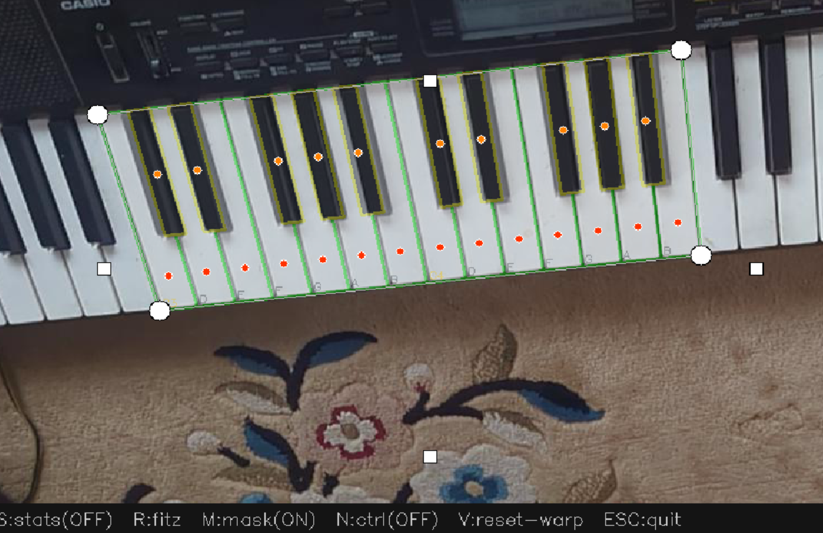
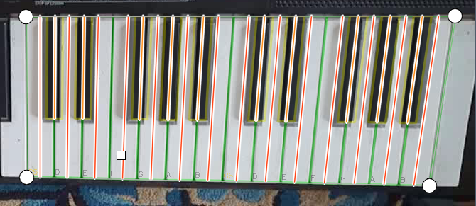
MPJPE: Metric Design & Bias Reduction
Horizontal error diagram h_err = |tip_x − key_cx|
2-D Euclidean → x-axis only · removes finger-length bias
• Horizontal-only: h_err = |tip_x − key_cx| — removes depth/angle bias entirely
For recording:
• Shared origin: rec_t0 = time.perf_counter() set at SPACE-press meaning MIDI signals and video data is aligned
• Sub-frame precision — no manual video labelling required
Before vs After horizontal only error

Slide 12
Results
Detection rate, MPJPE, skin tone, lighting & hand size

Slide 13
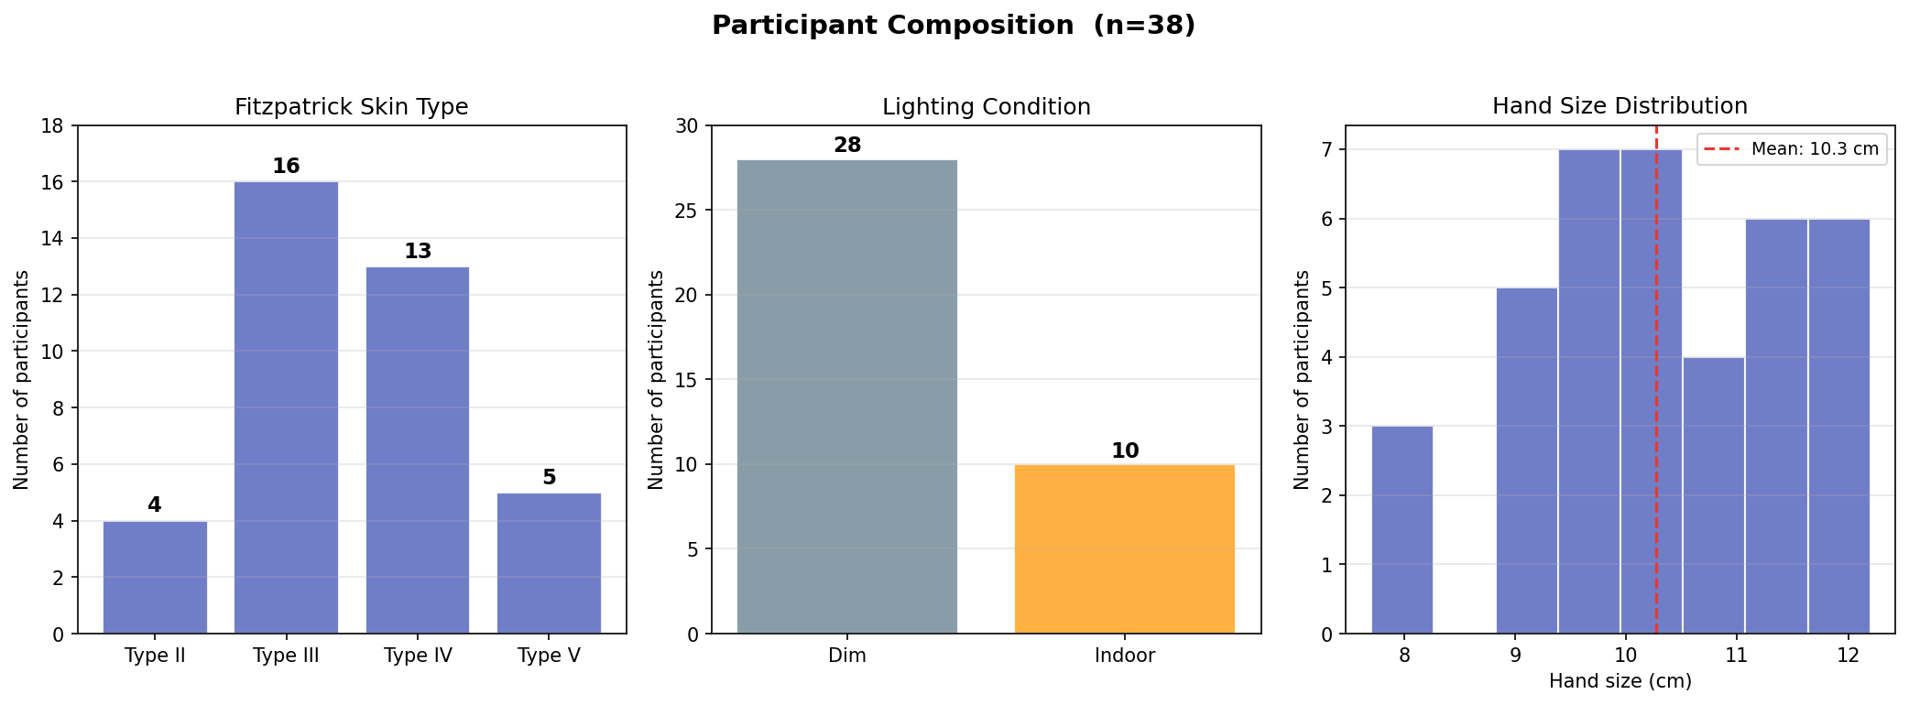
Dataset Overview
38 sessions · 4 777 note-on events · 89 560 video frames
Fitzpatrick types II–V · hand sizes 7.7–12.2 cm · dim & indoor lighting

Slide 14
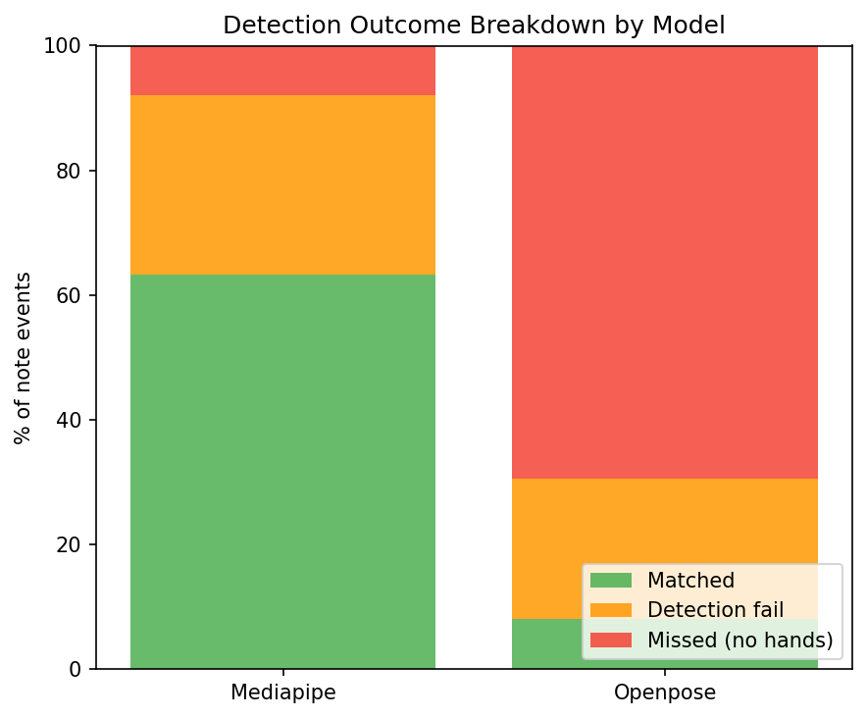
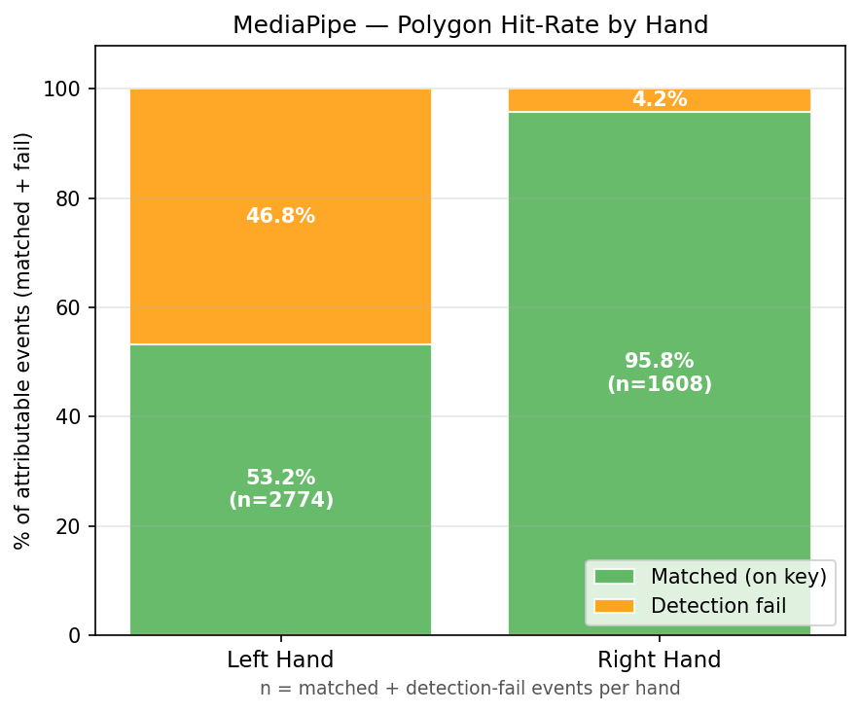
8.1 Overall Detection Rate
• MediaPipe: 63.3% matched · 28.7% detection-fail · ~8% missed — real-time capable (30+ FPS)
• OpenPose: 8.1% matched · 68.3% missed — requires hand-crop preprocessing; not real-time on CPU
• No-detection (OpenPose) loses all info; detection-fail (MediaPipe) can be snapped to nearest key

Slide 15
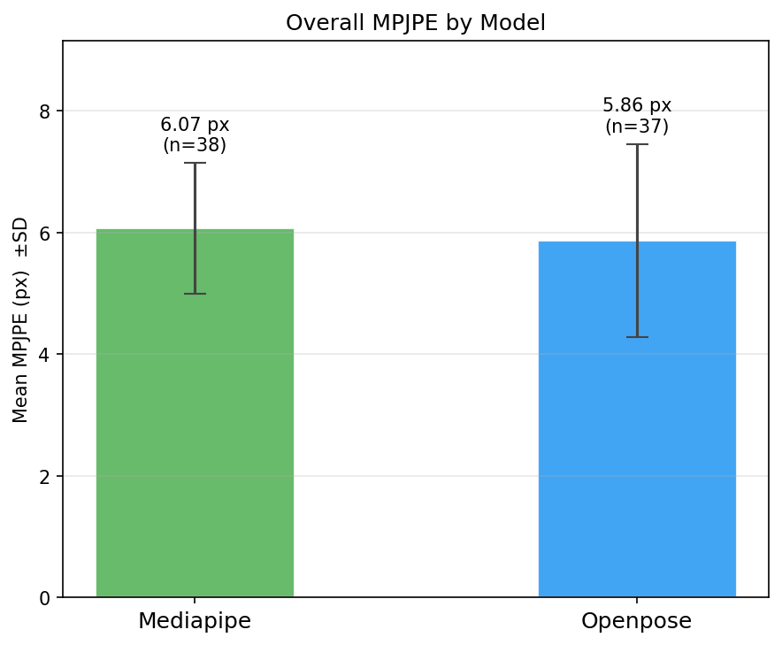
8.2 Overall MPJPE Comparison
• MediaPipe: 6.07 px (n=3 017) · OpenPose: 5.87 px (n=388) · key half-width ≈ 10–11 px
• OpenPose marginally lower MPJPE but on only 8.1% of events — selection bias, not true advantage
• Both models below key-width threshold when detected; OpenPose unusable due to detection rate

Slide 16
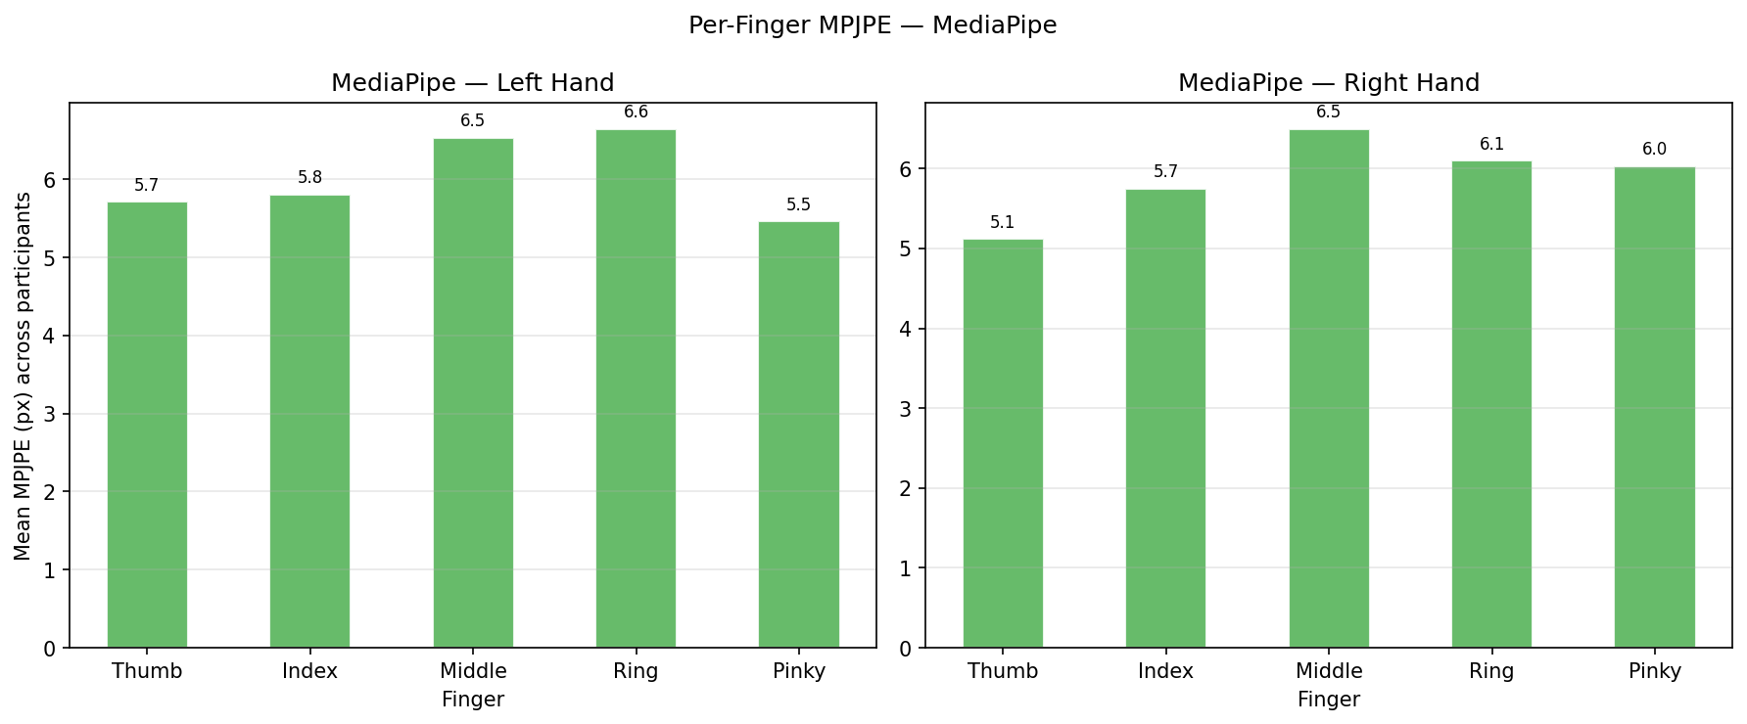
8.2.3 MediaPipe Per-Finger MPJPE & Polygon Hit Rate
• Ring & Middle: highest MPJPE — anatomically less independent digits
• Thumb & Index: lowest MPJPE — most motor-independent
• Right hand 95.8% hit rate vs Left 53.2% — right-hand dominance artifact, not model failure
• Despite asymmetric hit rate: Left 6.13 px vs Right 6.02 px — near-identical MPJPE

Slide 17
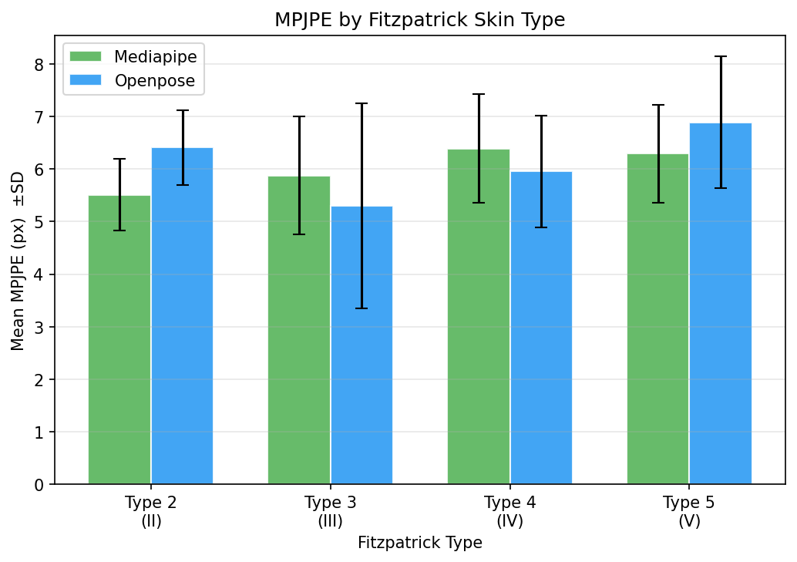
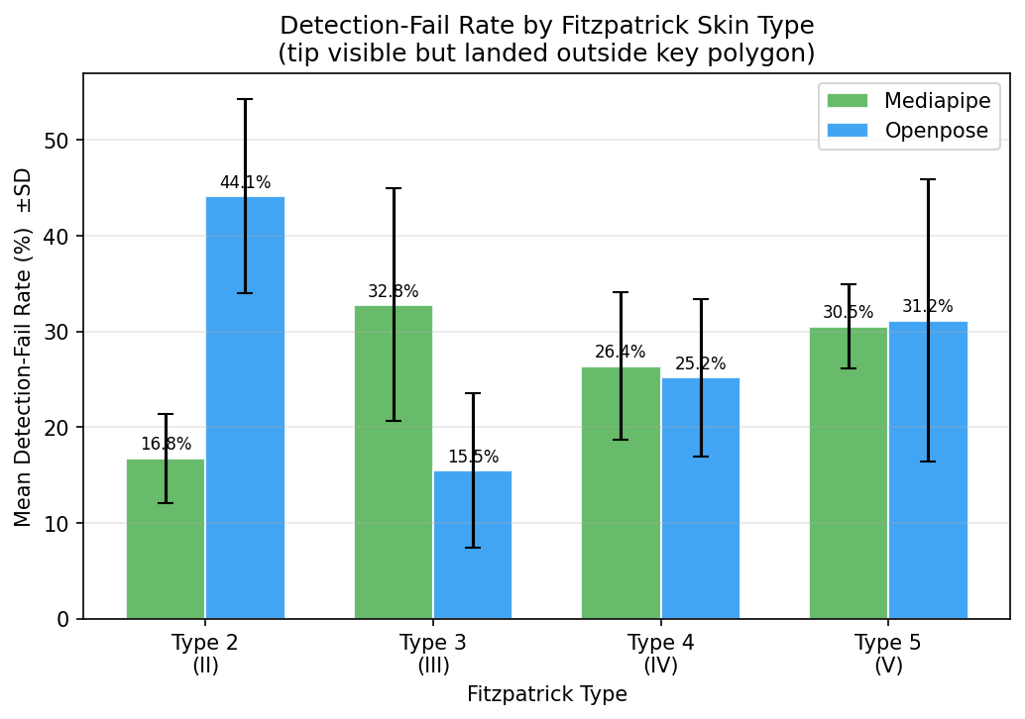
8.3 Effect of Skin Tone (Fitzpatrick Type) on MPJPE
• MediaPipe MPJPE range: Type II 5.51 px → Type V 6.29 px · total range 0.88 px (within SD)
• Trend not monotonic → no systematic skin-tone bias across tested range
• Detection-fail: Type III 32.8% (highest) vs Type II 16.8% — no consistent direction
• Types I & VI not represented — unable to test extremes of Fitzpatrick scale

Slide 18
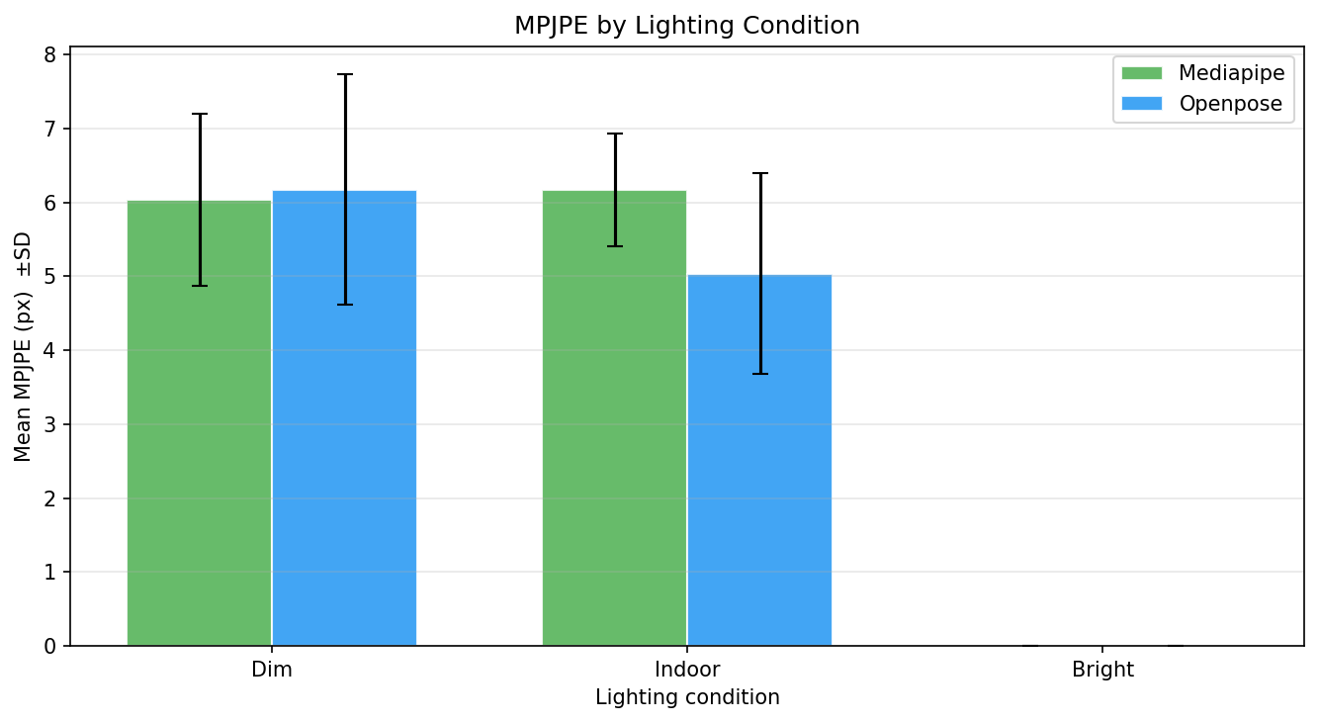
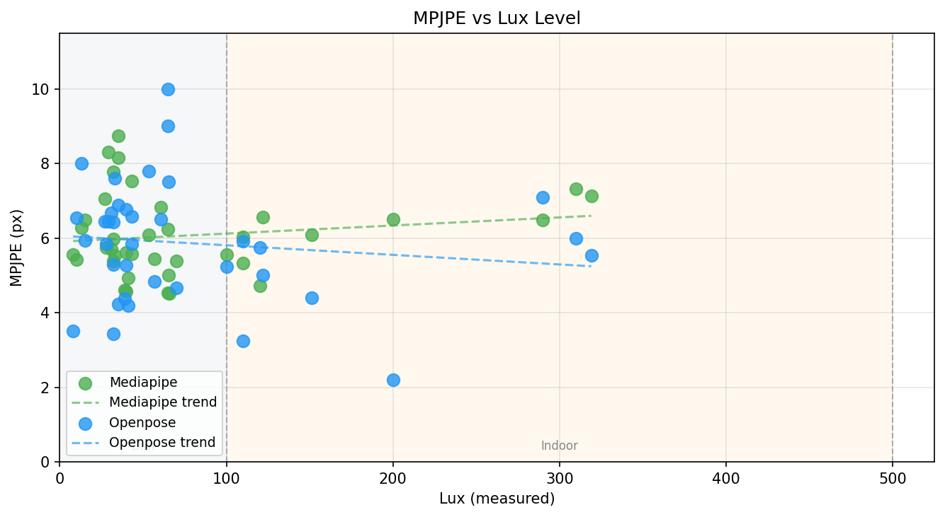
8.4 Effect of Ambient Illuminance on MPJPE
• MediaPipe: Dim 6.03 px (SD=1.16) vs Indoor 6.17 px (SD=0.76) — 0.14 px gap, within SD
• Regression nearly flat across full lux range — lighting does not affect MediaPipe accuracy
• Widespread within dim band → individual skill is the dominant variance source, not lighting
• No bright (>500 lux) sessions recorded — gap for future research

Slide 19
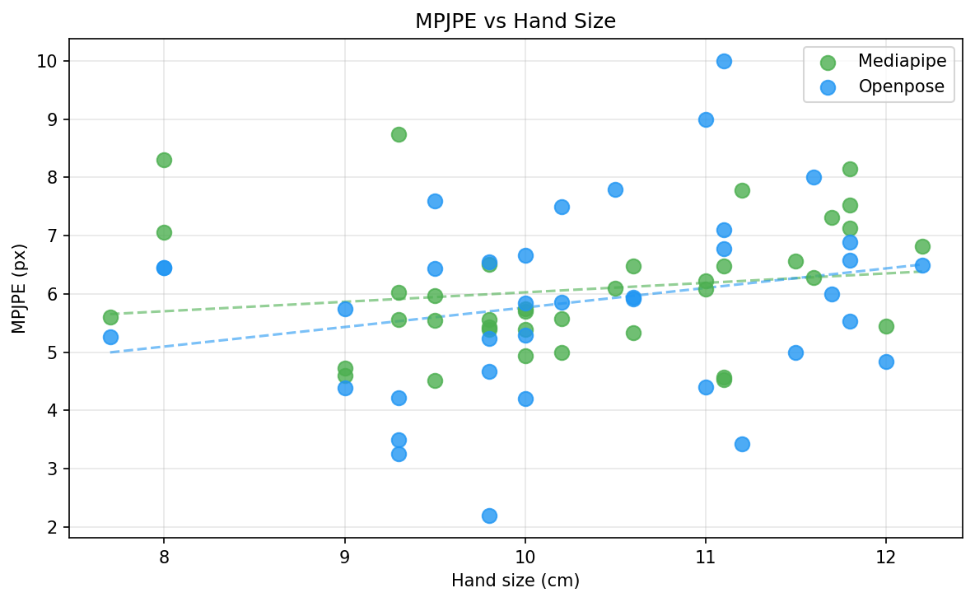
8.5 Effect of Hand Size on MPJPE
• MediaPipe: slope 0.162 px/cm · R² = 0.030 — total variation ~0.7 px across full range
• OpenPose: slope 0.336 px/cm · R² = 0.059 — also negligible (small n caveat applies)
• Hand size explains <6% of MPJPE variance — no per-user hand-size calibration needed

Slide 20
Novel Contributions & Conclusion

Slide 21
Novel Contributions
• 1 · Synchronised multi-modal dataset:
• 38 sessions · MIDI note-on events + video frames + Fitzpatrick/lux/hand-size metadata
• Fills gap between MAESTRO/MAPS (audio-only) and FreiHAND (keypoints, no MIDI)
•
• 2 · Sub-frame MIDI–video temporal alignment:
• Shared perf_counter origin → ground truth without manual frame labelling
•
• 3 · Homography-calibrated 2-D polygon mask:
• Handles oblique camera angles; isolates horizontal localisation error per key
•
• 4 · Horizontal-axis MPJPE metric:
• Removes finger-length & depth-angle bias present in prior full-2-D MPJPE metrics

Slide 22
Conclusion
• MediaPipe is the clear choice for real-time piano tutoring — 63.3% polygon hit rate, 6.07 px MPJPE
• OpenPose marginally better MPJPE (5.87 px) but only on 8.1% of events — not deployment-ready
• MediaPipe: offset detections can be snapped to nearest key; no-detection (OpenPose) loses all info
• Skin tone (II–V), lighting (dim/indoor) and hand size show negligible effect on MediaPipe accuracy
• Large left–right polygon-hit asymmetry (53.2% vs 95.8%) likely user-skill artifact — needs study
• Pipeline and dataset are open-source contributions enabling benchmarking of any new vision model
• MediaPipe viable on decent mobile hardware — no additional cost for a consumer tutoring application

Slide 23
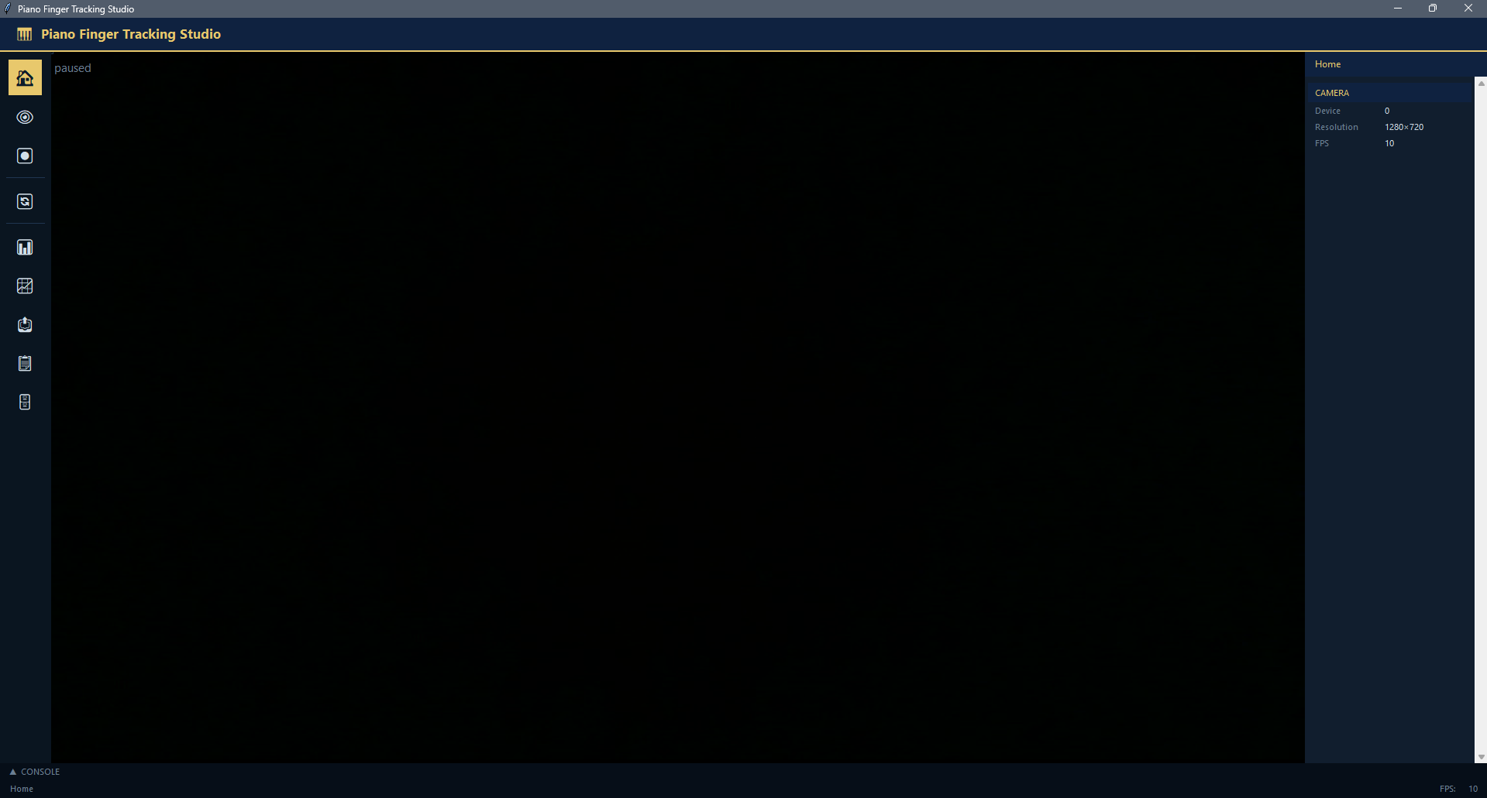
Future Enhancements and Further Research
Type I – V balanced
More hand sizes
Preprocessing layer for OpenPose
Filtering for Occlusions and finger overlaps
Expert Pianist for Dataset
Filtering for Occlusions and finger overlaps

Slide 24
Thank You
Questions & Discussion
Aayam Regmi · aayam.regmi2003@gmail.com
BSc (Hons) Computing · The British College / Leeds Beckett University · 2026

