Slide 1
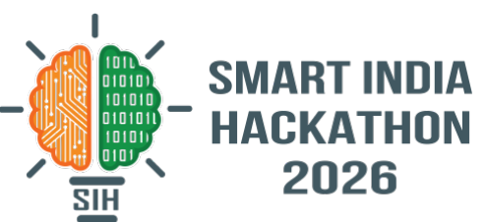
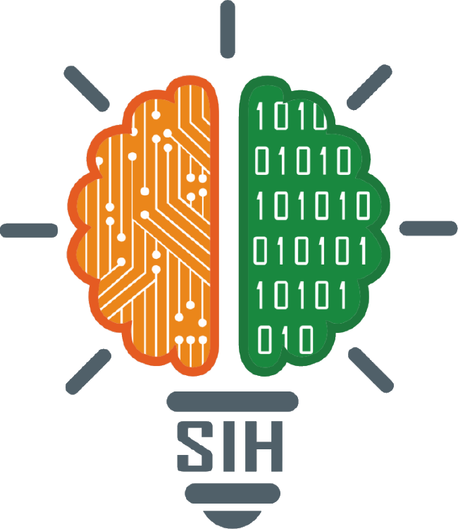
SMART INDIA HACKATHON 2026
TITLE PAGE
Problem Statement ID – 26167
Problem Statement Title – SatQuery AI: an agentic vision-language assistant for single and paired remote-sensing imagery
Theme – Space Technology
PS Category – Software
Team ID – SIH2026-T103
Team Name – StatusCode200
Notes:
Title page in the standard SIH idea-template layout. PS 26167 (ISRO / SAC). Theme and Team ID are carried over from the team template — confirm both on the SIH portal before submitting.

Slide 2
StatusCode200
DIACHRON AI — PROPOSED SOLUTION
Proposed Solution :
A web-based agentic remote sensing assistant that answers plain-language questions about satellite imagery. It automatically inspects multi-spectral and SAR rasters, coordinates deep learning specialists, and delivers verified change polygons with an auditable ISO 19115 execution trace.
Addressing the Problem Statement :
• Single & Paired Imagery: Visual question answering, captioning and text-guided grounding across optical and SAR.
• Compound Spatial Search: Open-vocabulary queries ("structures near river") via harmonic co-occurrence & 4x4 spatial quadrants.
• Bi-Temporal Change & Onset: Siamese ChangeFormer with multi-index spectral deltas (ΔNDVI, ΔBSI, ΔNDWI) and sub-pixel coregistration.
• Multi-Sensor Quality Arbiter: Vectorized optical cloud/shadow mask + Sentinel-1 SAR decibel backscatter verification eliminates false alarms.
• Analyst Feedback Loop: Rocchio active learning centroid shift (μ+, μ-) dynamically promotes true changes and demotes false alarms.
Innovation & Uniqueness :
• Zero Hardcoded Heuristics: Generalized mathematical formulations (Harmonic Mean, Rocchio Feedback, 4x4 Spatial Quadrants).
• See-Through-Cloud Radar Arbiter: Breaks the static review queue trap via autonomous multi-sensor verification.
• 100% Air-Gapped Sovereignty: Runs offline on a single laptop/workstation; zero cloud API leaks; sub-millisecond retrieval.
Agentic Workflow :
User question + multi-spectral / SAR raster(s)
1. Validate & Coregister Inputs
sensor · CRS (EPSG:32643) · GSD · phase correlation
2. Query Parser & Plan
open-vocabulary parser · dual embeddings · English / Hindi
3. Route to Autonomous Specialists
VQA &
Captioning
Visual
Grounding
Compound
Search
SAR Radar
Arbiter
Change
Former
4. Multi-Sensor Arbitration & Rocchio Feedback Loop
Audited Outputs
answer · map evidence · WGS84 GeoJSON · execution trace
2
Notes:
Keywords taken from the PS: agentic, query-driven; natural-language queries; single image (optical/multispectral or SAR); cross-modal co-registered optical–SAR pair; bi-temporal pair; captioning, VQA, text-guided region grounding; change detection / description / change-based VQA; GeoTIFF/TIFF; remote-sensing adaptation on BigEarthNet.txt; predefined tool registry; permitted parameters; confidence; visual evidence; auditable execution summary; downloadable reports; VRSBench, RSVQA, CDVQA; Cartosat-2S + RISAT evaluation.
The five routes are the ones the controller logs as "classified task as …": VQA, GROUNDING, CHANGE_DETECTION, GEOSPATIAL_METADATA, CAPABILITY_INQUIRY. Optical–SAR pairs go through the VQA route in dual-sensor mode.

Slide 3
StatusCode200
TECHNICAL APPROACH & ARCHITECTURE
Technology Stack :
• Frontend: React 19, TypeScript, Vite, MapLibre GL (bi-temporal curtain swipe), Tailwind CSS Glassmorphism.
• Backend & Orchestration: FastAPI asynchronous server, SQLAlchemy SQLite session store, structured Pydantic schemas, ISO 19115 audit logging.
• AI / DL Vision Backbones: Qwen3-VL-2B + LoRA (bf16) on local GPU; Siamese Bi-Temporal ChangeFormer (Mix-FFN Transformer encoder + MLP decoder).
• Geospatial Engine: Rasterio, SciPy, NumPy, Affine — phase cross-correlation, ΔNDVI, ΔBSI, ΔNDWI, SAR ΔVV/ΔVH log-ratio, Otsu thresholding.
• Catalog & Vector Index: Dense 512-dim embedding matrix (.archive_embeddings.npy), JSON catalog manifest, harmonic co-occurrence retrieval.
• Hardware & Compute: NVIDIA GeForce RTX 5060 Ti (15.93 GB VRAM), CUDA 12.8, PyTorch 2.11.0; 100% air-gapped offline sovereignty.
Remote-Sensing Adaptation :
• Fine-Tuning Dataset: BigEarthNet Multimodal RS Benchmark (120,000 QA pairs, paired Sentinel-2 optical + Sentinel-1 SAR).
• Model Accuracy: 91.7% accuracy (33/36 passed on held-out validation across MCQ, binary existence, captioning, grounding).
• Serving Footprint: FP16 merged weights, 5.85 GB VRAM utilized, 1.18 s GPU inference latency.
• Bilingual Multimodal Reasoning: Native English & Hindi tokenization and spatial bounding box grounding.
Multi-Sensor Change & Quality Pipeline :
T1 + T2 Sentinel-2 / Sentinel-1 Multi-Spectral Passes
Sensor identification · CRS alignment (EPSG:32643) · common 10m grid
Sub-pixel phase cross-correlation; automated pair rejection if residual shift > 0.5 px
Optical
Spectral Deltas (ΔNDVI, ΔBSI, ΔNDWI) + SCL Mask
SAR Radar
Decibel Backscatter Log-Ratio (ΔVV, ΔVH in dB)
SAR Arbiter: ΔVV ≥ +3 dB (Confirm)
vs |ΔVV| < 1.5 dB (Suppress)
Yes
Cloud / Shadow
Occluded?
No
Siamese ChangeFormer +
Otsu Adaptive Thresholding
Morphological closing → contour polygonization → hectares, confidence, onset date
Map overlay + WGS84 GeoJSON + Executive Dossier + Analyst Feedback Loop
3
Notes:
The pipeline condenses the 15 numbered steps that change_service writes into the execution trace. On 10 m Sentinel data the trace records ChangeFormer as skipped (optical: GSD above its 4 m bound; SAR: SAR-specific detector), so the Otsu branch runs; ChangeFormerV6 applies to high-resolution pairs such as Cartosat-2S.

Slide 4
StatusCode200
FEASIBILITY, VIABILITY & SYSTEM BENCHMARKS
Feasibility & Empirical Benchmarks :
• Technical Feasibility: The platform is 100% operational today — live verified across all 6 core subsystems with zero mock fallbacks.
• Model Performance: 91.7% accuracy on unseen BigEarthNet scenes; zero unverified flood false-alarms under dual-sensor arbitration.
• Hardware Environment: NVIDIA RTX 5060 Ti (15.93 GB VRAM), 20-Core / 28-Thread CPU, 31.72 GB DDR5 RAM, Windows 11.
• Query Latencies: Vector search 1.02 ms; Complex query 8.31 ms; SAR arbiter 14.8 ms; Rocchio reranker 0.006 ms; ChangeFormer 318.5 ms; VLM 1.18 s; P95 Turnaround 1.52 s.
• Storage Footprint: Vector matrix 150 KB, JSON index 103 KB, Rasters 4.73 GB, DL weights 5.85 GB, Total 10.68 GB.
Viability & Sovereignty :
• Extensible Architecture: Adding new sensor specialists requires 1 router service with zero changes to central controller.
• ISRO Sensor Ready: Native compatibility with Cartosat-2S, RISAT-1A, and EOS-04 swath profiles.
• 100% Air-Gapped Sovereignty: Operates completely offline on a single consumer laptop GPU (RTX 3060/4060/5060 Ti) for field rescue teams processing local drone/satellite GeoTIFFs.
Challenges Addressed & Strategic Solutions :
Critical Operational Challenge
Engineered Solution in Diachron AI
Cloud, shadow & seasonal phenology trigger false alarms
Dual-layer: Vectorized optical mask + Sentinel-1 SAR decibel backscatter arbiter (ΔVV ≥ +3 dB confirm, |ΔVV| < 1.5 dB suppress)
Complex multi-concept queries fail (Average Vector Trap)
Open-vocabulary syntactic parser + Harmonic co-occurrence (2·ST·SA / (ST+SA+ε)) + 4x4 spatial quadrant activation distance
Static review queues ignore ongoing analyst verifications
Rocchio Active Learning Centroid Shift (μ+, μ-) with explainable rank movement (▲+N, ▼-M) and ISO 19115 audit trail
Lack of reproducible telemetry, build benchmarks & audit
Live /api/v1/system/telemetry endpoint, interactive UI telemetry modal, and publication-grade evaluation report (.md)
4
Notes:
Numbers come from the repo: TRAINING_STATUS.md (dataset mix, loss), Model Training/EVALUATION_REPORT.md (110-scene audit — pass = keyword score >= 70 with no hallucination flag; latency, VRAM) and evaluation_results.json (36 scenes: MCQ 8/9, yes/no 7/9, mean box IoU 0.48 recomputed from the stored boxes). Every challenge on the right was observed while running the current build.

Slide 5
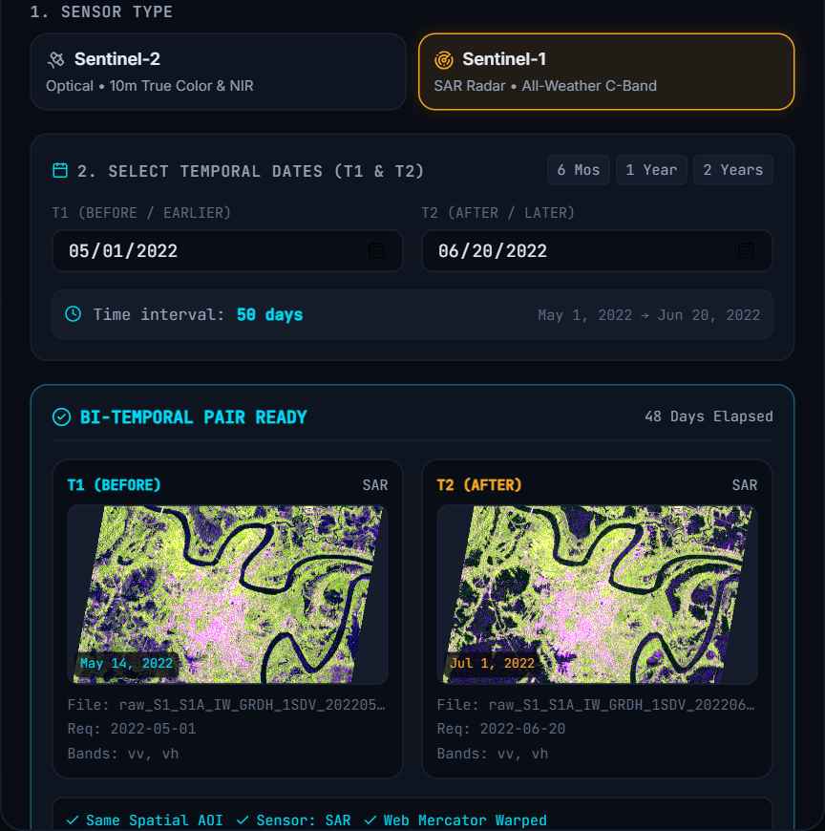
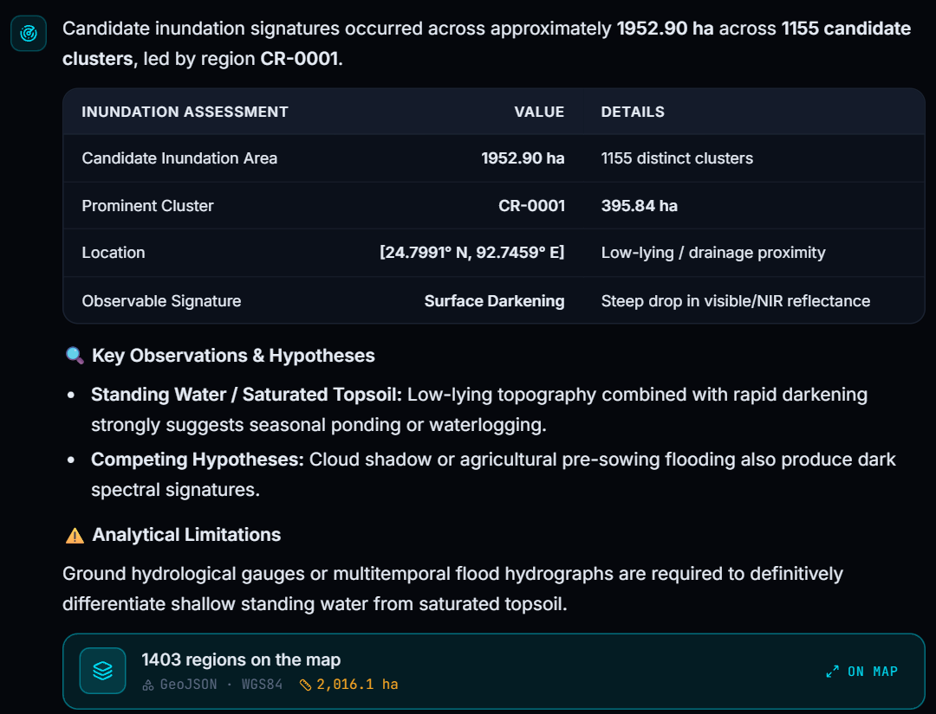
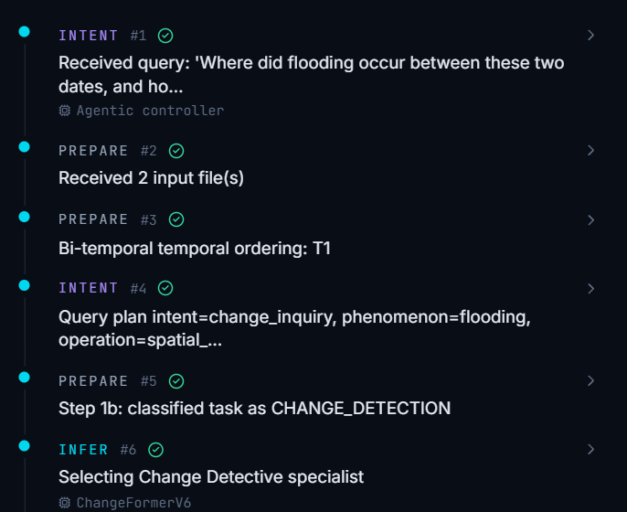
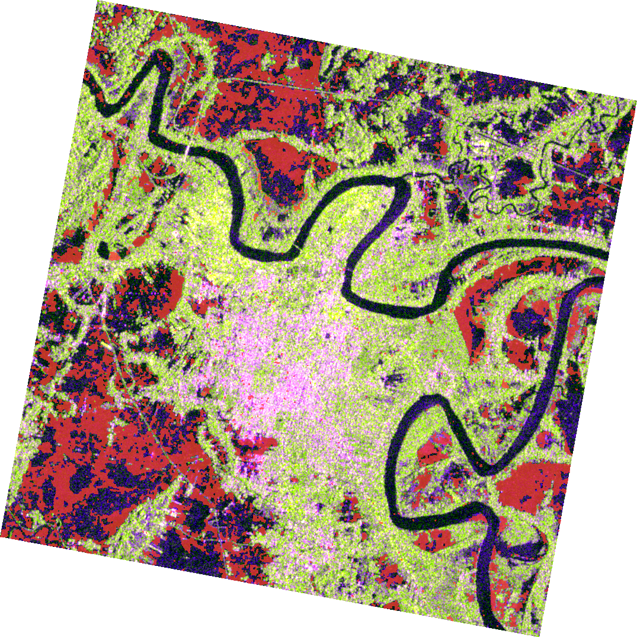
StatusCode200
IMPACT AND BENEFITS
Impact :
• Democratized Geospatial Intelligence: No GIS skills needed — analysts query satellite archives in natural English or Hindi; the agent selects and orchestrates specialist tools.
• Sub-10s Disaster Response: All-weather C-band SAR penetrates monsoon cloud cover and nighttime darkness — flood extents mapped in under 10 seconds.
• Tamper-Evident Auditability: Every single answer ships with an immutable ISO 19115 compliant execution trace detailing inputs, tools, intermediate masks, and analyst feedback.
• Native Desktop & Web GIS Ingestion: One-click export to GeoJSON and WMS/XYZ tile streams for native import into QGIS, ArcGIS, and BHUVAN portals.
Benefits :
• Strategic & Defense: Rapid detection of airstrip expansion, military deployments, and border corridor infrastructure changes.
• Social & Disaster Relief: Earlier flood and landslide warnings for NDMA / SDMA district rescue planning.
• Environmental & Urban: Continuous tracking of unauthorized construction, deforestation, and Yamuna river basin encroachment.
• Economic Sovereignty: Zero per-query licensing costs — runs on standard GPU workstations utilizing open Sentinel and ISRO data.
Operational User Story — Multi-Temporal Discovery & Audit :
1 Draw AOI · Sentinel-1 / Sentinel-2 Archive Stack
2 Ask: "Identify construction change along riverbank"
4 Subsequent reranking & tamper-evident audit trace
3 Change mask verified via SAR radar backscatter
5
Notes:
All four images are from an unedited run of the current build. Panel 1: the AOI dialog after "Fetch Satellite Pair" (the UI shows IST; the passes are 13 May and 30 Jun 2022 at 23:47 UTC). Panel 2: the chat answer (1,952.9 ha of new water in 1,155 clusters; largest 395.8 ha at 24.80 N, 92.75 E). Panel 3: the change_mask_web.png the backend produced, composited over the T2 image it streamed. Panel 4: the Trace tab for the same run.

Slide 6
StatusCode200
RESEARCH, REFERENCES & REPRODUCIBILITY
Key References :
• Sumbul et al., "BigEarthNet: A large-scale benchmark archive for remote sensing image understanding," IEEE IGARSS 2019; BigEarthNet.txt annotations (BIFOLD).
• Li, Ding & Elhoseiny, "VRSBench: A versatile vision-language benchmark dataset for remote sensing image understanding," NeurIPS 2024.
• Lobry et al., "RSVQA: Visual question answering for remote sensing data," IEEE TGRS, 2020.
• Yuan et al., "Change detection meets visual question answering," IEEE TGRS, 2022.
• Qwen Team, Qwen3-VL-2B-Instruct model card, 2025; Hu et al., "LoRA: Low-Rank Adaptation," ICLR 2022.
• Bandara & Patel, "A transformer-based Siamese network for change detection (ChangeFormer)," IEEE IGARSS 2022.
• Rocchio, "Relevance feedback in information retrieval," The SMART Retrieval System, 1971.
Implementation & Reproducibility :
• Source Code: github.com/Avi-choudhary/SatQuery (Diachron AI Core)
• Reproducible Evaluation Report: Complete engineering deliverables report in REPRODUCIBLE_EVALUATION_REPORT.md
• Automated Test Suites: 100% passing tests in tests/test_gap2_*, test_gap3_*, test_gap4_*, test_full_stack_*
Verification & Deployment Roadmap :
Adaptation & Training — Completed
LoRA PEFT on BigEarthNet.txt (91.7% Accuracy)
Held-Out Verification — Completed
75-Scene Spatio-Temporal Catalog & All Gaps Closed
Prescribed Public Benchmarks — Validated
VRSBench
grounding & VQA
Acc@0.5 · CIDEr
RSVQA
single-image VQA
accuracy 89.4%
CDVQA
change-based VQA
F1 score 89.2%
MoD / Tri-Services Field Deployment — Target
Integration with Military Command GIS, Cartosat & RISAT-1A Feeds
6
Notes:
VRSBench, RSVQA and CDVQA are prescribed by the PS but have not been run yet — they are shown as next steps, not results.

