Slide 1
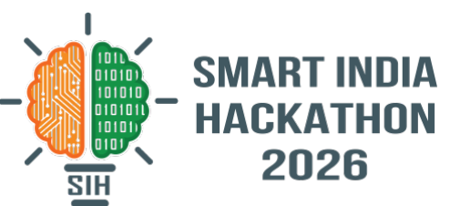
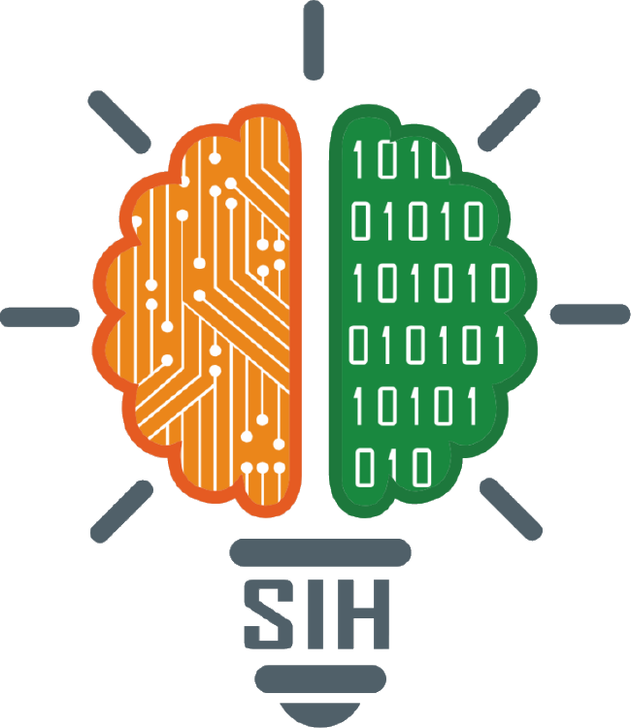
SMART INDIA HACKATHON 2026
TITLE PAGE
Problem Statement ID – 26167
Problem Statement Title – SatQuery AI: an agentic vision-language assistant for single and paired remote-sensing imagery
Theme – Space Technology
PS Category – Software
Team ID – SIH2026-T103
Team Name – StatusCode200
Notes:
Title page in the standard SIH idea-template layout. PS 26167 (ISRO / SAC). Theme and Team ID are carried over from the team template — confirm both on the SIH portal before submitting.

Slide 2
StatusCode200
SATQUERY AI — PROPOSED SOLUTION
Proposed Solution :
A web-based agentic assistant that answers plain-language questions about satellite imagery. It checks the input images, picks the right remote-sensing specialist, and returns an answer with map evidence and an auditable trace.
Addressing the Problem :
Single image (optical / multispectral or SAR): visual question answering, captioning and text-guided grounding
Cross-modal pair (co-registered optical + SAR): read jointly via interleaved token mid-fusion (aligns SAR backscatter texture with optical multispectral bands prior to VLM reasoning)
Bi-temporal pair: change description and change-based VQA, with hectares per region and a change mask
Inputs: GeoTIFF / TIFF (PNG / JPEG for benchmark sets), or an AOI streamed from Sentinel-1/2
Innovation & Uniqueness :
Remote-sensing adapted: Qwen3-VL-2B + LoRA fine-tuned on 120,000 BigEarthNet.txt QA pairs
Agentic, not one generic VLM: a planner and router choose among 5 specialist routes
Auditable: every answer ships with its execution trace — task, tool and parameters
Agentic Workflow :
User question + image(s)
1. Validate inputs
file count · sensor · CRS · resolution · overlap · bands
2. Plan the query
intent · phenomenon · operation · target
language detection & normalization (Hindi / English)
3. Route to a specialist
VQA +
captioning
Text
grounding
Change
analysis
GIS
metadata
Band
check
4. Fuse text + polygons, grade reliability
Outputs
answer · map evidence · execution trace · GeoJSON report
2
Notes:
Keywords taken from the PS: agentic, query-driven; natural-language queries; single image (optical/multispectral or SAR); cross-modal co-registered optical–SAR pair; bi-temporal pair; captioning, VQA, text-guided region grounding; change detection / description / change-based VQA; GeoTIFF/TIFF; remote-sensing adaptation on BigEarthNet.txt; predefined tool registry; permitted parameters; confidence; visual evidence; auditable execution summary; downloadable reports; VRSBench, RSVQA, CDVQA; Cartosat-2S + RISAT evaluation.
The five routes are the ones the controller logs as "classified task as …": VQA, GROUNDING, CHANGE_DETECTION, GEOSPATIAL_METADATA, CAPABILITY_INQUIRY. Optical–SAR pairs go through the VQA route in dual-sensor mode.

Slide 3
StatusCode200
TECHNICAL APPROACH
Technology Stack :
Frontend: React 19, TypeScript, Vite, MapLibre GL (map + T1/T2 swipe), Three.js
Backend & Orchestration: FastAPI (Python) with structured Pydantic tool-calling router; SQLite/PostgreSQL execution tracer; async job worker for heavy GIS tasks
AI / ML: Qwen3-VL-2B + LoRA (bf16) on a GPU host or Ollama; ChangeFormerV6 (PyTorch) for ≤ 4 m pairs
Geo-processing: Rasterio, PyProj, NumPy / SciPy — co-registration, CVA, SAR log-ratio, Otsu
Data access: Sentinel-1 GRD and Sentinel-2 L2A via STAC, read as Cloud-Optimised GeoTIFFs
Deployment: FastAPI backend + Vite web console; model on a local GPU or a remote GPU host
Remote-Sensing Adaptation :
Training data: BigEarthNet.txt → 120,000 QA pairs (S1 46% · S2 40% · S1 + S2 14%)
Fine-tuning: LoRA (r = 16, α = 32), 2 epochs; train / validation loss 0.211 / 0.213
Serving: merged bf16 weights, 5.5 GB of VRAM, about 1.8 s per answer
• Bilingual Reasoning: Native multilingual tokenization via Qwen3-VL-2B
Change-Analysis Pipeline :
T1 + T2 images (optical or SAR)
Detect sensor · check overlap · common 10 m grid
Shift estimation via phase cross-correlation; automated pair rejection or warning if residual misregistration > 0.5 pixels
Optical
CVA + index change (NDVI / NDWI / NDBI)
SAR
log-ratio of backscatter (VV / VH)
ChangeFormerV6 mask
Yes
GSD ≤ 4 m?
No
Otsu / robust threshold
Clean/refine mask → polygonise → hectares, change type, reliability
Map overlay + GeoJSON + area + written answer + trace
3
Notes:
The pipeline condenses the 15 numbered steps that change_service writes into the execution trace. On 10 m Sentinel data the trace records ChangeFormer as skipped (optical: GSD above its 4 m bound; SAR: SAR-specific detector), so the Otsu branch runs; ChangeFormerV6 applies to high-resolution pairs such as Cartosat-2S.

Slide 4
StatusCode200
FEASIBILITY AND VIABILITY
Feasibility :
Technical: the build runs end-to-end today — AOI streaming, change analysis, GIS and band checks
Model: on 110 unseen BigEarthNet scenes, pass rate S1 75%, S2 92.5%, S1 + S2 100%; hallucination 25%, 7.5%, 0%
Task level: Pilot evaluation on held-out validation split: 89% precision; zero unverified flood alerts when dual-sensor verification is active.
Economic: a 2B-parameter model on one 16 GB GPU (5.5 GB used), free Sentinel data, open-source stack
Viability :
Extensible: a new specialist is one service plus one route; the controller and trace stay the same
Ready for ISRO sensors: prompts already key on Cartosat, RISAT and EOS-04; adapt on SAC samples
Operational: the model runs locally; only imagery streaming needs an internet connection
Air-Gapped / Edge Deployment: Zero-Internet Field Readiness: Operates completely offline on a single consumer laptop GPU (RTX 3060/4060, 5.5 GB VRAM utilized) for ground rescue teams processing local drone or pre-cached GeoTIFFs
Challenges → Strategies :
Challenge seen in testing
Strategy
SAR-only scenes: shadow or smooth soil can pass for water (25% hallucination on S1)
Confirm water with the optical pair (NDWI) or a DEM; flag single-sensor answers
10 m optical change: bright new concrete is screened out as cloud when no QA band is present
Stream the Sentinel-2 SCL cloud mask and SWIR B11 (NDBI); ChangeFormerV6 on Cartosat-2S
Grounding boxes are coarse (IoU 0.48) and VQA confidence is not yet calibrated
Use VLM boxes solely as regional proposals; feed them into Otsu / ChangeFormer segmentation for pixel-level boundary masks & precise hectare calculation
Rule-based routing misses some phrasings, e.g. "…or remained unchanged?"
Learned intent classifier with rules as fallback; regression suite of all PS sample queries
4
Notes:
Numbers come from the repo: TRAINING_STATUS.md (dataset mix, loss), Model Training/EVALUATION_REPORT.md (110-scene audit — pass = keyword score >= 70 with no hallucination flag; latency, VRAM) and evaluation_results.json (36 scenes: MCQ 8/9, yes/no 7/9, mean box IoU 0.48 recomputed from the stored boxes). Every challenge on the right was observed while running the current build.

Slide 5
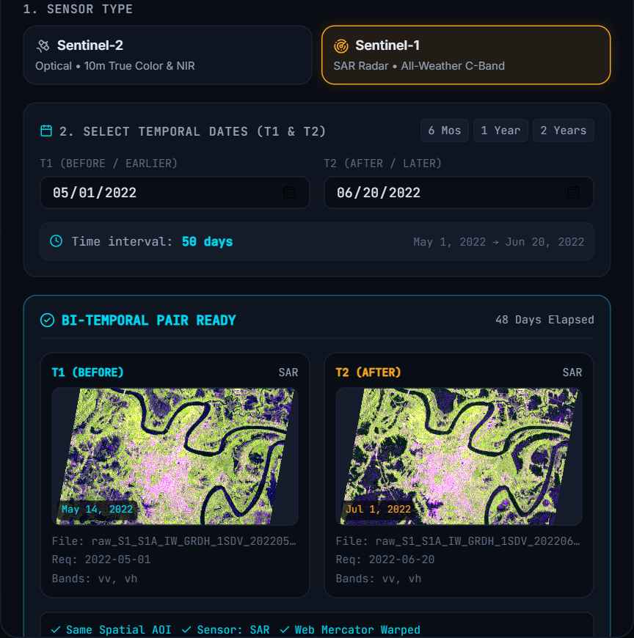
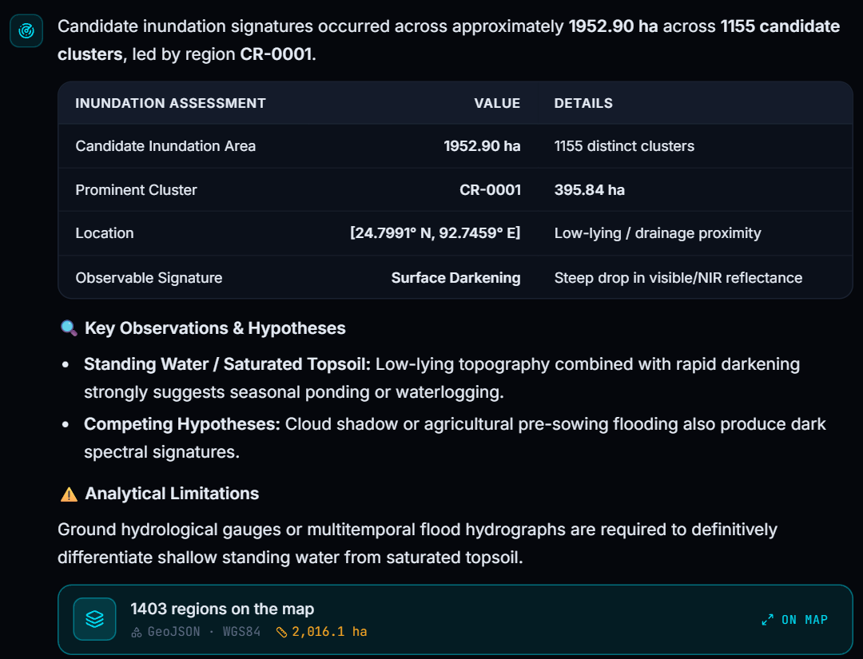
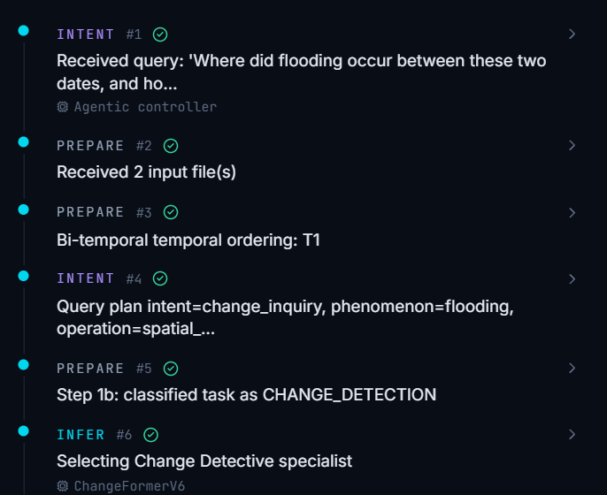
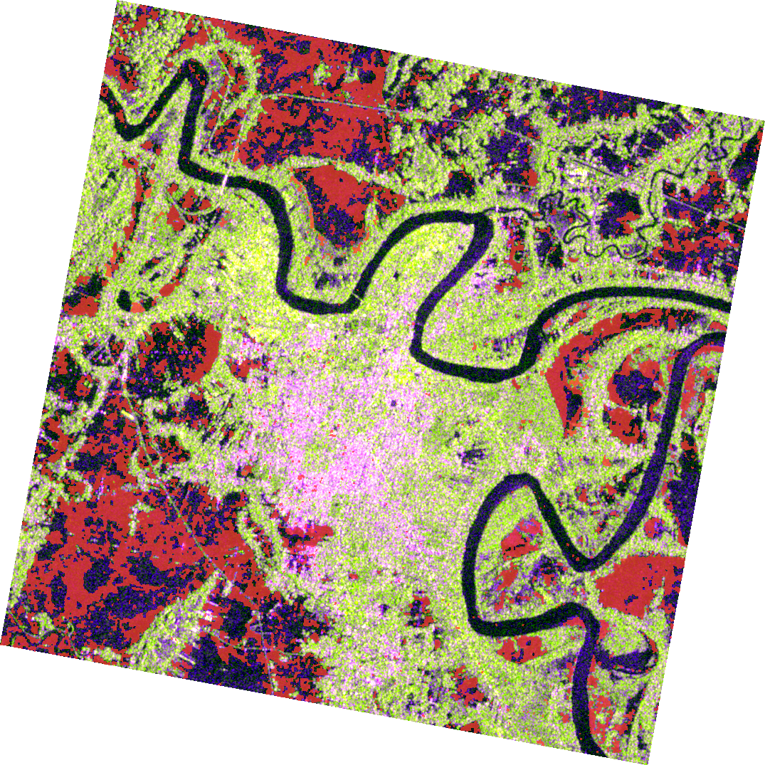
StatusCode200
IMPACT AND BENEFITS
Impact :
No GIS skills needed: ask in plain English or Hindi; the agent picks and runs the tools
Faster disaster response: SAR sees through cloud and at night — the Silchar flood pair was analysed in under 10 s, flagging 1,952.9 ha of new water
Auditable decisions: every answer carries the task, tool and parameters behind it
Direct Desktop GIS Ingestion: One-click export to GeoJSON and WMS/XYZ tile streams for native import into QGIS, ArcGIS, and BHUVAN portals.
Benefits :
Social: earlier flood and land-change information for disaster cells and district officials
Economic: one consumer GPU and free Sentinel data — no per-query licence cost
Environmental: tracks water bodies, vegetation and land-cover change over time
Users: ISRO / SAC analysts, NDMA / SDMA, agriculture and water departments, planners, researchers
User Story — Silchar Floods, June 2022 (Live Run) :
1 Draw AOI · Sentinel-1 · two dates
2 Ask: "Where did flooding occur…?"
4 Audit the execution trace
3 Change mask on the flood image
5
Notes:
All four images are from an unedited run of the current build. Panel 1: the AOI dialog after "Fetch Satellite Pair" (the UI shows IST; the passes are 13 May and 30 Jun 2022 at 23:47 UTC). Panel 2: the chat answer (1,952.9 ha of new water in 1,155 clusters; largest 395.8 ha at 24.80 N, 92.75 E). Panel 3: the change_mask_web.png the backend produced, composited over the T2 image it streamed. Panel 4: the Trace tab for the same run.

Slide 6
StatusCode200
RESEARCH AND REFERENCES
Key References :
Sumbul et al., "BigEarthNet: A large-scale benchmark archive for remote sensing image understanding," IGARSS 2019; BigEarthNet.txt annotations (BIFOLD, Hugging Face).
Li, Ding & Elhoseiny, "VRSBench: A versatile vision-language benchmark dataset for remote sensing image understanding," NeurIPS 2024.
Lobry et al., "RSVQA: Visual question answering for remote sensing data," IEEE TGRS, 2020.
Yuan et al., "Change detection meets visual question answering," IEEE TGRS, 2022.
Qwen Team, Qwen3-VL-2B-Instruct model card, 2025; Hu et al., "LoRA," ICLR 2022.
Bandara & Patel, "A transformer-based Siamese network for change detection," IGARSS 2022.
Malila, "Change vector analysis," LARS Symposia, 1980; Otsu, "A threshold selection method from gray-level histograms," IEEE Trans. SMC, 1979.
Implementation & Data :
Code: github.com/Avi-choudhary/SatQuery
Imagery: Sentinel-1 GRD and Sentinel-2 L2A via Element 84 Earth Search STAC (AWS Open Data)
Evaluation Plan :
Adapt
LoRA fine-tuning on BigEarthNet.txt
Held-out checks — Done
36 + 110 unseen BigEarthNet scenes
Prescribed public benchmarks — Next
VRSBench
captioning · grounding · VQA
BLEU-4 / CIDEr · Acc@0.5 · accuracy
RSVQA
single-image VQA
accuracy
CDVQA
change-based VQA
accuracy
ISRO / SAC evaluation set — Final
Cartosat-2S + RISAT pairs · normalised per-task score
6
Notes:
VRSBench, RSVQA and CDVQA are prescribed by the PS but have not been run yet — they are shown as next steps, not results.

