Slide 1
VIRTUAL COACH
PROJECT TEAM
23UAM079
Aayan T Mujawar
AI-Based Cricket Posture
Analysis System
23UAM080
Mohmmadnuh N Mujawar
Motion Capture & Sports Analysis
23UAM123
Aditya S Savale
Department of CSE (AIML) Engineering
D.K.T.E Society's Textile and Engineering Institute, Ichalkaranji
23UAM136
Goutam T Vaishnav
Academic Year: 2025–2026
23UAM039
Afreen W Kadegaonkar
Guide: Prof. V.B. Sutar

Slide 2
📋 Table of Contents
01
Introduction & Problem Overview
07
Performance & Design Constraints
02
Problem Statement & Objectives
08
Database & Security Design
03
System Overview & Architecture
09
Software Design (UML Diagrams)
04
System Workflow & Pipeline
10
Deployment Architecture
05
Module Descriptions
11
Technology Stack
06
Functional Requirements
12
References & Conclusion

Slide 3
🏏 Introduction
Domain Overview
This project integrates Artificial Intelligence and Computer Vision to automate athlete performance analysis. Traditional coaching relies on manual observation, which is inherently subjective and inconsistent. Virtual Coach provides an objective, numerical basis for evaluating posture and movement fluidity.
🎯 Domain
🏟️ Application
AI, Computer Vision,
Machine Learning & Deep Learning
Cricket Batting &
Bowling Posture Analysis
📱 Platform
⚡ Core Tech
Mobile-based Android
Application
MediaPipe, OpenCV,
TensorFlow / PyTorch

Slide 4
⚠️ Problem Description
Challenges in Cricket Training
Proposed Solution
Manual observation by coaches is subjective and inconsistent
No access to professional coaching in rural/resource-limited areas
Continuous monitoring of every player is not feasible
Existing motion analysis tools are expensive and require special equipment
Players develop incorrect techniques without proper guidance
Increased risk of injuries due to improper posture
Computer vision techniques to analyze batting/bowling posture
Detects body joints using pose estimation algorithms
Compares posture with ideal technique standards
Provides real-time feedback and posture correction suggestions
Injury risk alerts based on incorrect posture patterns
Affordable mobile-based solution accessible to all athletes

Slide 5
🎯 Problem Statement & Objectives
Problem Statement
To design and develop an AI-powered system that analyzes cricket player posture using video input and computer vision techniques, to evaluate performance, detect incorrect movements, and provide feedback for improvement and injury prevention in an accessible and cost-effective manner.
Project Objectives
Functional
Design and implement a system to analyze cricket posture from video input using computer vision and ML techniques for performance evaluation.
Functional
Develop a posture analysis module that detects body joints, identifies incorrect movements, and provides corrective suggestions and injury prevention guidance.
Performance
Evaluate and optimize system accuracy, response time, and reliability for real-time or near real-time analysis.
Non-Functional
Ensure the system is user-friendly, scalable, and adaptable across different users, environments, and video conditions using a mobile platform.

Slide 6
🔍 System Overview
Virtual Coach is a mobile-based AI application that processes cricket video input and provides comprehensive posture analysis through a multi-stage pipeline.
📹 Video Input
🦴 Pose Detection
📐 Feature Extraction
Accepts live camera feed or uploaded MP4/AVI video files from mobile devices
Detects body joints (shoulders, elbows, hips, knees, ankles) using MediaPipe/OpenCV
Calculates joint angles, body alignment, speed, acceleration, and motion patterns
📊 Posture Analysis
⭐ Performance Scoring
💡 Feedback System
Compares extracted features with ideal cricket technique standards using ML models
Generates accuracy score based on movement quality and technique correctness
Provides posture correction suggestions, injury risk alerts, and improvement tips

Slide 7
📌 System Scope & Boundaries
✅ What the System WILL Do
❌ What the System Will NOT Do
Accept video input (live or recorded)
Detect body joints using pose estimation
Analyze posture and movement patterns
Provide feedback and correction suggestions
Generate performance scores
Store user data and performance history
Generate visual reports and analytics
Allow downloading of reports
Replace human coaches completely
Work without video input
Support other sports (v1.0 limited to cricket)
Provide real-time biomechanical wearable data
Automatically control training equipment
Provide live coaching via chat or voice
Offer certified training certifications
Replace medical diagnosis of injuries

Slide 8
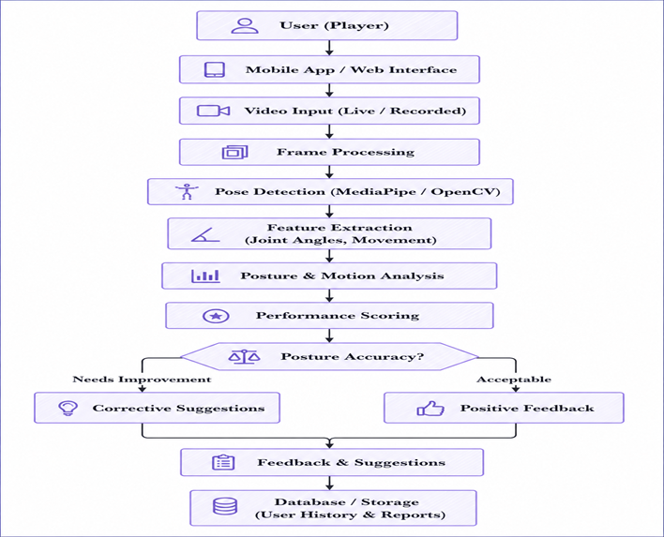
🏗️ System Architecture
Multi-layer pipeline architecture: User Layer → Processing Layer → Analysis Layer → Output Layer
Product Functions
The major functions of the system are:
1. Video Capture/Input
Accepts live or recorded cricket videos.
2. Pose Detection
Detects body joints like elbows, knees, shoulders.
3. Feature Extraction
Calculates joint angles and movement patterns.
4. Posture Analysis
Compares posture with ideal standards.
5. Performance Scoring
Generates scorebased on accuracy.
6. Feedback System
Provides suggestions and injury alerts.
7. Data Storage
Stores user performance history

Slide 9
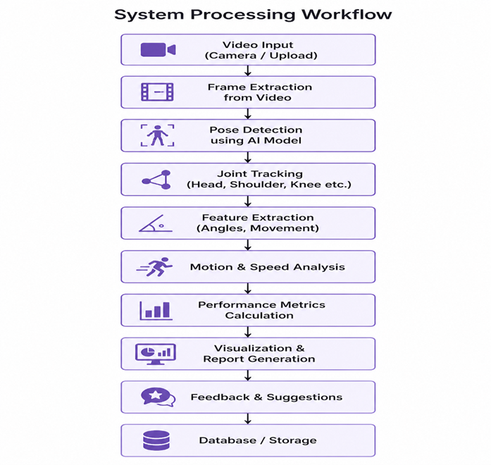
⚙️ System Processing Workflow
The system captures player movement using computer vision and AI.
Input is taken from a live camera feed or uploaded video.
The video is divided into multiple frames for processing.
Each frame is analyzed using pose detection algorithms like MediaPipe
or deep learning models.
The system detects key body joints such as shoulders, elbows,
hips, knees, and ankles.
Joint movements are tracked across frames to understand motion patterns.
Coordinates of joints are used to calculate metrics like:
Joint angles
Body posture
Speed and acceleration
Movement efficiency
Results are visualized using graphs, skeleton overlays, and analytical reports.
These insights help coaches and athletes evaluate performance.

Slide 10
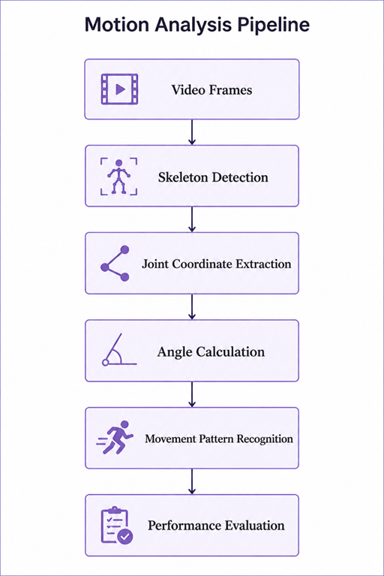
🔬 Motion Analysis Pipeline
Continuous frame buffer at 30 FPS from live camera or pre-recorded file
MediaPipe Holistic / BlazePose detects 33 body landmarks per frame
2D/3D coordinates (x, y, z) extracted for all major joints
Joint angles computed using vector cross-product formulas (elbow 160°, knee 120°)
Temporal sequence analysis using LSTM/CNN to identify batting/bowling phases
ML classifier compares patterns to ideal technique; generates score 0–100

Slide 11
📝 Functional Requirements
FR-01
Video Upload / Capture
FR-02
Joint Detection & Tracking
System shall allow users to upload or capture video recordings via mobile camera or file upload
System shall detect and track human body joints (33 keypoints) using AI pose estimation models
FR-03
Joint Angle Computation
FR-04
Motion Analysis
System shall compute joint angles and body posture metrics from detected keypoints
System shall analyze player speed, acceleration, and motion patterns across video frames
FR-05
Data Storage
FR-06
Visual Reports
System shall store analysis results, user profiles, and performance history in the database
System shall generate visual reports including skeleton overlays, heatmaps, and performance charts
FR-07
Report Download
FR-08
User Authentication
System shall allow users to download performance reports in PDF format for further study
System shall provide secure login and player profile management functionality

Slide 12
⚡ Non-Functional Requirements
🎯 Reliability
⚡ Performance
🔒 Security
≥90% accuracy in body joint detection
≥85% accuracy in posture classification
Error handling for poor quality videos
Consistent results across different lighting conditions
Support ≥50 concurrent users
30 FPS video processing for smooth tracking
Analysis results in <1 second response time
Efficient handling of large video files
Secure login with authentication
Encrypted data storage
User data privacy protection
Session management & access control
🌐 Portability
🔧 Maintainability
📈 Availability
Cross-platform: Windows, Linux, macOS
Multiple browser support
Android mobile application
Responsive interface for tablets
Modular system design for easy updates
Well-documented codebase
Bug tracking & debugging support
Version-controlled source code
24/7 online accessibility
Minimal downtime with cloud hosting
Auto-recovery from failure states
Regular backup of user data

Slide 13
📊 Performance Requirements
30
50+
<1s
90%
FPS
Users
Latency
Accuracy
Video Processing Speed
Concurrent Users Supported
Analysis Response Time
Joint Detection Accuracy
Additional Performance Specifications
◆
GPU Acceleration:
Optional GPU hardware integration for faster computation and intensive video analysis
◆
Video File Support:
Efficient processing of large video files (up to 1GB) without significant delays
◆
Scalability:
Horizontal scaling support via cloud infrastructure to handle peak usage loads
◆
Memory Efficiency:
Optimized memory management for mobile device compatibility (≥8GB RAM PC/laptop)

Slide 14
💻 Hardware & Software Requirements
Hardware Requirements
Software Requirements
🖥️ PC / Laptop
🐍 Language
Python (backend), Java/Kotlin (Android)
Intel i5 or higher processor, minimum 8GB RAM (16GB recommended)
📱 Mobile Dev
Android Studio for mobile app development
📱 Android Device
Smartphone with camera for live video capture and app usage
👁️ Vision Libs
OpenCV for image processing, MediaPipe for pose detection
🌐 Internet
🤖 ML Frameworks
TensorFlow / PyTorch for ML model training and inference
Stable internet connection for cloud database access and sync
🗄️ Database
Firebase (real-time) or MySQL (relational) for data storage
🖥️ GPU (Optional)
NVIDIA GPU for faster ML model inference and video processing
☁️ OS Support
Windows / Linux / macOS (cross-platform compatibility)

Slide 15
🛠️ Technology Stack
Frontend / Mobile
Computer Vision
Machine Learning
▸ Android (Java/Kotlin)
▸ MediaPipe (Pose)
▸ TensorFlow 2.x
▸ Android Studio
▸ OpenCV (Image Processing)
▸ PyTorch
▸ XML Layouts
▸ BlazePose Model
▸ CNN / LSTM Models
▸ Material Design UI
▸ Landmark Detection
▸ Scikit-learn (Metrics)
Backend / API
Database / Cloud
Tools & DevOps
▸ Python (Flask/FastAPI)
▸ Firebase Realtime DB
▸ Git / GitHub
▸ REST API
▸ MySQL
▸ Jupyter Notebook
▸ Video Processing
▸ Cloud Storage
▸ Google Colab
▸ JSON Data Exchange
▸ Firebase Auth
▸ Postman (API Testing)

Slide 16
🗄️ Database Design
Relational structure: Player → Video → Analysis → Report (one-to-many relationships)
Player
Video
Analysis
Report
Attributes
Attributes
Attributes
Attributes
playerId: String (PK)
videoId: String (PK)
analysisId: String (PK)
reportId: String (PK)
name: String
playerId: String (FK)
videoId: String (FK)
analysisId: String (FK)
age: Int
filePath: String
jointAngles: Map
perfScore: Int
sport: String
format: String
speed: Float
tips: String
email: String
1:N →
uploadDate: DateTime
1:N →
accuracy: Float
1:N →
createdAt: DateTime
Methods
Methods
Methods
Methods
login()
capture()
calculate()
visualize()
uploadVideo()
processFrames()
compare()
downloadPDF()
viewHistory()
extractAudio()
score()
sendAlert()

Slide 17
🔌 External Interfaces
INPUT
INTERFACES
OUTPUT
INTERFACES
📹 Live Camera
🏏
VIRTUAL COACH
SYSTEM
Core Processing
🦴 Skeleton Overlay
Mobile/webcam
MP4, AVI video streams
Body joint tracking
visual on video frames
📂 Video Upload
→
→
🔥 Heatmaps
Pre-recorded files
MP4, AVI, MOV formats
Movement intensity
and zone analysis
👤 User Input
📊 Graphs
Player name, age,
sport category selection
Performance charts
and metric trends
⌨️ Analysis Select
📄 PDF Reports
Speed, posture, or
movement pattern mode
Downloadable reports
with scores & tips

Slide 18
📱 User Interface Design
Navigation flow: Login → Dashboard → Upload Video → Analysis Viewer → Report Download
🔐 Login Screen
🏠 Dashboard
📤 Video Upload
Secure authentication with email/password. Player registration with profile details.
Player profiles, recent videos, performance stats, analysis tools, report section.
Upload or record cricket video. Select analysis type (batting/bowling), resolution settings.
🔍 Analysis View
📊 Graphs & Metrics
📄 Download Report
Skeleton tracking overlay on video frames. Performance graphs, joint angle display.
Historical performance charts, improvement trends, comparison with ideal benchmarks.
Generate and download PDF performance report with scores, tips, and visualizations.

Slide 19
📐 UML – Class Diagram Overview
Key classes, attributes, methods, and relationships in the Virtual Coach system
Player
Video
PoseDetector
+playerId: String
+videoId: String
+modelType: String
uploads ▶
uses ▶
+name: String
+filePath: String
+detectJoints()
+login()
+capture()
+trackMovement()
+uploadVideo()
+processFrames()
▲ generates
▲ stores
Analysis
Report
Database
+analysisId: String
+reportId: String
+connectionStr: String
+jointAngles: Map
+perfScore: Int
+storeData()
+calculate()
+visualize()
+retrieveHistory()
+score()
+downloadPDF()

Slide 20
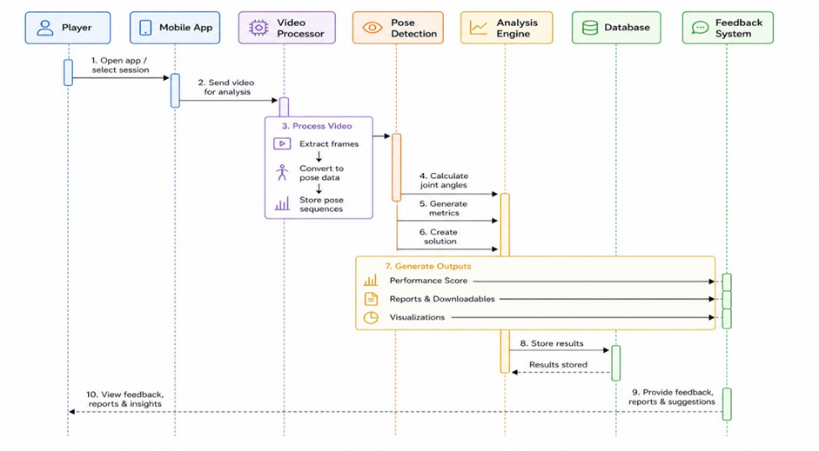
🔄 Behavioural Design – Sequence Diagram
Interaction flow for the cricket video analysis use case

Slide 21
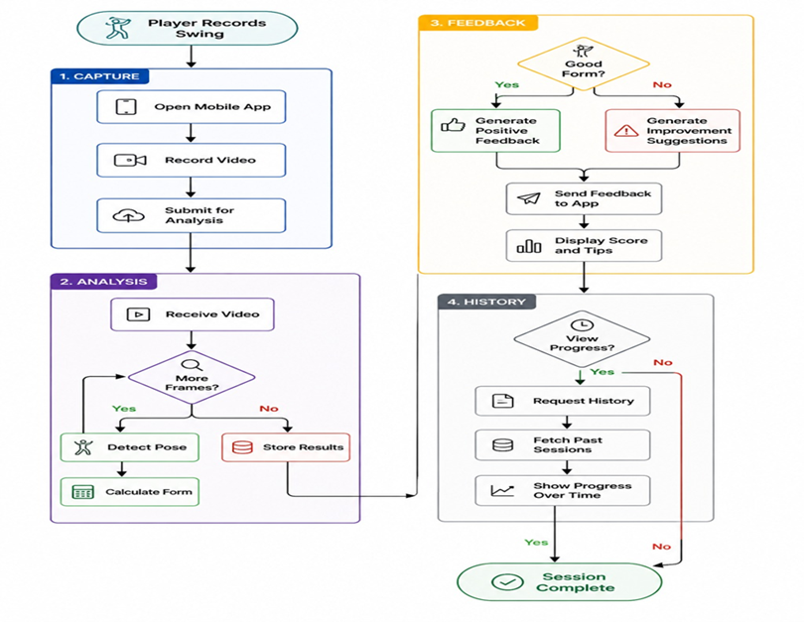
📋 Activity Diagram – Cricket Analysis Flow

Slide 22
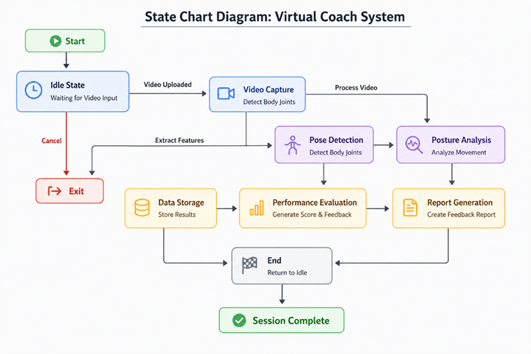
⚙️ State Chart Diagram – Virtual Coach System

Slide 23
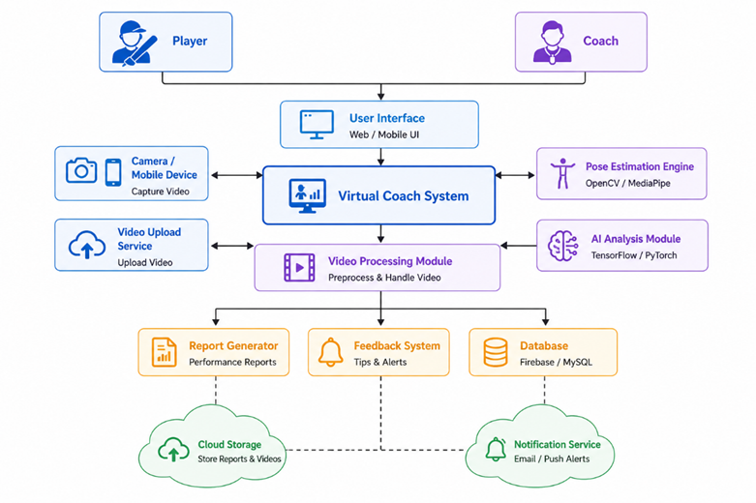
🏗️ Implementation Design – Component Diagram

Slide 24
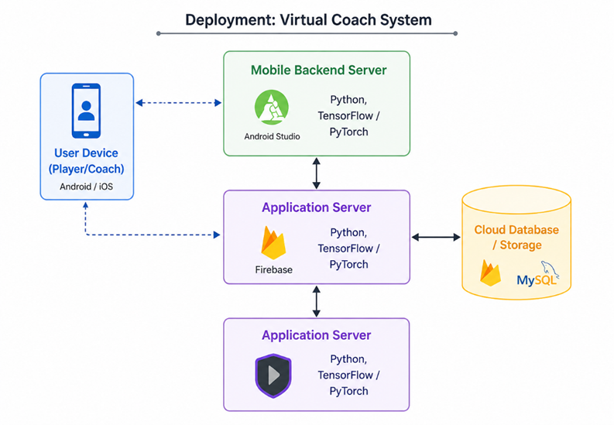
🚀 Deployment Diagram – Virtual Coach System
Network: HTTPS / REST API | Authentication: Firebase Auth | Data Encryption: TLS 1.3 | Cloud: Firebase + MySQL

Slide 25
📚 Related Work Review
P1
Real-Time Human Pose Estimation Using MediaPipe for Fitness Applications
Summary: Uses MediaPipe pose estimation to detect body keypoints in real-time. Tracks joints for basic fitness monitoring.
Limitation: No sports-specific analysis; missing performance scoring; not integrated into mobile app
Our Improvement: Virtual Coach targets cricket-specific posture with scoring & mobile integration
P2
Deep Learning-Based Human Activity Recognition Using Video Analysis
Summary: Uses CNN/LSTM models to classify human activities (running, walking, jumping) from video sequences.
Limitation: Recognizes activity type only; no posture quality evaluation; requires large labeled datasets
Our Improvement: Virtual Coach evaluates posture correctness, not just activity type, with real-time feedback
P3
AI-Based Sports Performance Analysis Using Pose Estimation Techniques
Summary: Uses pose estimation to compare sports movements with ideal techniques via joint angle analysis.
Limitation: No mobile integration; no injury prevention; lacks real-time feedback and performance scoring
Our Improvement: Virtual Coach extends this with mobile app, injury alerts, and live feedback integration

Slide 26
🧪 Dataset Requirements & Testing Strategy
Dataset Requirements
Testing Strategy
🎥 Cricket Action Videos
Unit Testing
Individual module testing — pose detection accuracy, angle computation correctness
Batting and bowling video clips in varied conditions, resolutions, and lighting environments
Integration Testing
End-to-end pipeline: video input → pose → analysis → feedback flow
🌐 Public Sports Datasets
Publicly available sports motion datasets for training pose estimation and action recognition models
Performance Testing
30 FPS processing benchmark, <1s response time, 50+ concurrent users
📹 Self-Recorded Videos
Custom recorded cricket videos for fine-tuning and testing model performance in real conditions
Accuracy Testing
Compare detected angles vs ground truth; target ≥90% joint detection accuracy
🏷️ Labeled Data
Annotated data including posture correctness labels, action types, and joint angle ground truth
User Acceptance
Field testing with cricket players and coaches for feedback and UX validation

Slide 27
📖 Key References
[1]
Z. Cao et al.
[2]
J. Shotton et al.
Realtime Multi-Person 2D Pose Estimation using Part Affinity Fields
Real-Time Human Pose Recognition in Parts from Single Depth Images
CVPR, 2017 | arxiv.org/abs/1611.08050
CVPR, 2011 | ieeexplore.ieee.org/document/5995316
[6]
Google Research
[7]
A. Toshev & C. Szegedy
MediaPipe: A Framework for Building Perception Pipelines
DeepPose: Human Pose Estimation via Deep Neural Networks
Google AI, 2020 | mediapipe.dev
CVPR, 2014 | arxiv.org/abs/1312.4659
[8]
S. Wei et al.
[11]
J. Carreira & A. Zisserman
Convolutional Pose Machines
Quo Vadis, Action Recognition? A New Model and the Kinetics Dataset
CVPR, 2016 | arxiv.org/abs/1602.00134
CVPR, 2017 | arxiv.org/abs/1705.07750
[14]
B. Xiao et al.
[4]
K. Simonyan & A. Zisserman
Simple Baselines for Human Pose Estimation and Tracking
Two-Stream Convolutional Networks for Action Recognition in Videos
ECCV, 2018 | arxiv.org/abs/1804.06208
NIPS, 2014 | arxiv.org/abs/1406.2199

Slide 28
🏆 Conclusion & Future Scope
Project Summary
Virtual Coach is an AI-powered mobile application that uses computer vision and deep learning to analyze cricket player posture from video input. The system detects body joints using MediaPipe, evaluates technique using ML models, and provides real-time feedback, performance scores, and injury alerts — making professional-level coaching accessible and affordable to all athletes.
Future Scope
🏏
Extend to multi-sport support (Badminton, Tennis, Swimming, Athletics)
⌚
Integrate wearable sensors for 3D motion capture and biomechanical data
🌐
Multi-language support and cloud-based collaborative team training
🤖
Advanced deep learning models for more granular technique evaluation
📊
Automated injury risk prediction with severity scoring and physiotherapy guidance
👥
Coach dashboard for managing multiple players with comparative analytics

Slide 29
🏏
THANK YOU
Virtual Coach — AI-Based Cricket Posture Analysis System
Department of CSE (AIML) | D.K.T.E Society's Textile and Engineering Institute, Ichalkaranji | 2025–2026
Guide: Prof. V.B. Sutar

