Slide 1
ML REVIEW 1 · SRM INSTITUTE OF SCIENCE AND TECHNOLOGY · GROUP AD1
Explainable Multimodal Physics-Aware Deep Learning for EV Battery
IN
10 min of V, I and T
from one discharge
MODEL
15 physics features ->
robust linear fit
Estimating State of Health from ten minutes of voltage, current and temperature - with robust linear regression
OUT
State of Health,
with a reason attached
Team
Swastik Mukherjee - RA2411026010181
Prahladh Alarpati - RA2411026010171
Aayan Noori - RA2411026010165
636 cycles · 4 cells · MAE 1.14 pp on an unseen cell
B.Tech CSE · Department of Computational Intelligence · October 2026

Slide 2
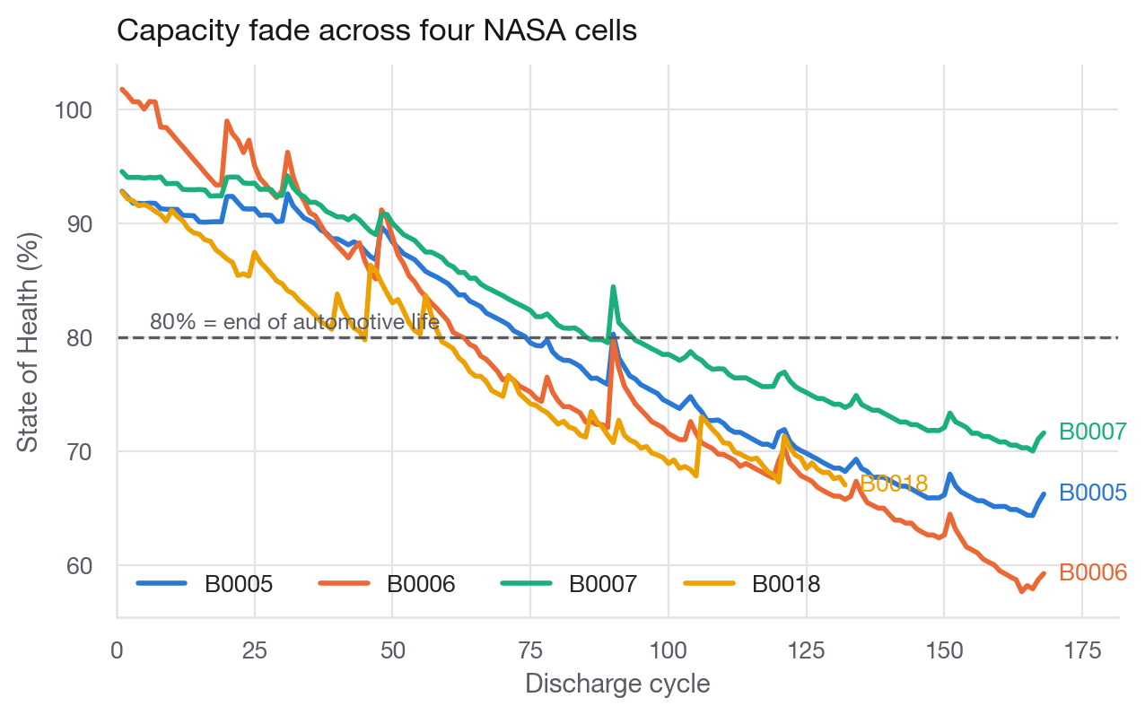
Problem and Objective
Why State of Health is hard
• An EV battery's real capacity is only known by fully discharging it - which no car can do on the road
• Battery Management Systems must instead infer it from short, noisy sensor windows
• Deep models can do this but give no reason, and nobody certifies a black box for a safety system
• Capacity labels themselves come from coulomb counters that drift and glitch
Capacity fade of the four NASA cells used in this project
UNIT 1
UNIT 2
GOAL
Statistical analysis of a 15,064-cycle battery ageing dataset
Robust linear regression on physics-aware multimodal features
An SOH estimate that is accurate, explainable and fault-tolerant

Slide 3
Two Datasets, Two Jobs
169,766
Dataset A - NASA PCoE
Dataset B - HNEI 18650
raw sensor samples (NASA)
• 4 cells (B0005/6/7/18) cycled to failure at 24 degC
• Within-cycle traces: voltage, current, temperature
• Used for the MODEL - label is measured capacity
• Split by cell: train on 3, test on the 4th
• 14 NMC-LCO cells, 8 cycle-summary measurements
• Cell identity had to be rebuilt from cycle-index resets
• Used for the STATISTICS - label is remaining useful life
• Deliberately a different lab, chemistry and format
636
discharge cycles, 4 cells
15,064
cycles, 14 cells (HNEI)
15 + 8
The leakage trap we had to design around
Full discharge duration correlates 0.997 with the capacity label - because the label IS that duration, integrated. Using it would score a fake R2 of 1.0, so every feature here is capped at the first 600 s.
engineered and measured features

Slide 4
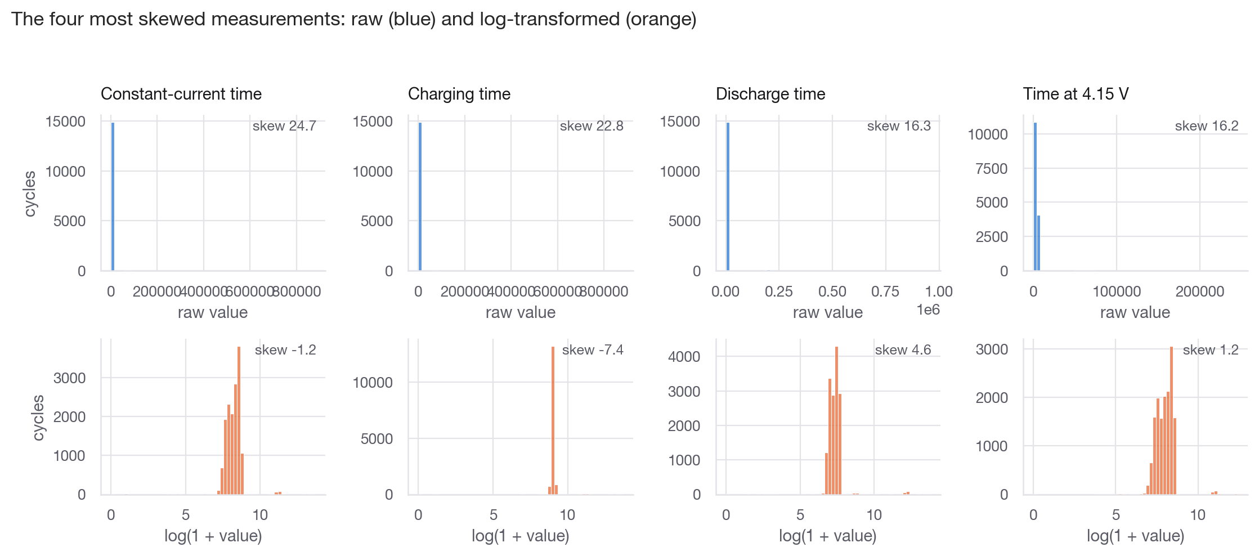
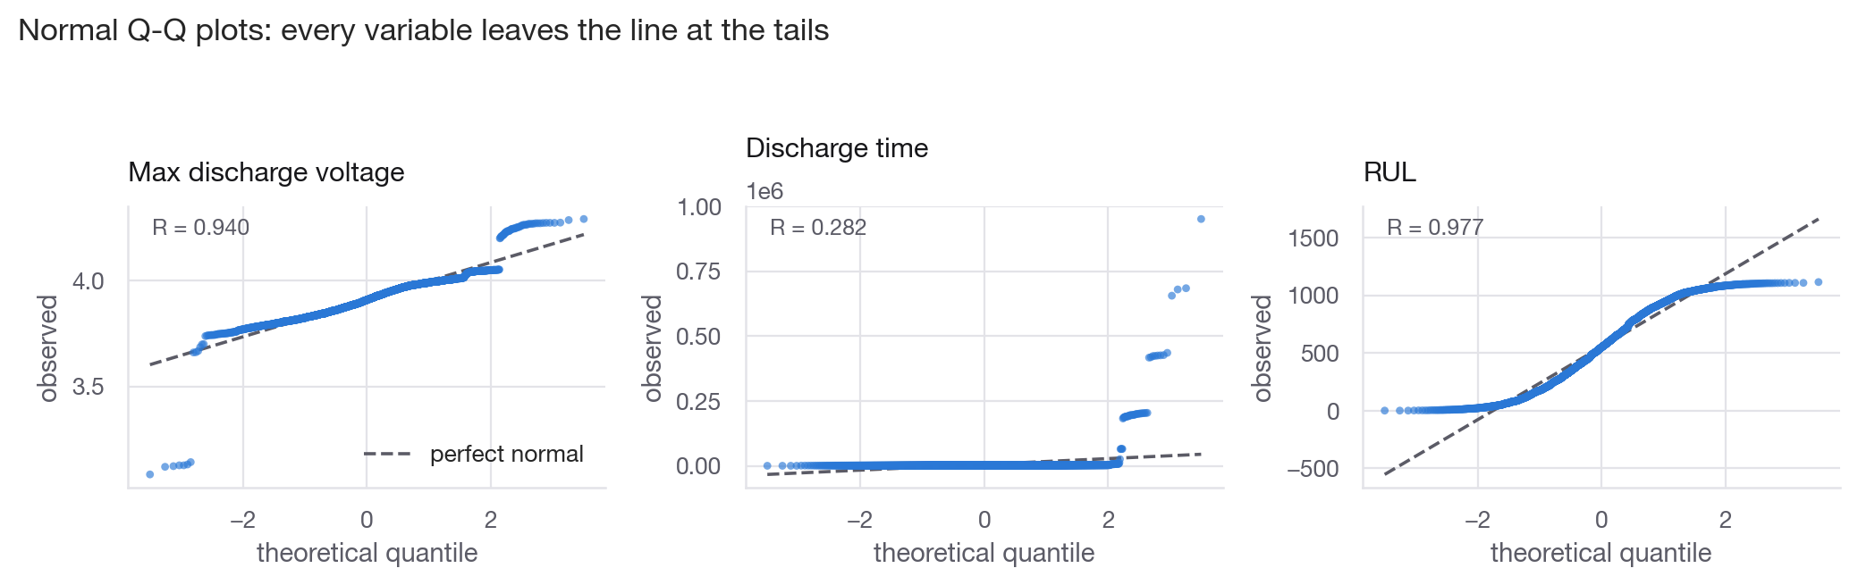
Unit 1: Nothing in This Data Is Normal
Normal Q-Q plots - every variable leaves the line at the tails
The four most skewed columns, raw (blue) vs log-transformed (orange)
9 of 9
0
1.8%
variables reject normality (D'Agostino and Shapiro, p < 0.001)
of them are rescued by a log transform
median share of cycles flagged as IQR outliers

Slide 5
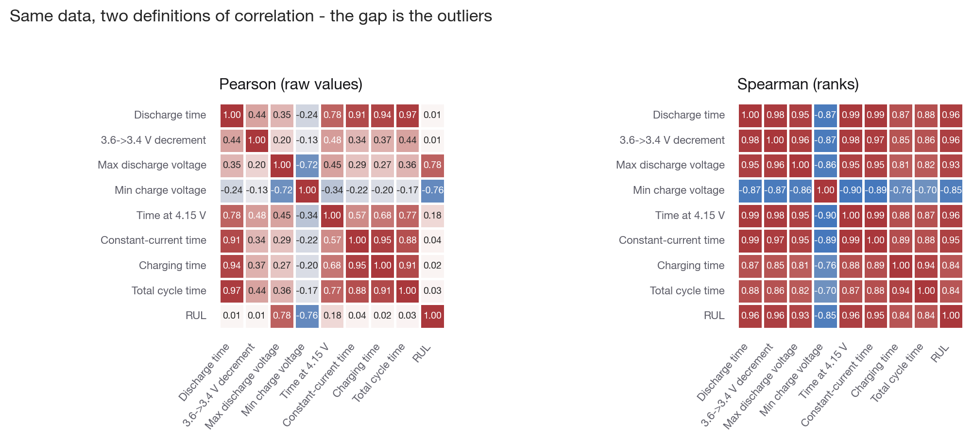
Unit 1: Outliers Hide the Strongest Signal
What the gap means
• 'Discharge time' scores Pearson r = +0.01 (p = 0.14, not significant)
• The same pair scores Spearman rho = +0.96 - near-perfect
• A handful of cycles logged for days flatten the straight-line fit
• Anyone reporting only Pearson r would discard the best feature in the dataset
Same eight columns, two definitions of correlation
0.96
0.01
8 of 8
Spearman rho, strongest monotone signal
Pearson r on the very same pair
features still significant after Holm-Bonferroni

Slide 6
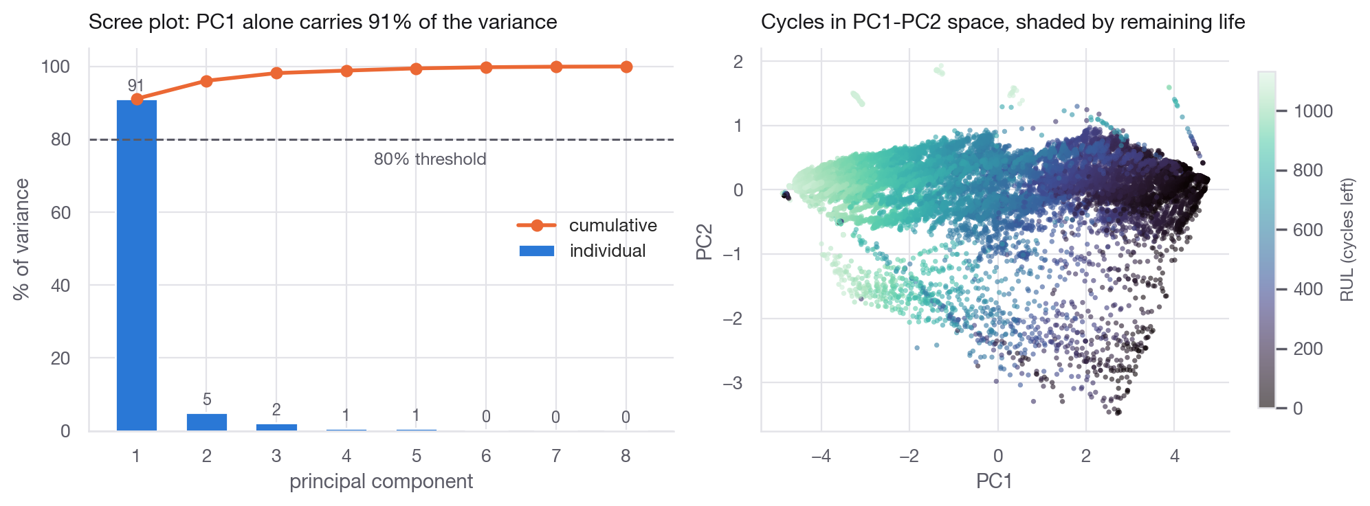
Unit 1: Structure, Groups and Hypothesis Tests
Six formal tests
• H1 cells differ in voltage level - Kruskal-Wallis, reject
• H2 variances differ across cells - Levene, reject
• H3/H4 early vs late life - Mann-Whitney, reject (CLES 0.98)
• H5 fade within one cell - Spearman rho = -0.96, reject
• H6 cells differ in RUL - cannot reject, and that is correct
PCA on rank-transformed features, and the cycles in PC1-PC2 space
91%
5 of 6
98.2%
of all variance sits in PC1 alone - one latent ageing axis
hypotheses reject H0 at alpha = 0.05
chance a random early cycle outranks a late one
Conclusion that drives Unit 2: non-Gaussian, outlier-heavy, one dominant latent axis, and cells that differ from each other -> a ROBUST LINEAR fit validated by holding out whole cells.

Slide 7
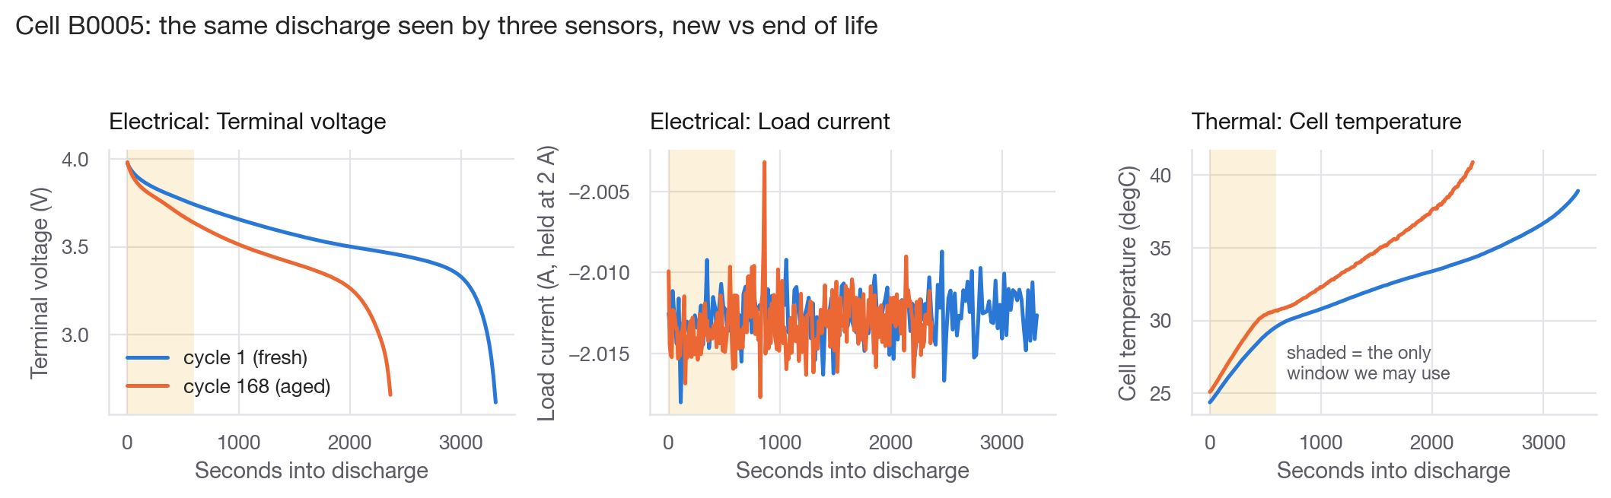
Unit 2: Multimodal Physics-Aware Features
One cell, three sensors, fresh cycle vs end of life. Shaded band = the only 600 s we allow the model to see.
ELECTRICAL (8)
THERMAL (4)
PHYSICS COUPLINGS (3)
Internal resistance from the first loaded sample · voltage at 60 / 300 / 600 s · plateau slope · 3.9->3.8 V crossing time · energy and RMS current in the window
Temperature rise · temperature at 600 s · heating rate · thermal dose above ambient (K·h)
Joule heat I²Rt · Arrhenius rate factor exp(-Ea/RT) for SEI growth · degrees of heating per Wh delivered

Slide 8
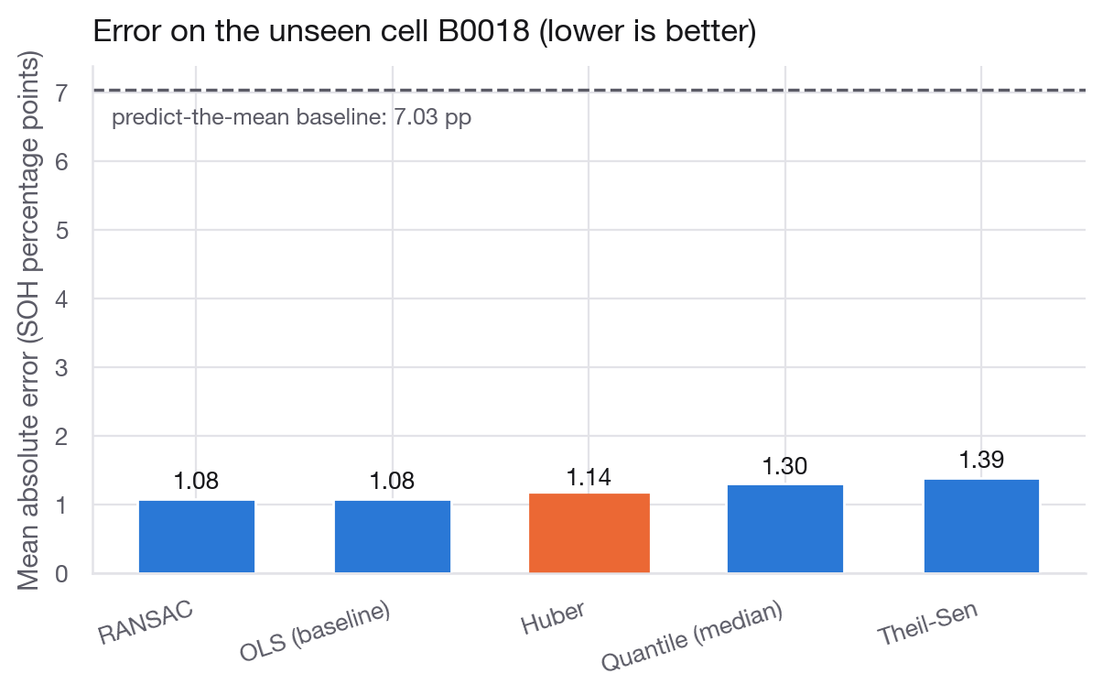
Unit 2: Five Lines, Five Definitions of 'Fit'
Setup
• Target: SOH = measured capacity / 2.00 Ah rated
• 504 training cycles (B0005/6/7), 132 test cycles (B0018, never seen)
• All 15 features standardised inside the pipeline, so coefficients are comparable
• OLS squares the error - one bad point bends the whole line
• Huber squares small errors, switches to absolute past 1.35 sigma
• RANSAC fits random subsets and keeps the consensus fit
• Theil-Sen takes the median of pairwise slopes
• Quantile regression fits the conditional median
Mean absolute error on the held-out cell, in SOH percentage points
1.14 pp
7.0 pp
0.953
Huber MAE on an unseen cell
predict-the-mean baseline
R² on the held-out cell

Slide 9
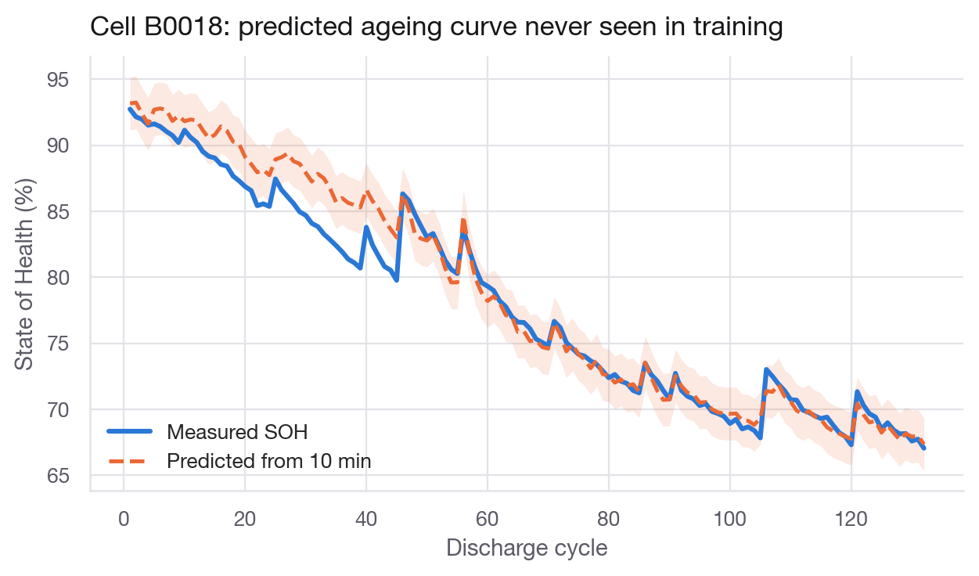
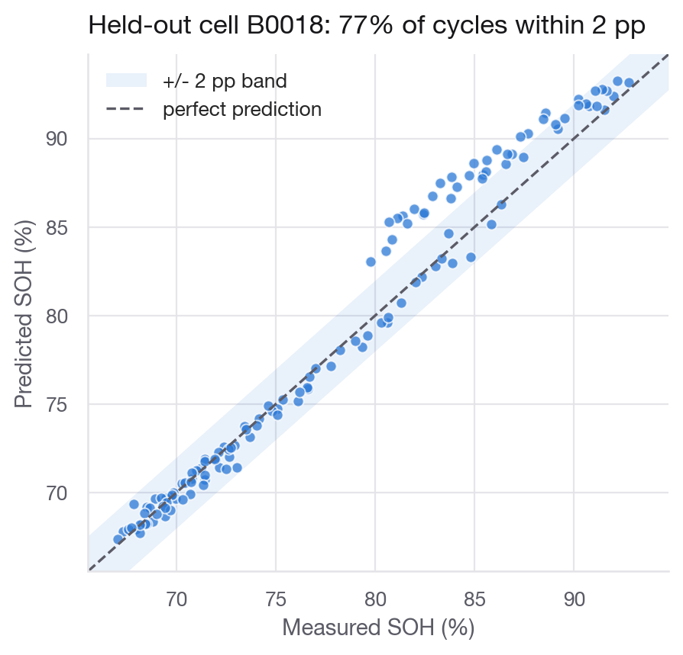
Results on a Cell the Model Has Never Seen
Cell B0018: measured ageing curve vs the curve predicted from 10-minute windows
Predicted vs measured, with the +/- 2 pp band
77%
6.2x
3.7 pp
10.0 pp
of test cycles land within 2 percentage points
better than the predict-the-mean baseline
best leave-one-cell-out CV (Theil-Sen)
same CV for OLS - robust fits transfer better

Slide 10
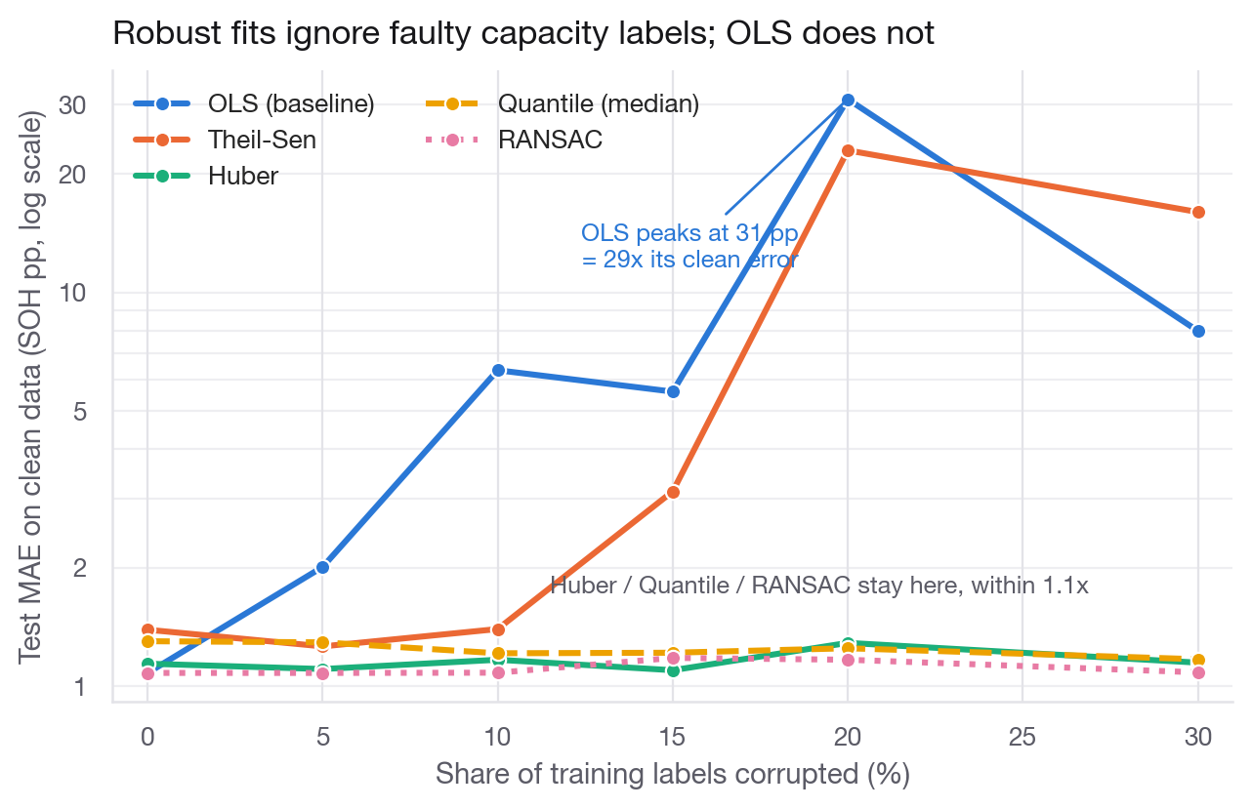
The Experiment That Justifies 'Robust'
How the test works
• Replace p% of training capacity labels with sensor-fault values: half stuck low at 35% SOH, half spiking to 160%
• The test set stays clean, so any loss is the model being fooled
• OLS peaks at an error of 31 pp - it is predicting nonsense
• Theil-Sen is the instructive failure: its breakdown point is ~29% and it collapses right on cue
• Huber, Quantile and RANSAC never move
Test error on clean data as a growing share of TRAINING labels is corrupted
29x
1.1x
1.29 pp
worse: OLS at its worst contamination level
worse: Huber at its worst
Huber's worst-case error, still under 1.3 pp

Slide 11
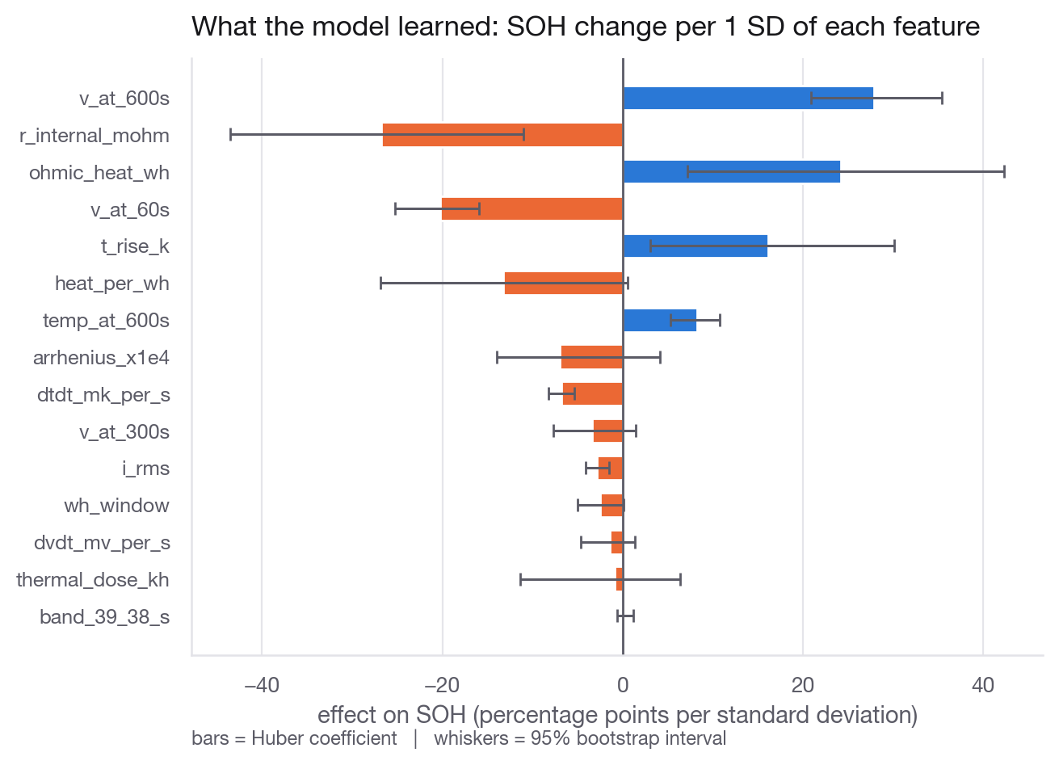
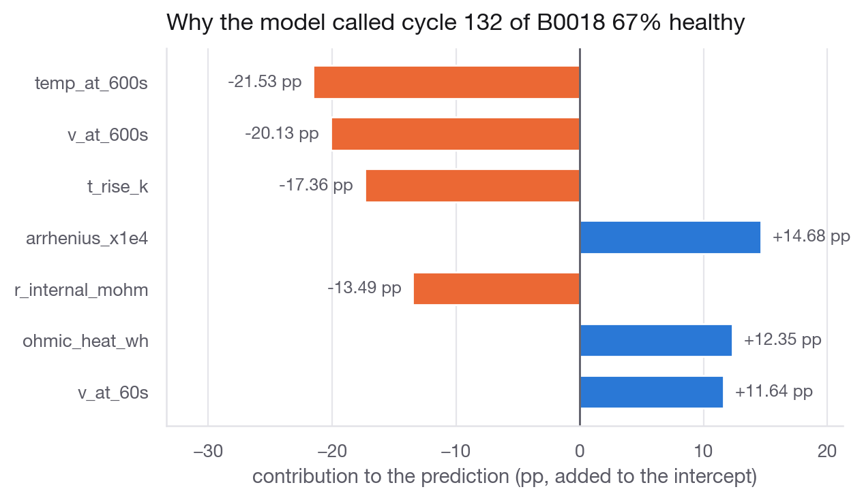
Explainability: Every Prediction Has a Reason
Effect on SOH per standard deviation, with 95% bootstrap intervals
One cycle decomposed: intercept plus a named contribution per feature
8 of 15
20 pairs
0.3 pp
coefficients keep their sign in 95% of bootstrap resamples
of features correlate above 0.9 - credit is shared, so read them as groups
gap between true and predicted SOH on the worked example

Slide 12
Conclusion
Ten minutes of voltage, current and temperature is enough to estimate State of Health to 1.14 pp on a cell the model never saw.
1
Robustness is not a detail: with 20% faulty labels OLS degrades 29x while Huber stays within 1.1x.
2
Physics-aware features keep the model readable - internal resistance, plateau voltage and temperature rise carry the signal, with intervals.
3
The statistics decided the modelling: non-Gaussian, outlier-heavy data with cell-to-cell differences demands a robust fit and grouped validation.
4
Limitations
Future Work
Only 4 cells, one ambient temperature (24 degC) · constant-current discharge only, not a real drive cycle · 20 correlated feature pairs blur individual coefficients · single held-out cell
More cells and varied temperatures · physics-informed neural network with the same features as inputs · per-cell random effects · online recursive update inside a live BMS

