Slide 1
ML REVIEW 1 · SRM INSTITUTE OF SCIENCE AND TECHNOLOGY
BUY
Top third of weekly returns
AI Investment Committee
HOLD
Middle third
A data-driven BUY / HOLD / SELL decision system for NIFTY 50 stocks
SELL
Bottom third
Team
Shaik Akbar Basha - RA2411026010158
Muthaluru Ranga Mokshagnya - RA2411026010155
Batchu Jatadhar - RA2411026010169
50 stocks · 287 weeks · 13 features
B.Tech CSE · Department of Computational Intelligence · October 2026

Slide 2
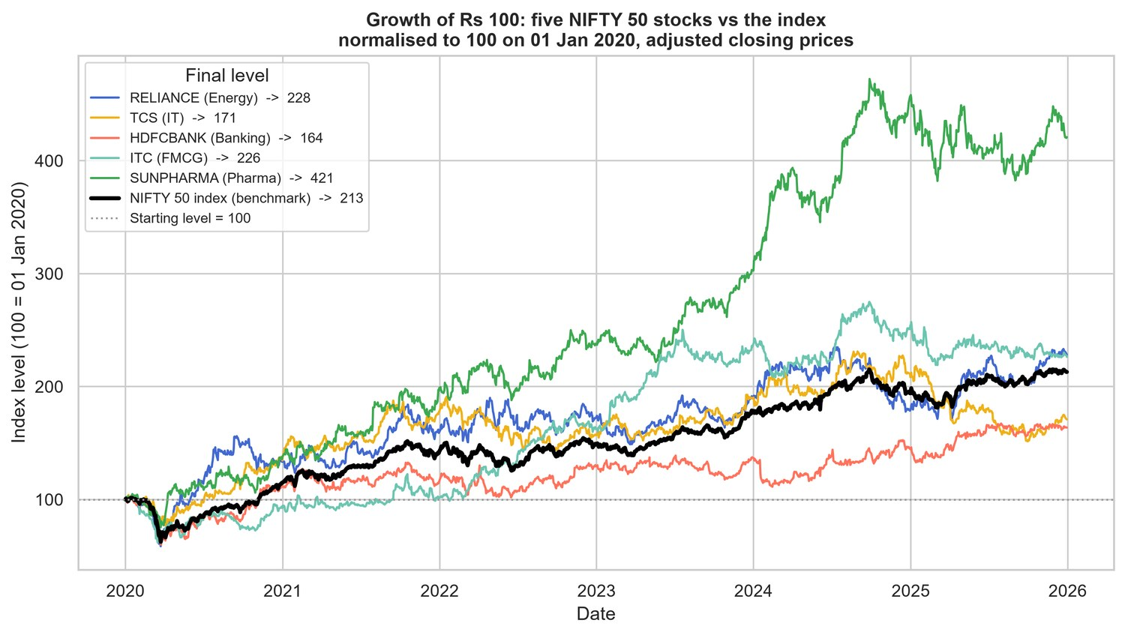
Problem and Objective
Why a data-driven committee?
Analyst BUY / HOLD / SELL calls are often subjective
Two analysts can read the same chart differently
Hard to check afterwards if a call was justified
Public price data can yield measurable indicators
Growth of ₹100: five sample stocks vs NIFTY 50 (2020–2025)
UNIT 1
Statistical analysis of returns and indicators
UNIT 2
SVM classification and regression
OUTCOME
Honest comparison against baselines

Slide 3
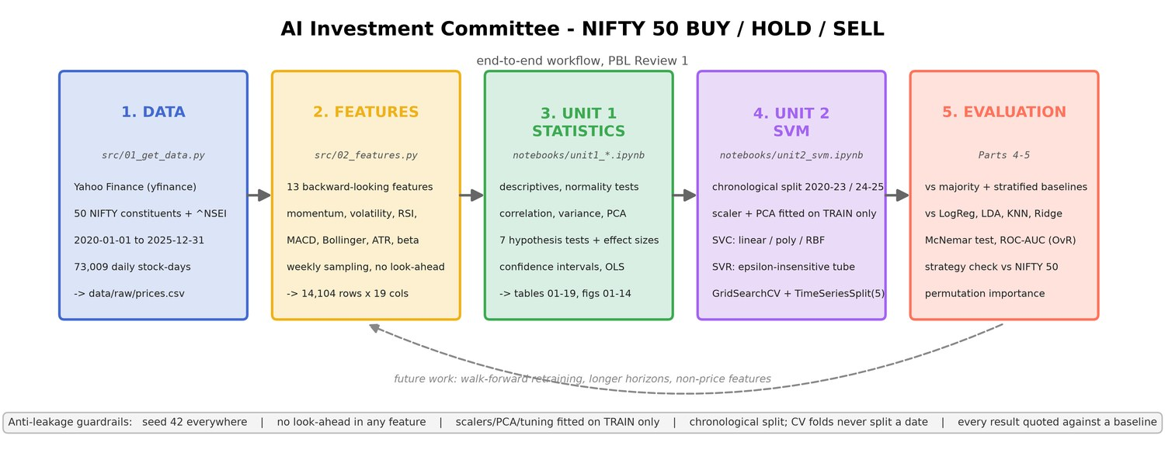
Dataset and Workflow
73,009
daily stock-days, 2020–2025
50 stocks
NIFTY 50, across 18 sectors
14,104
weekly rows after cleaning
Project workflow with anti-leakage safeguards
13 + 2
Targets: 5-day forward return (regression) and BUY / HOLD / SELL terciles across the 50 stocks each week (classification). Classes are balanced, so the majority baseline is only 34.0%.
features and two targets

Slide 4
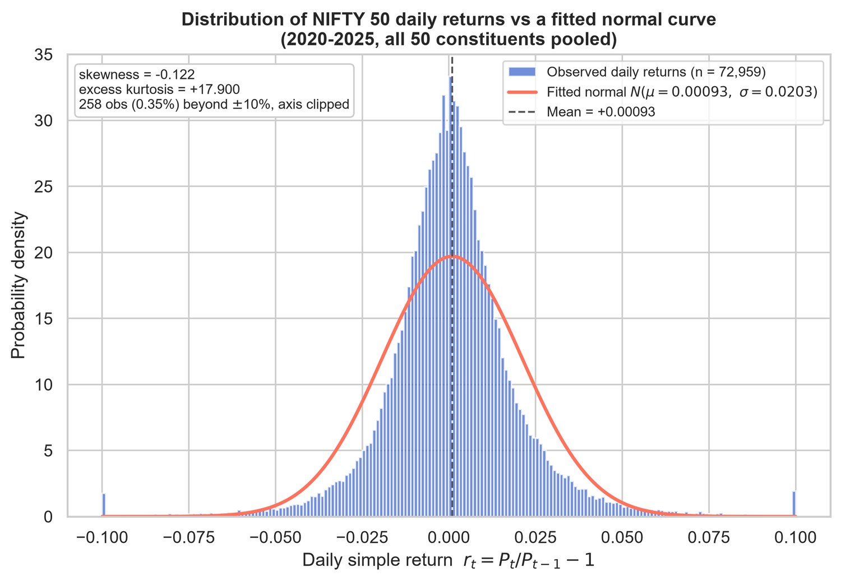
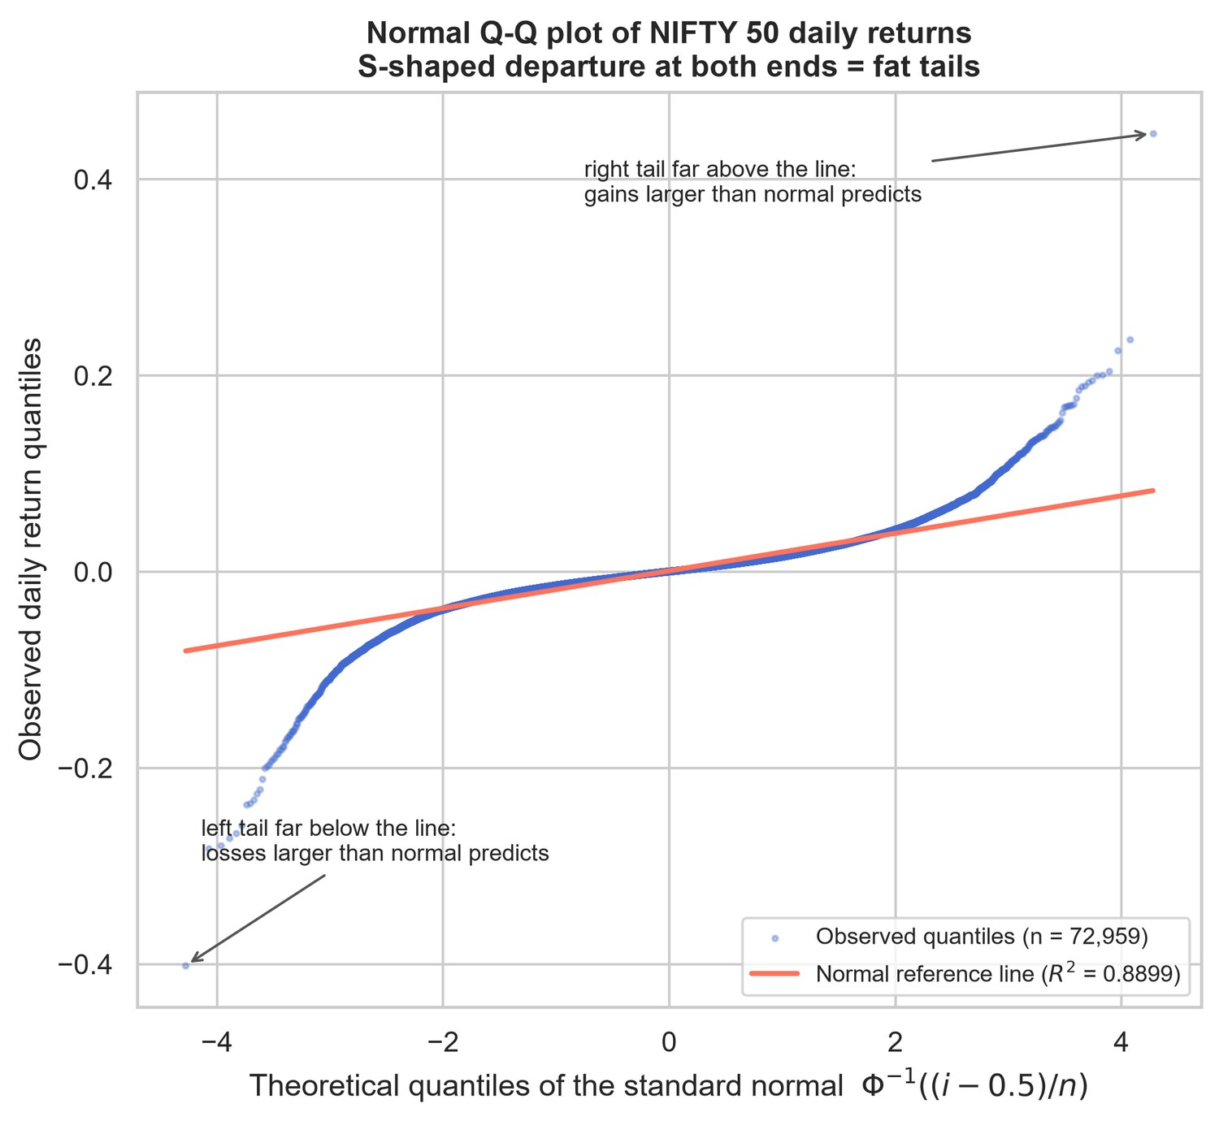
Unit 1: Returns Are Not Normal
17.9
excess kurtosis of daily returns
~100×
more 4σ moves than normal
4.0%
median outliers per variable (IQR rule)
Daily returns vs fitted normal
Normal Q-Q plot: fat tails
Outliers are genuine events, mostly the 2020 crash, so robust and non-parametric methods are needed.

Slide 5
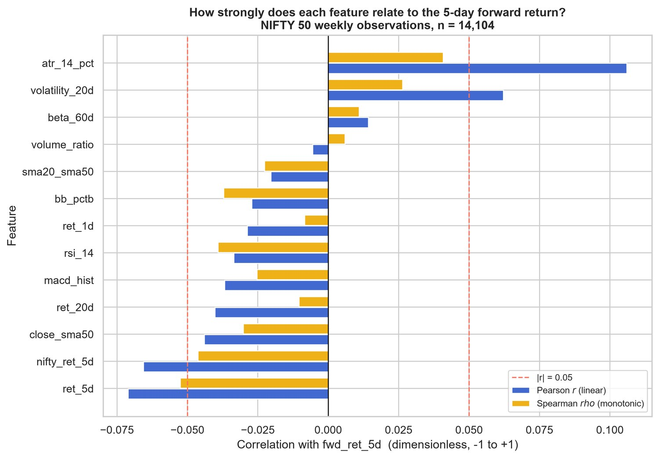
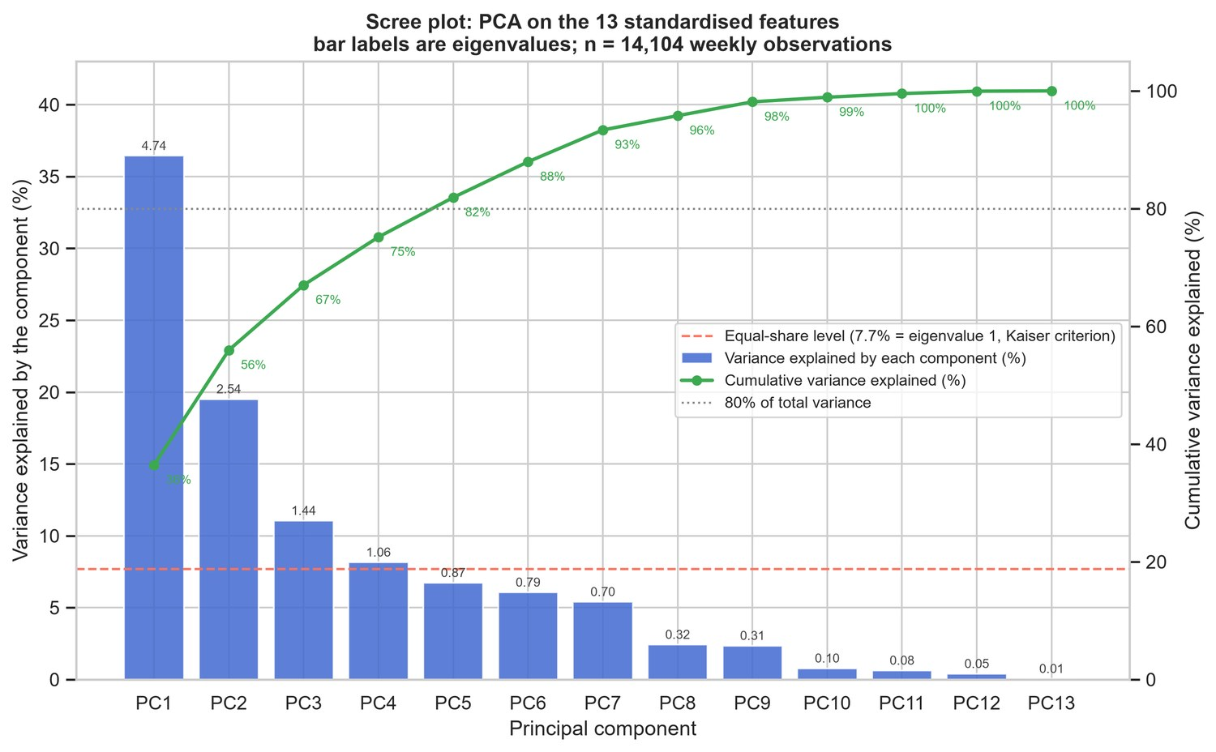
Unit 1: Real but Weak Signals
Feature correlation with 5-day forward return
PCA scree plot: four components explain 75%
1.1%
6 of 7
0.2%
variance explained by the strongest feature (ATR)
hypothesis tests significant
of return variance explained by sector

Slide 6
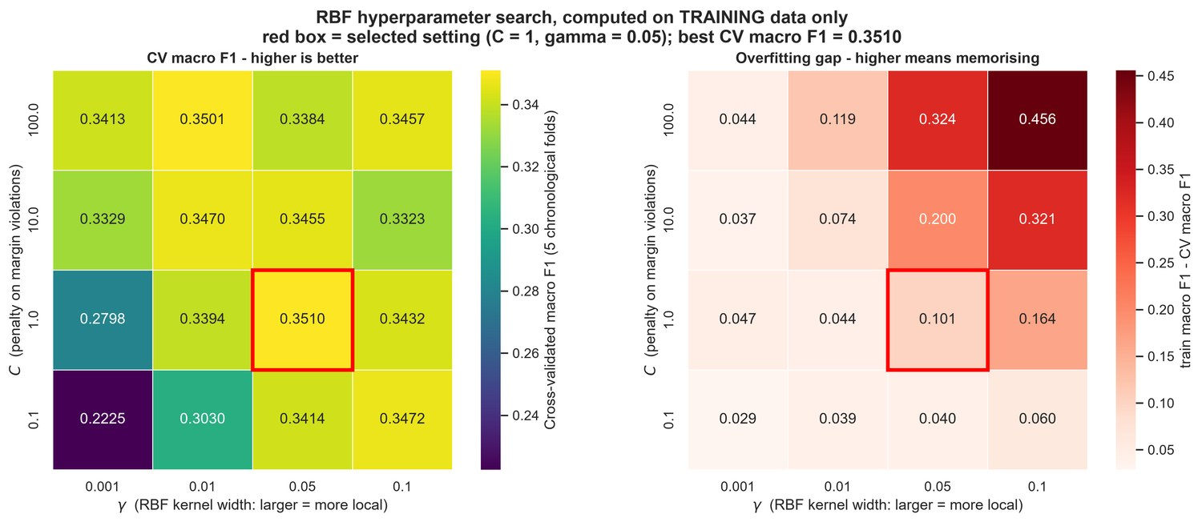
Unit 2: Support Vector Machines
Setup
Linear, polynomial and RBF kernels for BUY / HOLD / SELL, plus SVR for returns
Chronological split: train 2020–2023 (8,954 rows), test 2024–2025 (5,150 rows)
Test set used once
Train-only scaler and date-aware cross-validation
Baselines: Logistic Regression, LDA, KNN, Linear and Ridge Regression
Cross-validated macro F1 over the RBF C × γ grid and overfitting gap
Linear
C = 10
Poly d = 3
C = 10, γ = 0.1
RBF (selected)
C = 1, γ = 0.05

Slide 7
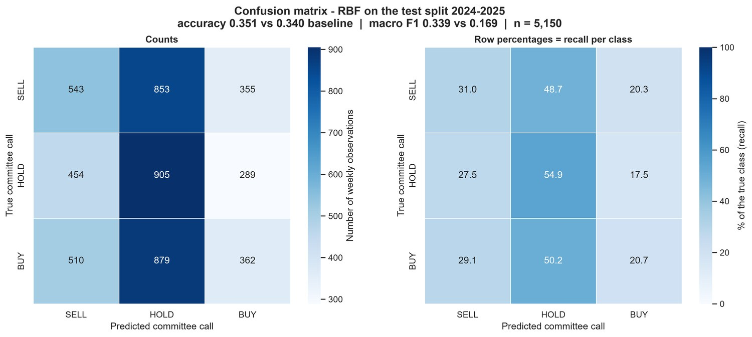
Classification Results
Kernel | CV F1 | Test acc. | Test F1 | Edge (pp)
Linear | 0.338 | 34.0% | 0.303 | +0.02
Poly d = 2 | 0.340 | 33.8% | 0.313 | −0.17
Poly d = 3 | 0.341 | 34.2% | 0.333 | +0.21
RBF (selected) | 0.351 | 35.2% | 0.339 | +1.15
Majority baseline | – | 34.0% | 0.169 | 0.00
Confusion matrix, RBF SVM, 2024–2025 test set
+1.15 pp
2×
0.55
R² ≈ 0
accuracy over the 34% baseline
macro F1: 0.339 vs 0.169
HOLD recall: unsure means HOLD
SVR cannot predict return size

Slide 8
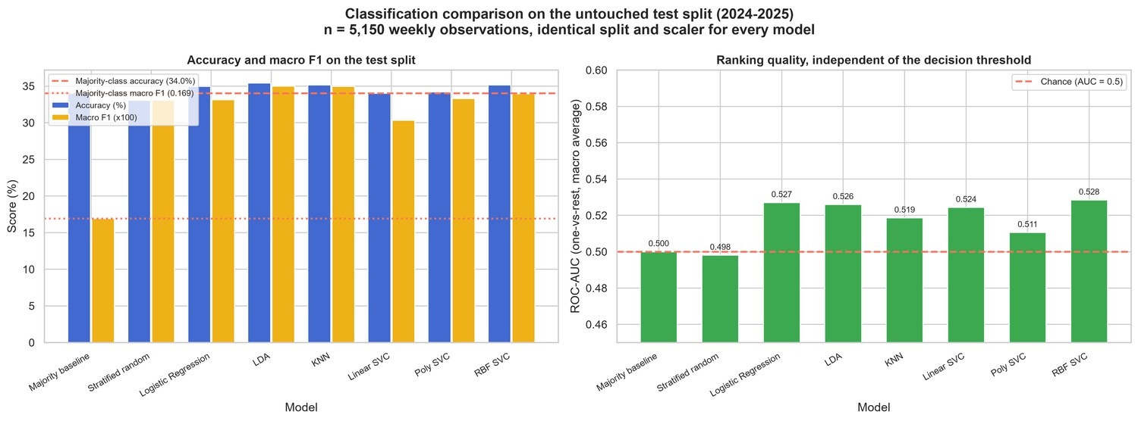
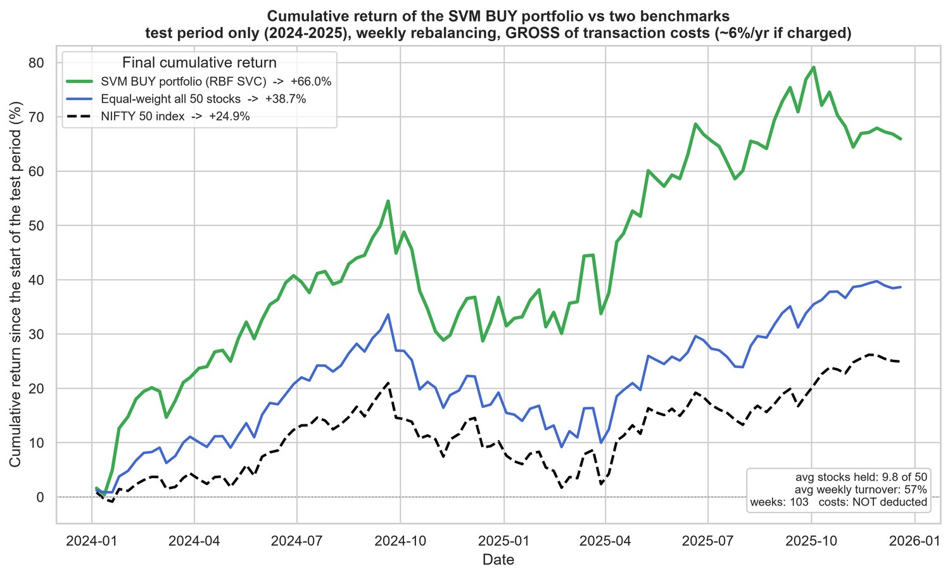
Benchmarking and Strategy Check
Eight classifiers on the same test set
BUY portfolio vs NIFTY 50 (gross of costs)
SVM ≈ LR
Sharpe 1.13
Caution
LDA and KNN score the same; McNemar finds no significant difference
SVM BUY portfolio vs 0.38 for NIFTY 50
103 test weeks, rising market, no transaction costs

Slide 9
Conclusion
Limitations
Market noise: 1 pp edge may be luck
Survivorship bias, current index list
Single 103-week test period
Price features only, no costs
1
Stock returns are fat-tailed and every signal is weak, but real
2
Tuned RBF SVM: 35.2% accuracy and 0.339 macro F1 vs 34.0% and 0.169 baseline
Simple models match the SVM; honest evaluation matters more than kernel choice
Future Work
3
Fundamentals, FII/DII flows, news sentiment
20 and 60-day horizons, walk-forward retraining
Point-in-time universe, net of costs
Multi-agent committee with an LLM analyst
4
Exact return prediction fails (R² ≈ 0); ranking stocks in thirds is more useful
Thank You

