Slide 1
MovieOnRent Data Analysis Project - Optimizing Movie Inventory and Customer Experience Customer Churn in Bank Data Analysis
BY
Shaik Aayesha Mohammadi
Batch Number: DA132S13
Enrollment ID:EN12024078064

Slide 2
TABLE OF CONTENTS
INTRODUCTION
BUSINESS OBJECTIVE
UNDERSTANDING THE DATA
EACH TASKS & OUTPUTS
ADVANTAGES
DISADVANTAGES
APPLICATIONS
CONCLUSION

Slide 3
INTRODUCTION
In today's highly competitive financial industry, retaining customers is essential for sustainable growth.
Customer churn can lead to revenue loss and decreased market share. Understanding the underlying reasons for attrition is crucial for developing proactive retention strategies.

Slide 4
BUSINESS OBJECTIVE
The credit card business of a North American bank is facing declining performance, with a significant number of customers discontinuing their credit card services.
To address this issue and reduce customer attrition, the bank needs to gain a deeper understanding of the factors contributing to customer churn.

Slide 5
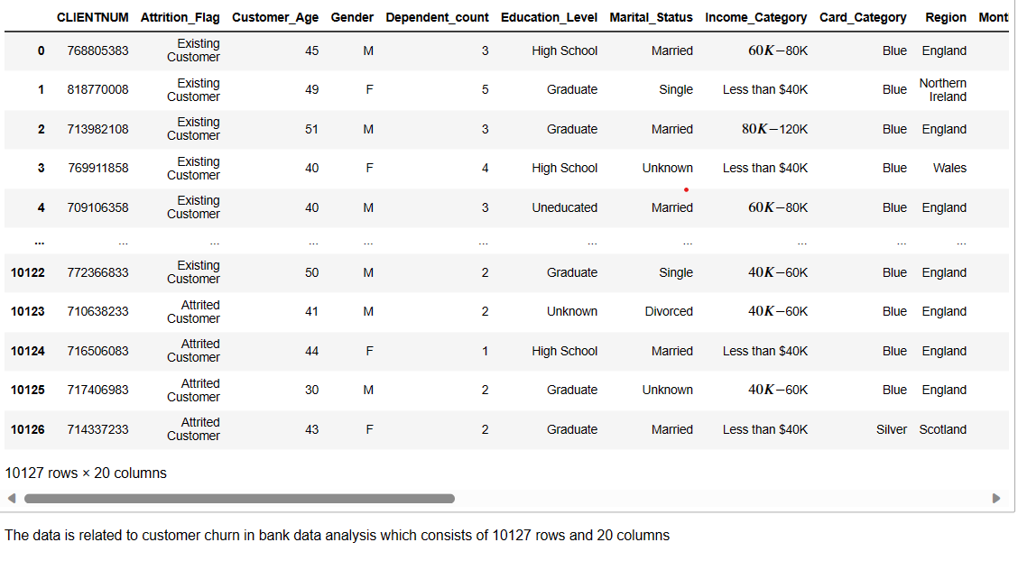
UNDERSTANDING THE DATASET

Slide 6
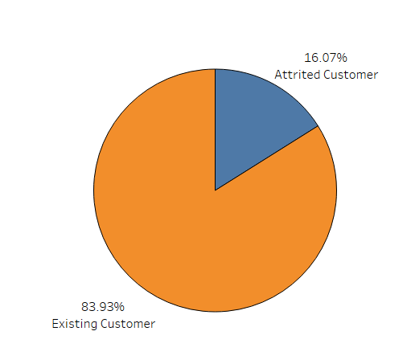
Percentage of the attrited and the existing customers
The Piechart shows that the bank has 83.93% Existing Customers and 16.07% Attrited Customers

Slide 7
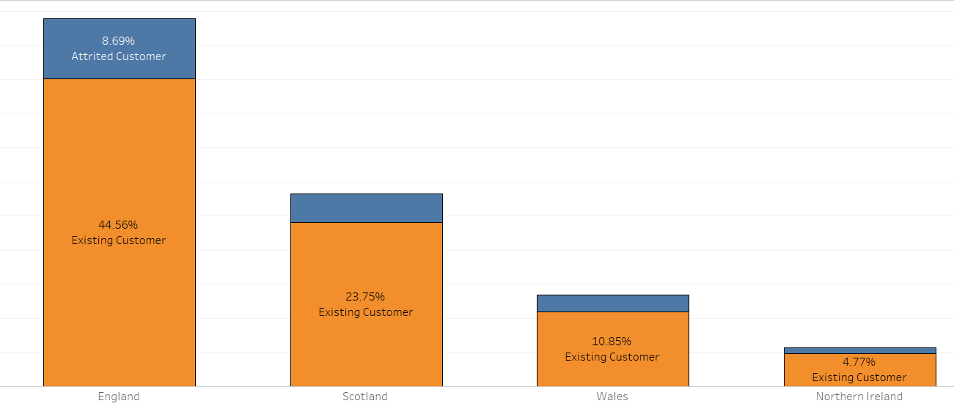
Region wise percentage of the attrition
The bank has most of the Existing Customers from England.

Slide 8
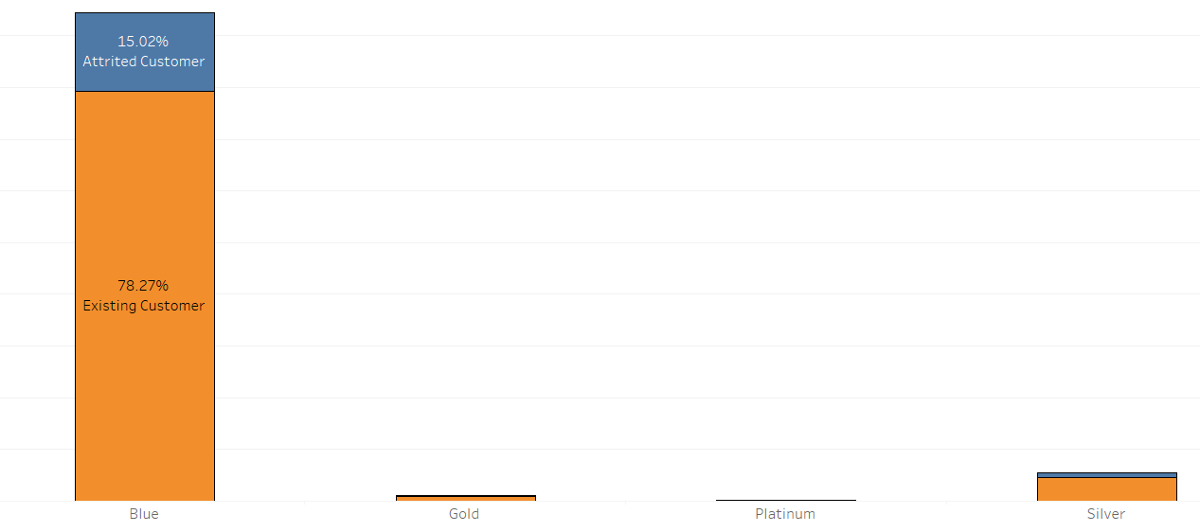
Credit Card wise percentage of the attrition
The bank has most of the Existing Customers from Blue Card Category.

Slide 9
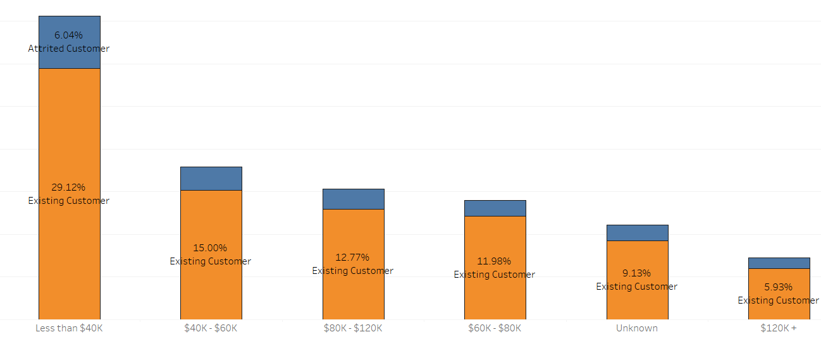
Income wise percentage of the attrition
The bank has most of the Existing Customers from Less than $40 Income Category.

Slide 10
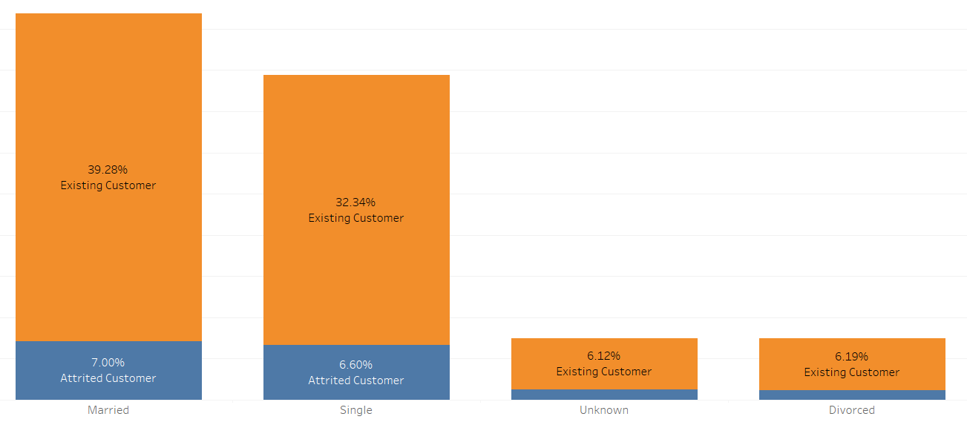
Marital Status wise percentage of the attrition
The bank has most of the Existing Customers from Married Category.

Slide 11
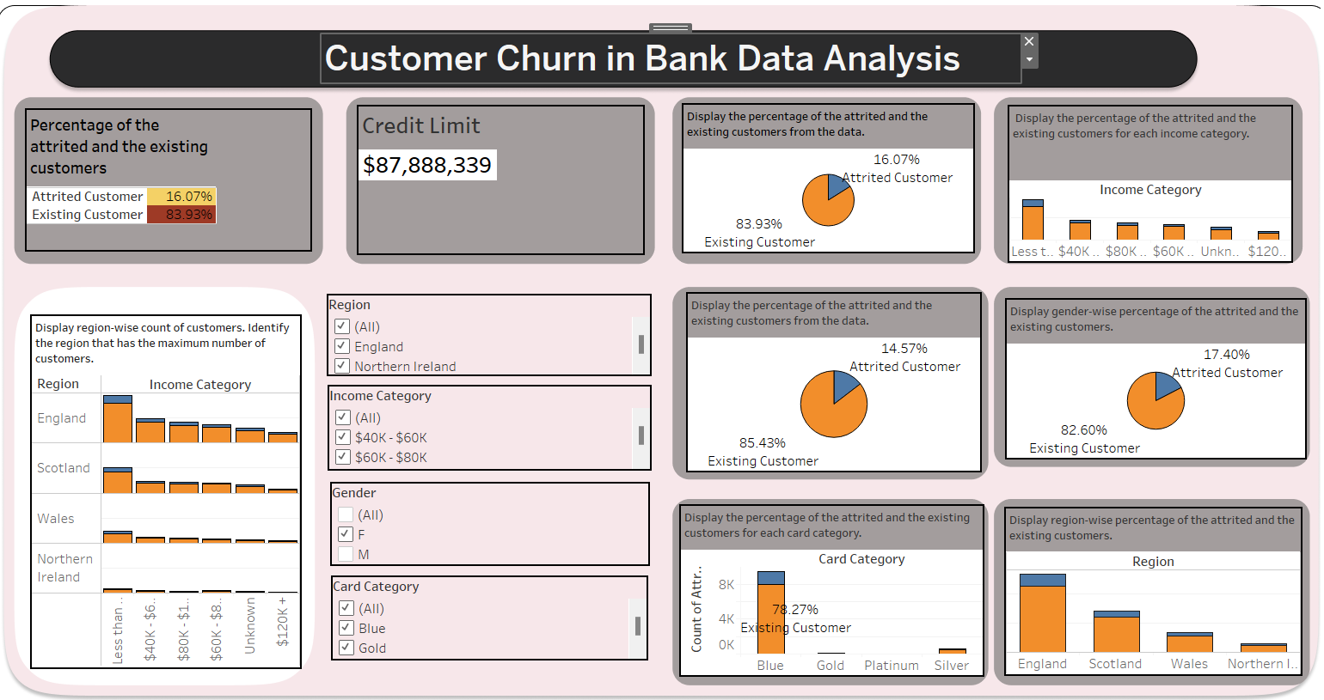

Slide 12
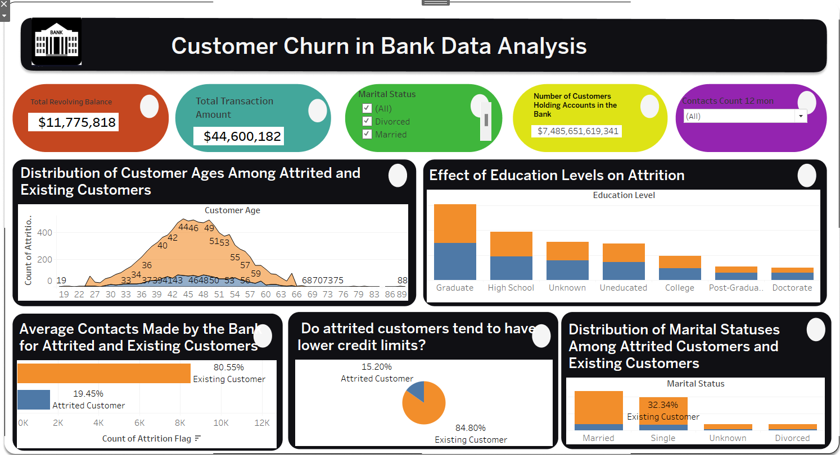

Slide 13
ADVANTAGES
Improved decision-making
Increased profitability
Improved Customer Retention
Competitive advantage

Slide 14
DISADVANTAGES
Implementation Costs
Time-consuming
Overreliance on data
Privacy concerns

Slide 15
APPLICATIONS
Risk Management
Regional Expansion
Marketing Strategy

Slide 16
CONCLUSION
The bank should prioritize on retaining Existing Customers by further understanding the particularly among high-value demographics in regions like England and those with incomes less than $40K.
This customer-centric approach, combined with tailored services for married customers, promotions targeting Blue cardholders, and optimized credit limits, can help maintain market dominance and potentially expand the customer base.

Slide 17
THANK YOU

