Slide 1
EMPOWERING DATA ANALYST CAREER CHOICES
By
Shaik Aayesha Mohammadi
Batch No:DA132S13
ENROLLMENT ID:EN12024078064

Slide 2
TABLE OF CONTENTS
INTRODUCTION
NEED OF STUDY
BUSINESS OBJECTIVE
TOOLS OR LIBRARIES USED
VISUAL INSPECTION OF DATA
DATASET EXPLORATION
DATA CLEANING
OUTLIER ANALYSIS: Methods and Tools Used for Removing Outliers
Processed Data
EXPLORATORY DATA ANALYSIS (EDA)
HYPOTHESES
DASHBOARD
INSIGHTS
ADVANTAGES AND DISADVANTAGES
APPLICATIONS
CONCLUSION

Slide 3
INTRODUCTION
"In the fast-evolving realm of data analytics, aspiring professionals often face a complex landscape of career options. Finding the right path to success means navigating through a multitude of job titles, considering diverse company locations, and understanding corresponding salary ranges. In this analysis spanning 2020 to 2023, we aim to simplify this decision-making process.
Our goal is to provide comprehensive insights into data analyst salaries and job titles, empowering job seekers to make informed career choices that align with their salary expectations and career aspirations.

Slide 4
Need of study
Career Planning
Geographical Preferences
Job Title Considerations
Salary Trends
Company Size Impact

Slide 5
BUSINESS OBJECTIVE
The primary objective of this study is to empower data analyst job seekers with the knowledge required to make strategic career decisions.
Provide a detailed overview of data analyst job titles and their corresponding salary ranges.
Offer insights into salary variations based on different company locations, enabling job seekers to choose locations that align with their income goals.
Guide job seekers in selecting job titles that match their expertise level and salary expectations.
Facilitate informed career planning by presenting salary trends over a four-year period.
Assist job seekers in understanding the impact of company size on salary levels, helping them target organizations that fit their career objectives.

Slide 6
Tools or libraries used
Numpy
Python
SQL
Tableau
EDA
Pandas
Matplotlib

Slide 7
Visual Inspection of data
Dataset Description: The data has records of 3951 data sciences jobs with salaries depending on 11 specific variables.

Slide 8
dataset EXPLORATION
Job Title: The title or position of the job.
Employment Type: The type of employment, such as full-time, part-time, contract, etc.
Experience Level: The level of experience required for the job, e.g., entry-level, mid-level, senior, etc.
Expertise Level: The level of expertise or skill required for the job, e.g., junior, intermediate, expert, etc.
Salary: The salary amount associated with the job.
Salary Currency: The currency in which the salary is provided.
Company Location:
The location of the company where the job is based.
Salary in USD: The salary amount converted to United States Dollars (USD) if the original salary is in a different currency.
Employee Residence: The location where the employee resides.
Company Size: The size of the company, often categorized by the number of employees.
Year: The year in which the job information is recorded.

Slide 9
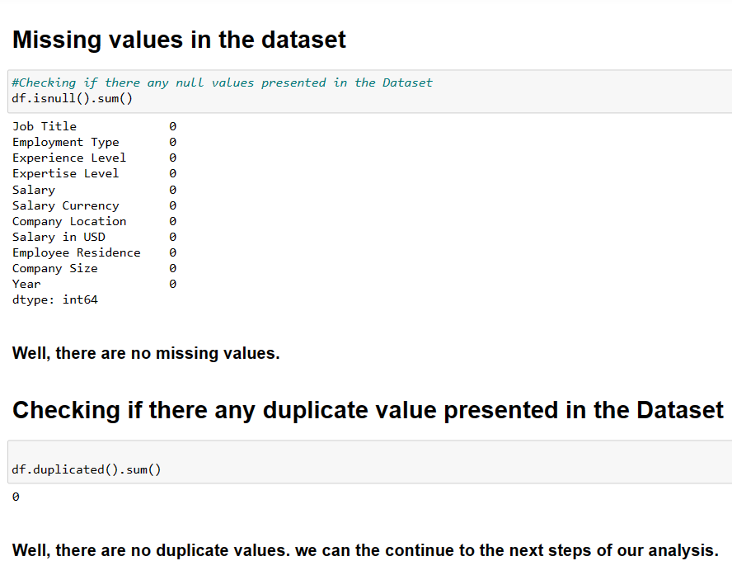
Data CLeaning
There are no missing values and Duplicate Values in the Dataset

Slide 10
Methods and Tools for Removing Outliers
Pandas: Pandas is used for handling the DataFrame and data manipulation.
NumPy: NumPy is utilized for calculations involving arrays and mathematical operations.
Boxplot: A boxplot is used to visualize the distribution of data and identify potential outliers.
Data Filtering: The boolean mask is applied to the original DataFrame to filter out rows containing outliers.
Boxplot Visualization: A boxplot is used to visually inspect the distribution of data, identify outliers, and confirm the effectiveness of the outlier removal process.

Slide 11
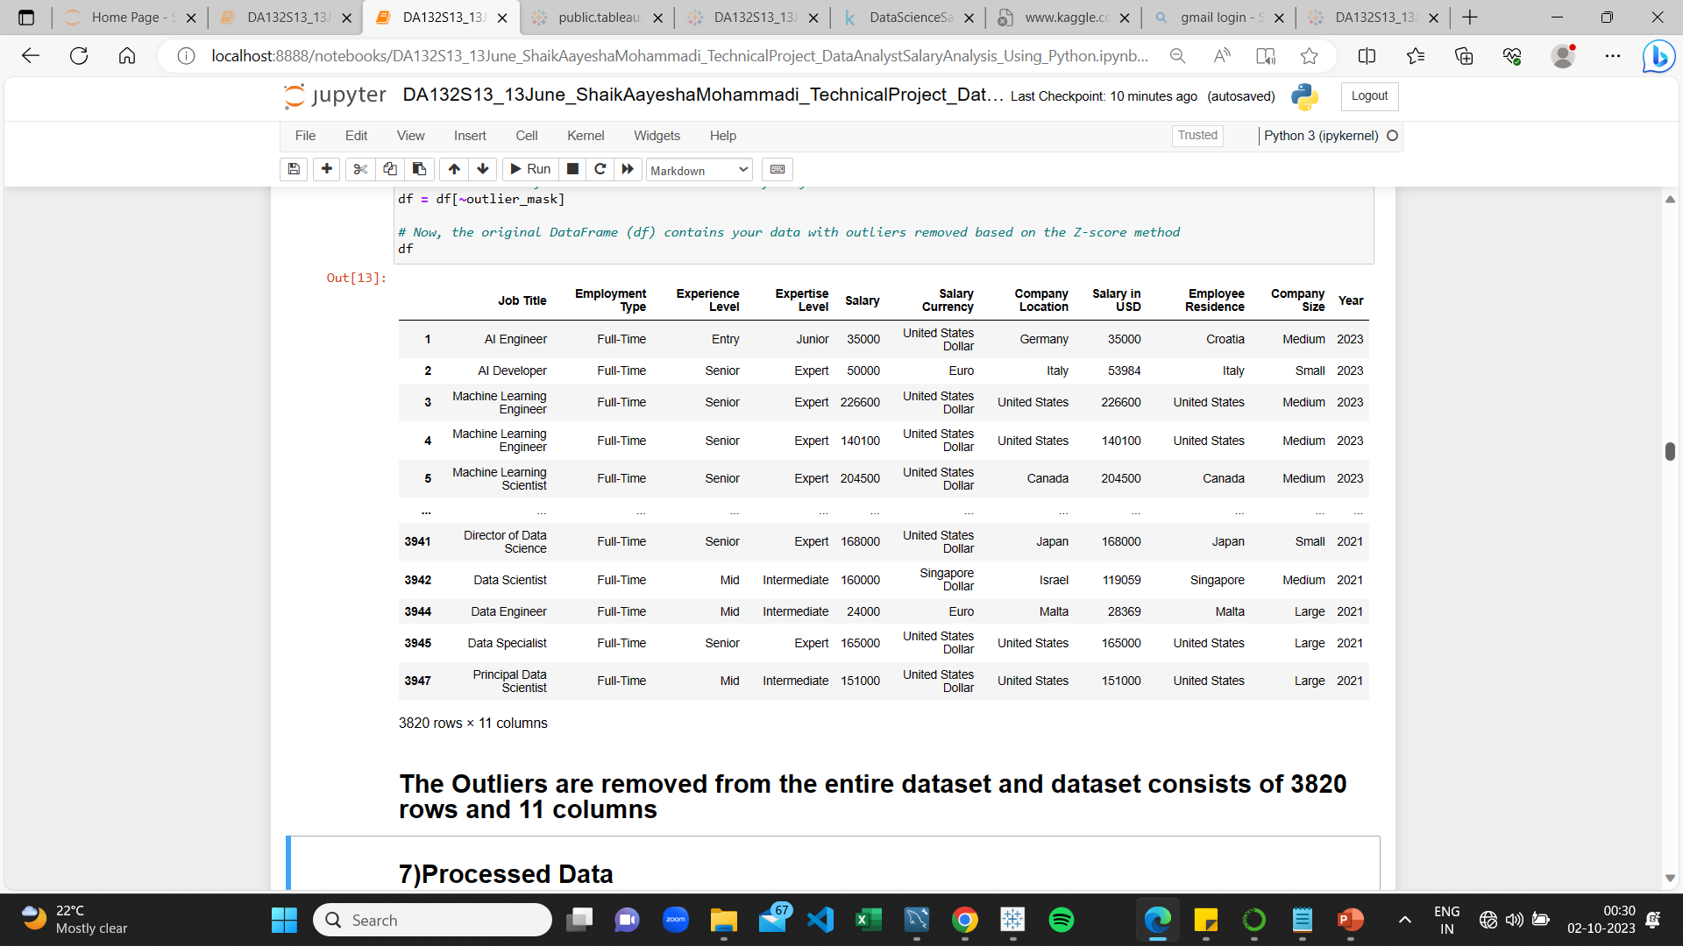
processed Data
The Outliers are removed from the dataset .Processed Data consists of 3820 rows and 11 columns

Slide 12
EXPLORATORY DATA ANALYSIS (EDA)
Exploratory Data Analysis (EDA) is a crucial step in the data analysis process. It involves examining and summarizing the main characteristics of a dataset to uncover initial insights and patterns.
Data Distribution Analysis
EDA begins by analyzing the distribution of key variables in the dataset to understand the data's central tendencies and variability.

Slide 13
HYPOTHESES
What are the top 10 company locations with the highest data Analyst salary?
What are the top 10 highest salaries and which data analyst job title corresponds to it?
What is the salary trend over the years for data analyst roles?
Do salaries vary for data analysts based on company size?
What is the differences in salaries based on employment type ?
Do salaries vary based on experience levels?“
What is the salary for top 10 entry-level job titles of data analyst positions?
What are Most Popular Data Analyst Job Titles in 2023?
which data analyst job titles corresponds to lowest salaries ?
Do employees working in their home country have higher or lower salaries compared to those working abroad?

Slide 14
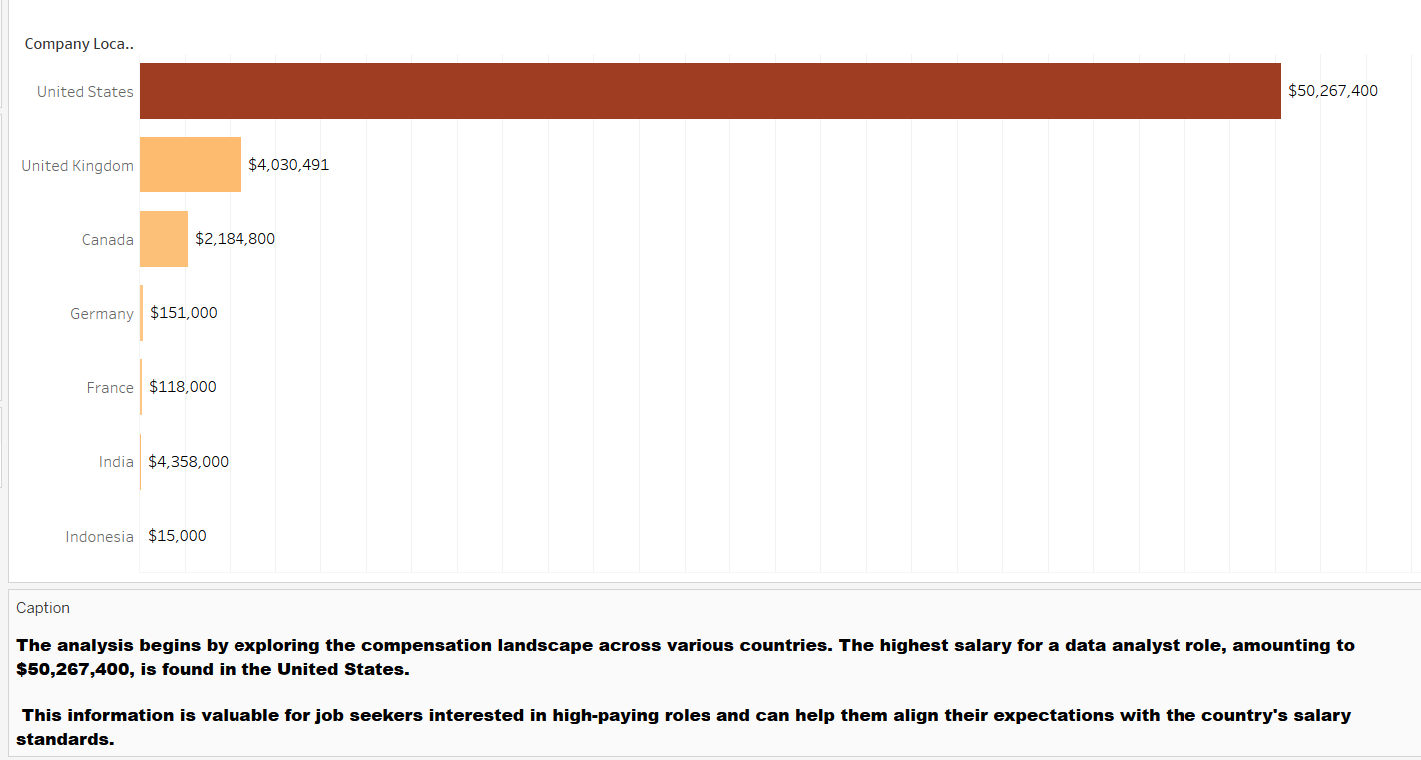
top 10 company location with highest data Analyst salAry

Slide 15
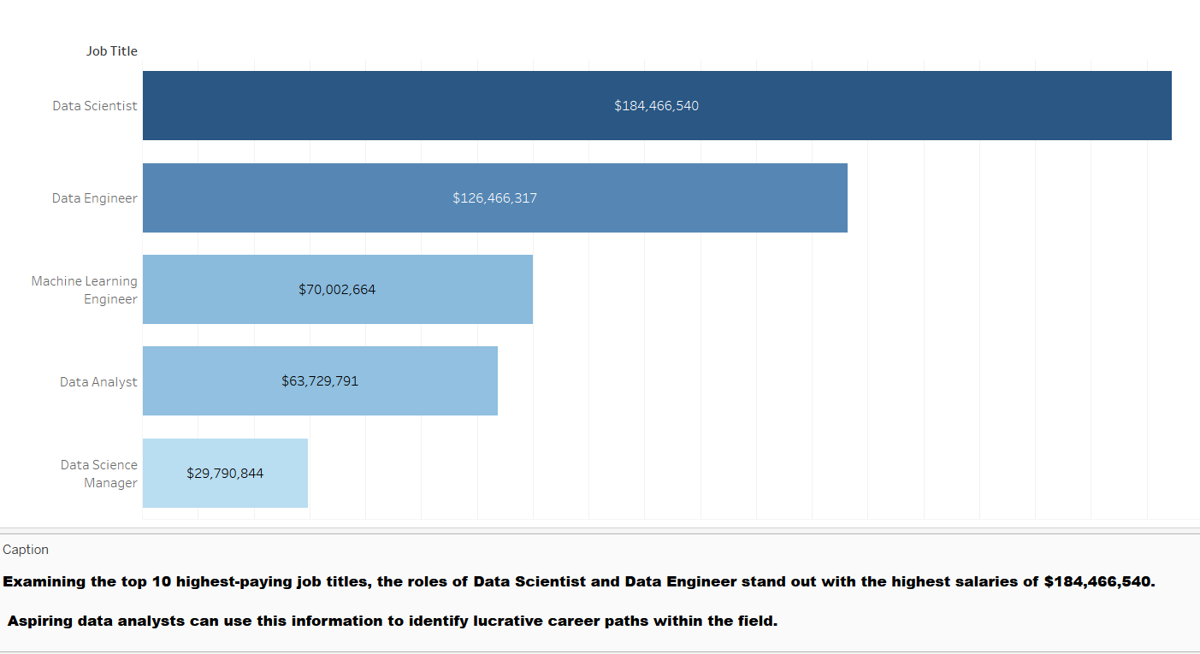
top 10 highest data analyst job title salaries

Slide 16
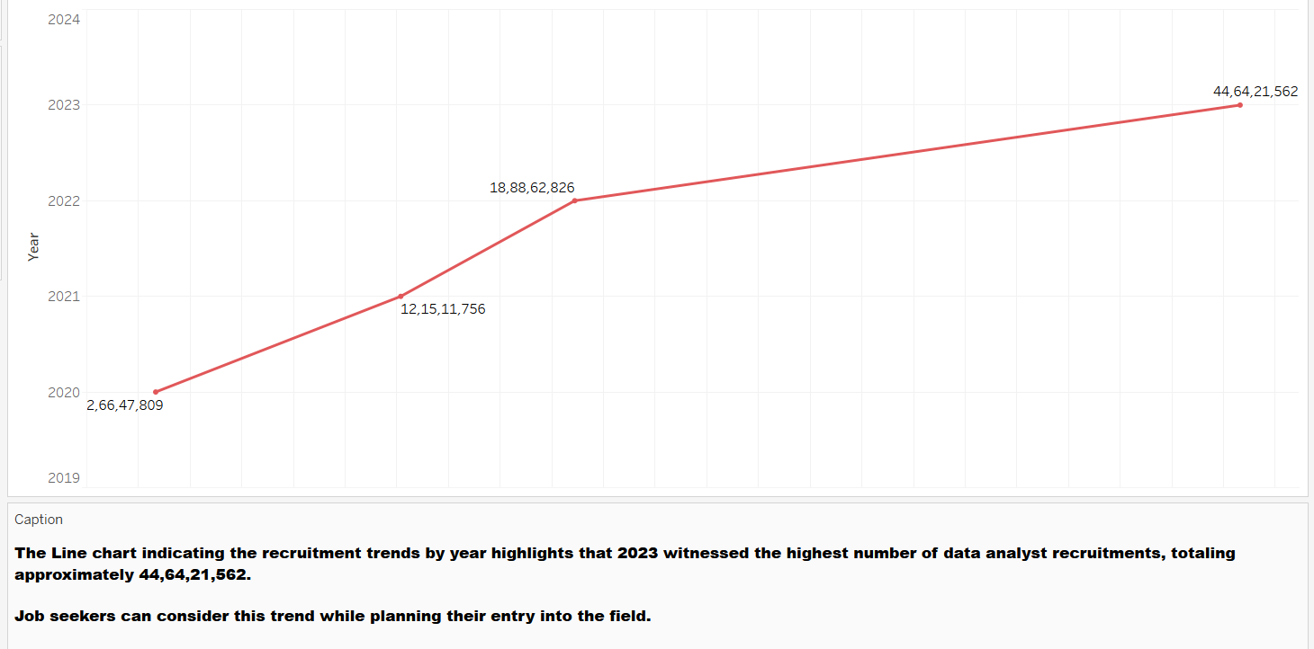
salary trend over the years for data analyst

Slide 17
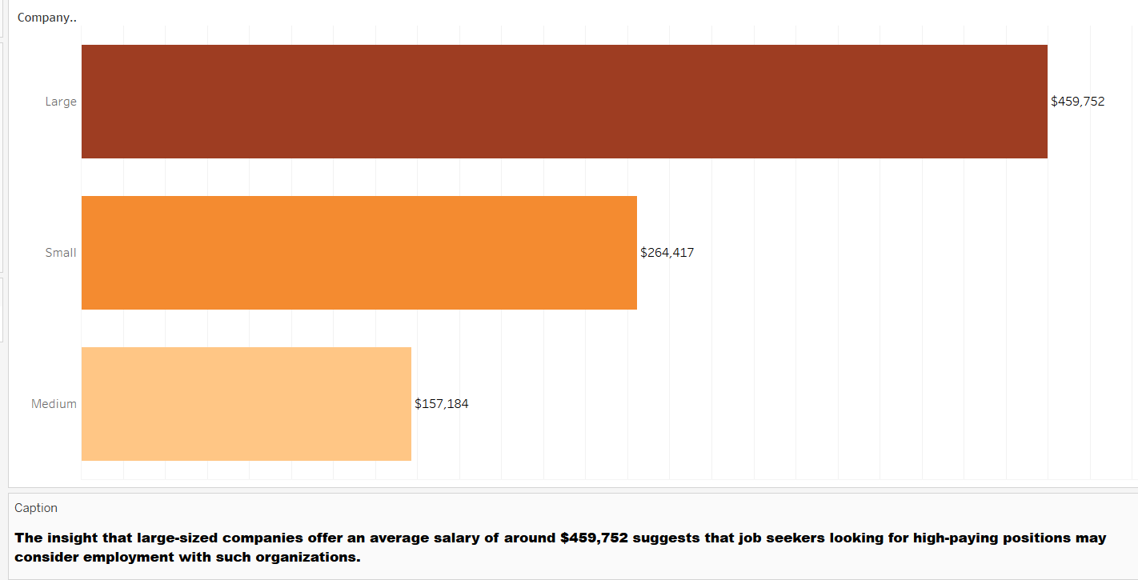
Do salaries vary for data analysts based on company size?

Slide 18
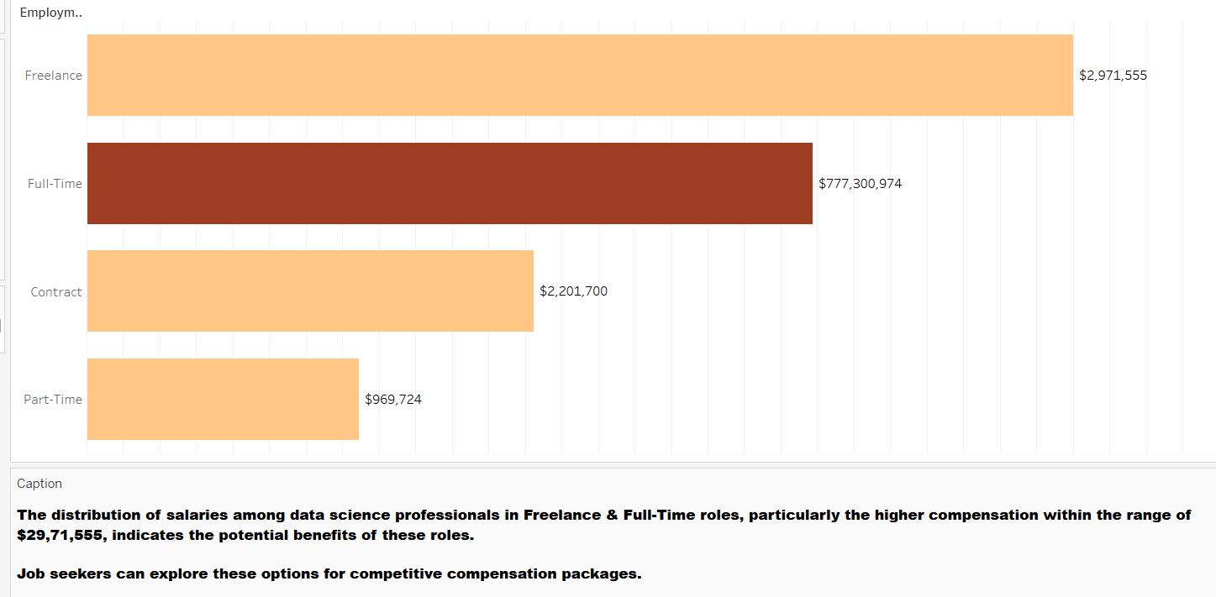
What is the differences in salaries based on employment type ?

Slide 19
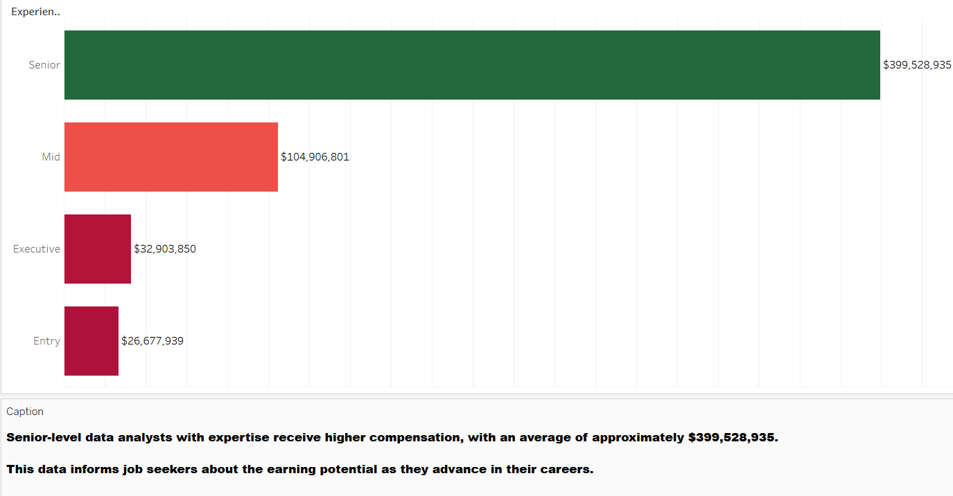
Do salaries vary based on experience levels?"

Slide 20
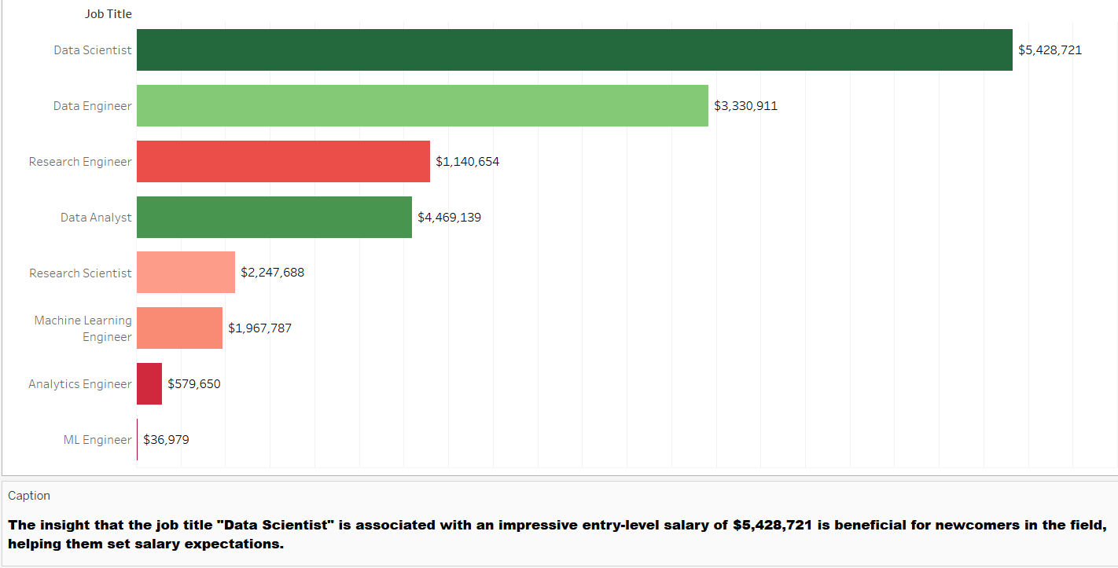
top 10 entry-level job titles of data analyst positions

Slide 21
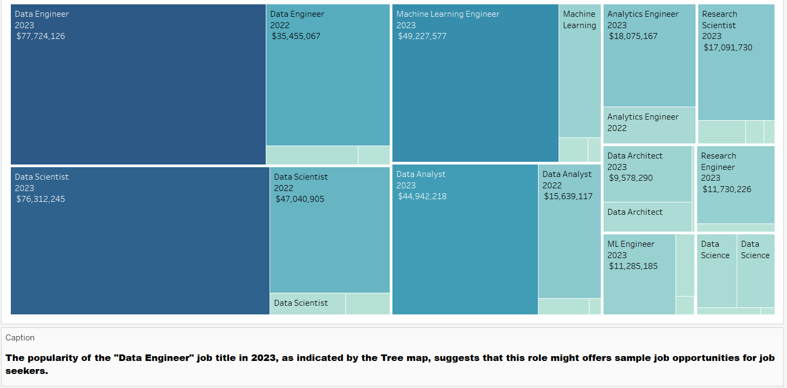
Most Popular Data Analyst Job Titles in 2023

Slide 22
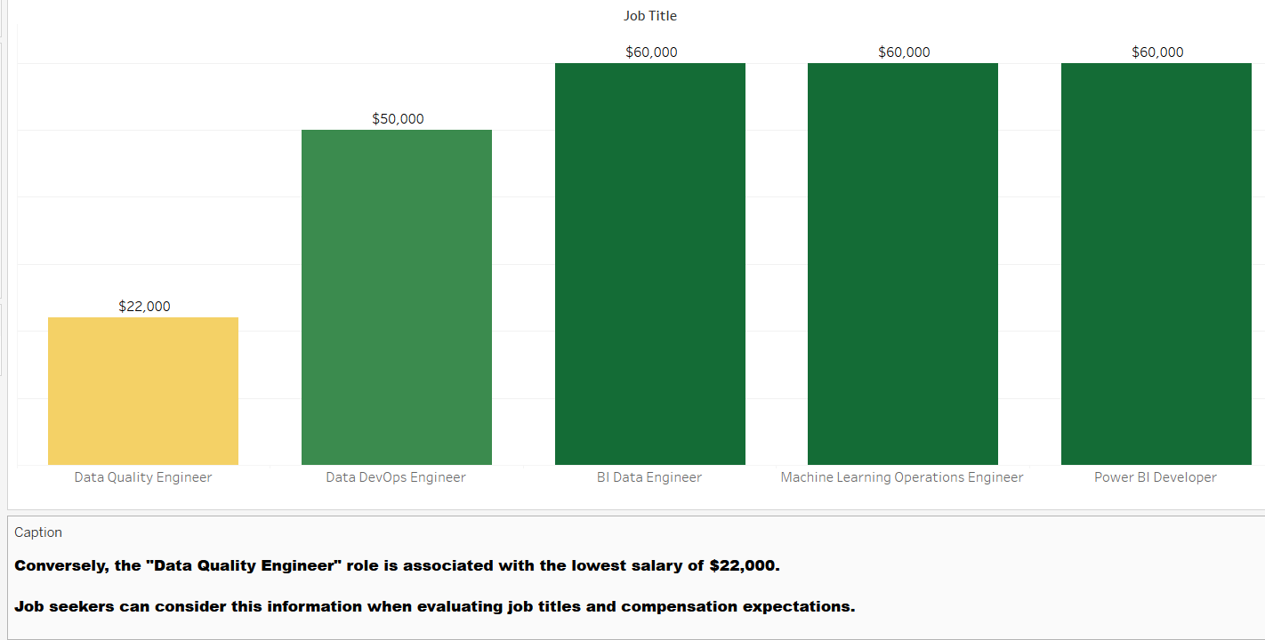
which data analyst job titles corresponds to lowest salaries ?

Slide 23
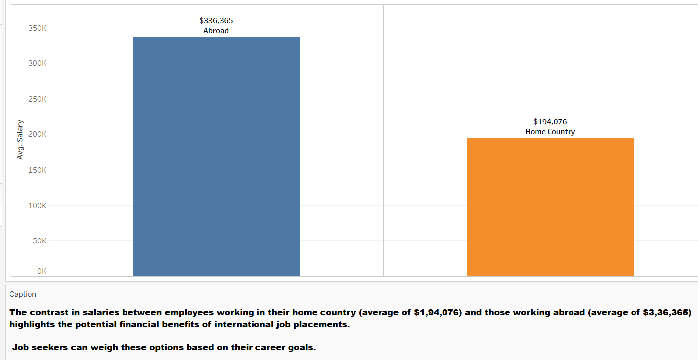
Do employees working in their home country have higher or lower salaries compared to those working abroad?

Slide 24
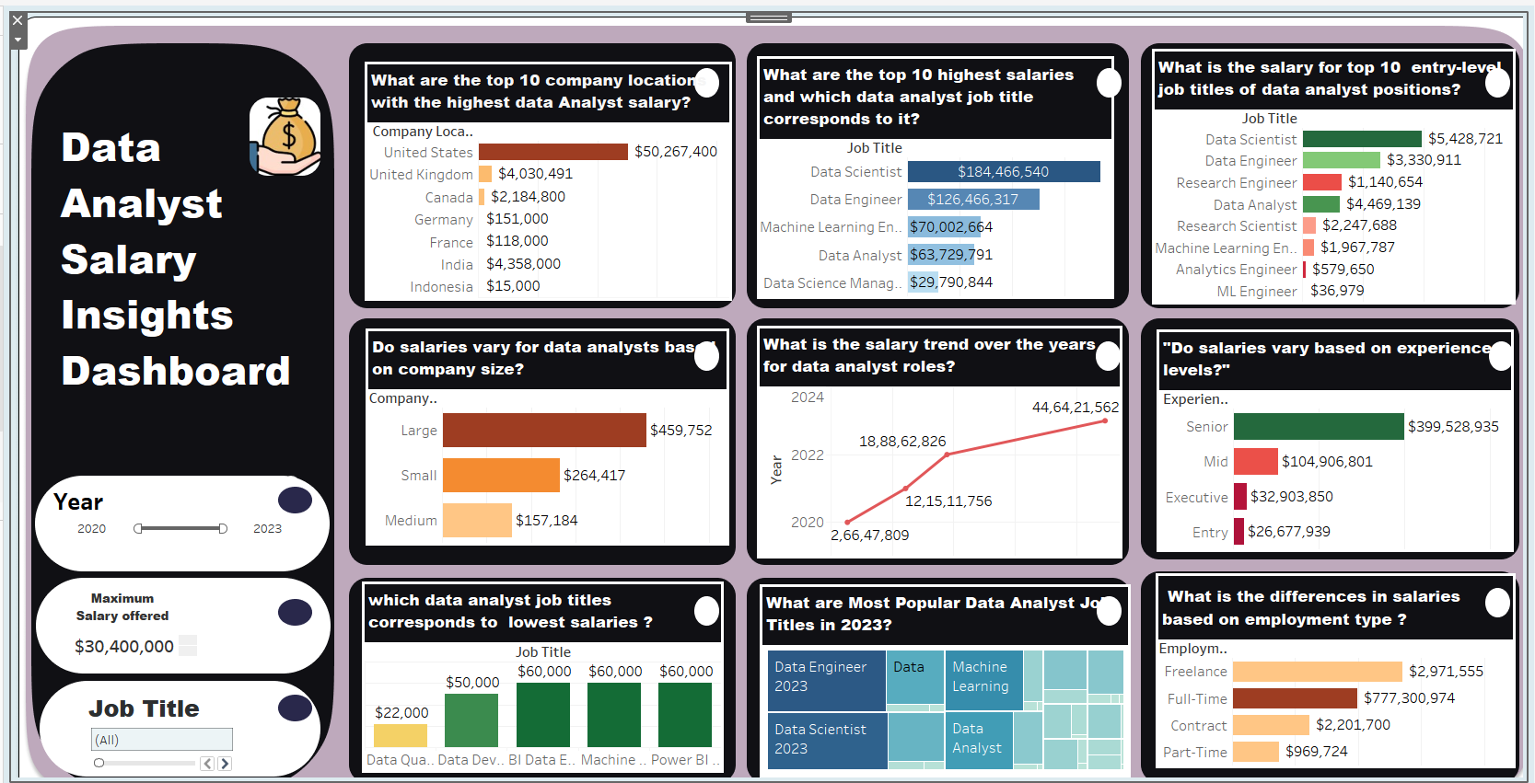
dASHBOARD

Slide 25
INSIGHTS
Highest Salary: Data Architects working in the United States for companies in the United States achieved the highest salaries, particularly in 2022This suggests that job seekers with aspirations for higher incomes should consider this role and geographical location.
Salary Variations: The lowest data analyst salaries were found in companies based in Ghana, Canada, Thailand, and Indonesia. Job seekers should be aware of these regions if they have specific salary expectations.
Geographical Impact: Israel boasts the highest median salary, while Indonesia has the lowest among the selected countries. Job seekers should consider these geographical variations when making location-based career choices.
Employment Type: Freelance and full-time data science professionals receive relatively high compensation, primarily falling within the salary range of $29,71,555. This suggests that job seekers should evaluate their employment type preferences carefully.

Slide 26
INSIGHTS
Experience Matters: Senior-level professionals command a significant portion of the compensation distribution, approximately 63.1%. This highlights the pivotal role of experience in determining data analyst salaries.
Demand in 2023: Data analysts experienced their highest levels of compensation in 2023. The demand for data analysts continues to rise, leading to increased compensation levels as companies compete for skilled professionals.
Exceptional Roles: Research Scientists earn the highest salaries, with a remarkable pinnacle of $450,000. This role stands out for its extraordinary earning potential, reflecting the value placed on research and data analysis expertise.

Slide 27
INSIGHTS
Junior-level Baseline: Junior-level positions have a median salary of $70,000, setting a baseline expectation for early-career professionals. Top Roles in the US: "Machine Learning Engineer" and "Data Scientist" command the highest median salaries in the United States, ranging from $150,000 to $175,000. Aspiring data analysts in the US may target these roles for competitive salaries.
Expertise Levels: The dataset includes individuals classified as experts, intermediates, juniors, and directors, signifying varying levels of expertise. Job seekers can assess their own expertise and align it with salary expectations.
Full-Time Preference: A significant preference exists among data analysts for full-time employment. Full-time roles offer job security, benefits, and growth opportunities, which appeal to job seekers seeking stability and commitment.

Slide 28
INSIGHTS
Unique Job Titles: The dataset contains 120 unique job titles for data analysts, providing a wide array of options for job seekers to consider.
Company Size Impact: Company size impacts average salaries, with medium-sized companies offering the highest average salaries. Job seekers can target organizations that match their size preferences.
In conclusion, this analysis equips data analyst job seekers with essential information to navigate their career paths effectively. By considering salary trends, geographical preferences, expertise levels, and employment types, individuals can make informed decisions aligned with their career aspirations and income goals.
This comprehensive conclusion summarizes the key findings and implications of the analysis, providing valuable guidance for data analyst job seekers in their career planning and decision-making process.

Slide 29
ADVANTAGES
Informed Career Choices: Job seekers can make informed decisions about their career paths, including job titles, geographical preferences, and company sizes, based on comprehensive salary data.
Maximized Earning Potential: Understanding the highest-paying roles, such as Data Architects in the U.S., empowers job seekers to aim for positions with greater income potential.
Salary Benchmarking: The analysis provides a baseline, like the junior-level salary of $70,000, helping early-career professionals set realistic salary expectations.
Expertise Alignment: By assessing their own expertise and aligning it with salary expectations, individuals can better negotiate compensation.
Diverse Career Options: The dataset's 120 unique job titles offer a wide array of career choices, catering to various interests and skill sets.
Career Growth Planning: Recognizing the preference for full-time roles and senior-level professionals' higher earnings, job seekers can plan their career growth strategies.

Slide 30
DISADVANTAGES
Generalization: Salary data can be influenced by various factors like location, experience, and company policies. Generalizing based on averages may not capture the full complexity.
Changing Trends: The data spans from 2020 to 2023, and salary trends can change rapidly. Job seekers should consider the most recent data when making decisions.
Lack of Qualitative Data: Salary figures don't capture job satisfaction, work-life balance, or other qualitative aspects of a job, which are also important for career decisions.

Slide 31
APPLICATIONS
Career Planning: Job seekers can use this analysis to plan their careers strategically, ensuring they choose roles and locations that align with their goals.
Negotiation: Armed with salary data, candidates can negotiate more effectively during job offers, aiming for competitive compensation packages.
Education and Skill Development: Aspiring data analysts can identify which skills and expertise levels are associated with higher salaries, guiding their education and skill development.

Slide 32
CONCLUSION
This study empowers aspiring data analysts with valuable insights to navigate their 2023 career paths effectively. Key takeaways include considering job opportunities in the United States for higher salaries, targeting medium-sized companies for competitive compensation, and being cautious when choosing regions like Ghana, Canada, Thailand, and Indonesia due to lower salary levels.
Additionally, job seekers should carefully evaluate their employment type preferences, recognize the impact of experience on salaries, and aim for roles like "Machine Learning Engineer" and "Data Scientist" in the United States for competitive incomes.
This conclusion aligns with the business objective, providing clear guidance for data analyst aspirants.

Slide 33
THANK YOU

