Slide 1
MovieOnRent Data Analysis Project - Optimizing Movie Inventory and Customer Experience Movie Data Analysis Using Python
BY
Shaik Aayesha Mohammadi
Batch Number: DA132S13
Enrollment ID:EN12024078064

Slide 2
TABLE OF CONTENTS
INTRODUCTION
BUSINESS OBJECTIVE
UNDERSTANDING THE DATA
EACH TASKS & OUTPUTS
ADVANTAGES
DISADVANTAGES
APPLICATIONS
CONCLUSION

Slide 3
INTRODUCTION
The film industry is highly competitive, and predicting a movie's success is a complex task.
This analysis aims to uncover patterns and relationships within a movie dataset to help production companies enhance their ability to create commercially successful films.

Slide 4
BUSINESS OBJECTIVE
The primary aim of this project is to use movie data analysis to provide valuable insights into the factors that influence a movie's commercial success.
Identifying the characteristics of successful movies.
Recognizing the most popular movie genres.
Analyzing the impact of factors such as budget and revenue.
Predicting a movie's commercial success.
Assisting in strategic investment decisions.
Understanding audience preferences for better marketing strategies.

Slide 5
UNDERSTANDING THE DATASET
The dataset comprises of TMDB-movie related data
It aims to uncover key factors driving a movie's commercial success and assist in strategic decision-making by analyzing movie data, including budget, genres, revenue, and audience preferences.
Budget: Movie budget in dollars (0 indicates unknown).
Genres: Movie genres.
Revenue: Total movie revenue in dollars.
Title: English title of a movie

Slide 6
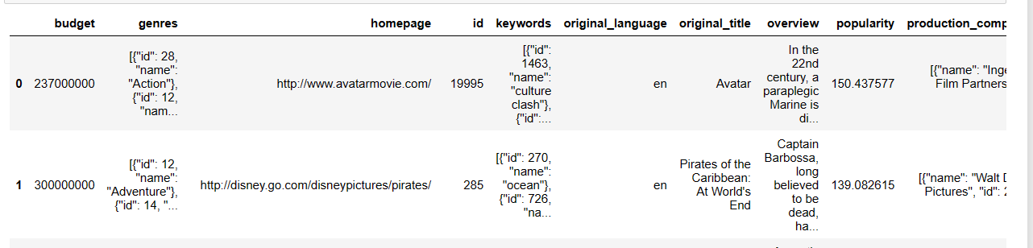
Basic information about the movie dataset
The dataset comprises TMDB-movie related data
By displaying the number of rows and columns, 4803 rows and 20 columns
listing the titles and genres of the first 50 movies and last 50 movies
Analyzing the missing values which includes homepage and tagline columns are have missing values.

Slide 7
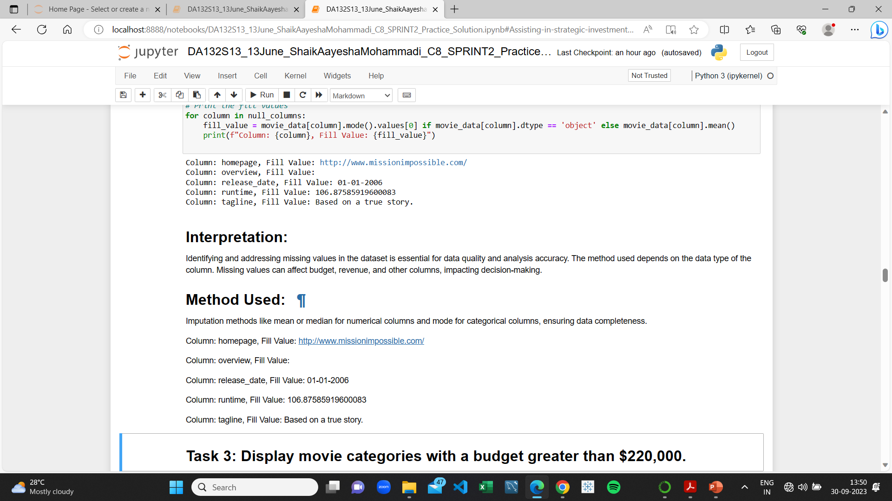
Null values in the dataset
Missing values can affect budget, revenue, and other columns, impacting decision-making.
Imputation methods like mean or median for numerical columns and mode for categorical columns, ensuring data completeness.

Slide 8

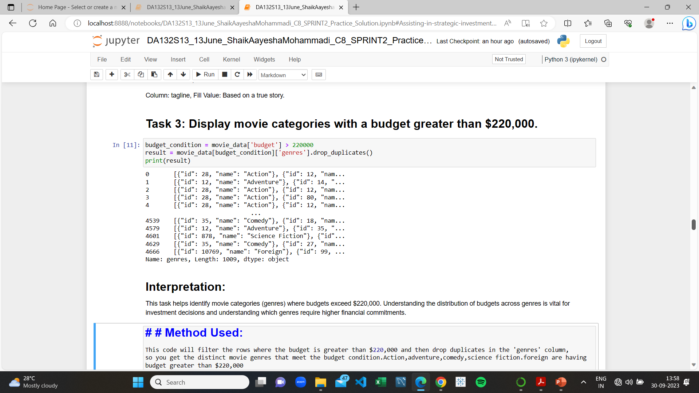
Movies with a budget greater than $220,000.
Understanding the distribution of budgets across genres is vital for investment decisions and understanding which genres require higher financial commitments.
Action, adventure ,comedy,science fiction, foreign are having budget greater than $220,000

Slide 9

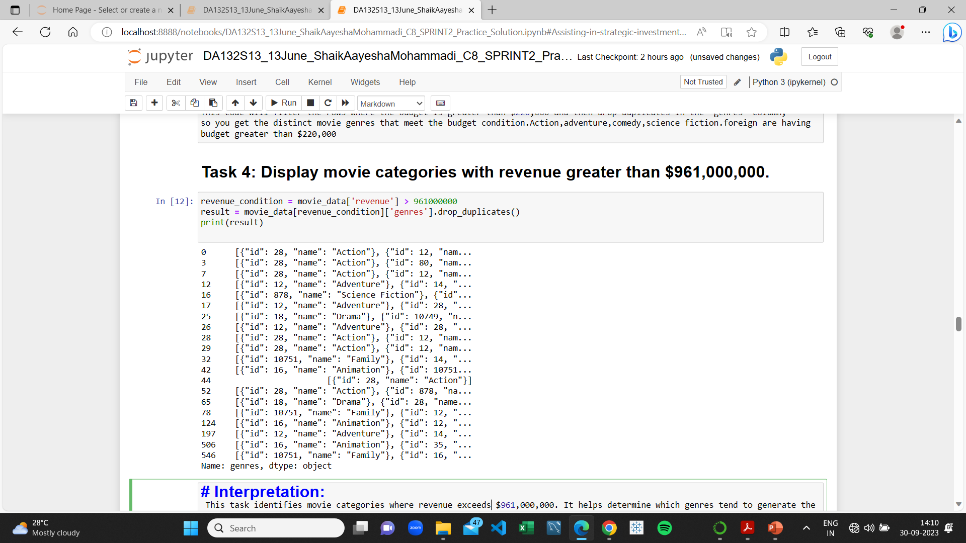
Movie revenue greater than $961,000,000.
It helps determine which genres tend to generate the highest revenues.
Action ,Adventure ,Science Fiction, Adventure, Animation, Drama are having revenue > $961,000,000.

Slide 10
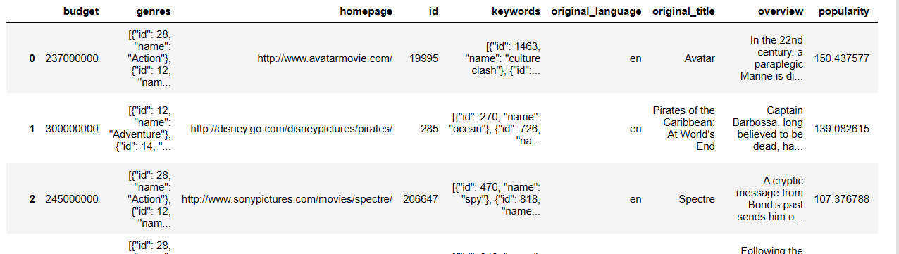
Remove rows with budget and revenue of 0.
Rows with zero budget or revenue indicate missing or unknown values, which can distort analyses.
The dataset size has reduced to 3229 rows × 20 columns

Slide 11
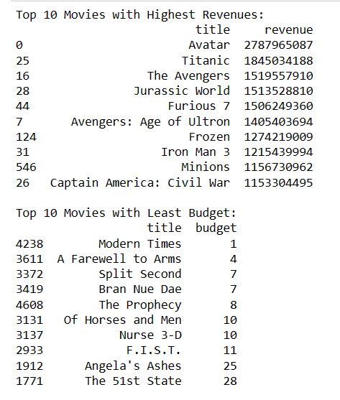
Top 10 movies with the highest revenues and top 10 movies with the least budget.
Identifying the top 10 revenue-generating movies and the top 10 movies with the lowest budgets provides insights into both commercial successes and cost-effective productions.
Avatar has the highest revenue of 2787965087
Modern times has the least budget of 1

Slide 12

Correlation between popularity and budget.
Understanding this relationship can help decide how much to invest in production to maximize popularity and, ultimately, revenue.
Indicates positive correlation but not strong.

Slide 13
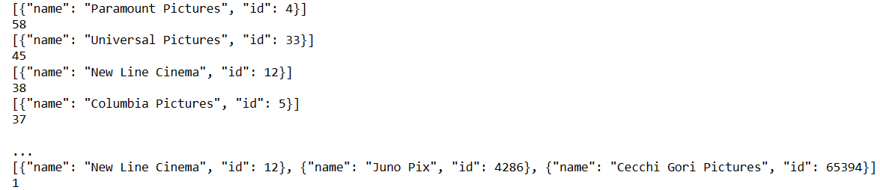
Production company names and their frequency.
Identifying production companies and the number of times they appear in the dataset helps recognize the most active production companies in the industry.
The "Paramount Pictures has the highest frequency of 58

Slide 14
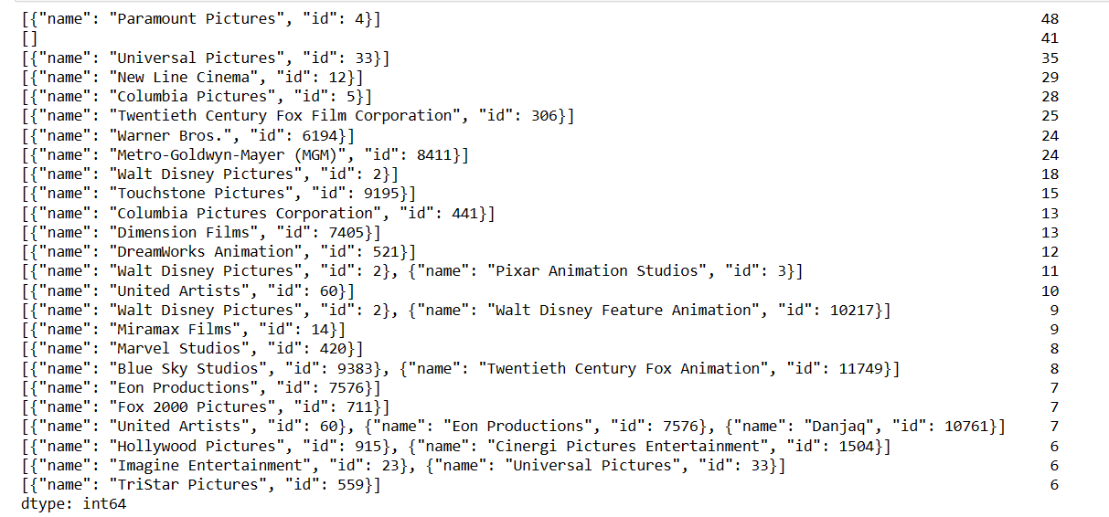
Top 25 production companies based on movie count.
It highlights the most prolific production companies in the industry.
The paramount Pictures has the highest movie count of 48

Slide 15
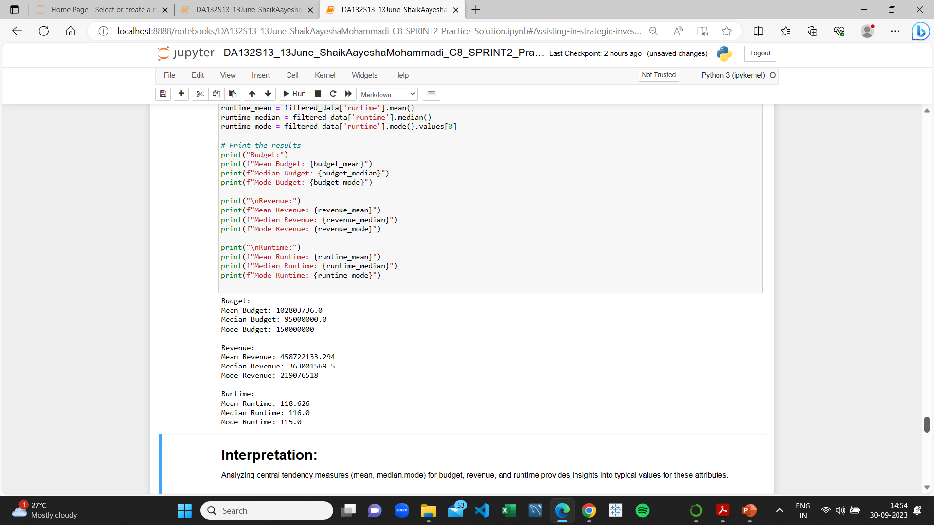
Top 500 movies by revenue and calculate measures of central tendency.
Analyzing central tendency measures (mean, median) for budget, revenue, and runtime provides insights into typical values for these attributes.
Revenue: Mean Revenue: 458722133.294 Median Revenue: 363001569.5 Mode Revenue: 219076518

Slide 16
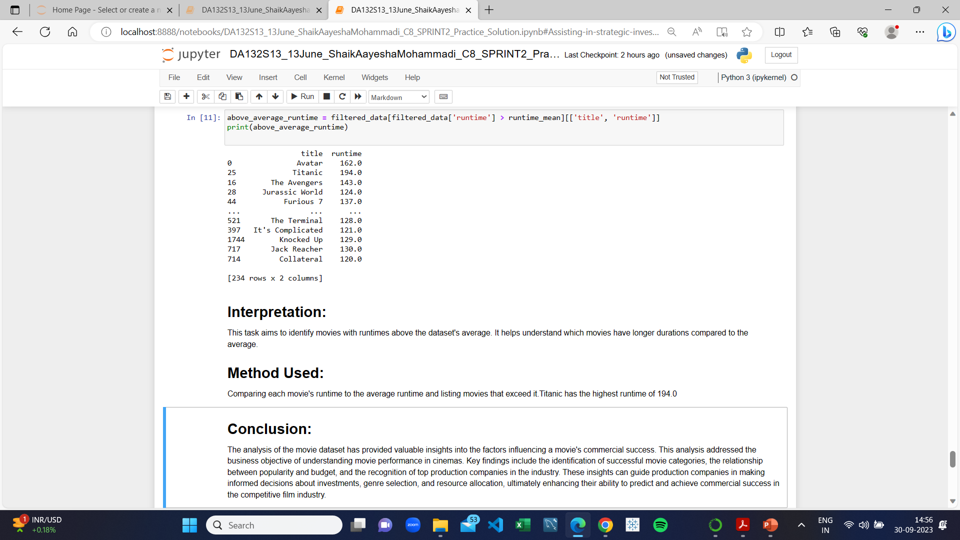
Movie names with above-average runtime.
This task aims to identify movies with runtimes above the dataset's average. It helps understand which movies have longer durations compared to the average.
Titanic has the highest runtime of 194.0

Slide 17
ADVANTAGES
Improved decision-making
Increased profitability
Better audience engagement
Improved content quality
Competitive advantage

Slide 18
DISADVANTAGES
Limited scope
High cost
Time-consuming
Overreliance on data
Privacy concerns

Slide 19
APPLICATIONS
Production Strategy
Investment Decisions
Marketing

Slide 20
CONCLUSION
The analysis of the movie dataset has yielded valuable insights for production companies striving for commercial success.
It identifies successful movie genres and highlights top-performing movies like "Avatar" with the highest revenue of $2,787,965,087 and "Titanic" with the longest runtime of 194 minutes.
Additionally, the positive correlation between popularity and budget suggests the importance of investment in production.
The dominance of "Paramount Pictures" with the highest movie count of 48 emphasizes the significance of established production companies.
These insights, along with notable high-budget movies, empower the industry to make data-driven choices, enhancing competitiveness and success in the dynamic film market.

Slide 21
THANK YOU

