Slide 1
ShopSmart USING PYTHON
- Python-based Smart Shopping
UNDER THE GUIDANCE OF Munna Pandey SIR
BY
` SHAIK AAYESHA MOHAMMADI

Slide 2
TABLE OF CONTENTS
ABSTRACT
SHOPSMART CODE
DESCRIPTION OF EACH FUNCTION
OUTPUT OF SHOPSMART
ADVANTAGES
DISADVANTAGES
APPLICATIONS
CONCLUSION

Slide 3
ABSTRACT
The " ShopSmart" is a Python program that facilitates seamless shopping for essential items.
The program allows customers to view a list of available items with their respective quantities and costs.
Customers can place their orders by specifying the desired quantity for each item, and the program ensures that the requested quantity is available in stock.
It calculates the total bill, including delivery charges based on the distance from the store.
The program is designed to offer an efficient and user-friendly shopping experience for essential goods.

Slide 4
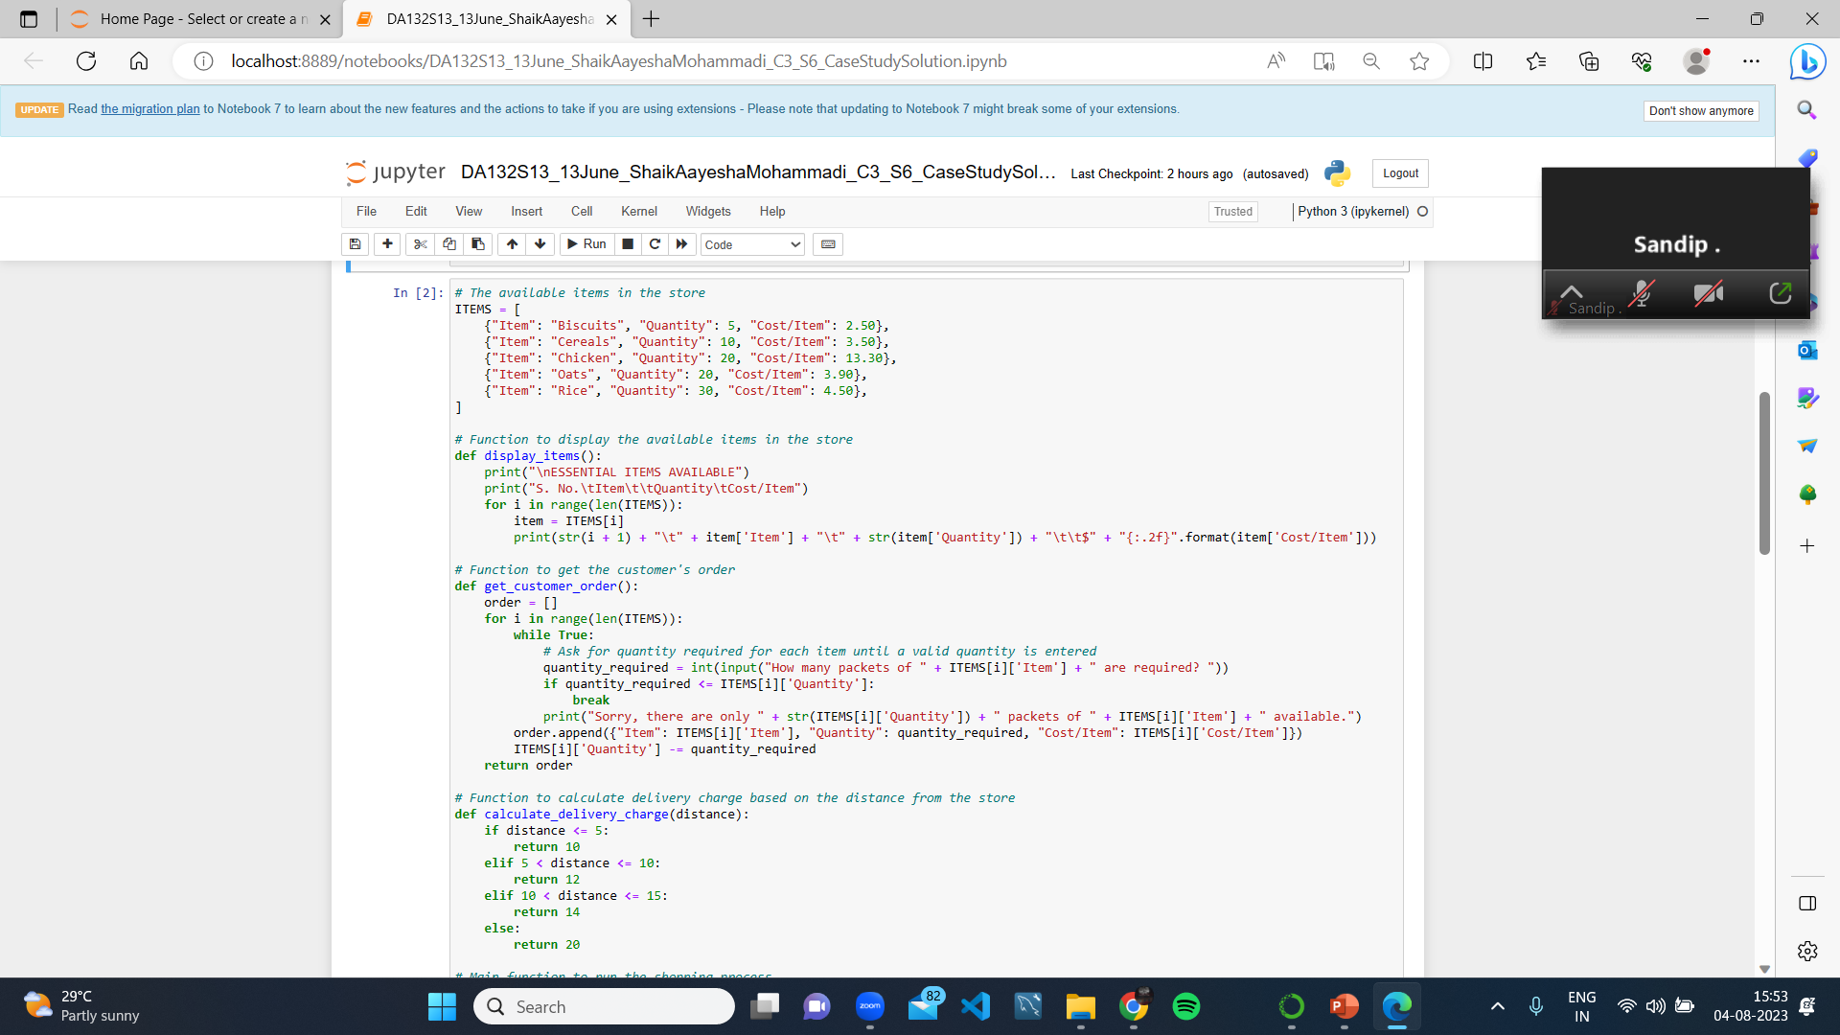
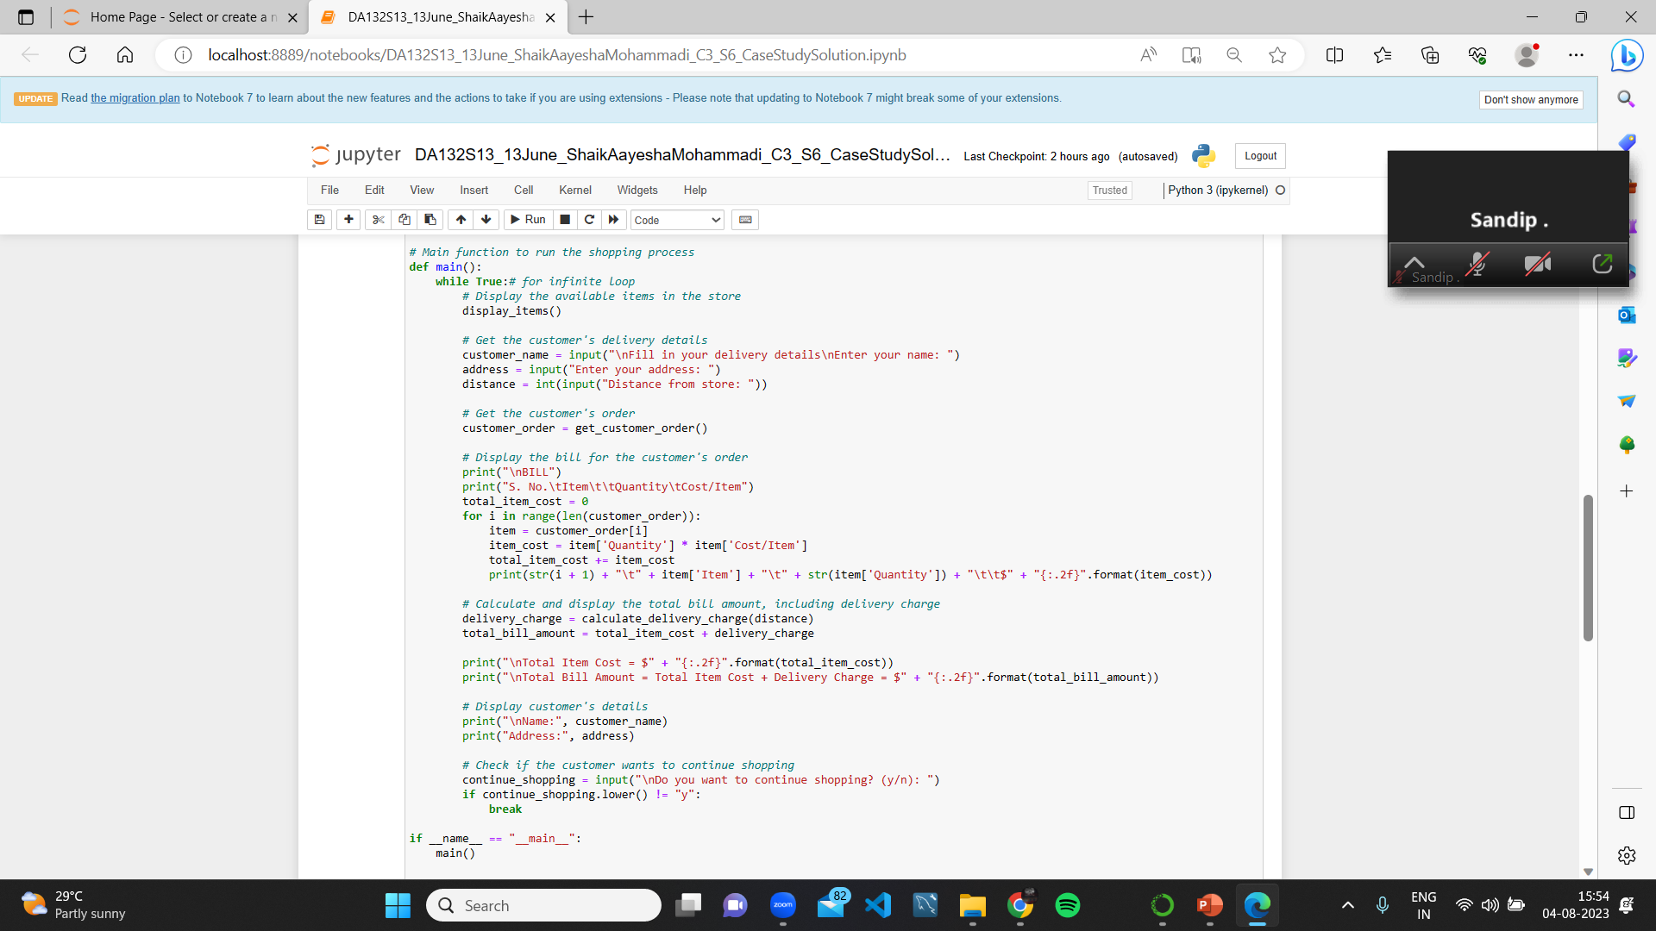
SHOPSMART CODE

Slide 5
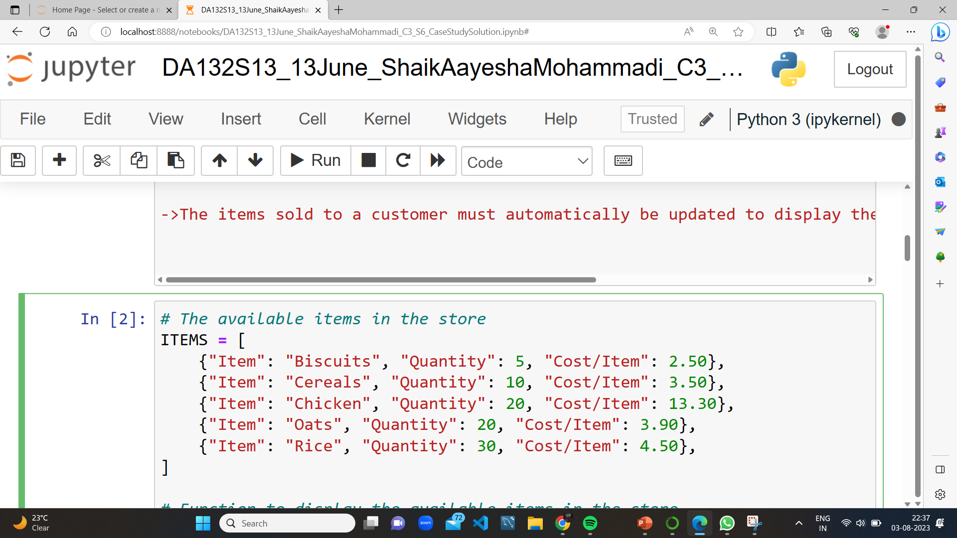
DATA representation
The code represents the available items in the store using a list of dictionaries.
Each dictionary represents an item and contains keys "Item", "Quantity", and "Cost/Item".

Slide 6
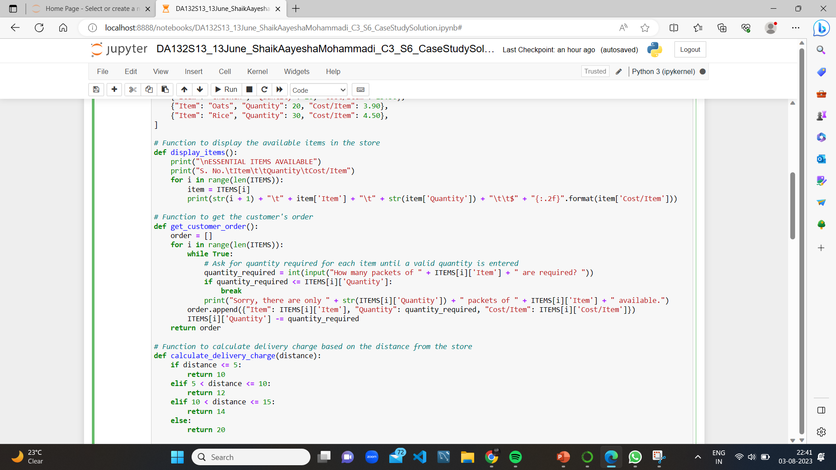
Display items function
The display_items() function is used to show the available items in the store with their quantities and costs per item.
It prints a table showing the item number, name, quantity, and cost per item.

Slide 7

get customer order function
The get_customer_order() function is used to take the customer's order by asking for the desired quantity of each item.
It checks if the requested quantity is available and updates the store's quantities accordingly.
The function returns a list containing the customer's order details.

Slide 8
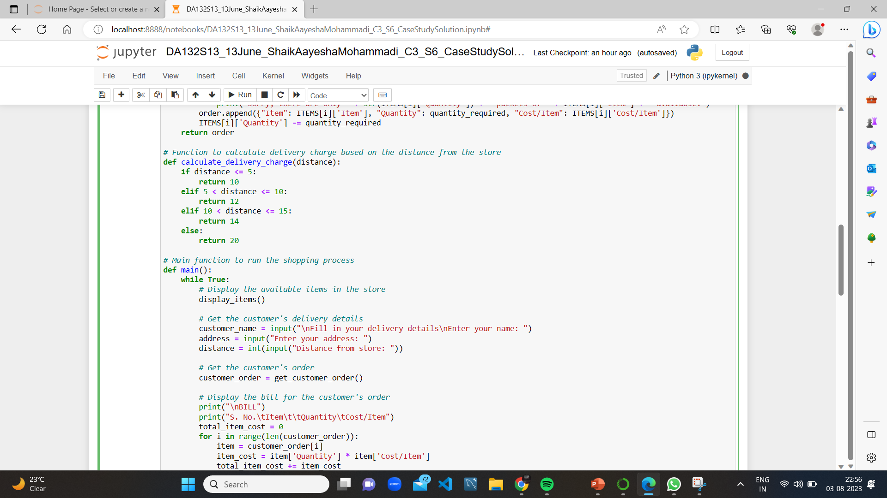
calculate_delivery_order function
The calculate_delivery_order function calculates the delivery charge based on the distance from the store. It applies different delivery charges for various distance ranges.
It takes the distance as input and returns the appropriate delivery charge according to the predefined rules.

Slide 9
Main function
The main() function is the main of the shopping process.
It uses a while loop to allow continuous shopping until the customer chooses to stop.
It calls the display_items() function to show the available items in the store.
It collects the customer's delivery details such as name, address, and distance from the store.
It calls the get_customer_order() function to get the customer's order.
It calculates the total bill amount, including the delivery charge, and displays the bill and customer details.

Slide 10
Methods used in main function()
The input() method is used to get user input for customer details such as name, address, and distance . It displays a prompt to the user and waits for the user to enter the input.
The format() method is used to format the cost and bill amount to two decimal places . It is used to display the cost and bill amount in a standardized format with two decimal places.
The lower() method is used to convert user input to lowercase for comparison.

Slide 11
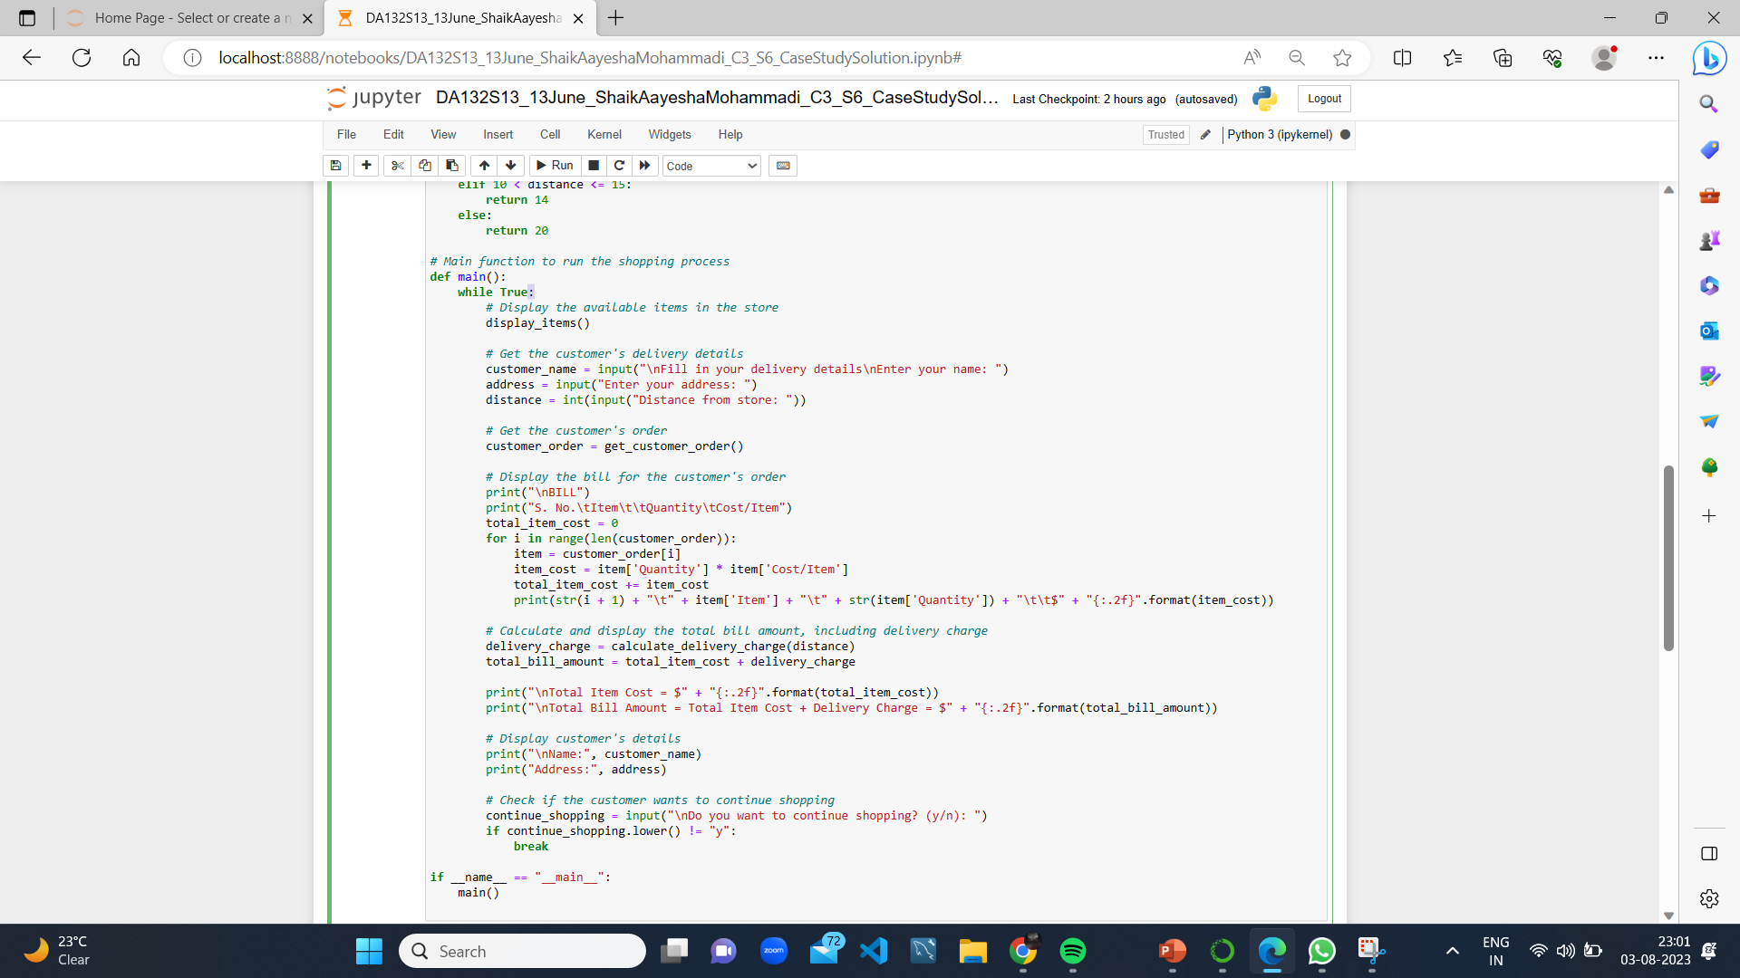
Main FUNCTION()

Slide 12
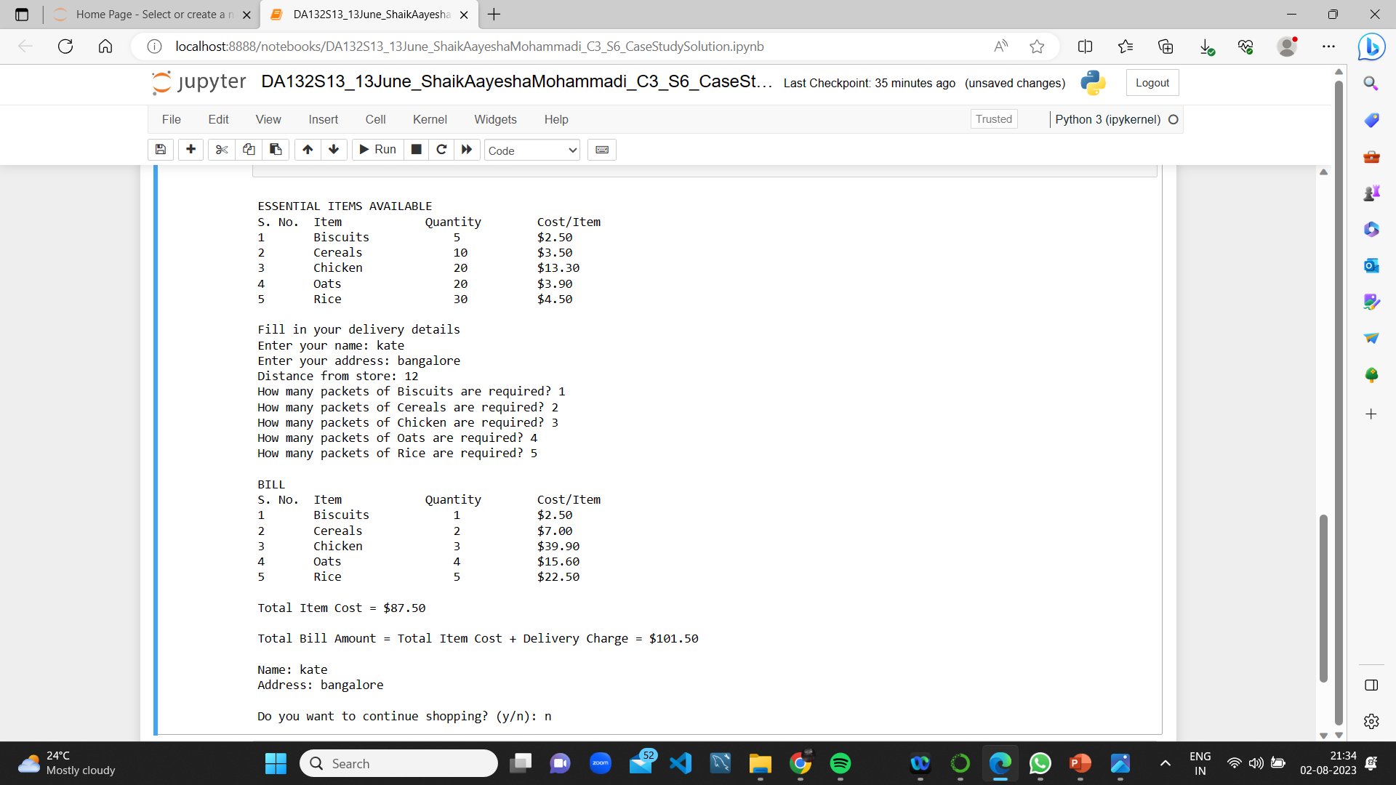
Output of ShopSmart

Slide 13
ADVANTAGES
Efficient Shopping Experience
Increased profitability
Money saving
Better customer engagement
Automated Billing and Delivery
Competitive advantage
Time saving

Slide 14
DISADVANTAGES
Limited Item Categories
Dependent on Internet Connectivity
Lack of Payment Integration
Privacy concerns

Slide 15
APPLICATIONS
Online Grocery Stores
Remote and Rural Areas
Community Support Initiatives

Slide 16
CONCLUSION
The Essential Items Shopping System offers a real-time, user-friendly platform for hassle-free shopping of essential goods, catering to various sectors from emergency relief to community services.
With its user-friendly features, it aims to enhance accessibility and convenience for essential item shopping.

Slide 17
THANK YOU

