Slide 1
PUMA Results

Slide 2
PUMA inference latency (batch size = 1)
Better inference latency is a win! [Ref: EIE, Deep Compression, Microsoft Brainscale]
Most real-time applications (driverless car, google autosuggest etc.) have very strict inference latency requirements (~100ms).
Unlike training, there isn’t large chunks of data available.
PUMA yields improvement of 600X in inference latency (averaged across all benchmarks) compared to GPUs (K80, Maxwell)

Slide 3
GPU/ASIC(cmos) computation with batching
I
N
P
U
T
Small DNN
Model
I
N
P
U
T
Small DNN
Model
I
N
P
U
T
Small DNN
Model
Small Batch size
Medium Batch size
Large Batch size
I
N
P
U
T
Large DNN
Model
I
N
P
U
T
Large DNN
Model
I
N
P
U
T
Large DNN
Model
Small Batch size
Medium Batch size
Large Batch size
Batching always helps GPU/TPU to share the cost associated with data-movements of the DNN model across multiple inferences (inputs)
Helps to improve energy per classification
Helps to improve throughput

Slide 4
Batching on PUMA vs GPU/TPU
PUMA doesn’t move DNN model - ``in-memory processing’’
No benefits from batching from energy standpoint (grows linearly)
How can PUMA leverage batching for performance?
PUMA’s spatial architecture enables pipelined execution of batches thereby boosting the throughput
Area-efficiency of tiles/cores can be used to replicate tiles across batches
GPU/TPU energy consumption and throughput grows sub-linearly with batch size
For large model sizes this is a huge advantage [Word-language modelling benchmarks]

Slide 5
Inter-layer parallelism and weight sharing across different DNNs
MLPs, LSTM (deep), LSTM (wide):
No inter layer parallelism – next layer needs all the outputs from previous layer to compute any output in the next layer
No weight sharing
CNNs:
Abundant inter-layer parallelism
Abundant weight sharing
GPU/TPU rely on data-batching to improve energy, throughput on networks other than CNNs.
Hence, analysis with varying batch sizes makes sense.

Slide 6
PUMA energy reductions vs GPU with varying batch sizes
PUMA is consistently more energy-efficient than GPUs across all benchmarks and batch sizes.
Energy reductions of 1000X, 300X, 130X for small (16), medium (64) and large batches (256) respectively.
Batch size 256 is unusual in inference [Reference: ]
Increasing batch size – PUMA grows linearly while GPU can be sub-linear (How much sub-linear - depends on model size, batch size).
For very big models (for instance, wlm) close to 800M parameters: energy improvements are lesser with higher batch sizes:
GPUs save a lot on model data movement (amortize across more inputs in the batch)
PUMA degrades due to MVMs in a layer spanning across multiple nodes (13 nodes here) [1 node = 160 Tiles]

Slide 7
PUMA speedup vs GPU with varying batch sizes
PUMA provides higher speedups across all (almost) benchmarks and batch sizes
Energy reductions of 400X, 100X, 80X for small (16), medium (64) and large batches (256) respectively.
Increasing batch size – PUMA grows linearly while GPU can be sub-linear (How much sub-linear - depends on model size, batch size)
For very big models (for instance, wlm):
GPUs save a lot on model data movement (amortize across more inputs in the batch)
PUMA degrades due to MVMs in a layer spanning across multiple nodes (13 nodes here) [1 node = 160 Tiles]

Slide 8
PUMA Design Space Exploration for CE and PE
Design space exploration of PUMA’s Tile CE on xbar size, vfu, num_xbar, num_core to find the sweet spot:
Large xbars don’t necessarily improve CE:
slower operation (xbar latency, MVM throughput due to higher demands on ADC sampling rate) and disproportionate area increase ADC area as well as supporting peripherals (buffer, control)
Large number of VFUs add to area without leading to significant benefits in computation
Isolated CE of VFU << Isolated CE of Xbar
More xbars: put more pressure on supporting peripherals
More cores: larger demand on EDRAM to sustain throughput, thereby making it slow.

Slide 9
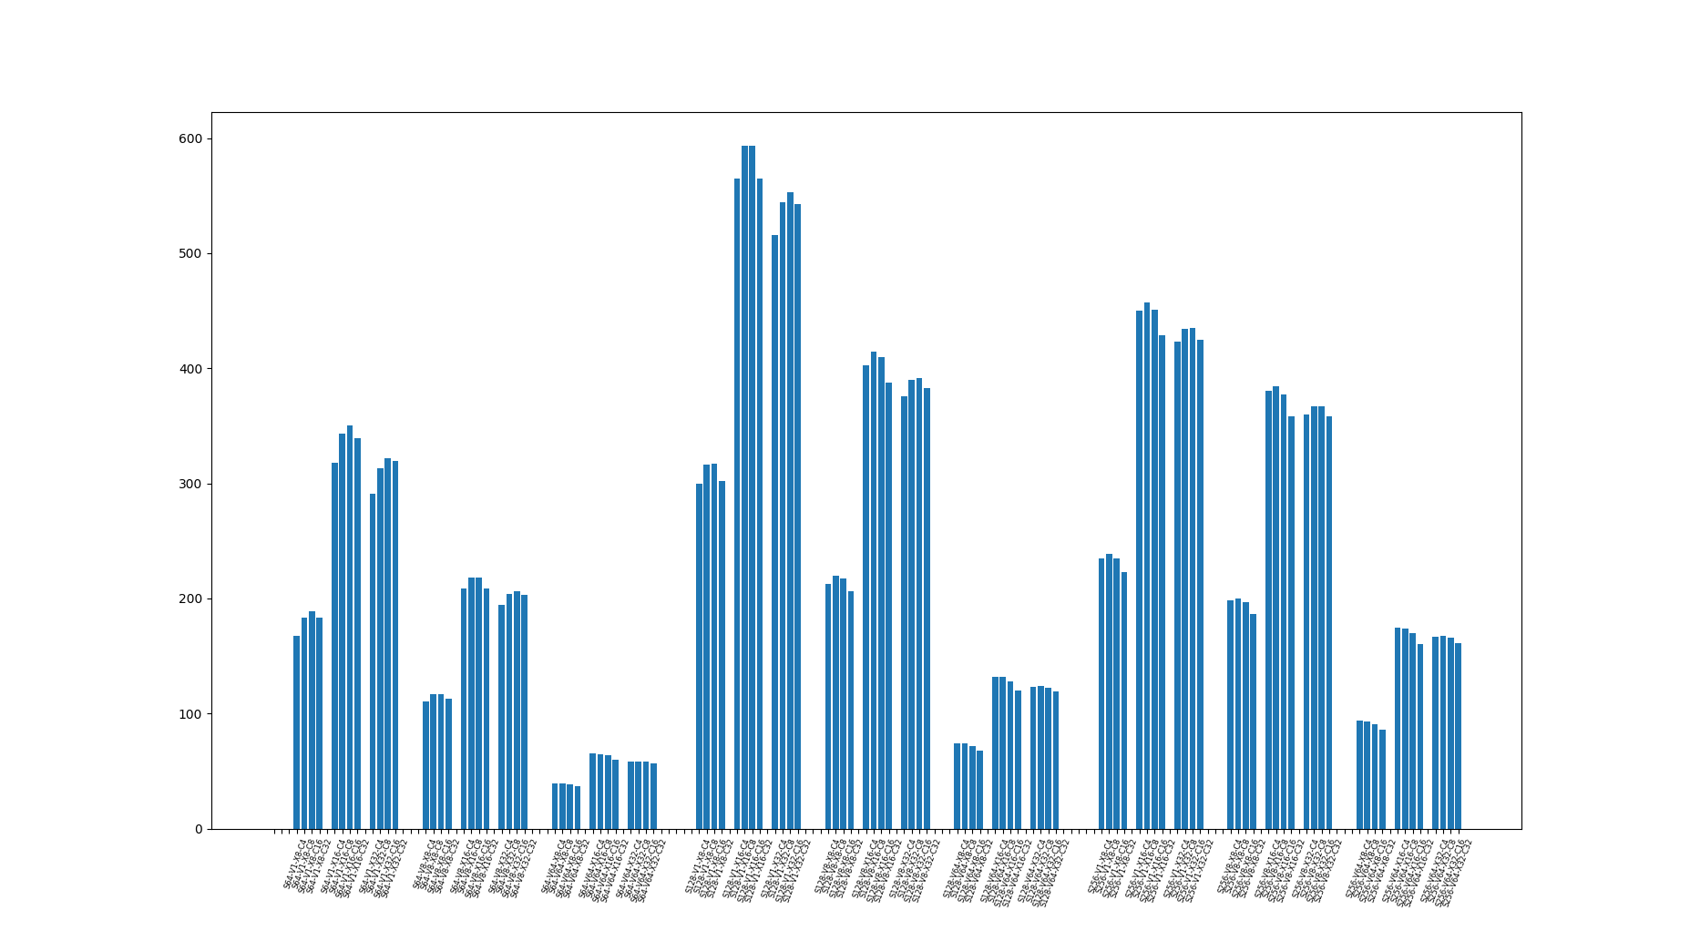
PUMA Tile CE

Slide 10
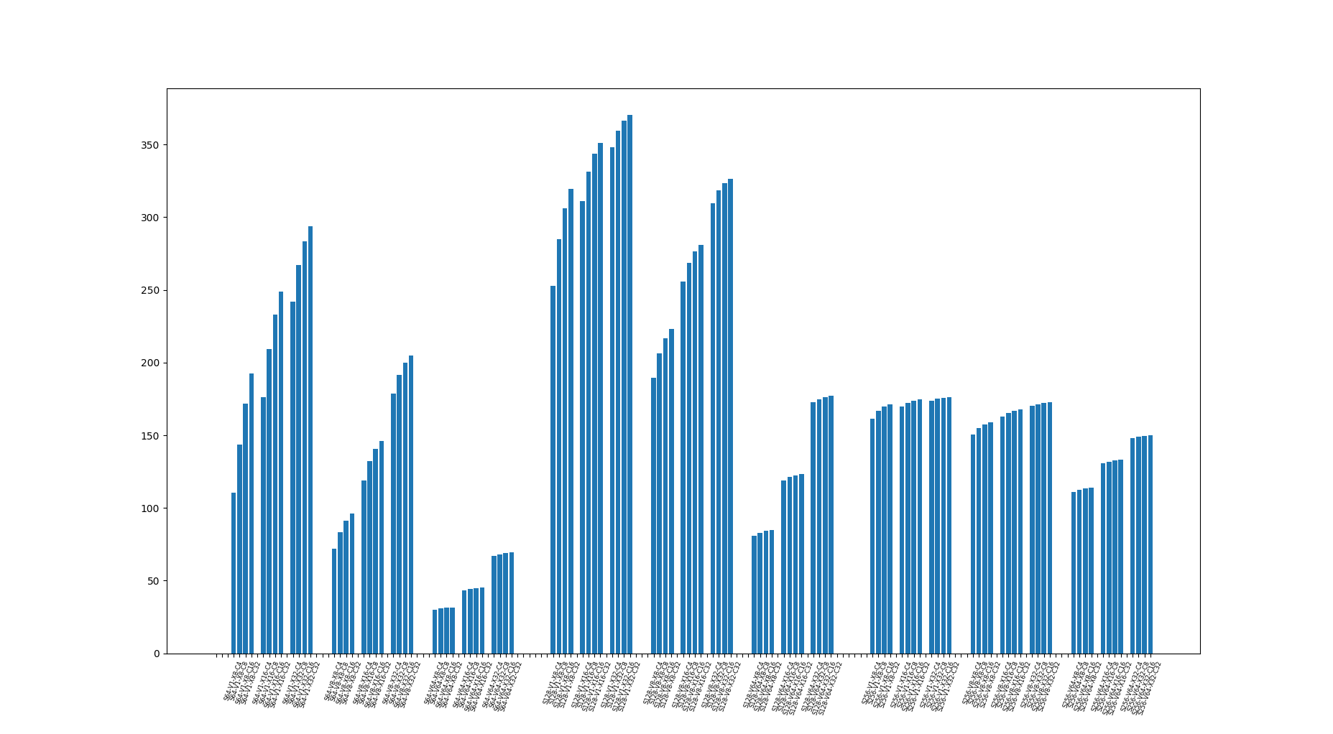
PUMA Tile PE

Slide 11
To do:
Add an ASIC data point (possibly TPU) for Inference Time, Energy reduction and throughput results.
Cambricon uses small benchmarks.
Small benchmarks don’t expose penalties stemming form MVM aggregation across Tiles, Nodes.
Add CNN benchmarks (AlexNet, Vgg16, Vgg19)
GPU results available
PUMA results awaiting [Should be ~similar to ISSAC], given out area-efficiency and energy efficiency per tile are comparable.
Improve CE, PE graphs (add colors!)

