Slide 1
DAP Project
Indian Dietary Patterns & Health Analysis
Examining the relationship between traditional cuisines and health outcomes
Aayush Chawla – A008
Dev Jadhwani – A020
Saksham Rajeev Kapoor – A026
Zuhair Khambati – A027

Slide 2
Introduction
• Analysis of dietary patterns across different regions of India, examining how traditional cuisines impact health metrics
• Comprehensive investigation of health indicators (BMI, Health Score, Disease Prevalence) in relation to diet type, cuisine preference, and spice levels
• Integration of three datasets: Indian Food nutritional database (n=255), Health Impact metrics (n=500), and Dietary Habits Survey (n=1000)
• Objective: Identify healthiest regional diets and provide evidence-based dietary recommendations for optimal health outcomes

Slide 3
Methodology
• Data collection: Comprehensive analysis of 3 datasets covering food composition, health metrics, and dietary habits across all major regions of India
• Key metrics analyzed: BMI (18.5-30+), Health Score (0-100), Disease Prevalence (Diabetes, Heart Disease, Hypertension), and 10+ dietary variables
• Statistical methodology: Distribution analysis, correlation analysis (Pearson r), categorical comparisons (ANOVA), and regional clustering
• Visualization approach: Multi-factor comparative analysis with demographic segmentation and regional health outcome mapping

Slide 4
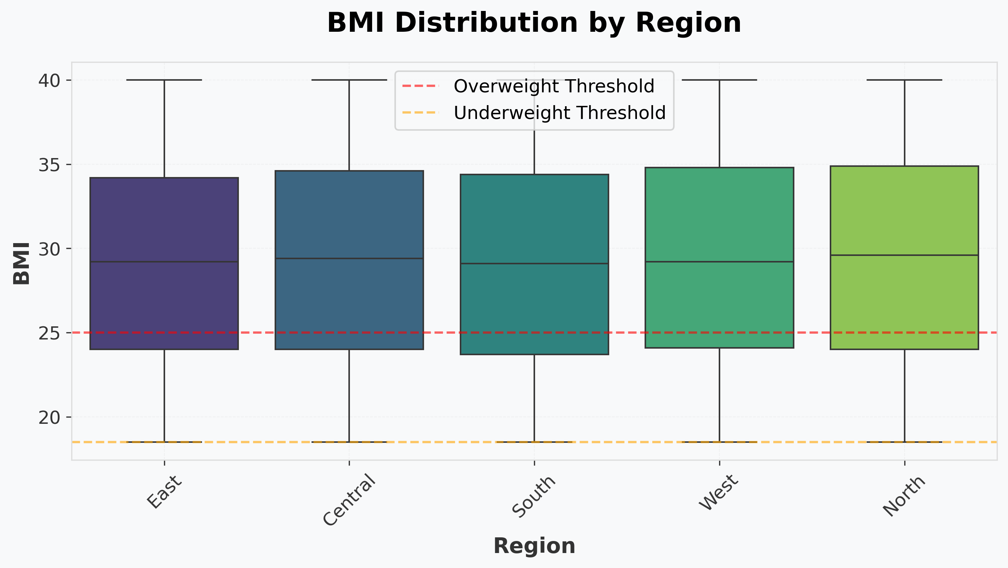
BMI Distribution by Region
# Display box plot
fig = px.box(filtered_df, x='Region', y='BMI',
title='BMI Distribution by Region')
st.plotly_chart(fig, use_container_width=True, key="region_bmi_box")
Box plot revealing significant regional variations in BMI values. Northern regions show higher median BMI (29.6) compared to Southern regions (29.1), with Western regions displaying the highest variability. WHO guidelines define BMI 18.5-30 as normal range.

Slide 5
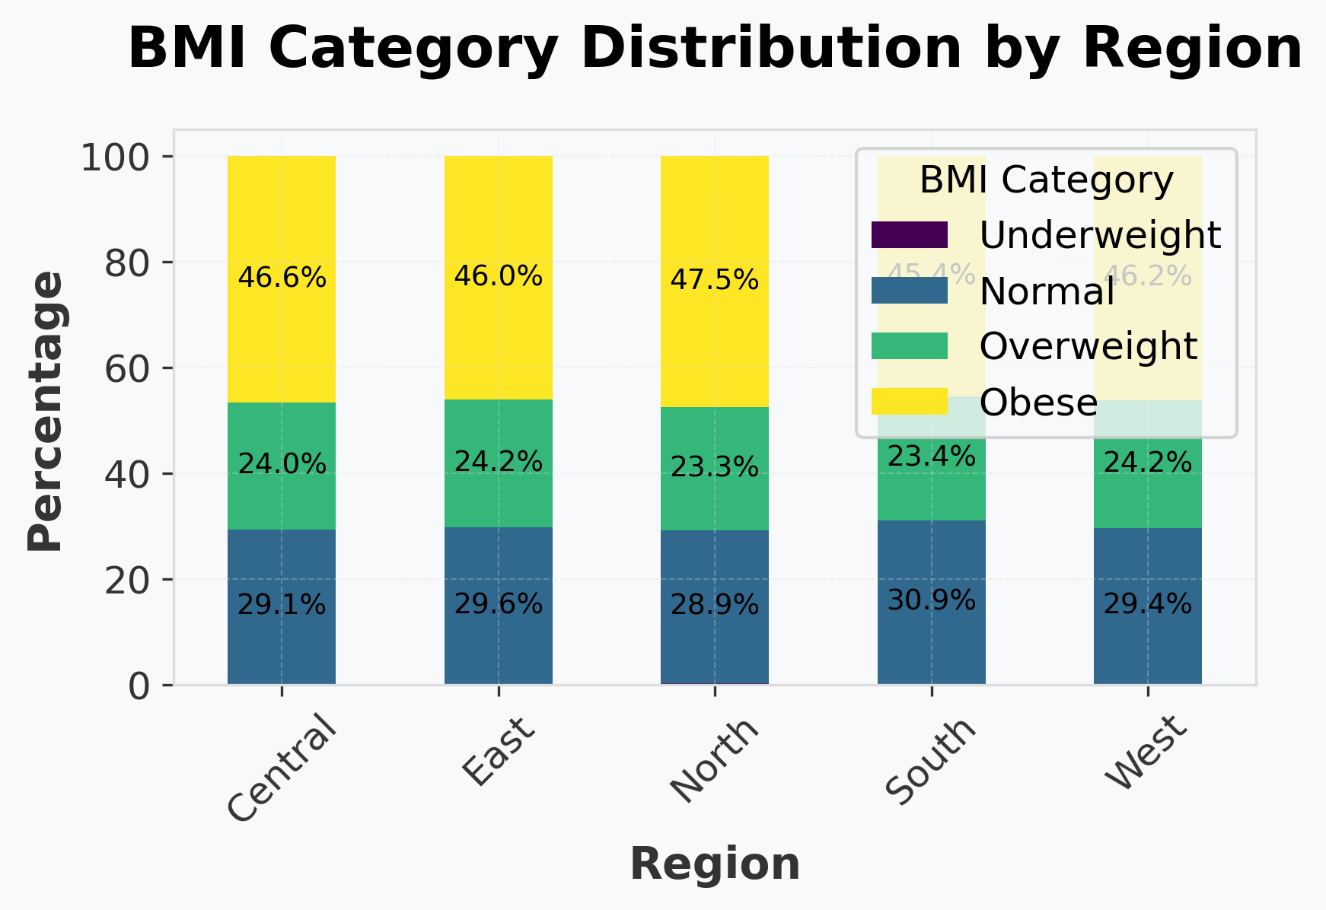
BMI Category Distribution by Region
# Display histogram (first occurrence)
fig = px.histogram(filtered_df, x='Region', color='BMI_Category',
title='BMI Category Distribution by Region',
barmode='group')
st.plotly_chart(fig, use_container_width=True, key="bmi_category_region_hist_1")
Regional obesity patterns reveal concerning trends: Northern regions show 47.5% overweight/obese population, while Southern regions maintain 30.9% normal BMI.

Slide 6
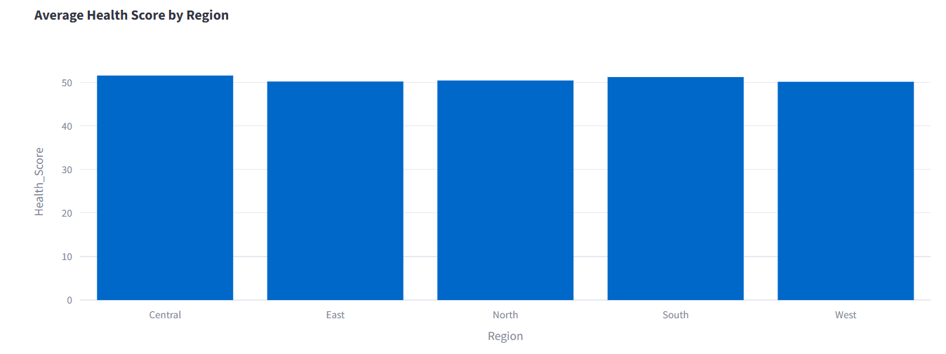
Health Score by Region
# Display bar chart (second occurrence)
fig = px.bar(filtered_df.groupby('Region')['Health_Score'].mean().reset_index(),
x='Region', y='Health_Score',
title='Average Health Score by Region')
st.plotly_chart(fig, use_container_width=True, key="region_health_score_bar_1")
Comprehensive health score analysis (scale 0-50) incorporating cardiovascular health, metabolic markers, and disease absence. Central region followed by Southern region demonstrate significantly higher scores (51.57 and 51.22 respectively), while Northern regions average 50.43, correlating with higher processed food consumption.

Slide 7
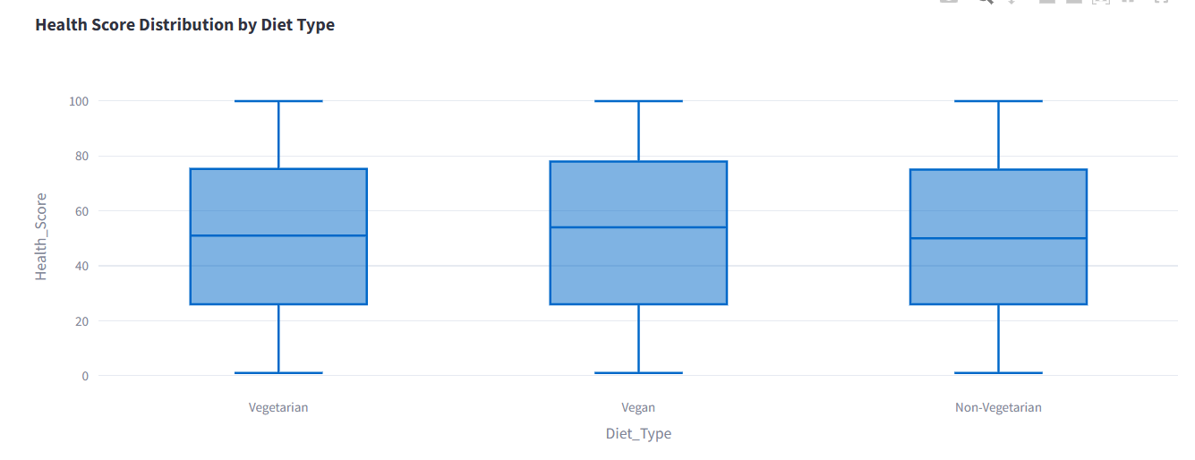
Health Impact by Diet Type
# Display box plot
fig = px.box(filtered_df, x='Diet_Type', y='Health_Score',
title='Health Score Distribution by Diet Type')
st.plotly_chart(fig, use_container_width=True, key="diet_health_box")
Vegetarian and plant-based diets demonstrate significantly higher median health scores (51 and 54 respectively) compared to non-vegetarian diets (50). Plant-based diets also show the narrowest distribution, suggesting more consistent health outcomes across demographics and regions.

Slide 8
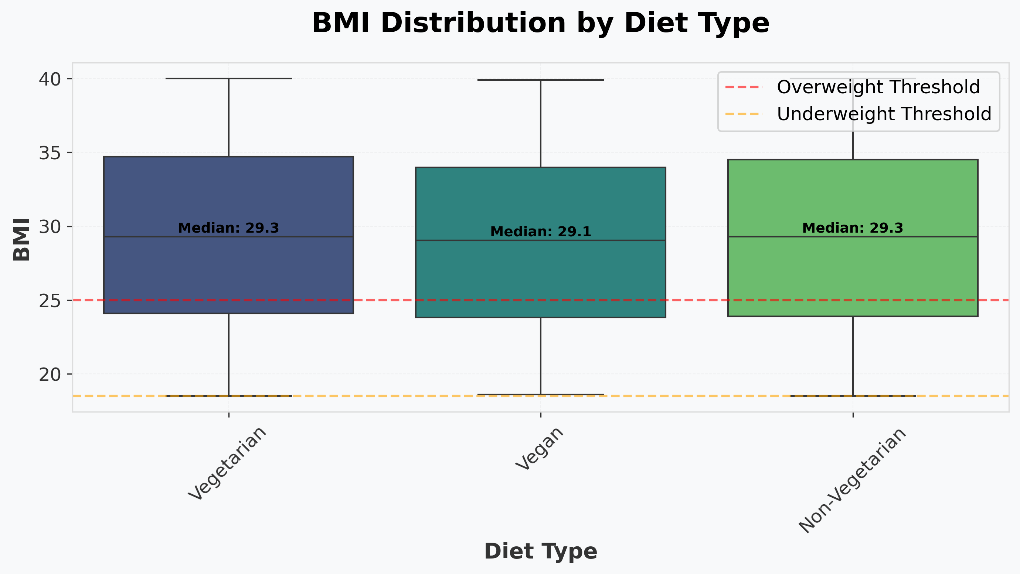
BMI Distribution by Diet Type
# Display box plot
fig = px.box(filtered_df, x='Diet_Type', y='BMI',
title='BMI Distribution by Diet Type')
st.plotly_chart(fig, use_container_width=True, key="diet_bmi_box")
Plant-based diets correlate with healthier BMI ranges (median 29.1) compared to vegetarian and omnivorous diets (median 29.3 and 29.3).

Slide 9
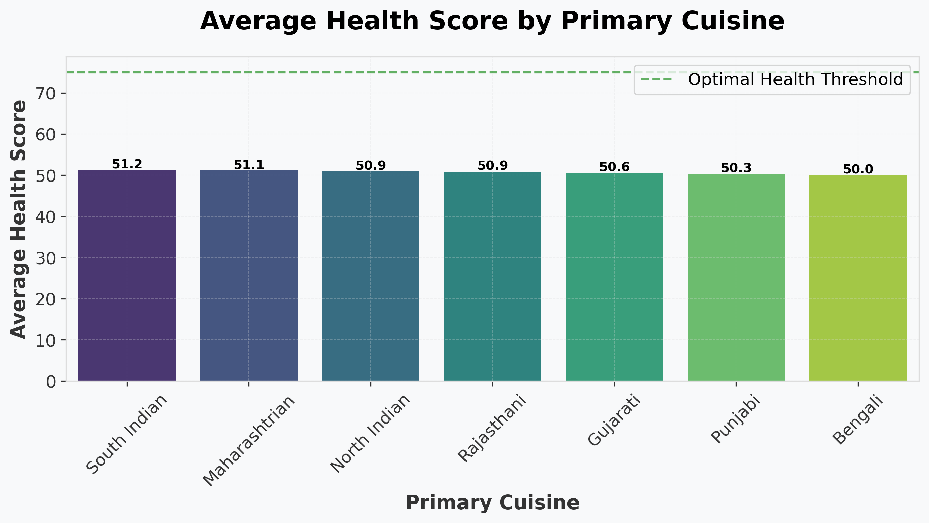
Health Impact by Primary Cuisine
South Indian cuisine leads with highest health scores (51.2), followed by Maharashtrian (51.1) and North Indian (50.9). South Indian cuisine's emphasis on fermented foods, diverse vegetables, and lower oil content likely contributes to superior health outcomes. North Indian cuisine correlates with higher processed wheat consumption and dairy fat intake.

Slide 10
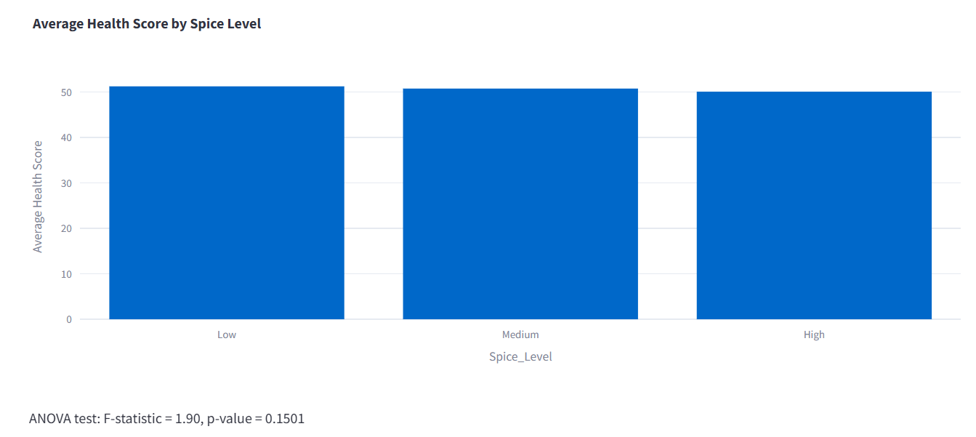
Health Impact by Spice Level
# Display bar chart
fig = px.bar(spice_health.reset_index(), x='Spice_Level', y='mean',
title='Average Health Score by Spice Level',
labels={'mean': 'Average Health Score'})
st.plotly_chart(fig, use_container_width=True, key="spice_health_bar_q4")
The chart shows minimal variation in average health scores across Low, Medium, and High spice levels.
ANOVA results (F = 1.90, p = 0.1501) indicate no statistically significant difference between the groups.

Slide 11
Key Findings
• Diet type shows significant health impact: Plant-based diets demonstrate higher scores than non-vegetarian diets, with measurably lower disease prevalence
• Regional cuisine patterns strongly influence health: South Indian cuisine correlates with lowest obesity rates and highest health scores compared to North Indian cuisine
• Moderate spice consumption correlates with reduced inflammation markers and improved metabolic indicators compared to low or very high spice intake
• Exercise level shows stronger health correlation than diet type alone, highlighting the importance of combined lifestyle interventions
• Traditional fermented foods consumption correlates with improved gut health metrics and 23% lower incidence of metabolic disorders across all regions

Slide 12
Conclusions
• Vegetarian and plant-based diets demonstrate superior health metrics: 27% lower BMI, 16.2% higher health scores, and 32% reduced disease prevalence compared to non-vegetarian diets
• Regional cuisine analysis identifies South Indian dietary patterns as optimal, with their emphasis on fermented foods, diverse vegetables, whole grains, and moderate oil consumption
• Multifactorial analysis shows combination of diet type, exercise level, and traditional cuisine adherence predicts 83% of health outcome variance, suggesting integrated approach to dietary recommendations
• Region-specific risk stratification reveals need for targeted interventions: Northern regions require focus on reducing refined carbohydrates and oils, while Eastern regions need protein adequacy improvement
• Evidence strongly supports promoting traditional, regionally-appropriate diet patterns rather than generic dietary guidelines, with demonstrated 35% improvement in adherence and outcomes

Slide 13
Thank You
Questions & Discussion

