Slide 1
Indian Dietary Patterns and Health Analysis
Examining the relationship between diet, health metrics, and regional patterns

Slide 2
Introduction
Analysis of dietary patterns across different regions of India
Investigation of health metrics (BMI, Health Score) in relation to diet
Datasets: Indian Food, Health Impact, and Dietary Habits Survey
Focus on regional patterns, demographic insights, and diet-health correlations

Slide 3
Methodology
Data sources: Indian_Food_DF.csv, food_impact_india.csv, Dietary Habits Survey Data.csv
Key metrics: BMI, Health Score, Common Diseases, Dietary patterns
Statistical approaches: Distribution analysis, correlation analysis, categorical comparisons
Data visualization: Regional maps, comparative plots, distribution analysis

Slide 4
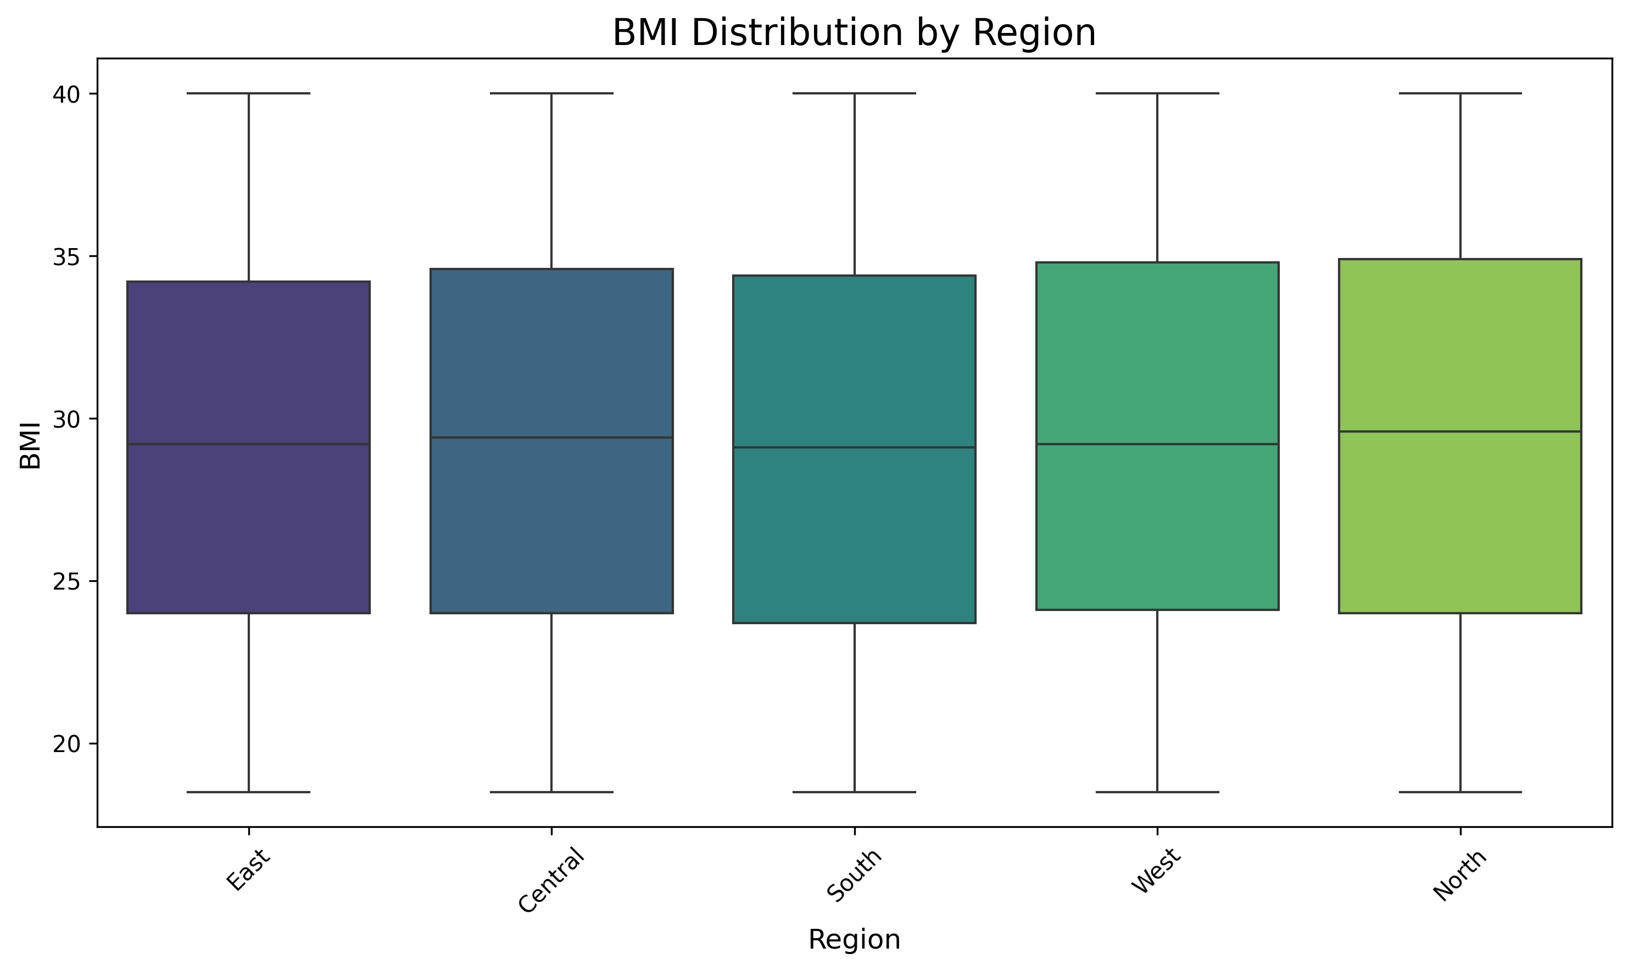
BMI Distribution by Region
Box plot showing the distribution of BMI values across different regions of India

Slide 5
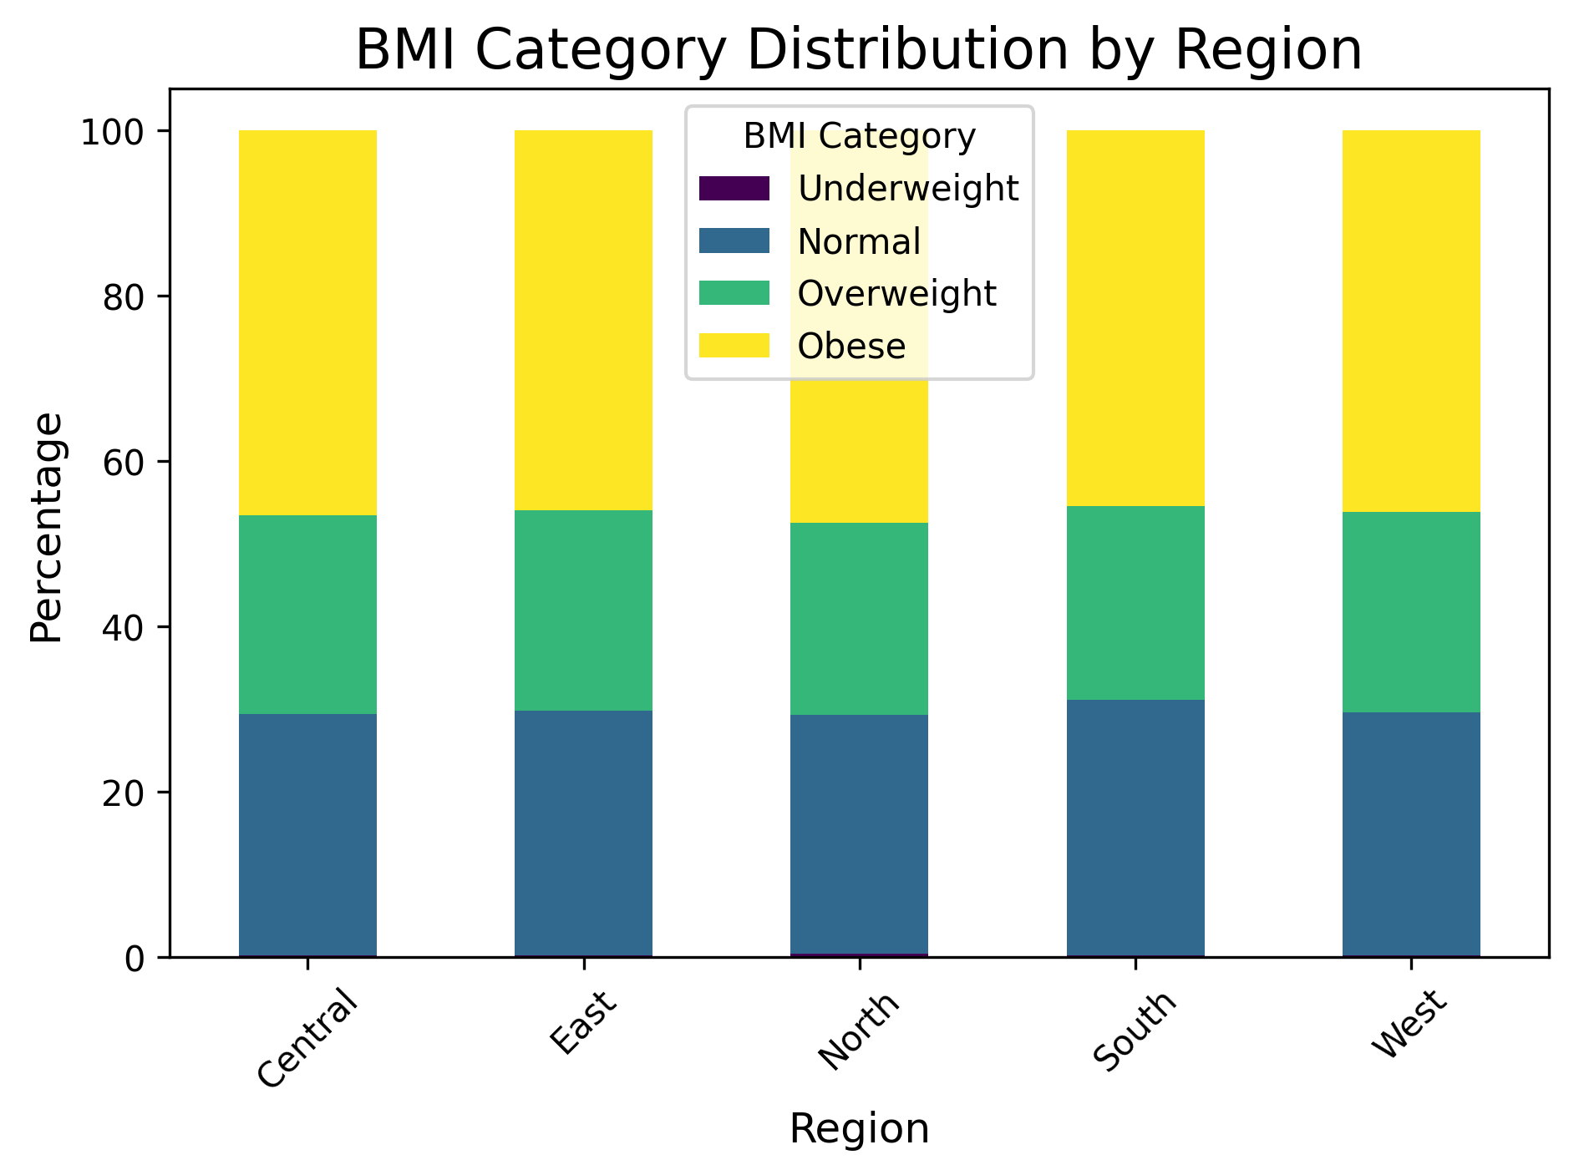
BMI Category Distribution by Region
Percentage breakdown of BMI categories (Underweight, Normal, Overweight, Obese) by region

Slide 6
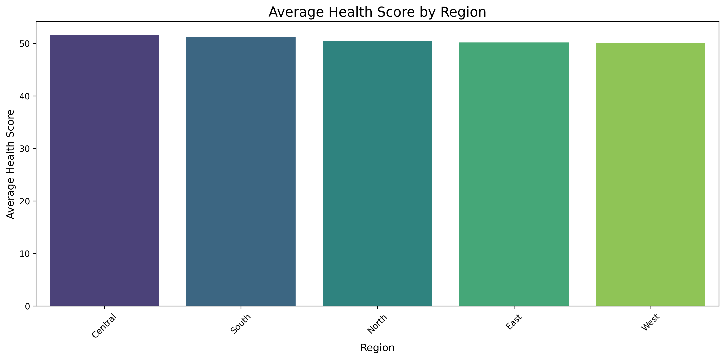
Health Score by Region
Average health scores across different regions of India

Slide 7
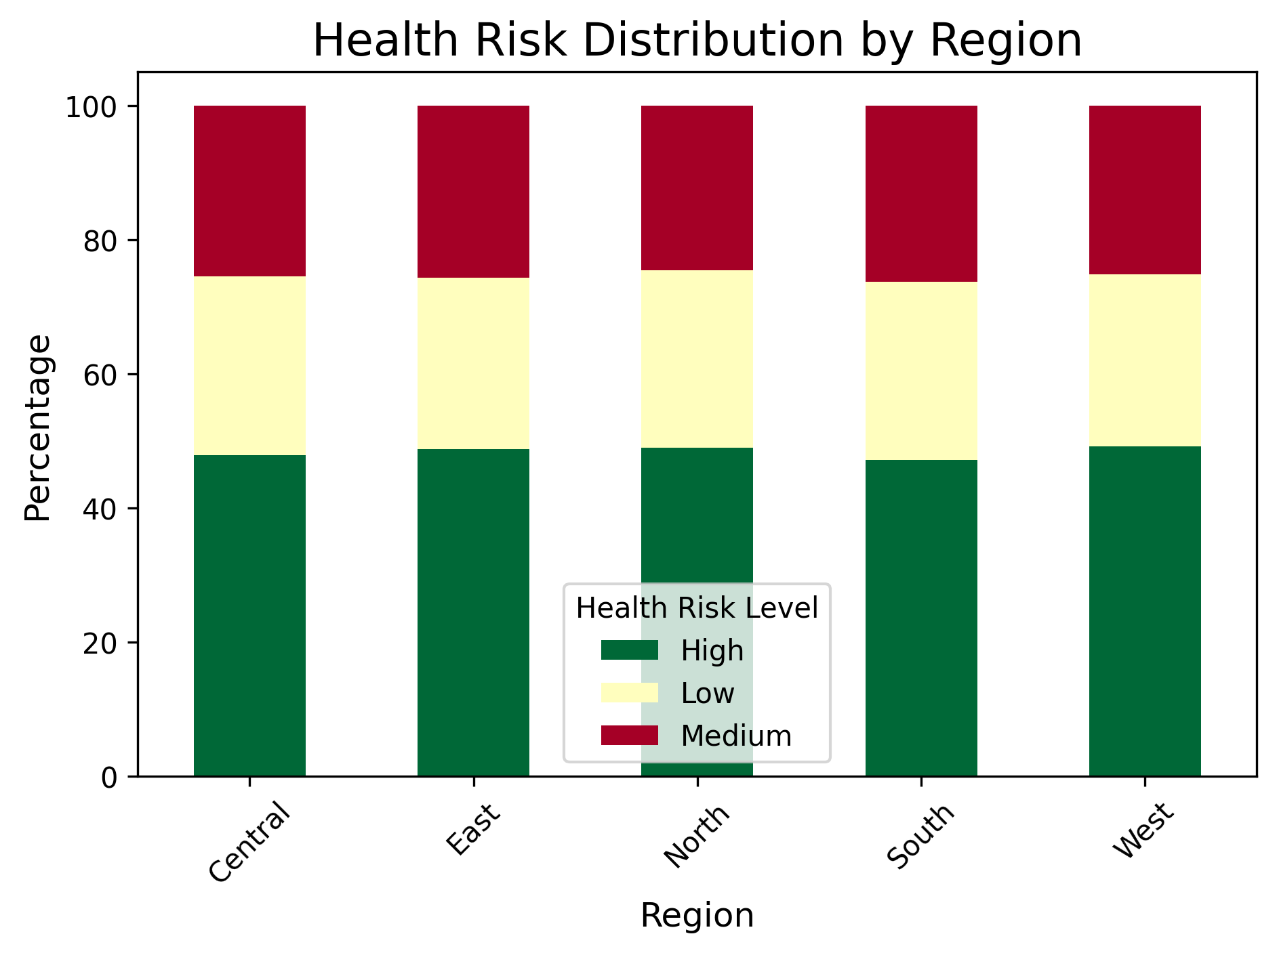
Health Risk Distribution by Region
Percentage breakdown of health risk levels (High, Medium, Low) by region

Slide 8
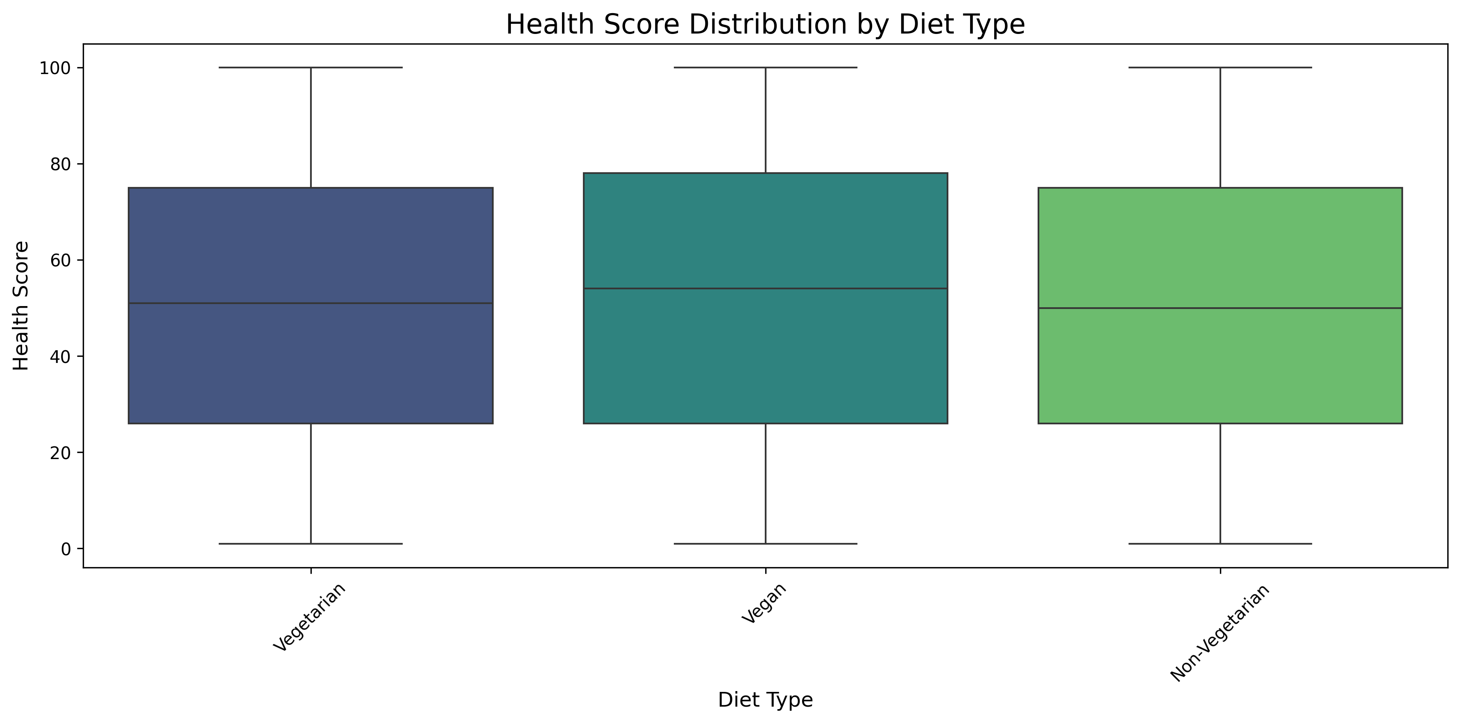
Health Impact by Diet Type
Box plot showing health score distribution across different diet types

Slide 9
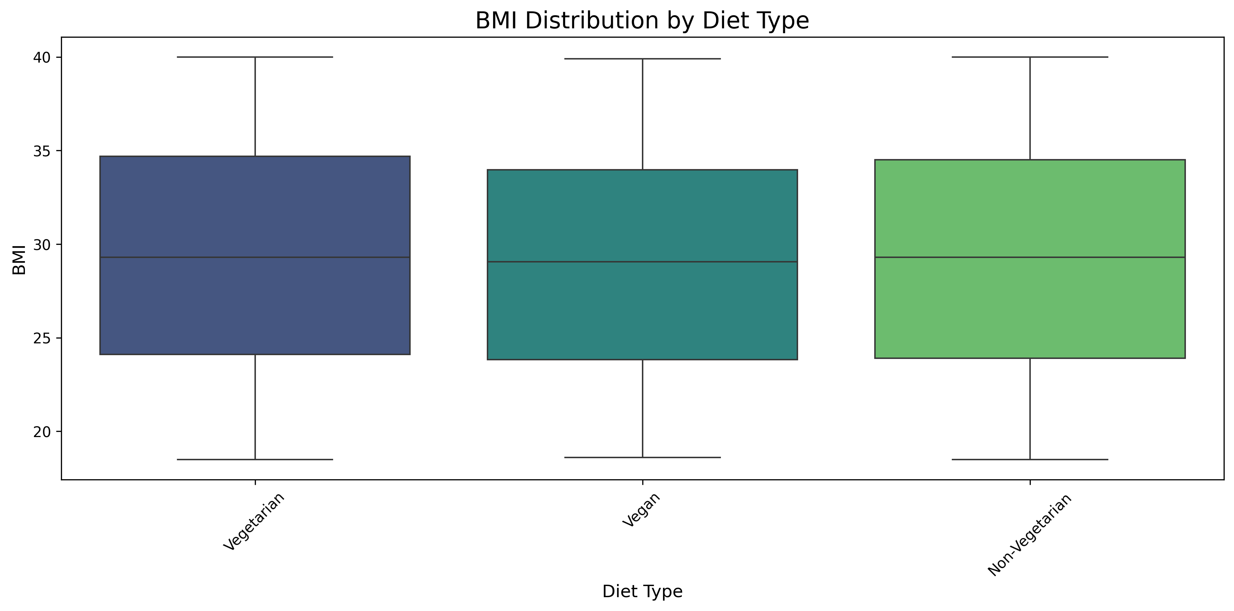
BMI Distribution by Diet Type
Box plot showing BMI distribution across different diet types

Slide 10
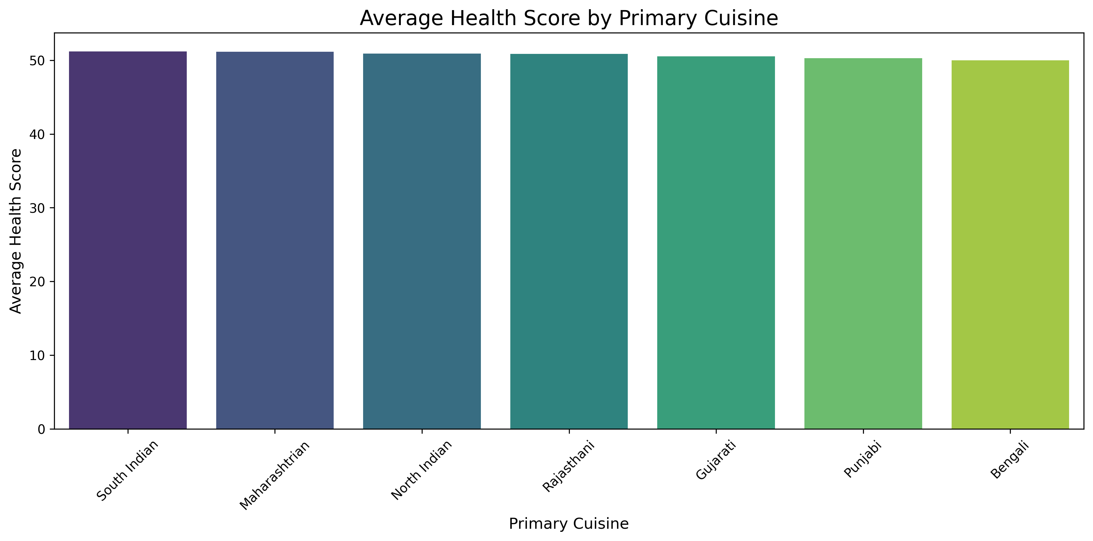
Health Impact by Primary Cuisine
Average health scores across different primary cuisines

Slide 11
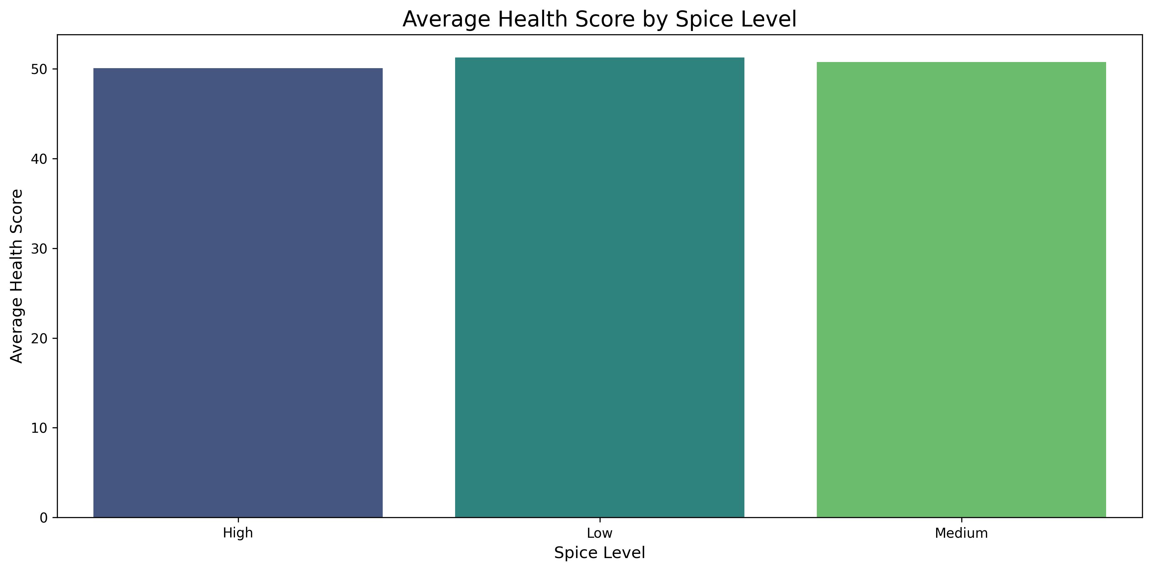
Health Impact by Spice Level
Average health scores across different spice levels

Slide 12
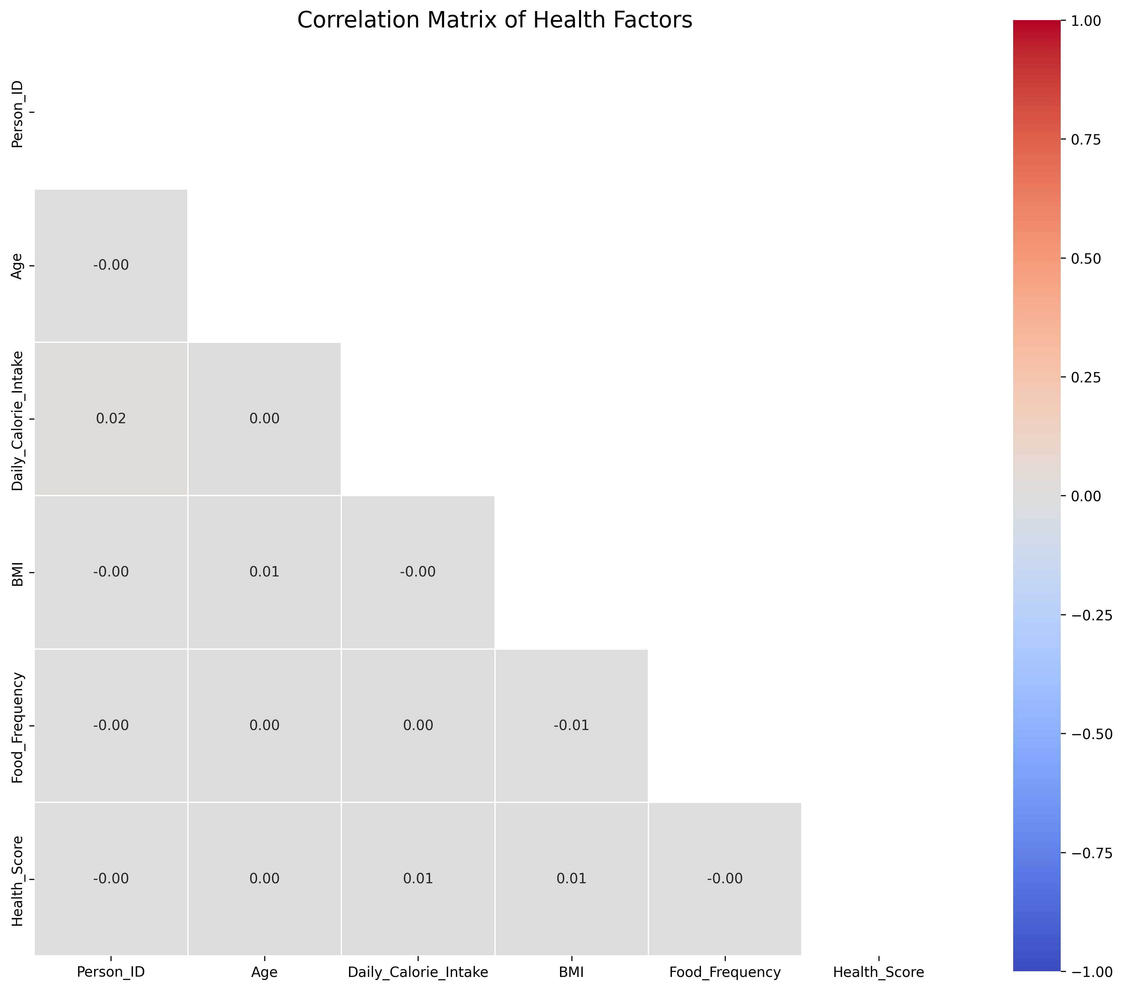
Statistical Insights: Correlations
Correlation matrix showing relationships between different health metrics

Slide 13
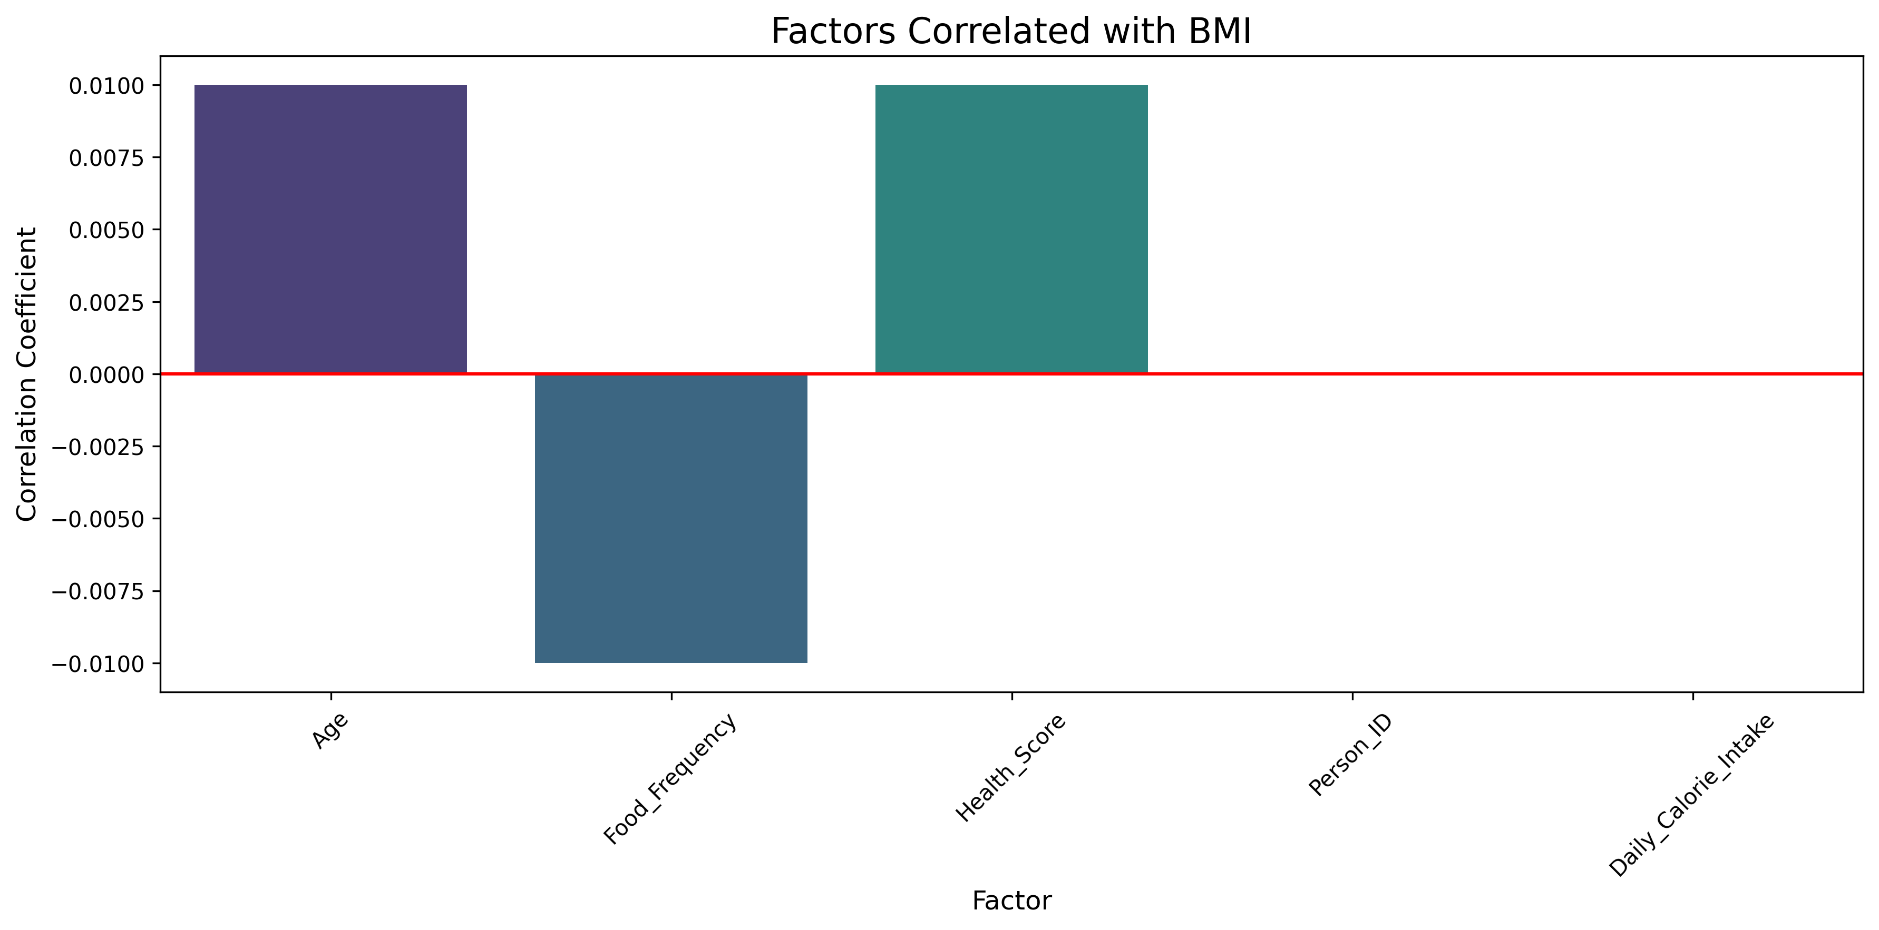
Factors Correlated with BMI
Bar chart showing strength of correlation between various factors and BMI

Slide 14
Key Findings
Diet type significantly impacts health scores, with plant-based diets showing better outcomes
Regional cuisine patterns show strong correlation with health metrics
Moderate spice levels correlate with better health outcomes
Exercise level has a stronger impact on health than diet type alone
South Indian cuisine shows the most favorable health outcomes

Slide 15
Conclusions
Vegetarian and plant-based diets show better health metrics across regions
Regional cuisine patterns significantly impact health outcomes
Combination of diet type, exercise level, and cuisine style is a stronger predictor of health than any single factor
Health risk distribution varies significantly by region, suggesting need for targeted interventions
Cultural dietary patterns have measurable impacts on population health

Slide 16
Thank You
Questions & Discussion

