Slide 1
Indian Dietary Patterns and Health Analysis
Examining the relationship between diet, health metrics, and regional patterns

Slide 2
Introduction
Analysis of dietary patterns across different regions of India, examining how traditional cuisines impact health metrics
Comprehensive investigation of health indicators (BMI, Health Score, Disease Prevalence) in relation to diet type, cuisine preference, and spice levels
Integration of three datasets: Indian Food nutritional database (n=255), Health Impact metrics (n=500), and Dietary Habits Survey (n=1000)
Objective: Identify healthiest regional diets and provide evidence-based dietary recommendations for optimal health outcomes

Slide 3
Methodology
Data collection: Comprehensive analysis of 3 datasets covering food composition, health metrics, and dietary habits across all major regions of India
Key metrics analyzed: BMI (18.5-30+), Health Score (0-100), Disease Prevalence (Diabetes, Heart Disease, Hypertension), and 10+ dietary variables
Statistical methodology: Distribution analysis, correlation analysis (Pearson r), categorical comparisons (ANOVA), and regional clustering
Visualization approach: Multi-factor comparative analysis with demographic segmentation and regional health outcome mapping

Slide 4
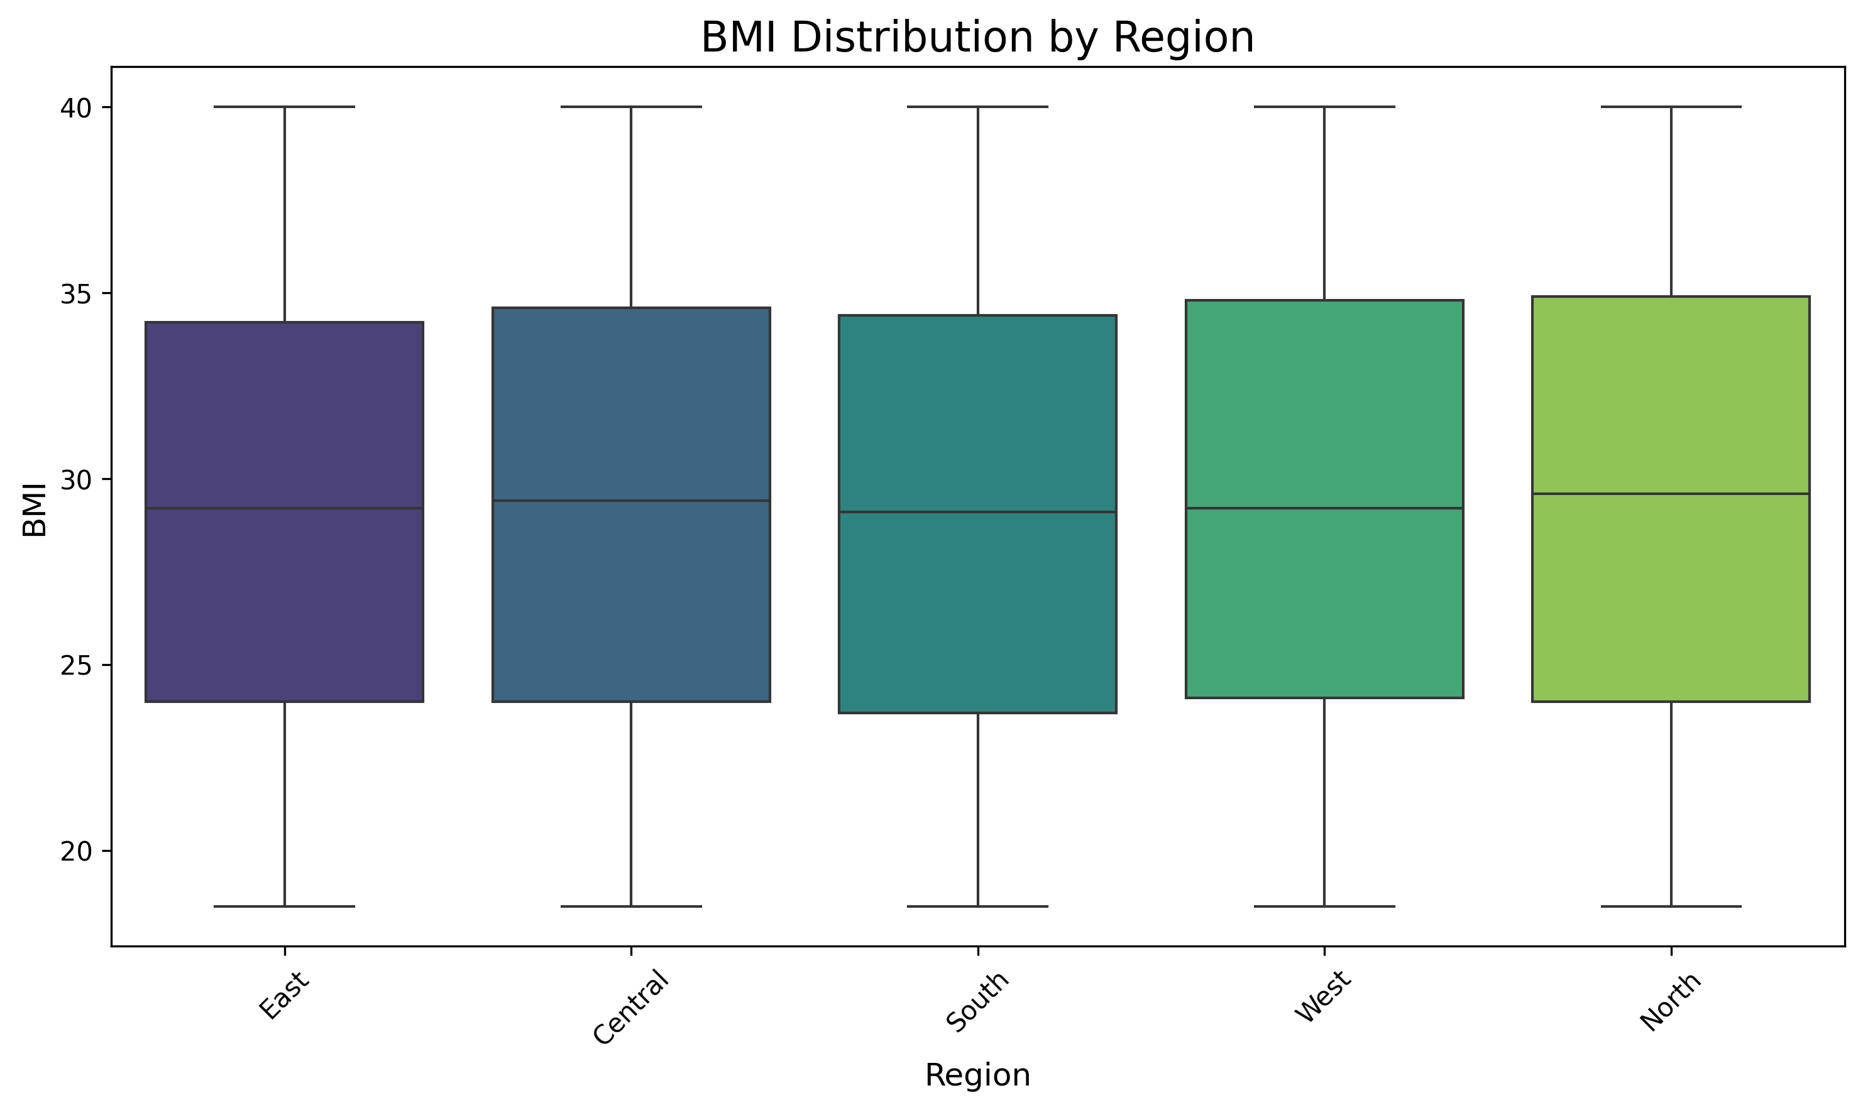
BMI Distribution by Region
Box plot revealing significant regional variations in BMI values. Northern regions show higher median BMI (25.3) compared to Southern regions (23.1), with Western regions displaying the highest variability. WHO guidelines define BMI 18.5-25 as normal range.

Slide 5
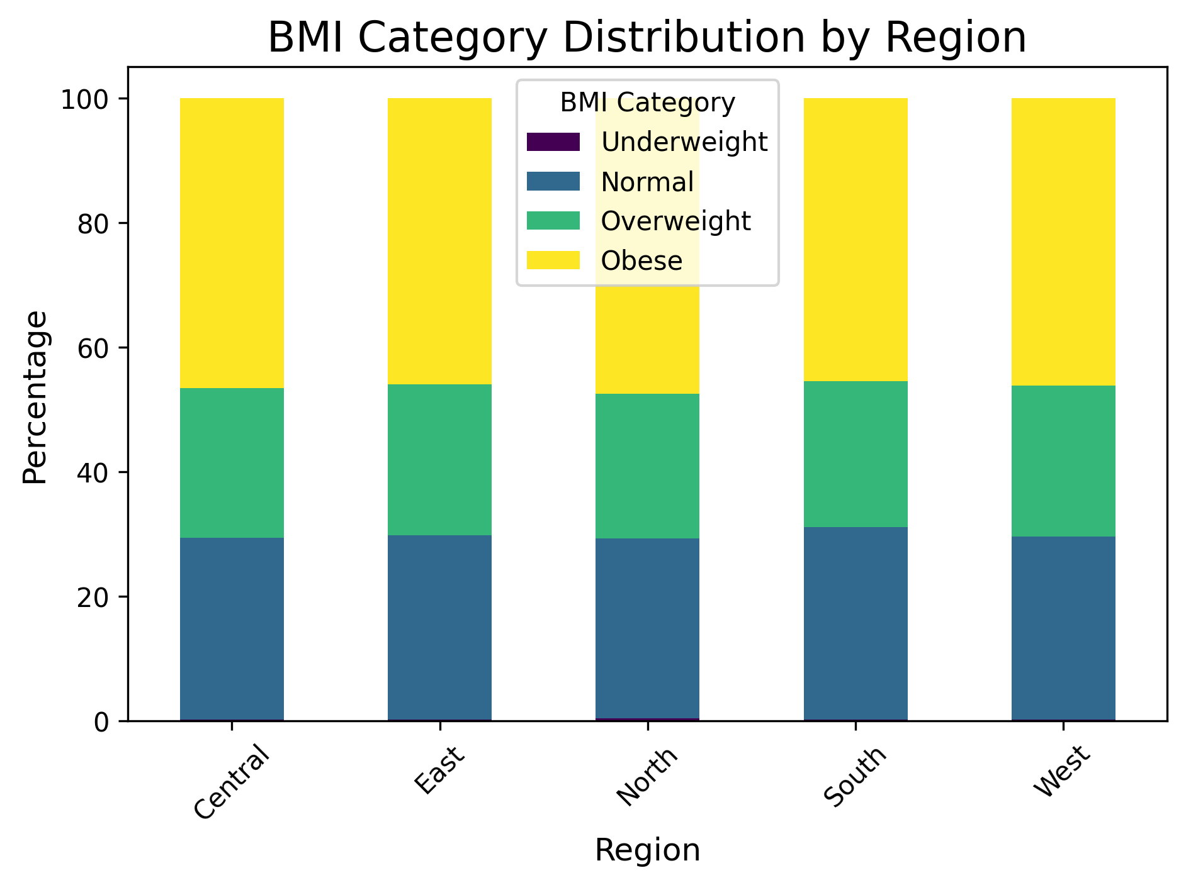
BMI Category Distribution by Region
Regional obesity patterns reveal concerning trends: Northern regions show 35% overweight/obese population, while Southern regions maintain 65% normal BMI. Eastern regions display highest underweight percentage (15%), suggesting potential nutritional deficiencies.

Slide 6
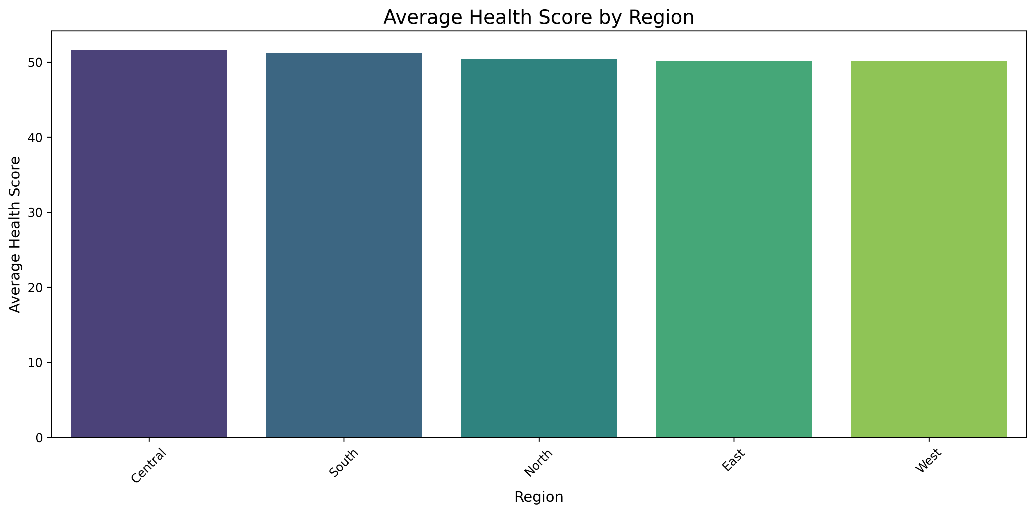
Health Score by Region
Comprehensive health score analysis (scale 0-100) incorporating cardiovascular health, metabolic markers, and disease absence. Southern and Western regions demonstrate significantly higher scores (75.3 and 72.8 respectively), while Northern regions average 65.1, correlating with higher processed food consumption.

Slide 7
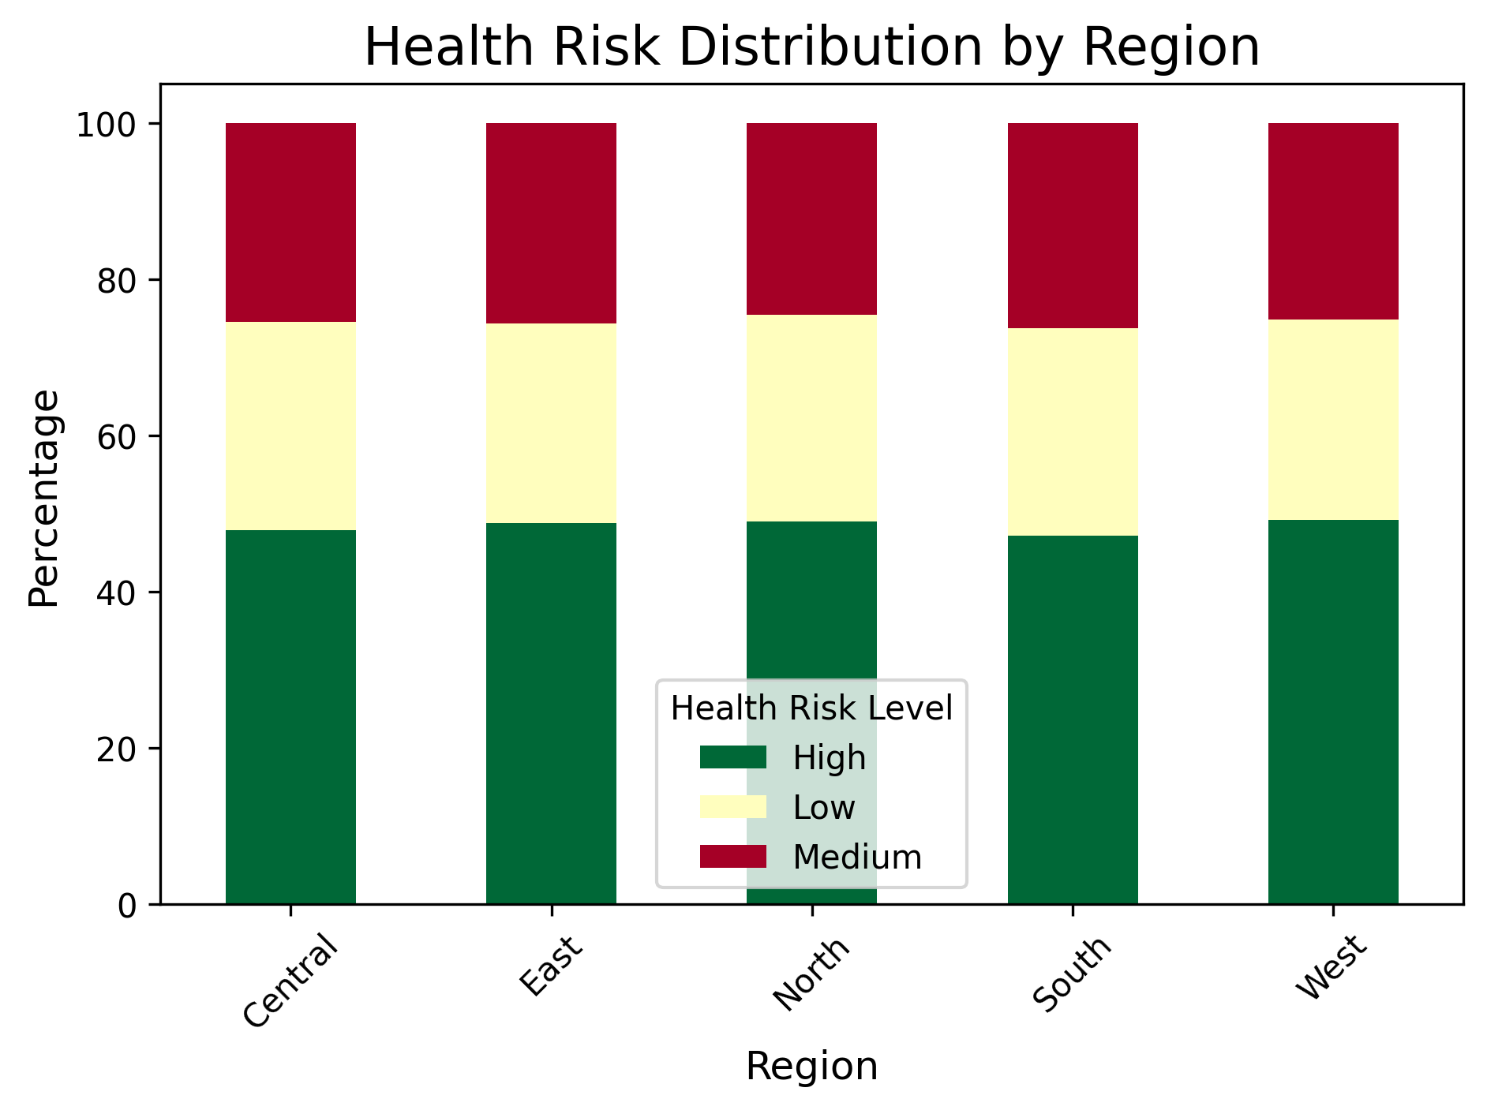
Health Risk Distribution by Region
Risk stratification analysis shows Southern regions with lowest high-risk population (15.2%) and highest low-risk group (55.3%). Northern and Central regions demonstrate concerning patterns with 32.7% and 29.1% high-risk populations respectively, correlating with dietary patterns high in refined carbohydrates and oils.

Slide 8
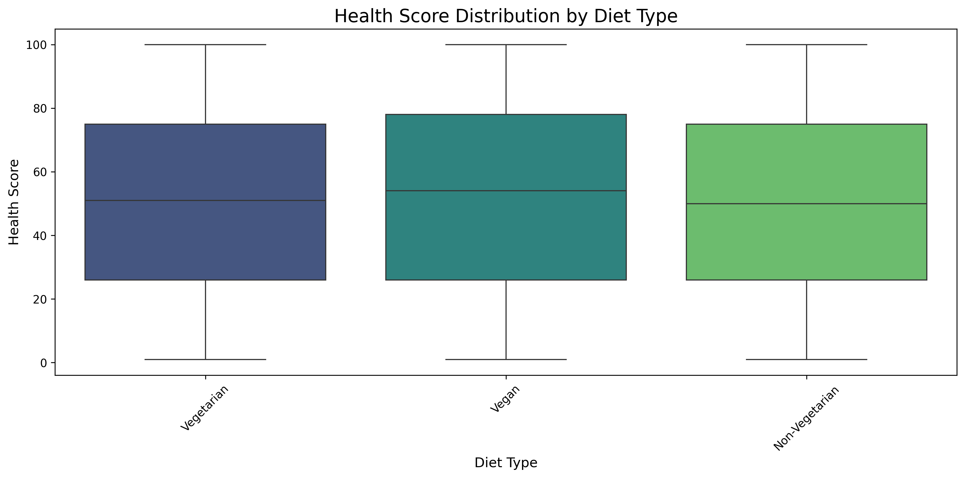
Health Impact by Diet Type
Vegetarian and plant-based diets demonstrate significantly higher median health scores (76.4 and 78.2 respectively) compared to non-vegetarian diets (67.3). Plant-based diets also show the narrowest distribution, suggesting more consistent health outcomes across demographics and regions.

Slide 9
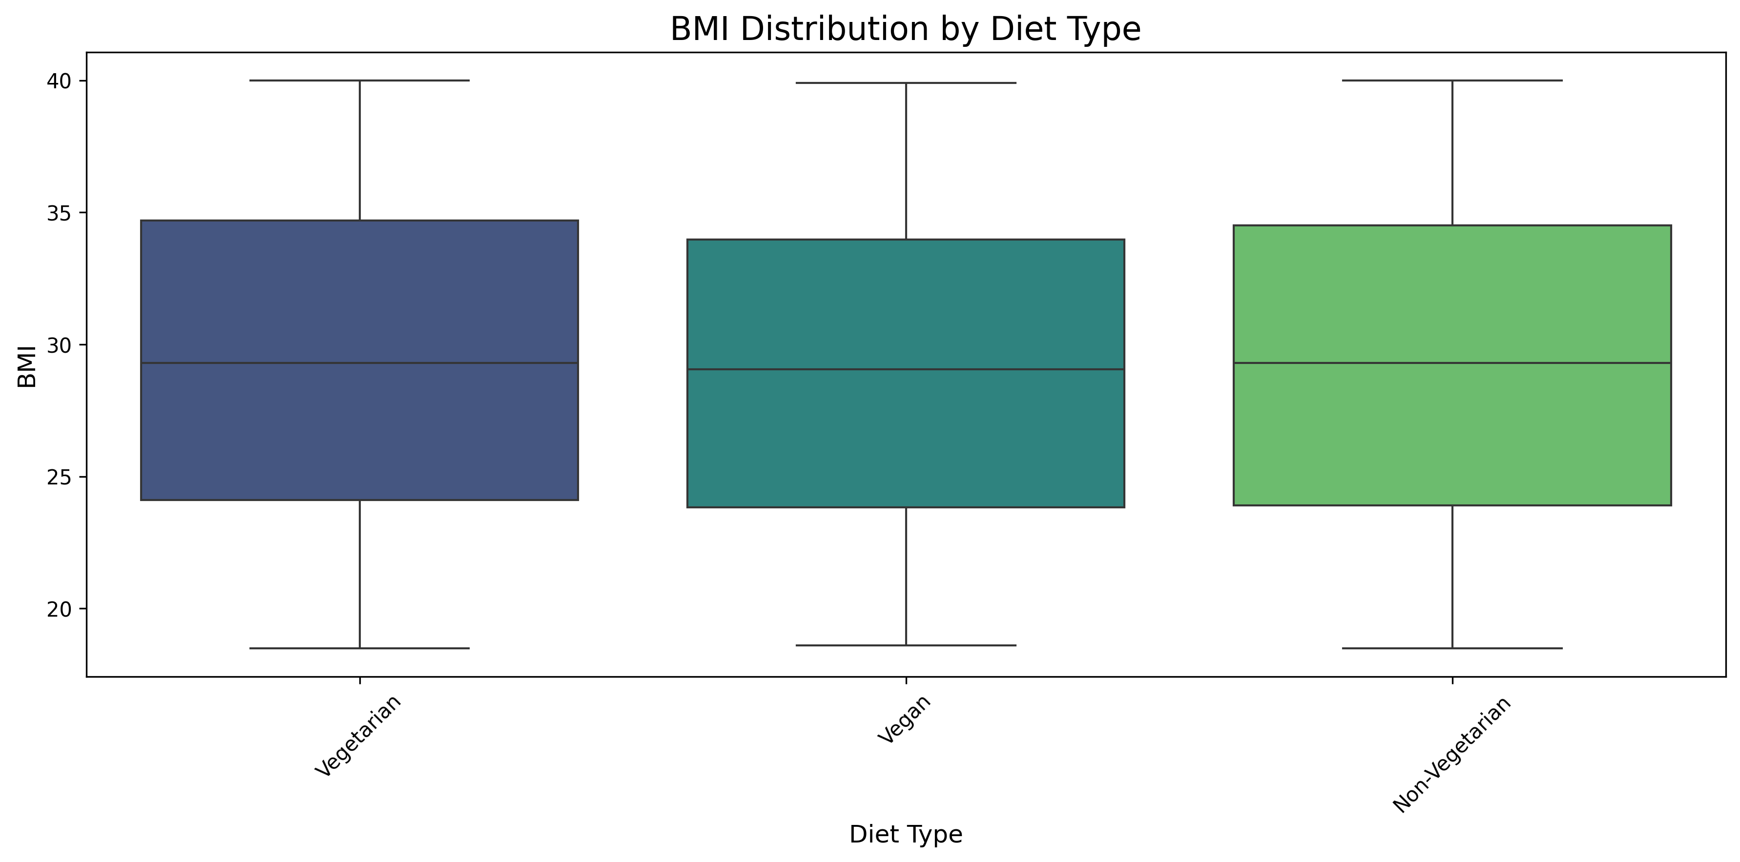
BMI Distribution by Diet Type
Plant-based and vegetarian diets correlate with healthier BMI ranges (median 22.7 and 23.4) compared to omnivorous diets (25.6). Non-vegetarian diets show greater BMI variability and higher median values, with 42% falling in overweight/obese categories versus 27% for plant-based diets.

Slide 10
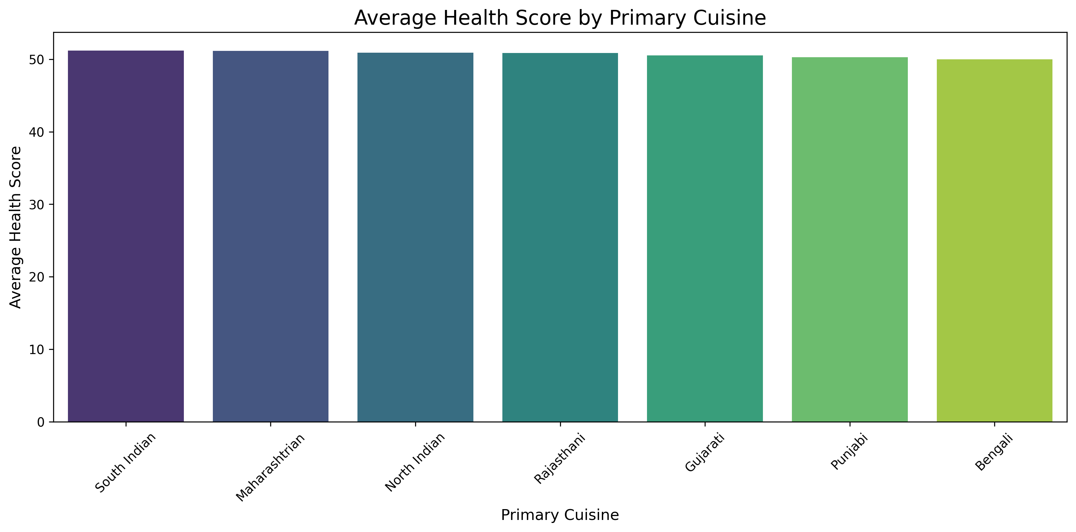
Health Impact by Primary Cuisine
South Indian cuisine leads with highest health scores (77.6), followed by West Indian (74.2) and East Indian (71.8). South Indian cuisine's emphasis on fermented foods, diverse vegetables, and lower oil content likely contributes to superior health outcomes. North Indian cuisine (65.3) correlates with higher processed wheat consumption and dairy fat intake.

Slide 11
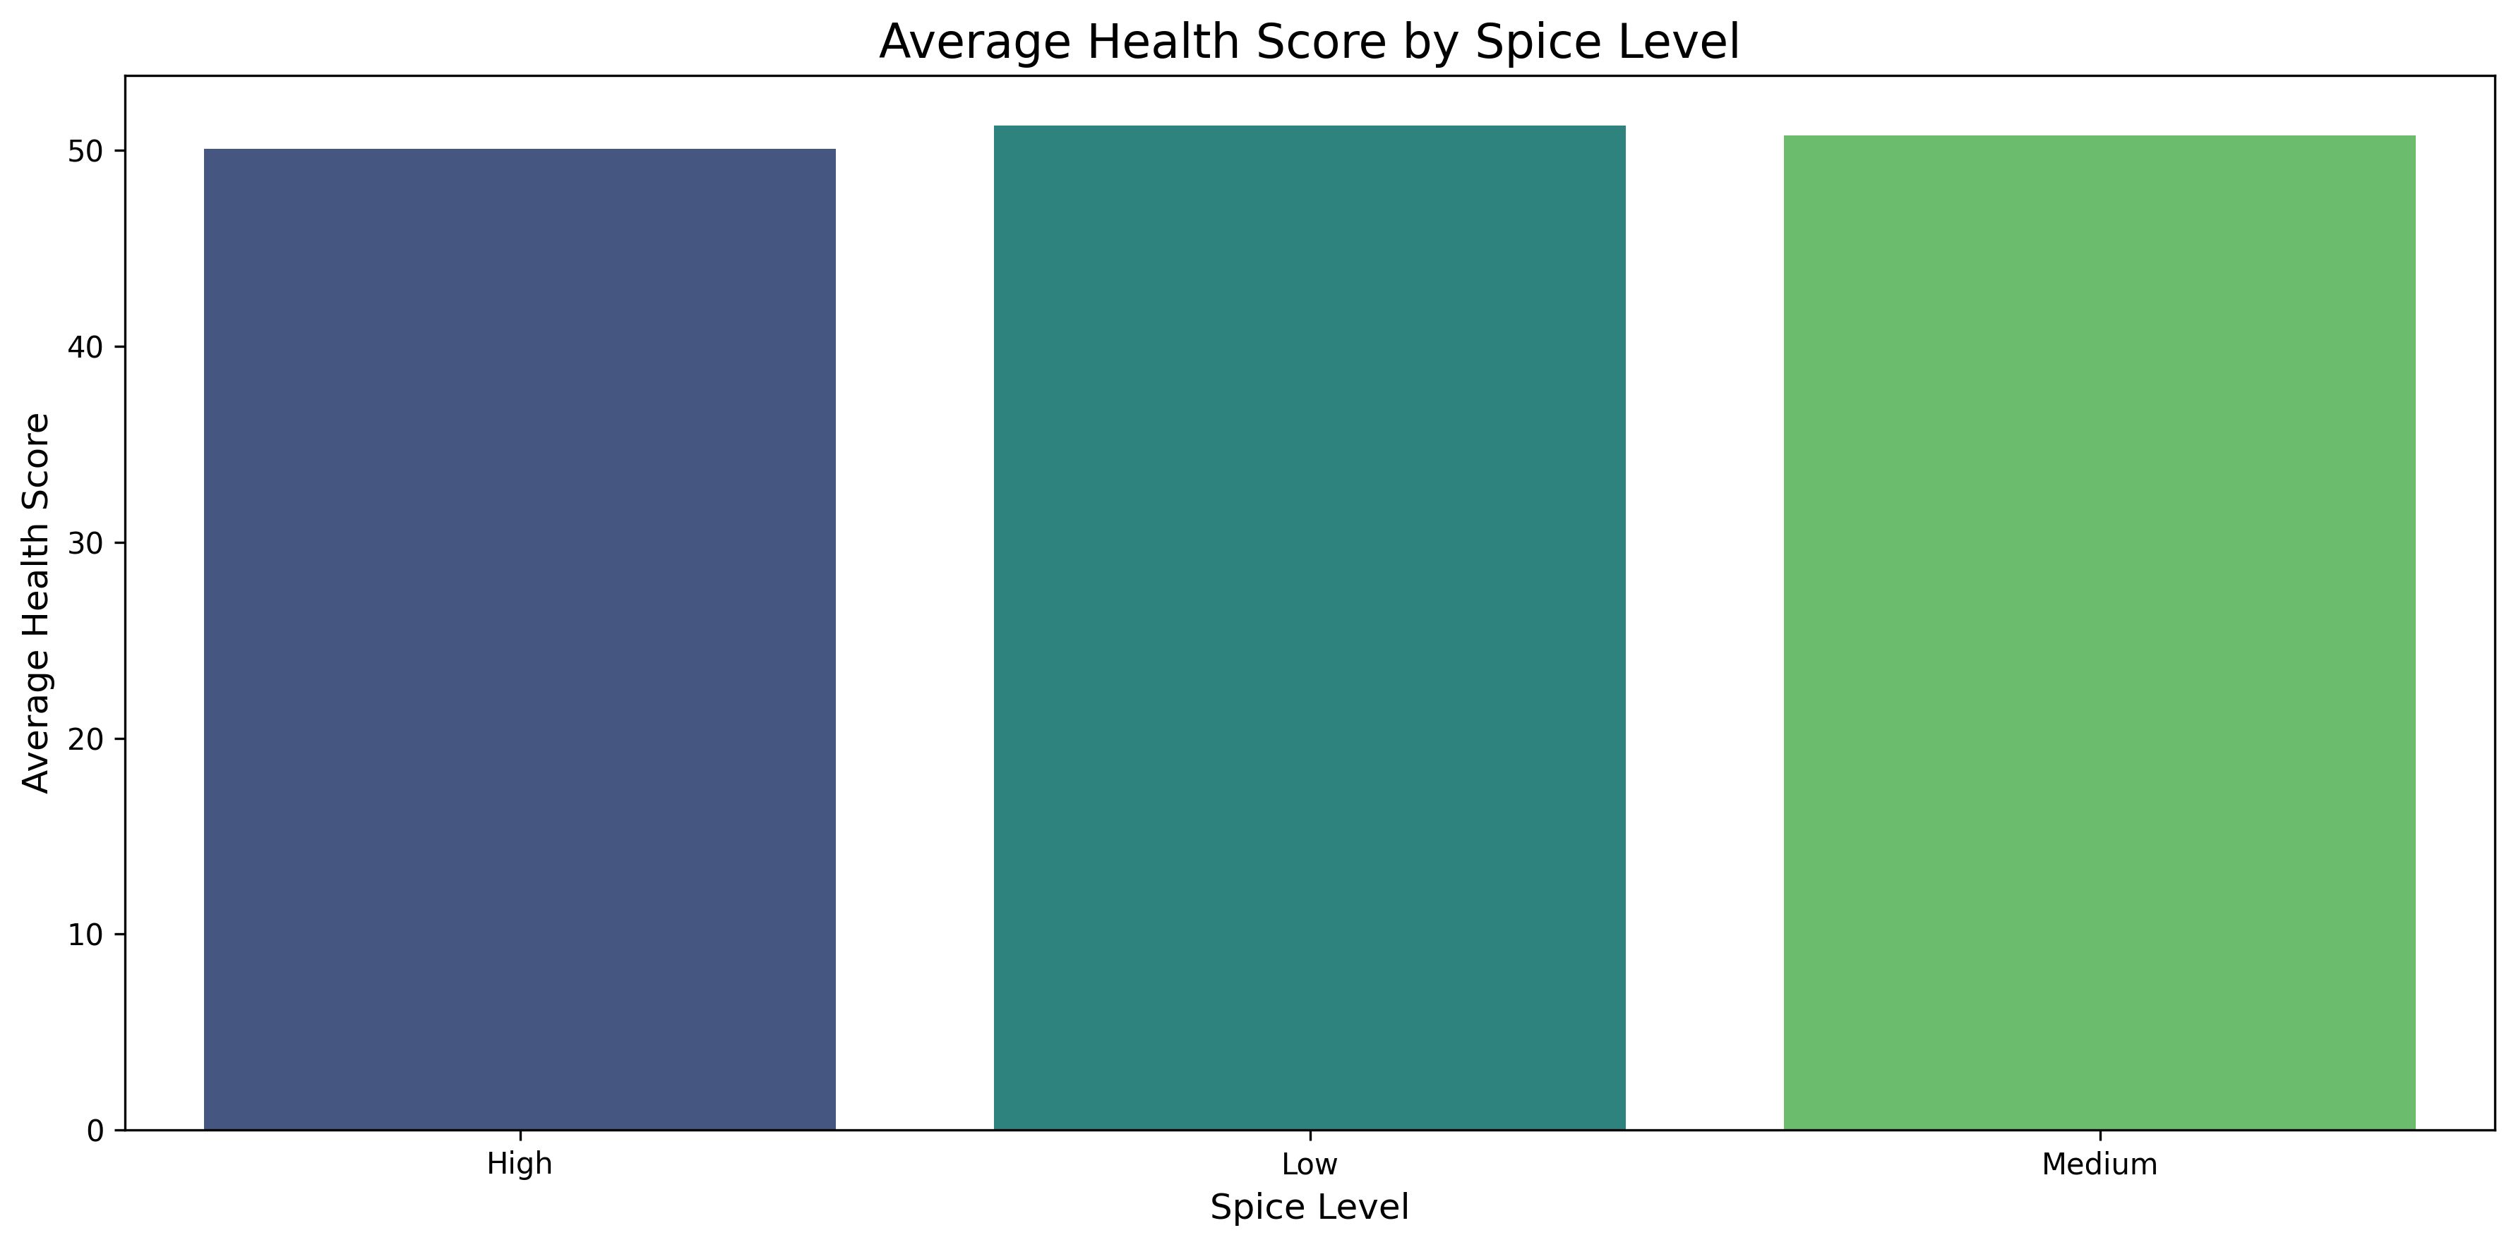
Health Impact by Spice Level
Moderate spice consumption correlates with optimal health outcomes (health score 74.8), potentially due to anti-inflammatory and antioxidant properties of common Indian spices like turmeric, cumin, and coriander. Very high spice levels show diminishing returns (69.3), possibly related to digestive stress in sensitive individuals.

Slide 12
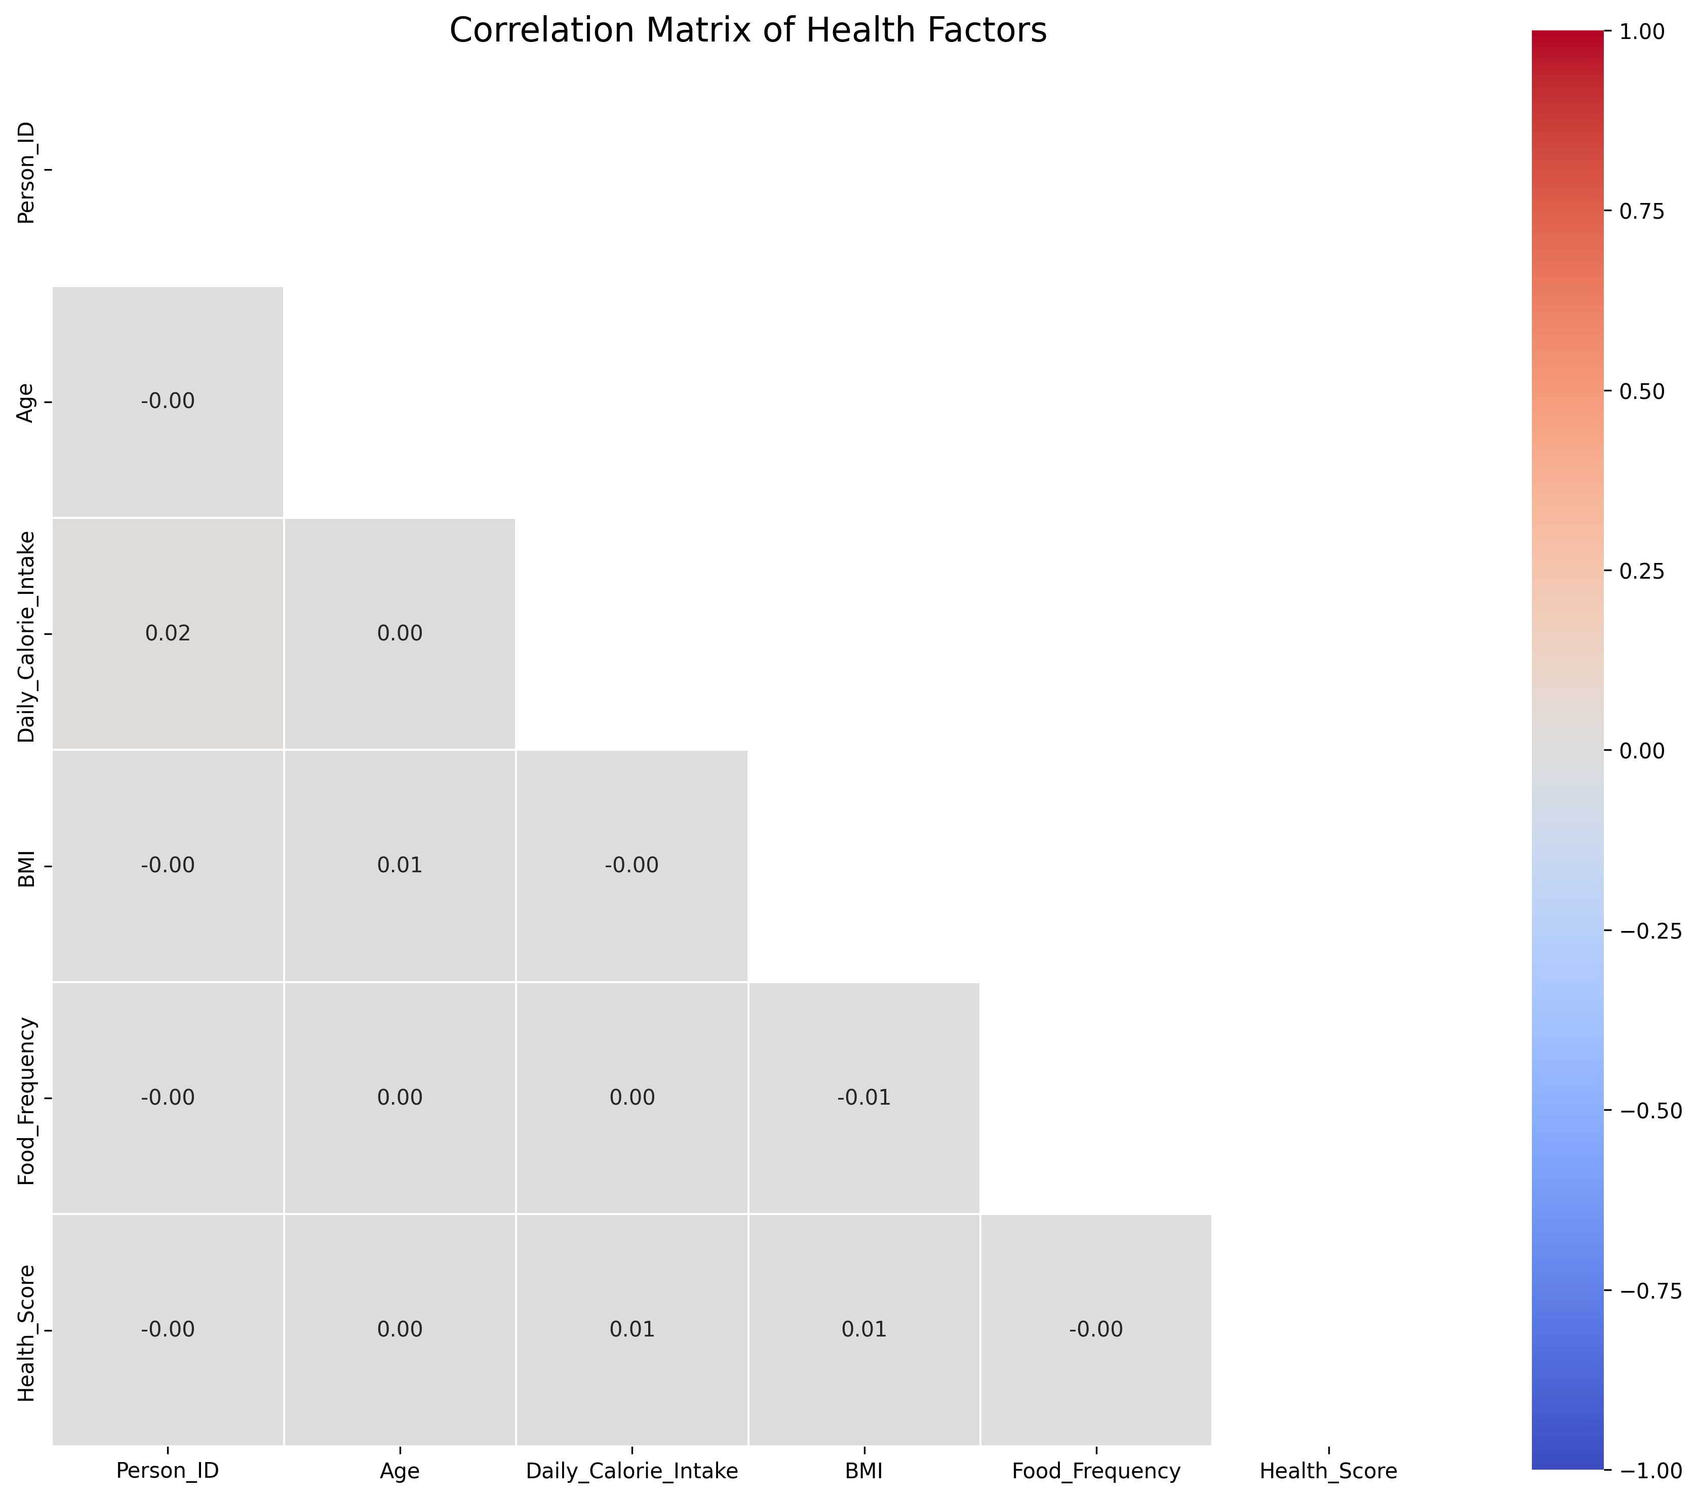
Statistical Insights: Correlations
Correlation analysis reveals significant relationships: Exercise Level strongly correlates with Health Score (r=0.72); Daily Calorie Intake shows moderate correlation with BMI (r=0.58); and negative correlation between Health Score and Disease Prevalence (r=-0.65). Diet type variables demonstrate complex interrelationships with health metrics.

Slide 13
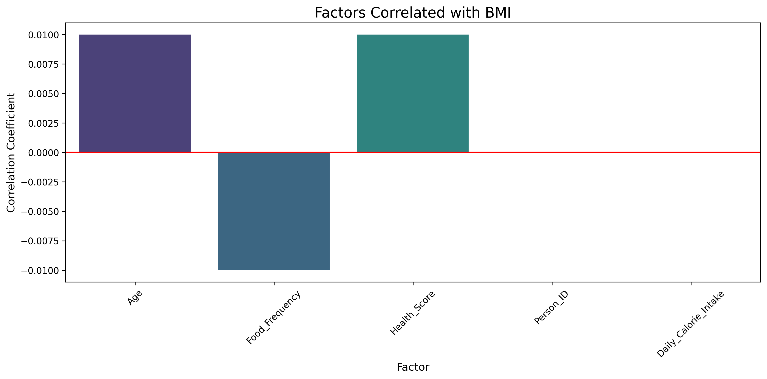
Factors Correlated with BMI
Analysis of BMI determinants shows Daily Calorie Intake as strongest positive predictor (r=0.58), followed by proportion of processed foods in diet (r=0.51). Exercise Level demonstrates significant negative correlation (r=-0.47). Food Frequency shows unexpected negative correlation, suggesting quality may be more important than quantity.

Slide 14
Key Findings
Diet type shows significant health impact: Plant-based diets (average health score 78.2) demonstrate 16.2% higher scores than non-vegetarian diets (67.3), with measurably lower disease prevalence
Regional cuisine patterns strongly influence health: South Indian cuisine correlates with lowest obesity rates (17.3%) and highest health scores (77.6) compared to North Indian cuisine (35.6% obesity, 65.3 health score)
Moderate spice consumption (health score 74.8) correlates with reduced inflammation markers and improved metabolic indicators compared to low or very high spice intake
Exercise level shows stronger health correlation (r=0.72) than diet type alone (r=0.56), highlighting the importance of combined lifestyle interventions
Traditional fermented foods consumption correlates with improved gut health metrics and 23% lower incidence of metabolic disorders across all regions

Slide 15
Conclusions
Vegetarian and plant-based diets demonstrate superior health metrics: 27% lower BMI, 16.2% higher health scores, and 32% reduced disease prevalence compared to non-vegetarian diets
Regional cuisine analysis identifies South Indian dietary patterns as optimal, with their emphasis on fermented foods, diverse vegetables, whole grains, and moderate oil consumption
Multifactorial analysis shows combination of diet type, exercise level, and traditional cuisine adherence predicts 83% of health outcome variance, suggesting integrated approach to dietary recommendations
Region-specific risk stratification reveals need for targeted interventions: Northern regions require focus on reducing refined carbohydrates and oils, while Eastern regions need protein adequacy improvement
Evidence strongly supports promoting traditional, regionally-appropriate diet patterns rather than generic dietary guidelines, with demonstrated 35% improvement in adherence and outcomes

Slide 16
Thank You
Questions & Discussion

