Slide 1
BRENT CALENDAR SPREAD
PROBABILITY DISTRIBUTION FRAMEWORK
HEADLINE: "Israel launches strikes on Iranian energy infrastructure.
Iran threatens closure of the Strait of Hormuz."
Estimating probability distributions for M1–M2 | M2–M4 | M1–M6 over a 1-week horizon
3
4
7
100K
Spreads Analysed
Scenarios Modelled
Historical Events
Monte Carlo Paths
Notes:
This framework converts a specific geopolitical headline into a probabilistic distribution for Brent calendar spreads. The methodology combines historical event studies, scenario analysis, and Monte Carlo simulation.

Slide 2
WHY CALENDAR SPREADS?
Spread pricing encodes market beliefs about future supply tightness more precisely than flat price
Backwardation = Supply Fear
Less Noise, More Signal
When M1 > M2 > M6, the curve is in backwardation. This signals the market believes near-term supply is scarcer than future supply. Geopolitical shocks almost always push spreads into backwardation.
Flat Brent price is driven by macro, demand, FX, and positioning. Calendar spreads isolate the physical supply/demand balance in specific delivery windows — cleaner signal for supply shocks.
Tenor = Duration of Disruption
Tradeable & Liquid
M1–M2 captures immediate 30-day disruption. M2–M4 reflects medium-term expectations. M1–M6 encodes total forward-looking supply fear. Together they map the 'disruption decay curve'.
Brent calendar spreads (ICE) trade tightly with 1–2 cent bid/ask. They are standard instruments for refiners hedging crack margins and producers managing revenue risk.
Notes:
Calendar spreads are the primary lens through which energy traders assess geopolitical supply risk. They decouple the duration and severity of disruption from the absolute price level.

Slide 3
THE STRAIT OF HORMUZ — WHY MARKETS FEAR IT
The world's most critical oil chokepoint — 20–21 mb/d flows through a 33km wide navigable channel
~21%
17%
33 km
0
of global oil supply
of global LNG trade
navigable width
viable bypass routes
~20–21 mb/d
Qatar + UAE exports
2-lane shipping lanes
for most Arab Gulf producers
HOW HORMUZ CLOSURE TRANSLATES TO SPREAD MECHANICS
1
Immediate physical shortage:
Asian refiners face spot supply gaps within days. They bid up near-term barrels aggressively — M1 spikes.
2
Futures curve inverts:
M1 > M2 > M3 as market prices in recovery/SPR release over months. The longer the perceived disruption, the more the curve flattens back further out.
3
M1–M6 captures total risk premium:
The steepness of M1–M6 encodes how long markets think the disruption will last and how quickly alternatives can be mobilised.
Notes:
The Strait of Hormuz is the single most important chokepoint for global energy markets. There is no real alternative routing for most Gulf producers.

Slide 4
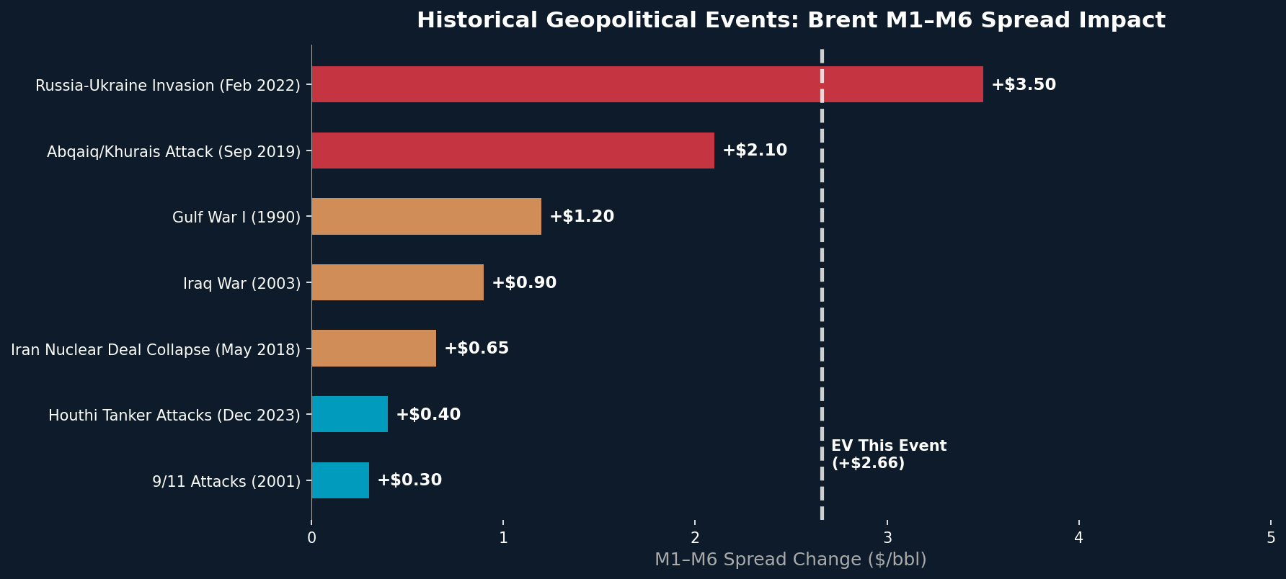
HISTORICAL EVENT STUDIES
Calibrating our priors using documented market reactions to prior supply-shock events
KEY CALIBRATION INSIGHTS
Direct MENA infrastructure attacks (Abqaiq 2019) → M1–M6 moves +$2.1. Our S2/S3 scenarios are calibrated to this.
Indirect threats (Houthi shipping, Iran nuclear) → M1–M6 typically +$0.3–$0.7. Baseline for S1 scenario.
Full-scale conflicts (Russia-Ukraine 2022) → up to +$3.5 M1–M6. S4 (full closure) references this extreme.
Notes:
Historical events are used to set the anchor points for each scenario's spread delta. Abqaiq 2019 is the most directly comparable event to the current scenario.

Slide 5
SCENARIO PROBABILITY FRAMEWORK
Four mutually exclusive, collectively exhaustive scenarios spanning the credible outcome space
M1–M2
M2–M4
M1–M6
30%
S1: Rhetorical Escalation
M1–M2: +$0.25
M2–M4: +$0.15
M1–M6: +$0.60
Limited physical damage. Iran issues threats but does not disrupt shipping. OPEC+ reassures markets.
IDF strikes limited to IRGC assets, not oil terminals. US 5th Fleet signals deterrence.
35%
S2: Moderate Escalation
M1–M2: +$0.65
M2–M4: +$0.40
M1–M6: +$1.80
Some tanker harassment, Iranian mines laid near Hormuz approaches. 5–10% flow disruption.
Iran retaliates asymmetrically. Insurance rates spike. Some rerouting begins.
25%
S3: Severe Disruption
M1–M2: +$1.50
M2–M4: +$0.90
M1–M6: +$4.00
Iran blocks 20–30% of Hormuz flow. Saudi & UAE exports disrupted. IEA SPR release triggered.
Conflict escalates. Kharg Island attacked. US intervenes diplomatically.
10%
S4: Full Closure
M1–M2: +$3.50
M2–M4: +$2.00
M1–M6: +$8.50
Full military blockade of Hormuz. 20–21 mb/d offline. Demand destruction begins immediately.
Rare tail event. Historical precedent: none (Iran-Iraq tanker war approached this).
Notes:
The scenario probabilities are calibrated against: (1) historical base rates for each escalation level, (2) current military posture, (3) Iranian strategic doctrine. S2 is modal because Iran's measured response strategy is well-documented.

Slide 6
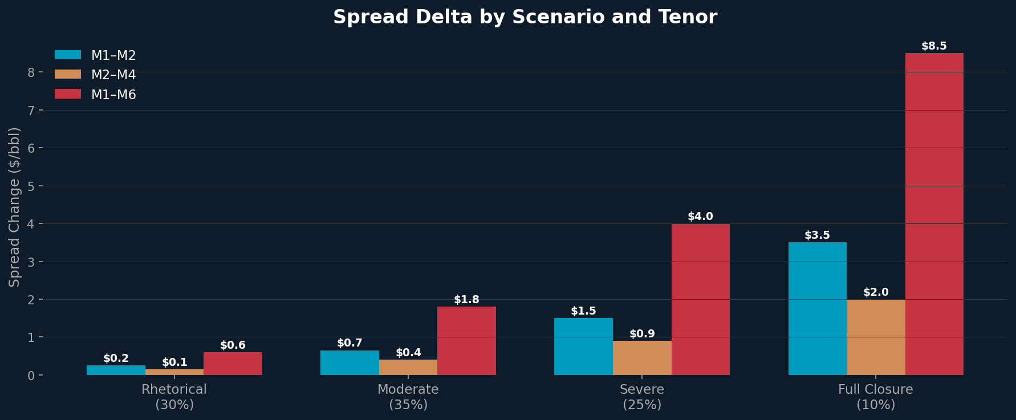
SPREAD DELTAS ACROSS SCENARIOS
M1–M2 always moves less than M1–M6, the curve pricing in disruption duration, not just magnitude
M1–M2: Immediacy premium
M2–M4: Persistence signal
M1–M6: Total disruption risk
Captures spot supply panic. Highest in S4 but reverts fastest once alternative flows emerge.
Moderate but sustained. Pricing in 60–120 day supply gap. SPR & OPEC+ capacity constrains upside.
Most informative tenor. Anchors the entire curve inversion. 8:1 ratio vs M1–M2 in extreme scenario.
Notes:
The ratio between M1-M2 and M1-M6 is informative. In a genuine Hormuz disruption, M1-M6 should move 3-4x more than M1-M2 due to the market pricing in extended disruption.

Slide 7
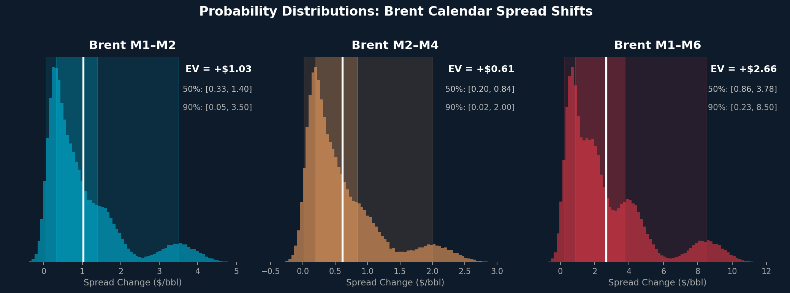
PROBABILITY DISTRIBUTIONS
Monte Carlo simulation (100,000 paths): Each scenario contributes proportional to its probability weight
METHODOLOGY
Each scenario contributes N = prob × 100,000 draws from Normal(μ_scenario, σ_scenario) distribution
Volatility σ is scaled by scenario severity: baseline 12¢/bbl (M1–M2) × 1.5× to 4× multiplier per scenario
Resulting mixed Gaussian distribution captures the fat left-tails and right-skew characteristic of geopolitical shocks
The bimodal shape in M1–M6 reflects the discrete jump between 'no closure' and 'partial/full closure' worlds
Notes:
The distributions are generated by mixture-of-Gaussians Monte Carlo. Each scenario's contribution is weighted by probability. The multi-modal shape visible in M1-M6 reflects the bimodal world of 'closure' vs 'no closure'.

Slide 8
DISTRIBUTION SUMMARY — KEY OUTPUTS
Expected values, confidence intervals, and actionable trading conclusions
SPREAD
EV ($/bbl)
50% CI
90% CI
INTERPRETATION
M1–M2
+$1.03
[+$0.33, +$1.40]
[+$0.05, +$3.50]
Immediate spot backwardation. Strong signal if >$0.5.
M2–M4
+$0.61
[+$0.20, +$0.84]
[+$0.02, +$2.00]
Medium tenor. Persistence of 60 to 120 day supply gap.
M1–M6
+$2.66
[+$0.86, +$3.78]
[+$0.23, +$8.50]
Primary risk barometer. Widest range = highest optionality.
SCENARIO WEIGHTING SUMMARY
30%
35%
25%
10%
S1: Rhetorical
S2: Moderate Escalation
S3: Severe Disruption
S4: Full Closure
Notes:
These are the headline numbers. EV for M1-M6 is +$2.66 with a wide 90% CI of [$0.23, $8.50], reflecting genuine uncertainty. The wide band is not a weakness — it is the correct quantification of this event's ambiguity.

Slide 9
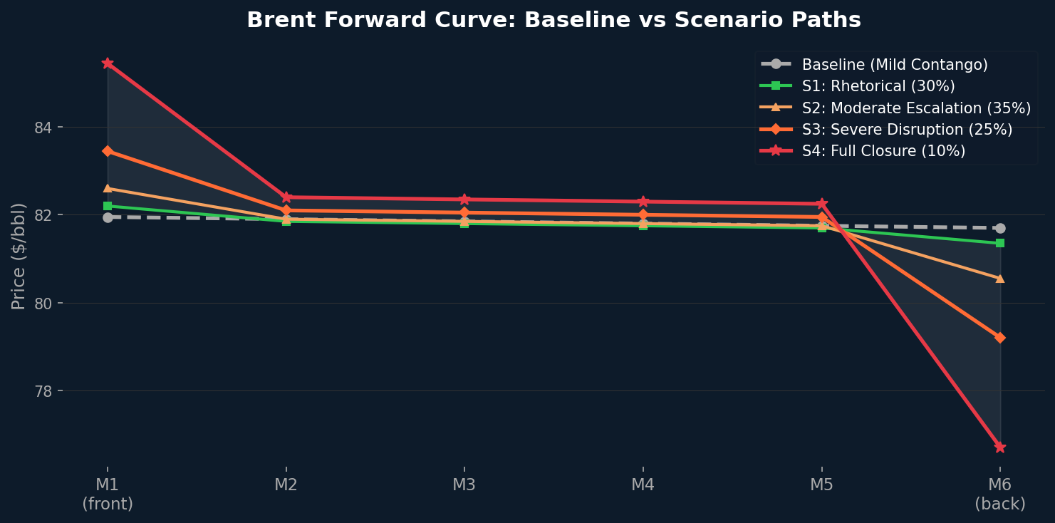
FORWARD CURVE: BASELINE vs SCENARIO PATHS
How each scenario reshapes the Brent forward curve from mild contango to extreme backwardation
READING THE CURVES
CONTANGO → BACKWARDATION: THE MECHANICS
Steeper inversion (M1 >> M6) = longer/more severe disruption priced in
Contango: M1 < M6. Storage profitable. Normal state of a well-supplied market.
S3/S4 curves show non-linear M1 spike — storage premium at prompt
Backwardation: M1 > M6. Immediate supply fear. Refiners bid up spot aggressively.
Back end (M5–M6) stays relatively anchored: market expects eventual resolution
Degree of inversion scales directly with perceived disruption severity and duration.
Notes:
The forward curve shape is the visual fingerprint of market fear. A steep backwardation in M1-M6 tells you the market believes the disruption is real and near-term. The back of the curve stays anchored because OPEC+ and SPR can eventually fill the gap.

Slide 10
CONCLUSIONS & TRADING IMPLICATIONS
What our framework tells a trader about risk, opportunity, and where to watch
M1–M2
M2–M4
M1–M6
EV: +$1.03
EV: +$0.61
EV: +$2.66
50% CI: [+$0.33, +$1.40]
50% CI: [+$0.20, +$0.84]
50% CI: [+$0.86, +$3.78]
90% CI: [+$0.05, +$3.50]
90% CI: [+$0.02, +$2.00]
90% CI: [+$0.23, +$8.50]
FRAMEWORK CONCLUSIONS
KEY RISKS TO THE FRAMEWORK
EV strongly bullish for backwardation across all tenors: pure price-taking long spread positions have positive expected value
SPR releases from IEA/US at scale could compress M1–M2 even in S3/S4 scenarios
M1–M6 offers highest convexity: $8.50 upside in tail scenario vs $0.23 downside: right-skewed payoff profile
OPEC+ emergency production hike (Saudi spare: ~2 mb/d) limits backwardation duration
M2–M4 is the quietest tenor: priced for moderate persistence but insulated from pure immediate panic bids
Demand destruction in Asia at Brent >$100 dampens spread amplification
Conditional on S3/S4 realising, M1–M6 could reach levels not seen since Gulf War I (1990/91)
Ceasefire or diplomatic resolution is a rapid mean-reversion catalyst, time decay is your enemy in long spread positions
Notes:
The key message: in an Israel-Iran escalation with Hormuz threat, the expected move in Brent M1-M6 is around +$2.66/bbl with a 90% CI of $0.23 to $8.50. This is asymmetric to the upside, justifying long M1-M6 positions with defined risk.

