Slide 1
Do oil speculators’ bets predict WTI prices?
Managed Money positioning in WTI crude | 2021 to 2026
On its own, no. But once you know how STALE the positioning is and how CALM the market is, clear and usable patterns appear.
Fresh crowding keeps rising; once it has been crowded for a month it stalls.
A book that stays light for a month tends to set up a rebound.
A calm market with light positioning is the steadiest setup for gains (+2.9% over 4 weeks).
In plain terms: "Managed Money" = the large speculative funds. "Net position" = how much they are betting prices rise, minus betting they fall.

Slide 2
What we measured, in plain terms
The data. Each week the US regulator (CFTC) reports how heavily the big funds are betting on WTI. We pulled the real Managed Money series straight from the CFTC archive.
The price. WTI front-month crude, 2021 to 2026.
"Extreme" positioning. The most-long and least-long weeks (top and bottom 10%), and a z-score that says how unusual this week is versus the past year.
A fair test. The data is measured on a Tuesday but only published on the Friday, so we only ever act from the Friday close. No hindsight.
The deeper cuts. How long positioning stays extreme (its staleness), and whether the market is calm or choppy (volatility).
Is it real? We measure WTI 1, 2 and 4 weeks later versus an average week, and check it with t-tests and bootstrap resampling.

Slide 3
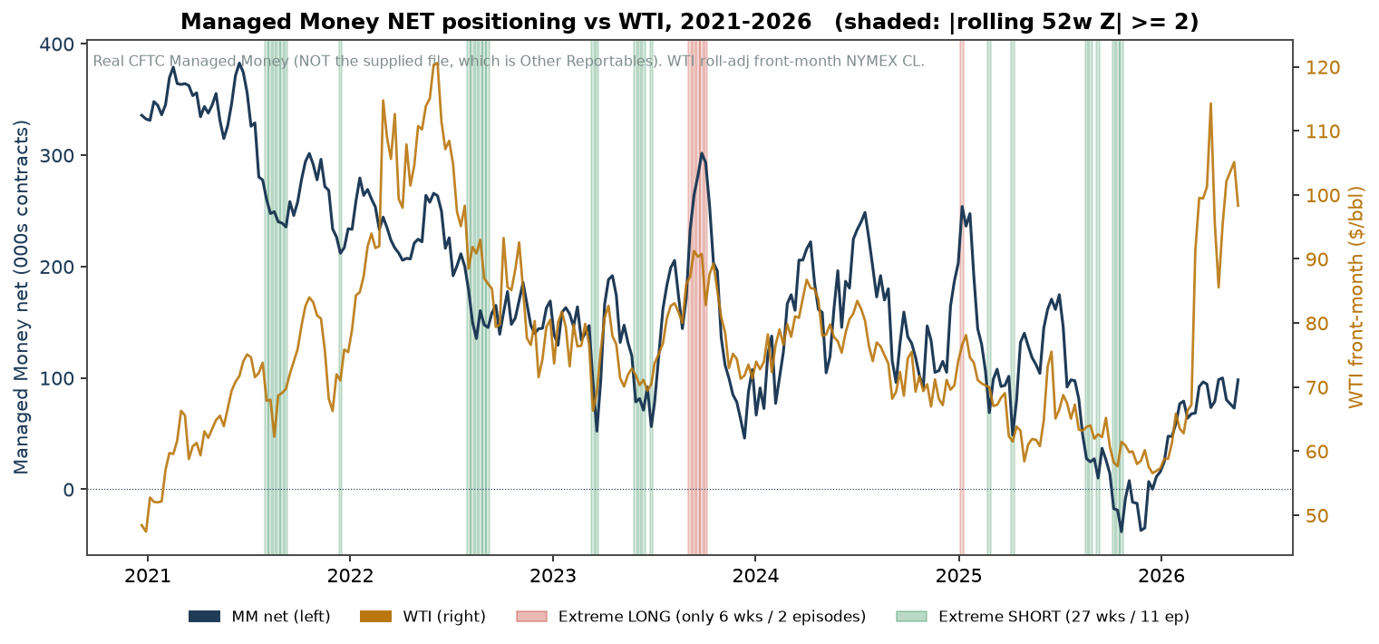
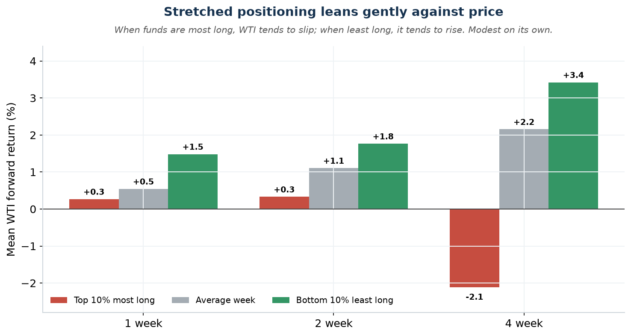
First look: stretched bets lean gently against price
When the funds are most long, WTI tends to slip over the next month (about -2.1%). When they are least long, it tends to rise (about +3.4%).
Useful, but gentle. The size of the bet on its own is a weak timer. The stronger signal is on the next slide.

Slide 4
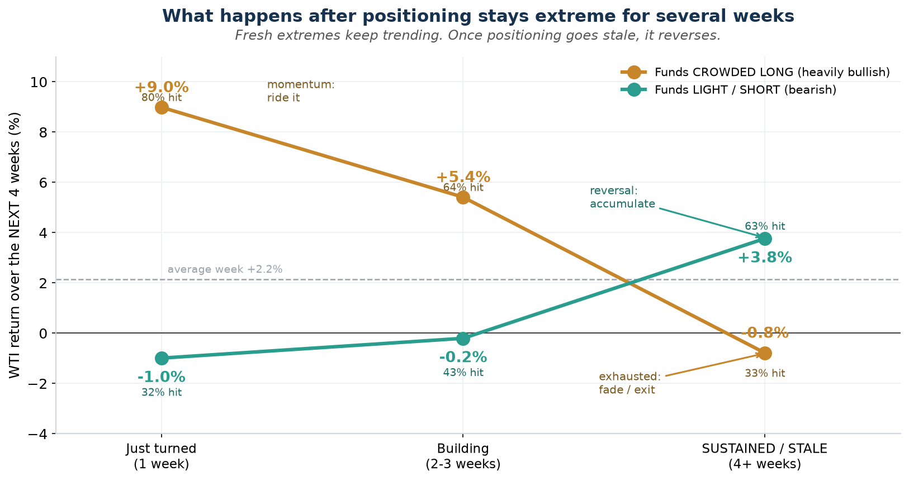
The key: it is the staleness, not the size
Same bet, opposite meaning.
A FRESH crowded long keeps rising: +9.0% over the next 4 weeks (80% hit). Ride it.
Once it has been crowded for a month it is exhausted: -0.8% (33% hit). Step aside.
A book that has stayed LIGHT for a month tends to rebound: +3.8% (63% hit). Accumulate.
So how long the positioning has lasted flips the conclusion. This staleness effect is the real signal.

Slide 5
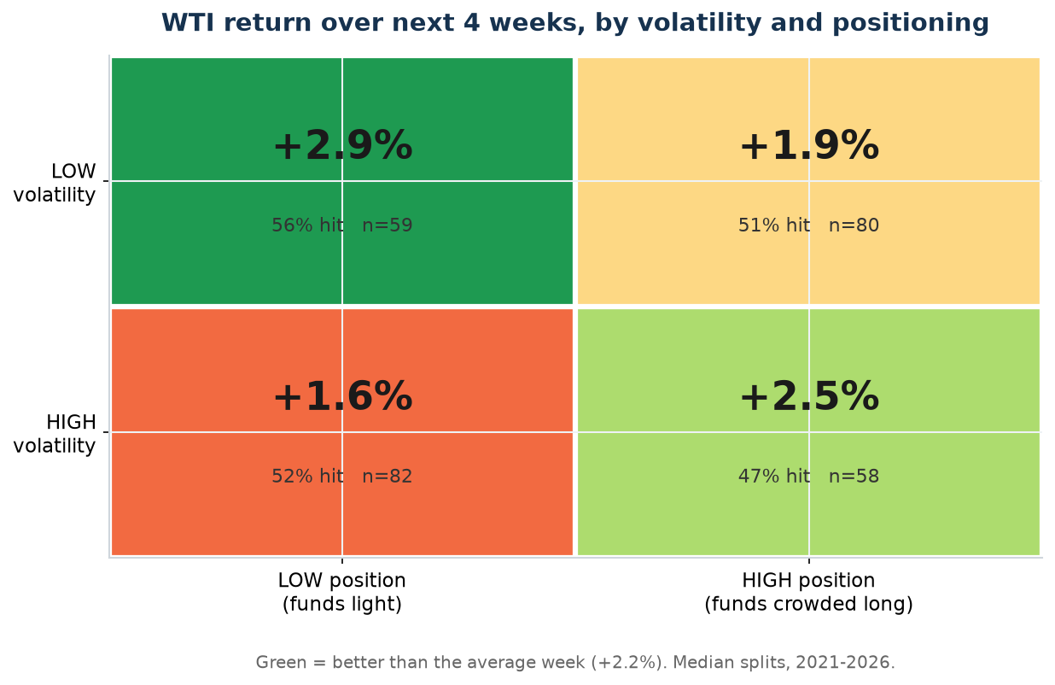
The playbook: simple equations
Conditioning rules (next 4 weeks)
Calm market + Light position = CL +2.9% (56% hit)
Calm market + Crowded long = CL +1.9% (51% hit)
Choppy market + Light position = CL +1.6% (52% hit)
Choppy market + Crowded long = CL +2.5% but only 47% hit (coin-flip)
Fresh crowded long = CL +9.0% (80% hit, ride momentum)
Crowded long, gone STALE = CL ~0% (33% hit, step aside)
Light book, gone STALE = CL +3.8% (63% hit, accumulate)
Size with volatility, ride fresh extremes, fade stale ones. Caveats: 2021 to 2026 only, extreme-long has few episodes, returns are gross of costs.

