Slide 1
Does Managed Money positioning predict WTI returns?
The level does not time direction. But crowded longs and fast unwinds both precede WTI weakness.
Knowing Managed Money is heavily long or short does not tell you next week’s direction (correlation with the next week is 0.00).
When Managed Money sits at an extreme long, WTI falls about 3.6% over the next 4 weeks, with every one of the 6 such weeks down (p below 0.001). The classic fade-the-crowd works here, but it rests on only 2 episodes in this window.
When Managed Money unwinds fastest, WTI keeps falling (about -2.3% over 4 weeks). This is momentum, the opposite of Other Reportables, where the same test gave a rebound.
This uses the real CFTC Managed Money series, pulled from the official archive, not the supplied file (which is Other Reportables).
Real CFTC Managed Money. Roll-adjusted front-month NYMEX CL. 2021 to 2026, 282 weekly observations.

Slide 2
How we tested it
Signal. Real CFTC Managed Money net for WTI, pulled from the official CFTC archive. We first confirmed the supplied file was Other Reportables, so we sourced the genuine Managed Money series to do the study the brief intended.
Price and timing. Roll-adjusted continuous front-month WTI from local one-minute data. Every forward return starts from the first close on or after the Friday release, never the Tuesday as-of date.
Signals and tests. 52-week rolling z-score for extremes (absolute z of 2 or more), the 4-week change for the flow, conditional returns versus the base rate, with Newey-West standard errors and block-bootstrap p-values.
Window. 2021 to 2026, because that is where the local WTI prices begin (your earlier choice).
Read this caveat first. In this window Managed Money rarely reached an extreme long: just 6 weeks across 2 episodes. The long-side result is striking but underpowered. The full 2016 to 2026 sample, which includes the 2018 build and the 2020 crash, is what would properly test it.

Slide 3
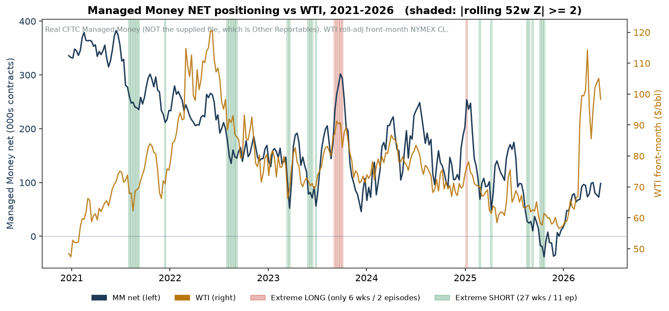
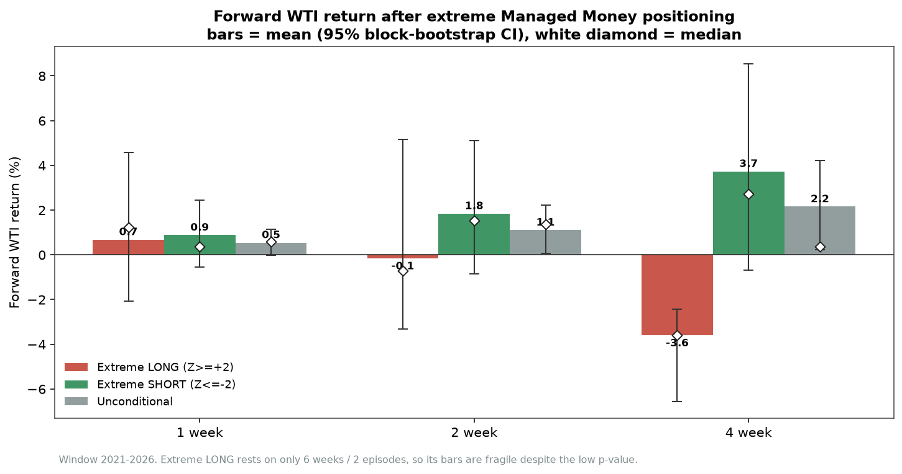
Crowded longs lead to weakness; the level alone still does not time it
The contemporaneous correlation with price is weak (+0.15), and the level does not forecast the next week (correlation 0.00).
Extreme long (6 weeks, 2 episodes): WTI fell -3.6% over 4 weeks, with all 6 weeks down. Striking, but fragile on 2 episodes. Extreme short (27 weeks, 11 episodes): mildly positive and not significant.

Slide 4
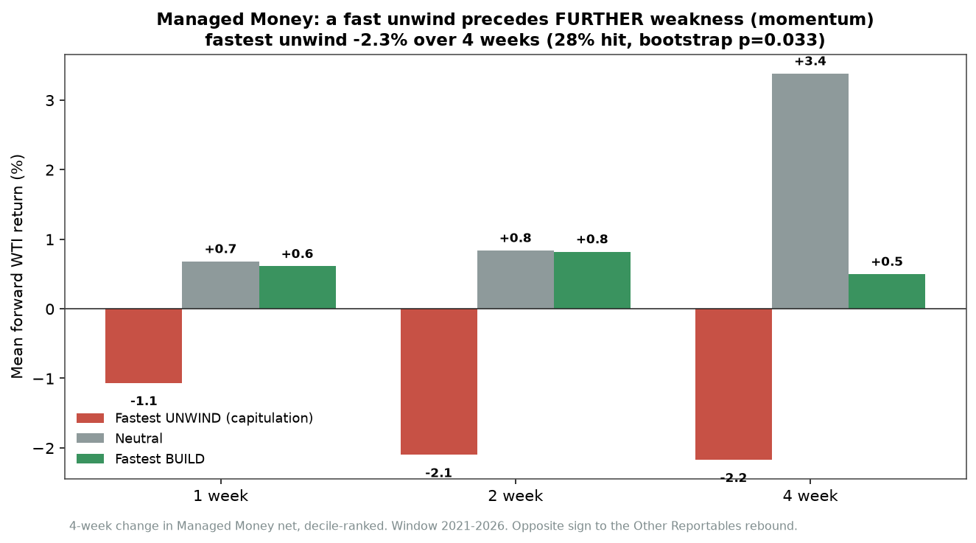
A fast Managed Money unwind precedes further weakness
Momentum, not mean reversion.
After the fastest 4-week unwind, WTI keeps sliding: about -1.1%, -2.1% and -2.3% at 1, 2 and 4 weeks (bootstrap p around 0.03 to 0.05).
This is the opposite sign to Other Reportables, where the very same test gave a +5.6% rebound.
Same statistic, different trader group, opposite conclusion. That is exactly why getting the category right matters.

Slide 5
Conclusion: Managed Money versus Other Reportables
Extreme long. Managed Money: WTI tends to weaken (fade the crowd works, on 2 episodes). Other Reportables: no edge.
Fast unwind. Managed Money: the decline continues (momentum). Other Reportables: a rebound (mean reversion). Opposite signals from the same test.
Both groups. The level on its own does not predict the next week. Positioning is about inflections and risk, not a simple direction call.
Desk use. For Managed Money, treat an extreme long or a fast unwind as a caution or short-bias flag, alongside fundamentals, not as a buy signal. The move mostly happens after the Friday release, so it is at least actionable. Costs are not modelled.
Caveats. 2021 to 2026 only, with just 2 extreme-long episodes; the crowding-versus-volatility result is unreliable in so short a window. Rebuild on 2016 to 2026 to confirm the long-side and crowding findings.

