Slide 1
Do extreme Other-Reportables positioning extremes predict WTI returns?
Verdict: WEAK & ASYMMETRIC — only deep SHORT extremes show an edge.
After extreme SHORT positioning (|Z|≥2): WTI bounces ~+4% over 2 weeks vs +1.1% base rate (78% hit) — but only marginally significant (bootstrap p=0.04) and gone by week 4.
After extreme LONG positioning: no reliable edge — median returns are negative and nothing is significant.
Confidence: LOW. Only 10 short / 4 long distinct episodes in the 2021–2026 window.
Data flag: the supplied series is CFTC OTHER REPORTABLES, not Managed Money (verified vs CFTC). The whole deck is labelled accordingly.
CFTC Disaggregated futures-only WTI · roll-adjusted front-month NYMEX CL · 2021–2026 · n=282 weeks

Slide 2
Data & method
Signal: CFTC Disaggregated, futures-only, WTI — "Other Reportables" NET. Identity confirmed by exact match to CFTC-published values on 5 test dates (it is NOT Managed Money, despite the brief’s framing).
Price: roll-adjusted continuous front-month WTI (NYMEX CL), built from local 1-minute data (65 clean monthly rolls). Window 2021–2026 — local WTI starts 2021; chosen over a Brent proxy.
Look-ahead fix: every forward return starts from the first WTI close ON/AFTER the Friday release date — never the Tuesday "as-of" date (~3-day reporting lag).
Extremes: 52-week ROLLING z-score (no full-sample look-ahead); threshold |Z|≥2. Long and short extremes analysed separately (they behave differently).
Significance: conditional returns vs the UNCONDITIONAL base-rate (not zero); Newey-West (HAC) standard errors for overlapping windows; block-bootstrap p-values for clustering.
Limitation: open interest is not in the local file, so signals use net-level rolling Z (no %-of-OI normalisation).

Slide 3
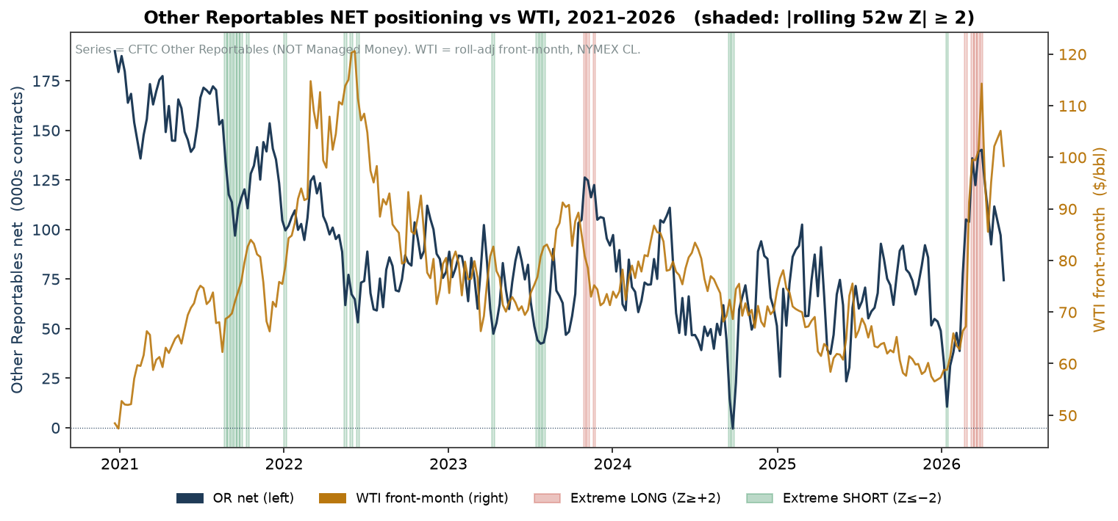
Extreme positioning is rare and clustered
Extreme LONG (Z≥+2): 8 weeks → 4 distinct episodes (late-2023, early-2026). Extreme SHORT (Z≤−2): 18 weeks → 10 distinct episodes (2021–2026).
The largest historical extremes — the 2018 long build and the 2020 crash (all-time OR-net max) — pre-date 2021 and are excluded by the local-WTI window.

Slide 4
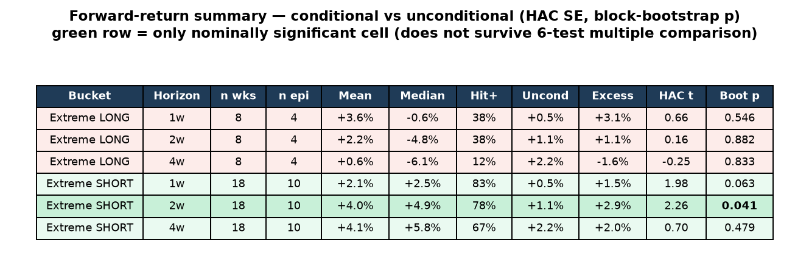
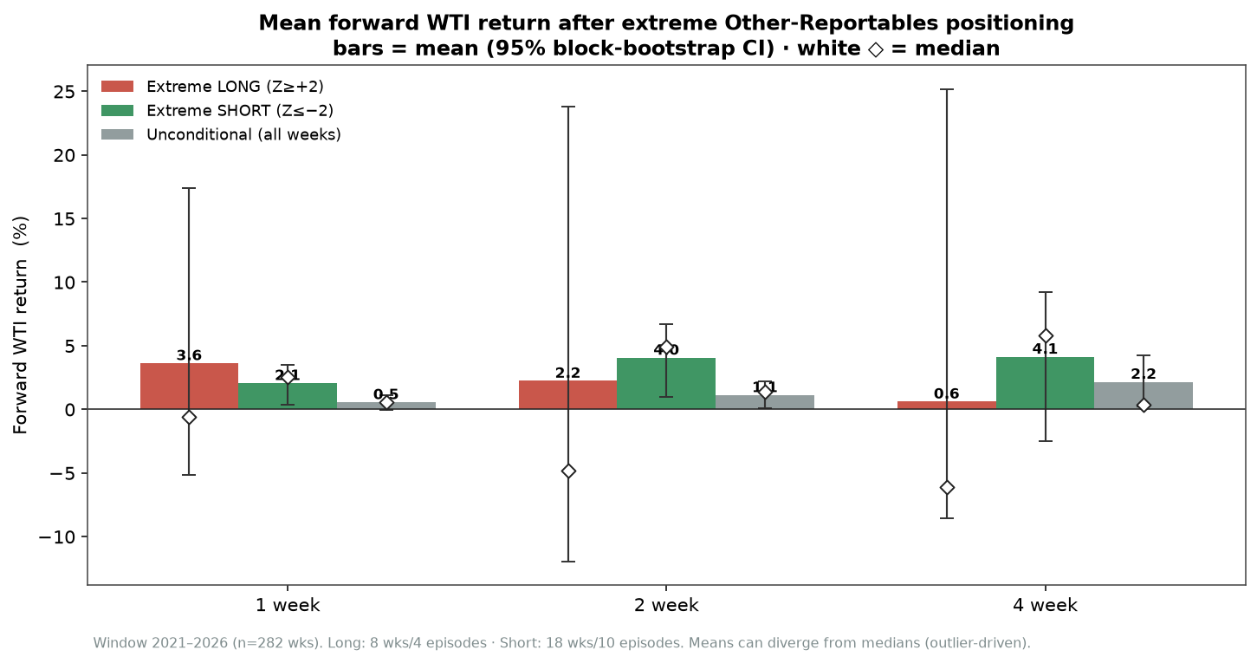
Forward returns: shorts bounce, longs don’t
SHORT extremes → +2.1% / +4.0% / +4.1% at 1/2/4wk. Best at 2wk: +2.9% above base rate, HAC t=2.3, bootstrap p=0.04, 78% hit.
LONG extremes → means positive but outlier-driven; medians negative (−0.6/−4.8/−6.1%), hit ≤38%, none significant.
Only the 2-week short cell is nominally significant — and it does NOT survive a 6-test multiple-comparison correction.

Slide 5
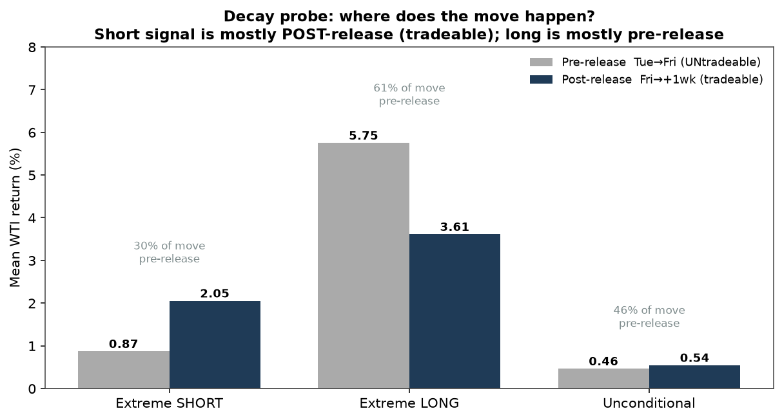
Conclusion & caveats
Verdict: a weak, asymmetric contrarian tilt — deep SHORT extremes precede a short-lived WTI bounce; LONG extremes carry no edge.
Tradeable? the short-signal move is ~70% POST-release (plausibly tradeable, see chart); the long "move" is ~60% PRE-release (untradeable anyway). Costs not modelled.
Fragile: tiny episode counts; the edge fades by week 4, weakens under a looser decile threshold, and fails multiple-testing. Suggestive, not bankable.
Category: Other Reportables (smaller funds / locals / wealthy individuals) — a weaker behavioural rationale than Managed Money.
To strengthen: extend to 2016–2026 with true WTI history (not in local Data) to recover the 2018/2020 episodes; add OI normalisation.

