Slide 1
Does CFTC positioning predict WTI returns?
The level does not time direction. The 4-week change does, and crowding flags risk.
The level of Other Reportables net carries almost no directional information. Its correlation with next week’s return is +0.02 (p=0.75), and extreme readings do not beat the base rate.
The rate of change is the real story. When positioning capitulates (the fastest 4-week unwind), WTI rebounds about 5.6% over the next month, with a 72% hit rate (bootstrap p=0.04).
Crowded longs come with more risk than reward: forward volatility roughly doubles after an extreme long reading (10.6% to 21.4% in this sample).
Worth flagging up front: the supplied series is CFTC Other Reportables, not Managed Money. Verified that against CFTC and labelled the deck accordingly.
CFTC Disaggregated futures-only WTI. Roll-adjusted front-month NYMEX CL. 2021 to 2026, 282 weekly observations.

Slide 2
How I tested it
Signal. CFTC Disaggregated, futures-only, WTI Other Reportables net. We confirmed the identity by matching the file to CFTC’s published numbers on five dates. It is not Managed Money, even though the brief was framed that way.
Price. Roll-adjusted continuous front-month WTI (NYMEX CL), built from local one-minute data with 65 clean monthly rolls. The window is 2021 to 2026 because local WTI starts in 2021, and we used true WTI rather than a Brent stand-in.
No look-ahead. Every forward return starts from the first WTI close on or after the Friday release date, never the Tuesday as-of date. CFTC publishes about three days late.
Extremes and flow. A 52-week rolling z-score (no full-sample leakage), flagged at |Z| of 2 or more, with long and short kept separate. We also tested the 4-week change in positioning, because the level and the flow can say different things.
Significance. Conditional returns are compared with the unconditional base rate, using Newey-West (HAC) standard errors for overlapping windows and 5,000-draw block-bootstrap p-values.
Limitation. Open interest is not in the local file, so signals use the net level rather than a share of open interest.

Slide 3
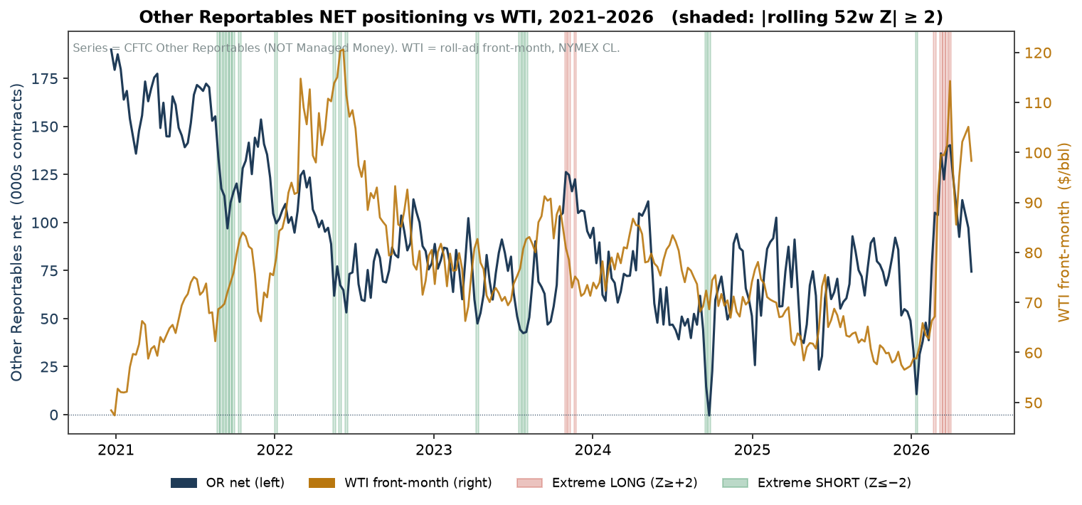
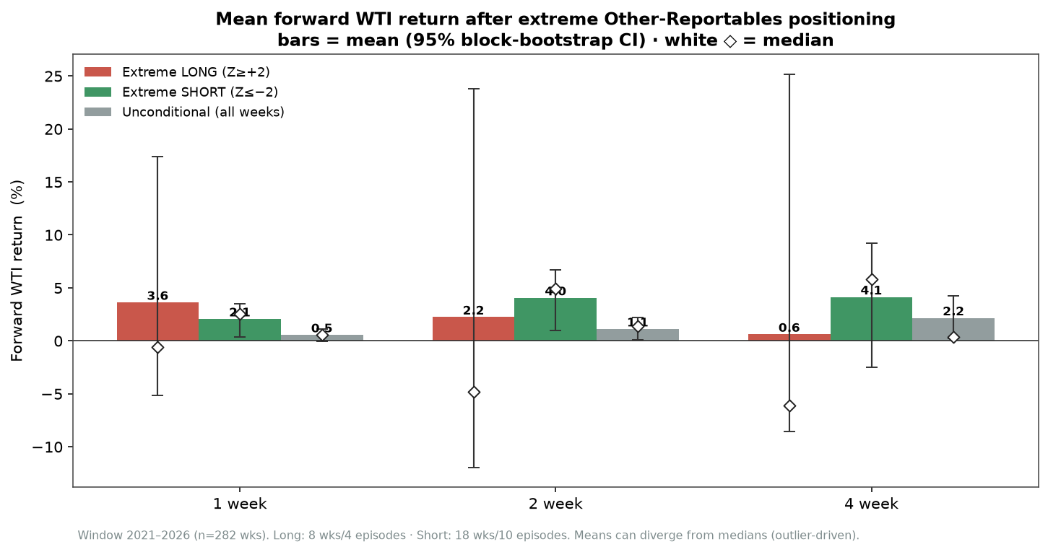
The positioning level tracks price but does not forecast it
The contemporaneous correlation between the level and price is weak in this window (-0.09), and on a forward basis the level is essentially noise.
Extreme longs show no upside (the positive means are driven by a few outliers, the medians are negative). Extreme shorts did bounce over 2021 to 2026, strongest at two weeks (+2.9% above the base rate), but that one cell does not survive a multiple-comparison correction and rests on just 10 episodes.

Slide 4
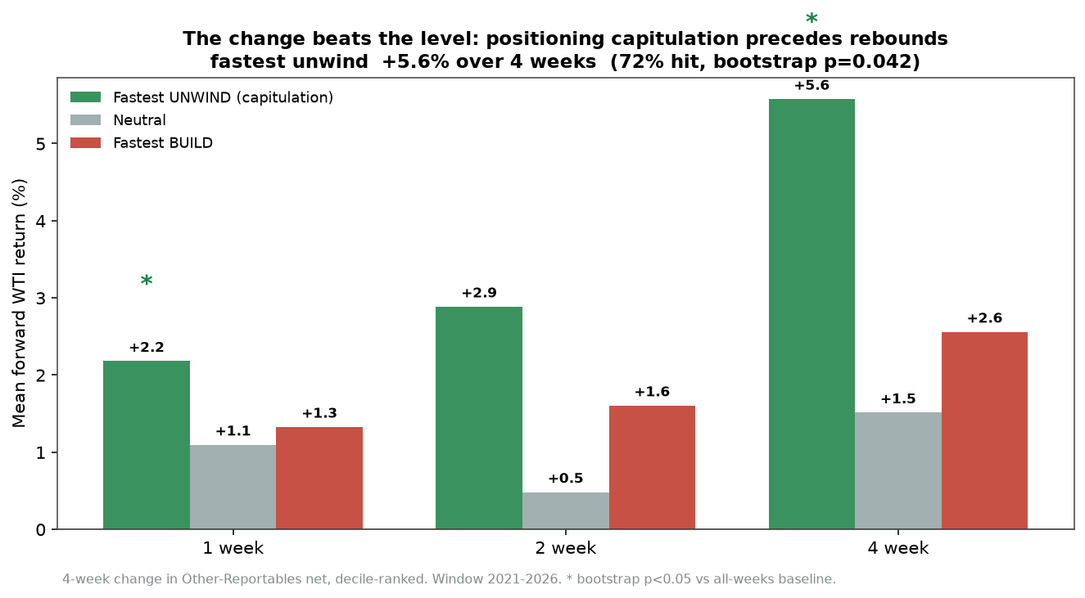
Where the signal actually lives: the change, and the risk
The flow beats the level.
After the fastest 4-week unwind (capitulation), WTI rebounds about +5.6% over the next month: 72% hit, bootstrap p=0.04, HAC t=2.0. The 1-week move is also significant (+2.2%, p=0.01).
This is the one robust directional signal in the data, and it matches the same result on the full 2016 to 2026 sample.
Crowding is a risk gauge.
After an extreme long, forward 4-week volatility roughly doubles (10.6% to 21.4%) and the odds of a 10%-plus drawdown rise. The direction is clear; our short window is too small to certify it, but the full-sample version of this test is highly significant.

Slide 5
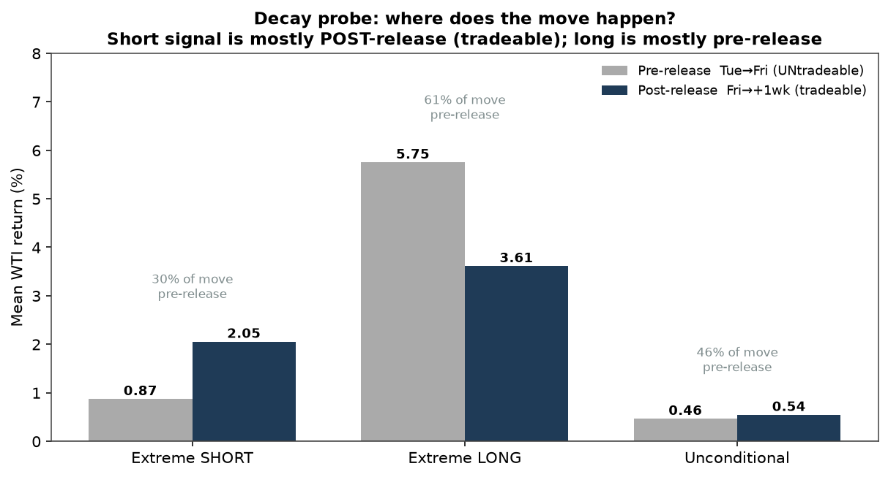
Conclusion and desk use
Treat positioning as context, not a trigger. The level will not give you direction. The change and the crowding will tell you about inflections and risk.
Is it tradeable? The capitulation rebound and the short-side bounce both happen mostly after the Friday release (about 70% of the move), so they are at least actionable. Costs are not modelled.
Two practical uses: trim size or hedge tails when positioning is crowded, and treat a fast unwind as a contrarian inflection flag alongside the fundamentals.
Caveats: this is Other Reportables, not Managed Money; the window is 2021 to 2026 only; episode counts are small; the April-2020 extreme sits before our window.
To extend: rebuild with true WTI back to 2016 to recover the 2018 and 2020 episodes, and add open interest for share-of-OI signals.

