Slide 1
Crude positioning, structure, and what actually trades
WTI and Brent | CFTC Managed Money + term structure
Positioning is a momentum / context gauge, not a contrarian timing signal. The durable, tradeable edge is in the term structure and structural COT columns.
Managed Money is coincident and trend-following (it adds as price rises). Its net extremes give no robust forward edge, and the apparent edges do not survive on Brent.
The one robust, cross-validated price signal is the curve: deep backwardation is a forward-return headwind (contango is too rare to trade).
Structural columns add real risk information: the short side is now the most crowded in the sample (squeeze-prone), and rising price on rising open interest is the best trend-continuation tell.
Use all of this as an overlay and risk filter on your main factors, never as a standalone trigger.
WTI 2021-2026, Brent 2016-2026. De-rolled returns; no look-ahead; validated by bootstrap and cross-instrument replication.

Slide 2
How we tested it, and how we made it credible
Instruments. WTI (2021-2026) and Brent (2016-2026), local price curves, de-rolled so contract rolls do not create fake jumps.
Positioning. CFTC Managed Money net, plus the structural columns: gross positions, trader counts, open interest, weekly flows. Brent positioning uses the CFTC NYMEX Brent Last Day proxy (ICE's own COT is gated).
Factors and returns. all known at the Friday close; forward returns at 1, 2 and 4 weeks versus the base rate.
Validation. block-bootstrap p-values, and replication across two independent crude markets. Single-market results are treated as fragile.
Cross-check. an independent study on 2019-2021 CME data reached similar structural conclusions; where our newer, longer sample disagrees (e.g. the Other-Reportables contrarian tilt), we flag it as regime-specific rather than durable.

Slide 3
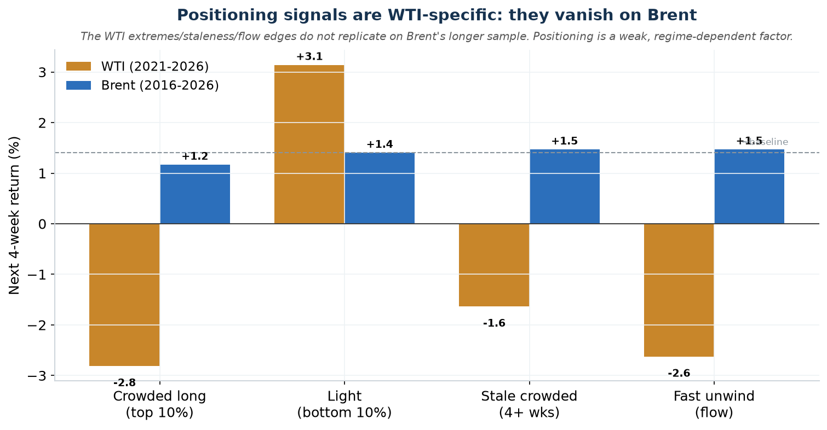
Positioning is coincident, and its edges do not generalize
Momentum, not contrarian.
Managed Money adds length as price rises (change in net vs same-week return +0.19, p=0.002). It confirms moves, it does not predict them.
Its extremes, staleness and flow looked tradeable on WTI 2021-2026 but collapse to the base rate on Brent.
The Other-Reportables "contrarian" tilt seen in 2019-2021 does not hold out of sample (it turns positive on WTI 2021-2026). Category signals are regime-specific.

Slide 4
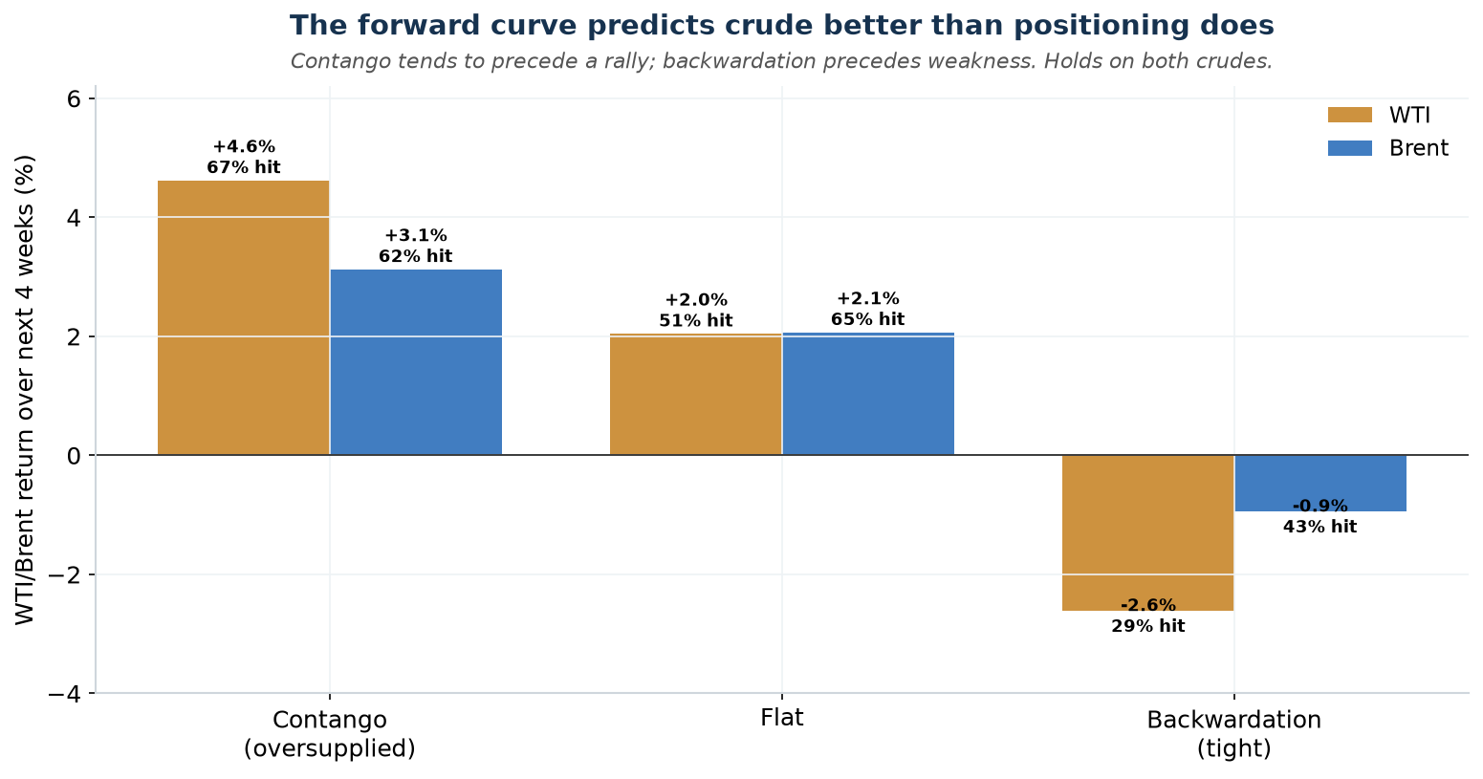
The one durable price signal: deep backwardation is a headwind
Fade deep backwardation, do not chase it.
The most backwardated third of weeks precedes weak returns: WTI -2.6%, Brent -0.9% over 4 weeks (bootstrap p<0.01), on both crudes.
Contango precedes strong gains, but it is rare and episodic (18% of WTI weeks, mostly the 2020 and 2016 crises), so it is not a standing rule.
Usable version: treat deep backwardation as a reason to reduce or fade, not a green light.

Slide 5
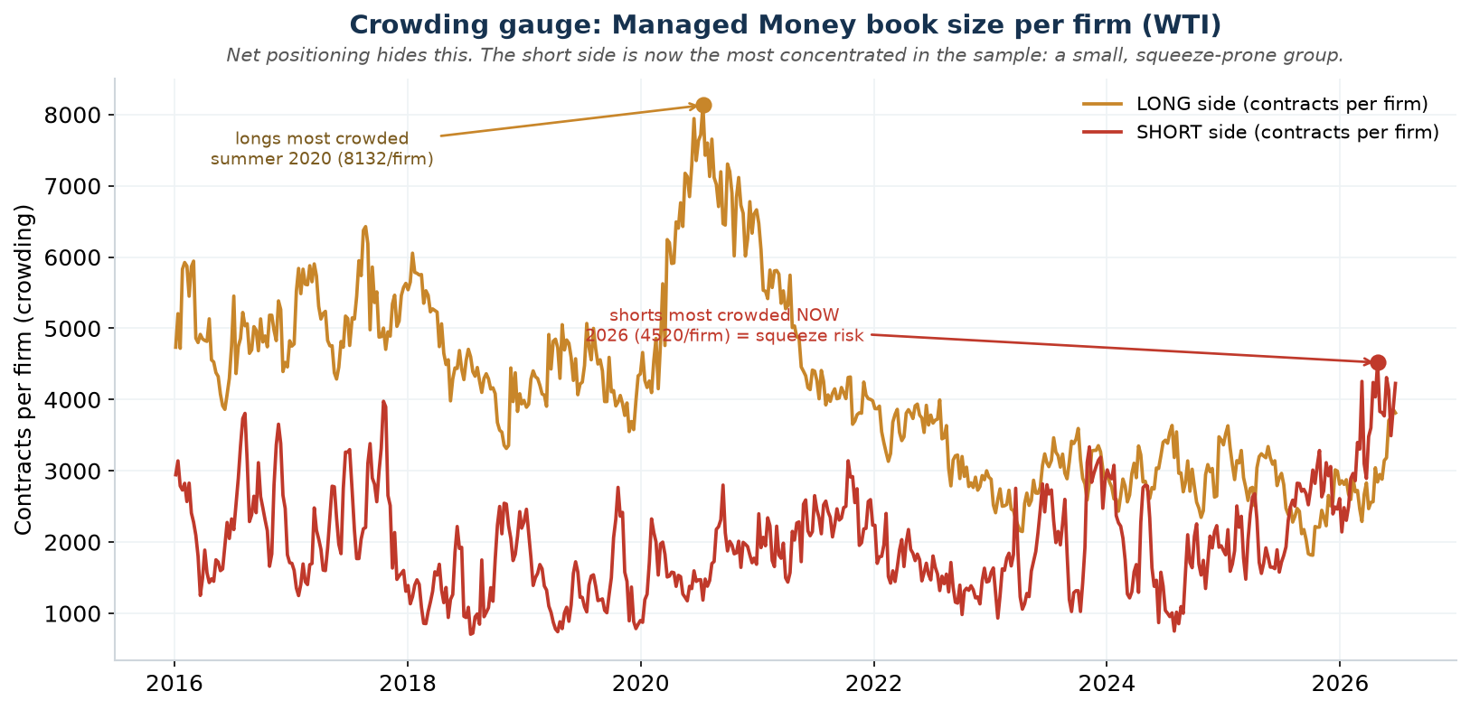
Crowding: a risk gauge that net positioning hides
Book size per firm = fragility.
Dividing gross positions by the number of firms shows how concentrated each side is.
Longs were most crowded in summer 2020 (a recovery bet in very few hands). The short side is the most crowded in the whole sample now (2026): a small, squeeze-prone group.
Use: when one side is this concentrated, respect short-covering / squeeze risk in sizing and stops.

Slide 6
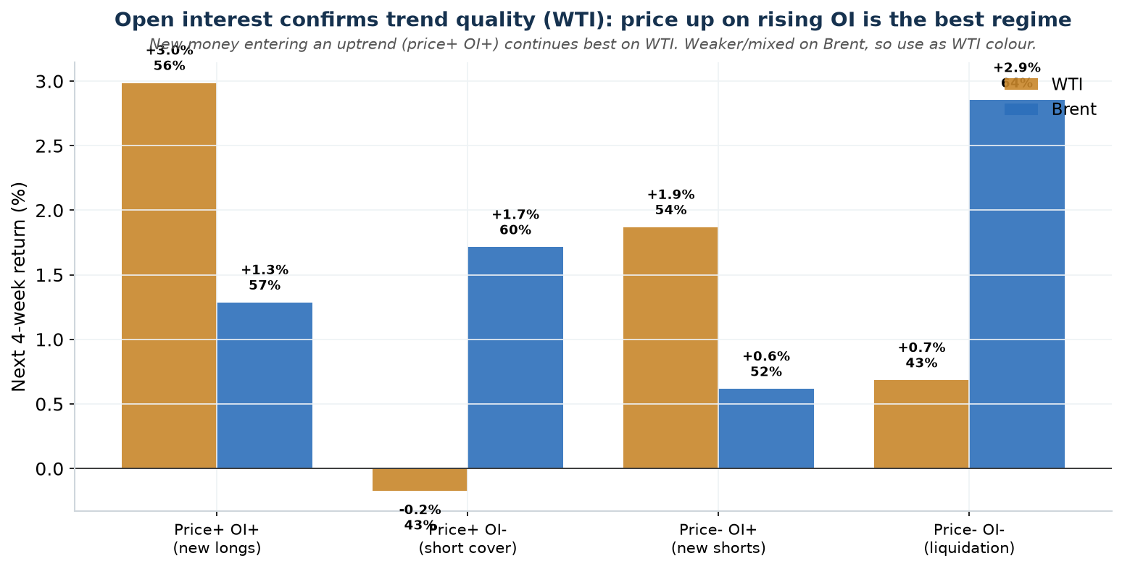
Open interest confirms trend quality
Is new money behind the move?
Crossing the weekly change in open interest with the price change sorts trends by quality.
On WTI, price up on RISING open interest (new money in the trend) is the best 4-week continuation (+3.0%). Price up on FALLING open interest (short covering) is the weakest: a lower-quality bounce to fade.
Weaker and mixed on Brent, so use it as WTI colour rather than a universal rule.

Slide 7
The roll is invisible to COT; watch the curve instead
A front-month roll closes CL1 and reopens CL2. It is net-neutral, and it is not a CFTC "spread" (which needs simultaneous long and short legs), so weekly positioning literally cannot see it. Positioning in the pre-expiry week looks like any other week (our test: Managed Money net and %-spreading are statistically unchanged into the roll).
The roll's risk lives in the CL1 minus CL2 spread, not in the COT. It is orderly in normal cycles but carries severe tail risk at stressed expiries (the April-2020 negative-price roll printed roughly -58 $/bbl the day before expiry).
Practical use: do not look for a roll signal in positioning. Read the spread, and roll a few sessions early to cut delivery and squeeze exposure. Our WTI data shows a mild pre-expiry softening that is worse when funds are crowded long, but it is small and not significant.

Slide 8
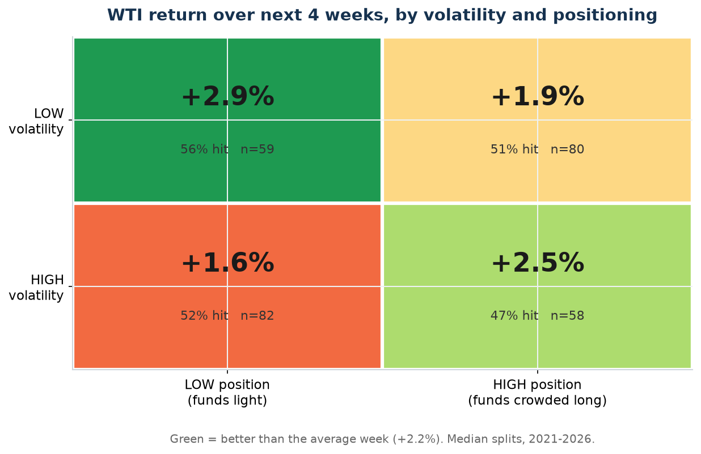
WTI conditioning rules, written as equations
Next 4 weeks on WTI 2021-2026. Base rate +2.2% (52% hit).
MARKET x POSITION
Calm market + Light position = CL +2.9% (56% hit)
Calm market + Crowded long = CL +1.9% (51% hit)
Choppy market + Light position = CL +1.6% (52% hit)
Choppy market + Crowded long = CL +2.5% but 47% hit (coin-flip)
STALENESS (how long the bet has lasted)
Fresh crowded long = CL +9.0% (80% hit, ride it)
Crowded long, gone STALE = CL ~0% (33% hit, step aside)
Light book, gone STALE = CL +3.8% (63% hit, accumulate)
Read as WTI desk colour, not universal law: these conditioning and staleness effects are strong on WTI 2021-2026 but do not replicate on Brent. Use them to size and time WTI risk on top of your main factors, never as standalone triggers.

Slide 9
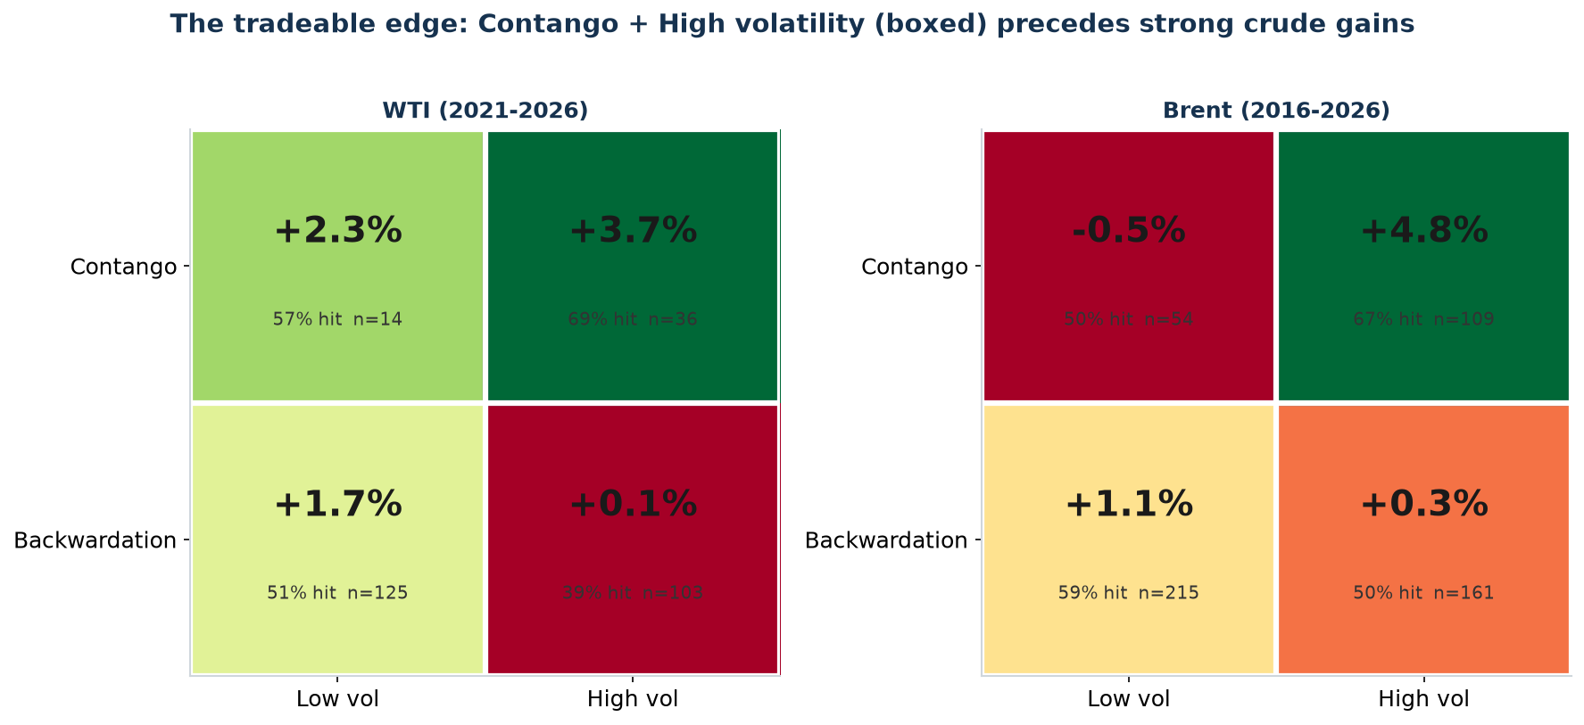
Curve (CL1-CL2) and expiry, written as equations
CALENDAR SPREAD (CL1 minus CL2), next 4 weeks
Near / in contango (least backwardated third) = +4.6% (67% hit) | Brent +3.1%
Deep backwardation (tightest third) = -2.6% (29% hit) | Brent -0.9%
Contango + High volatility = +3.7% | Brent +4.8% (best long, both crudes)
Deep backwardation + High volatility = +0.1% | Brent +0.3% (~flat, stand aside)
EXPIRY WINDOW (last 7 days, WTI/NYMEX rule)
Crowded long into expiry = CL -1.4%, then +0.9% after (roll / de-risk)
Light book into expiry = CL +0.7%
All expiries pooled = CL -0.3% (mild, NOT significant; base +0.3%)
Squeeze logic: the crowded side is the one forced to unwind into expiry. Measured here it is crowded LONGS de-risking (mild selling, rebounds after); the mirror image is a crowded SHORT book (where WTI sits now) that risks a squeeze HIGHER. The effect is small and not significant (t=-0.69), Brent uses the WTI expiry rule so it is only a proxy, and true contango is just ~18% of WTI weeks (the label is a tercile).

Slide 10
Playbook: overlays for your main factors
USE AS OVERLAYS
Deep backwardation = headwind, fade or reduce longs
Contango (rare) = tailwind, opportunistic only
One side extremely crowded (shorts now) = squeeze risk, tighten risk, expect sharp counter-moves
Price up + OI up (WTI) = quality uptrend, stay / add
Price up + OI down = covering bounce, fade
Crowded into the expiry week = roll early, expect de-risk softness then rebound
DO NOT
Trade Managed Money net extremes as a contrarian signal (it is momentum).
Use COT for roll timing (it cannot see the roll).
Rely on a single market or single window (demand cross-instrument replication).
How to use: a context and risk layer on top of your primary fundamentals / flow model. It sizes and filters; it does not trigger.
Caveats: Brent positioning is a NYMEX proxy (ICE COT gated); results are gross of costs; much of the apparent positioning edge in prior studies is the 2020 dislocation; the curve edge partly reflects 2021-2026 regimes.

