Slide 1
PropFlow
Property Management System
BCA Project Report | Tribhuvan University
Submitted by: Aayush Kakshapati (6-2-20-3-2022)
Supervisor: Mr. Madan Nath
Department of Computer Application, Bhaktapur Multiple Campus

Slide 2
Table of Contents
Chapter 1: Introduction
• Introduction • Problem Statement • Objectives • Scope & Limitations • Development Methodology • Report Organization
Chapter 2: Background Study & Literature Review
• Background Study • Literature Review
Chapter 3: System Analysis & Design
• Requirement Analysis • Feasibility Analysis • Data Modeling • Process Modeling • System Design • Algorithms Used
Chapter 4: Implementation & Testing
• Tools Used • Module Implementation • Unit Testing • System Testing
Chapter 5: Conclusions & Future Recommendations
• Lessons Learnt • Conclusion • Future Recommendations

Slide 3
Chapter 1: Introduction
1.1 Introduction
Growth of rental properties and urban housing has increased need for efficient property management
Property owners managing multiple units deal with large amounts of information
Traditional methods (paper records, spreadsheets) lack structure, scalability, and real-time access
Digital solutions increasingly adopted to centralize and streamline property operations
PropFlow is a web-based Property Management System to assist property owners
Focuses on improving visibility, reducing manual effort, and better operational control

Slide 4
Chapter 1: Introduction
1.2 Problem Statement
Many property owners still rely on manual or semi-digital methods despite available tools
No centralized rent tracking → inconsistent records, difficulty monitoring income
Tenant information not properly organized → hard to manage and retrieve
Maintenance requests handled informally → delays, missed issues, no tracking
No real-time visibility into unit availability → affects occupancy management
These challenges lead to inefficiencies, increased workload, and reduced control
PropFlow provides a structured and centralized system to address all these issues

Slide 5
Chapter 1: Introduction
1.3 Objectives
Simplify and organize property management for owners handling multiple units across different locations.
Provide a centralized system for tracking property occupancy, tenant details, and rent status in real time
Provide payment and maintenance tracking between tenants and property owners
Enable real-time unit availability monitoring (vacant / occupied)
Support dashboard and reporting features for better financial decision-making

Slide 6
Chapter 1: Introduction
1.4 Scope & Limitations
Scope:
Tenant registration and association with specific rental units
Rent tracking and payment status monitoring
Maintenance request submission and resolution tracking
Occupancy management vacant and occupied unit availability
Basic reporting and dashboard visualization
Limitations:
No banking / payment gateway integration
No mobile application support
No advanced analytics or AI predictions
No offline functionality
No real-time notifications

Slide 7
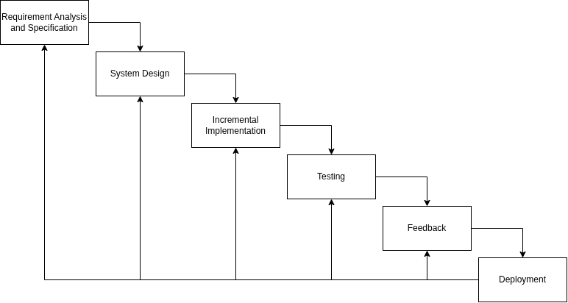
Chapter 1: Introduction
1.5 Development Methodology
Follows a Hybrid Incremental Model combines structured planning with step-by-step implementation

Slide 8
Chapter 1: Introduction
1.6 Report Organization
Chapter 1 — Introduction: Background, problem statement, objectives, scope, limitations, and methodology
Chapter 2 — Background Study: Literature review and key concepts in property management systems
Chapter 3 — System Analysis & Design: ER diagrams, DFDs, system architecture, and database schema
Chapter 4 — Implementation & Testing: Technologies used, module development, and testing approaches
Chapter 5 — Conclusions: Key outcomes and recommendations for future improvements

Slide 9
Chapter 2: Background Study & Literature Review
2.1 Background Study
Property management involves administration of residential/commercial real estate
Covers tenant handling, rent collection, maintenance, and property occupancy
Urban housing growth means owners increasingly manage multiple units across locations
Earlier practices relied on paper records or spreadsheets — lack real-time updates and consistency
As data volume grows, manual systems become inefficient and error-prone
Modern systems digitize operations with centralized platforms for all property administration tasks
Full-stack applications using Next.js, Django, and PostgreSQL enable scalable and secure systems
PropFlow is built on these concepts for individual owners managing multiple rental units

Slide 10
Chapter 2: Background Study & Literature Review
2.2 Literature Review
[1] Traditional property management relies heavily on manual records → inconsistencies in data, rent tracking, and maintenance
[2] Web-based systems integrating tenant management, payment tracking, and reporting improve transparency and decision-making
[3] User-friendly interfaces with simple dashboards and clear data visualization improve usability for non-technical users
[4] Structured relational databases enhance data consistency and enable efficient querying of large datasets
[5] Modern JavaScript-based frontends and backend frameworks improve performance, maintainability, and scalability
Gap: Most existing systems are too complex or not tailored for small-to-medium property owners
PropFlow addresses this gap with a simplified yet structured system focused on essential functionalities

Slide 11
Chapter 3: System Analysis & Design
3.1.1 Functional Requirements
Property Management — add, update, delete properties and units; view property details and status
Tenant Management — register tenant info; assign tenants to specific units; view/manage tenant records
Rent Management — record rent payments; track payment status (paid/unpaid); maintain payment history
Maintenance Management — submit maintenance requests; track status (pending/resolved); manage records
Availability Tracking — view occupied and vacant units; update unit availability status
Dashboard & Reports — display summary of properties, tenants, and payments; generate simple reports

Slide 12
Chapter 3: System Analysis & Design
3.1.1 Non-Functional Requirements
Usability — simple and intuitive interface for property owners
Performance — fast response time for data retrieval and updates
Security — user authentication and authorization; protection of sensitive data
Scalability — ability to handle increasing number of properties and users
Reliability — accurate data storage and minimal system downtime
Maintainability — modular code structure for easy updates and improvements

Slide 13
Chapter 3: System Analysis & Design
3.1.2 Feasibility Analysis
Technical Feasibility — uses modern technologies (Next.js, Django, PostgreSQL); tools and resources readily available
Economic Feasibility — uses open-source technologies; minimal development cost; suitable for academic and small-scale deployment
Operational Feasibility — easy to use; designed for owners with basic technical knowledge; simplifies manual processes
Schedule Feasibility — completable within academic timeframe using incremental development; each module implemented step-by-step

Slide 14
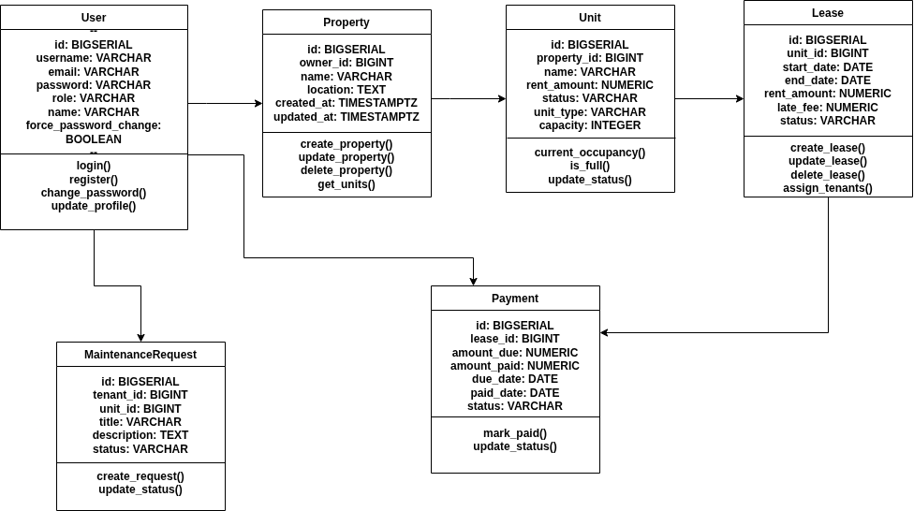
Chapter 3: System Analysis & Design
3.1.3 Data Modeling — Class Diagram

Slide 15
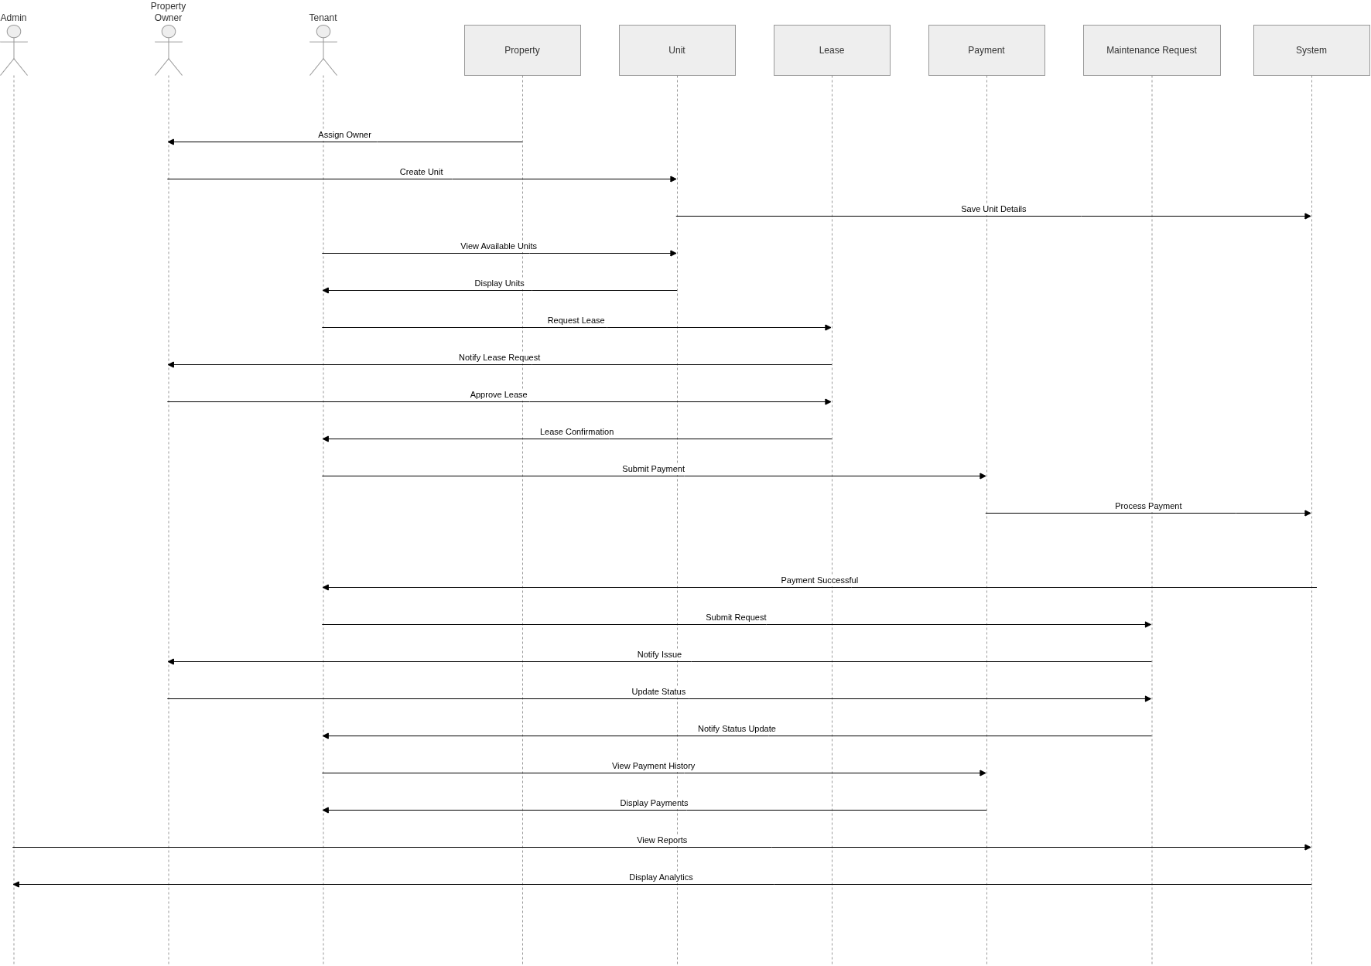
Chapter 3: System Analysis & Design
3.1.4 Process Modeling — Sequence Diagram

Slide 16
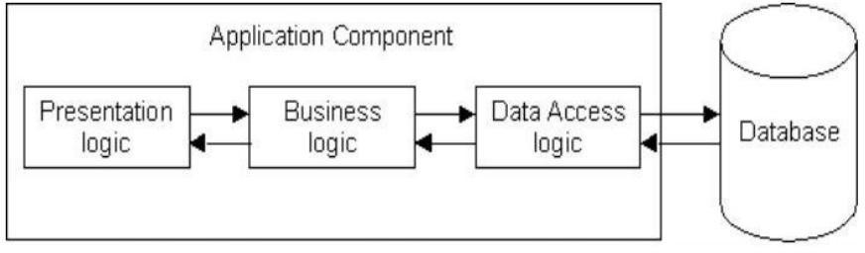
Chapter 3: System Analysis & Design
3.2.1 Architectural Design

Slide 17
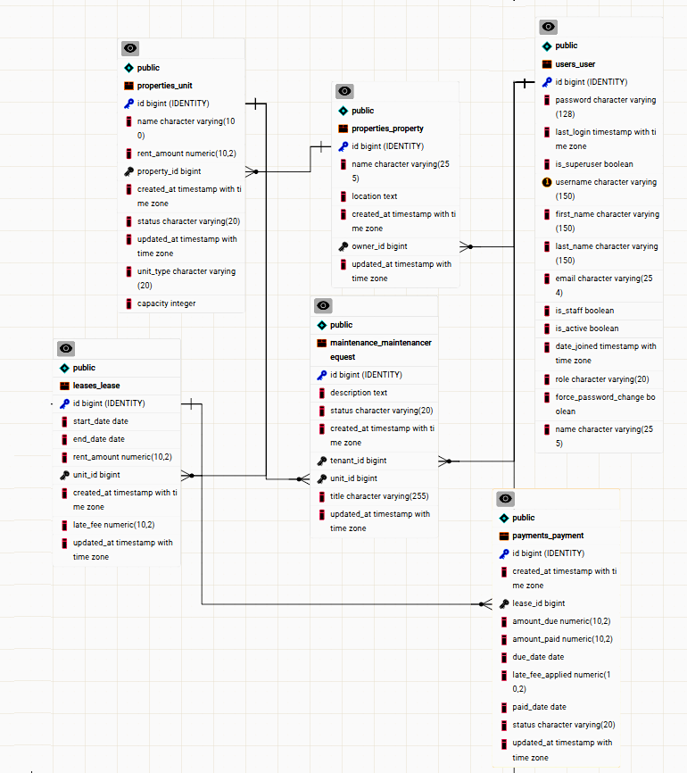
Chapter 3: System Analysis & Design
3.2.3 Database Schema Design

Slide 18
Chapter 3: Algorithms Used
3.4 Algorithm 1: Late Fee Calculation
Purpose: Determine penalty fees for rent payments submitted after the due date
Input: rent_amount, due_date, payment_date
Step 1: If payment_date is null, use today's date
Step 2: Compare payment_date with due_date — if on time, late_fee = 0
Step 3: Calculate days_overdue = payment_date − due_date
Step 4: Apply tiered fee — ≤5 days: 5% | ≤15 days: 10% | >15 days: 15%
Step 5: late_fee = rent_amount × fee_percentage | Round to 2 decimal places
Example: rent=1000, days_overdue=10 → 10% → late_fee = 100.00
Time Complexity: O(1) — constant time; best for high-volume payment processing

Slide 19
Chapter 3: Algorithms Used
3.4 Algorithm 2: Occupancy Rate Calculation
Purpose: Determine percentage of occupied units across all properties
Input: All units from the database (optionally filtered by property)
Step 1: Count total_units from the database
Step 2: Filter units with status = 'occupied' and count them
Step 3: Handle edge case — if total_units = 0, occupancy_rate = 0.0
Step 4: occupancy_rate = (occupied_units / total_units) × 100
Step 5: Categorize — ≥80%: High | ≥50%: Medium | <50%: Low
Example: 3 occupied out of 5 → 60.00% → Status: Medium
Time Complexity: O(n) — linear; n = number of units

Slide 20
Chapter 3: Algorithms Used
3.4 Algorithm 3: Maintenance Request Prioritization
Purpose: Assign priority levels (High/Medium/Low) to maintenance requests
Factors considered: age of request (days since creation) + current status
Step 1: Initialize priority_score = 0
Step 2: Calculate days_old = today − created_at
Step 3: Age scoring — >7 days: +3 | >3 days: +2 | else: +1
Step 4: Status scoring — pending: +2 | in_progress: +1 | else: +0
Step 5: Final priority — score ≥4: High | score ≥3: Medium | else: Low
Example: days_old=10 (+3) + status=pending (+2) = score 5 → Priority: High
Time Complexity: O(1) per request — highly scalable for large maintenance volumes

Slide 21
Chapter 3: System Analysis & Design
3.5 Algorithm Result Analysis
Late Fee Calculation — O(1) best/worst case; constant time; ideal for real-time payment processing
Occupancy Rate Calculation — O(n) best/worst case; linear due to database queries; efficient for typical datasets
Maintenance Prioritization — O(1) per request; constant time; highly scalable for large request volumes
All three algorithms are deterministic, easy to implement, and provide clear business value
Late Fee: fastest — suitable for high-volume processing
Occupancy Rate: only O(n) algorithm — still efficient for typical property management datasets
Maintenance Prioritization: most operationally valuable — enables efficient workflow management

Slide 22
Chapter 4: Implementation & Testing
4.1.1 Tools Used
Frontend — Next.js (routing, SSR, API handling); Tailwind CSS (responsive UI); JavaScript/React (state management)
Backend — Python (core logic, authentication, data processing); Django Framework (models, views, REST APIs)
Backend Libraries — re, random, json, datetime, timezone, Django ORM (Q, Sum, Avg, Count), messages
Database — PostgreSQL (stores users, properties, tenants, leases, payments, maintenance records)
Design — Draw.io (DFDs, ER diagrams, system architecture diagrams)

Slide 23

Chapter 4: Implementation & Testing
4.1.2 Module: Login / Signup

Slide 24
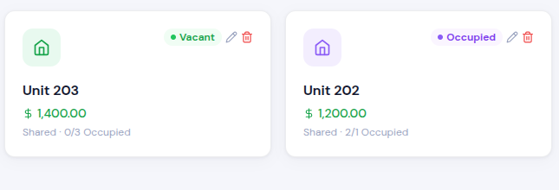
Chapter 4: Implementation & Testing
4.1.2 Module: Property Management

Slide 25
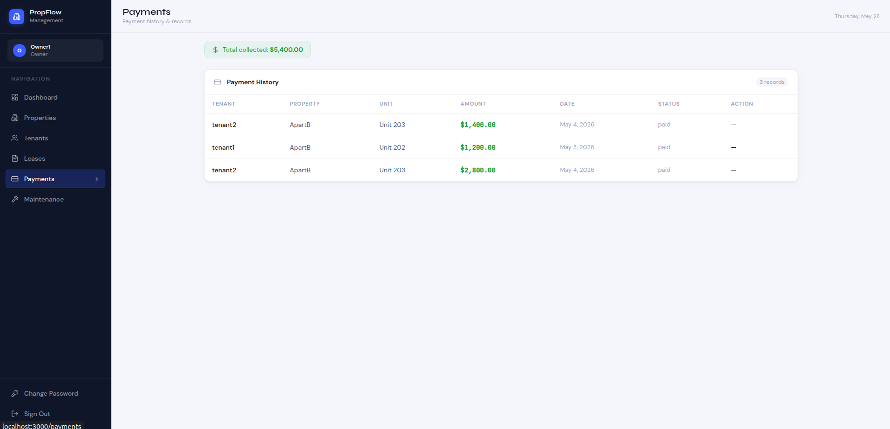
Chapter 4: Implementation & Testing
4.1.2 Module: Payment Management

Slide 26
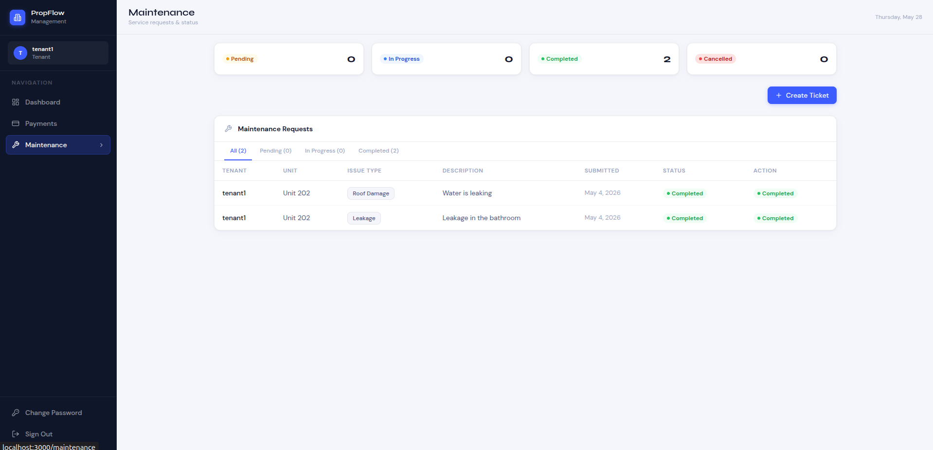
Chapter 4: Implementation & Testing
4.1.2 Module: Maintenance Management

Slide 27
Chapter 4: Implementation & Testing
4.2.1 Unit Testing
Login Test 1 — correct email and password → Login successful ✓
Login Test 2 — incorrect password → Login unsuccessful ✓
Login Test 3 — any field left empty → Login unsuccessful ✓
Sign Up Test 1 — all details provided correctly → Registration successful ✓
Sign Up Test 2 — any field left empty → Registration unsuccessful ✓
Create Property Test 1 — all details provided → Property added successfully ✓
Create Property Test 2 — one field empty → Unsuccessful ✓
Lease Test — prevent more lease assignments than unit capacity → Unsuccessful ✓

Slide 28
Chapter 4: Implementation & Testing
4.2.2 System Testing
Application Launch — open app → System Login Page opens → Pass ✓
Login Functionality — correct credentials → Login successful → Pass ✓
Add Property — click add property, enter details → Property added successfully → Pass ✓
Add Lease — select tenant and add lease → Lease created successfully → Pass ✓
Add Maintenance Ticket — create ticket → Maintenance ticket created successfully → Pass ✓
Update Payment Status — change status to paid → Status changes from pending to paid → Pass ✓
Logout — click logout → System Login Page opens → Pass ✓

Slide 29
Chapter 5: Conclusions & Future Recommendations
5.1 Lessons Learnt / Outcome
Gained strong practical knowledge of full-stack web development using Django, Python, Next.js, and PostgreSQL
Learned to design, implement, and integrate multiple modules into a complete system
Understood importance of database management, session management, and role-based authentication
Improved problem-solving skills handling real-world issues: duplicate rent records, tenant data consistency, maintenance tracking
Enhanced understanding of modular system development using the Hybrid Incremental Model
Gained experience developing a real-world property management solution for multiple rental unit owners

Slide 30
Chapter 5: Conclusions & Future Recommendations
5.2 Conclusion
PropFlow was successfully designed and implemented as a web-based Property Management System
Digitalizes and simplifies: property listing, tenant management, rent tracking, maintenance handling, occupancy tracking, reporting
Provides a user-friendly, centralized platform for managing multiple properties from a single system
Reduces manual workload, minimizes record-keeping errors, improves data organization
Supports real-time tracking of tenant info, payment status, maintenance requests, and unit availability
Achieved the primary objective of creating a structured, reliable, and efficient web-based solution

Slide 31
Chapter 5: Conclusions & Future Recommendations
5.3 Future Recommendations
Mobile Application — develop iOS/Android app for property owners and tenants
Notifications — integrate inApp, SMS/email alerts for rent due dates, payment confirmations, maintenance updates
Online Payment Gateway — support secure and automated digital rent payments
Advanced Analytics & AI — predict occupancy trends, rent collection patterns, and property performance
Additional Modules — lease agreement management, visitor management, document management
Cloud Backup & Enhanced Security — improve reliability, scalability, and data protection

Slide 32
Thank You
PropFlow · Property Management System · BCA Project
Aayush Kakshapati | Supervisor: Mr. Madan Nath | Bhaktapur Multiple Campus

