Slide 1
Secure Data Hiding in Image Using Steganography
CAPSTONE PROJECT
Presented By: Aayush Sunil Patil Wankhede
Student Name: Aayush Sunil Patil Wankhede
College Name: Shri Guru Gobind Singh Ji Institute of Engineering and Technology, Nanded-431606
Department: Electronics and Telecommunication Engineering

Slide 2
OUTLINE
Introduction to Steganography
Problem Statement
Technology used
Block diagram and Flowchart
Wow factor
End users
Result
Conclusion
Git-hub Link
Future scope

Slide 3
Introduction to Steganography
What is Steganography? A technique for hiding information inside other data to avoid detection.
Project Focus Implements image-based steganography, allowing text messages to be concealed within an image.
Key Advantage Hidden data remains undetectable without the correct decryption key, ensuring stealthy communication.

Slide 4
Problem Statement
Traditional encryption methods make data unreadable but do not hide its existence, making it susceptible to detection.
Steganography provides a discreet method by embedding secret messages within images, ensuring security without raising suspicion.
This project focuses on developing a Python-based system that can securely hide and retrieve messages from images, offering a seamless and covert method of data protection.
Key Points
Hidden in Plain Sight : Secret messages are embedded in images without altering their visible appearance.
Enhanced Security & Confidentiality : Protects sensitive information from unauthorized access.
User-Friendly & Efficient : Simple Python-based system for message hiding and extraction.
Real-World Applications
Secure communication for journalists & organizations.
Protecting confidential data in digital media.
🚀 Steganography + Python = A Smart & Secure Data-Hiding Solution!

Slide 5
Technology used
Platform: Windows 11 : Ensures compatibility and smooth execution of the application.
Programming Language: Python : A versatile and powerful language for image processing and GUI development.
Libraries: OpenCV : For image processing and pixel manipulation. NumPy : Efficient numerical computations for encoding and decoding. Tkinter : GUI framework for an interactive user interface.
Techniques Used
ASCII Value Mapping : Converts text into numerical values for secure encoding.
Image Pixel Manipulation : Embeds secret data into image pixels without noticeable distortion.
Passcode-Based Access Control : Ensures only authorized users can extract hidden messages.
File Format
PNG/JPG : Supports lossless image storage, maintaining data integrity.
Tools Used
Jupyter Notebook & PyCharm : For coding, testing, and debugging. Tkinter : For building an intuitive and user-friendly GUI.
🚀 A Blend of Cutting-Edge Tools & Techniques for Secure Data Hiding!

Slide 6
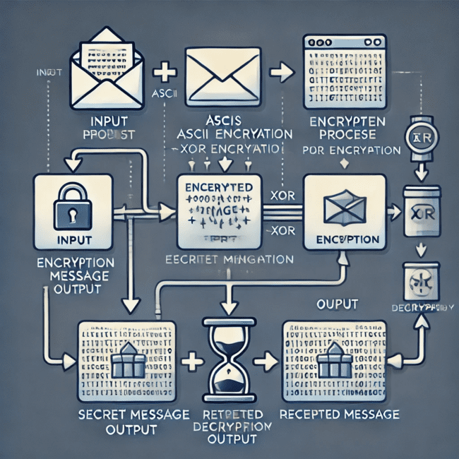
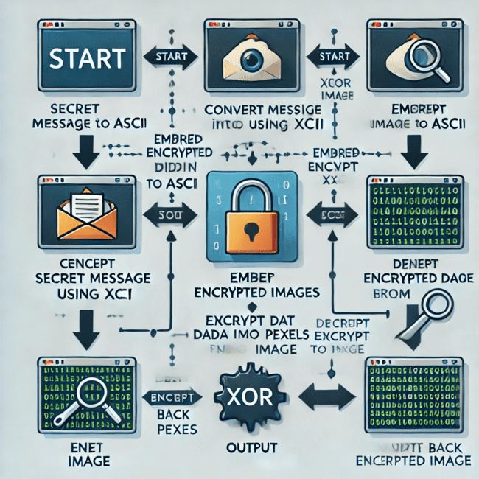
Block diagram and Flowchart

Slide 7
Wow factors
Security : Passcode-based protection ensures that only authorized users can retrieve hidden messages.
Automation : Intuitive Tkinter-based GUI makes the process seamless and user-friendly.
Scalability : Can be extended to support video and audio steganography in future enhancements.
Error Handling : Prevents oversized messages and incorrect file selections, ensuring smooth execution.
Multi-Platform Support : Compatible with Windows 11, Linux, and macOS, offering cross-platform functionality.
🚀 A Secure, Scalable, and Smart Approach to Steganography!

Slide 8
End users
Cybersecurity Professionals : Ensures secure communication and aids in digital forensics.
Journalists & Whistleblowers : Enables confidential data sharing without raising suspicion.
Military & Intelligence Agencies : Facilitates covert message transmission for secure operations.
General Users : Protects personal data from unauthorized access and breaches.
🚀 Empowering Secure & Undetectable Communication for Everyone!

Slide 9
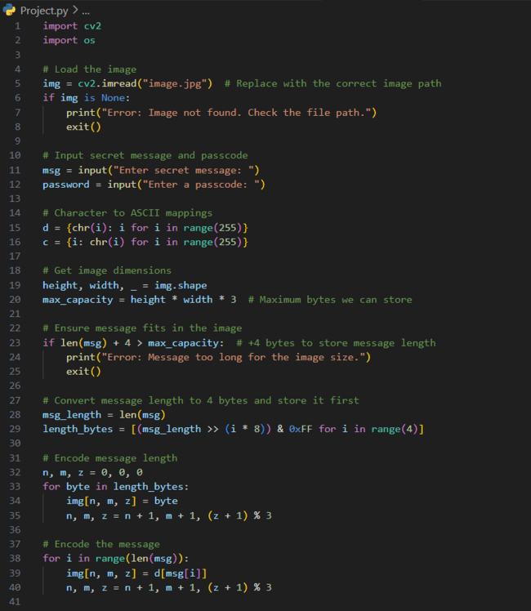
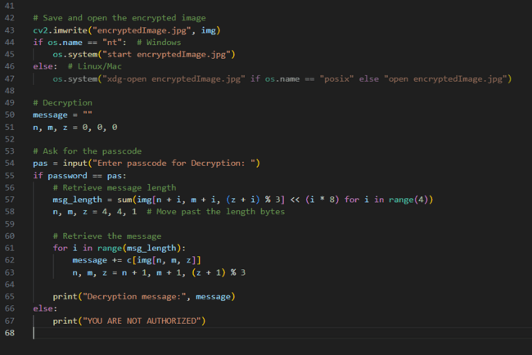

Results

Slide 10
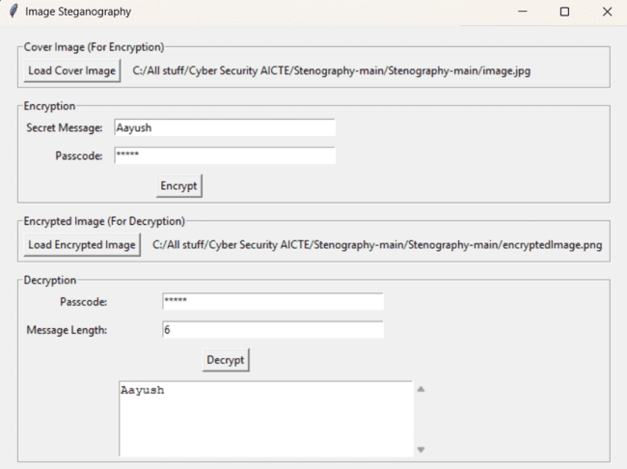
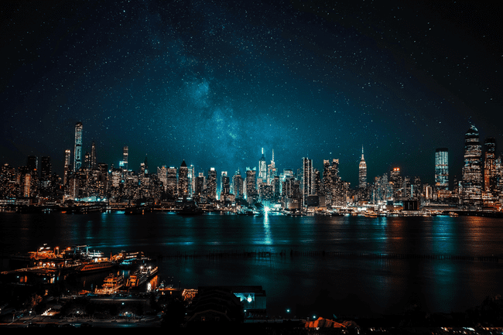
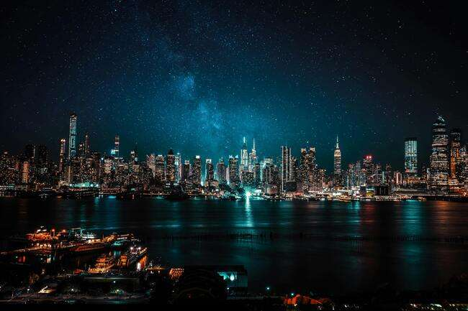
Results
Input image
Output image

Slide 11
Conclusion
Enhanced Security : Steganography hides messages within images, adding an extra layer of protection.
Stealthy Communication : Ensures undetectable data transfer without raising suspicion.
Practical Implementation : Demonstrates how image manipulation can be leveraged for secure messaging.
Future Scope : Can be extended to video, audio, and real-time applications for broader security needs.
Secure, Invisible, Reliable.

Slide 12
GitHub Link
https://github.com/Aayush-PatilWankhede/Steganography.git

Slide 13
Future scope
Advanced Encryption : Enhancing security by integrating AES encryption along with steganography.
Multi-Level Steganography : Concealing data within multiple layers of an image for added security.
Video & Audio Steganography : Expanding the technique beyond images to video and audio formats.
AI-Resistant Steganography : Developing advanced techniques to counter steganalysis using deep learning.

Slide 14
THANK YOU!

