Slide 1


Garbage Monitoring System Using IOT
Smart bin
Aayush Gupta
Gaurav Rai
Rasik Modi
Shivam Upadhyay
Swaranjali Rawat

Slide 2
Presentation Outline
Problems
Solutions
Introduction of project
Block Diagram
Working
Advantage
Impact of project
Conclusion

Slide 3
Problems
Collection
Transportation
Segregation
Reuse/recycle
Disposal

Slide 4
Sollutions
Manual operating
Increase the monitoring
Improve transportation
Automation using aurduno
Monitoring using Raspberry pi

Slide 5
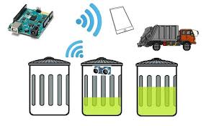
INTRODUCTION
This project is a very innovative system which helps to keep the city clean.
This system of monitoring the garbage bins the information of level of the bin and the position of the bin is collected using the ultrasonic sensor and accelerometer and the collected information is send to a web serer for monitoring and a mail is send to the subscriber with the information about the bin .

Slide 6
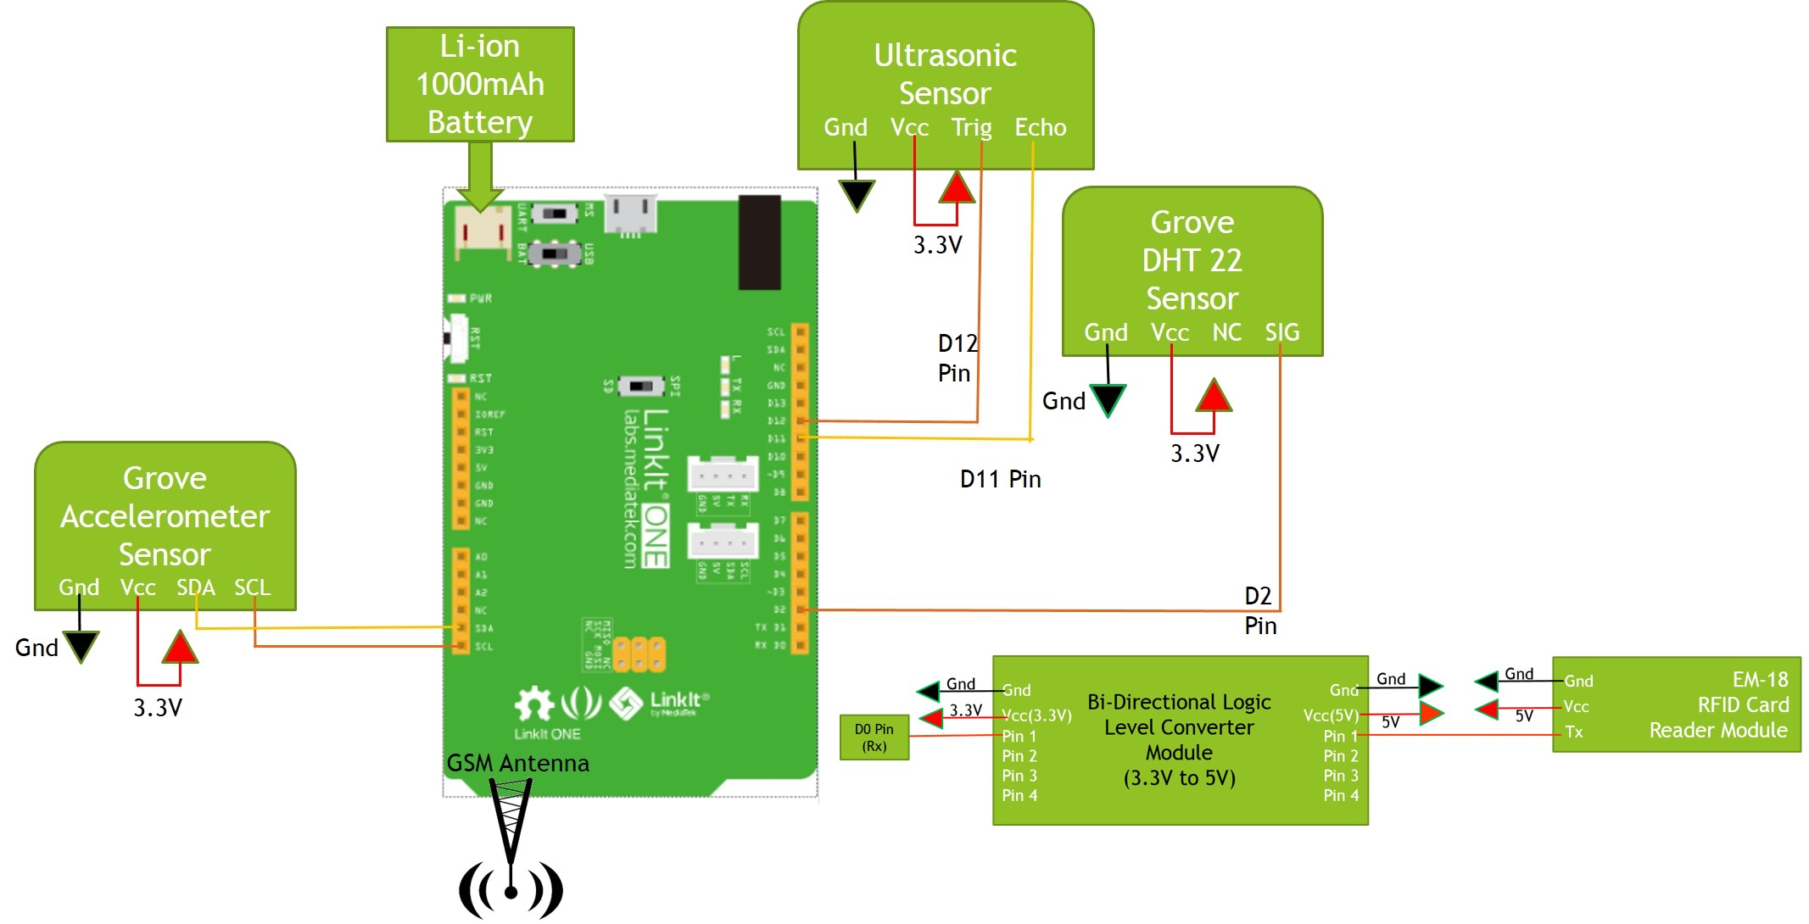
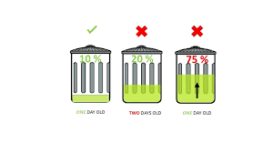
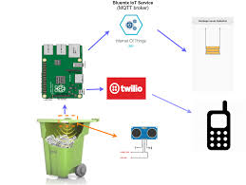
Block Diagram

Slide 7
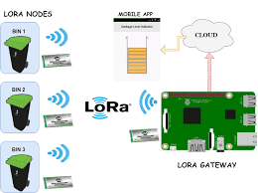
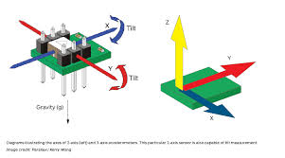
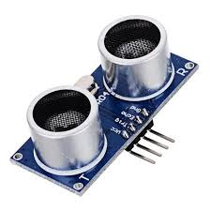


Working

Slide 8
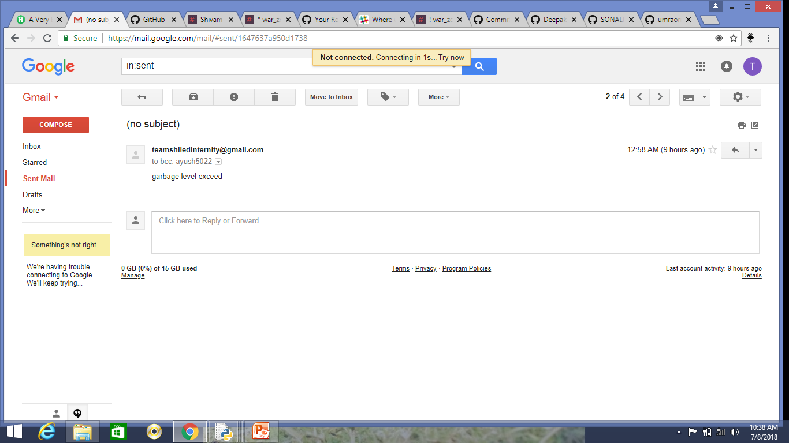

Slide 9
Advantage
Fully automated monitoring
Very less maintenance cost
Highly reliable system
Reduce the human errors
Highly productive
Proper waste management
Proper handling

Slide 10
Impact of this technology
Proper monitoring
Reduces the human errors
Makes the system automated
Proper waste management
Saves money
makes the system Distance independent
Easly accessible

Slide 11
FUTURE ASPECT
We can use GPS system to get the locations of the bins in the various area of the city.
Some work can be done to distinguish the type of the waste and can be used for further processing like recyling and reduce.
Push notification can also be send to the mobile phone of the sweepers.

Slide 12
Conclusion
So we conclude here that this technology makes a valuable and desirable change in the garbage monitoring and handling which makes the system more efficient and highly reliable

