Slide 1
Future Strategies
on
Quality Assurance in Eye Care
NNNJS
3 December 2011
Sunu Dulal
MD FICS FRSPH MSc (ICEH London)

Slide 2



Quality Defined
QUALITY IS MULTIDIMENSIONAL
Different people interpret quality differently.
Quality is delivering of products and services faster, better, cheaper and newer at the minimum possible cost
It is not a static perception, is like a liquid

Slide 3

Quality Defined contd….
Quality is the right product to the right place at the right time; exceeding customers expectations“ at the lowest cost

Slide 4
Dimensions of Service Quality
Classifying the dimensions of service quality is more
challenging than to classify the product quality.
Some of the dimensions of service quality:
-Access to services
-Effectiveness of care
-Efficiency of service delivery
-Interpersonal relations
-Continuity of services
-Safety
-Physical infrastructure and comfort
-Personal interaction with staff
-Degree of two-way understanding in patient and caregiver
-Level of patient participation in decision making

Slide 5
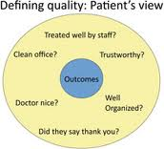
Measuring and monitoring are other important concepts for improving quality (FOLLOW UP OF THE PTS.)
Patient centred care

Slide 6
"Quality" is often mistakenly linked with "high-cost" modalities
Sophisticated technological tools undoubtedly add to the quality of eye care but equally critical are many inexpensive measures to improve the outcome.

Slide 7
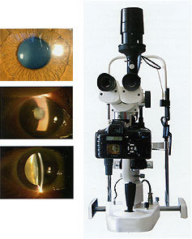

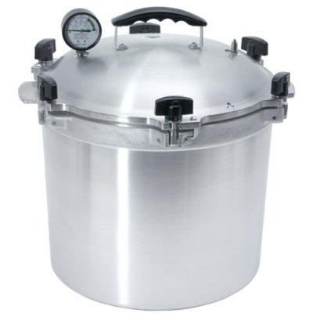
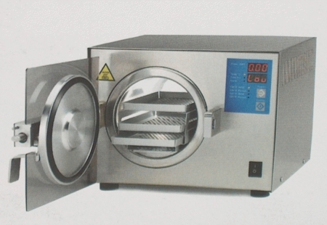

Quality Eye Care: Today’s Perspective
IOL has revolutionalized but other factors are equally important
proper preoperative evaluation
slit-lamp biomicroscopy
applanation tonometry
dilated fundus examination/B Scanning
attention to every detail in the operating room
Availability of Povidone Iodine
all aspects of asepsis
Better Sterilization methods

Slide 8



Quality Assurance
Quality assurance in health care can be defined as all activities that contribute to defining, designing, assessing, monitoring, and improving the quality of healthcare service
These activities can be performed as part of the
accreditation of facilities
supervision of health workers, or other efforts to improve the performance of health workers and
the quality of health services

Slide 9


Quality Assurance contd…
Four core principles to guide quality assurance in healthcare:
Focus on the client: services should be designed so as to meet the needs and expectations of clients and communities
Focus on systems and processes: providers must understand the service delivery system and its key service processes in order to improve them
Focus on measurement: data are needed to analyze processes, identify problems, and measure performance
Focus on teamwork: quality is best achieved through a team approach to problem solving and quality improvement.

Slide 10
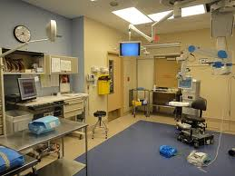

Benchmarking
Benchmarking is a methodology that is used to search for best practices.
Benchmarking can be applied to strategies, policies, operations, processes, products, and organizational structures.
By finding and adopting best practices one can improve organization’s overall performance.

Slide 11
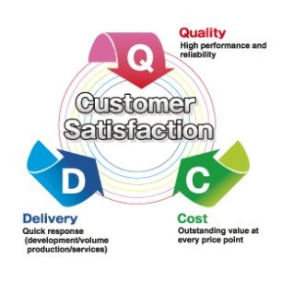

Customer Satisfaction
Customer satisfaction is a perception. It can vary from high satisfaction to low satisfaction. Customers may experience high or low satisfaction low satisfaction.
Since satisfaction is a perception, customers may not be satisfied even though you’ve met all contractual requirements.
Just because you haven’t received any complaints doesn’t mean that customers are satisfied.

Slide 12


Quality Assurance in one sentence
Quality assurance is a set of activities intended to establish confidence that quality requirements will be met.
QA is a part of quality management.

Slide 13
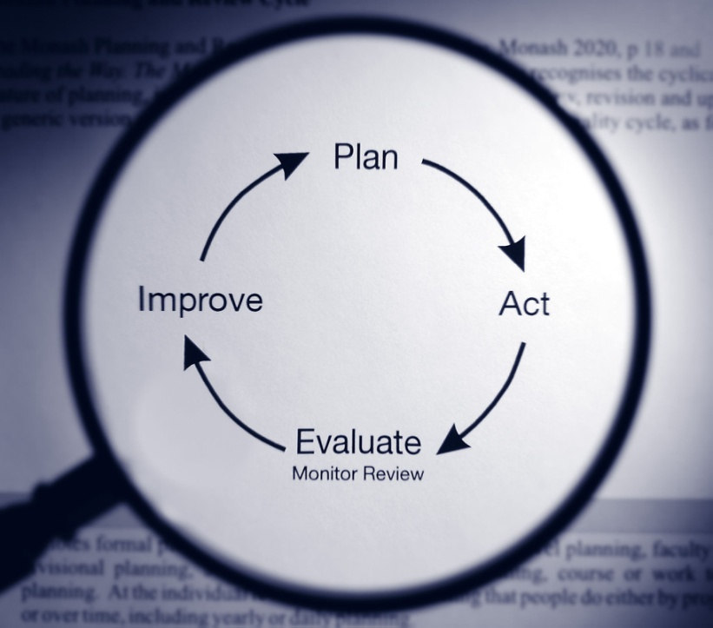

Quality Improvement
Quality Improvement or Quality Assurance is a systematic and planned approach to assessing, monitoring and improving quality of health services on continuous basis.
Criteria to access patient satisfaction
Medical care
Nursing care
Behaviour of staff
Clear information
Personal attention
Responsiveness to complaints & care
Integrity
Physical facilities
Supportive services
Cleanliness & maintenance
Waiting time
Charges

Slide 14

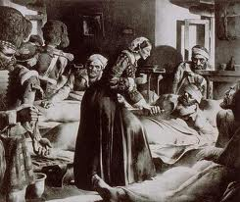

Clinical Audit
An audit is an evidence gathering process. It will help us understand the factors that are causing us to fail, so that we can set priorities and make improvements
Florence Nightingale conducted one of the first clinical audits during the Crimean War (1853–1855).
As a result of Nightingale’s analysis and her nurses’ work, the mortality rate fell from 40% to 2%

Slide 15
Clinical Audit contd....
Clinical monitoring of post-operative visual outcome should be considered mandatory in any setting where cataract surgery is performed
Auditing surgical outcomes is an essential part of practice. The targets for cataract surgery are clearly set by the World Health Organization.
WHO criteria for categorizing Visual Outcome
Post Operative Visual Acuity | Outcome category | Available VA | Best Corrected VA
6/6-6/18 | Good | > 80% | >90%
<6/18-6/60 | Borderline | <15% | <5%
<6/60 | Poor | <5% | <5%

Slide 16

The EUREQUO Project
The European Registry of Quality Outcomes of Cataract and Refractive Surgery (EUREQUO) a system for 16 European countries to collect and register data on cataract and refractive surgery and to analyze the data and audit the outcomes, either on an individual basis or for a collective unit

Slide 17


Bangladesh Study
The most powerful predictor for client satisfaction was:
provider behaviour, especially respect and politeness. For patients this aspect was much more important than the technical competence of the provider.
Furthermore, prolongation of the waiting time more than 2 hours greatly dissatisfied the clients.

Slide 18
Summary
Quality is multidimensional
Quality is dynamic
Quality work needs team work
Audit is important for quality improvement
Follow us is mandatory for audit
Errors and confusion can happen
Quality is not doing different thing but doing the things differently

Slide 19
Future Strategies
Protocol Development
Emergency Care
Outreach Service including surgical eye camp
Surgical Guidelines
Sterilization guidelines
Cost Containment

Slide 20
Guidelines for audit
Clinical Audit
Surgical Audit
Service Quality Audit
Client perception/ Satisfaction
Bench Mark
Replica

Slide 21
What are common practices elsewhere?
Performance evaluation/self appraisal
Number of surgeries performed/doctor
Visual outcome/patient satisfaction
Employee satisfaction
Fellowship/residency/training/manufacture/
production

Slide 22

Thank You

