Slide 1

ARTIFICAL INTELLIGENCE
AI
Presented by Aayush Sojitra

Slide 2
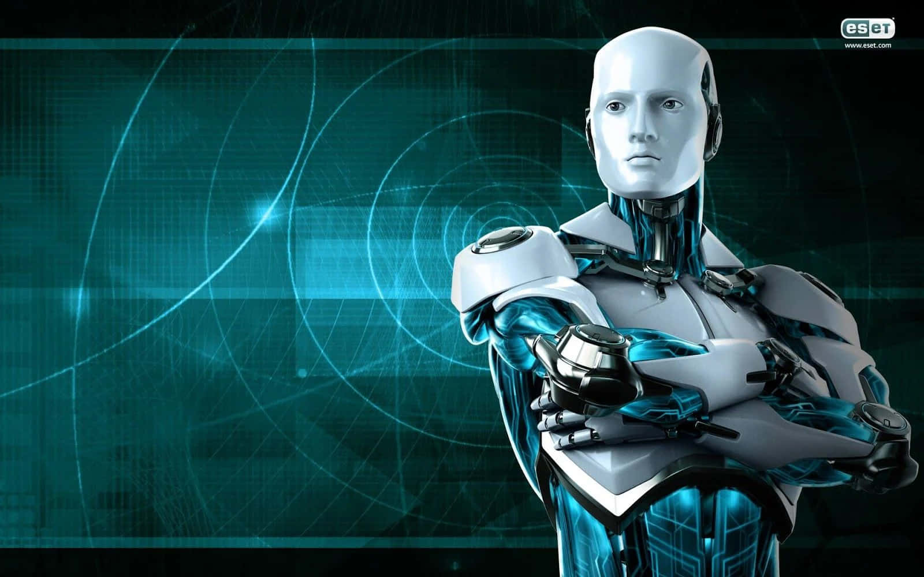
CONTENTS
What is Artificial Intelligence?
How is machine learning related?
Examples of AI
What problem can AI solve?
Disadvantages od AI
How can we use AI responsibly?

Slide 3
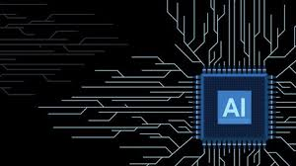
1. What is AI?
Artificial Intelligence is the ability for a computer to think, learn and simulate human mental processes, such as perceiving, reasoning, and learning.
It can also independently perform complex tasks that once required human input.

Slide 4
2. how does machine Learning Relate to Ai?
Although the terms artificial intelligence (AI) and machine learning are frequently used interchangeably, (machine learning is a subset of the larger category of AI. )
Artificial intelligence signifies computers' general ability to mimic human thought while carrying out tasks in real-world environments
Machine learning implies to the technologies and algorithms that allow systems to recognize patterns, make decisions, and improve themselves through experience and data.

Slide 5
3. Examples
AI can be used for various situations, but these are some examples of AI in our daily life.
Virtual Assistance
Autonomous vehicles
Chatbots
E-commerce
Recommendation systems
Navigation apps

Slide 6
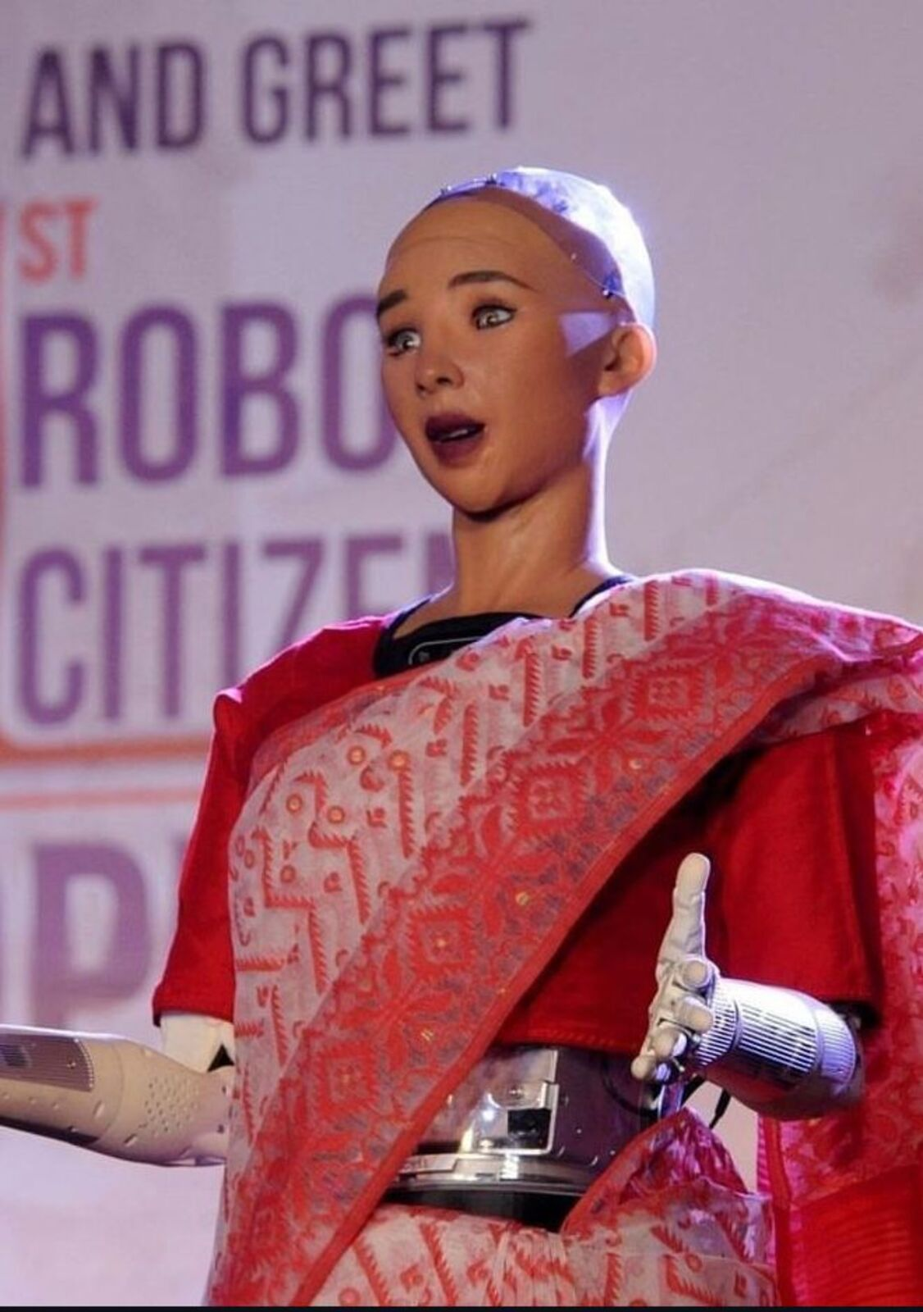
Sofia The AI Robot
Sophia is a realistic humanoid robot capable of displaying humanlike expressions and interacting with people. It's designed for research, education, and entertainment, and helps promote public discussion about AI ethics and the future of robotics.

Slide 7
4. WHAT PROBLEMS CAN AI SOLVE?
Cybersecurity → dectecting spam
Healthcare → medical records
Research → idea generation, finding data
Transportation → self driving cars
As shown above, AI can solve a LOT of problems. Let's explore a few on the next slide!

Slide 8
Uses of AI
(Advantages of AI)
fImage and facial recognition
It can help make data safer and more secure.
For example, face authentication can ensure that only the appropriate person has access to sensitive information that is intended specifically for them.
Medical diagnosis
Provides more exact diagnoses, detects hidden patterns in imaging investigations, and predicts how patients will respond to specific medications.
This leads to better treatment strategies, fewer clinical errors, and more accurate diagnosis.
Customer service
Customer service teams can get feedback from customers by using AI.
For example, AI-powered information can provide agents with information on client intent, language, and sentiment so they are aware of how to approach an encounter.
Recommendation systems
AI content recommendations help people stay engaged and informed.
For example, Virtual ( Siri and Alexa.), Personalized content on streaming platforms, Apps that suggest best routes based on traffic.

Slide 9
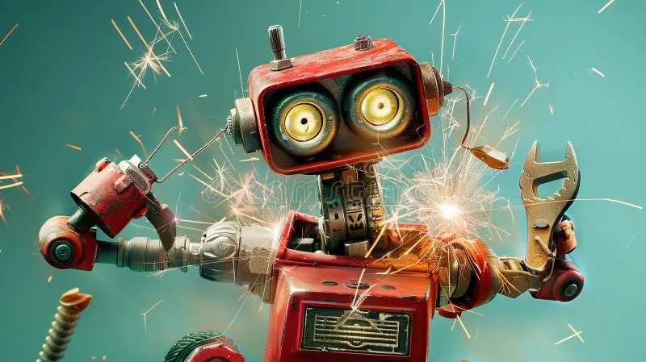


5. what are the disadvantages of AI?
Lack of Transparency
Bias and Discrimination
Privacy Concerns
Ethical Dilemmas
Security Risks
Concentration of Power
Dependence on AI
Job Displacement

Slide 10
6. How can we use AI responsibly?
People should use their own creativity, not copy off of AI! AI is just a tool for efficiency!
Put People First
Consider data and privacy goals
Minimize unintended bias
Ensure AI transparency

Slide 11
Responsible AI use
AI can help do repetitive work for humans, but humans should still be prioritized. Create a culture that utilizes creativity, empathy, and dexterity from humans and AI for increased efficiency.
Businesses should adopt strong security measures, limit access to sensitive data, and anonymize data whenever possible to secure data privacy with AI and ML technologies.
There needs to be fairness in AI which entails identifying and eliminating discrimination while also encouraging diversity and inclusion. This is can be done by using training models with equal representation.
Develop explainable AI that is visible across processes and functions to generate trust among employees and customers. Provide examinability, comprehension, and traceability.

Slide 12
Thank You.
AS
Aayush Sojitra
Aayush Sojitra
23010101253
23010101253@Darshan.ac.in
www.Darshan.ac.in

