Slide 1

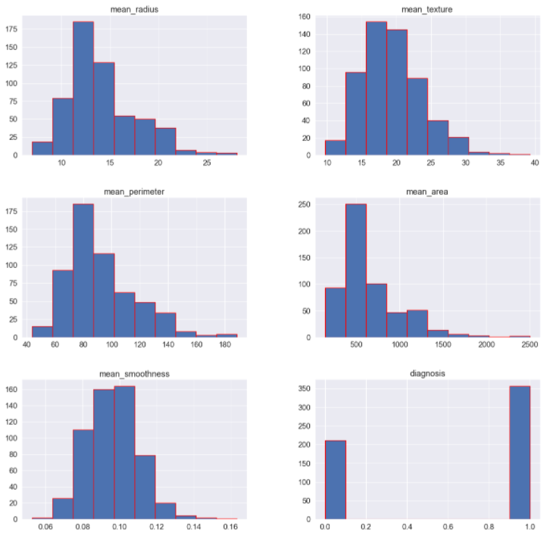
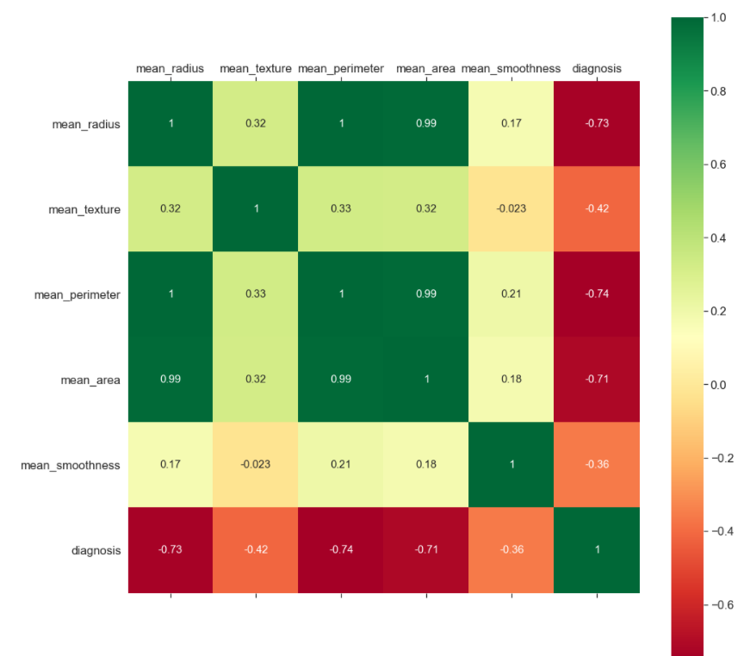
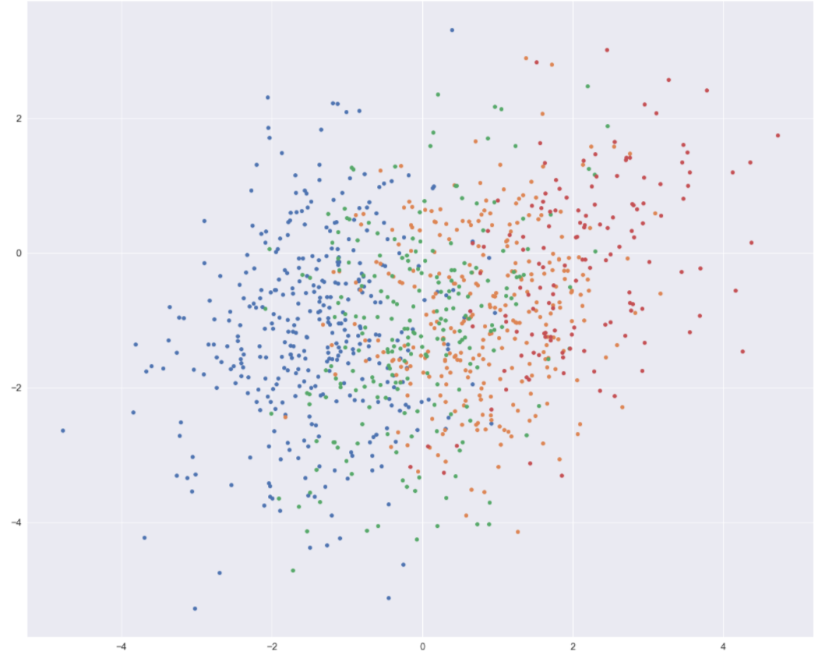
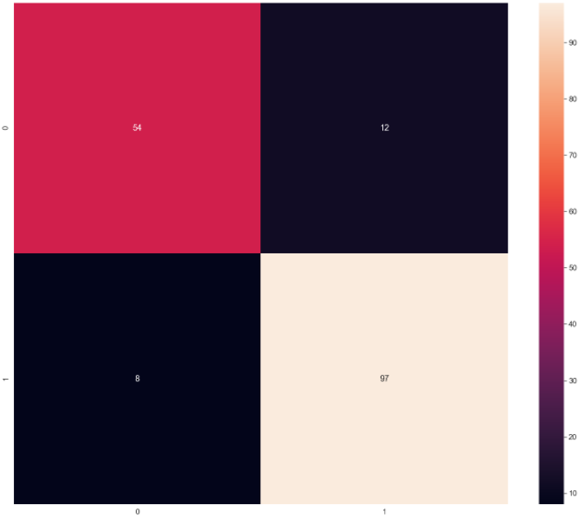
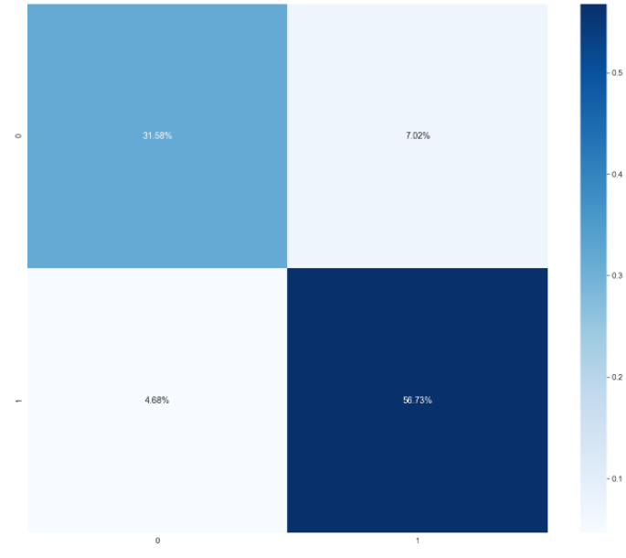
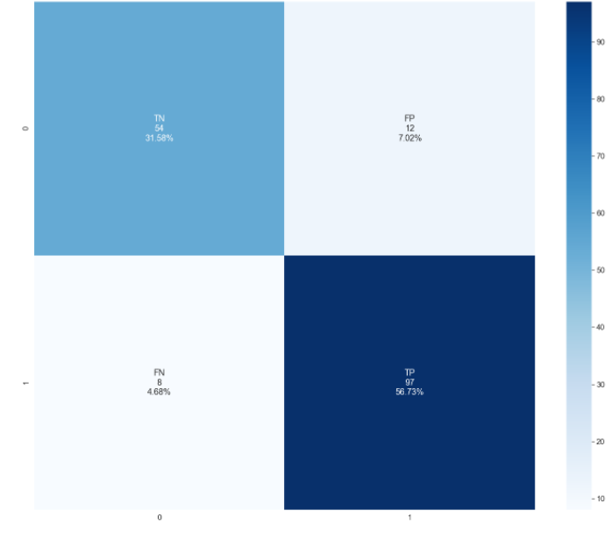

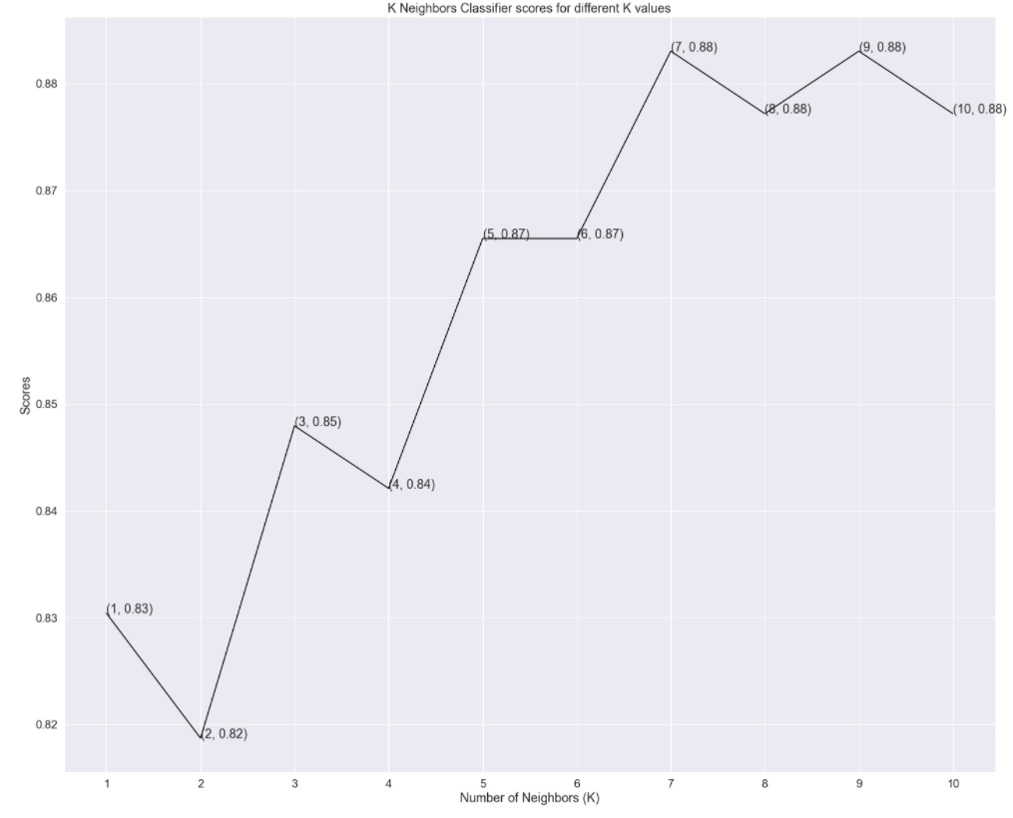
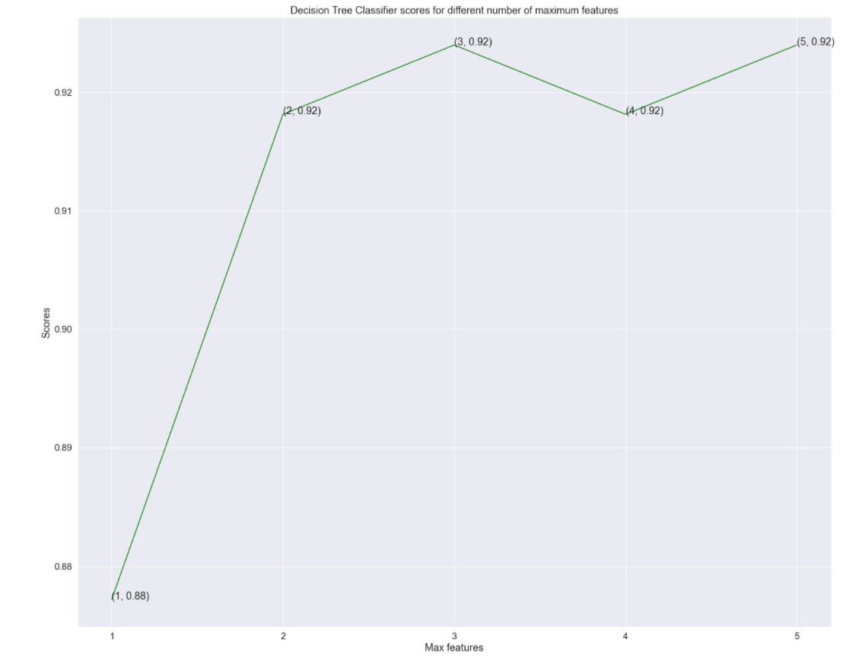
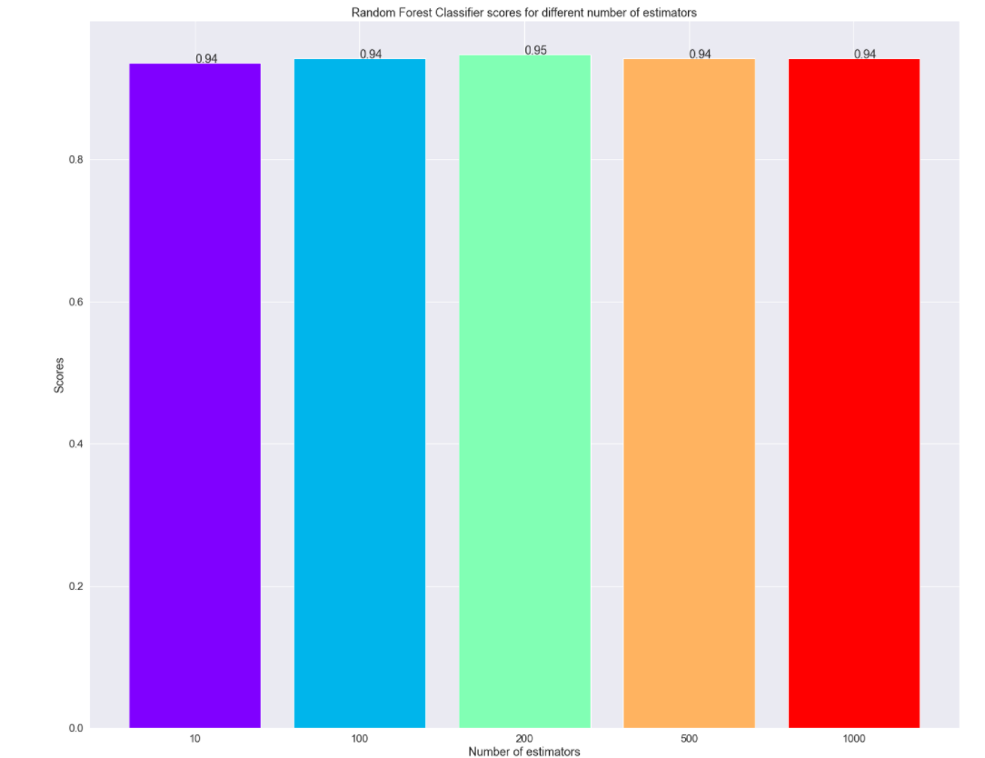
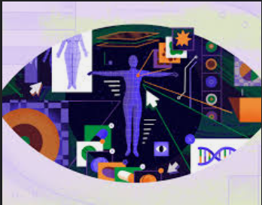
Breast Cancer Prediction Using Machine Learning
Aayush Bhatta
Sophomore, Fisk University, Nashville, TN, 37208
ABSTRACT
With the rapid population growth, the risk of death incurred by breast cancer is rising exponentially. Breast cancer is the second most severe cancer among all the cancers already unveiled and the major cause of death in women worldwide. Any improvement in the treatment of breast cancer will lead to a healthy life of people. Therefore, machine learning techniques can contribute to the process of prediction and early diagnosis of breast cancer. So, in this paper, I will be comparing three machine learning techniques i.e., k-nearest neighbors (KNN), random forest classifier, and Decision Tree Classifier (DT) and find out the most effective way of predicting the breast cancer by comparing their accuracy. Moreover, I will be measuring the performance based on the sensitivity, specificity, precision, True positive rate, False positive rate, True negative rate, False Negative rate, and F1 score. Work will be done in the anaconda environment using python.
Background
Data Visualization
Conclusion
I used machine learning to predict the breast cancer in this project. After using the dataset and dividing them inro two parts such that I took half of the data for training my model and half of the data for testing my model, I used three machine learning algorithms to find the more accurate techniques to predict the breast cancer. And I concluded that the accuracy of k Neighbors classifier is 88.3% and decision tree classifier is 91.81%; however, the random classifier achieved the highest score of 94.15%.
Breast cancer is the most common cancer among today’s generation. In the past two decades, the overall number of people diagnosed with cancer nearly doubled, from an estimated 10 million in 2000 to 19.3 million in 2020. Today, one in 5 people worldwide will develop cancer during their lifetime. There are different cause of breast cancer.
Confusion Matrix and Heatmaps
Future work
For now, I used the dataset where I was predicting the breast cancer based on the mean radius, mean texture, mean perimeter, mean area, and mean smoothness of the breast lumps on the breast. But there might also be a case where the person can get breast cancer without the appearing of lumps in the breast, so in that case my algorithm might not work because I have not taken that case into consideration; therefore, in the future I will be working on it.
Results
References
Islam, M. M., Haque, M. R., Iqbal, H., Hasan, M. M., Hasan, M., & Kabir, M. N. (2020, September 1). Breast cancer prediction: A comparative study using machine learning techniques. SN Computer Science. Retrieved November 24, 2021, from https://link.springer.com/article/10.1007/s42979-020-00305-w#ref-CR2.
Breast cancer - statistics. Cancer.Net. (2021, February 24). Retrieved November 24, 2021, from https://www.cancer.net/cancer-types/breast-cancer/statistics.
Naji, M. A., Filali, S. E., Aarika, K., Benlahmar, E. L. H., Abdelouhahid, R. A., & Debauche, O. (2021, September 8). Machine learning algorithms for breast cancer prediction and diagnosis. Procedia Computer Science. Retrieved November 24, 2021, from https://www.sciencedirect.com/science/article/pii/S1877050921014629.
Li, J., Zhou, Z., Dong, J., Fu, Y., Li, Y., Luan, Z., & Peng, X. (2021, April 16). Predicting breast cancer 5-year survival using Machine Learning: A Systematic Review. PloS one. Retrieved November 24, 2021, from https://www.ncbi.nlm.nih.gov/pmc/articles/PMC8051758/.
Breast cancer statistics: Facts & figures: NBCC. National Breast Cancer Coalition. (2021, March 12). Retrieved November 24, 2021, from https://www.stopbreastcancer.org/information-center/facts-figures/.
Using machine learning algorithms for breast cancer risk prediction and diagnosis. IEEE Xplore. (n.d.). Retrieved November 24, 2021, from https://ieeexplore.ieee.org/document/8739696.
Montazeri, M., Montazeri, M., Montazeri, M., & Beigzadeh, A. (2016, January 1). Machine learning models in breast cancer survival prediction. Technology and Health Care. Retrieved November 24, 2021, from https://content.iospress.com/articles/technology-and-health-care/thc1071.
Breast cancer mortality rates: Recent figures and Trends - Moose and doc. Breast Cancer - Moose and Doc. (2019, December 7). Retrieved November 24, 2021, from https://breast-cancer.ca/diag-chnces/.
Jerez, J. M., Molina, I., García-Laencina, P. J., Alba, E., Ribelles, N., Martín, M., & Franco, L. (2010, July 16). Missing data imputation using statistical and machine learning methods in a real breast cancer problem. Artificial Intelligence in Medicine. Retrieved November 24, 2021, from https://www.sciencedirect.com/science/article/pii/S0933365710000679.
I compared different machine learning algorithms and at last, I came with a result that random classifier achieved the higher score of 94.15%.

