Slide 1
Process Synchronization

Slide 2
Module 6: Process Synchronization
Background
The Critical-Section Problem
Peterson’s Solution
Synchronization Hardware
Semaphores
Classic Problems of Synchronization
Monitors
Synchronization Examples
Atomic Transactions

Slide 3
Cooperating Processes
Independent process cannot affect or be affected by the execution of another process
Cooperating process can affect or be affected by the execution of another process
Advantages of process cooperation
  Information sharing
  Computation speed-up
  Modularity
  Convenience

Slide 4
Producer-Consumer Problem
Paradigm for cooperating processes, producer process produces information that is consumed by a consumer process
  unbounded-buffer places no practical limit on the size of the buffer
  bounded-buffer assumes that there is a fixed buffer size

Slide 5
Bounded-Buffer – Shared-Memory Solution
Shared data
      #define BUFFER_SIZE 10
      Typedef struct {
      . . .
      } item;
      item buffer[BUFFER_SIZE];
      int in = 0;
      int out = 0;
Solution is correct, but can only use BUFFER_SIZE-1 elements

Slide 6
Bounded-Buffer – Insert() Method
while (true) {
/* Produce an item */
while((((in + 1) % BUFFER SIZE count) == out)
// ; /* do nothing -- no free buffers */
Busy waiting
buffer[in] = item;
in = (in + 1) % BUFFER SIZE;
}

Slide 7
Bounded Buffer – Remove() Method
while (true) {
while (in == out)
; // do nothing -- nothing to consume
// remove an item from the buffer
item = buffer[out];
out = (out + 1) % BUFFER SIZE;
return item;
}

Slide 8
Background
Concurrent access to shared data may result in data inconsistency
Maintaining data consistency requires mechanisms to ensure the orderly execution of cooperating processes
Suppose that we wanted to provide a solution to the consumer-producer problem that fills all the buffers. We can do so by having an integer count that keeps track of the number of full buffers. Initially, count is set to 0. It is incremented by the producer after it produces a new buffer and is decremented by the consumer after it consumes a buffer.

Slide 9
Producer
while (true) {
/* produce an item and put in nextProduced */
while (count == BUFFER_SIZE)
; // do nothing
buffer [in] = nextProduced;
in = (in + 1) % BUFFER_SIZE;
count++;
}

Slide 10
Consumer
while (true) {
while (count == 0)
; // do nothing
nextConsumed = buffer[out];
out = (out + 1) % BUFFER_SIZE;
count--;
/* consume the item in nextConsumed
}

Slide 11
Race Condition
count++ could be implemented as
register1 = count
register1 = register1 + 1
count = register1
count-- could be implemented as
register2 = count
register2 = register2 - 1
count = register2
Consider this execution interleaving with “count = 5” initially:
  S0: producer execute register1 = count {register1 = 5}
  S1: producer execute register1 = register1 + 1 {register1 = 6}
  S2: consumer execute register2 = count {register2 = 5}
  S3: consumer execute register2 = register2 - 1 {register2 = 4}
  S4: producer execute count = register1 {count = 6 }
  S5: consumer execute count = register2 {count = 4}

Slide 12
PROCESS SYNCHRONIZATION
Critical Sections
A section of code, common to n cooperating processes, in which the processes may be accessing common variables.
A Critical Section Environment contains:
Entry Section Code requesting entry into the critical section.
Critical Section Code in which only one process can execute at any one time.
Exit Section The end of the critical section, releasing or allowing others in.
Remainder Section Rest of the code AFTER the critical section.

Slide 13
Solution to Critical-Section Problem
1. Mutual Exclusion - If process P_{i} is executing in its critical section, then no other processes can be executing in their critical sections
2. Progress - If no process is executing in its critical section and there exist some processes that wish to enter their critical section, then the selection of the processes that will enter the critical section next cannot be postponed indefinitely
3. Bounded Waiting - A bound must exist on the number of times that other processes are allowed to enter their critical sections after a process has made a request to enter its critical section and before that request is granted.

Slide 14
Peterson’s Solution
Two process solution
Assume that the LOAD and STORE instructions are atomic; that is, cannot be interrupted.
The two processes share two variables:
  int turn;
  Boolean flag[2]
The variable turn indicates whose turn it is to enter the critical section.
The flag array is used to indicate if a process is ready to enter the critical section. flag[i] = true implies that process P_{i} is ready!

Slide 15
Algorithm for Process P_{i}
while (true) {
flag[i] = TRUE;
turn = j;
while ( flag[j] == true && turn == j);
CRITICAL SECTION
flag[i] = FALSE;
REMAINDER SECTION
}

Slide 16
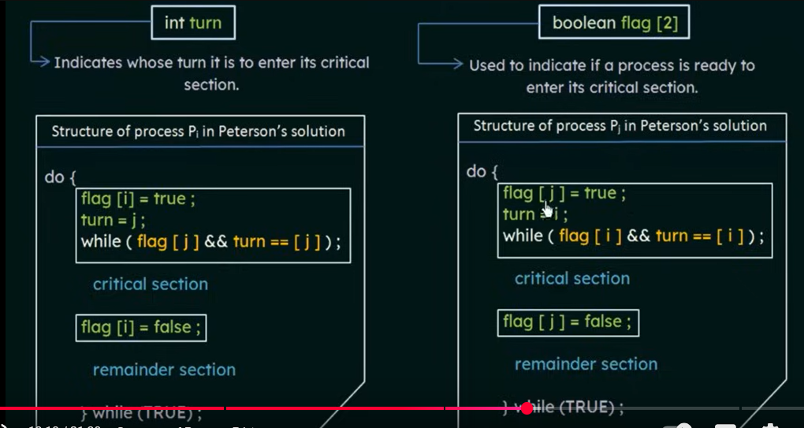
Notes:
For the first time the recent/lastly set value by pj should consider that is ---turn=I ; while condition is true then it vl stuck in while.if fails enter in its cs.

Slide 17
Process={0,1}
Flag ={ f,f}
Turn=0
Process 0 Process 1
Flag[0]=T Flag[1]=T
Turn=1 Turn =0
While(flag[1]==t&&turn==1); while(flag[0]=T&&turn==0);
CS CS
Flag[0]= F Flag[1]=F

Slide 18
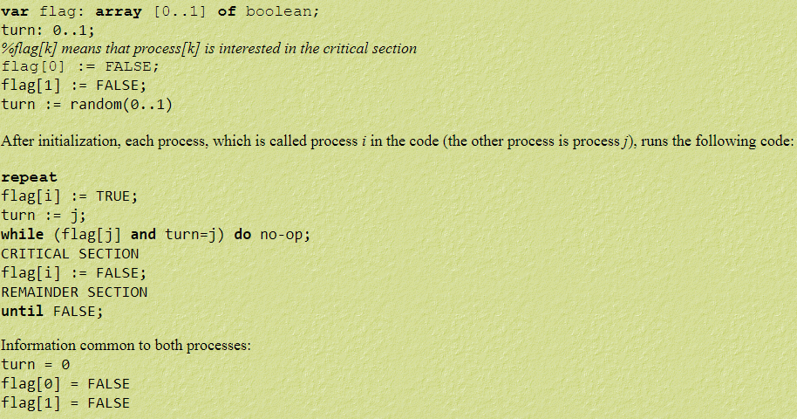

Slide 19
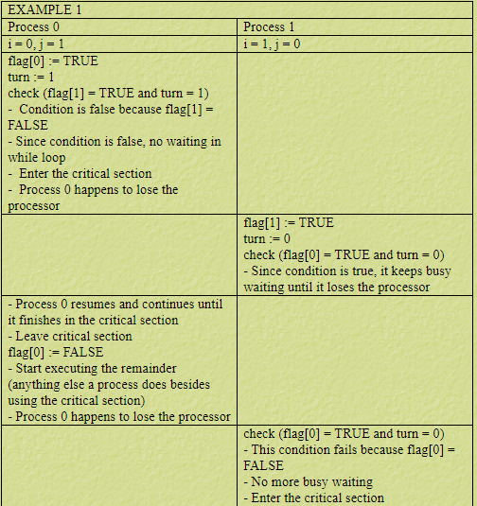

Slide 20
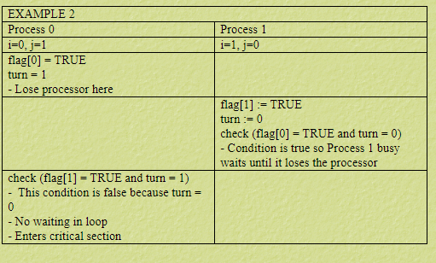

Slide 21
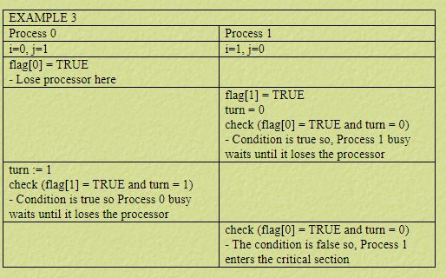

Slide 22
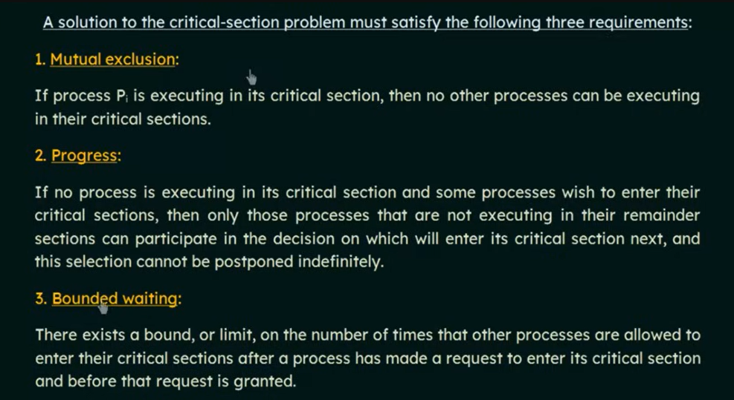

Slide 23

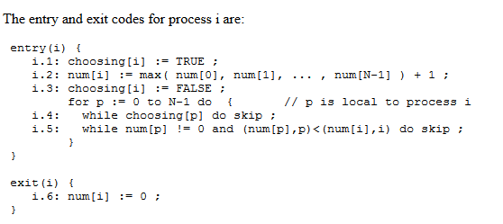
Bakery Algorithm
N process solution

Slide 24
Processes = {P1,P2,P3}
Choosing = { F, F, F}
Num= {0,0,0}
CS
Num[i]=0

Slide 25
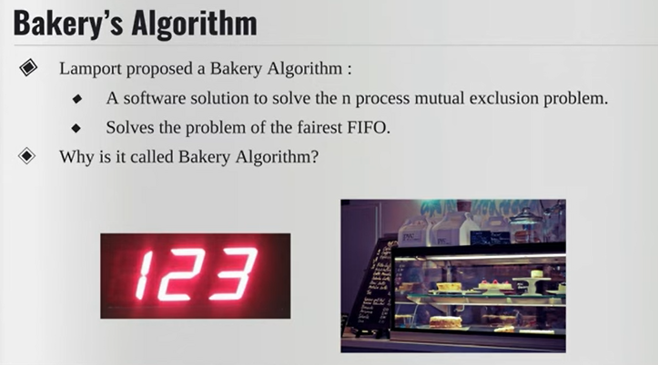

Slide 26
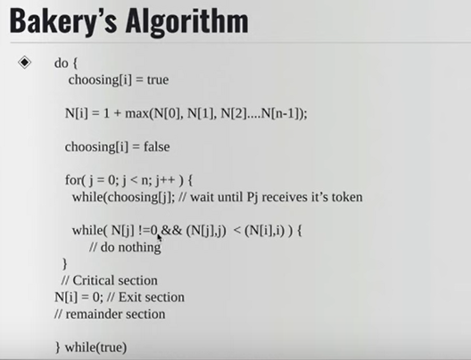

Slide 27
Synchronization Hardware
Many systems provide hardware support for critical section code
Uniprocessors – could disable interrupts
  Currently running code would execute without preemption
  Generally too inefficient on multiprocessor systems
    Operating systems using this not broadly scalable
Modern machines provide special atomic hardware instructions
    Atomic = non-interruptable
  Either test memory word and set value
  Or swap contents of two memory words

Slide 28
TestAndSet Instruction
Definition:
boolean TestAndSet (boolean *target)
{
boolean rv = *target;
*target = TRUE;
return rv:
}

Slide 29
Solution using TestAndSet
Shared boolean variable lock., initialized to false.
Solution:
while (true) {
while ( TestAndSet (&lock ))
; /* do nothing
// critical section
lock = FALSE;
// remainder section
}

Slide 30
boolean waiting[n];
boolean lock;
lock = FALSE; waiting[i] = FALSE;
do
{
waiting[i]=TRUE;
Key=TRUE;
While(waiting[i] && key)
key=TestAndSet(&lock);
Waiting[i]=FALSE;
//CS
j=(i+1)%n;
While((j!=i)&&!waiting[j])
j=(j+1)%n;
If(j==i)
lock=FALSE;
Else
Waiting[j]=FALSE;
//Remainder section
} while(TRUE);

Slide 31
Swap Instruction
Definition:
void Swap (boolean *a, boolean *b)
{
boolean temp = *a;
*a = *b;
*b = temp:
}

Slide 32
Solution using Swap
Shared Boolean variable lock initialized to FALSE; Each process has a local Boolean variable key.
Solution:
while (true) {
key = TRUE;
while ( key == TRUE)
Swap (&lock, &key );
// critical section
lock = FALSE;
// remainder section
}

Slide 33
Semaphore
Synchronization tool that does not require busy waiting
Semaphore S – integer variable
Two standard operations modify S: wait() and signal()
  Originally called P() and V()
Less complicated
Can only be accessed via two indivisible (atomic) operations
  wait (S) {
  while S <= 0
  ; // no-op
  S--;
  }
  signal (S) {
  S++;
  }

Slide 34
Semaphore as General Synchronization Tool
Counting semaphore – integer value can range over an unrestricted domain
Binary semaphore – integer value can range only between 0
and 1; can be simpler to implement
  Also known as mutex locks
Can implement a counting semaphore S as a binary semaphore
Provides mutual exclusion
  Semaphore S; // initialized to 1
  wait (S);
  Critical Section
  signal (S);

Slide 35
Semaphore Implementation
Must guarantee that no two processes can execute wait () and signal () on the same semaphore at the same time
Thus, implementation becomes the critical section problem where the wait and signal code are placed in the crtical section.
  Could now have busy waiting in critical section implementation
    But implementation code is short
    Little busy waiting if critical section rarely occupied
Note that applications may spend lots of time in critical sections and therefore this is not a good solution.

Slide 36
Semaphore Implementation with no Busy waiting (spin lock)
With each semaphore there is an associated waiting queue. Each entry in a waiting queue has two data items:
  value (of type integer)
  pointer to next record in the list
Two operations:
  block – place the process invoking the operation on the appropriate waiting queue.
  wakeup – remove one of processes in the waiting queue and place it in the ready queue.

Slide 37
Semaphore Implementation
typedef struct
{
int value;
struct process * list;
}semaphore;

Slide 38
Semaphore Implementation with no Busy waiting (Cont.)
Implementation of wait:
wait (semaphore *S){
S->value--;
if (S->value < 0) {
add this process to S->list
block(); }
}
Implementation of signal:
Signal (semaphore *S){
S-> value++;
if (S->value > 0) {
remove a process P from the waiting queue
wakeup(P); }
}

Slide 39
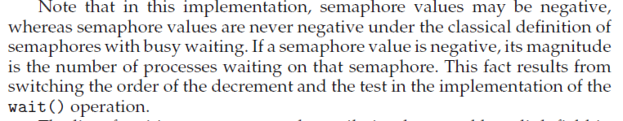

Slide 40
Deadlock and Starvation
Deadlock – two or more processes are waiting indefinitely for an event that can be caused by only one of the waiting processes
Let S and Q be two semaphores initialized to 1
P₀ P₁
wait (S); wait (Q);
wait (Q); wait (S);
. .
. .
. .
signal (S); signal (Q);
signal (Q); signal (S);
Starvation – indefinite blocking. A process may never be removed from the semaphore queue in which it is suspended.

Slide 41
Classical Problems of Synchronization
Bounded-Buffer Problem
Readers and Writers Problem
Dining-Philosophers Problem

Slide 42
Bounded-Buffer Problem
N buffers, each can hold one item
Semaphore mutex initialized to the value 1
Semaphore full initialized to the value 0
Semaphore empty initialized to the value N.

Slide 43
Bounded Buffer Problem (Cont.)
The structure of the producer process
Mutex=1, full=0,empty=N
while (true) {
// produce an item
wait (empty);
wait (mutex);
// add the item to the buffer
signal (mutex);
signal (full);
}

Slide 44
Bounded Buffer Problem (Cont.)
The structure of the consumer process
while (true) {
wait (full);
wait (mutex);
// remove an item from buffer
signal (mutex);
signal (empty);
// consume the removed item
}

Slide 45
Readers-Writers Problem
A data set is shared among a number of concurrent processes
  Readers – only read the data set; they do not perform any updates
  Writers – can both read and write.
Problem – allow multiple readers to read at the same time. Only one single writer can access the shared data at the same time.
Shared Data
  Data set
  Semaphore mutex initialized to 1.
  Semaphore wrt initialized to 1.
  Integer readcount initialized to 0.

Slide 46
Readers-Writers Problem (Cont.)
The structure of a writer process
while (true) {
wait (wrt) ;
// writing is performed
signal (wrt) ;
}

Slide 47
Readers-Writers Problem (Cont.)
The structure of a reader process
while (true) {
wait (mutex) ;
readcount ++ ;
if (readercount == 1) wait (wrt) ;
signal (mutex)
// reading is performed
wait (mutex) ;
readcount - - ;
if (redacount == 0) signal (wrt) ;
signal (mutex) ;
}

Slide 48
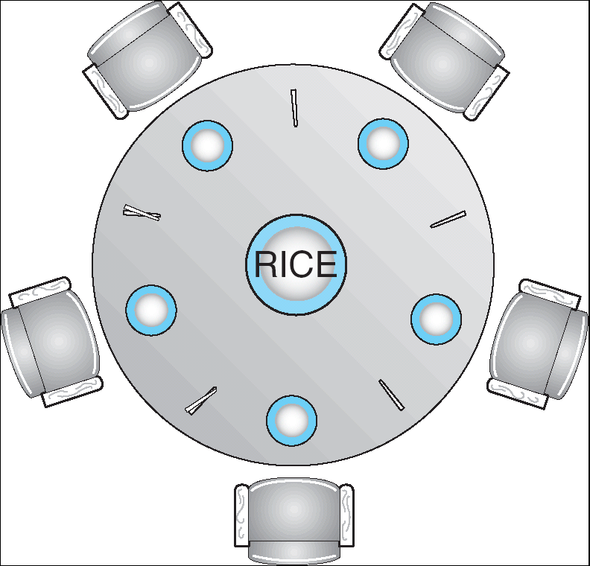
Dining-Philosophers Problem
Shared data
  Bowl of rice (data set)
  Semaphore chopstick [5] initialized to 1

Slide 49
Philo i
Wait(chopstick[0]); //0
Wait(chopstick[1]); //0
Eat
Signal(chopstick[0]);
Signal(chopstick[1]);

Slide 50
Dining-Philosophers Problem (Cont.)
The structure of Philosopher i:
    While (true) {
    wait ( chopstick[i] );
    wait ( chopStick[ (i + 1) % 5] );
    // eat
    signal ( chopstick[i] );
    signal (chopstick[ (i + 1) % 5] );
    // think
    }

Slide 51
Problems with Semaphores
Correct use of semaphore operations:
  signal (mutex) …. wait (mutex)
  wait (mutex) … wait (mutex)
  Omitting of wait (mutex) or signal (mutex) (or both)

Slide 52
Monitors
A high-level abstraction that provides a convenient and effective mechanism for process synchronization
Only one process may be active within the monitor at a time
    monitor monitor-name
    {
    // shared variable declarations
    procedure P1 (…) { …. }
    …
    procedure Pn (…) {……}
    Initialization code ( ….) { … }
    …
    }
    }

Slide 53

Schematic view of a Monitor

Slide 54
Condition Variables
condition x, y;
Two operations on a condition variable:
  x.wait () – a process that invokes the operation is
  suspended.
  x.signal () – resumes one of processes (if any) that
  invoked x.wait ()
  Two possibilities for signal
  1. Signal and wait: P either waits until Q leaves the monitoror waits for another condition
  2. Signal and continue: Q either waits until P leaves the monitor or waits for another condition.

Slide 55

Monitor with Condition Variables

Slide 56
Producer - Consumer
monitor PC
{
int slots=0;
condition full, empty;
Void producer()
{
while(slots==N) empty.wait();
slots++;
full.signal();
}
Void consumer()
{
While(slots==0) full.wait();
slots--;
empty.signal();
}

Slide 57
Solution to Dining Philosophers
monitor DP
{
enum { THINKING; HUNGRY, EATING) state [5] ;
condition self [5];
void pickup (int i) {
state[i] = HUNGRY;
test(i);
if (state[i] != EATING) self [i].wait();
}
void putdown (int i) {
state[i] = THINKING;
// test left and right neighbors
test((i + 4) % 5);
test((i + 1) % 5);
}

Slide 58
Solution to Dining Philosophers (cont)
void test (int i) {
if ( (state[(i + 4) % 5] != EATING) &&
(state[i] == HUNGRY) &&
(state[(i + 1) % 5] != EATING) ) {
state[i] = EATING ;
self[i].signal () ;
}
}
initialization_code() {
for (int i = 0; i < 5; i++)
state[i] = THINKING;
}
}

Slide 59
Solution to Dining Philosophers (cont)
Each philosopher I invokes the operations pickup()
and putdown() in the following sequence:
dp.pickup (i)
EAT
dp.putdown (i)

