Slide 1
Synchronization Tools

Slide 2
Outline
Background
The Critical-Section Problem
Peterson’s Solution
Hardware Support for Synchronization
Mutex Locks
Semaphores
Monitors
Liveness
Evaluation

Slide 3
Objectives
Describe the critical-section problem and illustrate a race condition
Illustrate hardware solutions to the critical-section problem using memory barriers, compare-and-swap operations, and atomic variables
Demonstrate how mutex locks, semaphores, monitors, and condition variables can be used to solve the critical section problem
Evaluate tools that solve the critical-section problem in low-, Moderate-, and high-contention scenarios

Slide 4
Background
Processes can execute concurrently
  May be interrupted at any time, partially completing execution
Concurrent access to shared data may result in data inconsistency
Maintaining data consistency requires mechanisms to ensure the orderly execution of cooperating processes
We illustrated in problem when we considered the Bounded Buffer problem with use of a counter that is updated concurrently by the producer and consumer,. Which lead to race condition.

Slide 5
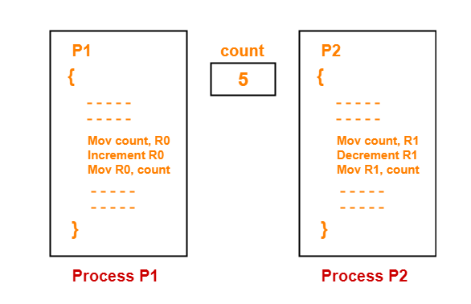
Race Condition

Slide 6
Critical Section Problem
Consider system of n processes {p₀, p₁, … p_{n-1}}
Each process has critical section segment of code
  Process may be changing common variables, updating table, writing file, etc.
  When one process in critical section, no other may be in its critical section
Critical section problem is to design protocol to solve this
Each process must ask permission to enter critical section in entry section, may follow critical section with exit section, then remainder section

Slide 7
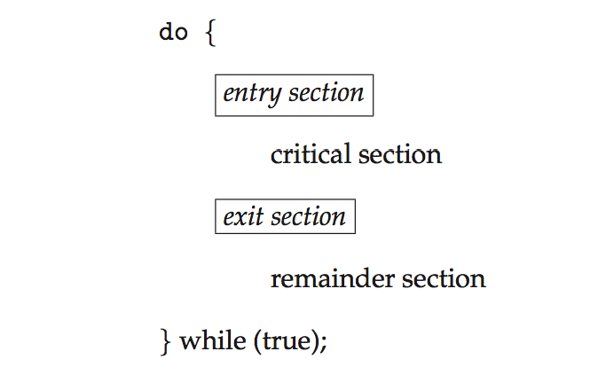
Critical Section
General structure of process P_{i}

Slide 8
Critical-Section Problem (Cont.)
Requirements for solution to critical-section problem
1. Mutual Exclusion - If process P_{i} is executing in its critical section, then no other processes can be executing in their critical sections
2. Progress - If no process is executing in its critical section and there exist some processes that wish to enter their critical section, then the selection of the process that will enter the critical section next cannot be postponed indefinitely
3. Bounded Waiting - A bound must exist on the number of times that other processes are allowed to enter their critical sections after a process has made a request to enter its critical section and before that request is granted
  Assume that each process executes at a nonzero speed
  No assumption concerning relative speed of the n processes

Slide 9
Interrupt-based Solution
Entry section: disable interrupts
Exit section: enable interrupts
Will this solve the problem?
  What if the critical section is code that runs for an hour?
  Can some processes starve – never enter their critical section.
  What if there are two CPUs?

Slide 10
Software Solution 1
Two process solution
Assume that the load and store machine-language instructions are atomic; that is, cannot be interrupted
The two processes share one variable:
  int turn;
The variable turn indicates whose turn it is to enter the critical section

Slide 11
Algorithm for Process P_{i}
while (true){
turn = i;
while (turn = = j);
;
/* critical section */
turn = j;
/* remainder section */
}

Slide 12
Correctness of the Software Solution
Mutual exclusion is preserved
P_{i} enters critical section only if:
turn = I
and turn cannot be both 0 and 1 at the same time
What about the Progress requirement?
FOObar
What about the Bounded-waiting requirement?

Slide 13
Peterson’s Solution
Software Solution
Two process solution
Assume that the load and store machine-language instructions are atomic; that is, cannot be interrupted
The two processes share two variables:
  int turn;
  boolean flag[2]
The variable turn indicates whose turn it is to enter the critical section
The flag array is used to indicate if a process is ready to enter the critical section.
  flag[i] = true implies that process P_{i} is ready!

Slide 14
Algorithm for Process P_{i}
while (true){
flag[i] = true;
turn = j;
while (flag[j] && turn = = j)
;
/* critical section */
flag[i] = false;
/* remainder section */
}

Slide 15
Correctness of Peterson’s Solution
Provable that the three CS requirement are met:
1. Mutual exclusion is preserved
P_{i} enters CS only if:
either flag[j] = false or turn = i
2. Progress requirement is satisfied
3. Bounded-waiting requirement is met

Slide 16
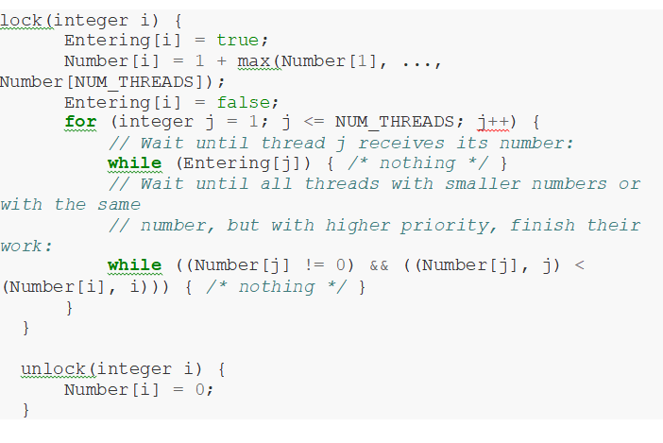
Bakery Algorithm

Slide 17
Synchronization Hardware
Many systems provide hardware support for implementing the critical section code.
Uniprocessors – could disable interrupts
  Currently running code would execute without preemption
  Generally too inefficient on multiprocessor systems
    Operating systems using this not broadly scalable
We will look at three forms of hardware support:
1. Hardware instructions
2. Atomic variables

Slide 18
Hardware Instructions
Special hardware instructions that allow us to either test-and-modify the content of a word, or two swap the contents of two words atomically (uninterruptedly.)
  Test-and-Set instruction
  Compare-and-Swap instruction

Slide 19
The test_and_set Instruction
Definition
boolean test_and_set (boolean *target)
{
boolean rv = *target;
*target = true;
return rv:
}
Properties
  Executed atomically
  Returns the original value of passed parameter
  Set the new value of passed parameter to true

Slide 20
Solution Using test_and_set()
Shared boolean variable lock, initialized to false
Solution:
do {
while (test_and_set(&lock))
; /* do nothing */
/* critical section */
lock = false;
/* remainder section */
} while (true);
Does it solve the critical-section problem?

Slide 21
Swap Instruction
Definition
void swap( boolean *a, boolean *b)
{
boolean temp = *a ;
*a = *b;
*b = temp;
)
.

Slide 22
Solution using swap
Shared integer lock initialized to false;
Solution:
do {
key = true;
while (key == true)
{
swap (&lock, &key);
)
/* critical section */
lock = false;
/* remainder section */
} while (true)

Slide 23
Mutex Locks
Previous solutions are complicated and generally inaccessible to application programmers
OS designers build software tools to solve critical section problem
Simplest is mutex lock
  Boolean variable indicating if lock is available or not
Protect a critical section by
  First acquire() a lock
  Then release() the lock
Calls to acquire() and release() must be atomic
  Usually implemented via hardware atomic instructions such as compare-and-swap.
But this solution requires busy waiting
  This lock therefore called a spinlock

Slide 24
Solution to CS Problem Using Mutex Locks
while (true) {
acquire lock
critical section
release lock
remainder section
}

Slide 25
Semaphore
Synchronization tool that provides more sophisticated ways (than Mutex locks) for processes to synchronize their activities.
Semaphore S – integer variable
Can only be accessed via two indivisible (atomic) operations
  wait() and signal()
    Originally called P() and V()
Definition of the wait() operation
  wait(S) {
  while (S <= 0)
  ; // busy wait
  S--;
  }
Definition of the signal() operation
  signal(S) {
  S++;
  }

Slide 26
Semaphore (Cont.)
Counting semaphore – integer value can range over an unrestricted domain
Binary semaphore – integer value can range only between 0 and 1
  Same as a mutex lock
Can implement a counting semaphore S as a binary semaphore
With semaphores we can solve various synchronization problems

Slide 27
Semaphore Usage Example
Solution to the CS Problem
  Create a semaphore “mutex” initialized to 1
    wait(mutex);
    CS
    signal(mutex);
Consider P₁ and P₂ that with two statements S₁ and S₂ and the requirement that S₁ to happen before S₂
  Create a semaphore “synch” initialized to 0
    P1:
    S₁;
    signal(synch);
    P2:
    wait(synch);
    S₂;

Slide 28
Semaphore Implementation
Must guarantee that no two processes can execute the wait() and signal() on the same semaphore at the same time
Thus, the implementation becomes the critical section problem where the wait and signal code are placed in the critical section
Could now have busy waiting in critical section implementation
  But implementation code is short
  Little busy waiting if critical section rarely occupied
Note that applications may spend lots of time in critical sections and therefore this is not a good solution

Slide 29
Semaphore Implementation with no Busy waiting
With each semaphore there is an associated waiting queue
Each entry in a waiting queue has two data items:
  Value (of type integer)
  Pointer to next record in the list
Two operations:
  block – place the process invoking the operation on the appropriate waiting queue
  wakeup – remove one of processes in the waiting queue and place it in the ready queue

Slide 30
Implementation with no Busy waiting (Cont.)
Waiting queue
typedef struct {
int value;
struct process *list;
} semaphore;

Slide 31
Implementation with no Busy waiting (Cont.)
wait(semaphore *S) {
S->value--;
if (S->value < 0) {
add this process to S->list;
block();
}
}
signal(semaphore *S) {
S->value++;
if (S->value <= 0) {
remove a process P from S->list;
wakeup(P);
}
}

Slide 32
Problems with Semaphores
Incorrect use of semaphore operations:
  signal(mutex) …. wait(mutex)
  wait(mutex) … wait(mutex)
  Omitting of wait (mutex) and/or signal (mutex)
These – and others – are examples of what can occur when semaphores and other synchronization tools are used incorrectly.

Slide 33
Monitors
A high-level abstraction that provides a convenient and effective mechanism for process synchronization
Abstract data type, internal variables only accessible by code within the procedure
Only one process may be active within the monitor at a time
Pseudocode syntax of a monitor:
    monitor monitor-name
    {
    // shared variable declarations
    function P1 (…) { …. }
    function P2 (…) { …. }
    function Pn (…) {……}
    initialization code (…) { … }
    }

Slide 34
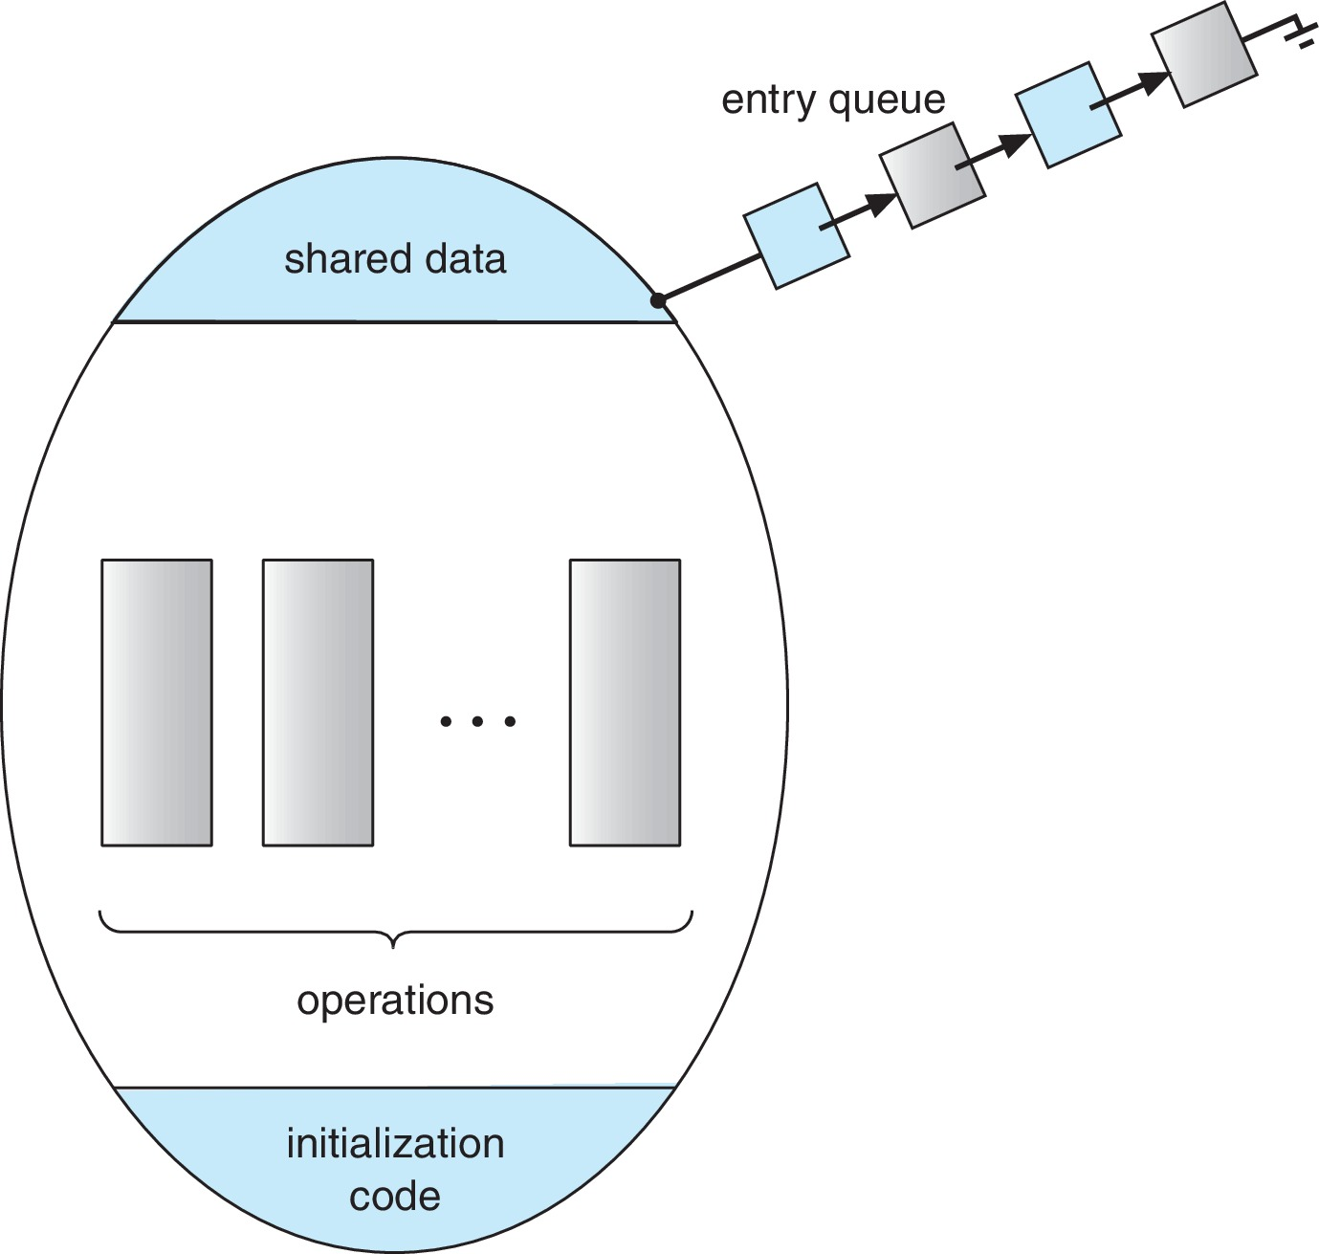
Schematic view of a Monitor

Slide 35
Condition Variables
condition x, y;
Two operations are allowed on a condition variable:
  x.wait() – a process that invokes the operation is suspended until x.signal()
  x.signal() – resumes one of processes (if any) that invoked x.wait()
    If no x.wait() on the variable, then it has no effect on the variable

Slide 36
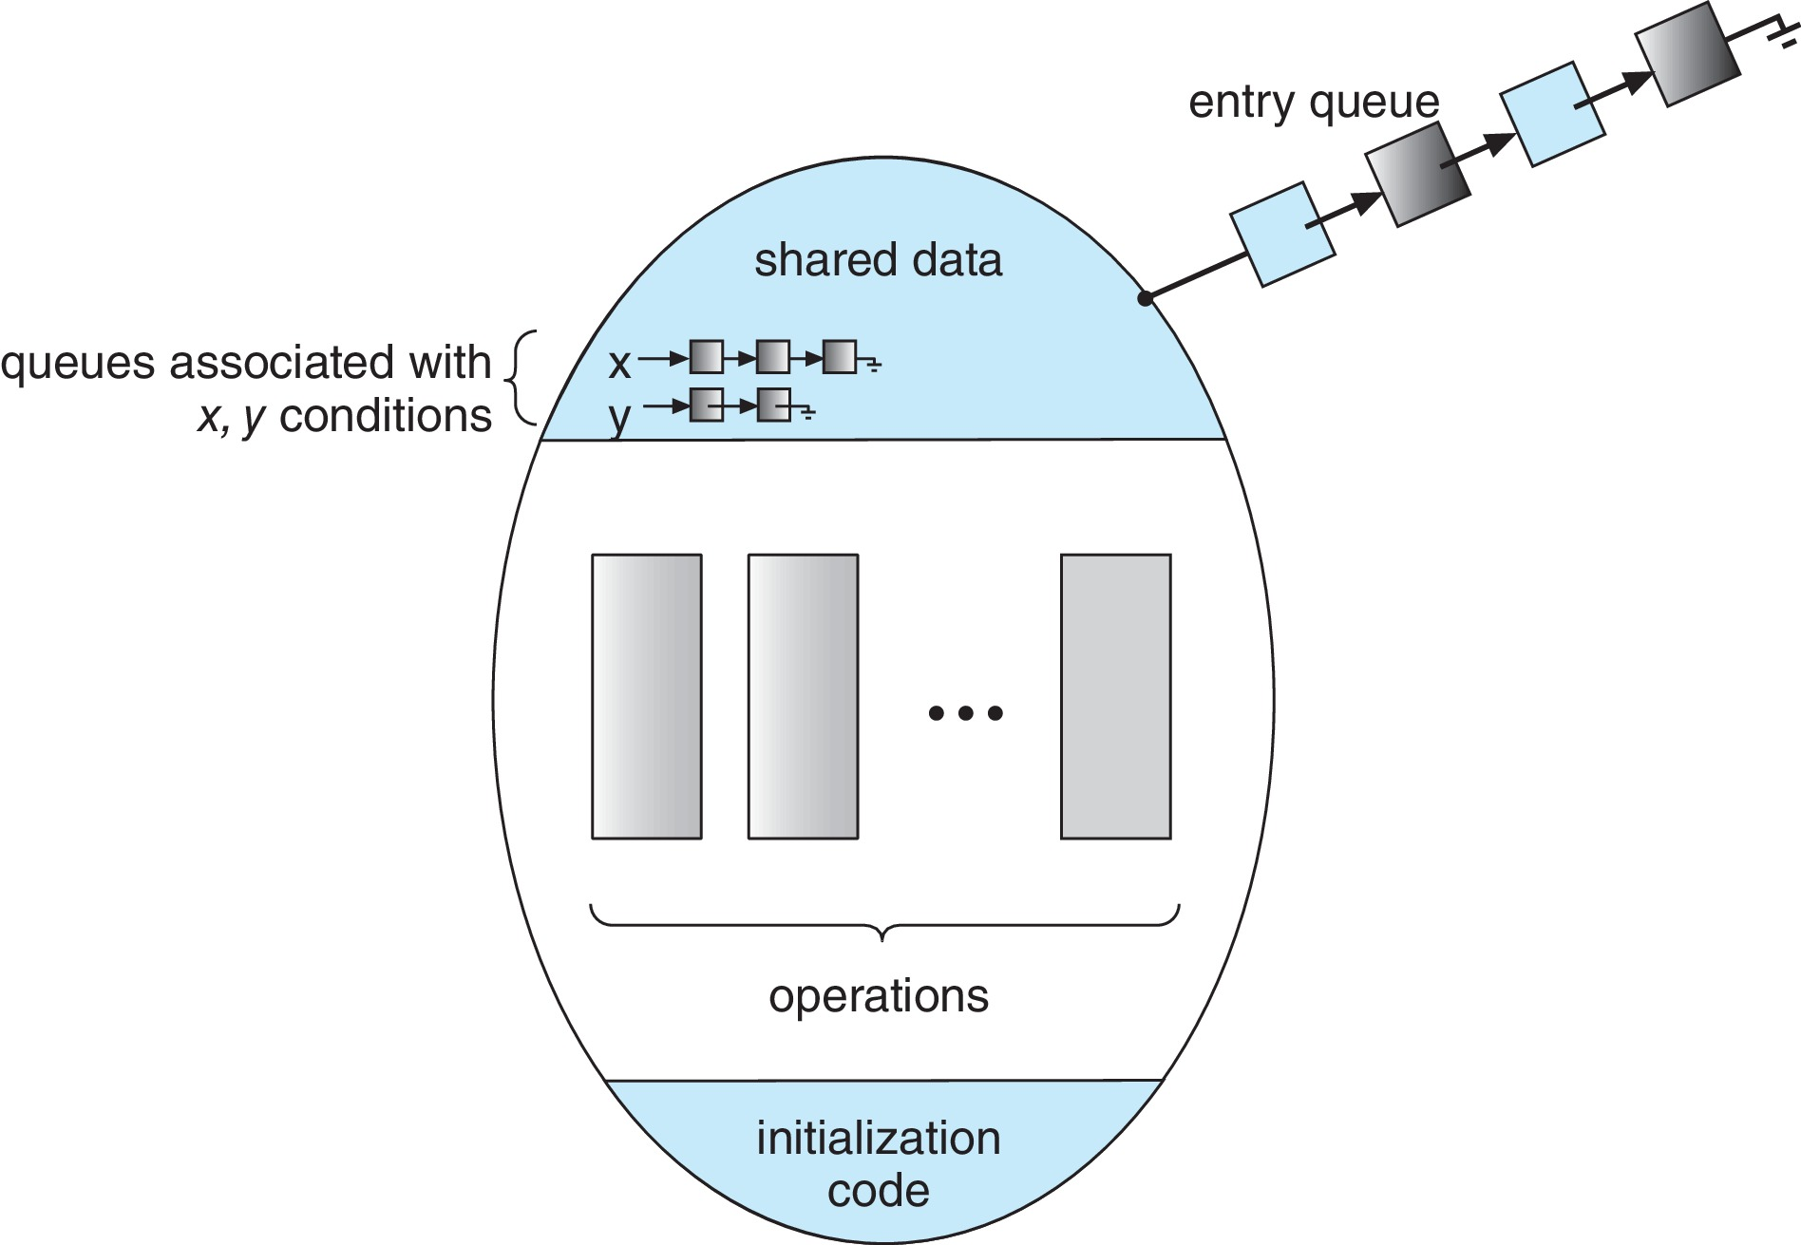
Monitor with Condition Variables

Slide 37
Condition Variables Choices
If process P invokes x.signal(), and process Q is suspended in x.wait(), what should happen next?
  Both Q and P cannot execute in parallel. If Q is resumed, then P must wait
Options include
  Signal and wait – P waits until Q either leaves the monitor or it waits for another condition
  Signal and continue – Q waits until P either leaves the monitor or it waits for another condition
  Both have pros and cons – language implementer can decide
  Monitors implemented in Concurrent Pascal compromise
    P executing signal immediately leaves the monitor, Q is resumed
  Implemented in other languages including Mesa, C#, Java

Slide 38
Monitor Implementation Using Semaphores
Variables
semaphore mutex; // (initially = 1)
semaphore next; // (initially = 0)
int next_count = 0; // number of processes waiting
inside the monitor
Each function F will be replaced by
wait(mutex);
…
body of F;
…
if (next_count > 0)
signal(next)
else
signal(mutex);
Mutual exclusion within a monitor is ensured

Slide 39
Implementation – Condition Variables
For each condition variable x, we have:
semaphore x_sem; // (initially = 0)
int x_count = 0;
The operation x.wait() can be implemented as:
x_count++;
if (next_count > 0)
signal(next);
else
signal(mutex);
wait(x_sem);
x_count--;

Slide 40
Implementation (Cont.)
The operation x.signal() can be implemented as:
if (x_count > 0) {
next_count++;
signal(x_sem);
wait(next);
next_count--;
}

Slide 41
Resuming Processes within a Monitor
If several processes queued on condition variable x, and x.signal() is executed, which process should be resumed?
FCFS frequently not adequate
conditional-wait construct of the form x.wait(c)
  Where c is priority number
  Process with lowest number (highest priority) is scheduled next

Slide 42
Single Resource allocation
Allocate a single resource among competing processes using priority numbers that specify the maximum time a process plans to use the resource
R.acquire(t);
...
access the resurce;
...
R.release;
Where R is an instance of type ResourceAllocator

Slide 43
A Monitor to Allocate Single Resource
monitor ResourceAllocator
{
boolean busy;
condition x;
void acquire(int time) {
if (busy)
x.wait(time);
busy = true;
}
void release() {
busy = FALSE;
x.signal();
}
initialization code() {
busy = false;
}
}

Slide 44
Single Resource Monitor (Cont.)
Usage:
acquire
...
release
Incorrect use of monitor operations
  release() … acquire()
  acquire() … acquire())
  Omitting of acquire() and/or release()

Slide 45
Liveness
Processes may have to wait indefinitely while trying to acquire a synchronization tool such as a mutex lock or semaphore.
Waiting indefinitely violates the progress and bounded-waiting criteria discussed at the beginning of this chapter.
Liveness refers to a set of properties that a system must satisfy to ensure processes make progress.
Indefinite waiting is an example of a liveness failure.

Slide 46
Liveness
Deadlock – two or more processes are waiting indefinitely for an event that can be caused by only one of the waiting processes
Let S and Q be two semaphores initialized to 1
P₀ P₁
wait(S); wait(Q);
wait(Q); wait(S);
... ...
signal(S); signal(Q);
signal(Q); signal(S);
Consider if P₀ executes wait(S) and P₁ wait(Q). When P₀ executes wait(Q), it must wait until P₁ executes signal(Q)
However, P₁ is waiting until P₀ execute signal(S).
Since these signal() operations will never be executed, P₀ and P₁ are deadlocked.

Slide 47
Liveness
Other forms of deadlock:
Starvation – indefinite blocking
  A process may never be removed from the semaphore queue in which it is suspended
Priority Inversion – Scheduling problem when lower-priority process holds a lock needed by higher-priority process
Solved via priority-inheritance protocol

Slide 48
End of Chapter 6

Slide 49
Priority Inheritance Protocol
Consider the scenario with three processes P1, P2, and P3. P1 has the highest priority, P2 the next highest, and P3 the lowest.
Assume a resource P3 is assigned a resource R that P1 wants.
  Thus, P1 must wait for P3 to finish using the resource. However, P2 becomes runnable and preempts P3.
  What has happened is that P2 - a process with a lower priority than P1 - has indirectly prevented P3 from gaining access to the resource.
To prevent this from occurring, a priority inheritance protocol is used. This simply allows the priority of the highest thread waiting to access a shared resource to be assigned to the thread currently using the resource. Thus, the current owner of the resource is assigned the priority of the highest priority thread wishing to acquire the resource.

Slide 50
Priority Inheritance Protocol
Consider the scenario with three processes P1, P2, and P3. P1 has the highest priority, P2 the next highest, and P3 the lowest.
Assume a resource P3 is assigned a resource R that P1 wants. Thus, P1 must wait for P3 to finish using the resource. However, P2 becomes runnable and preempts P3. What has happened is that P2 - a process with a lower priority than P1 - has indirectly prevented P3 from gaining access to the resource.
To prevent this from occurring, a priority inheritance protocol is used. This simply allows the priority of the highest thread waiting to access a shared resource to be assigned to the thread currently using the resource. Thus, the current owner of the resource is assigned the priority of the highest priority thread wishing to acquire the resource.

