Slide 1
BCSE303L: Operating Systems
Module 4:
Process Synchronization

Slide 2
Module 3: Process Synchronization
Background
The Critical-Section Problem
Peterson’s Solution
Synchronization Hardware
Semaphores
Classic Problems of Synchronization
Monitors
Synchronization Examples
Atomic Transactions

Slide 3
Objectives
To introduce the critical-section problem, whose solutions can be used to ensure the consistency of shared data
To present both software and hardware solutions of the critical-section problem
To introduce the concept of an atomic transaction and describe mechanisms to ensure atomicity

Slide 4
Inter process Communication

Slide 5
Interprocess Communication
Processes within a system may be independent or cooperating
Cooperating process can affect or be affected by other processes, including sharing data.
Any process that shares data with other processes is a cooperating process.
Reasons for cooperating processes:
  Information sharing
  Computation speedup
  Modularity
  Convenience
Cooperating processes need interprocess communication (IPC)
Two models of IPC
  Shared memory
  Message passing

Slide 6
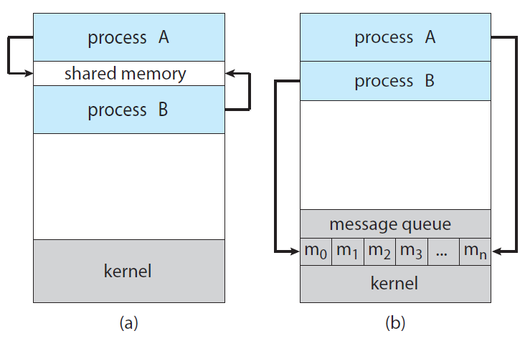
Communications Models
Communications models. (a) Shared memory. (b) Message passing

Slide 7
Difference
Shared Memory | Message Passing
Faster | Slower
No kernel assistance is required | Kernel assistance is required
More data can be kept in shared region | Exchanging smaller amounts of data
System Calls are required only to establish shared memory regions | Implemented using System Calls
Requires Synchronization | No synchronization
Shared caches, Client – server communication | Can be used in distributed systems
Processes share a common memory region | Processes don’t share address space

Slide 8
Cooperating Processes
Independent process cannot affect or be affected by the execution of another process
Cooperating process can affect or be affected by the execution of another process
Advantages of process cooperation
  Information sharing
  Computation speed-up
  Modularity
  Convenience

Slide 9
Producer-Consumer Problem
Paradigm for cooperating processes
Producer process produces information that is consumed by a consumer process
producer–consumer problem uses shared memory. To allow producer and consumer processes to run concurrently, we must have available a buffer of items that can be filled by the producer and emptied by the consumer.
Two types of buffers can be used
  unbounded-buffer places no practical limit on the size of the buffer
  bounded-buffer assumes that there is a fixed buffer size

Slide 10
Bounded-Buffer – Shared-Memory Solution
Shared data
      #define BUFFER_SIZE 10
      typedef struct {
      . . .
      } item;
      item buffer[BUFFER_SIZE];
      int in = 0;
      int out = 0;
Can only use BUFFER_SIZE-1 elements
The variable in points to the next free position in the buffer; out
points to the first full position in the buffer.

Slide 11
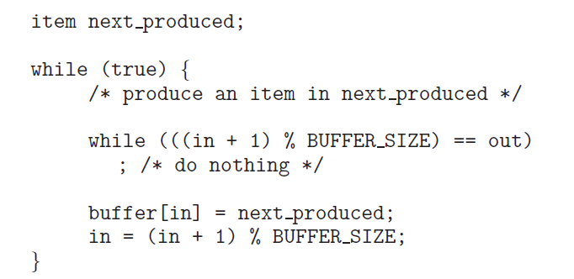
Bounded-Buffer – Producer
The buffer is empty when in == out;
the buffer is full when ((in + 1) % BUFFER SIZE) == out

Slide 12
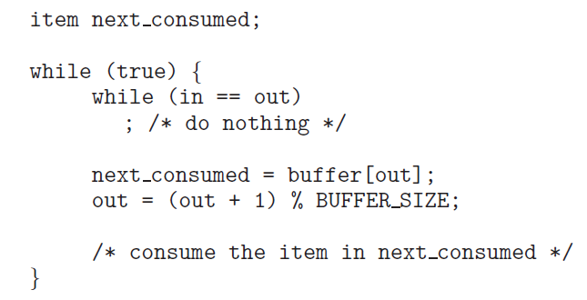
Bounded Buffer – Consumer

Slide 13
Interprocess Communication –
Message Passing
Mechanism for processes to communicate and to synchronize their actions
Message system – processes communicate with each other without resorting to shared variables
IPC facility provides two operations:
  send(message) – message size fixed or variable
  receive(message)
If P and Q wish to communicate, they need to:
  establish a communication link between them
  exchange messages via send/receive
Implementation of communication link
• Direct or indirect communication (Naming)
• Synchronous or asynchronous communication (Synchronization)
• Automatic or explicit buffering (Buffering)

Slide 14

IPC: Naming
Processes that want to communicate must have a way to refer to each other.
They can use either direct or indirect communication.
Under direct communication, each process that wants to communicate must explicitly name the recipient or sender of the communication.
In this scheme, the send() and receive() primitives are defined as:

Slide 15

Indirect communication, the messages are sent to and received from mailboxes, or ports.
A process can communicate with another process via a number of different mailboxes, but two processes can communicate only if they have a shared mailbox.
The send() and receive() primitives are defined as follows:
A mailbox may be owned either by a process or by the operating system.
When a process that owns a mailbox terminates, the mailbox disappears.
A mailbox that is owned by the operating system has an existence of its own. The operating system then must provide a mechanism that allows a process to do the following:
• Create a new mailbox.
• Send and receive messages through the mailbox.
• Delete a mailbox.

Slide 16
IPC: Synchronization
Message passing may be either blocking (Synchronous) or non-blocking (Asynchronous)
Blocking is considered synchronous
  Blocking send has the sender block until the message is received
  Blocking receive has the receiver block until a message is available
Non-blocking is considered asynchronous
  Non-blocking send has the sender send the message and continue
  Non-blocking receive has the receiver receive a valid message or null

Slide 17
IPC: Buffering
Queue of messages attached to the link; implemented in one of three ways
  Zero capacity – 0 messages
  Sender must wait for receiver
  Bounded capacity – finite length of n messages
  Sender must wait if link full
  3. Unbounded capacity – infinite length
  Sender never waits

Slide 18
RACE CONDITION

Slide 19
Race condition: The situation where several processes access – and manipulate shared data concurrently. The final value of the shared data depends upon which process finishes last.
To prevent race conditions, concurrent processes must be synchronized.
Example:
Consider the bounded buffer problem , where an integer variable counter, initialized to 0 is added . counter is incremented every time we add a new item to the buffer and is decremented every time we remove one item from the buffer

Slide 20
Concurrent Execution - Race Condition
Concurrent execution has to give the same results as serial execution. Concurrent execution with shared data leads us to speak about synchronization.
To get data consistency we should have mechanism to avoid data inconsistency problem.
Synchronization as embedded system topic we have to speak about producer consumer problem.
Maintaining data consistency requires mechanisms to ensure the orderly execution of cooperating processes.
Suppose that we wanted to provide a solution to the consumer-producer problem that fills all the buffers. We can do so by having an integer count that keeps track of the number of full buffers. Initially, count is set to 0.
It is incremented by the producer after it produces a new buffer and is decremented by the consumer after it consumes a buffer.

Slide 21
Producer Consumer Problem – Creates RACE condition
The producer-consumer problem illustrates the need for synchronization in systems where many processes share a resource.
In the problem, two processes share a fixed-size buffer. One process produces information and puts it in the buffer, while the other process consumes information from the buffer.
These processes do not take turns accessing the buffer, they both work concurrently.
It is also called bounded buffer problem

Slide 22
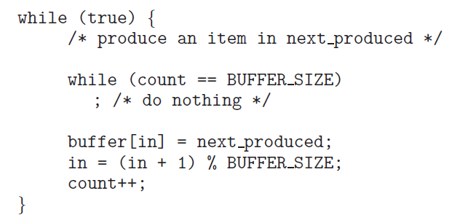
Producer
0
1
2

Slide 23
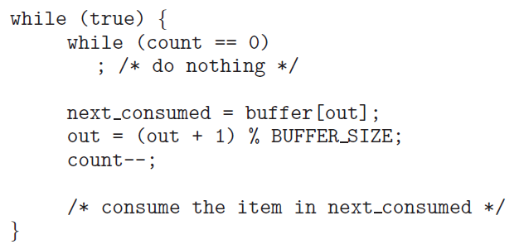
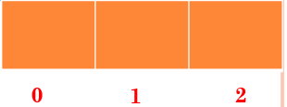
Consumer

Slide 24


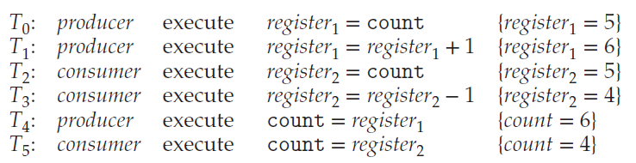
Race Condition
counter++ could be implemented as
counter-- could be implemented as
Consider this execution interleaving with “count = 5” initially:

Slide 25
Now we have arrived at the incorrect state "counter == 4", indicating that four buffers are full, If we reversed the order of the statements at T4 and T5, we would arrive at the incorrect state "counter = 6".
We would arrive at this incorrect state because we allowed both processes to manipulate the variable counter concurrently.
A situation like this, where several processes access and manipulate the same data concurrently and the outcome of the execution depends on the particular order in which the access takes place, is called a race condition.
To avoid the race condition, we need to ensure that only one process at a time can be manipulating the variable counter. To make such a guarantee, we require that the processes be synchronized in some way.

Slide 26
CRITICAL-SECTION PROBLEM

Slide 27
Critical Section Problem
Consider system of n processes {p₀, p₁, … p_{n-1}}
Each process has critical section segment of code
  Process may be changing common variables, updating table, writing file, etc
  When one process in critical section, no other may be in its critical section
Critical section problem is to design protocol to solve this
Each process must ask permission to enter critical section in entry section, may follow critical section with exit section, then remainder section
Especially challenging with preemptive kernels

Slide 28
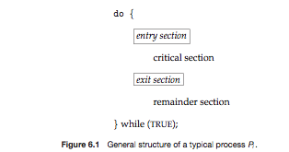
Critical Section
General structure of process p_{i} is

Slide 29
Requirements to be satisfied for a Solution to the Critical-Section Problem:
1. Mutual Exclusion - If process P_{i} is executing in its critical section, then no other processes can be executing in their critical sections
2. Progress - If no process is executing in its critical section and there exist some processes that wish to enter their critical section, then the selection of the processes that will enter the critical section next cannot be postponed indefinitely
3. Bounded Waiting - After a process has made a request to enter it’s CS, there is a bound on the number of times that the other processes are allowed to enter their CS
  otherwise the process will suffer from starvation
  Of course also no deadlock (no cycles)

Slide 30
Solutions to Critical Section Problem
Software Solution
  Peterson Solution – Two process only
  Bakery Algorithm – N processes
Hardware Solution
  Test and Set Instructions
  Compare and Swap Instruction
High Level Abstraction
  Mutex Lock
  Semaphores

Slide 31
Peterson’s solutions
A classic software-based solution to the critical-section problem known as Peterson’s solution.
Peterson’s solution is restricted to two processes that alternate execution between their critical sections and remainder sections.
The processes are numbered P0 and P1 .
Peterson’s solution requires the two processes to share two data items:

Slide 32
The variable turn indicates whose turn it is to enter its critical section.
That is, if turn == i, then process Pi is allowed to execute in its critical section.
The flag array is used to indicate if a process is ready to enter its critical section.
For example, if flag[i] is true, Pi is ready to enter its critical section.

Slide 33
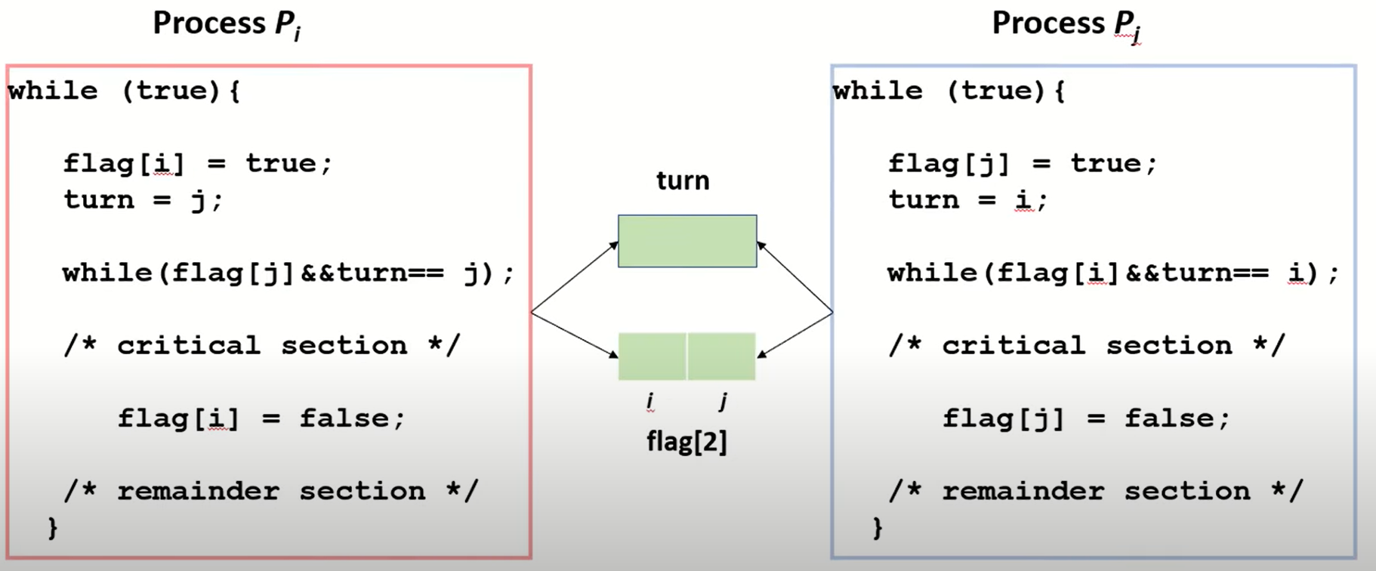

Slide 34
We now prove that this solution is correct. We need to show that:
1. Mutual exclusion is preserved.
2. The progress requirement is satisfied.
3. The bounded-waiting requirement is met.
To prove property 1, we note that each Pi enters its critical section only if either flag[j] == false or turn == i.
To prove properties 2 and 3, we note that a process Pi can be prevented from entering the critical section only if it is stuck in the while loop with the condition flag[j] == true and turn == j; this loop is the only one possible.
If Pj is not ready to enter the critical section, then flag[j] == false, and Pi can enter its critical section.
If Pj has set flag[j] to true and is also executing in its while statement, then either turn == i or turn == j. If turn == i, then Pi will enter the critical section.
If turn == j, then Pj will enter the critical section. However, once Pj exits its critical section, it will reset flag[j] to false, allowing Pi to enter its critical section.

Slide 35
Scenario
Imagine an online banking system where two processes are running simultaneously:
Process P0: Updates the account balance after a deposit.
Process P1: Updates the account balance after a withdrawal.
Both processes need to access and update the shared variable Balance.
Answer the following questions:
Is there any chances of Race condition?
If so, how Peterson solution helps to overcome the issue?

Slide 36
Bakery Algorithm
The Bakery Algorithm, proposed by Leslie Lamport.
In the Bakery Algorithm, each process is assigned a number (a ticket).
Before entering the critical section, a process receives a ticket number, and the process with the smallest ticket number enters the critical section.
If two processes receive the same ticket number, the process with the lower process ID is given priority.

Slide 37
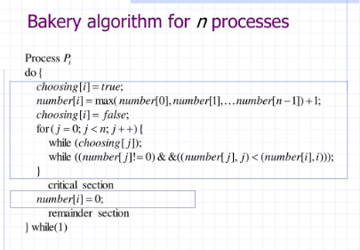
Bakery Algorithm – Software Solution (N Processes)

Slide 38
Hardware Support for Synchronization
Hardware Instructions
test and set()
compare and swap()

Slide 39
Test and Set
Many modern computer systems provide special hardware instructions that allow us either to test and modify the content of a word or to swap the contents of two words atomically— that is, as one uninterruptible unit. This is accomplished by test and set() and compare and swap() instructions.
The important characteristic of test and set() instruction is that it is executed atomically. Thus, if two test and set() instructions are executed simultaneously each on a different core), they will be executed sequentially in some arbitrary order.
If the machine supports the test and set() instruction, then we can implement mutual exclusion by declaring a boolean variable lock, initialized to false.

Slide 40
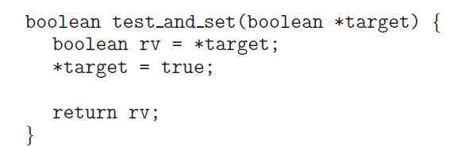
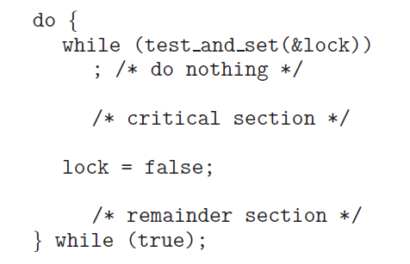
test and set() instruction
Process Pi
Process Pj

Slide 41
compare and swap() instruction (CAS)
The compare and swap() instruction (CAS), just like the test and set() instruction, operates on two words atomically, but uses a different mechanism that is based on swapping the content of two words.
The operand value is set to new value only if the expression (*value == expected) is true. Regardless, CAS always returns the original value of the variable value. The important characteristic of this instruction is that it is executed atomically.

Slide 42
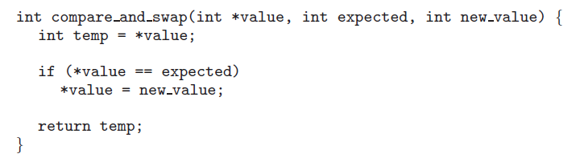
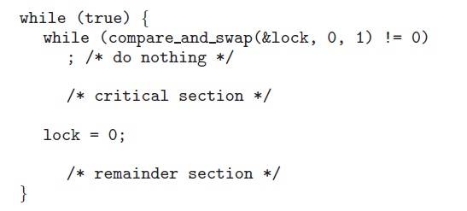
compare and swap() instruction (CAS)

Slide 43
Mutual exclusion using CAS can be provided as follows: A global variable (lock) is declared and is initialized to 0. The first process that invokes compare and swap() will set lock to 1. It will then enter its critical section, because the original value of lock was equal to the expected value of 0.
When a process exits its critical section, it sets lock back to 0, which allows another process to enter its critical section.

Slide 44
Semaphores

Slide 45
Semaphores
It is a synchronization tool that is used to generalize the solution to the critical section problem.
Semaphore S is an integer variable that, apart from initialization,
Is accessed only through two standard atomic operations: wait() and signal().
Semaphores were introduced by the Dutch computer scientist Edsger Dijkstra,
the wait() operation was originally termed P (from the Dutch proberen, “to test”);
signal() was originally called V (from verhogen, “to increment”).
  1. wait or P operation ( to test )
  2. signal or V operation ( to increment )

Slide 46
Types
1. Binary Semaphore
2. Counting Semaphore

Slide 47
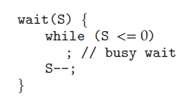

Semaphore Implementation with
Busy waiting
The definition of wait()
do {
wait(S)
Critical Section
signal(s)
Remainder section
} while(1)
The definition of signal()
Disadvantages:
Busy waiting
This is called Spin Lock

Slide 48
Semaphore Implementation
• The semaphore discussed so far requires a busy waiting. That is if a process is in critical-section, the other process that tries to enter its critical-section must loop continuously in the entry code.
• To overcome the busy waiting problem, the definition of the semaphore operations wait and signal should be modified.
• When a process executes the wait operation and finds that the semaphore value is not positive, the process can block itself. The block operation places the process into a waiting queue associated with the semaphore.
• A process that is blocked waiting on a semaphore should be restarted when some other process executes a signal operation. The blocked process should be restarted by a wakeup operation which put that process into ready queue.

Slide 49
Classical Problems of Synchronization
Classical problems used to test newly-proposed synchronization schemes
  Bounded-Buffer Problem
  Readers and Writers Problem
  Dining-Philosophers Problem

Slide 50
Bounded Buffer Problem

Slide 51
Bounded-Buffer Problem
The producer and consumer processes share the following
data structures:
N buffers, each can hold one item
Semaphore mutex initialized to the value 1
Semaphore full initialized to the value 0
Semaphore empty initialized to the value N

Slide 52
The bounded buffer problem, also known as the producer-consumer problem, is a classic synchronization issue in operating systems. It shows how producers and consumers can safely share a fixed-size buffer using semaphores and mutexe.
Producer: Generates data items and puts them into a shared buffer.
Consumer: Takes data items from the buffer and processes them.
Bounded Buffer: The buffer has a fixed capacity.
Constraints:
  Producer must wait if the buffer is full.
  Consumer must wait if the buffer is empty.
  Access to the buffer must be mutually exclusive to avoid race conditions.

Slide 53
empty semaphore tracks available slots in the buffer.
full semaphore tracks filled slots.
mutex ensures only one thread accesses the buffer at a time (ensures the status of the critical section).

Slide 54
Bounded Buffer Problem (Cont.)
The structure of the producer process
do {
// produce an item in nextp
wait (empty);
wait (mutex);
// add the item to the buffer
signal (mutex);
signal (full);
} while (TRUE);
The structure of the consumer process
do {
wait (full);
wait (mutex);
// remove an item from buffer to nextc
signal (mutex);
signal (empty);
// consume the item in nextc
} while (TRUE);
Wait – decrement
Signal - increment
Buffer
Mutex = 1
Empty = n =
Full = 0

Slide 55
Readers/Writers Problem

Slide 56
Readers/Writers Problem
Some of these processes may want only to read the database, whereas others may want to update (that is, read and write) the database
Motivation: Consider a shared database
  Two classes of users:
    Readers – never modify database
    Writers – read and modify database
  Is using a single lock on the whole database sufficient?
    Like to have many readers at the same time
    Only one writer at a time

Slide 57
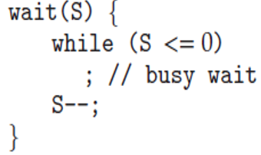
Readers-Writers Problem (Cont.)
The structure of a reader process
do {
wait (mutex) ;
readcount ++ ;
if (readcount == 1)
wait (wrt) ;
signal (mutex)
// reading is performed
wait (mutex) ;
readcount - - ;
if (readcount == 0)
signal (wrt) ;
signal (mutex) ;
} while (TRUE);
The structure of a writer process
do {
wait (wrt) ;
// writing is performed
signal (wrt) ;
} while (TRUE);
wrt = 1
Mutex = 1
readcount = 0

Slide 58
Readers/Writers Problem
A database is to be shared among several concurrent processes. Some of these processes may want only to read the database, whereas others may want to update the database
We distinguish between these two types of processes by referring to the former as readers and to the latter as writers
Obviously, if two readers access the shared data simultaneously, nothing bad will happen
However, if a writer and some other process (either a reader or a writer) access the database simultaneously, chaos may ensue

Slide 59
Readers/Writers Problem
To ensure that these difficulties do not arise, we require that the writers have exclusive access to the shared database
There are several variations of this problem, all involving priorities
  The first and simplest one, referred to as the first readers/writers problem, requires that no reader will be kept waiting unless a writer has already obtained permission to use the shared object (i.e., no reader should wait for other readers to finish simply because a writer is waiting) NOTE: writers may starve
  The second readers/writers problem requires that, once a writer is ready, that writer performs its write as soon as possible (i.e., if a writer is waiting, no new readers may start reading) NOTE: readers may starve

Slide 60
Dining-Philosophers Problem

Slide 61
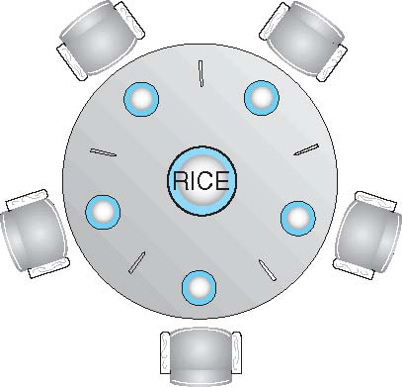
Dining-Philosophers Problem
Consider five philosophers who spend their lives thinking and eating.
The philosophers share a circular table surrounded by five chairs, each belonging to one philosopher.
In the center of the table is a bowl of rice, and the table is laid with five single chopsticks
When a philosopher thinks, she does not interact with her colleagues.
From time to time, a philosopher gets hungry and tries to pick up the two chopsticks that are closest to her (the chopsticks that are between her and her left and right neighbors).
A philosopher may pick up only one chopstick at a time.
Obviously, she cannot pick up a chopstick that is already in the hand of a neighbor.
When a hungry philosopher has both her chopsticks at the same time, she eats without releasing the chopsticks.
When she is finished eating, she puts down both chopsticks and starts thinking again.

Slide 62
Dining-Philosophers Problem
Philosophers spend their lives thinking and eating
Don’t interact with their neighbors, occasionally try to pick up 2 chopsticks (one at a time) to eat from bowl
  Need both to eat, then release both when done
In the case of 5 philosophers
  Shared data
    Bowl of rice (data set)
    Semaphore chopstick [5] initialized to 1

Slide 63
Dining-Philosophers Problem Algorithm
The structure of Philosopher i:
    do {
    wait ( chopstick[i] );
    wait ( chopStick[ (i + 1) % 5] );
    // eat
    signal ( chopstick[i] );
    signal (chopstick[ (i + 1) % 5] );
    // think
    } while (TRUE);
This solution guarantees that no two neighbors can be eating simultaneously (i.e., mutual exclusion)
What is the problem with this algorithm?
  This solution could create a deadlock. How?
chopstick[i] = 1
chopstick[i+1] = 1

Slide 64
Deadlock situation and Solution
Suppose that all five philosophers become hungry at the same time and each grabs her left chopstick. All the elements of chopstick will now be equal to 0.
When each philosopher tries to grab her right chopstick, she will be delayed forever. This creates Deadlock.
Several possible remedies to the deadlock problem are the following:
• Allow at most four philosophers to be sitting simultaneously at the table.
• Allow a philosopher to pick up her chopsticks only if both chopsticks are available (to do this, she must pick them up in a critical section).
• Use an asymmetric solution—that is, an odd-numbered philosopher picks up first her left chopstick and then her right chopstick, whereas an even numbered philosopher picks up her right chopstick and then her left chopstick.

Slide 65
Problems with Semaphores
Incorrect use of semaphore operations:
  signal (mutex) …. wait (mutex)
  wait (mutex) … wait (mutex)
  Omitting of wait (mutex) or signal (mutex) (or both)
Deadlock and starvation

Slide 66
Monitors
A high-level abstraction that provides a convenient and effective mechanism for process synchronization
Goal of OS is to share resources amongst many programs.
Separate schedulers should be created for each class of resource.
Each scheduler contains local data + procedures that programs may use to acquire and release resources. Such a collection of data + procedures is a monitor.
Abstract data type, internal variables only accessible by code within the procedure
Only one process may be active within the monitor at a time If more than one program attempts to enter at the same time, only one will succeed, and the remaining programs will remain on a queue.
But not powerful enough to model some synchronization schemes

Slide 67
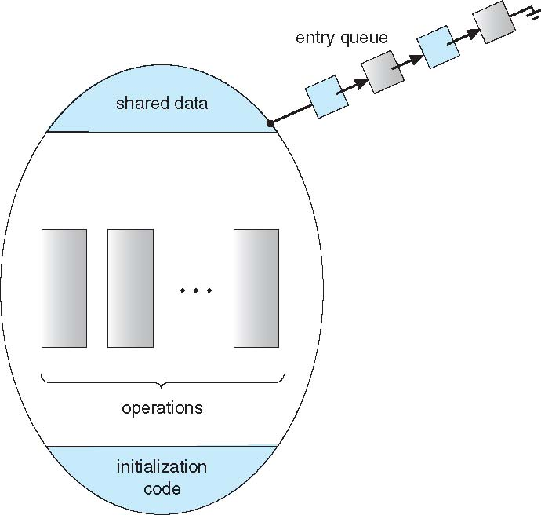
    monitor monitor-name
    {
    // shared variable declarations
    procedure P1 (…) { …. }
    procedure Pn (…) {……}
    Initialization code (…) { … }
    }
    }

Slide 68
Schematic view of a Monitor
The initialization component contains the code that is used exactly once when the monitor is created
The monitor procedures are procedures that can be called from outside of the monitor.
The monitor entry queue contains all threads that called monitor procedures but have not been granted permissions.
Shared Data

Slide 69
Condition Variables
condition x, y;
Two operations on a condition variable:
  x.wait () – a process that invokes the operation is suspended until x.signal ()
  If a procedure calls wait, the calling program will block until some other procedure calls signal.
  x.signal () – resumes one of processes (if any) that invoked x.wait ()
  When a procedure calls signal, then the lock on the monitor is also released, and another program that previously called wait will run immediately.
    If no x.wait () on the variable, then it has no effect on the variable.

Slide 70
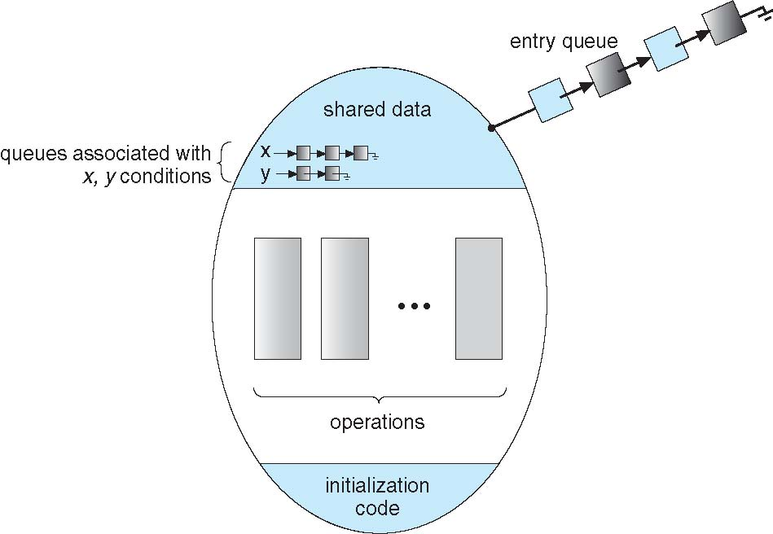
Monitor with Condition Variables

Slide 71
Condition Variables Choices
If process P invokes x.signal (), with Q in x.wait () state, what should happen next?
  If Q is resumed, then P must wait
Options include
  Signal and wait – P waits until Q leaves monitor or waits for another condition
  Signal and continue – Q waits until P leaves the monitor or waits for another condition
  Both have pros and cons – language implementer can decide
  Monitors implemented in Concurrent Pascal compromise
    P executing signal immediately leaves the monitor, Q is resumed
  Implemented in other languages including Mesa, C#, Java

Slide 72
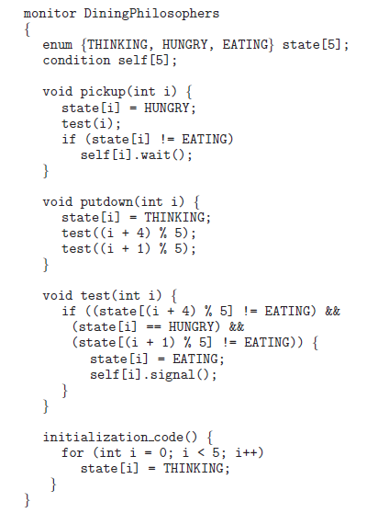
Solution to Dining Philosophers

Slide 73
Solution to Dining Philosophers (Cont.)
Each philosopher i invokes the operations pickup() and putdown() in the following sequence:
DiningPhilosophers.pickup (i);
EAT
DiningPhilosophers.putdown (i);
No deadlock, but starvation is possible

Slide 74
Monitor Implementation Using Semaphores
Variables
semaphore mutex; // (initially = 1)
semaphore next; // (initially = 0)
int next_count = 0;
Each procedure F will be replaced by
wait(mutex);
…
body of F;
…
if (next_count > 0)
signal(next)
else
signal(mutex);
Mutual exclusion within a monitor is ensured

Slide 75
Monitor Implementation – Condition Variables
For each condition variable x, we have:
semaphore x_sem; // (initially = 0)
int x_count = 0;
The operation x.wait can be implemented as:
x-count++;
if (next_count > 0)
signal(next);
else
signal(mutex);
wait(x_sem);
x-count--;

Slide 76
Monitor Implementation (Cont.)
The operation x.signal can be implemented as:
if (x-count > 0) {
next_count++;
signal(x_sem);
wait(next);
next_count--;
}

Slide 77
Resuming Processes within a Monitor
If several processes queued on condition x, and x.signal() executed, which should be resumed?
FCFS frequently not adequate
conditional-wait construct of the form x.wait(c)
  Where c is priority number
  Process with lowest number (highest priority) is scheduled next

Slide 78
A Monitor to Allocate Single Resource
monitor ResourceAllocator
{
boolean busy;
condition x;
void acquire(int time) {
if (busy)
x.wait(time);
busy = TRUE;
}
void release() {
busy = FALSE;
x.signal();
}
initialization code() {
busy = FALSE;
}
}

Slide 79
Synchronization Examples
Solaris
Windows XP
Linux
Pthreads

Slide 80
Solaris Synchronization
Implements a variety of locks to support multitasking, multithreading (including real-time threads), and multiprocessing
Uses adaptive mutexes for efficiency when protecting data from short code segments
  Starts as a standard semaphore spin-lock
  If lock held, and by a thread running on another CPU, spins
  If lock held by non-run-state thread, block and sleep waiting for signal of lock being released
Uses condition variables
Uses readers-writers locks when longer sections of code need access to data
Uses turnstiles to order the list of threads waiting to acquire either an adaptive mutex or reader-writer lock
  Turnstiles are per-lock-holding-thread, not per-object
Priority-inheritance per-turnstile gives the running thread the highest of the priorities of the threads in its turnstile

Slide 81
Windows XP Synchronization
Uses interrupt masks to protect access to global resources on uniprocessor systems
Uses spinlocks on multiprocessor systems
  Spinlocking-thread will never be preempted
Also provides dispatcher objects user-land which may act mutexes, semaphores, events, and timers
  Events
    An event acts much like a condition variable
  Timers notify one or more thread when time expired
  Dispatcher objects either signaled-state (object available) or non-signaled state (thread will block)

Slide 82
Linux Synchronization
Linux:
  Prior to kernel Version 2.6, disables interrupts to implement short critical sections
  Version 2.6 and later, fully preemptive
Linux provides:
  semaphores
  spinlocks
  reader-writer versions of both
On single-cpu system, spinlocks replaced by enabling and disabling kernel preemption

Slide 83
Pthreads Synchronization
Pthreads API is OS-independent
It provides:
  mutex locks
  condition variables
Non-portable extensions include:
  read-write locks
  spinlocks

