Slide 1

SOUL SPACE
Presented By:
Aayush Raj Patrabansh
Krish Khanal
Samarpan Karki

Slide 2

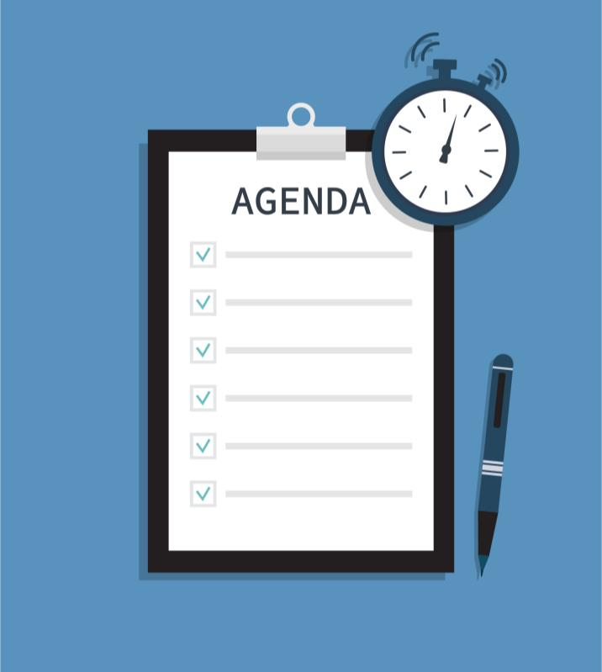
Agenda
Introduction
Project Overview
Work Breakdown Structure
Jira Implementation and Dashboard Overview
Issue Tracking in Jira
Risk Management Strategies
Prototyping and Wireframes
Working Demo
Conclusion
Q&A

Slide 3

Introduction
MENTAL HEALTH IS A GROWING CONCERN, OFTEN HINDERED BY STIGMA AND LIMITED RESOURCES. OUR PROJECT ADDRESSES THIS BY CREATING A USER-FRIENDLY APP THAT EMPOWERS INDIVIDUALS WITH TOOLS LIKE JOURNALING, MOOD TRACKING, AND GUIDED MEDITATIONS.
THERAPISTS CAN TRACK CLIENT PROGRESS, AND USERS CAN FIND SUPPORT THROUGH ANONYMOUS COMMUNITY FORUMS. OUR GOAL IS TO MAKE MENTAL WELLNESS ACCESSIBLE, FOSTERING A SAFE SPACE FOR SELF-CARE AND SUPPORT ANYTIME, ANYWHERE.

Slide 4

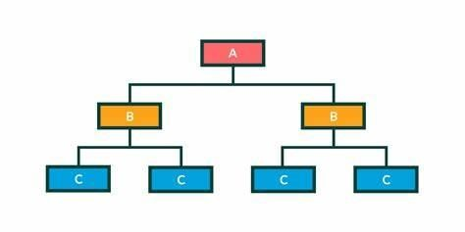
Work Break Down Structure

Slide 5
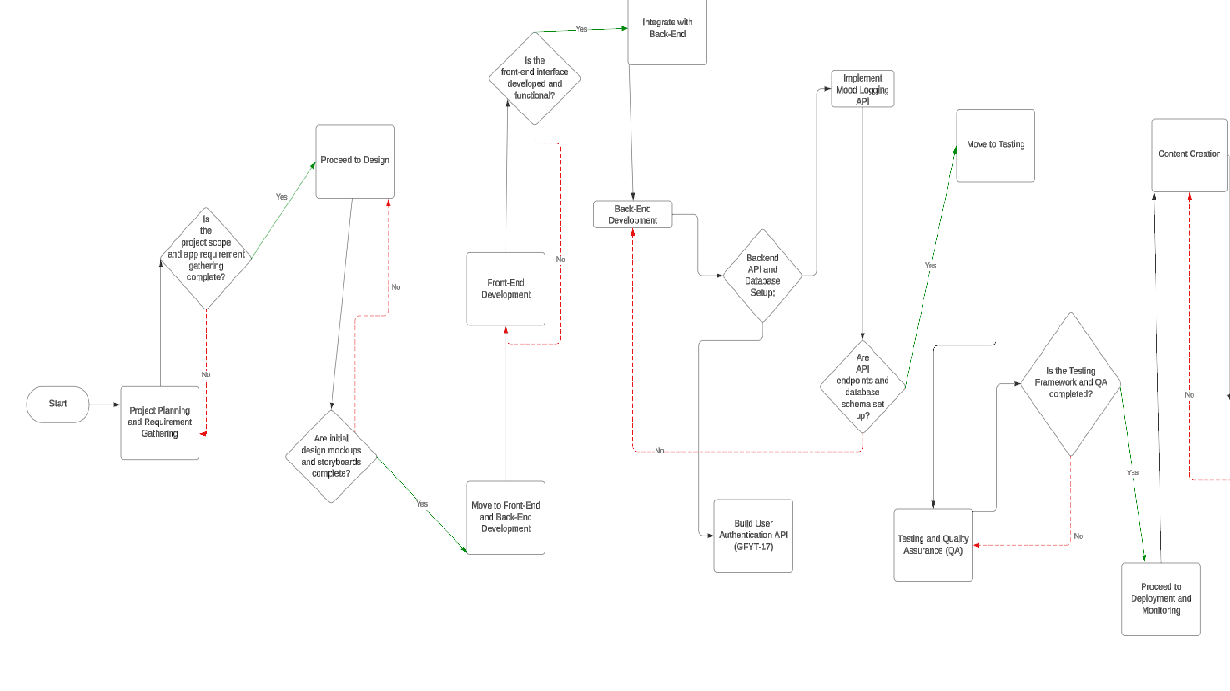

Slide 6
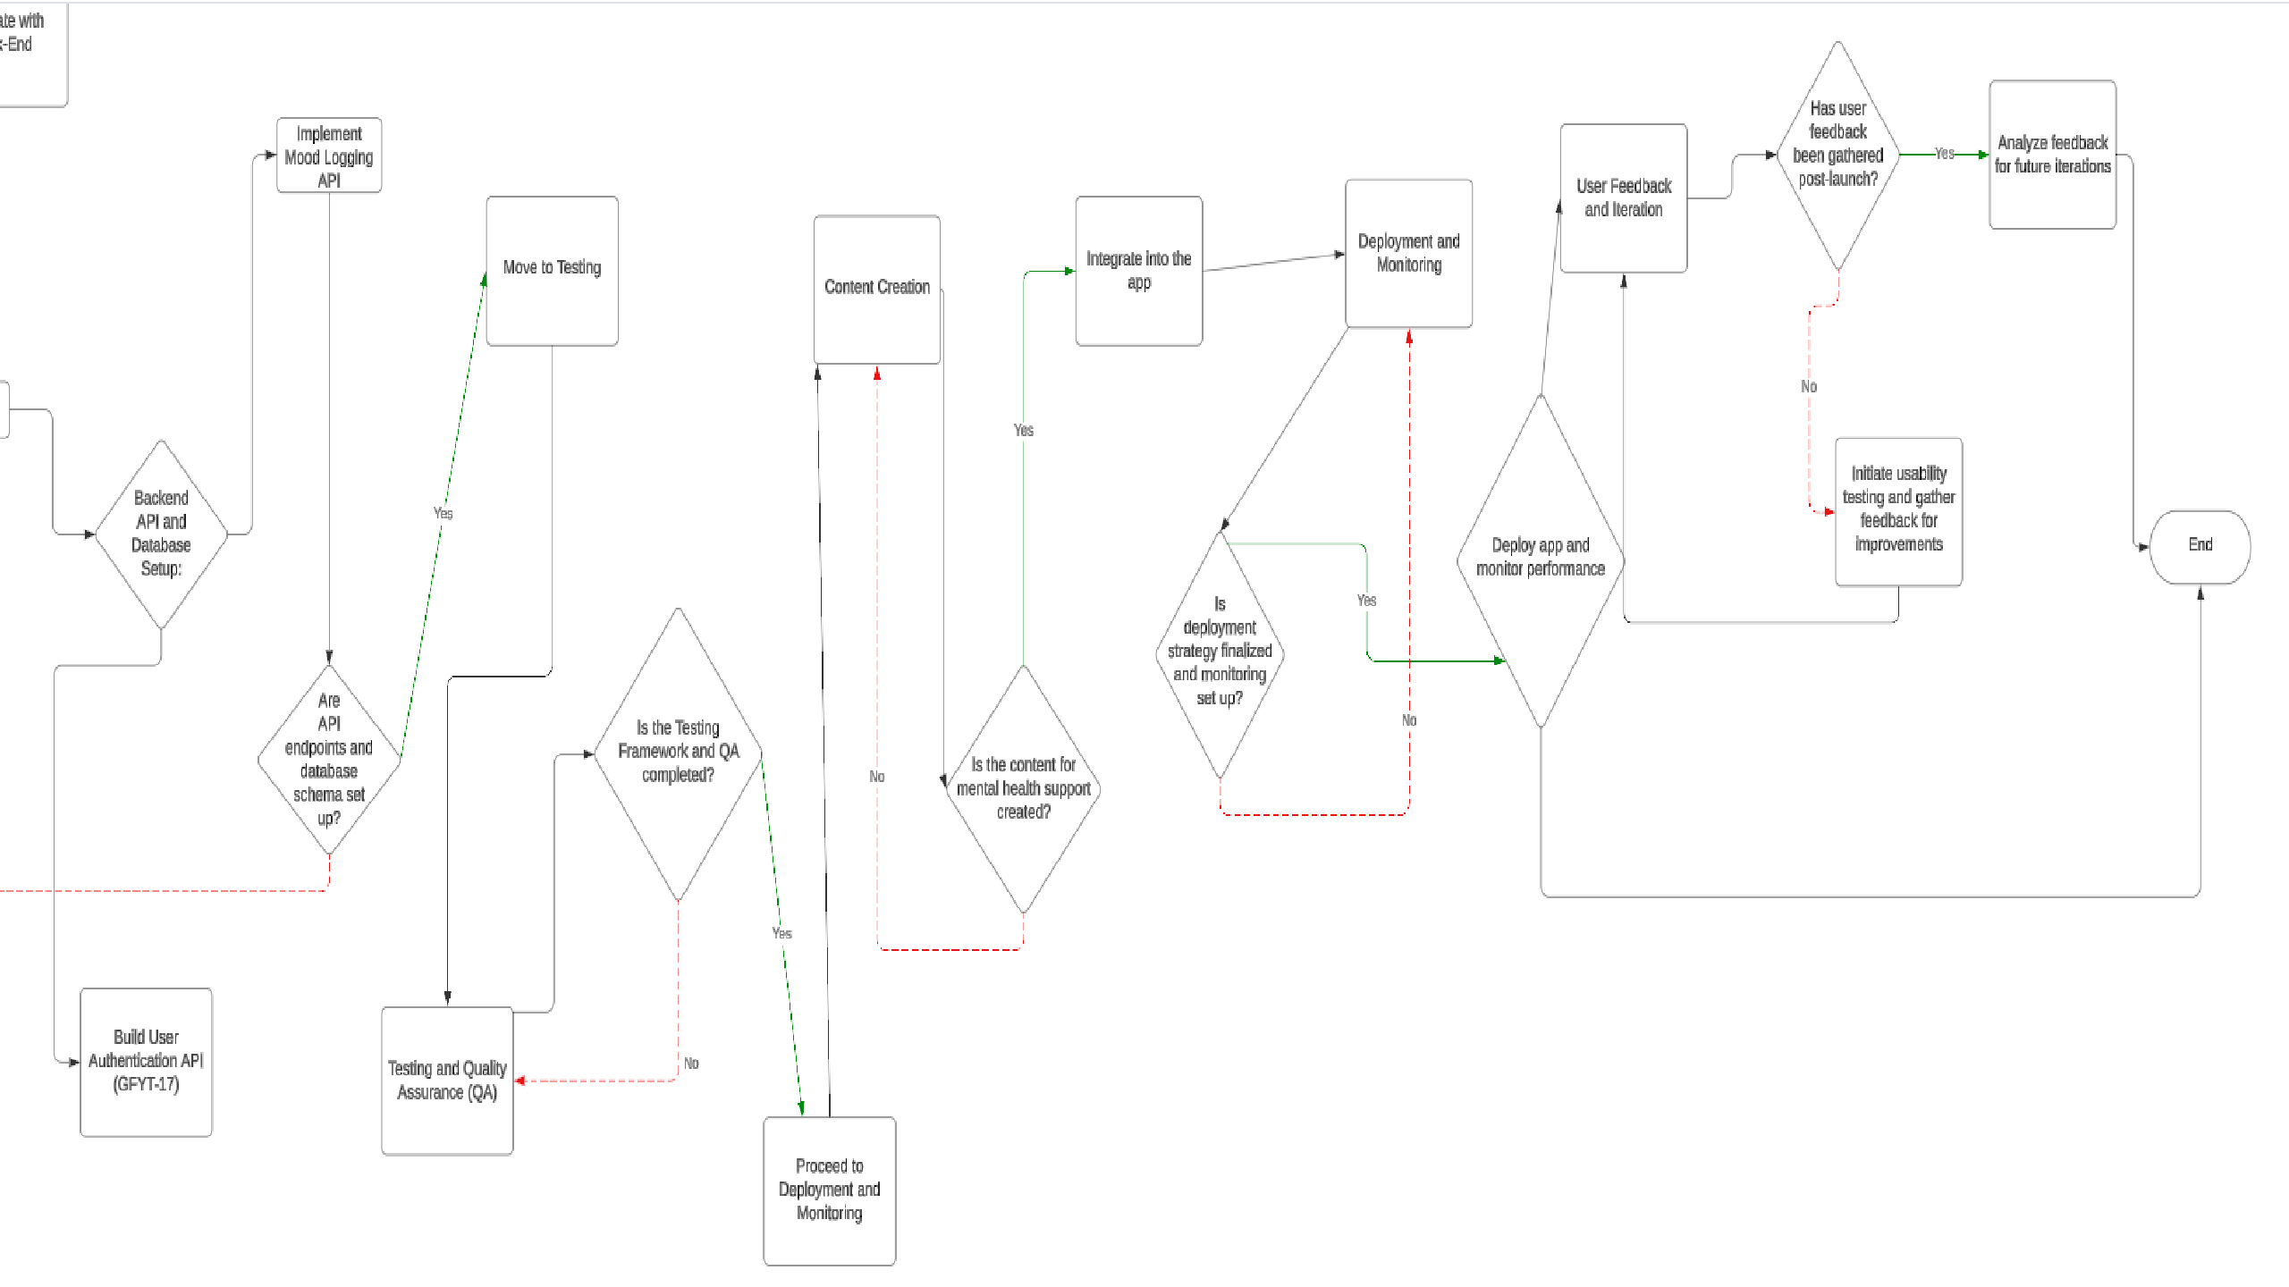

Slide 7


JIRA
Implementation with DashBoard

Slide 8

Implementation
PURPOSE: TRACKING TASKS AND ENSURING DEADLINES.
DASHBOARD FEATURES:
TASK TRACKING FOR EACH DEVELOPMENT STAGE.
STATUS UPDATES (TO DO, IN PROGRESS, DONE).
PROGRESS MONITORING.

Slide 9
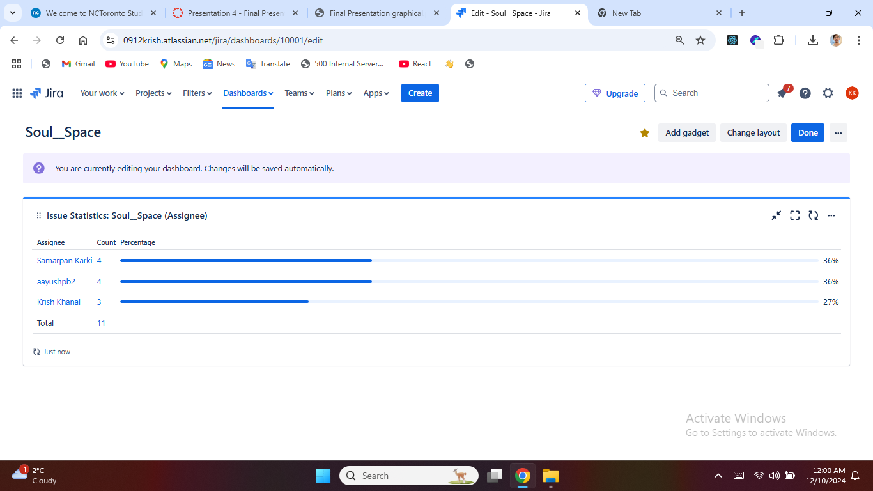

Slide 10
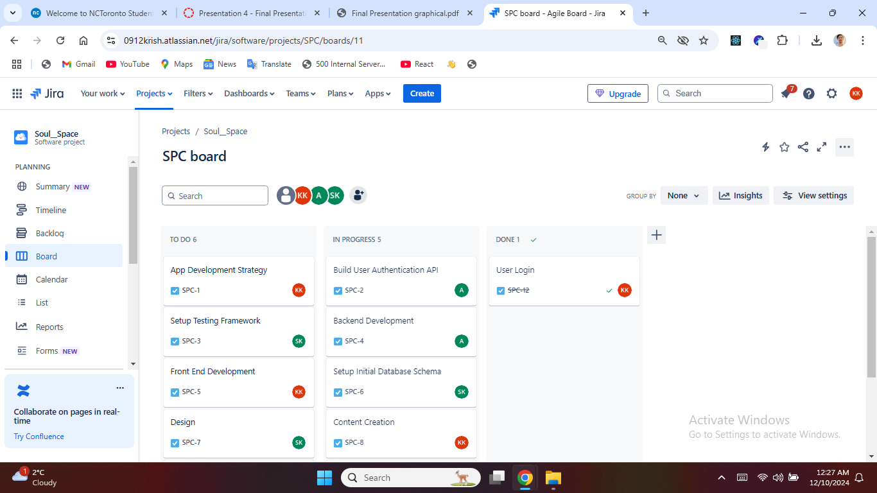

Slide 11
Issue Tracking
Purpose:
Efficiently organize, prioritize, and resolve tasks.
Key Features:
Categorized issues: Bugs, Stories, Tasks
Set priorities: High, Medium, Low
Assign tasks to team members for accountability Tracking Process:
Kanban Board: Visualize task flow (To Do, In Progress, Done)

Slide 12

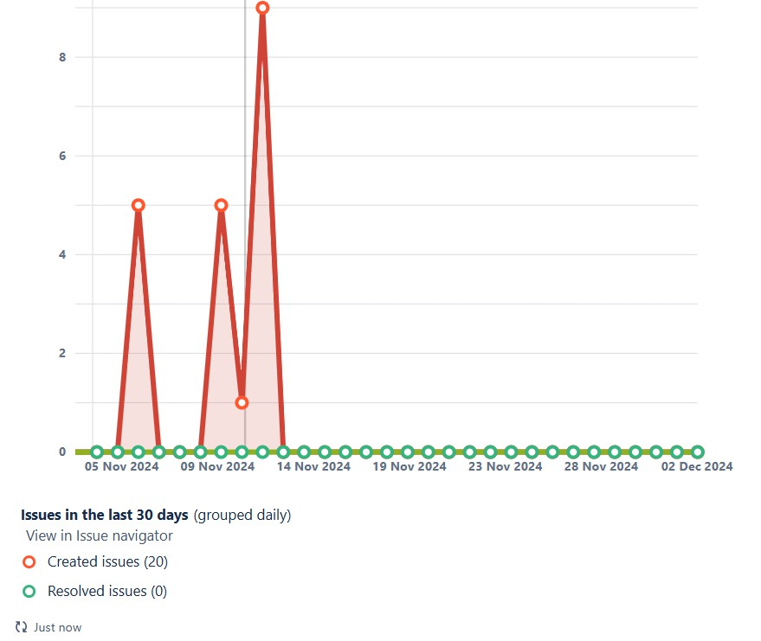
Issue Tracking In Jira

Slide 13
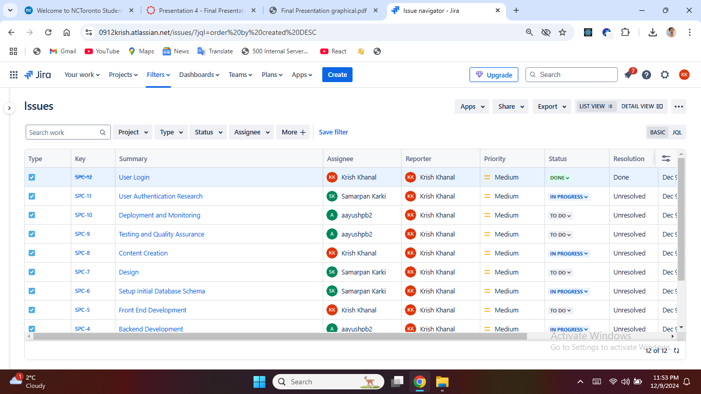

Slide 14
Risk Management in Jira
As we develop our mental health app, it's essential to identify and mitigate potential risks. Our risk management plan aims to ensure user trust, maintain high engagement, and comply with all relevant regulations. We’ve identified key risks with strategies in place to address each one effectively."
Compliance and Legal Risk
Data Privacy risk
Funding Shortfalls
Market Competition
Negative User Review
Resource Availability
System Downtime
Technical Performance Issue
User Engagement

Slide 15
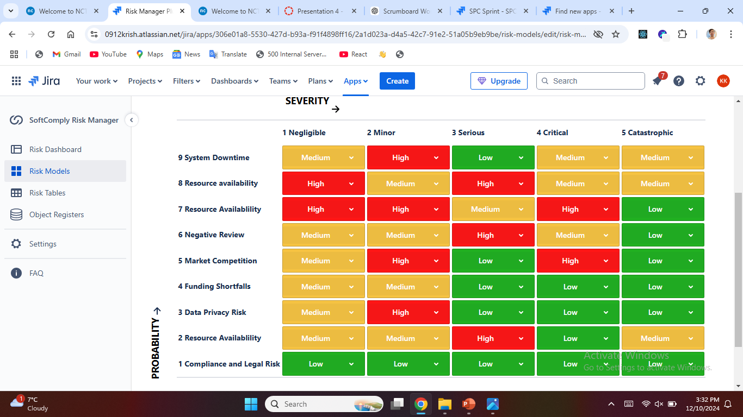
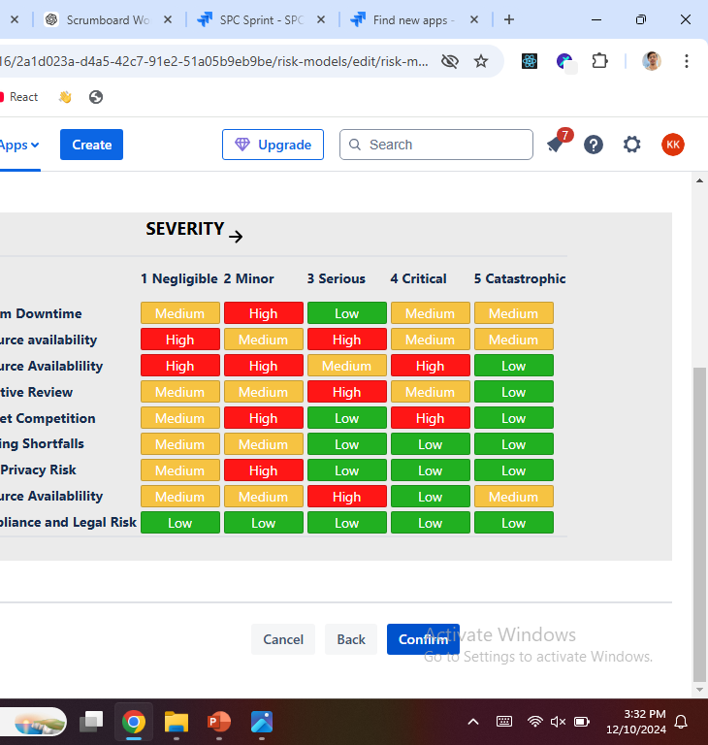
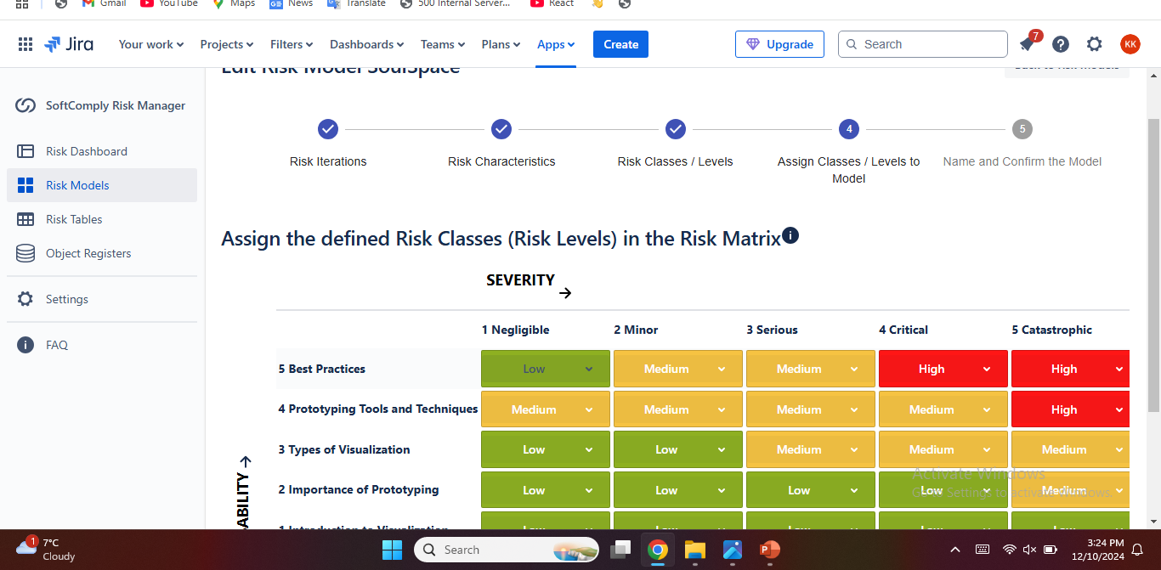

Slide 16
Prototyping Of Soul Space
Content:
Focus Area:
Currently, we have developed the Login Screens as the first step of prototyping.
Details:
User Login: A secure interface for users to access their accounts.
Role Differentiation: Separate options for regular users and therapists.
User Experience: Simple design for easy navigation.
Future Steps:
Expand prototypes to include Mood Tracking, Journaling, and Therapist Dashboard.
Collect feedback from team members and improve navigation flow. Outcome:
The login screens set the groundwork for user authentication and role-based access.

Slide 17
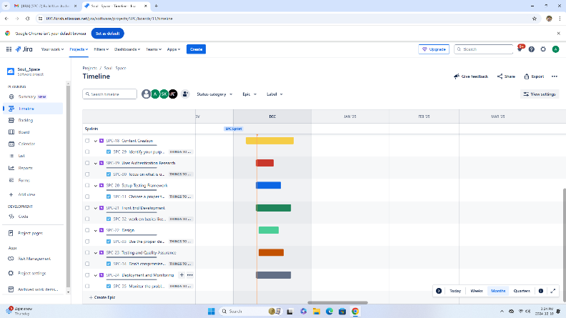
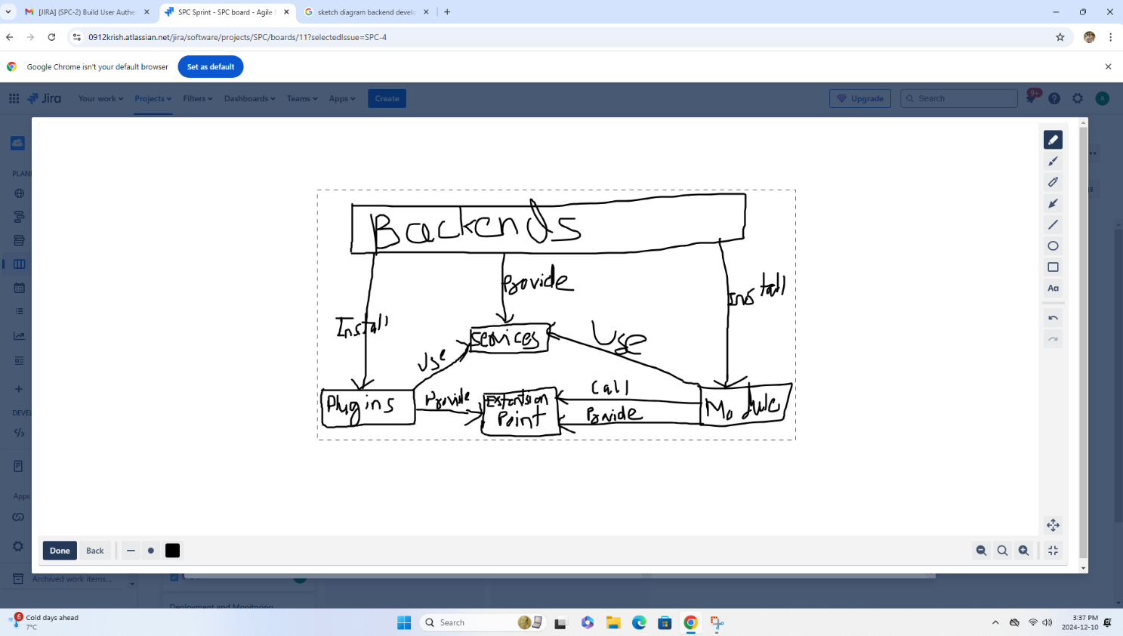
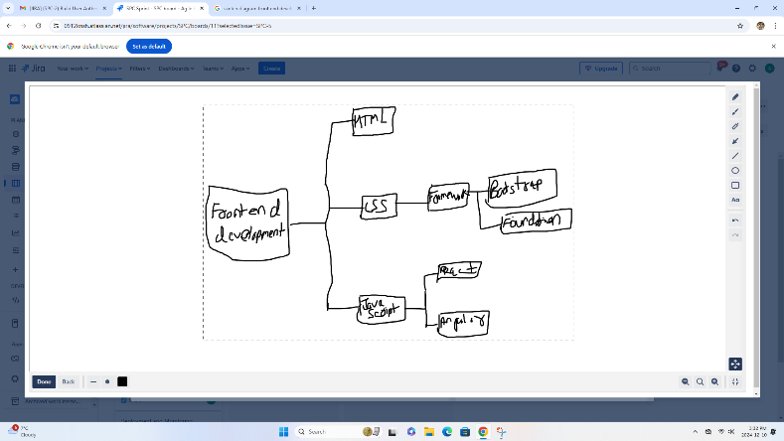

Slide 18
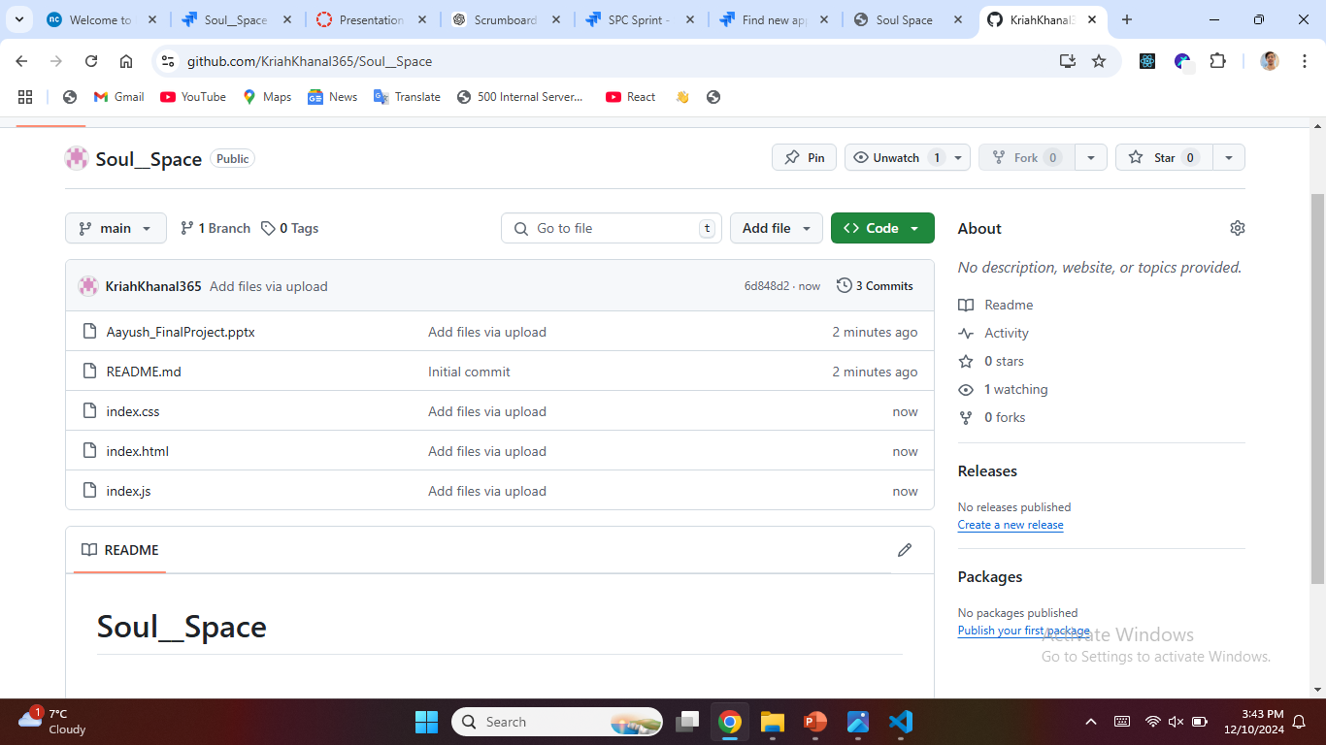

Slide 19

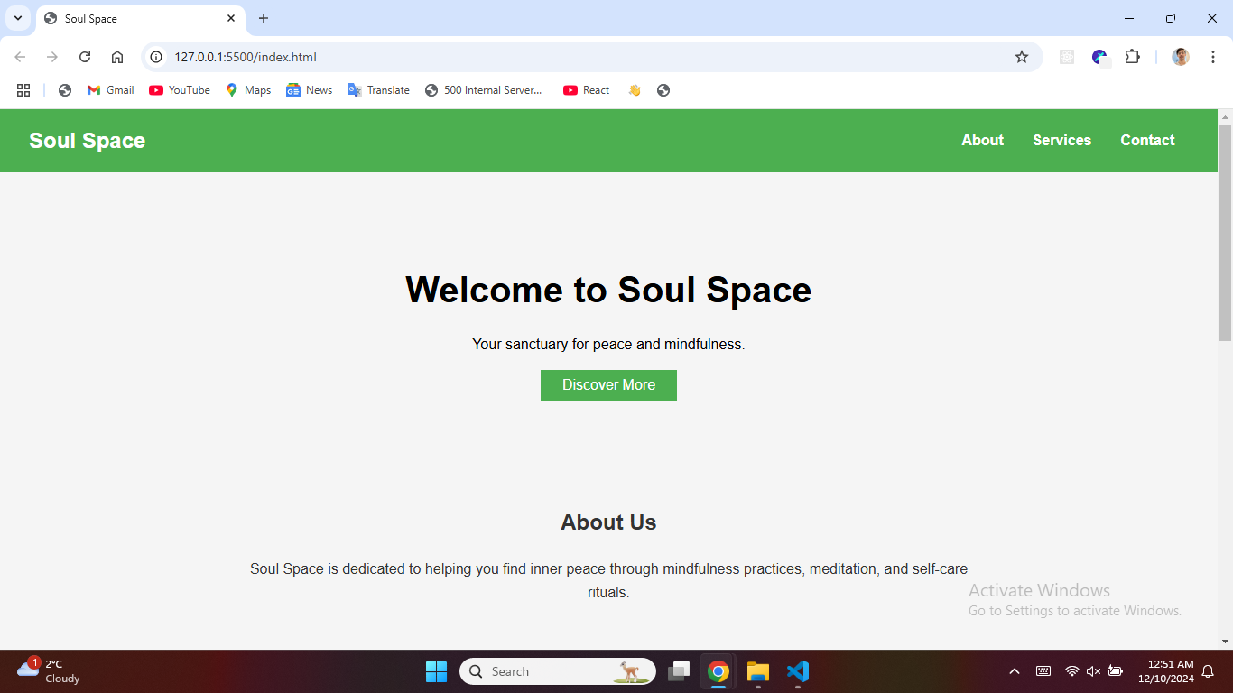
Login Screen

Slide 20
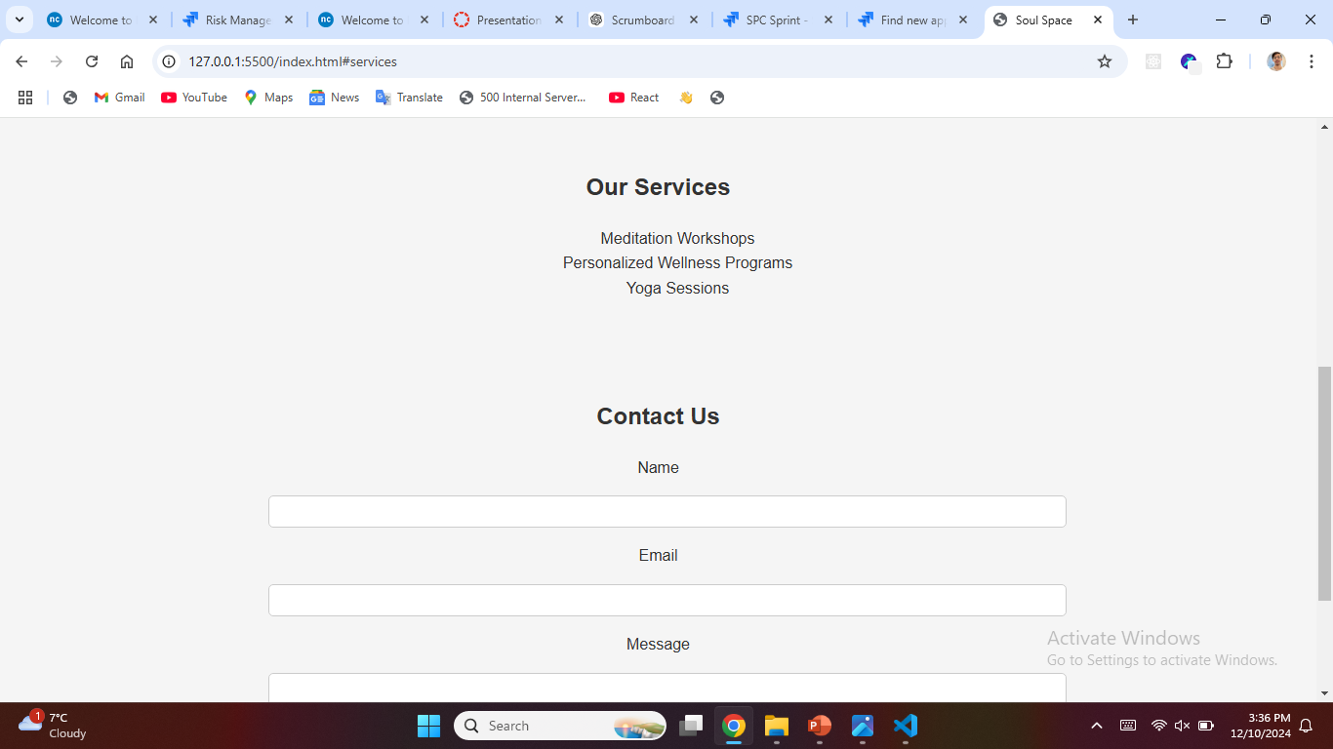
Working Demo of Soul Space

Slide 21

Conclusion
Our mental health app project has been a significant step toward creating accessible tools for emotional well-being. We successfully developed a functional prototype focusing on secure role-based login, setting the foundation for features like Mood Tracking and Journaling. Through effective teamwork and Agile practices, we navigated challenges and learned the value of user feedback in refining our design. Moving forward, our next steps include completing feature development, conducting usability testing, and preparing the app for deployment. This project has deepened our understanding of how technology can support mental health, and we are eager to continue improving and expanding our app to make a meaningful impact.

Slide 22
Any Questions??

Slide 23
Additional Resources
Books & Articles:
The Design of Everyday Things – Don Norman
Mental Health and Technology: Trends and Applications – P. Michael Websites:
Mind.org – Mental health support
Headspace.com – Guided meditations Tools:
Jira: Task management
Power Apps, Justinmind: Prototyping
Figma: UI/UX design

