Slide 1
Smart Data and Discovery

Slide 2
MODULE INFORMATION
⯈ Aims
⯈ Learning outcomes
⯈ Main topics
⯈ Teaching materials
⯈ Learning and teaching
⯈ Assessment

Slide 3
MODULE AIMS
The main aim of this module :
⯈ To provide students with an understanding of the fundamental concepts and
techniques of data science and its applications in a wide range of business context.
⯈ To expose to the approaches used for problem formulation, data preparation, data modelling, visualization, forecasting, and data-driven decision-making.
⯈ To gain practical skills in the tools and techniques used for data science projects in a modern business environment

Slide 4
LEARNING OUTCOMES
At the end of the module, Students should be able to:
⯈ LO1: Understand fundamental concepts and techniques of data science.
⯈ LO2: Appreciate the business context in which the analysis of data can be fruitful and effective for decision-making and creating value.
⯈LO3: Understand and compare the techniques and tools for analysing and visualising data.
⯈LO4: Develop the practical skills in preparing, modelling and visualising data.
⯈ LO5: Gain exposure to the practice of formulating and structuring problems and identifying the
relevant tools to aid problem-solving.

Slide 5
MAIN TOPICS
The main topics to be covered are:
⯈ Introduction to key concepts in data science: data science tools, approaches, techniques and application scenarios.
⯈ An overview of data mining process for business: business understanding, data understanding, data preparation, data
modelling, results evaluation and deployment.
⯈ Business data environment: operational database, data warehouse, web and big data platform
⯈ Data understanding and preparation: data measurement, statistical summaries, transformation, cleaning, and graphical
visual exploration.
⯈ Data science business applications: credit scoring, fraud detection, customer relationship management, associated products detection, correlation and identification.
⯈ Web data analysis: Social network analysis, affiliation prediction and recommendation

Slide 6
TEACHING MATERIALS
Recommended text books and websites
⯈ Provost, F. & Fawcett, T., Data Science for Business: What you need to know about Data Mining and Data-
analytic thinking, (2013), O’Reilly Media [CORE].
⯈ EMC Education Services, Data Science and Big Data Analytics: Discovering, Analysing, Visualizing and Presenting Data, (2015), John Wiley & Sons.
⯈ Graham, A., Statistics – A Complete Introduction: Teach Yourself Paperback, (2013), Hodder & Stoughton.
⯈ Jeffrey M. Stanton, 2013. Introduction to data science – e-copy is freely available at https://ischool.syr.edu/media/documents/2012/3/DataScienceBook1_1.pdf
⯈ http://www.datasciencecentral.com

Slide 7
LEARNING AND TEACHING
Delivery Strategy:
⯈ ⯈ Lecture (1 hour / week): Tutorial/ Workshop (2 hour / week):
⯈ Blended learning:
Learning and Teaching Total Hours:
⯈ Scheduled learning and teaching activities – 45 hours
⯈ Guided Independent studying - 105 hours

Slide 8
ASSESSMENT
Assessment Strategy:
⯈ Individual coursework assignment
⯈ 2-hour written exam
Description of assessment items
Assessment Method | Description of Item | % weighting | Week Due
Coursework | Individual Business data analytical report [1500 words + analytical output and evaluation] | 60% | 11
Written Exam | 2 hour unseen exam. | 40% | 15

Slide 9
OVERVIEW OF DATA SCIENCE CONCEPTS AND TECHNIQUES
⯈ What is data science?
⯈ Methods and techniques for extracting useful information and knowledge from data.
⯈ Interdisciplinary (Computer Science, Maths, Statistics, and Decision Science)
⯈ Technical, analytical, and business skills.
⯈ Why are Businesses interested in data science projects?
⯈ Competitive advantages.
⯈ Productivity increase.
⯈ Enhance customer engagement/satisfaction.

Slide 10
⯈ Data driven decision making:
Is the practice of making business decisions on the analysis of data rather than purely on intuition.
⯈ for example a data driven decision making in marketing would select advertisements based on the analysis of data regarding how consumers react to different ads instead of based on experience in the marketing field.
⯈ Common mistakes in data science projects:
⯈ Rushing into data collection and analysis.
⯈ Spending less time to plan and scope the amount of work involved.
⯈ Not performing data and business domain understanding.

Slide 11
⯈ Data analytics ( data mining) lifecycle:
⯈ Data mining or extraction of useful information and knowledge from data is a process with well defined stages.
⯈ Based on the Cross Industry Standard Process for Data Mining (CRISP-DM), analytics lifecycle includes six stages:
⯈ Business Understanding
⯈ Data Understanding
⯈ Data Preparation
⯈ Modelling
⯈ Evaluation
⯈ Deployment

Slide 12
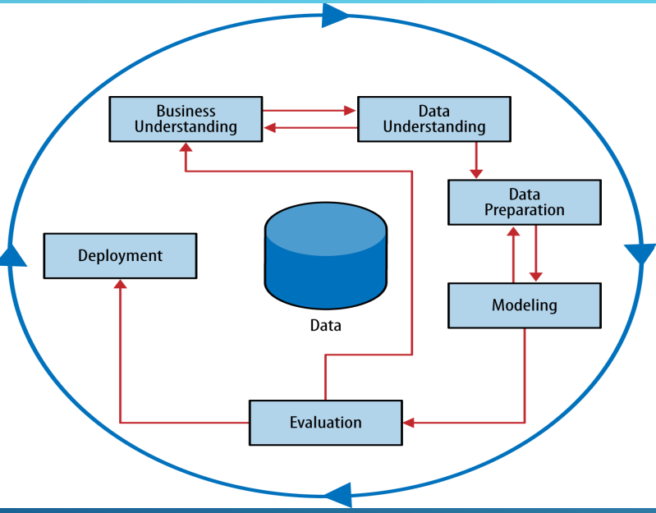
Data analytics ( data mining) lifecycle: iterative process.

Slide 13
BUSINESS UNDERSTANDING
⯈ The most important activities are
⯈ Understand the current situation and past related data science projects.
⯈ Frame/state the business problem as analytics challenge.
⯈ Map defined business problem to one or more common data science tasks.
⯈ Assess available resources (technology, systems, tools, people and data)

Slide 14
⯈ Common data mining or analysis tasks.
⯈ Classification and class probability estimation:
⯈ Attempt to predict, for each individual in a population, which of a (small) set of classes this individual belongs to.
⯈ An example classification question would be: “Among all the customers of a company, which are likely to respond to a given offer?” In this example the two classes could be called will respond and will not respond.
⯈ Regression (“value estimation”)
⯈ Attempts to estimate or predict, for each individual, the numerical value of some variable for that individual.
⯈ An example regression question would be: “How much will a given customer use the service?” The property (variable) to be predicted here is service usage, and a model could be generated by looking at other, similar individuals in the population and their historical usage.
⯈ Clustering
⯈ Attempts to group individuals in a population together by their similarity, but not driven by any specific purpose.
⯈ An example clustering question would be: “Do our customers form natural groups or segments?”
⯈ Co-occurrence grouping (also known as frequent itemset mining, association rule discovery, and market-basket analysis)
⯈ Attempts to find associations between entities based on transactions involving them.
⯈ An example co-occurrence question would be: What items are commonly purchased together?
⯈ Profiling
⯈ Attempts to characterize the typical behavior of an individual, group, or population.
⯈ An example profiling question would be: “What is the typical cell phone usage of this customer segment?”

Slide 15
⯈ Supervised Versus Unsupervised Methods
⯈ Supervised methods are data mining tasks where specific targets along with a set of examples are given. Tasks such as classification and regression belong to this method.
⯈ “Can we find groups of customers who have particularly high likelihoods of cancelling their service soon after their contracts expire?”
⯈ In the above example of supervised data mining task, the specific target defined is - will a customer leave when her contract expires?
⯈ Unsupervised methods are data mining tasks without specific targets or no information about the purpose of the learning. The goal is to find what the given examples have in common. Tasks such as clustering and dimensional reduction belong to this method.
Example of business problem solved using unsupervised methods: “Do our customers
naturally fall into different groups?”

Slide 16
DATA UNDERSTANDING
⯈ The most important activities are
⯈ Identify potential data sources.
⯈Transactional databases, spread sheet, CSV, text files, web logs, web services, etc.
⯈ Capture aggregate data sources
⯈ This is for previewing the data and providing high-level understanding.
⯈ Review the raw data
⯈ Obtain preliminary data from initial data feeds. Begin understanding the interdependencies among the data attributes, and become familiar with the content of the data, its quality, and its limitations.
⯈ Evaluate the data structures and tools needed

Slide 17
DATA PREPARATION
⯈ It includes the steps to explore, pre-process, and condition data prior to modelling and analysis.
⯈ It tends to be the most labor-intensive step in the analytics lifecycle.
⯈ The most important activities are
⯈ Preparing an Analytics sandbox
⯈ A central repository environment separate from the production environment. ( Data warehouse, Data Lake, and Big data platform)
⯈ The repository should collect all kinds of data (summary-level aggregated data, structured data, raw data feeds, unstructured text data from call logs or web logs.
⯈ Performing ETL/ELT
⯈ To get data into the sandbox by performing a combination of extract, transform, and load activities.
⯈ Learning or understanding about the data
⯈ To clarify what data is accessible
⯈ Highlight gaps by identifying datasets which are useful but not accessible.
⯈ Identify external datasets that might be useful to obtain through APIs, data sharing or purchasing .
⯈ Data Conditioning
⯈ It refers to the process of cleaning data, normalizing datasets, and performing transformation on the data.
⯈ Survey and Visualize
⯈ To gain an overview of the data and understand characteristics about the data using data visualization tools

Slide 18
MODELLING
⯈ Modelling includes two major activities:
⯈ Model planning
⯈ Model building
⯈ Model Planning
⯈ Data Exploration and Variable Selection
⯈ The objective of the data exploration is to understand the relationships among the variables to inform selection of the variables and methods and to understand the problem domain
⯈ Model selection: main goal is to choose an analytical technique, or a short list of candidate techniques, based on the end goal of the project
⯈ Linear Regression, Decision trees, Naïve Bayes, K-nearest neighbour, Logistic regression, and Neural network
⯈ K-means, Gaussian Mixture Models (GMM), Principal Component Analysis (PCA) and etc..
⯈ Construct initial models using statistical /machine learning software packages such as R, SAS, Python or MATLAB.

Slide 19
MODELLING
⯈ Model Building
⯈Develop datasets for training and testing.
⯈ These datasets enable the data scientist to develop the analytical model and train it (“training data”), while holding aside some of the data (“hold-out data” or “test data”) for testing the model.
⯈ The training dataset for conducting the initial experiments and the test sets for validating an approach once the initial experiments and models have been r

Slide 20
EVALUATION
⯈ The purpose of the evaluation stage is to assess the data mining results rigorously
and to gain confidence that they are valid and reliable before deployment.
⯈ The evaluation stage also serves to help ensure that the model satisfies the original business goals
⯈ Put the results of data mining in order to realize some return on investment.
DEPLOYMENT

